Slide 1
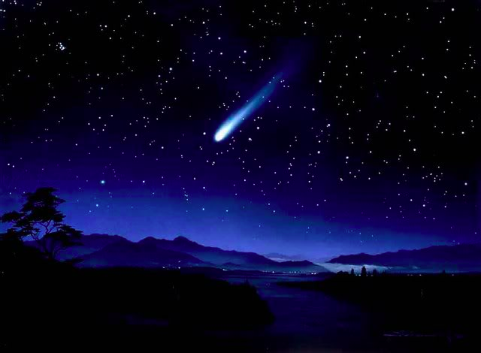
Refinement of Bolide Characteristics from Infrasound measurements
Nayeob(Caroline) Gi and Peter Brown
University of Western Ontario, Canada
Meteoroids 2016 : June 9, 2016

Slide 2
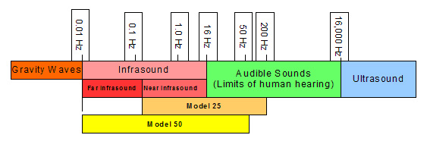
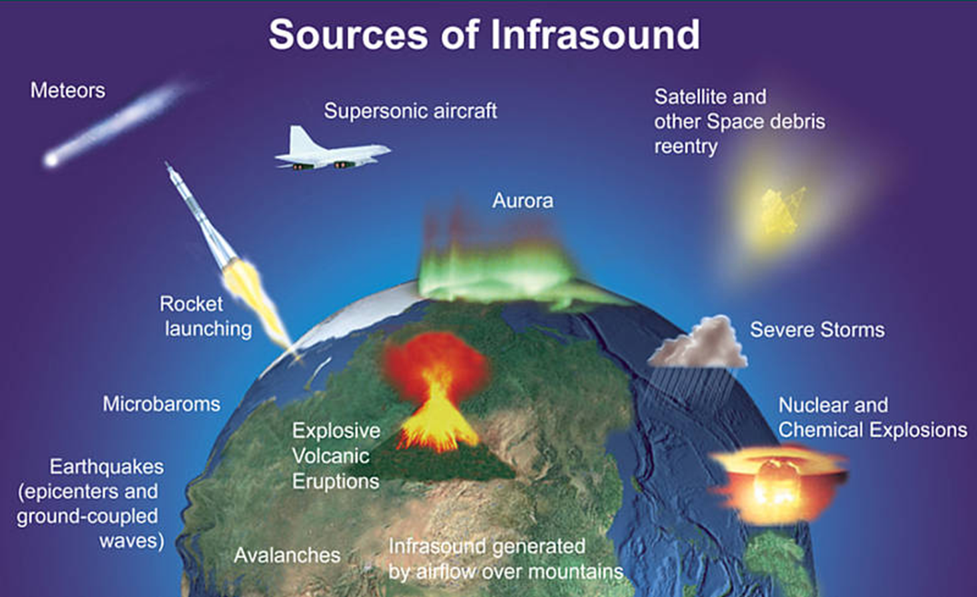
Infrasound
f

Slide 3
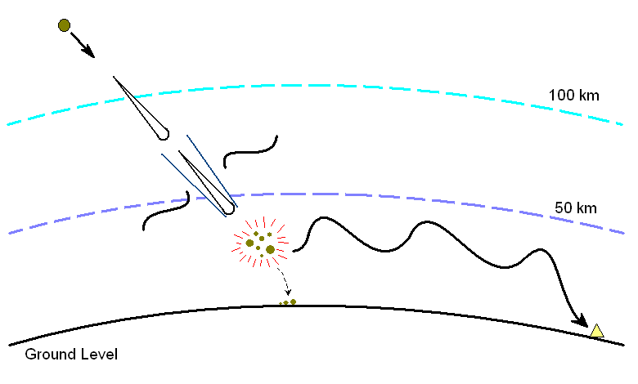
Meteor Infrasound
Meteoroid intersects Earth and “collides”
Typical velocity ~20 km/s (11 – 73 km/s)
Meteoroid size: 0.1 – 10 m
2) Around 80 – 100 km Meteoroid becomes luminous
3) Hypersonic shock wave
Cylindrical line source
4) 15 – 40 km: Fragmentation
Point (spherical) source
5) Meteorites
6) Ducted sound “heard” at
Infrasound station

Slide 4
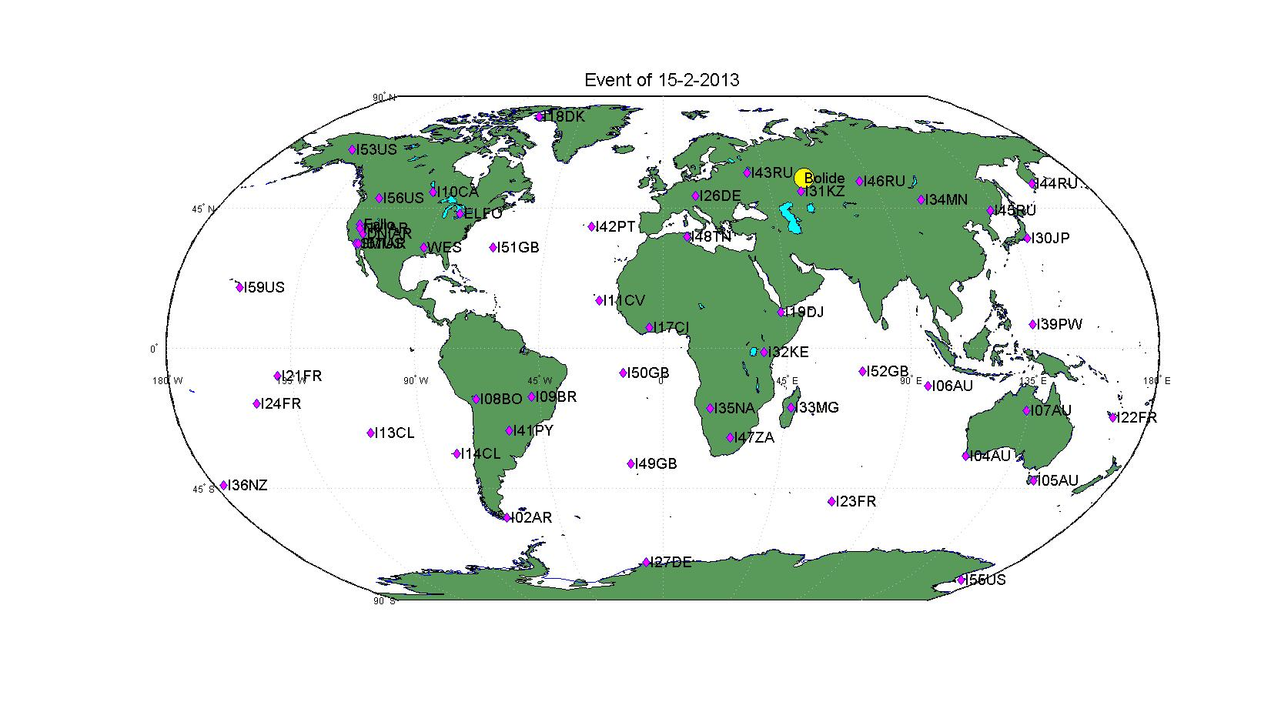
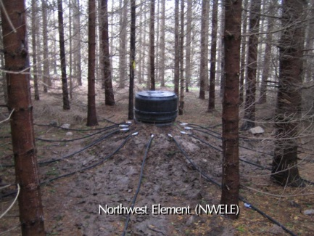
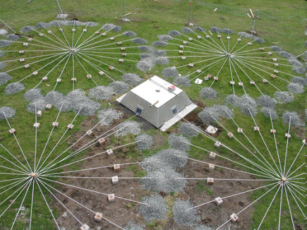
International Monitoring System (IMS) Network
Elginfield, ON, Canada
1 km
2-3 km
Tristan da Cunha, U.K.

Slide 5
Objectives
To improve overall energy estimates and uncertainties for bolides
To determine empirical correlations between bolide infrasound signal metrics and JPL bolide energy modified by secondary characteristics (height, speed, and entry angle)

Slide 6
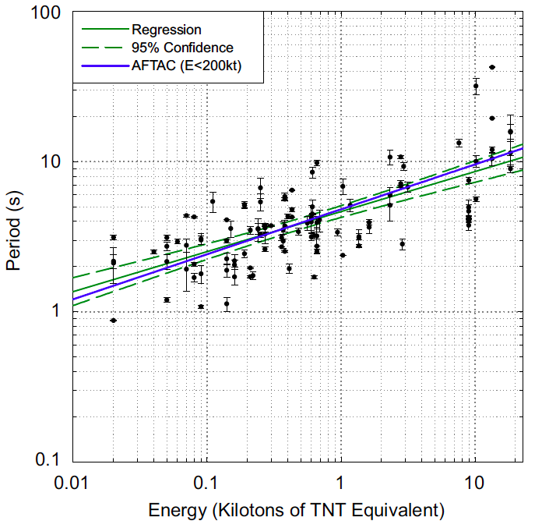
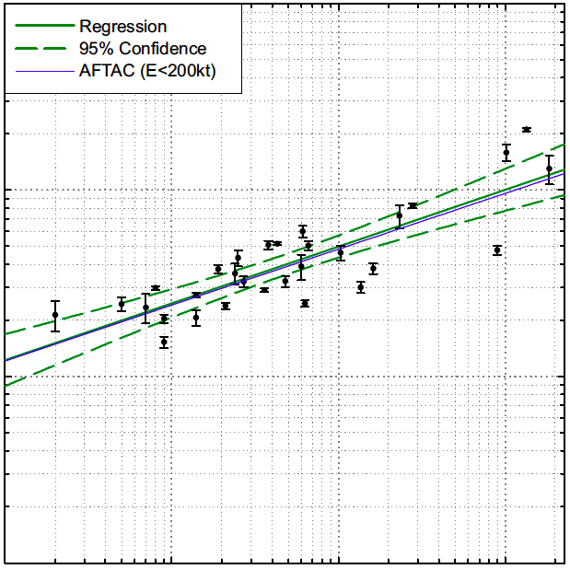
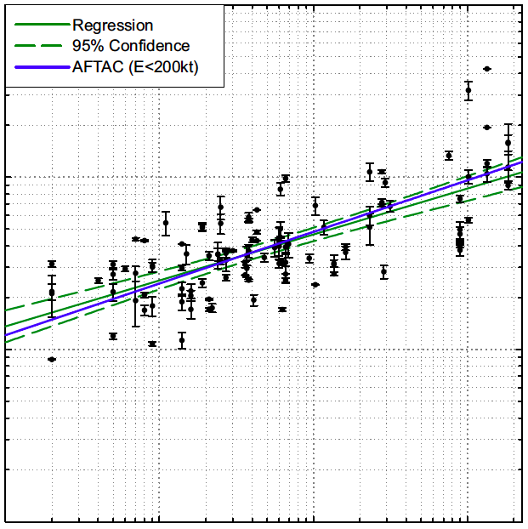
(Ens et al., 2012)
Only multi-station events with
Periods averaged
JPL energy (KT of TNT)

Slide 7
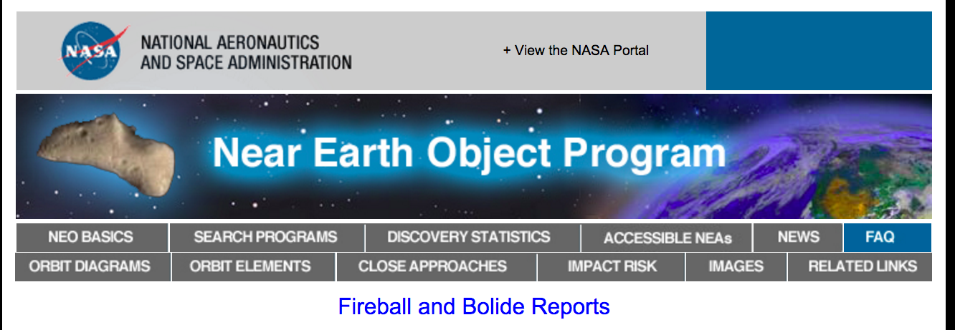
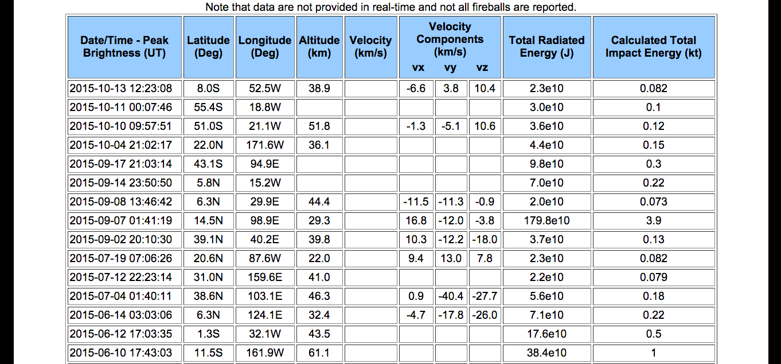
NASA Jet Propulsion Laboratory (JPL) fireball data

Slide 8
Period-Energy relationship
174 individual bolide events (2006-2015)
34 multi-station events
Speed at peak brightness
Height at peak brightness
Period(s)
Period(s)
JPL energy (kT)
JPL energy (kT)

Slide 9
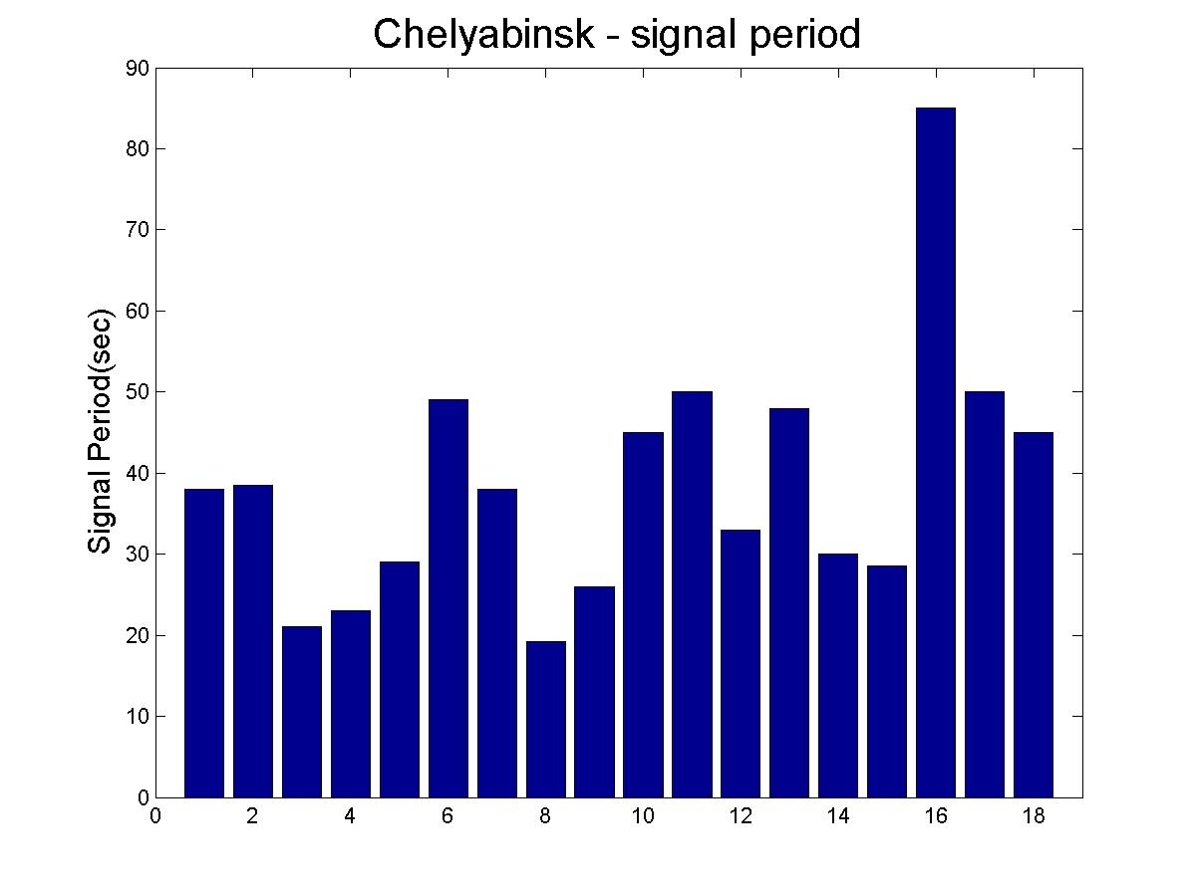
Chelyabinsk Fireball - IS46
Date: Feb 15, 2013
Time: 03:20:33 UT (09:20:33 local)
Location: S. of Chelyabinsk, Russia
(54.8N, 61.1E)
IS46 location: 53.95N, 84.82E
I31 I43 I46 I34 I26 I18 I45 I44 I54 I32 I52 I10 I33 I56 I57 I59 I05 I27
Infrasound Stations

Slide 10
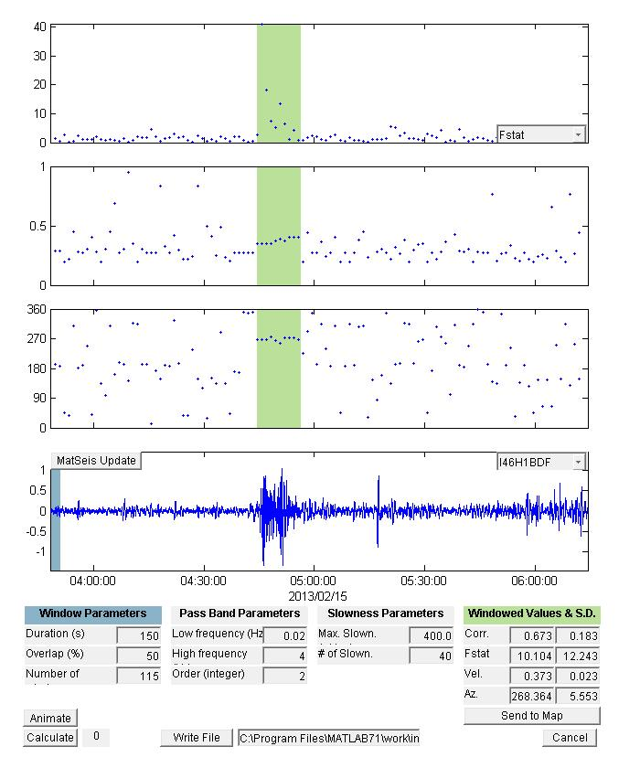
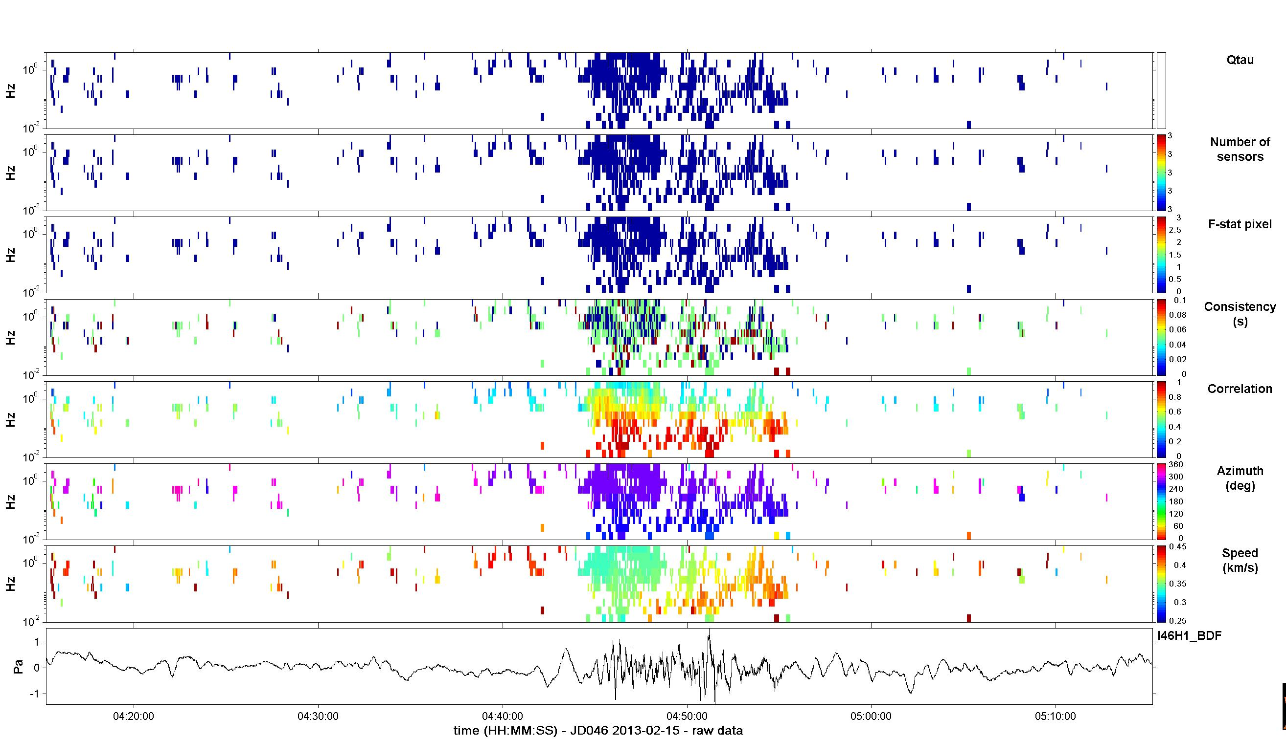
Infratool & PMCC
Consistency
(s)
Correlation
Azimuth
(deg)
Speed
(km/s)
PMCC result
Inframeasure analysis result
Period: 21.079 sec
Max. Amplitude: 1.4898 Pa
Travel Time: 5056.0 sec
Infratool result

Slide 11
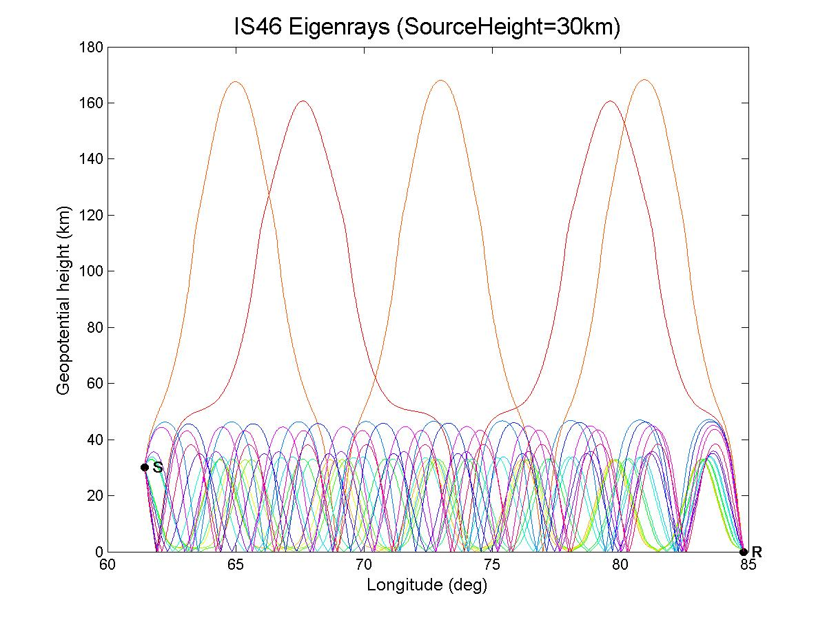
Raytracing - GeoAc
Source height range
20-45km
receiver

Slide 12
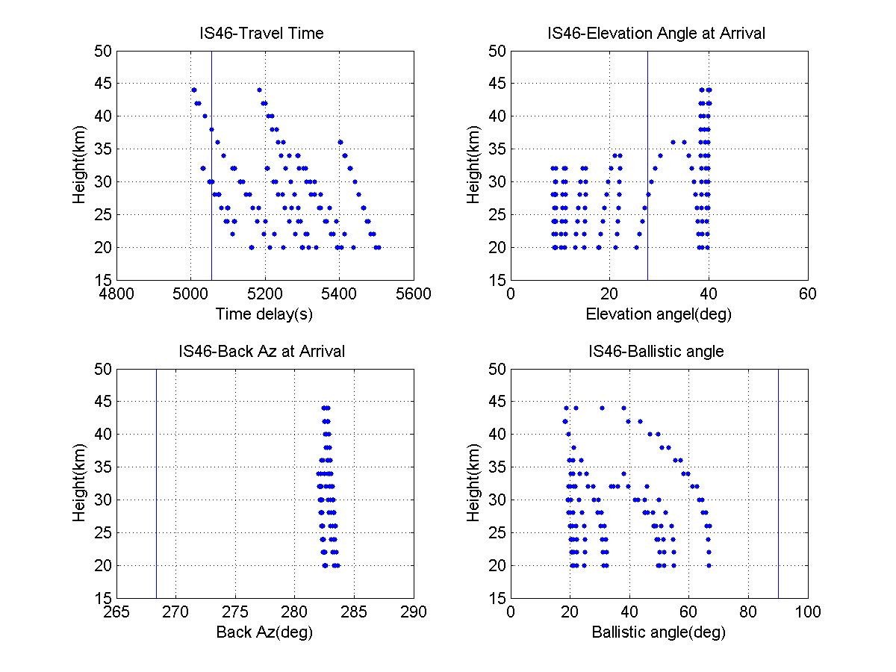
Composite Plots

Slide 13
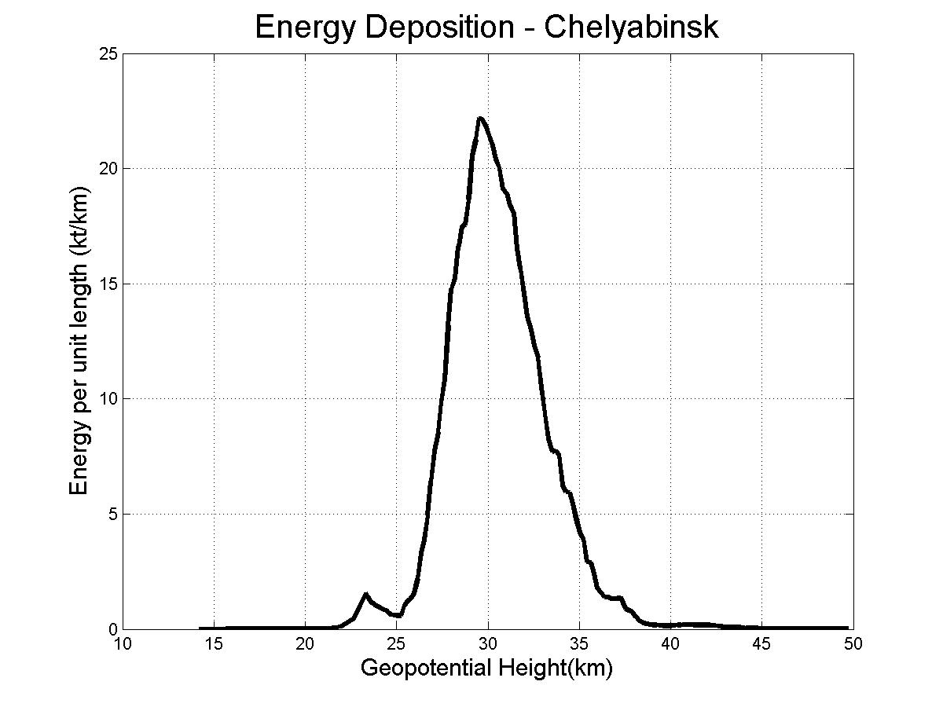
ReVelle (1974) Weak Shock Model
Analytical model - requires well defined input parameters, such as entry angle, velocity, blast radius (Ro), etc.
Model predicts the infrasonic signal overpressure(amplitude) and period at the ground
Energy Deposition - Chelyabinsk
Energy per unit length (kT/km)
Height (km)

Slide 14
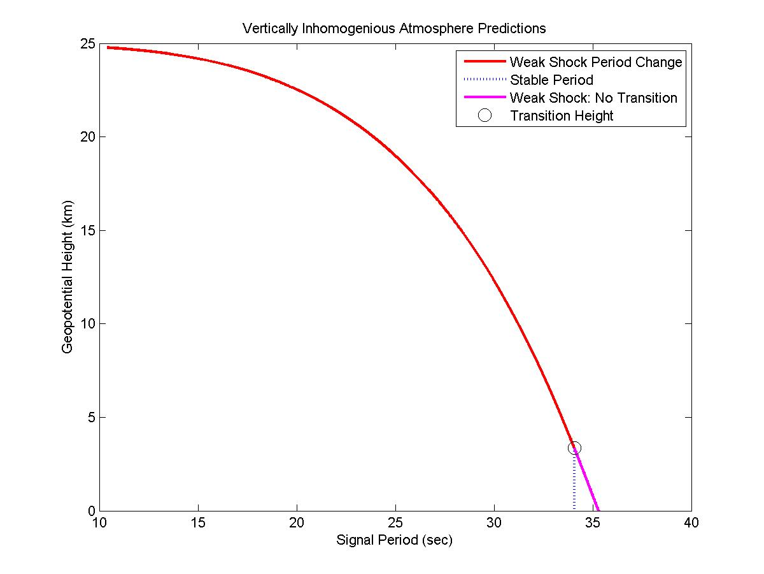
IS46 Blast Radius Modeling
Fundamental Period Estimate
Fundamental period
Geopotential Height (km)
Transition Height
Signal Period (sec)

Slide 15
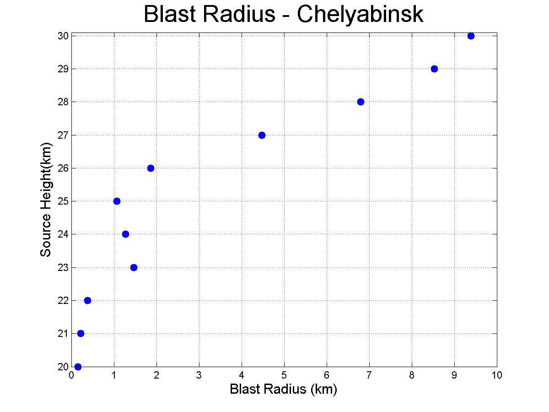
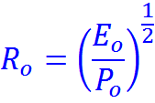

Slide 16
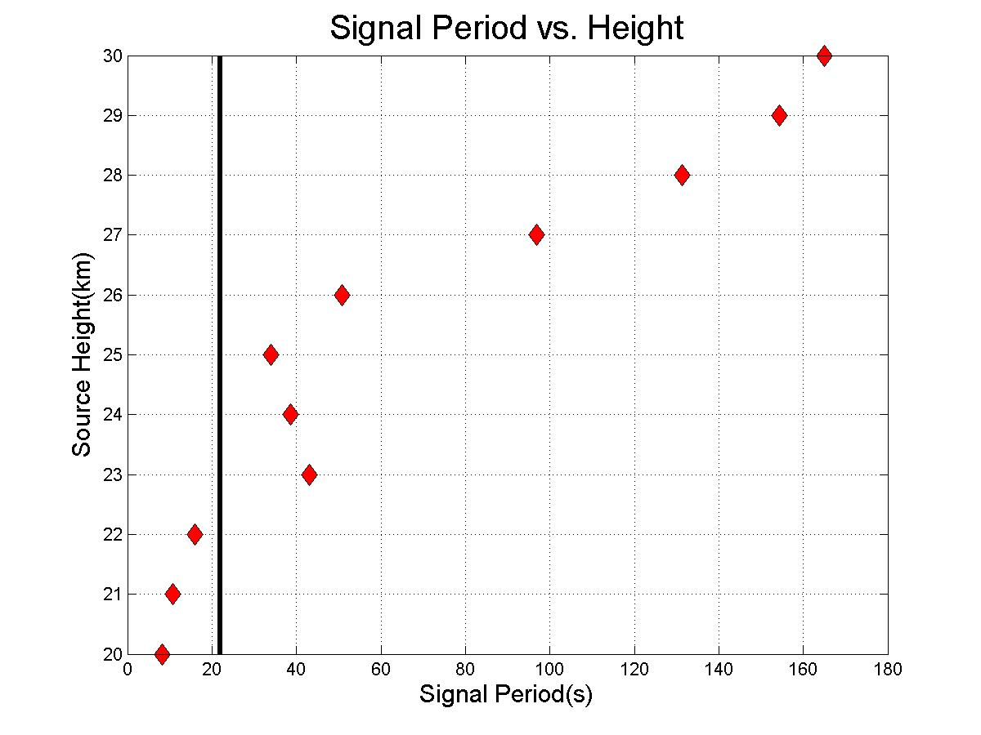

Slide 17
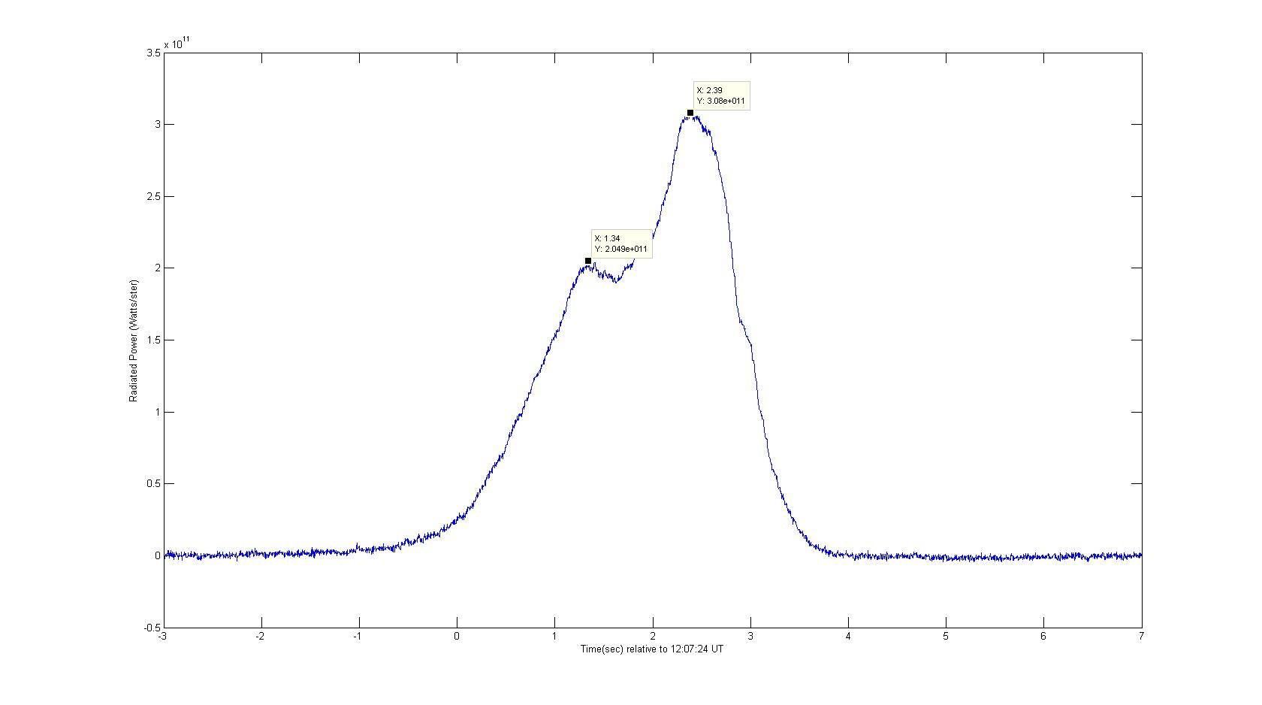
Antarctica Fireball –IS27
Date: Sep 3, 2004
Time: 12:07:24 UT
Location: Antarctica
(67.64’S, 18.83’E)
IS27 location: 70.66’S, 8.32’W
Visible Sensor Lightcurve
Radiated Power (Watts/Steradian)
Time (sec) relative to 12:07:24 UT

Slide 18
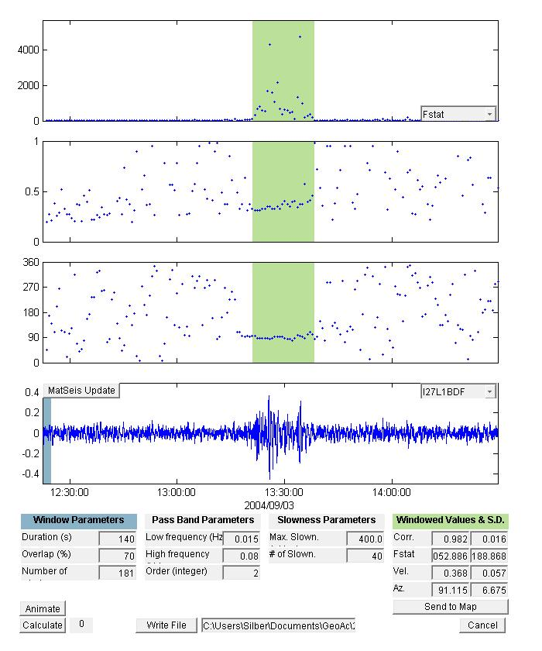
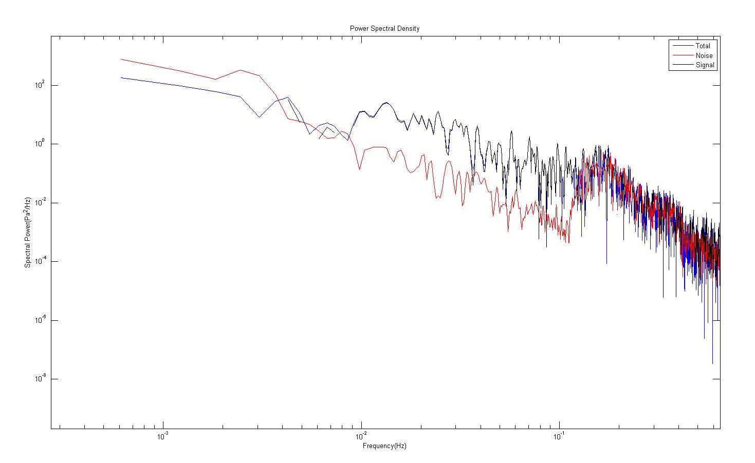
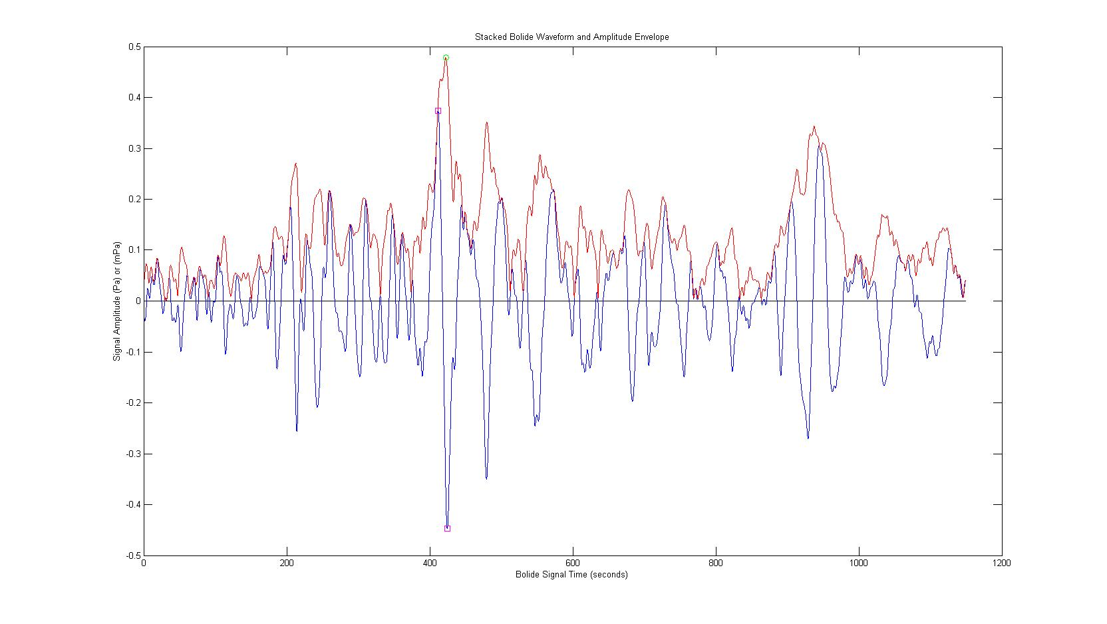
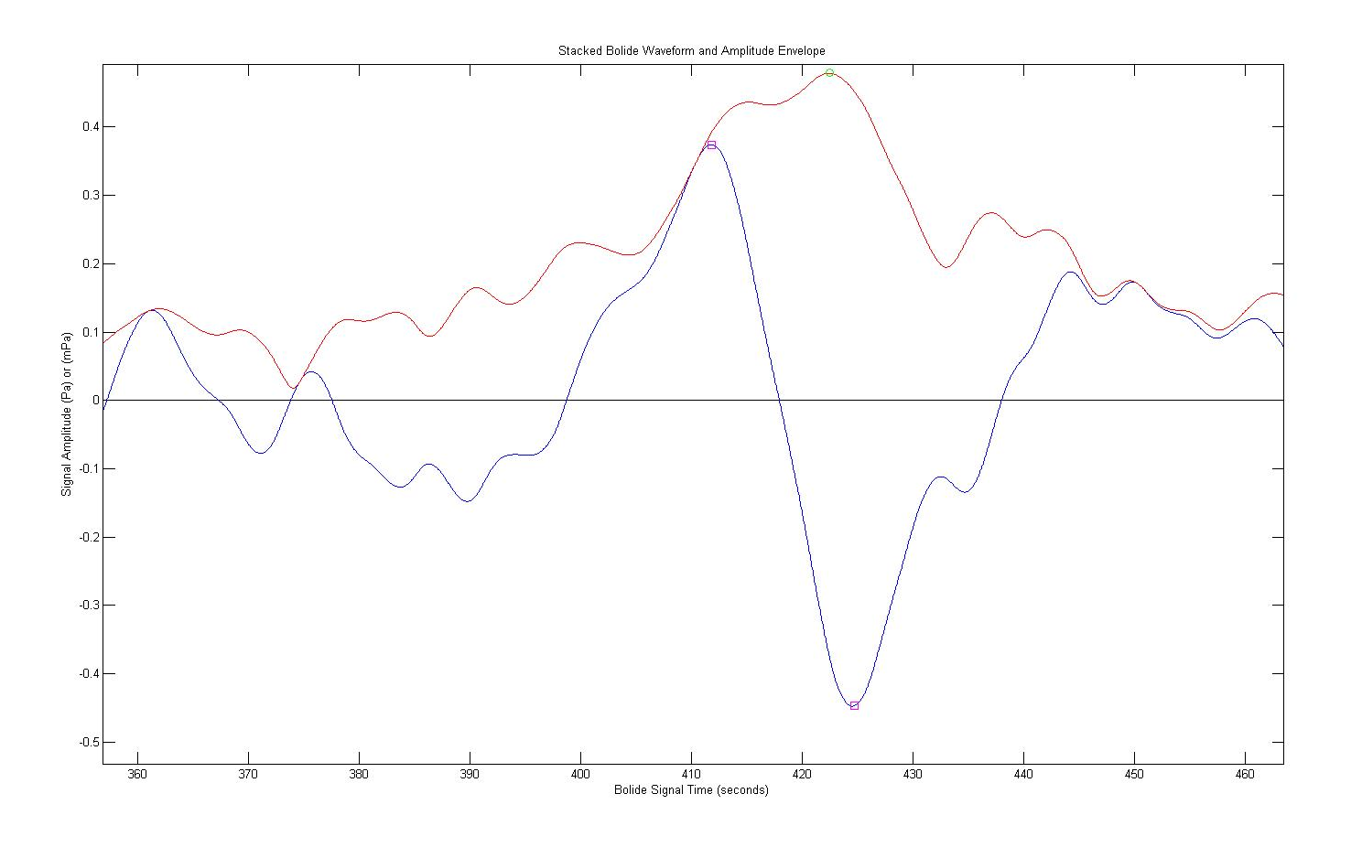
Infratool & Inframeasure
Power Spectral Density
Spectral Power (Pa^2/Hz)
Inframeasure analysis result
Travel Time: 4281.0 sec
Freq. @ Max. PSD : 0.02441 Hz
Max. Amplitude: 0.47869 Pa
Period: 39.801 sec
Frequency (Hz)
Stacked Bolide Waveform and Amplitude Envelope
Stacked Bolide Waveform and Amplitude Envelope
39.246sec
Signal Amplitude (Pa)
Signal Amplitude (Pa)
40.356sec
Infratool result
Bolide Signal Time (sec)
Bolide Signal Time (sec)

Slide 19
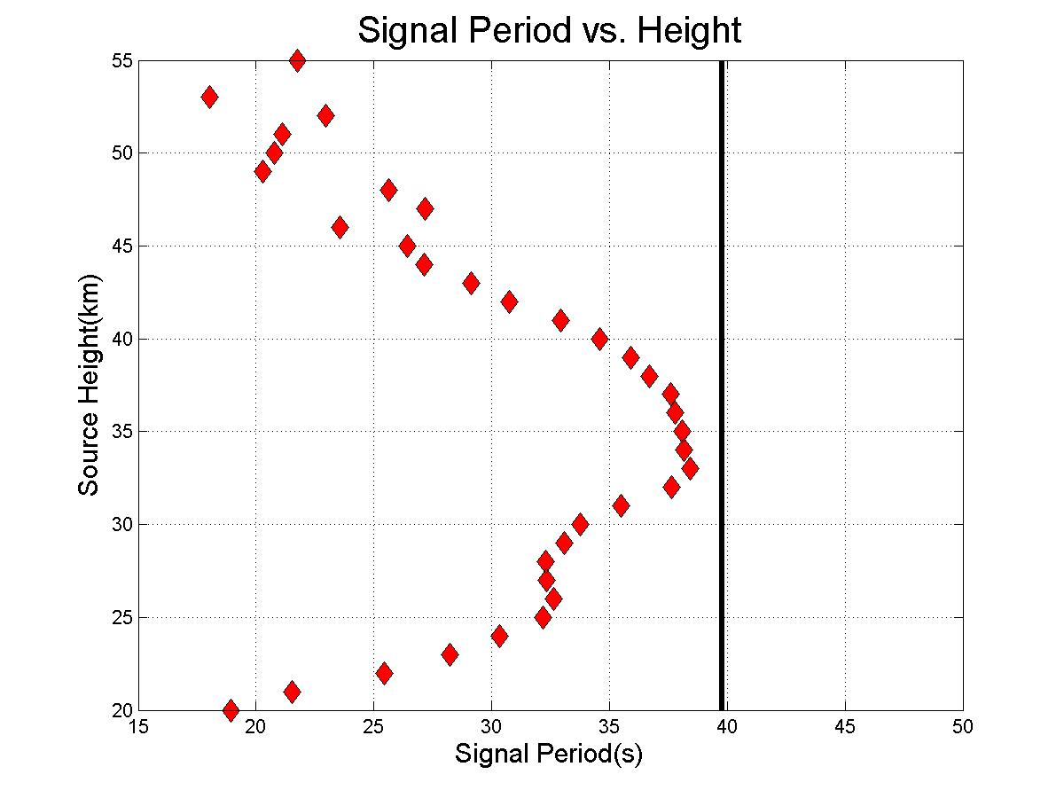

Slide 20
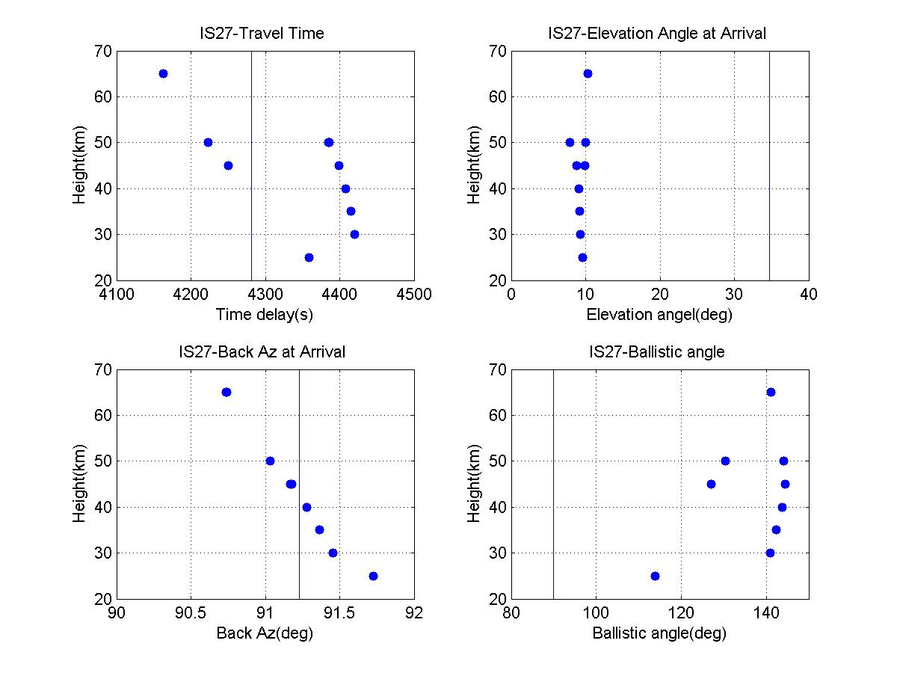
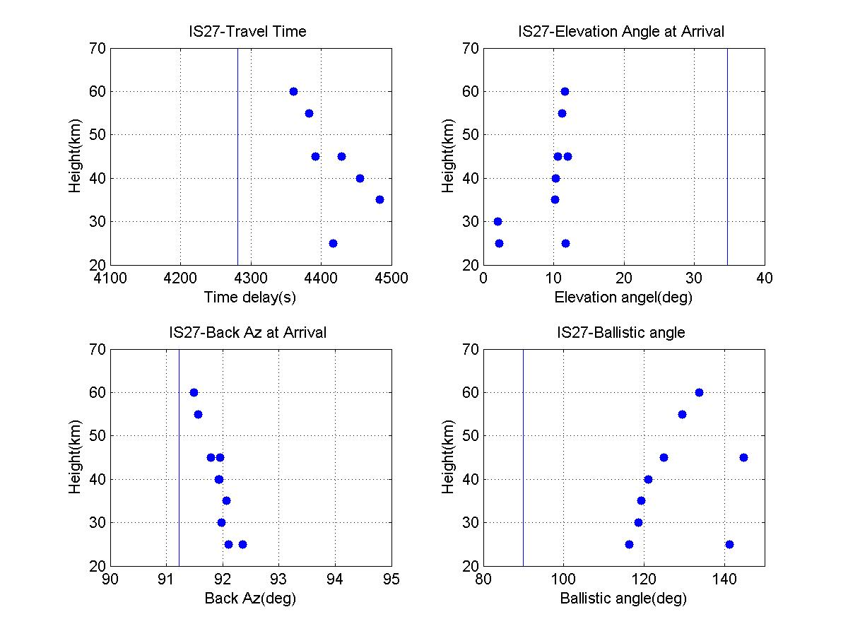
Composite Plots
Bolide location (67.70’S,18.20’E)
Midpoint (69.18’S,3.05’E)

Slide 21
Summary
Chelyabinsk (IS46) source height ~30km
Antarctica (IS27) source height ~35km
Next Steps
Apply range dependent atmosphere model for raytracing
Validate the method for determining the likely source height using other events

Slide 22
Thank you!

Slide 25
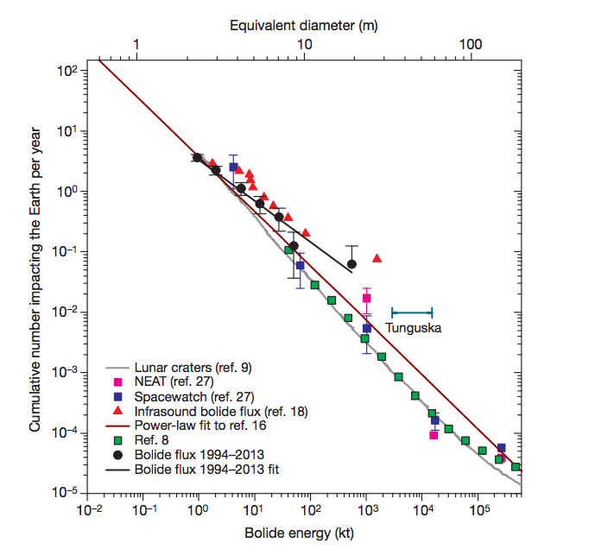
(Brown et al., 2013)

Slide 26
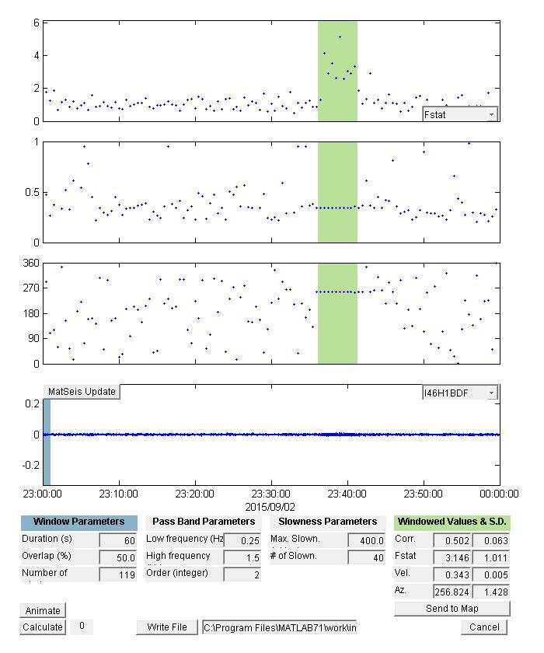
METHOD: Infratool
F-statistic
Trace velocity
Back Azimuth

Slide 27
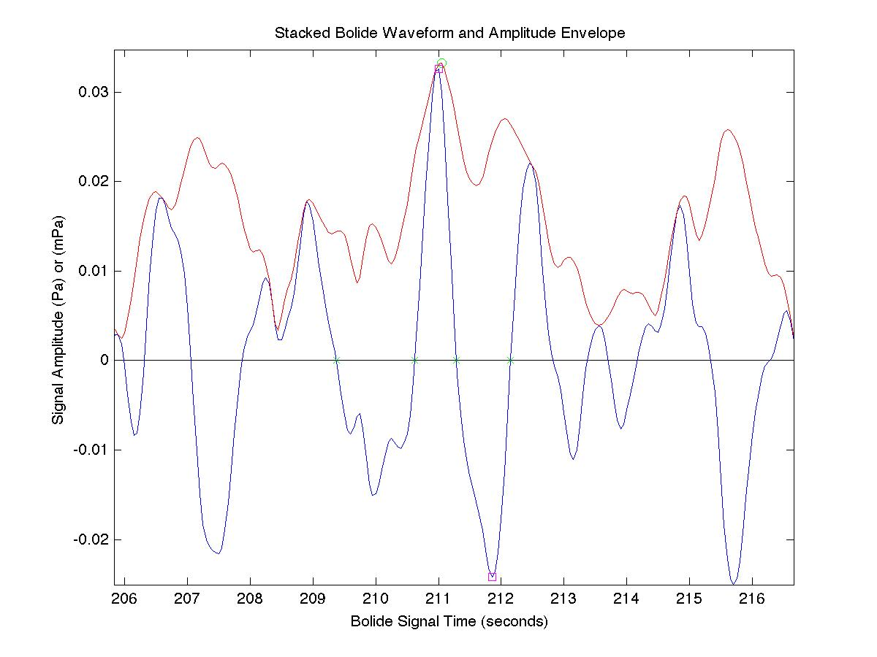
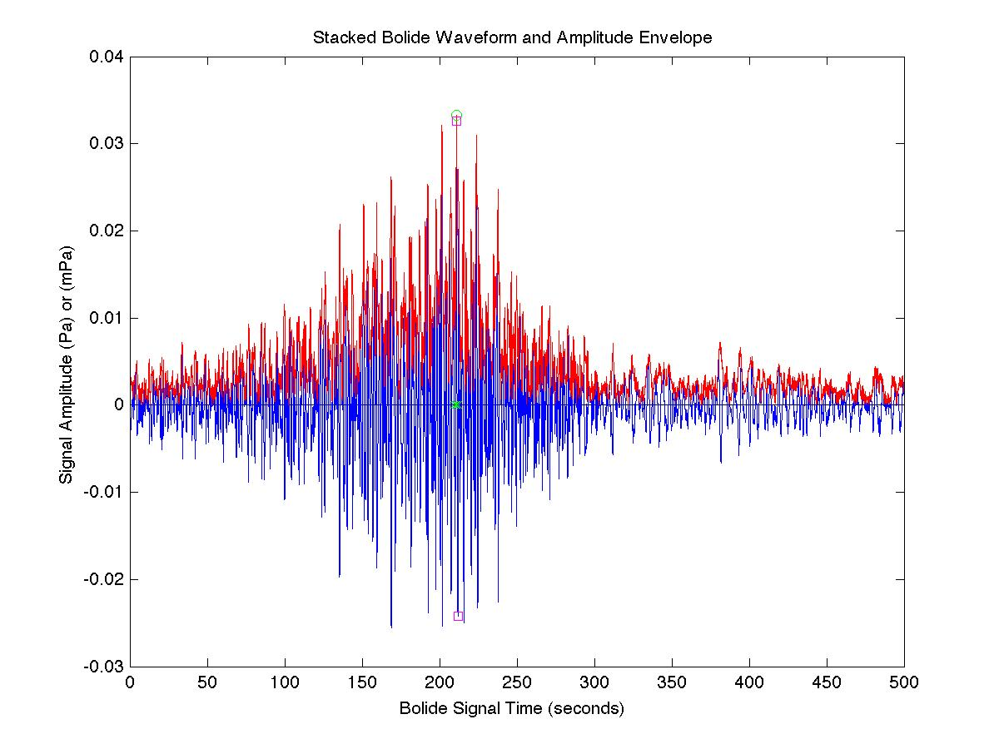
METHOD: Inframeasure analysis

Slide 28
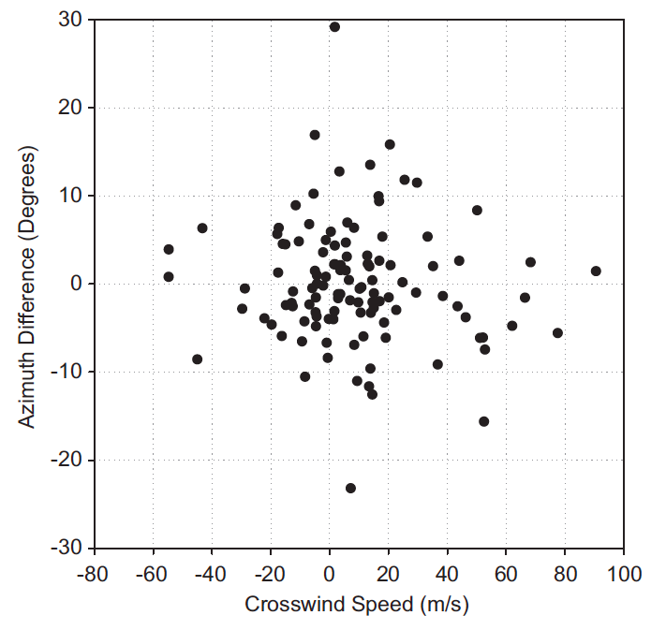
Back Azimuth deviation
(Ens et al., 2012)

Slide 29
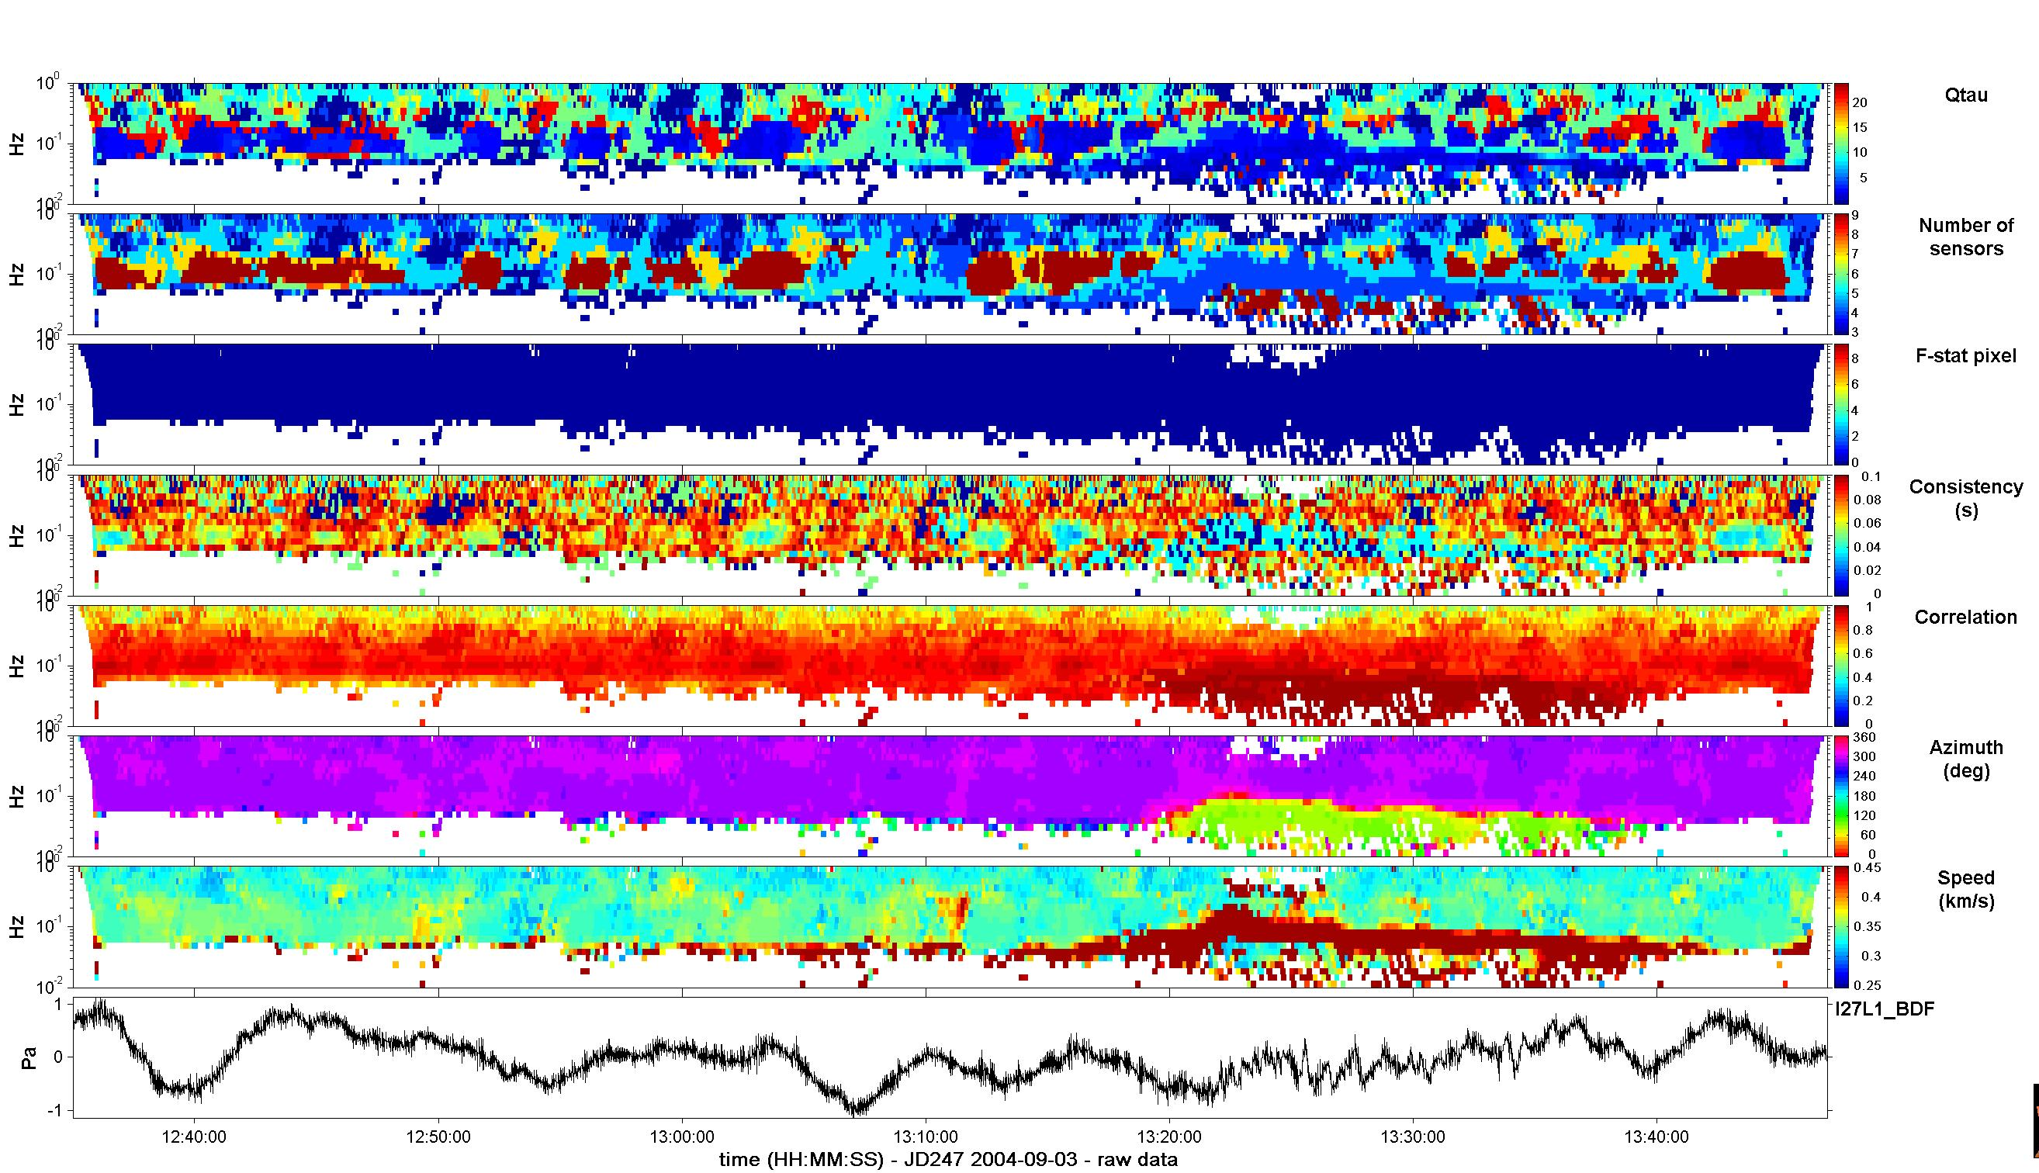
Infratool & PMCC
Consistency
(s)
Correlation
Azimuth
(deg)
Speed
(km/s)
PMCC result
Inframeasure analysis result
Period: 45.721 sec
Max. Amplitude: 0.47869 Pa
Travel Time: 4281.0 sec
Infratool result

