Slide 1
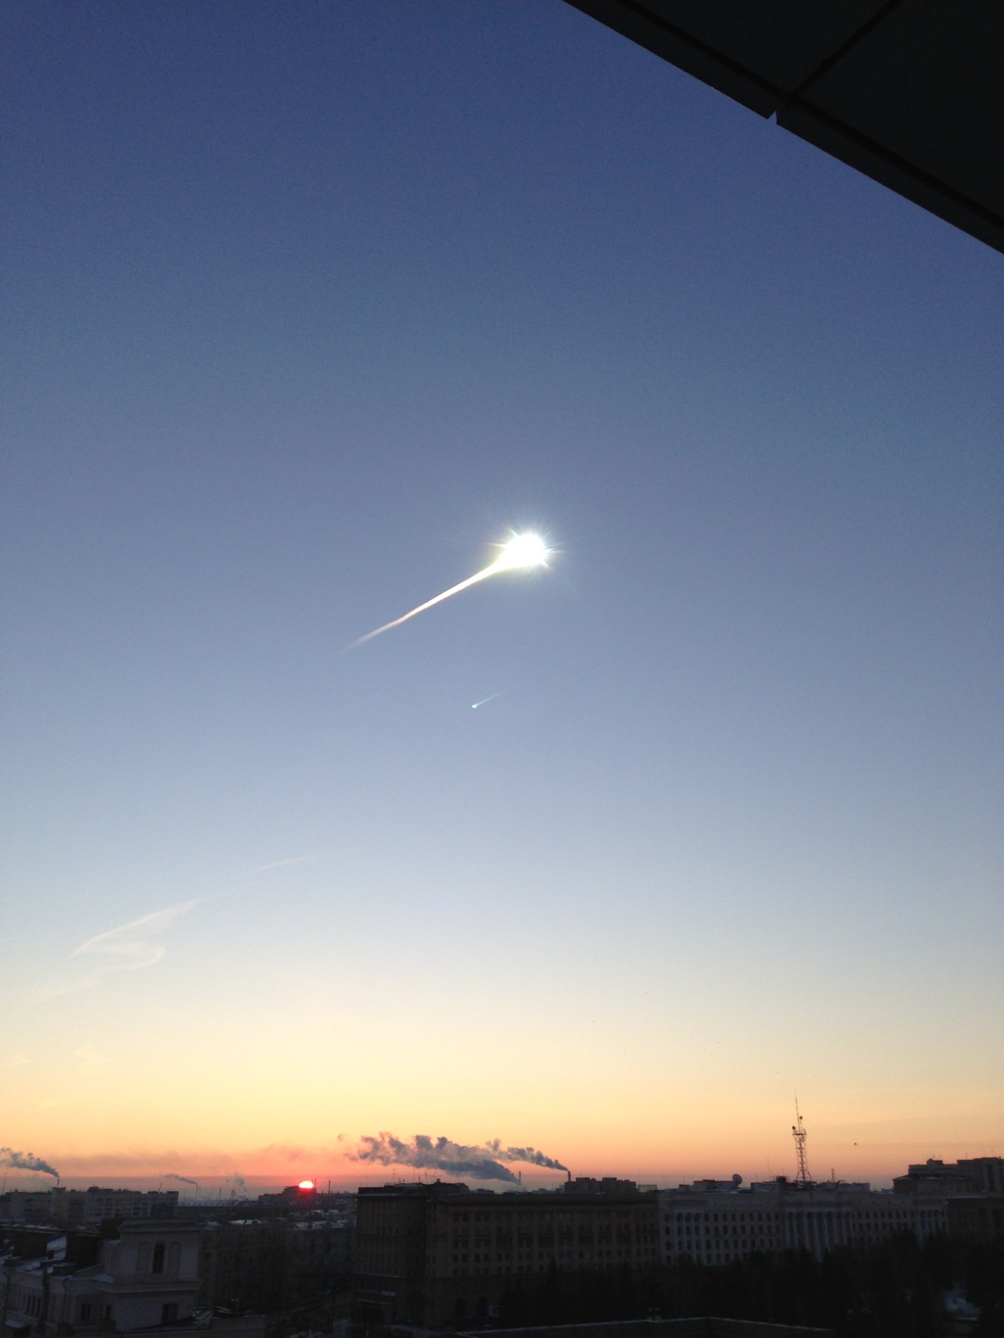
Numerical model of the Chelyabinsk meteoroid
as a strengthless object
V. Shuvalov, V. Svetsov,
O. Popova, D. Glazachev
Meteoroids 2016
Institute for Dynamics of Geospheres RAS

Slide 2
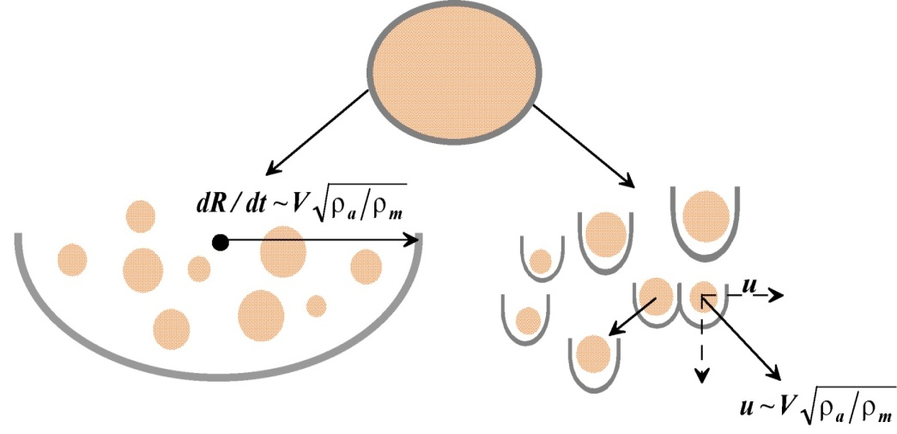
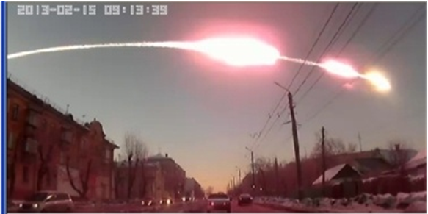
Fragmentation scenario
Small meteoroids (<1-20 meters):
complicated fragmentation, where fragments:
- may form debris cloud,
- may move as individual bodies,
- decelerate before total evaporation
- produce meteorites and dust deposition in the atmosphere
Larger (30-300m) meteoroids (hydrodynamical modeling), their fragments
-move as a cloud surrounded by a common shock,
-decelerate later and have more chances to be totally evaporated
Aerial bursts - "burning out" of comparatively large (D~ 100 m) bodies in the atmosphere
(Wasson and Boslough, 2000)
- the entire energy is released in the atmosphere
- no observable crater is formed
- affect the Earth’s surface (fires, shock waves)
- typical example - Tunguska event
Large meteoroids (>100-1000m):
- do not decelerate in the atmosphere,
- produce craters
The boundaries between these regimes - on projectile composition, entry V and impact angle

Slide 3
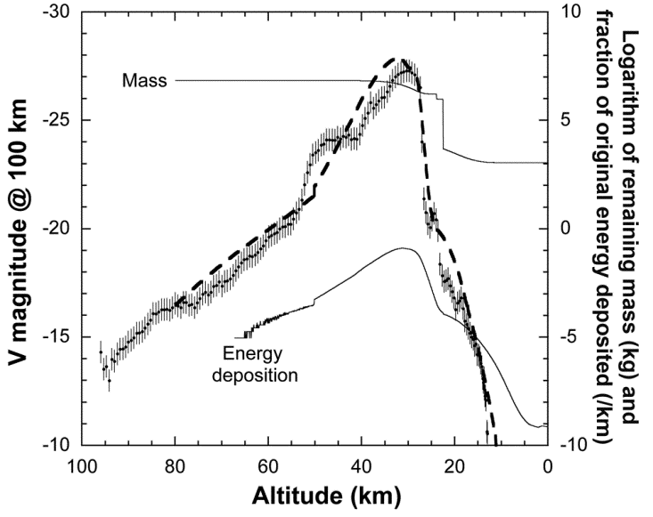
Simple Models
Hybrid model:
part of mass – independent fragments (~20t at H~27 km, could reach the ground)
part of mass - spreading debris clouds (decelerated at 27-20 km; observed: 29-26 km)
fragmentation occurred at loadings ~P~0.3-10 MPa
allows to reproduce the observed light/deceleration curves
model
observed
M_{vapor}~76% M₀;
M_{dust}~24% M₀
M_{meteorites}~0.03-0.06% M₀
Lightcurve, model fit (dashed),
mass passing given altitude (thin),
normalised rate of energy deposition (low thin)
All models agree with complicated character of fragmentation, which start at ~50-45 km and end at ~20-18 km (essential around 30-40 km)
(Borovicka et al 2013, Brown et .al 2013, Avramenko et al. 2014 etc)

Slide 4
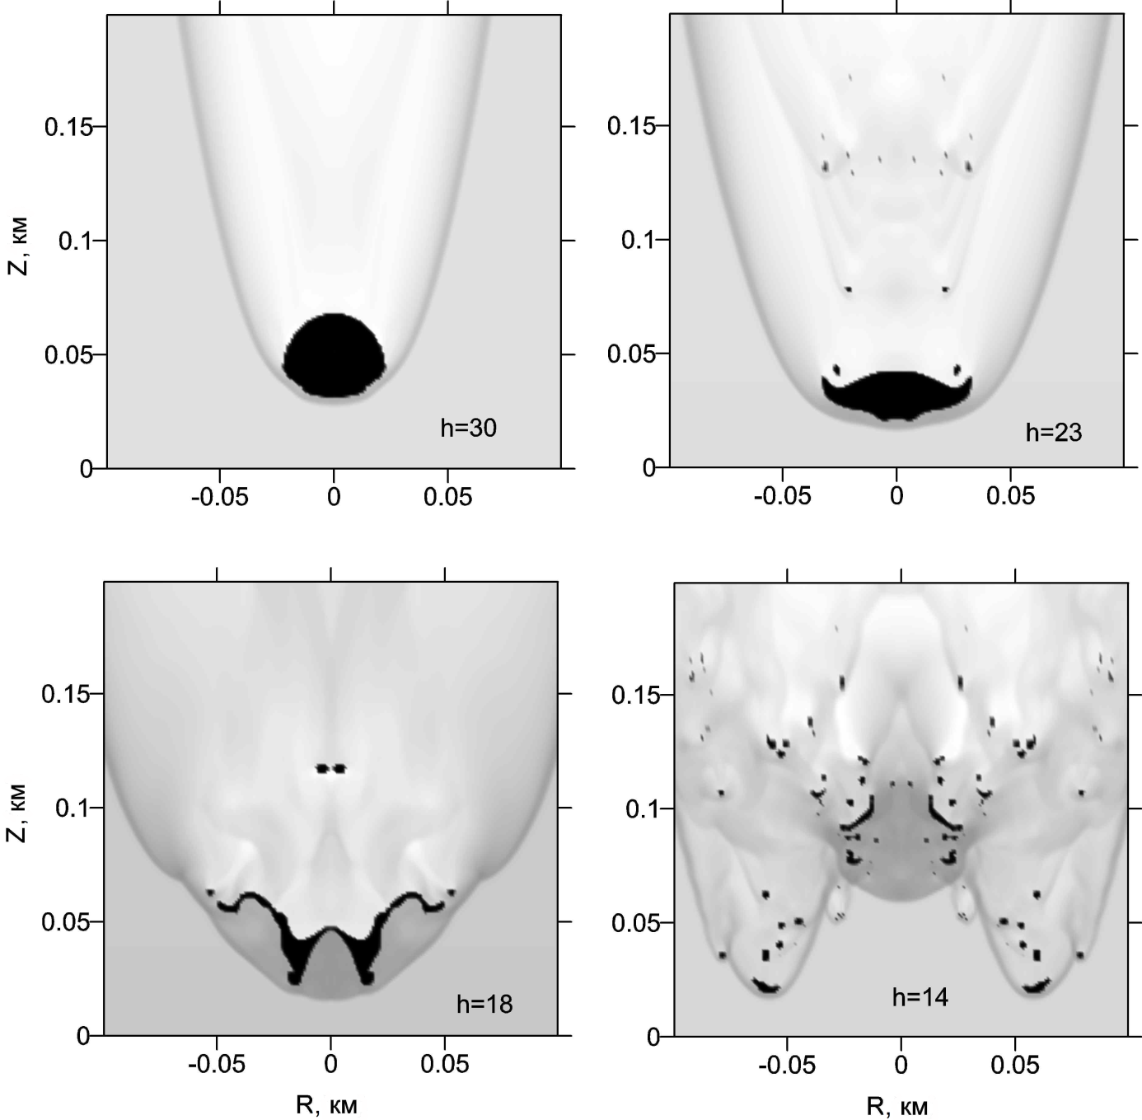
Quasi-liquid meteoroid model
Basis:
large meteoroid deformation begins at H, where aerodynamical loading>>strength
Main assumptions
Zero strength
Ablation as evaporation
Radiation transfer in thermal conductivity approximation
Formal range
D>30-50 m; H<40 km (Svettsov et al. 1993)
Restrictions:
quasi-liquid assumption
( no strength, separated fragments formation are not taken into account)
Relative density distribution along trajectory at different altitudes H
D=40 m, V=18 km/s; chondritic material (2650 kg/m³), α=90⁰
Black – solid meteoroid material
Quasi-liquid model= QL model

Slide 5
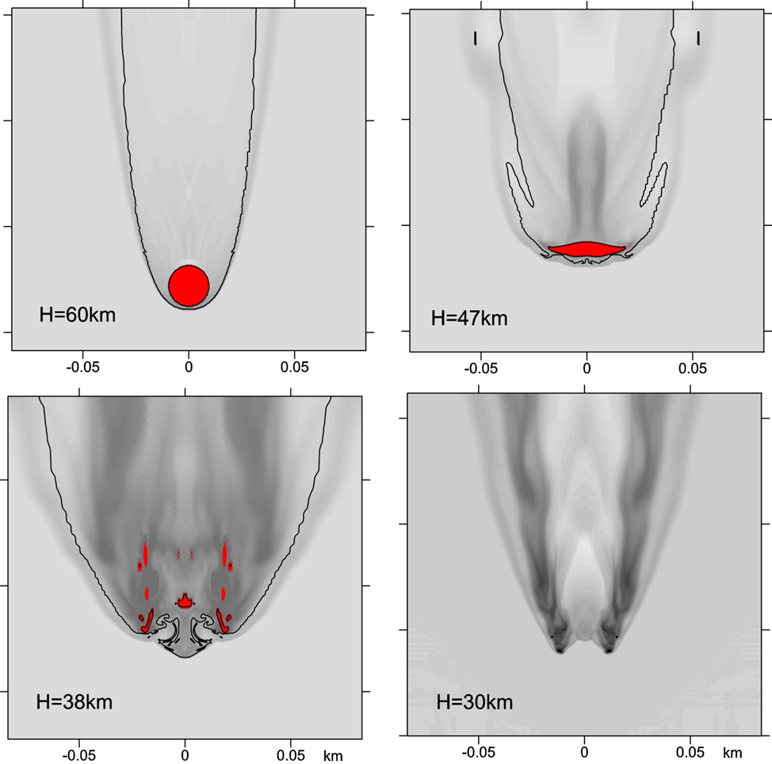
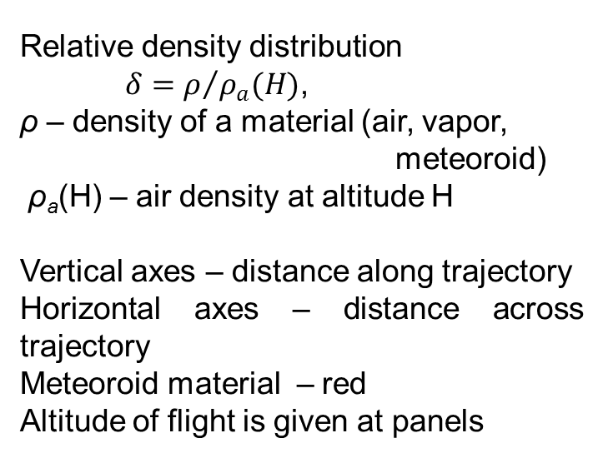
Quasi-liquid model for Chelyabinsk – like body I
Chondritic meteoroid
D=19 m,
V=19 km/s
ρ=3.32 g/cm³
entry angle - 18.5 degrees
Relative density distribution
$δ=ρ/{ρ_{a}(H)}$,
ρ – density of a material (air, vapor, meteoroid)
ρ_{a}(H) – air density at altitude H
Vertical axes – distance along trajectory
Horizontal axes – distance across trajectory
Meteoroid material – red
Altitude of flight is given at panels

Slide 6
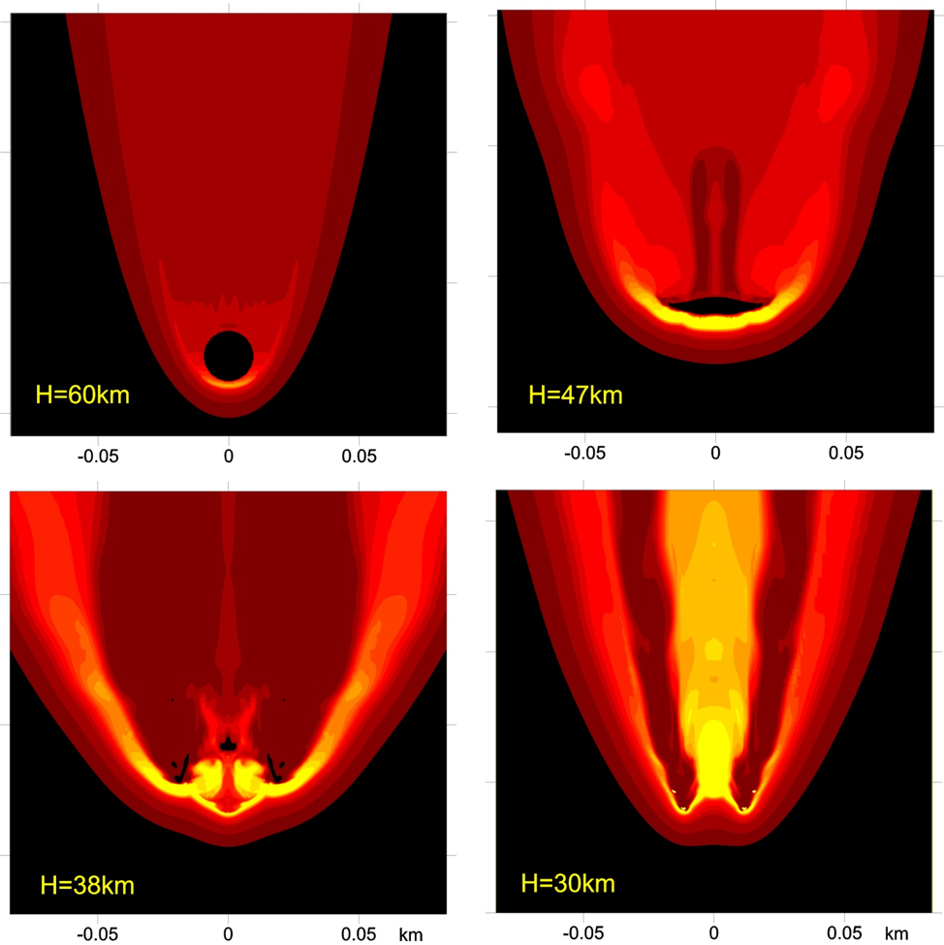
Quasi-liquid model for Chelyabinsk – like body II
Chondritic meteoroid
D=19 m,
V=19 km/s
ρ=3.32 g/cm³
entry angle - 18.5 degrees
Temperature distribution
Vertical axes – distance along trajectory
Horizontal axes – distance across trajectory
Meteoroid material – black
Altitude of flight is given at panels

Slide 7
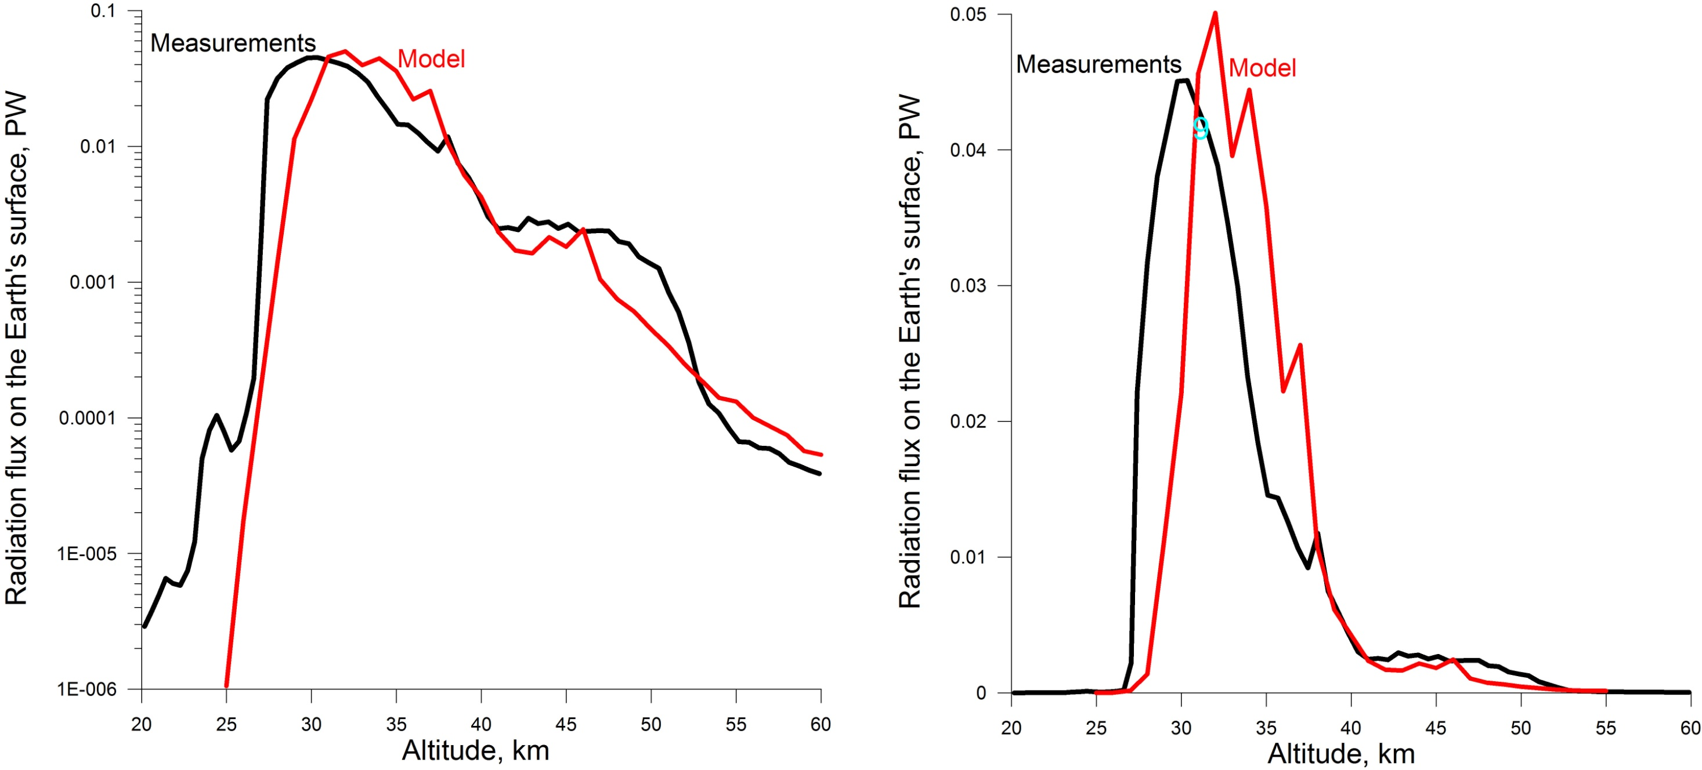
Light curve in the frame of QL model
Temperature/density distributions - to determine light curve and radiation fluxes at the Earth's surface.
The equation of radiative transfer along 6400 rays passing through the luminous area (T>500 K) was solved.
Absorption coefficients (for air and ordinary chondrite) were taken into account in the multi-group approximation
(previously used for power explosions, Svettsov, 1994a, b)

Slide 8
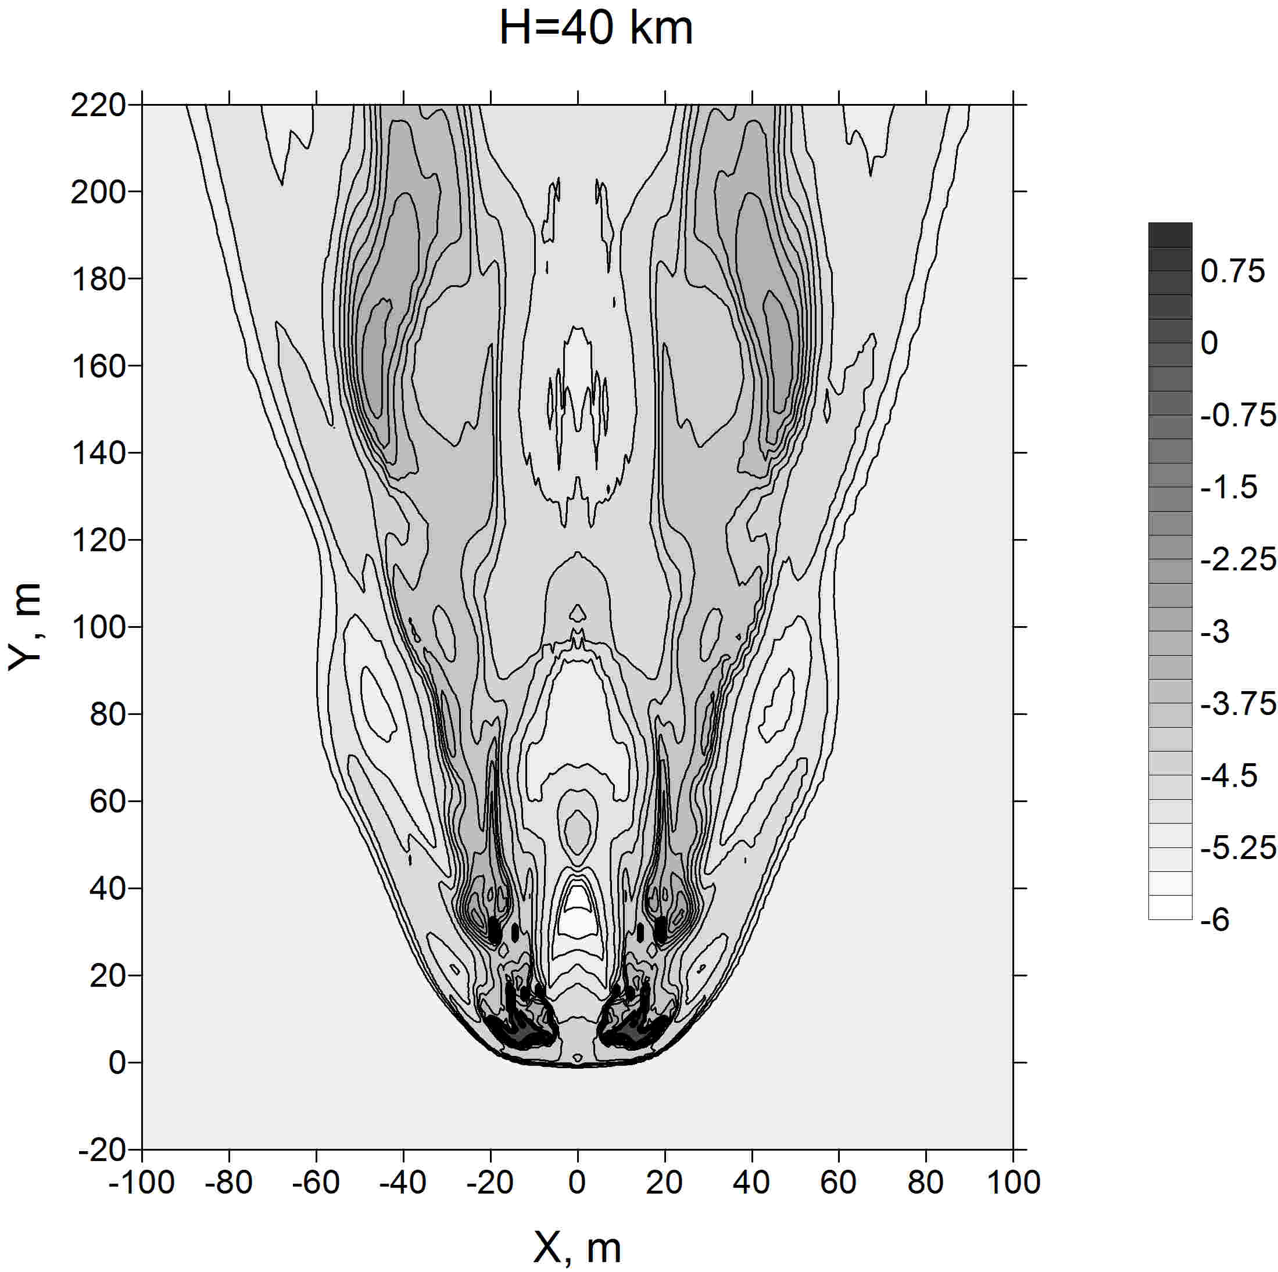
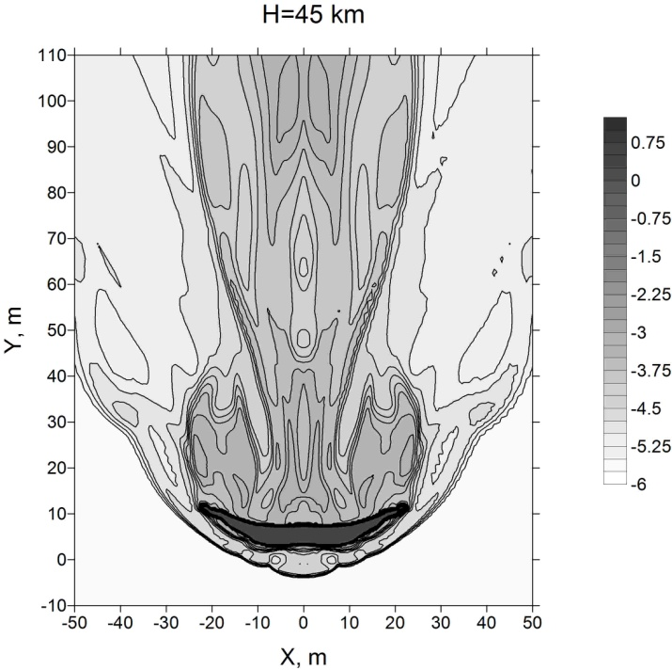
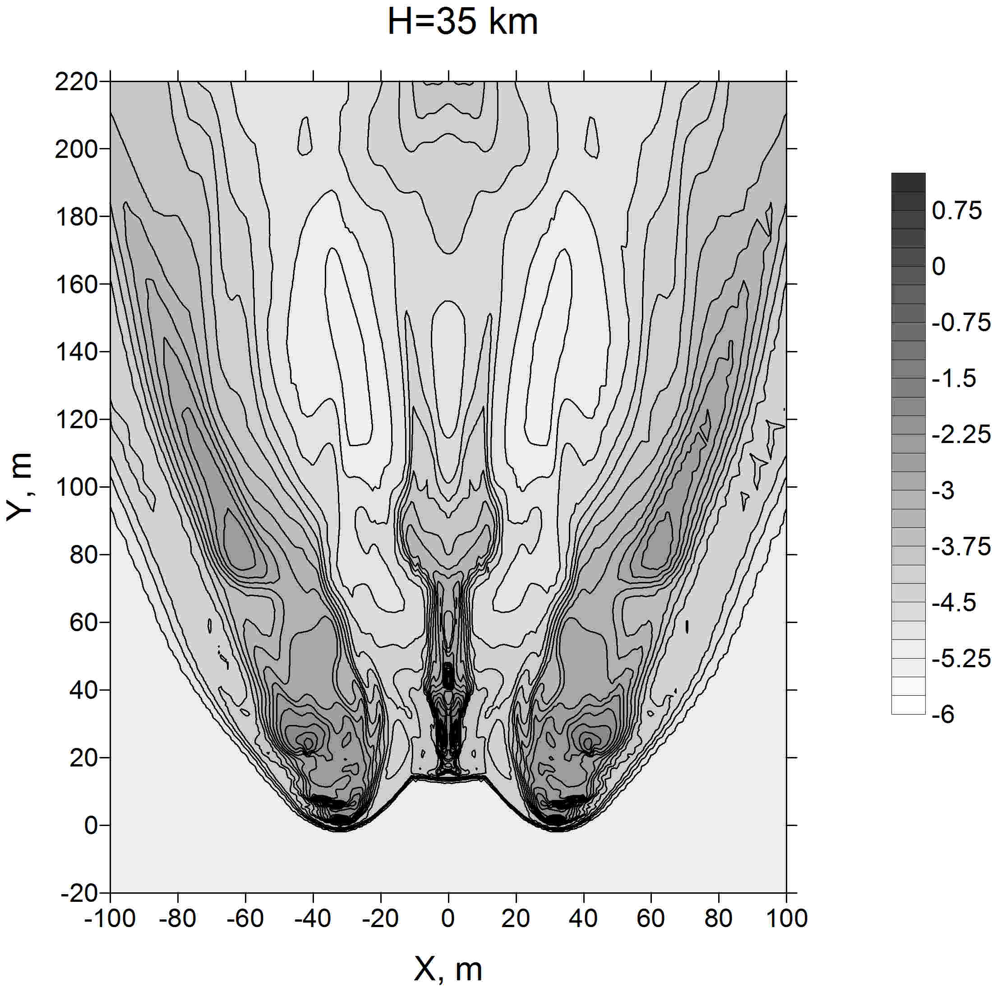
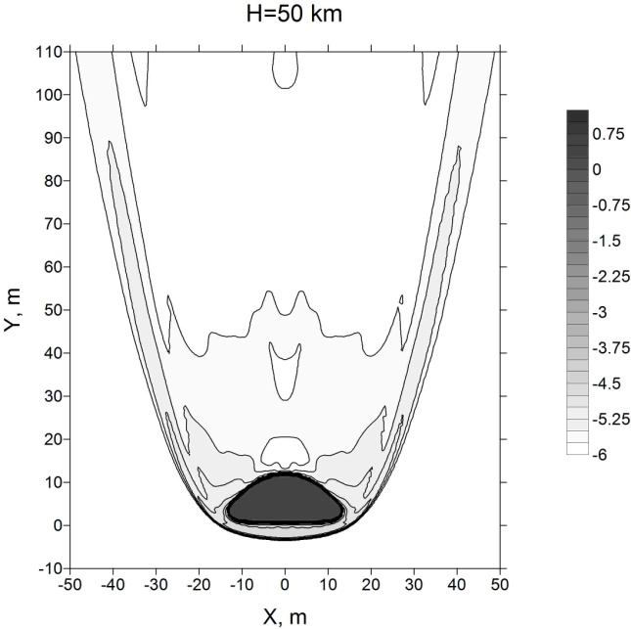
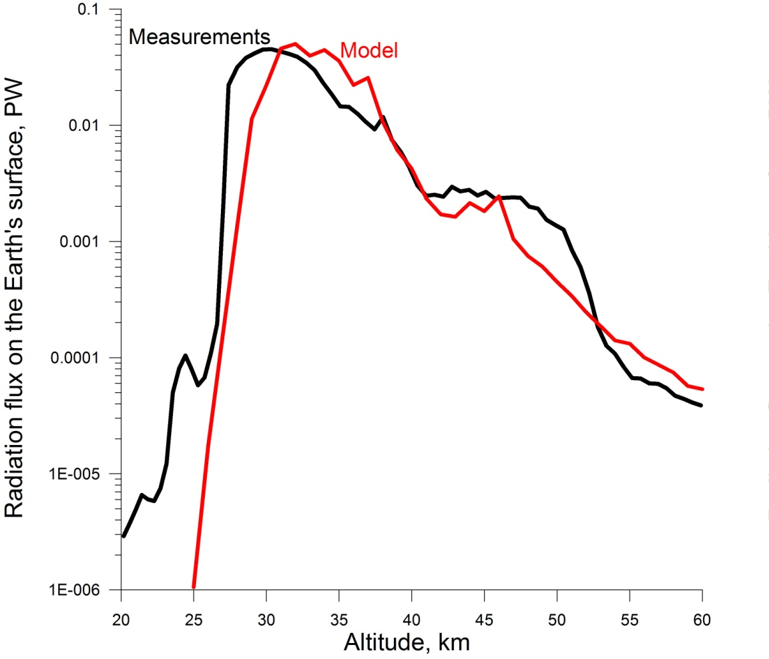
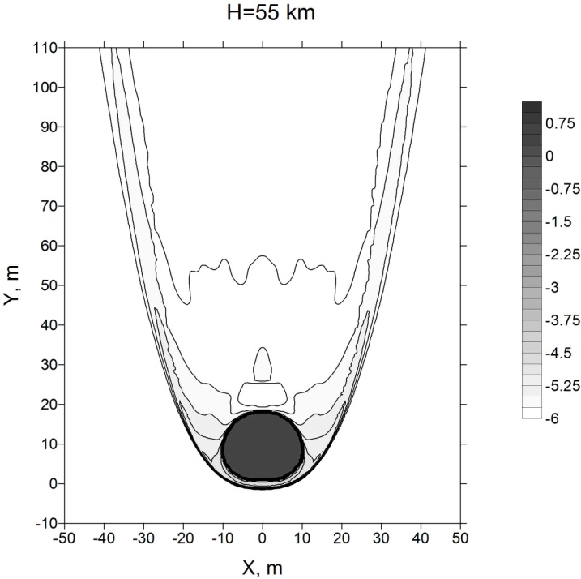
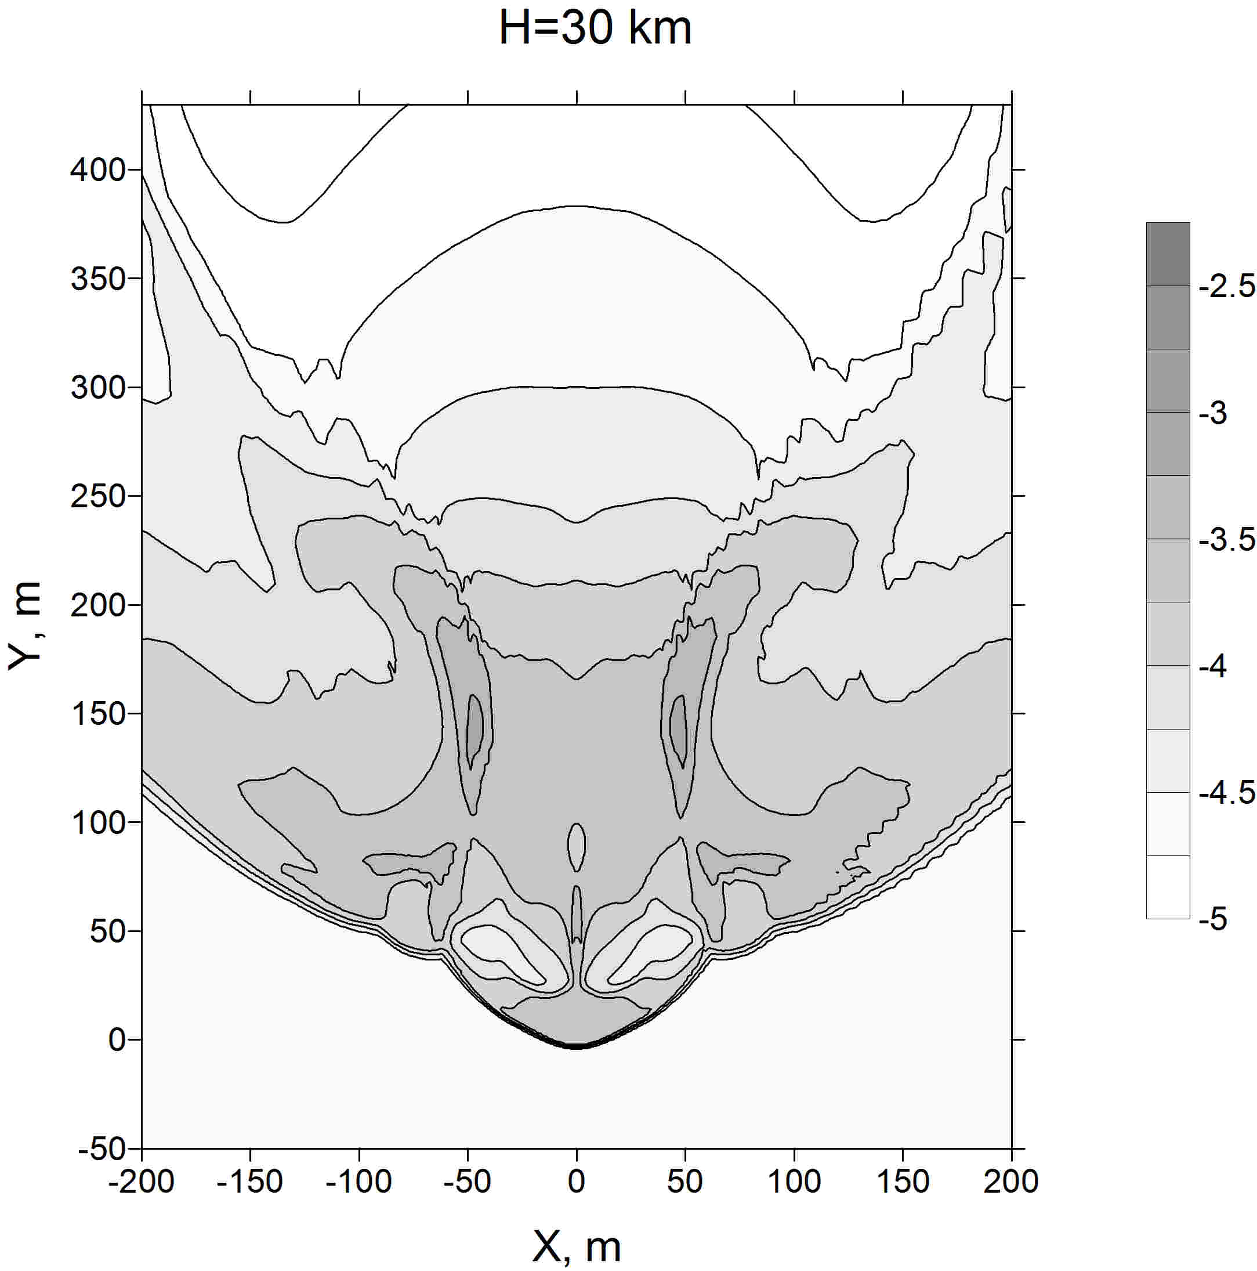
Features on the light curve
Observations, simple hybrid models – fragmentation
QL model – (1) deformation/increase of lateral size, (2) fragmented into nonuniform debris jet

Slide 9
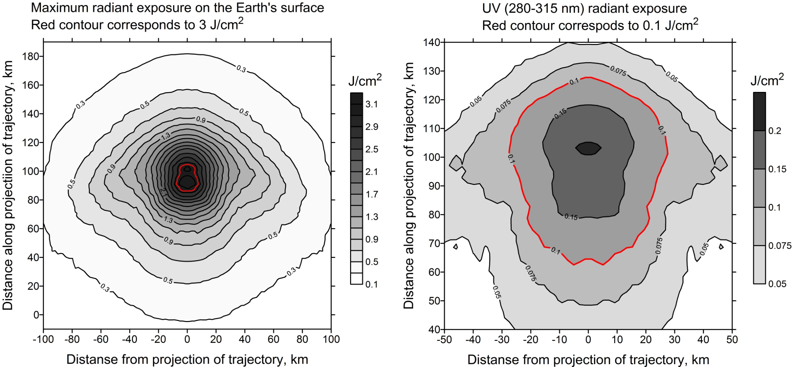
Radiation energy on the surface
Note different scale
Distance is counted from the point where initial trajectory (without deceleration) would reach the ground.
Ideal visibility is assumed.
Maximal thermal energy : ~ 3100 J/m² (not enough for skin burn, but enough to fill the heat)

Slide 10
Luminous efficiencies in the frame of QL-model
 | Previous estimates | QL model
Integral luminous efficiency η | 14-17% (Popova et al.2013) 17%, (Brown et al. 2013) | 18.4%
Panchromatic passband luminous efficiency | 7±3% (Popova et al.2013) 5.6−13.2% (ReVelle&Ceplecha 2001) | 6.8%
UV-B (280-315 nm) |  | 1.1%
Sunburns were reported.
Korkino (30 km from the point of peak brightness):
one resident - sunburn on the face, followed by loss of skin flakes.
Such effects occur at a minimum erythema dose of ~1,000 J/m² (290-320 nm radiation, mostly UV-B).
Previous estimates: Assuming 6000 K radiation ~200 J/m² at Korkino.
Snow reflectioin – could increase the dose.
QL-model: maximal irradiated energy UV-B 2000 J/m² . In Korkino - ~1000 J/m²

Slide 11
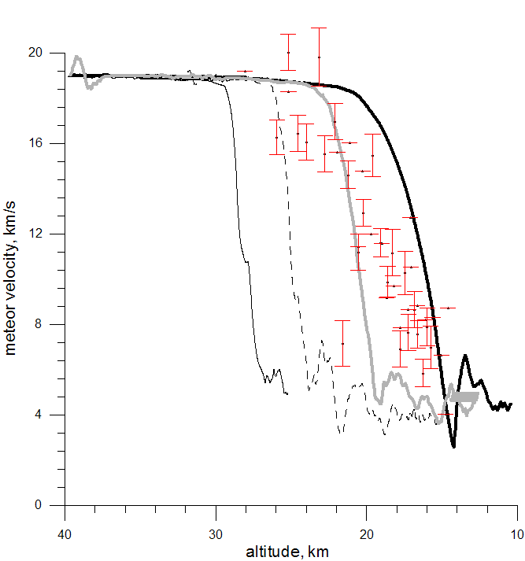
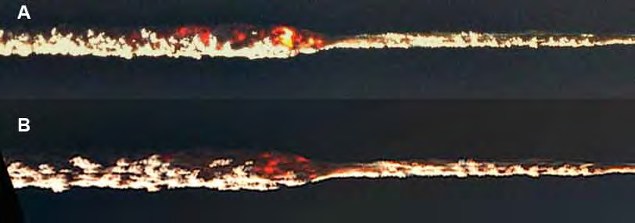
Deceleration curve in the frame of QL model
QL model
18
30
90
Observations:
cloud of thermally emitting debris came to rest between altitudes of 29 and 26 km ( )
deceleration of the main fragment – red dots with error bars
45
QL model
-does not describe the formation of separated fragments
(model restriction), total evaporation at 33 km (18⁰)
-observed deceleration of most material doesn’t contradict to observations (H~30 km)
-provides reasonable estimate of energy deposition curve
- vertical entry decreases deceleration H more than on 10 km
Deceleration curves QL model for different entry angles
(marked at curves)

Slide 12
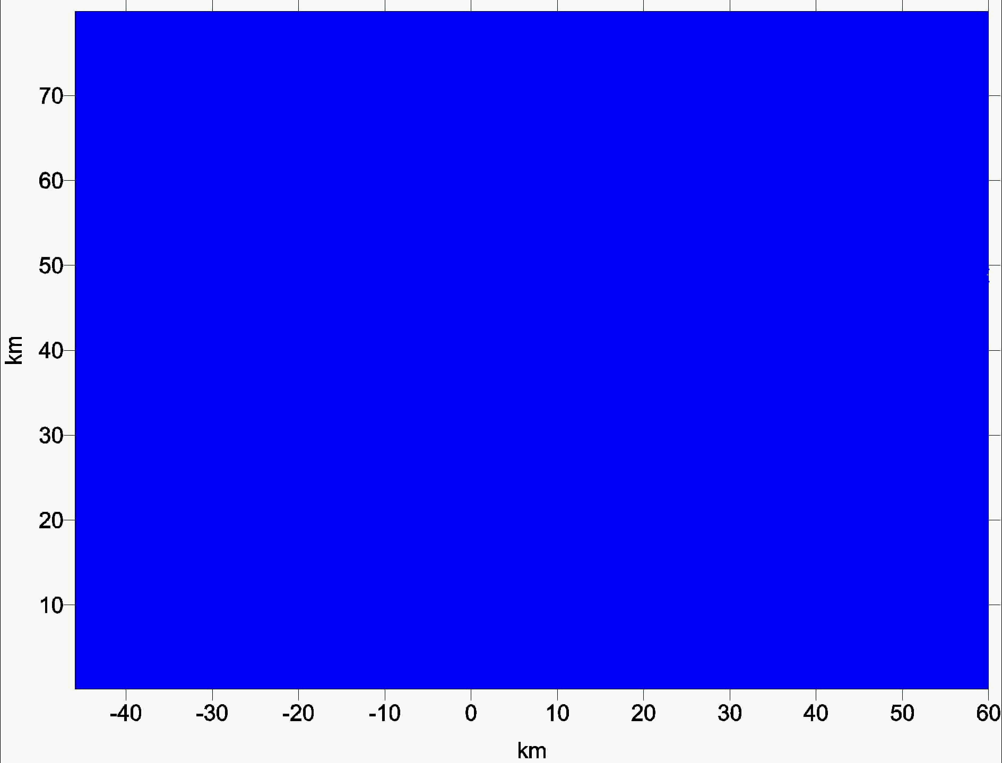
Shock wave of Chelyabinsk meteoroid
Energy 520 кт,
Energy deposition
~light curve
Time evolution:
- outer shock wave
- area of energy release

Slide 13
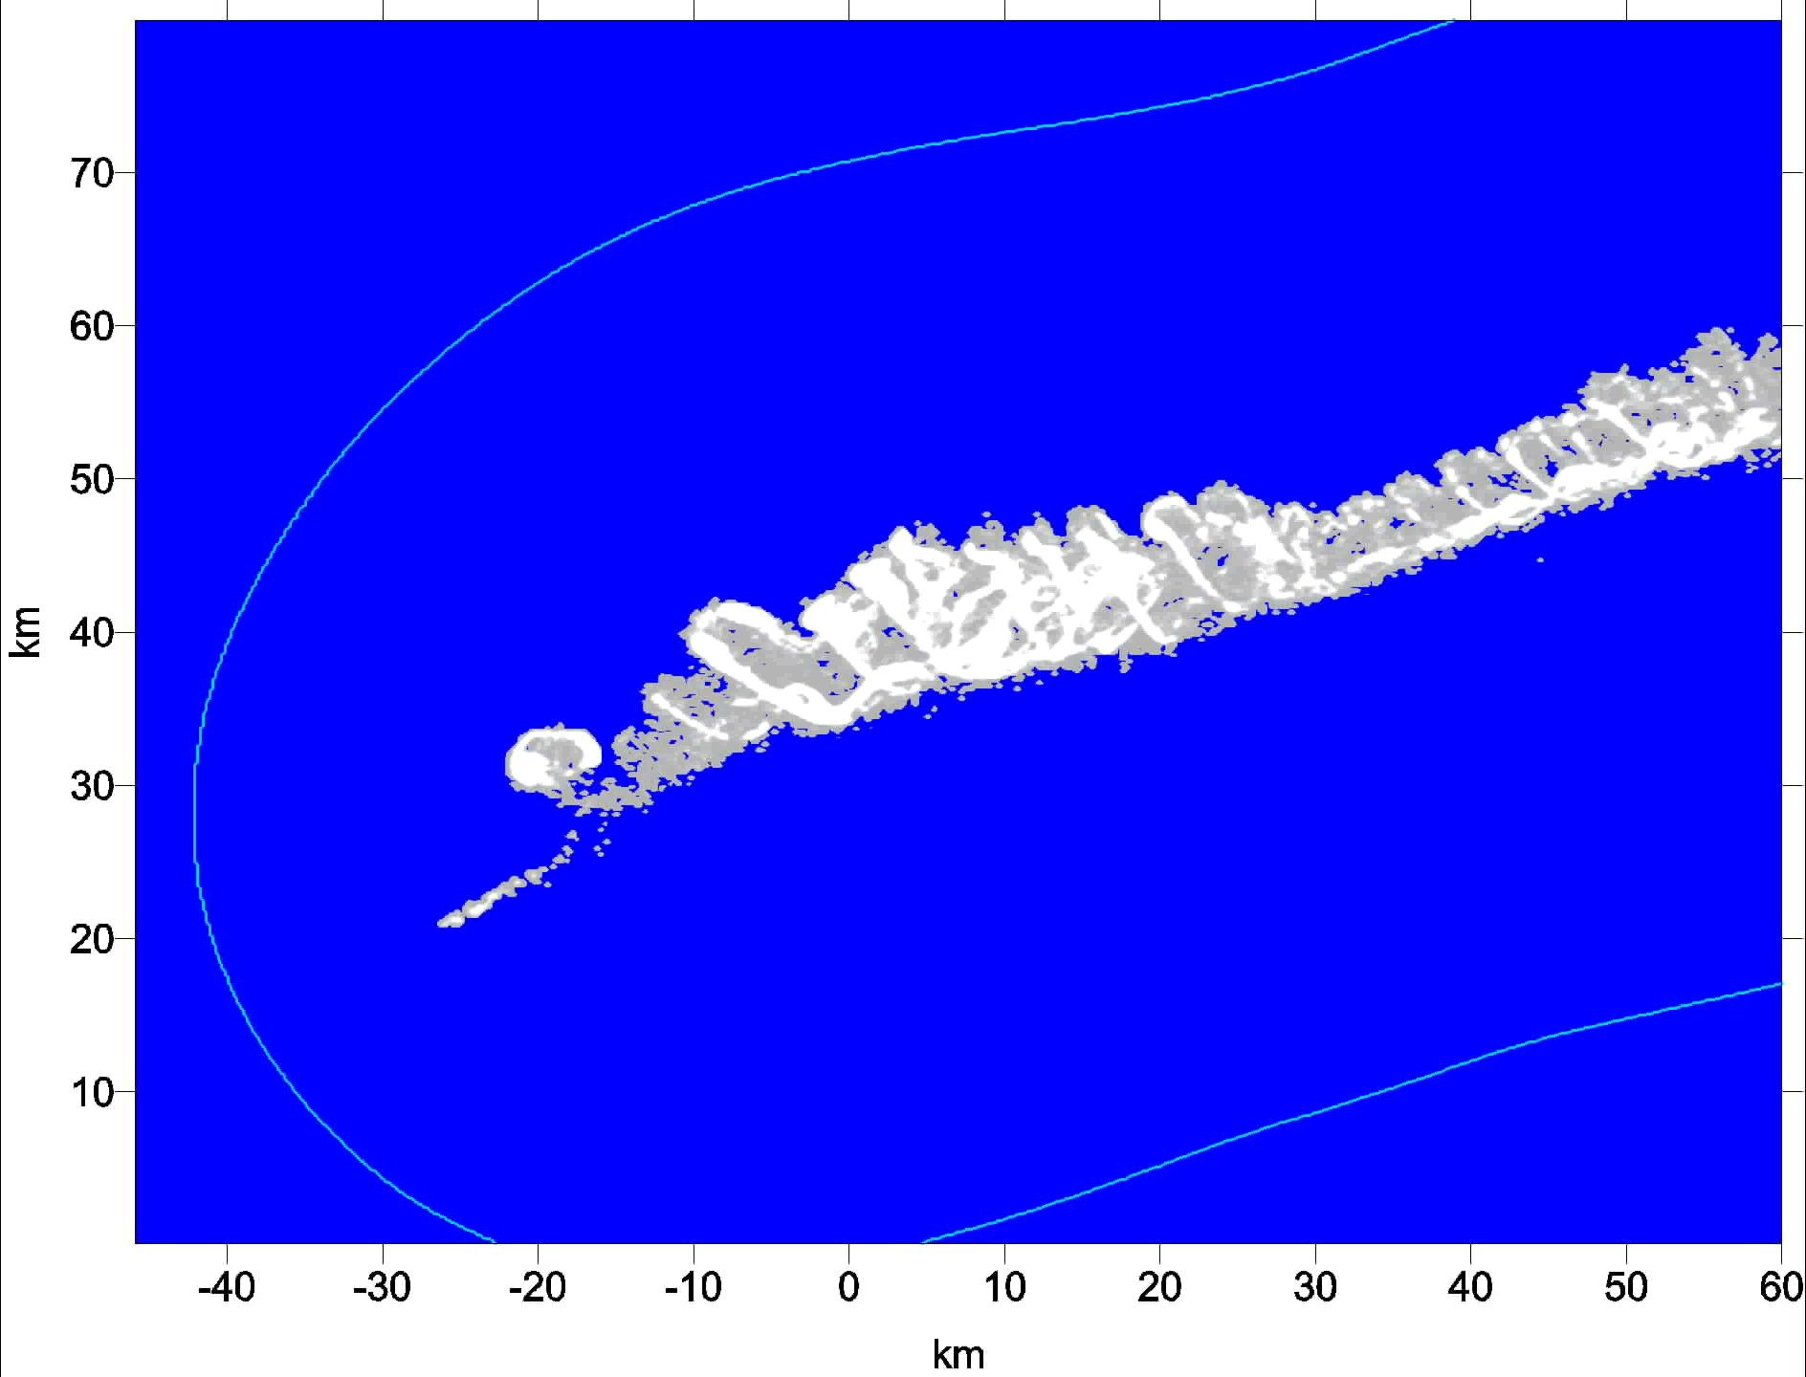
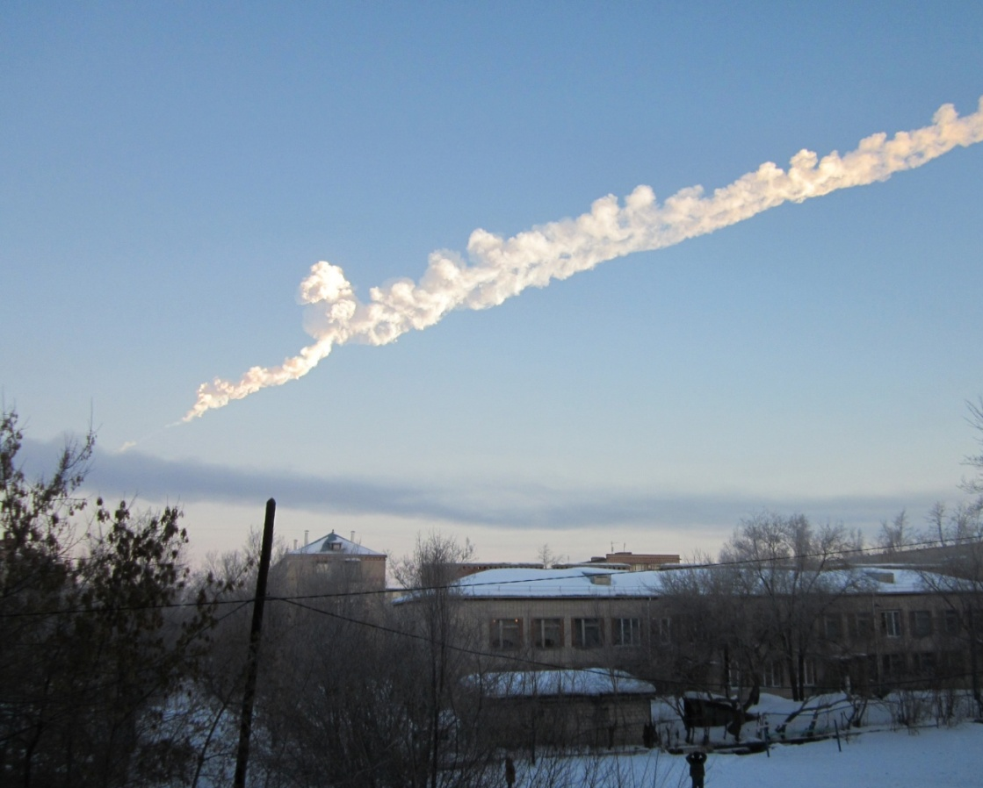
Shock wave of Chelyabinsk meteoroid
~85 km S

Slide 14
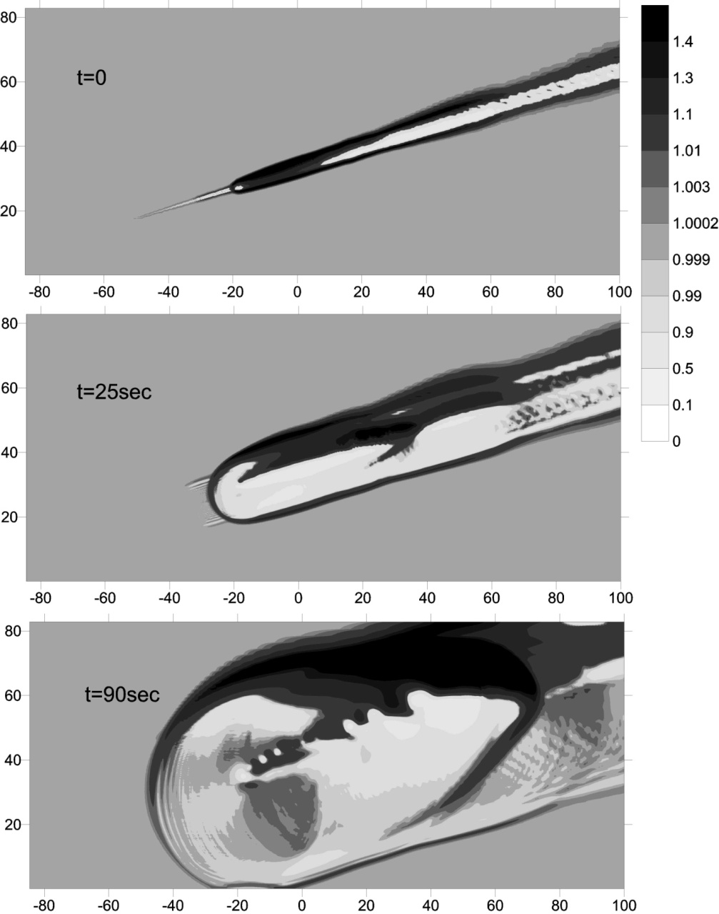

Modeling of Chelyabinsk bolide shock wave
dE/dz~light curve
dE/dz~QL model
The peculiarities of energy release influence on density and pressure distribution in the disturbed area formed in the atmosphere after the entry, and on its subsequent evolution as well as on overpressure on the ground

Slide 15
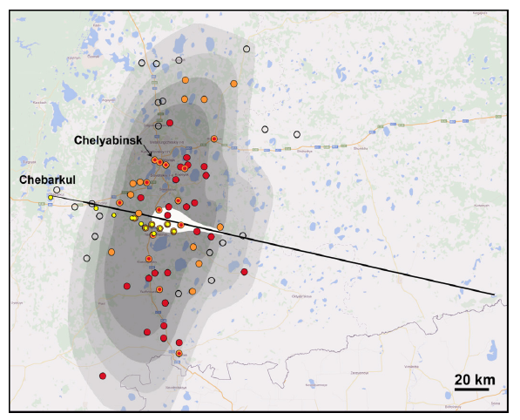
Map of glass damage on the ground
Contours :
(from dark to light)
300 kt Δp>1000 Pa,
520 kt Δp>1000 Pa,
300 kt Δp>500 Pa,
520 kt Δp>500 Pa
The shape of damaged area
– corresponds to energy deposition along extended part of trajectory
P_{max}>4.3 kPa
solid orange circles - for reported damage
open black circles - for no damage;
solid red circles the most damaged villages in each district (as reported by the government)..
White - the fireball brightness on a linear scale.
Chelyabinsk, Korkino
model ~2-4kPa
Korkino: P>1.2-2.5 kPa
Brown et al.(2013):
P~2.6-3.8 kPa in Chelyabinsk

Slide 16
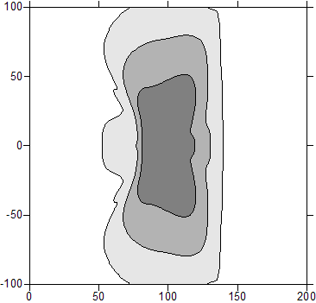
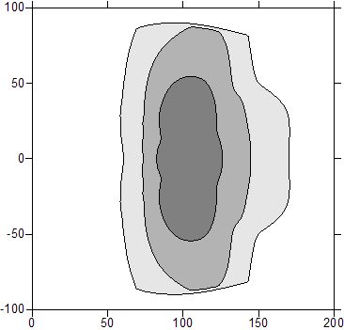

Overpressure at the ground level I
dE/dz~QL model
dE/dz~light curve
Dark: >2000 Pa
Gray: > 1000 Pa
Light gray:>500 Pa
The calculations was stopped before this area was totally covered
Maximal ∆P~3.3 kPa
Maximal ∆P~4 kPa
Main characteristics of overpressure zones (>1 kPa) (sizes, maximal ∆P) -
satisfactory agreement
between results obtained in the frame of QL model and previous modeling
under assumption that energy deposition is proportional to the light curve

Slide 17
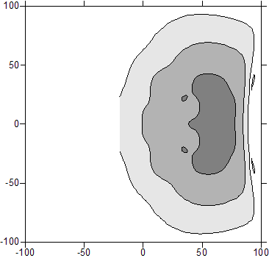
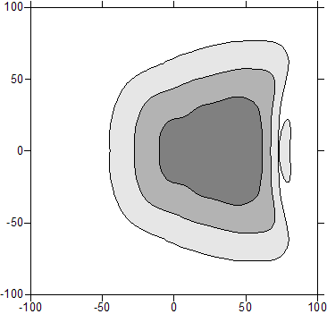
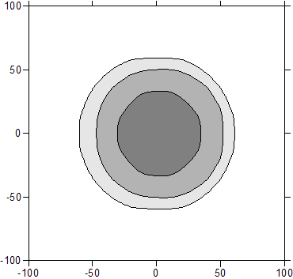
Overpressure at the ground level II
Dark: >2000 Pa
Gray: > 1000 Pa
Light gray:>500 Pa, non-completed
QL model : different angles of trajectory inclination
18⁰
30⁰
45⁰
90⁰
The area of high overpressure value (>1 kPa) has approximately the same size, but different shape.
The maximal value of ∆P increases with trajectory angle increase from 3.3 kPa at 18⁰ up to 5.2 kPa at 90⁰
The relatively small change of maximal overpressure is probably connected with appearance of upward flow along the wake, which result in shock wave attenuation, despite the lower altitude of debris deceleration

Slide 18
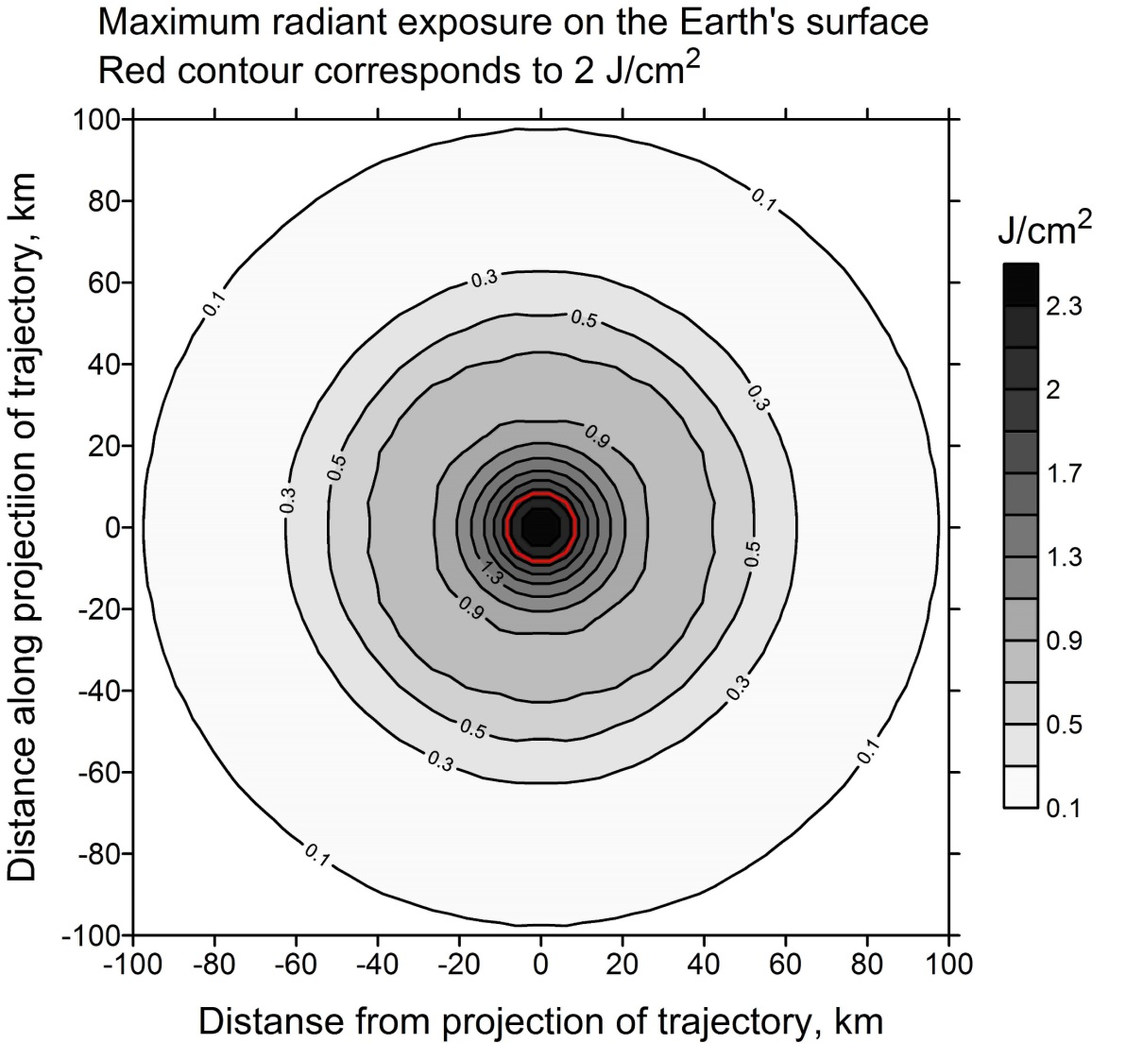
Radiation energy on the surface II
For vertical impact the irradiated energy on the surface is smaller than for oblique one
Distance is counted from the point where initial trajectory (without deceleration) would reach the ground.
Ideal visibility is assumed.
Maximal thermal energy : ~ 2100 J/m² (instead 3100 J/m² )

Slide 19
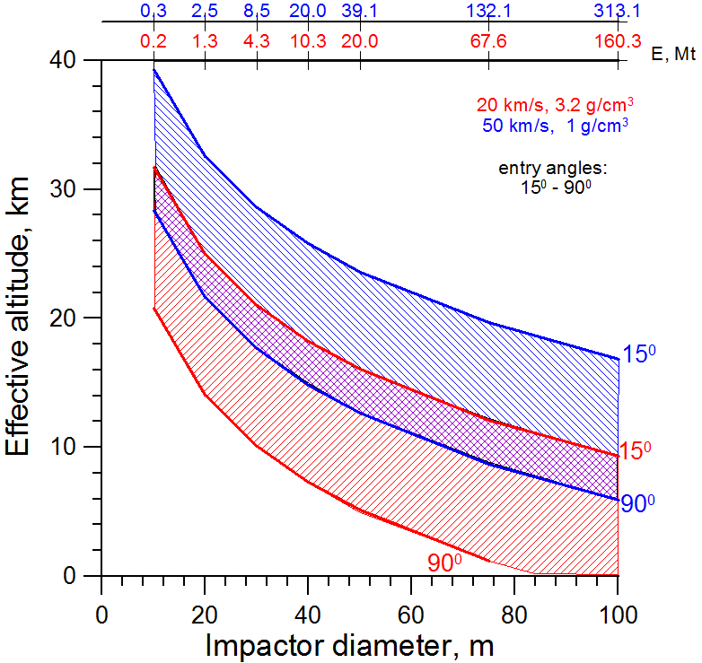
Effective airburst altitude
For quick rough evaluation of the impact consequences
(levels of damage, area of the damage, etc)
at large distances from the ground zero
spherical source - reasonable SW evaluation
if the altitude Z of E-equivalent point explosion is correctly determined
QL model was used to determine Z =f(D,density,α) (Shuvalov et al. 2014)
(there is no velocity dependence as the deceleration efficiency and increase of disrupted meteoroid cross-section are both dependent on entry V)
Red – asteroids;
Blue – comets;
This approach:
Precision of estimates - 2-3 km
(random character of disruption)
Is applicable for D>10-30 m when strength and fragmentation features are not essential
for D~10-30 m the uncertainty in effective altitude may reach 10-15 km (Chelyabinsk, TC₃2008 and other cases)
(strength, fragmentation features etc)
Effective altitude Z dependence on meteoroid size

Slide 20
Concluding remarks
Formally, the quasi-liquid model is not applicable to Chelyabinsk meteoroid, it is too small and demonstrated complicated fragmentation behavior
The QL model is not able to consider the formation of separated fragments/meteorites
The QL model is able satisfactory reproduce the light curve of the meteoroid, radiation effects, formation of the shock wave and overpressure on the ground
Vertical entry of Chelyabinsk-like body causes only moderate increase of overpressure on the ground

Slide 21
ЗАПАСНЫЕ

Slide 22
Effective airburst altitude
For quick rough evaluation of the impact consequences
(levels of damage, area of the damage, etc)
at large distances from the ground zero
spherical source - reasonable SW evaluation
if the altitude Z of E-equivalent point explosion is correctly determined
QL model was used to determine Z =f(D,density,α) (Shuvalov et al. 2014)
(there is no velocity dependence as the deceleration efficiency and increase of disrupted meteoroid cross-section are both dependent on entry V)
Red – asteroids;
Blue – comets;
This approach:
Precision of estimates - 2-3 km
(random character of disruption)
Is applicable for D>10-30 m when strength and fragmentation features are not essential
for D~10-30 m the uncertainty in effective altitude may reach 10-15 km (Chelyabinsk, TC₃2008 and other cases)
(strength, fragmentation features etc)
Effective altitude Z dependence on meteoroid size

Slide 23
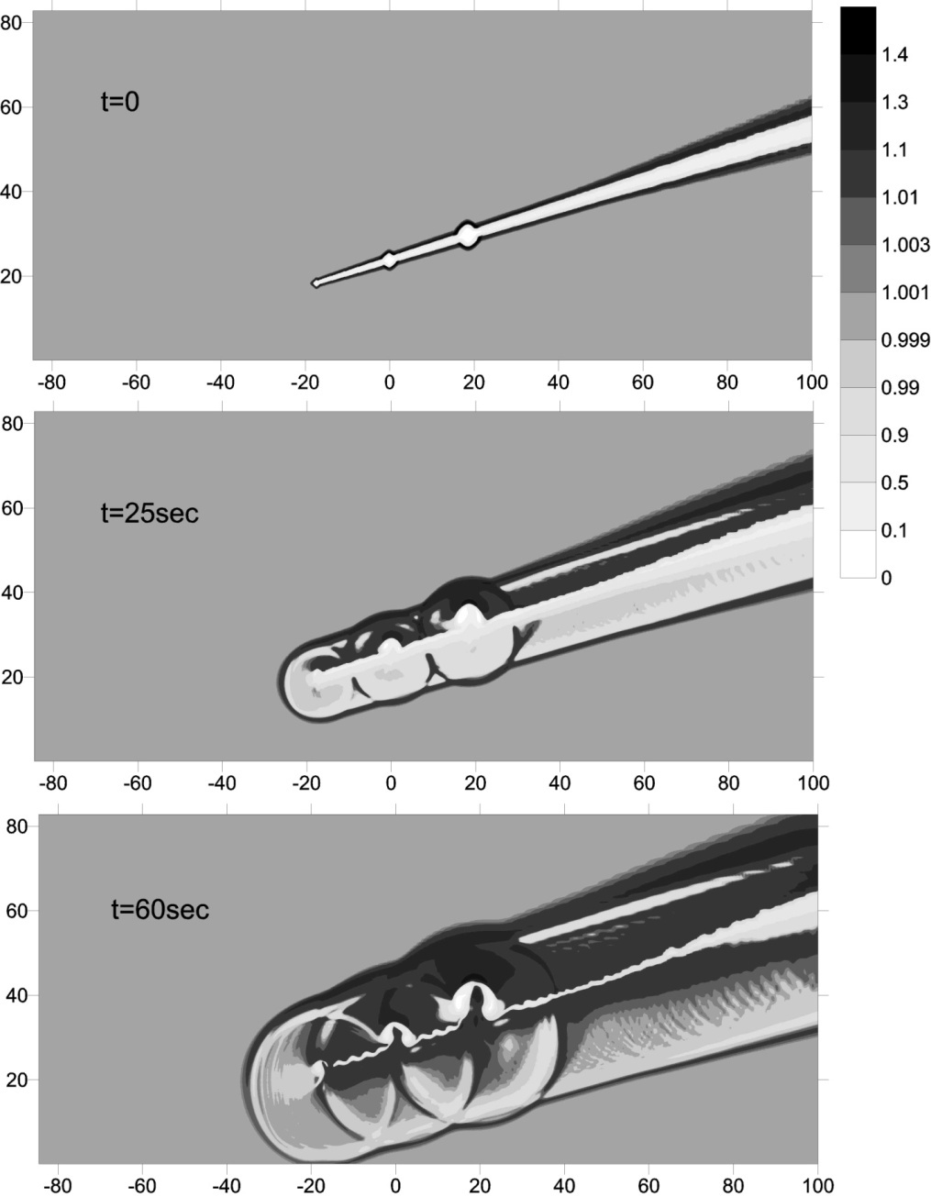
Modeling of Chelyabinsk bolide shock wave
The peculiarities of energy release influence on density and pressure distribution in the disturbed area formed in the atmosphere after the entry,
and on its subsequent evolution as well as on overpressure on the ground

Slide 24
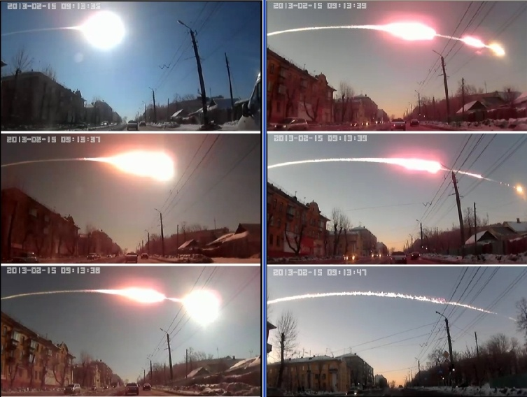
Meteoroid fragmentation
Video records demonstrated complicated character of meteoroid disruption:
- formation of decelerated debris cloud and independent fragments continued their flight with subsequent further disruption

Slide 25
Concluding remarks
Chelyabinsk event unique: large damage in the populated area (large size), huge amount of data;
demonstrates that 20-m bodies are dangerous, provides a unique opportunity to calibrate models
Assumption that the energy release followed the meteor light curve satisfactory explained the butterfly-shape of the damaged area.
The SW characteristics may be described in the frame of the suggested hydrodynamical model (and simplified model for Δt(z)), are in agreement with observational data
(damage area, arrival times, overpressure level)
Main SW arrival is coming from the closest point of trajectory (in 3D), local shocks may be generated by energy release maxima
(propagate inside ballistic cone, may reveal as separate peaks after main arrival, their number and time delays depend on parameters of maxima and location of registration)
For quick rough evaluation of impact consequences for ~20-100 m bodies the point source provides a reasonable first approximation (due to similarity of SW at large distances from ground zero).
Numerical simulations of impactor disruption/deceleration determine the effective height of the explosion, which is described by simple analytical formula
A prototype of the information-analytical system on risk assessment and prevention of the consequences of cosmic impacts was created, which collects all possible consequences and demonstrates them visually on the geographical map (used simplified estimates should be refined)

Slide 26
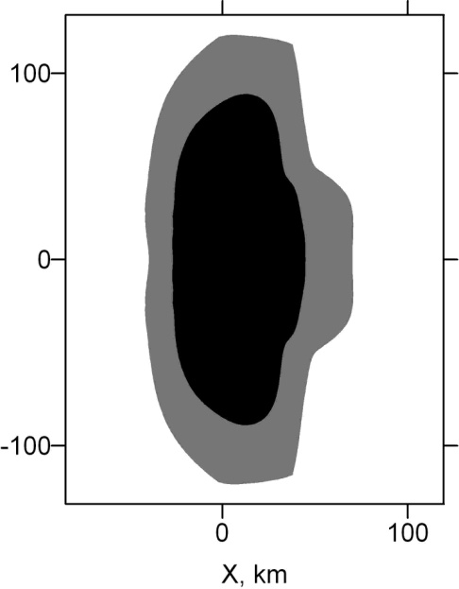
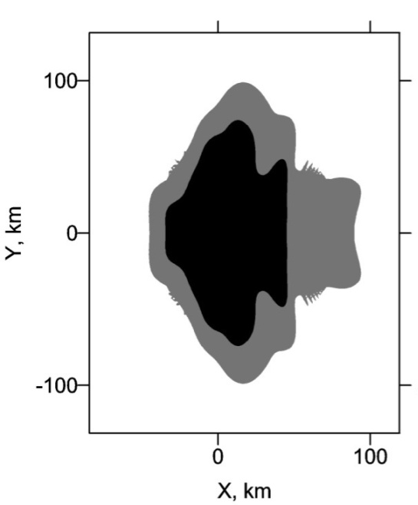

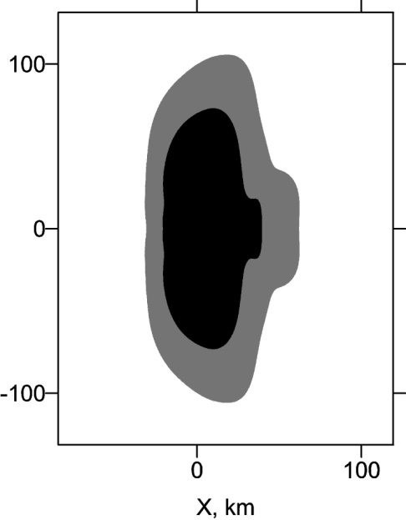
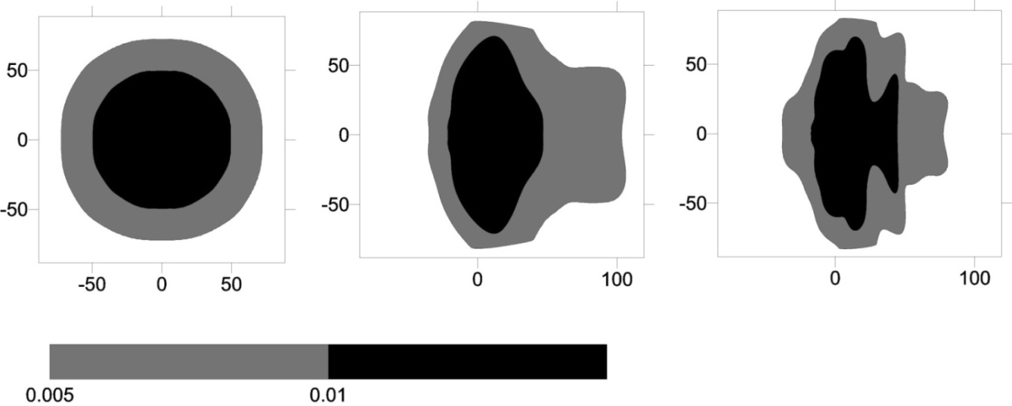

Overpressure at the ground level
E₁
(3)
(1)
(2)
(4)
E₂
conical (flight) +
3 point flares (fragmentation)
point source
conical source (flight)
~light curve
The size of affected area roughly ~ ³√ E (E₁ >E₂)
Shape of the area ~ features of assumed energy release
(differs from spherical)
Black: >1000 Pa Grey: > 500 Pa
TO COMPARE WITH LIQUID APPROACH

Slide 27
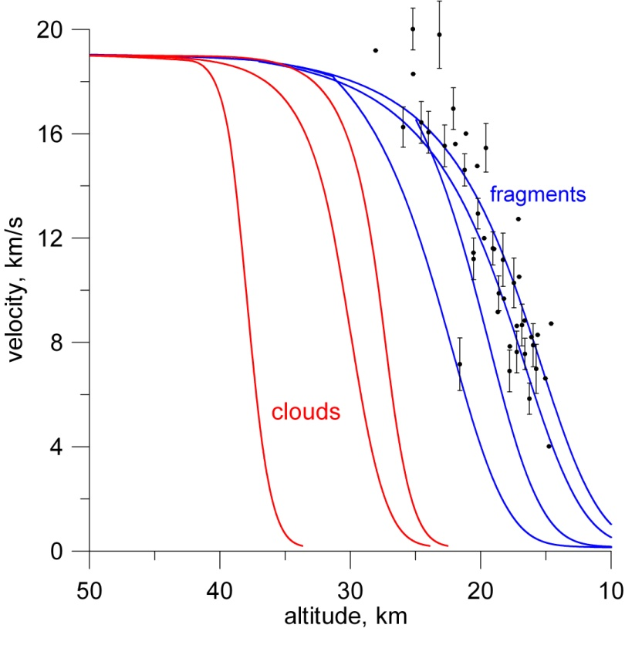
Deceleration curve in the frame of QL model
18
30
90
45
QL model
Speed of some fragments for one of the fragmentation scenario in the simple hybryd model. Red- small debris and dust ("Clouds") formed prior to the 27-km
event , "fragments" - the surviving fragments (blue). Deceleration of the main fragment – dots with error bars
Deceleration curves QL model for different entry angles.
Observations:
cloud of thermally emitting debris came to rest between altitudes of 29 and 26 km

