Slide 1




A reliable methodology to determine fireball terminal heights
Manuel Moreno-Ibáñez^{1,2}, Maria Gritsevich²
& Josep M. Trigo-Rodríguez¹
¹Institute of Space Sciences (CSIC-IEEC), Barcelona, Spain
²Finnish Geospatial Research Institute (FGI), Masala, Finland

Slide 2
Scaling laws and dimensionless variables: Equations of motion
1
The equations of motion for a meteoroid entering the atmosphere projected onto the tangent and to the normal to the trajectory
2
Variation of the mass
3
Extra equations
4
Use of dimensionless parameters
Where index e indicates values at the entry of the atmosphere.
h0 is the scale height (7.16 km)
(See: Stulov et al.,1995; Stulov, 1997; and Gritsevich, 2007)

Slide 3
Scaling laws and dimensionless variables: final equations
In this methodology we gather all the unknown values of the meteoroid’s atmosphere flight motion equations into two new variables (Gritsevich, 2009):
Ballistic Coefficient
Mass loss parameter
Already tested in: Gritsevich, 2008; Gritsevich, 2009; Gritsevich and Koschny, 2011; Bouquet et al., 2014; and Moreno-Ibáñez et al., 2015.

Slide 4
Introduction: terminal heights in the literature.
Definition: it is the point during the meteoroid atmospheric flight where its kinetic energy is no longer sufficient to produce luminosity.
Ceplecha and McCrosky (1976)
Wetherill and Revelle (1981)
Focus : to distinguish between ordinary and carbonaceous chondrites within the PN.
The end height as the principal discriminating observational parameter in their discussion (photometric mass).
Empirical criterion based on the terminal height (dynamic):
Second criterion based on fireball physics:
Both criteria are complementary.
Focus: to find ordinary chondrites within the PN data.
Criterion: any ordinary chondrite shall show similar flight properties that the Lost City ordinary chondrite meteorite.
They used four criteria: agreement of the observed and theoretical single-body end heights (using dynamic mass).
Similar results than Ceplecha and McCrosky (1976).

Slide 5
Simplifications of the exact solution
I
For quick meteors, a strong evaporation process takes place so β becomes high (β >> 1), the deceleration can be neglected and the velocity thus assumed constant. Stulov (1998, 2004) developed the following asymptotic solution:
II
However, the meteor velocity begins to decrease in a certain vicinity of m=0. In order to account for this change in velocity we combine the Eq.[1] (valid for arbitrary β values) with the Eq. [3] suitable for high β values:

Slide 6
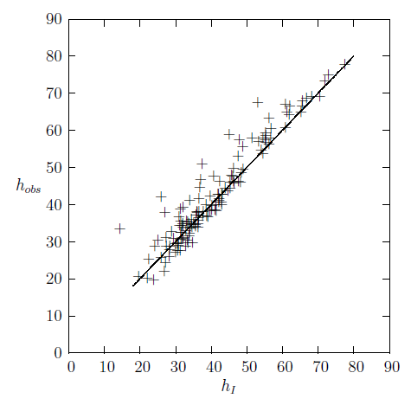
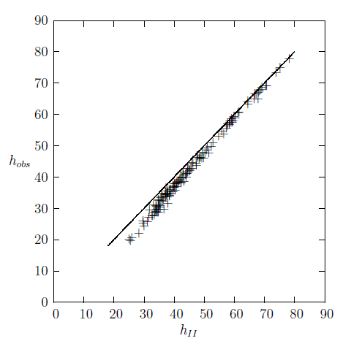
We compare our derived terminal heights with the fireball terminal heights registered by the Meteorite Observation and Recovery Project operated in Canada between 1970 and 1985 (MORP) (Halliday et al. 1996).
We use previous α and β values derived by Gritsevich (2009).

Slide 7
Improvement using approximated functions
Problem: terminal height h_{II} shows certain discrepancies at low values.
Solution: we suggest to improve the performance of the simplification adopted compared to the analytical solution of the problem.
vs.
We use the mathematical analysis carried out in Gritsevich et al. (2016), which considers the possibility of including an approximation function which slightly modified this equation.
This approximation function is thought to improve accuracy in those cases where β > 3, which is not completely our current scenario. We want to improve accuracy for those cases with moderated β values showing low terminal heights.

Slide 8
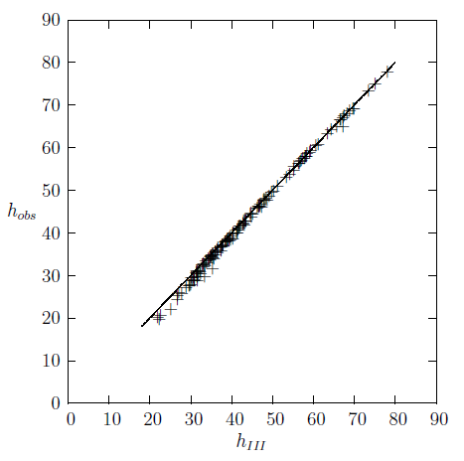

Slide 9
Future Work
Atmospheric correction:
the amount of air that a fireball encounters depends on the atmosphere conditions. Thus, it should be considered particularly for large mass, slow, low penetrating fireballs which usually indicate meteorite-droppers.
(see Lyytinen and Gritsevich, 2016 )
Annama
(2014)
    Meteor observation:
    we foresee a calculation of terminal height to be useful when the lower part of the trajectory is not instrumentally registered.
New types of studies to be scoped:
Meteor height as a function of time:
- Determination of luminous efficiency based on meteor duration.
- Critical Kinetic Energy to produce luminosity.
Analysis of the inverse problem:
possible for non decelerated bodies if the terminal height is known → constraints in α and β.

Slide 10
Conclusions
    We have accurately derived the terminal heights for MORP fireballs using a new developed methodology based on scaling laws and dimensionless variables.
    This methodology had only been tested on several fully ablated fireballs with large β values (Gritsevich and Popelnskaya, 2008). Now, we have proved it works equally for fully ablated fireballs and meteorite-producing ones.
    The study of terminal height of large FN datasets could provide interesting knowledge about the recorded fireballs (e.g. works by Ceplecha and McCrosky, 1976; and Wetherill and Revelle, 1981), or show unexpected inaccuracies in the FN recordings.
    Future work could scope new research based on terminal height analysis. E.g. we can highly recommend the use of equation [7] also to solve inverse problem when heights and velocities are available from the observations, and parameters α and β need to be derived.

Slide 11
References
M. Moreno-Ibáñez, et al., Icarus 250, 544-552 (2015).
mmoreno@ice.csic.es, gritsevich@list.ru , trigo@ice.csic.es,
Z. Ceplecha and R.E. McCrosky, J.Geophys. Res. 81, 6257-6275 (1976).
Bouquet et al. Planetary Space Science 103:238-249 (2014).
M. Gritsevich, Solar Syst. Res. 41 (6), 509-514 (2007).
M. Gritsevich, Solar Syst. Res. 42, 372-390 (2008).
M. Gritsevich and N.V. Popelenskaya, Doklady Phys. 53, 88-92 (2008).
M. Gritsevich, Adv. Space Res. 44. 323-334 (2009).
M. Gritsevich, and D. Koschny, Icarus 212 (2), 877-884 (2011).
M. Gritsevich et al., Mat. Model. Comp. Simul. 8 (1) 1-6 (2016).
I. Halliday et al., Meteorit. Planet. Sci. 31, 185-217 (1996).
E. Lyytinen and M. Gritsevich, Planet. Space Sci. 120, 35-42(2016).
V.P. Stulov et al., Aerodinamika bolidov, Nauka (1995).
V.P. Stulov, Appl. Mech. Rev. 50, 671-688 (1997).
V.P. Stulov, Planet. Space Sci. 46, 253-260 (1998).
V.P. Stulov, Planet. Space Sci. 52 (56), 459-463 (2004).
G.W. Wetherill and D.O. Revelle, Icarus 48, 308-328 (1981).
F. L. Whipple and L. Jacchia , Smithson. Contrib. Astrophys. 1, 183–206 (1957)

