Slide 1
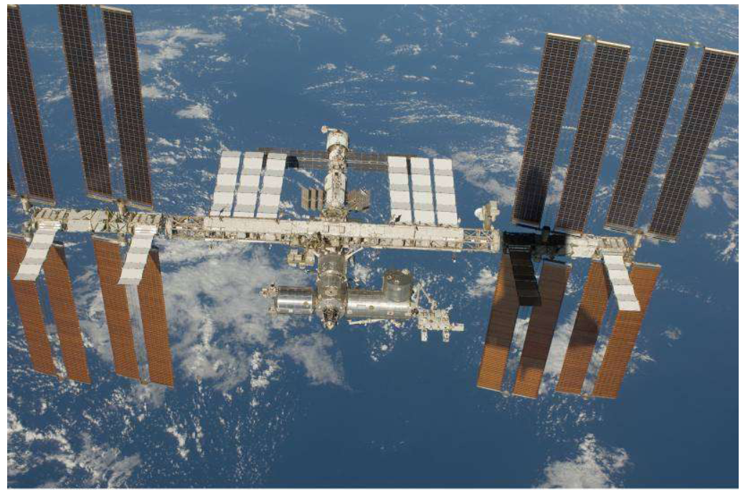
Cellino
INFN and INAF – Astrophysical Observatory of Torino (Italy)
M. Bertaina
INFN and University of Torino (Italy)
For the JEM-EUSO Collaboration

Slide 2
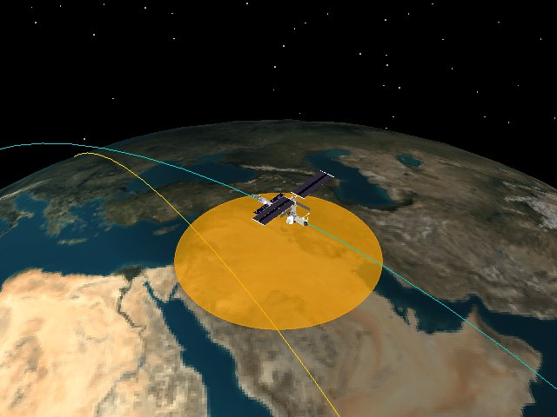
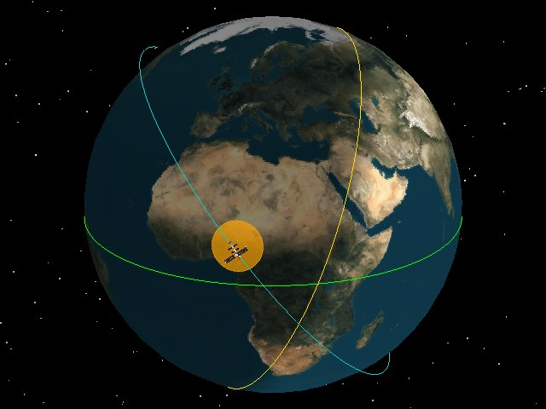
Why to use space-based facilities to observe meteors?
Several advantages in terms of efficiency (large FOV, high duty cycle, no cloud problems).

Slide 3

Extreme Universe
Space Observatory
(EUSO) in the
Japanese Experiment Module (JEM) of the International Space Station (ISS)
Measuring UHECRs from Space

Slide 4
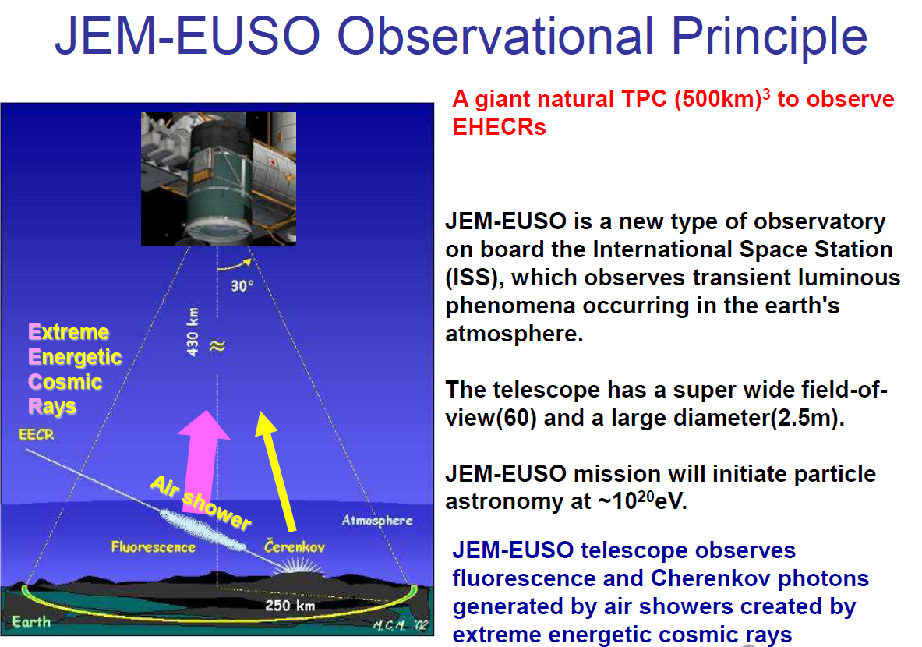

Slide 5
JEM-EUSO: Science Objectives
Main Objectives：
Astronomy and astrophysics through particle channel with extreme energies
  Possible identification of the particle and energy sources based on the analysis of the arrival direction
  Possible identification of the acceleration and radiation mechanisms with the measurement of energy spectrum from individual sources
Exploratory objectives：
  Measurement of extreme energy gamma rays
  Detection of extreme energy neutrinos
  Estimation of the structure of galactic magnetic field and its intensity
  Identification of relativity and quantum gravitational effect
  Study of atmospheric transient phenomena

Slide 6
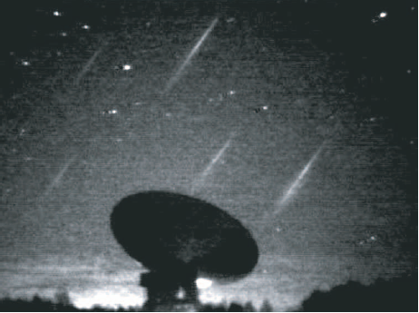
Atmospheric Luminous Phenomena
Transient Luminous Events
Exploratory Objectives
Lightning picture observed from ISS
OH airglow observed from ground
Meteors and Fireballs
Leonid meteor swarm in 2001 taken by Hivison camera
Various trangent airglows

Slide 7
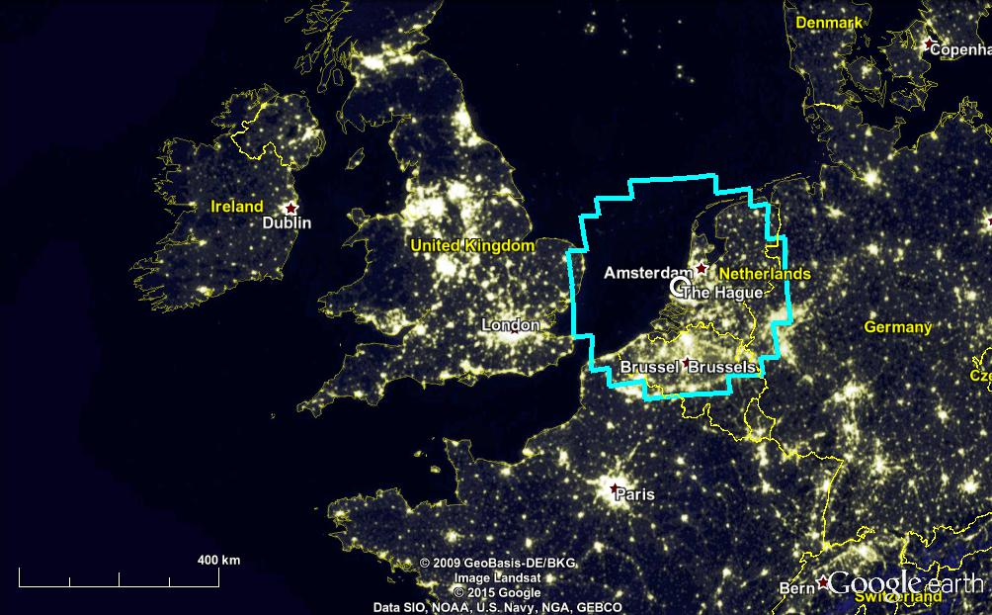
Monitored Area - FoV
Adams et al. , Astr. Part. Phys. 2013
Notes:
Besides others, two are the main aspects to try to do UHE science from space: the monitored area.

Slide 8
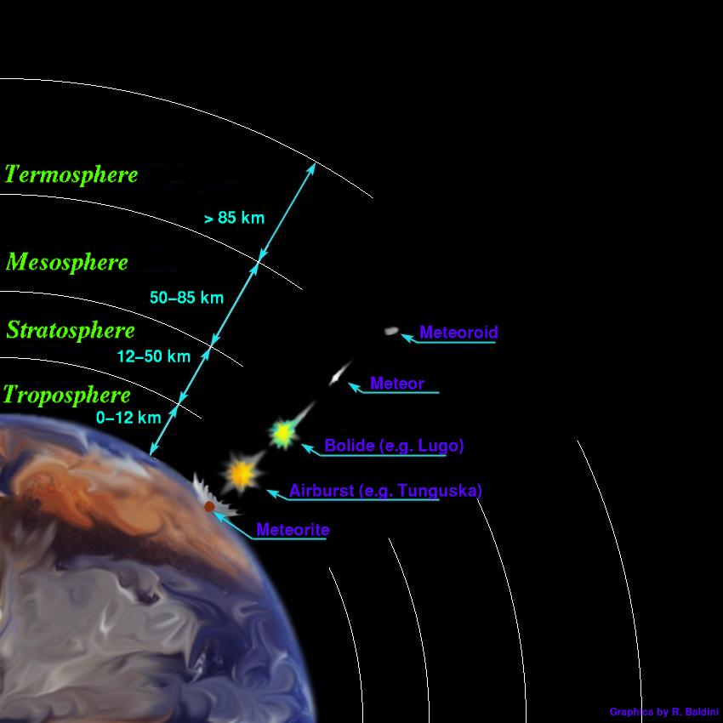
METEORS
Speeds: between 12 and 72 km/sec
Durations: : ~ 0.5 ÷ 3 s
These are slow events for JEM-EUSO !
Gate time Unit (GTU) of the electronics for data acquisition is 2.5 μs
A meteor simulator has been developed.
The goal of simulations is to have a phenomenological model of the expected signals, to optimize the procedure of data treatment for JEM-Euso operations.
See: Adams et al., Experimental Astronomy 40, 253-279 (2015)

Slide 9
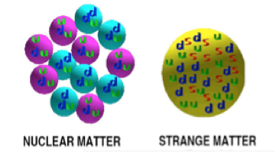
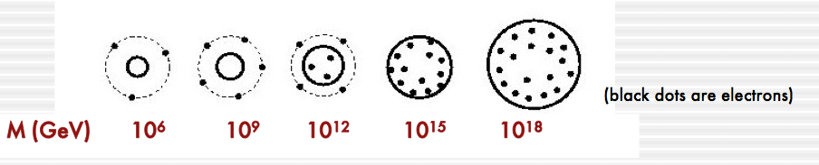
Another, exciting application: Strange quark matter (nuclearites, strangelets)
• Aggregates of u, d, s quarks + electrons of equal
number, density: 3.5 x 10¹⁴ g cm⁻³.
• Ground state of nuclear matter (E/A < 930 MeV).
• Stable for any baryon number A
Nuclearites : core + electrons , neutral, A > 10⁶ CDM candidate
Strangelets : positively charged, A < 10⁶ Cosmic ray component
References:
E. Witten Phys Rev D30(1984) 272A
De Rujula & Glashow Nature 312 (1984) 734

Slide 10

The fraction of energy dissipated as light in possible collisions is ~ 4%. It does not depend upon radius or velocity.
Speed: of the order of 300 km/sec. No ablation.
Absolute magnitude
Expression of the magnitude derived from predicted luminosity expressed as a function of mass.
Apparent Visual magnitude : 20 g nuclearite at 400 km distance from observer → M = 6
Absolute magnitude : 20 g nuclearite → M = 3.6
Models expect a Maximum possible height for light emission
Nuclearites are expected to be essentially a low atmosphere phenomenon.
10⁻⁴ g nuclearite → h_{max} ~ 6 km 10⁴ g nuclearite → h_{max} ~ 60 km
E. Witten Phys Rev D30(1984) 272
De Rujula Glashow Nature 312 (1984) 734
Nuclearites with masses > 0.1 g can cross the whole Earth and move upward!

Slide 11
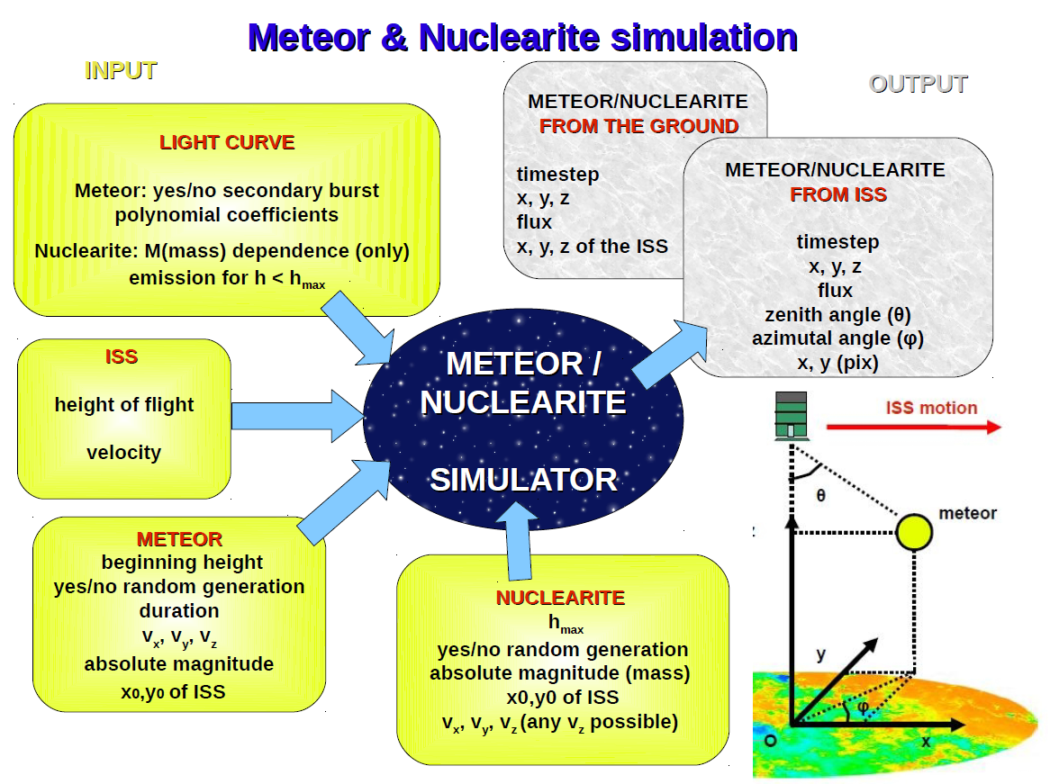

Slide 12
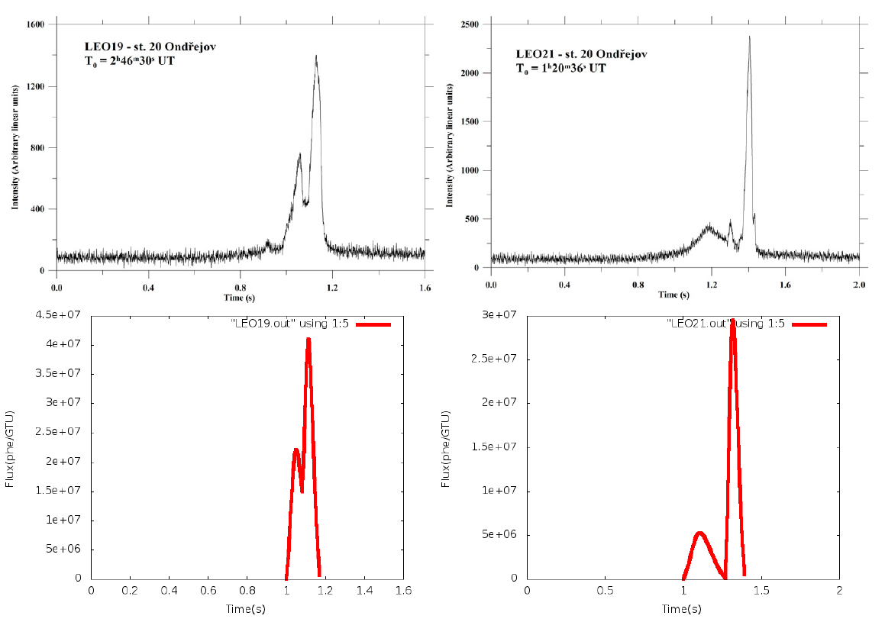
Simulated meteor lightcurves taken from some real data. Single polynomial signal, plus the option for adding a possible secondary light burst
Examples of simulations of the lightcurves of two meteors recorded from the Leonid shower, using data from Shrbeny' and Spurny, “Precise data on Leonid fireballs from all-sky photographic records”, Astronomy & Astrophysics, 506, 1445-1454 (2009).

Slide 13
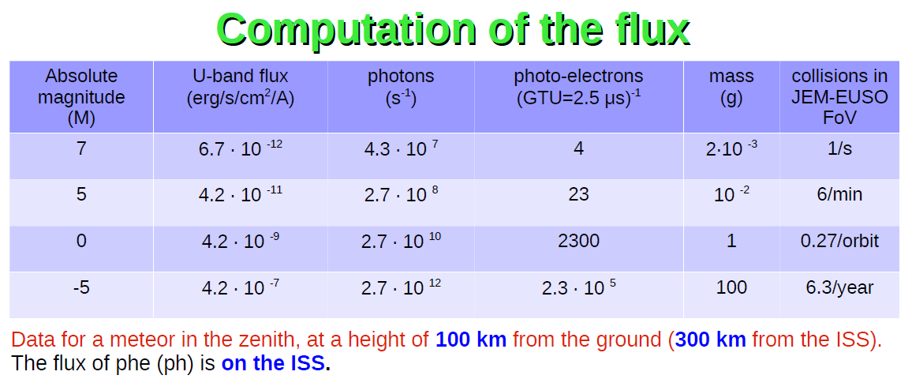
The flux above is the one measured on the ISS
Computed frequencies of collisions in the JEM-EUSO FOV are based on the meteor mass distribution by Gruen et al. (1984)
Notes:
Conti: integrale sull’angolo solido. F(60) è JEM-EUSO.

Slide 14
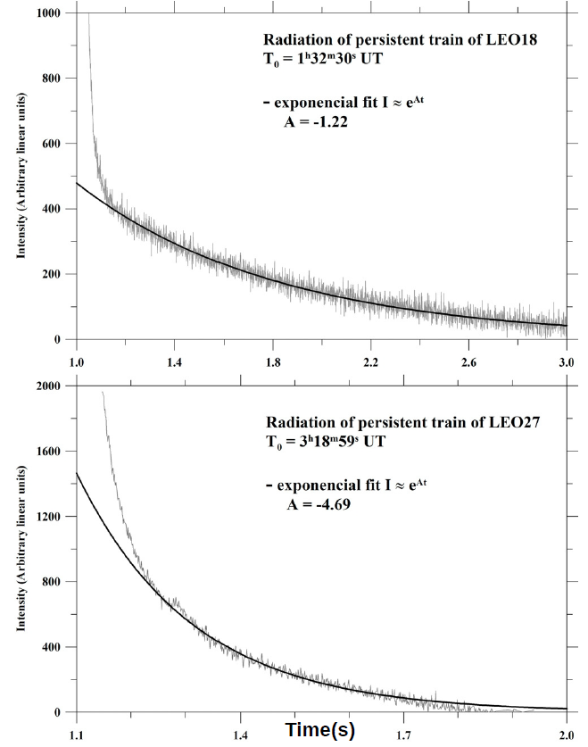
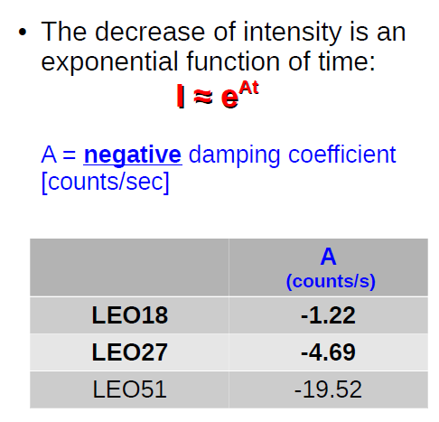
Can we compute 3-D meteor orbit from JEM-Euso data taken aboard the ISS? Possibly yes, in some cases!
Every point of the light trajectory does not disappear instantaneously, but it decreases according to some exponential function of time:
A = damping coefficient

Slide 15
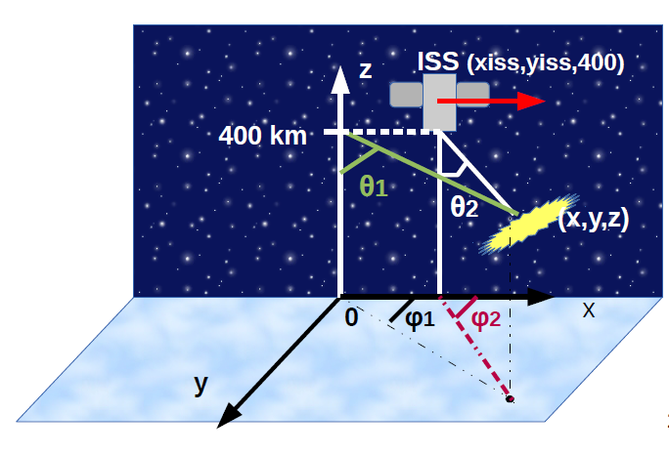
Single, fading points of the meteor track can then be seen from different directions, by exploiting the motion of the ISS (7.8 km/s)

Slide 16
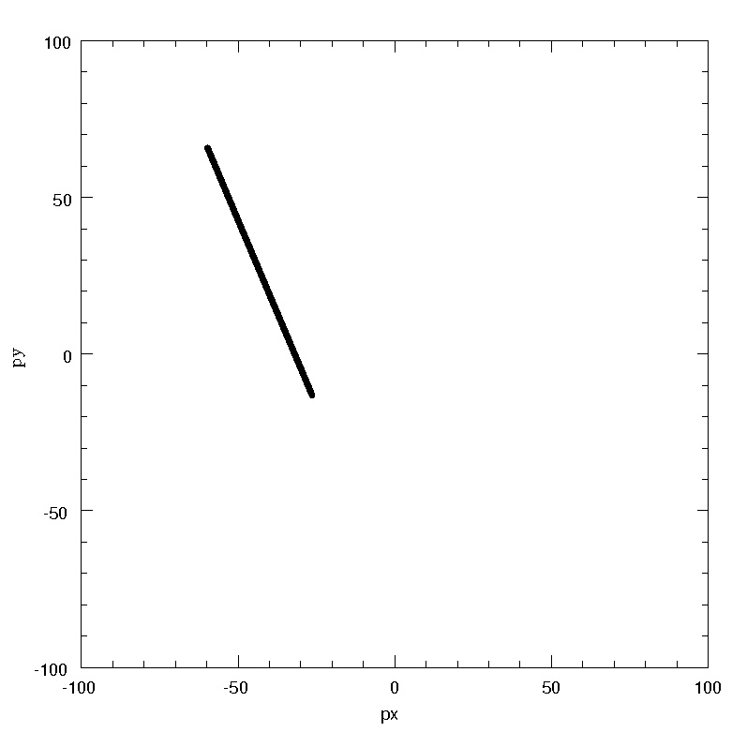
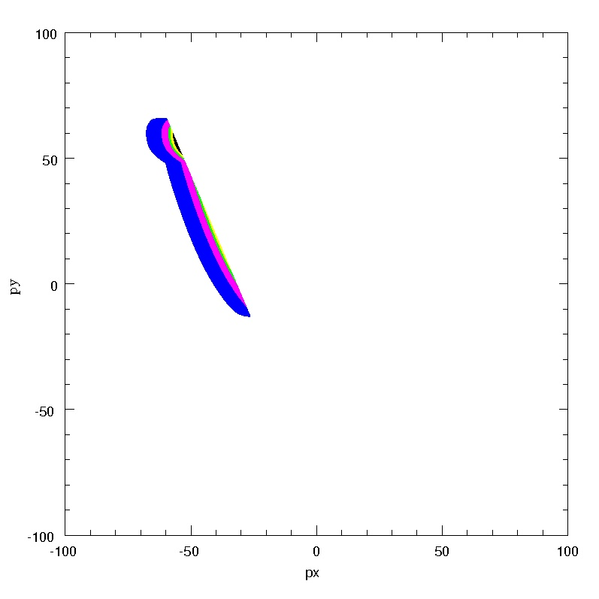
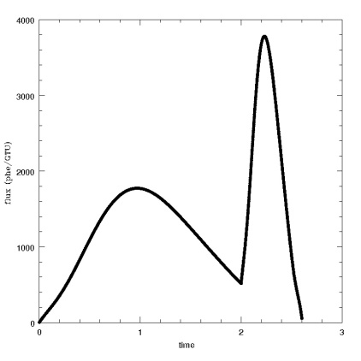
Meteor “head” recorded motion Recorded signal including persistence
Beginning height = 110 km
Vx = 2.5 km/s, Vy = 12.0 km/s, Vz = -5.0 km/s
Abs. Mag (of secondary burst) = -1.7
Attenuation coefficient A = -10
Meteor’s simulated lightcurve

Slide 17
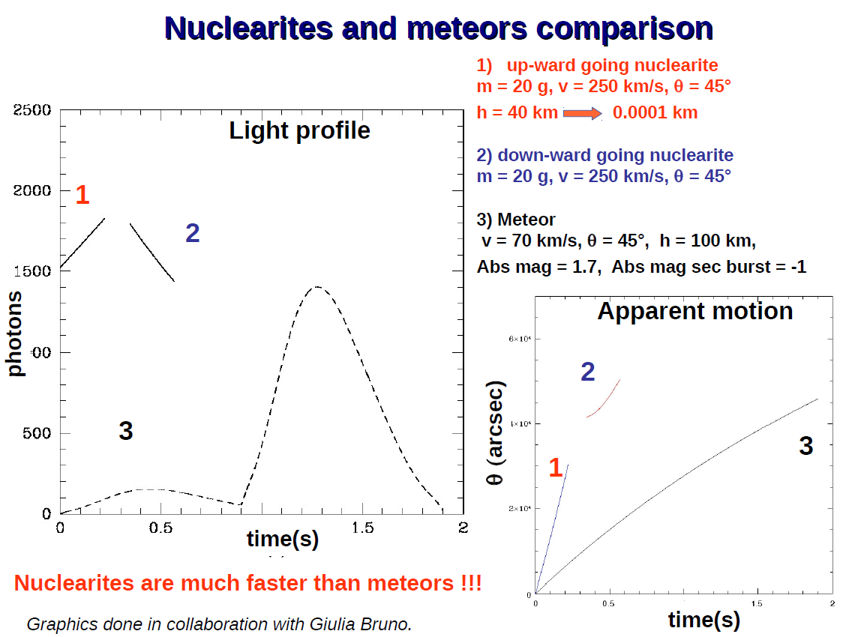

Slide 18
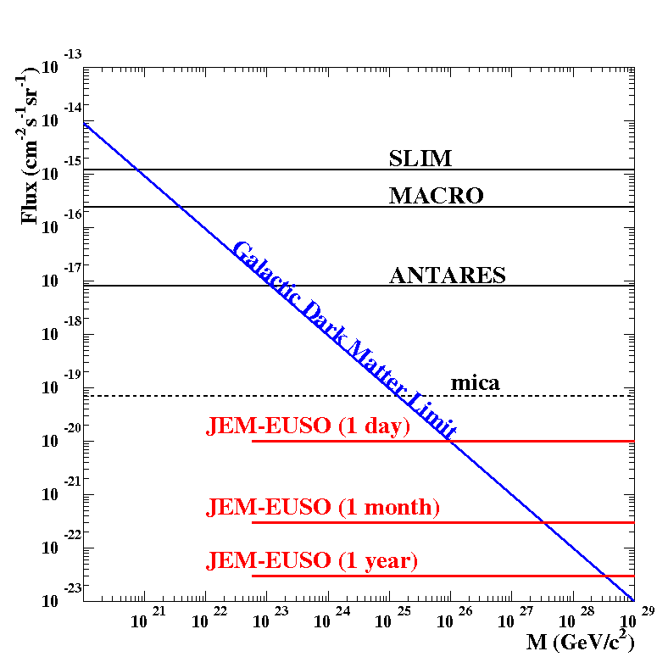
JEM-EUSO sensitivity to nuclearites: 24 h acquisition time
V_{proj}^{min} (km/s) | θ _{min} (deg) | R_{acc} (%)
100 | 23.6 | 84%
130 | 31.3 | 73%
160 | 39.8 | 59%
190 | 49.5 | 42%
220 | 61.6 | 23%
(Assumed v = 250 km/s)
Selection cut on the projected velocity on FS (v_{proj}^{min})

Slide 19
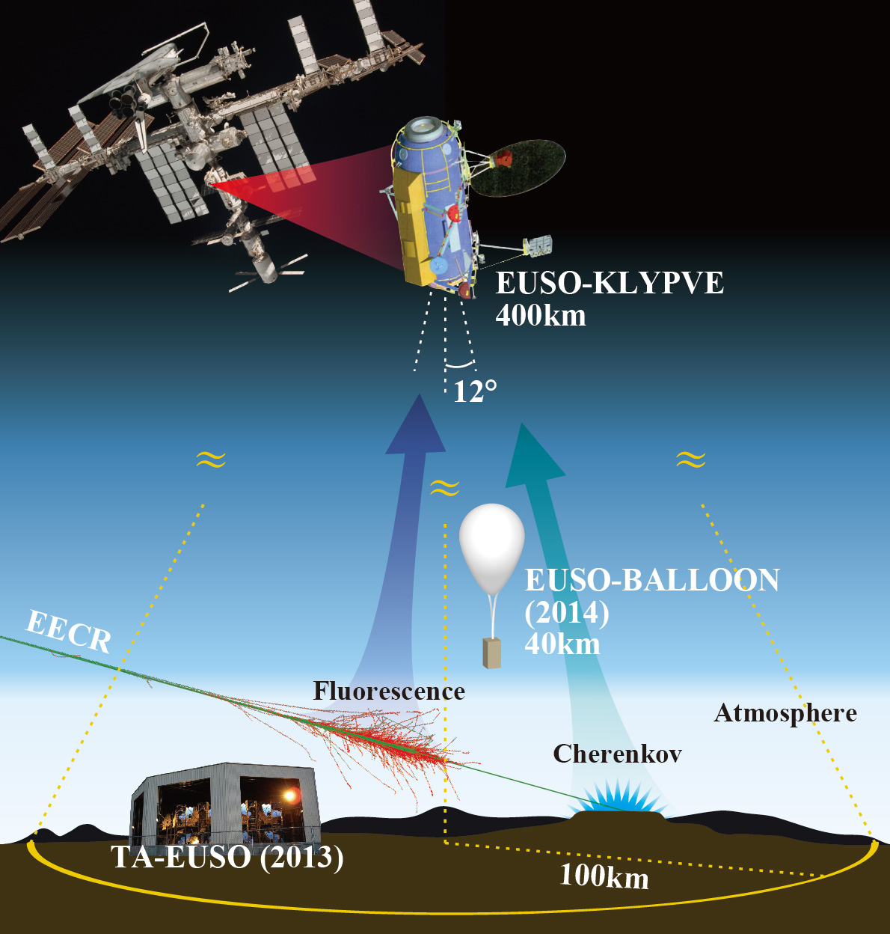
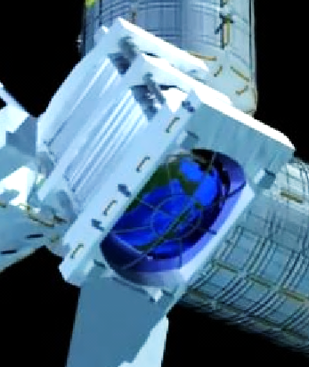
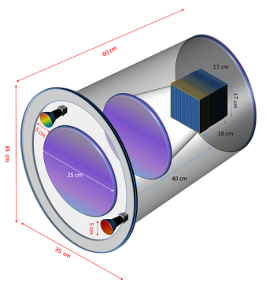
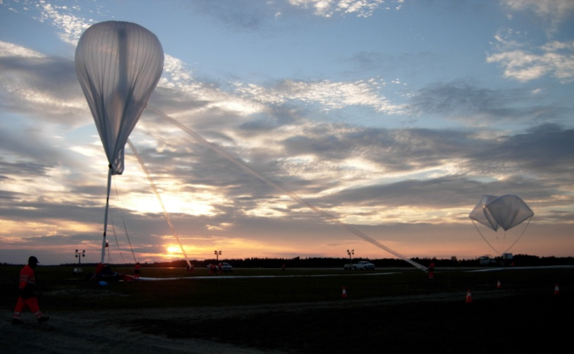
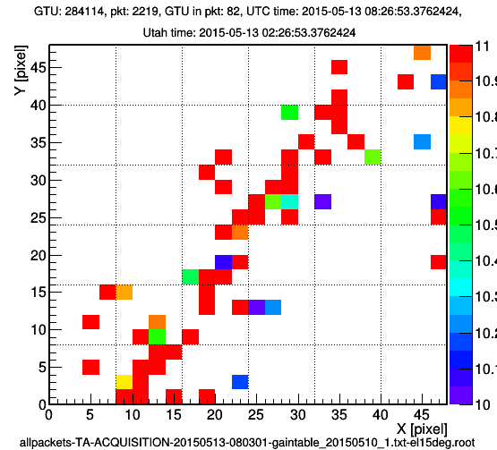
Steps toward
the (JEM)-EUSO
program
EUSO-TA: Ground detector at Telescope Array site: 2013
EUSO-BALLOON: 1st flight Timmins, Canada (CNES) Aug 2014; Ultra long duration flight (EUSO-SPB) New Zealand, 2017
MINI-EUSO (2017)
K-EUSO (2019)
JEM-EUSO
(>2020+)
JEM-EUSO
MINI-EUSO
14º
EUSO-TA (2013-)

Slide 20
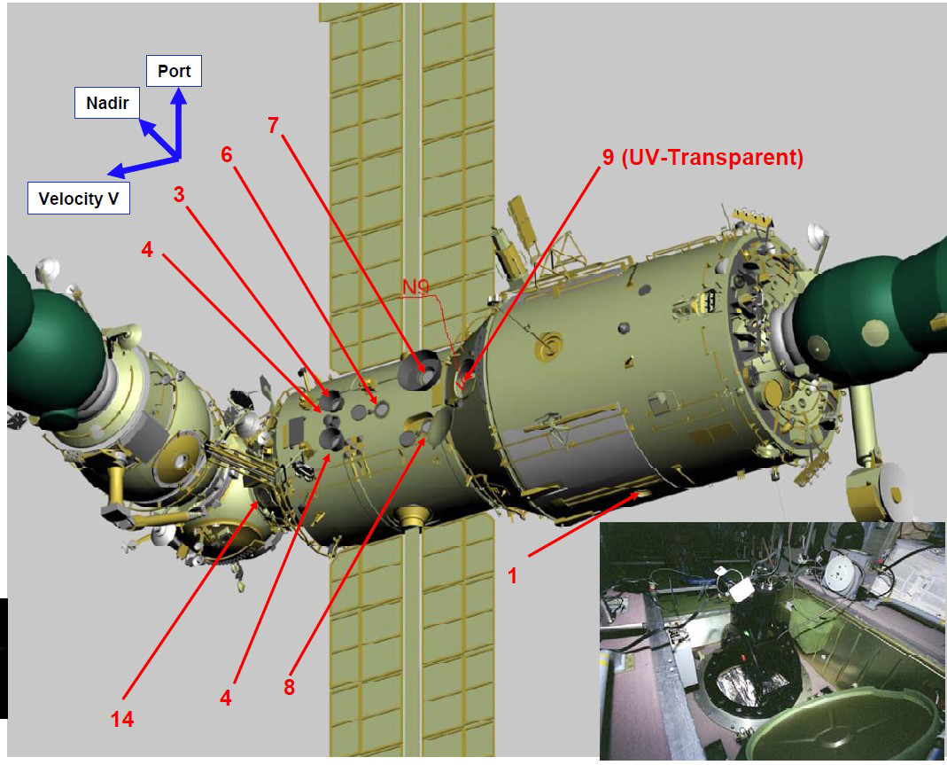
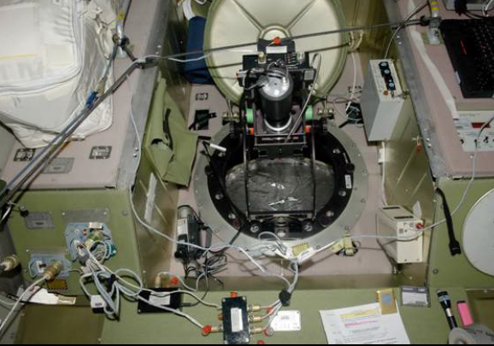
Pathfinders: Mini-EUSO
It will be hosted in the Zvezda Module of the ISS. UV transparent Nadir looking window.
Based on a proposal approved by ASI- the Italian Space Agency
Mini-EUSO is included, with the name UV Atmosphere, into the Russian “Stage program of scientific and applied research and experiments”
Flight is scheduled in 2017

Slide 21
Main driver idea
Bring one single JEM-EUSO
Photo Detector Module
and two Fresnel lenses (25 cm diam.)
to ISS and expose it to an ISS UV-transparent window to perform UV background measurements as a precursor for larger missions

Slide 22
Mini-EUSO
Scientific objectives
a.1) UV emissions from night-Earth
    6.5 km resolution, from 2.5 μs and above ± 51°
    Noise from different lightning conditions, moon phase
    Noise from different inclinations
a.2) Map of the Earth in UV
a.3) Study of atmospheric phenomena
a.4) Study of meteors
    Search for Strange quark matter
    Space Debris assessment

Slide 23
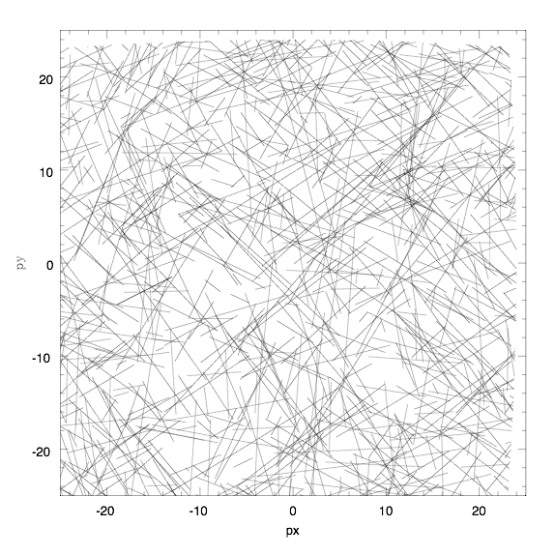
Simulation of 1000 meteors in the FoV

Slide 24
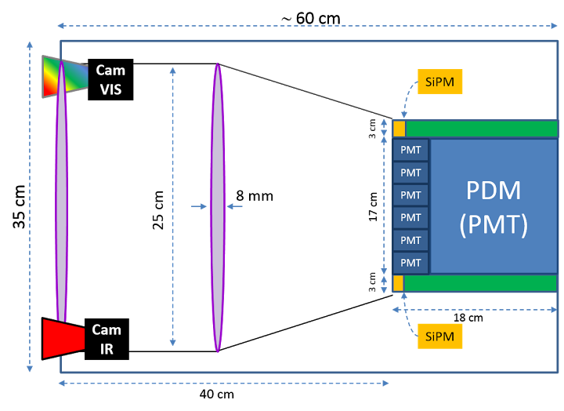
MINI-EUSO
0.01
0.4/s
0.06
2.4/min
6
0.11/orb
600
2.5/year
The flux above is the one measured on the ISS
Reminder: the FOV of JEM-EUSO is 60°
For smaller FOV, the frequencies of collision in the FOV change:
f(40°) (MINI-EUSO) = 0.45 f(60°)
f(28°) (K-EUSO) = 0.22 f(60°)
Note that a very small FOV means also partial recovery of the lightcurve in many cases.

Slide 25
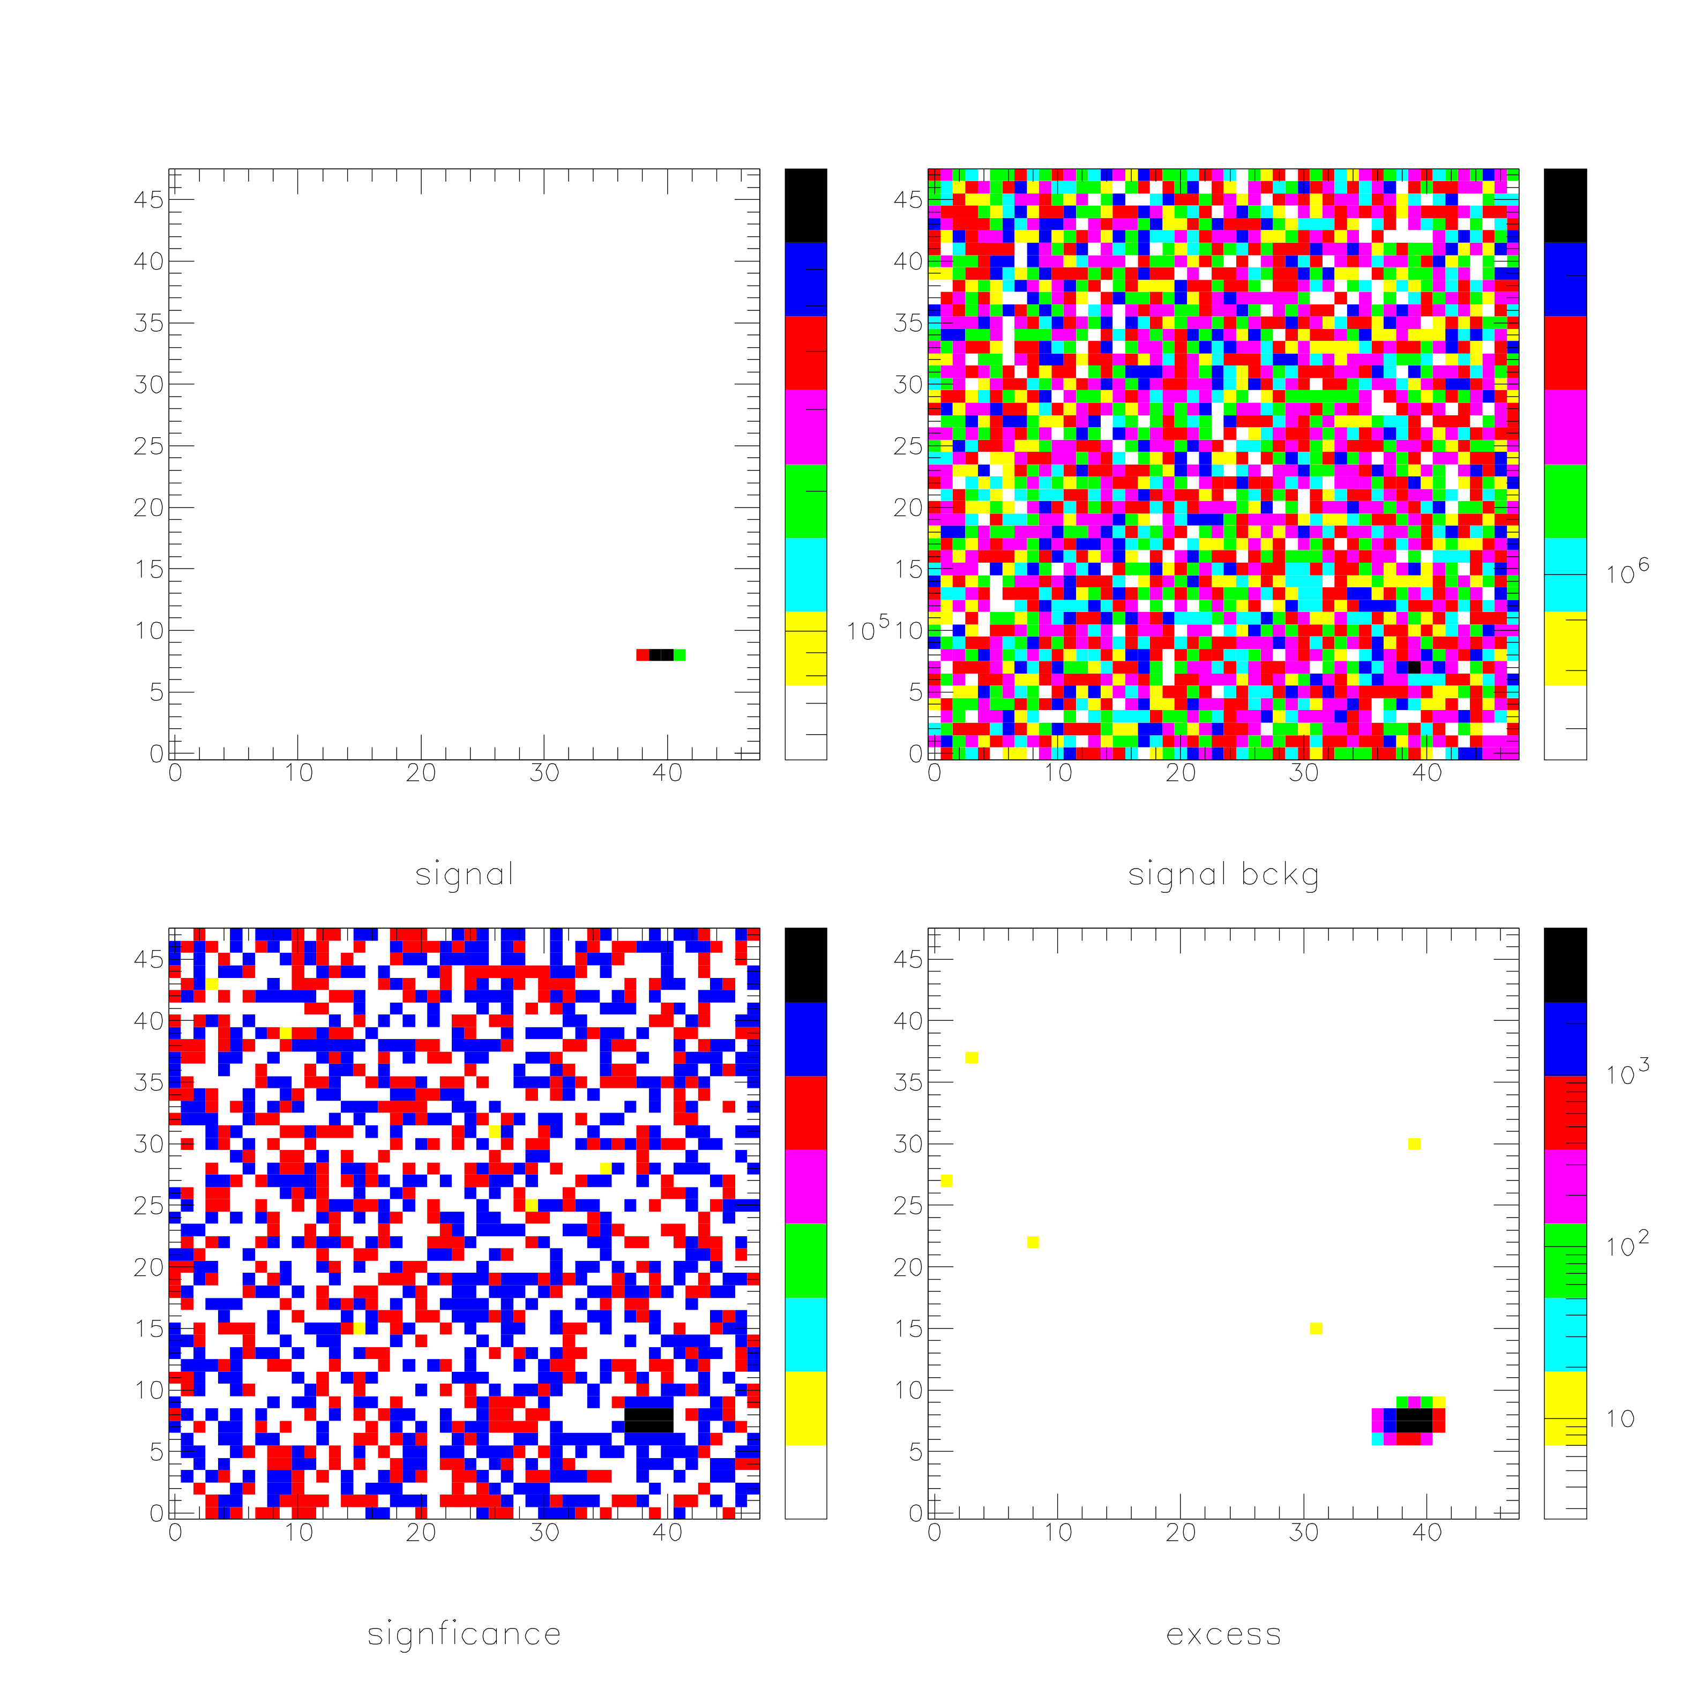
Meteor with absolute Mag=-0.4 (flux=8.4 counts/GTU @ max)
signal
signal+bckg
excess above 2.5 sigma
significance

Slide 26
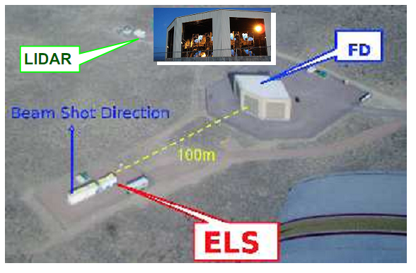
Pathfinders: EUSO-TA
EUSO-TA: Cross-Calibration tests at the Telescope Array site in Utah in collaboration with the ICRR in Tokyo and the TA collaboration
Equipped with one JEM-EUSO Photon Detection Module. FOV of ±6º
It is triggered by the fluorescence detectors of the TA.
TA site, UTAH, Black Mesa
TA FD
(Fluorescence detector)
TA-EUSO location
ELS: Electron Light Source
located at Black Rock Mesa FD Station
  Electron Light Source at 100m
  Most nearby SD is at ~3.5 km
  Central Laser Facility ~21km
Some meteors have been already detected!
Notes:
Otttica in miniatura, e unità elementare di quello che dovrebbe essere l’insieme di rivelatori su JEM-EUSO.

Slide 27
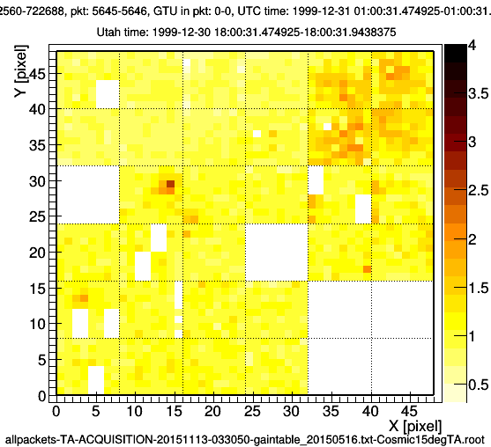
Apparent velocity: 6 degrees in 0.7 sec

Slide 28
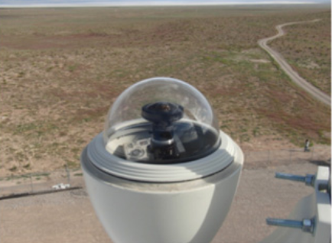
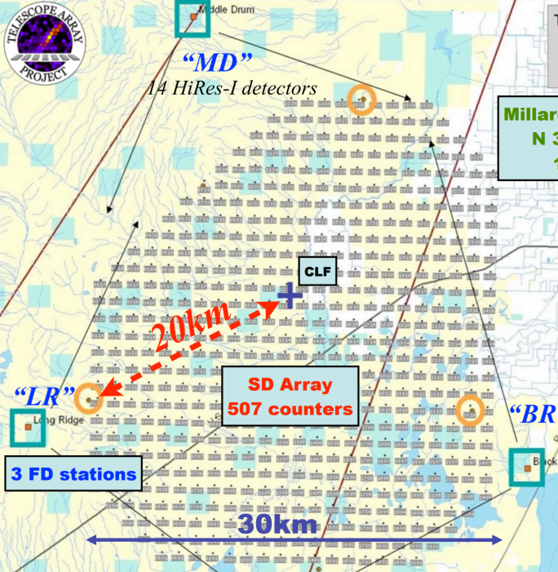
TA CCD Cloud Monitor and EUSO-TA
Proposal under discussion:
The CCD cloud monitor system of the Telescope Array Experiment is in operation at BRM, LR and CLF sites.
Meteor tracks could be found in the data of this system. The velocity of the meteor can be obtained using CCD cloud monitor and EUSO-TA data. Study of nuclearite is also possible. The CCD monitor would be able to observe stars brighter than
~5 mag.
EUSO-TA FoV
The time resolution is 2.5 μs !
Notes:
Questa e’ una cosa a livello di proposta. Però il rivelatore è già funzionante!

Slide 29
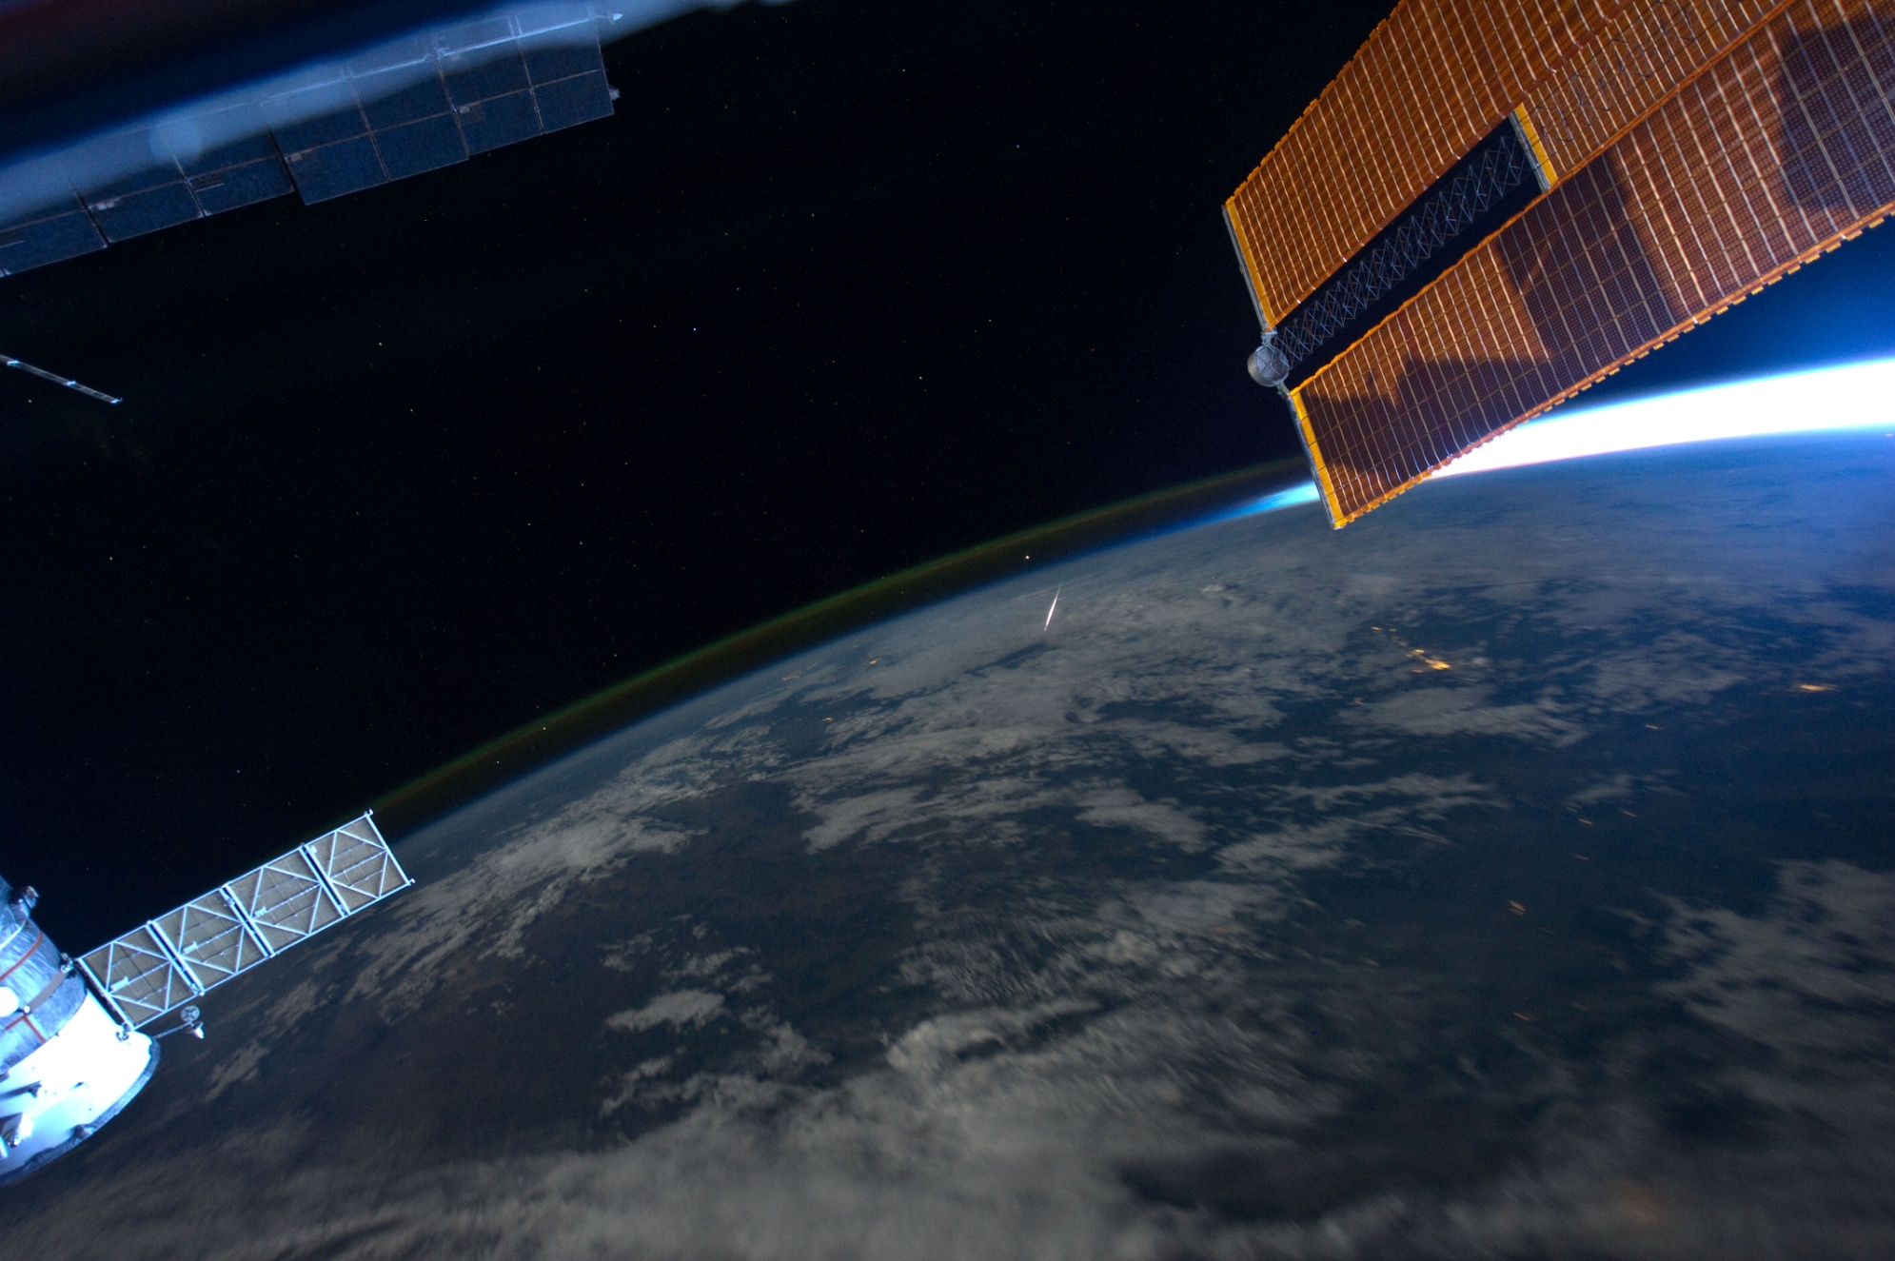
Thank you for your attention!

Slide 30
