Slide 1

Luminous Efficiency Estimates from the Canadian Automated Meteor Observatory
Dilini Subasinghe, Margaret Campbell-Brown, Edward Stokan
METEOROIDS 2016

Slide 2
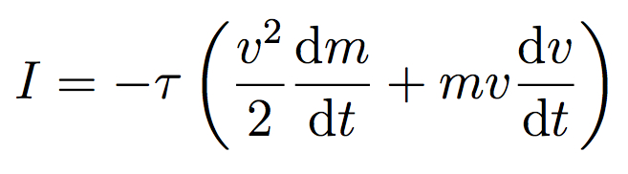
meteor ablation
τ: the fraction of kinetic energy emitted as light
can be used to determine the photometric mass
poorly constrained

Slide 3
past work

Slide 4
difficulties & importance
optical observations: need precise measurements
hard to simulate meteors in a lab (accurate speeds)
artificial meteors are not accurate representations
needed for mass determination
  Weryk & Brown (2013) suggest video masses are an order of magnitude smaller than previously thought

Slide 5
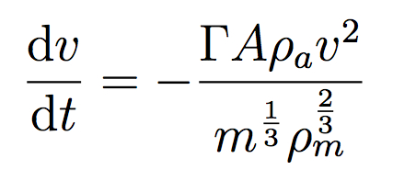
approach
drag equation
luminous intensity
isolate the dynamic mass, take the derivative, substitute into luminous intensity equation

Slide 6
approach - difficulties
required:
  non-fragmenting bodies (classical equations)
    high-resolution observations
  deceleration
    observations provide lag (2nd derivative needed)
  low uncertainties
    propagation through derivatives and exponents

Slide 7
observations

Slide 8
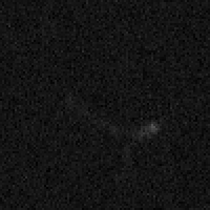
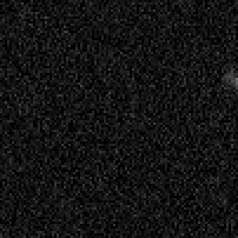
narrowfield observations
find events showing single body ablation (minimal wake/no fragmentation)
100 m
100 m
Tavistock
Elginfield

Slide 9
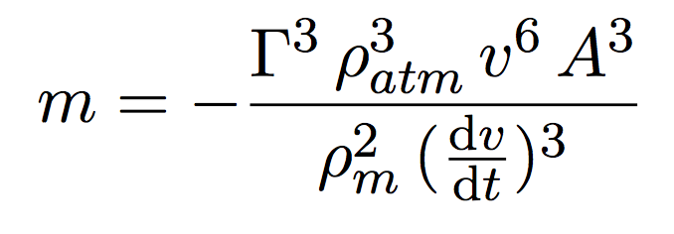
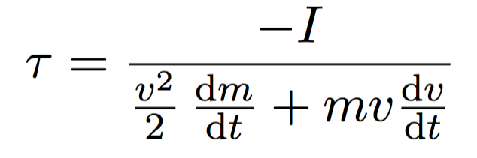
current work
how do we ensure the code works?
  simulated meteors
given:
  ρ_{m} = 2000 kg/m³
  Γ = 1
  A = 1.21 (sphere)
  ρ_{atm} model
find τ

Slide 10
results

Slide 11
Speed: 60 km/s
Speed: 11 km/s
Speed: 20 km/s

Slide 12
sensitivity analysis

Slide 13
sensitivity analysis

Slide 17
future considerations
deceleration method
add noise to this modeled meteor
  how does it propagate and how does that affect the final result?
what if more than one term is incorrect?
real data

Slide 18
summary
luminous efficiency values vary widely between studies
accurate values are needed for accurate meteor masses
we are using high-resolution optical observations with meteor ablation equations to better constrain luminous efficiency

