Slide 1
Annual occurrence of meteorite-dropping fireballs
N.A. Konovalova¹, T.J. Jopek²
(1) Institute of Astrophysics of the Academy of Sciences of the Republic of Tajikistan, nakonovalova@mail.ru
(2) Institute Astronomical Observatory, Faculty of Physics, A.M. University, Poznan, Poland

Slide 2
The goal of studying of the annual occurrence of meteorite-dropping fireballs
Event of the Chelyabinsk meteorite has shown that the meteoroids of the decameters size also can be dangerous.
In resent time the interest has increased to study the meteorite-dropping fireballs similar Chelyabinsk bolide to understand when and whence can arrive on the Earth the meteorites of such class.
In this regard, it is interesting to analyze the annual occurrence of both the potential meteorite-dropping sporadic fireballs and the meteorites with the known dates of fall.
The study was conducted using the data published in meteor and fireball catalogues, as well as in scientific publications, from which were selected the sporadic fireballs brighter than magnitude -8 according to the criteria shown on a following slide.

Slide 3
Data base of Meteors, Meteorites and
Near Earth Objects
IAU Meteor Data Center (http://www.astro.sk/~ne/IAUMDC/Ph2003/database.html).
Meteoritical Bulletin Database. July 2013 http://www.lpi.usra.edu/meteor/metbull.php
NeoDys database (NEODyS-2) ; JPL Small-Body Database
SAO/NASA ADS Astronomy Query Form http://adsabs.harvard/edu/abstract_service.html
The result was a compilation of more than some hundreds objects: the meteorites with known dates of fall and the sporadic fireballs. Criteria for selection: sporadic fireballs brighter than magnitude -8
initial velocity V∞ ≤ 25 km/s;
terminal velocity V_{e} ≤ 10 km/s;
terminal height H_{e} ≤ 30 km;
terminal mass m_{end} > several tens of grams.
Table: Data for both the potential meteorite-dropping and the known meteorite-producing sporadic bright fireballs.
Name | Date y m d | M_{max} mag | RA (°) | DEC (°) | V∞ _{Km/s} | V_{e} _{Km/s} | H_{e} _{km} | a a.e | e | i (°) | q a.e. | ω (°) | Ω (°) | m_{t} kg

Slide 4
Different types of ablation and instantaneous images of fireballs
Other criteria for selection: Type of ablation depend on the physical characteristics of the meteor particle: its bulk density, structural strength, and manifest themselves in the features of the luminescence that is visible on the light curve.
For an example figures 1, 2 show the different types of ablation and instantaneous images of some slow fireballs observed in Tajikistan.
Figure 1. Type of ablation of dustball Figure 2. Type of ablation of ordinary brighter than full Moon and instantaneous chondrite (- 8 mag) - some flares - and images of wakes. instantaneous images of splinters.

Slide 5
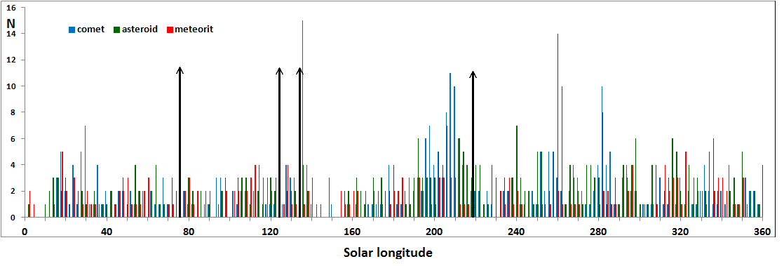
Annual occurrence of meteorite-dropping fireballs and meteorites
All studied sporadic bright fireballs were divided into cometary and asteroidal, according to the Tisserand parameter T_{J}:
T_{J} = a_{J}/a + 2 cos i (a/a_{J})(1 − e²), T_{J} ≤ 3 – cometary, T_{J} > 3 – asteroidal orbits
We created a histogram of the Annual occurrence of meteorite-dropping sporadic fireballs of asteroidal (green line) and cometary (blue line) origin and meteorites with known fall dates (red line) with 2-day bins.
As one can see, the Annual occurrence shows four major (around the dates: 1 Aug., 24 Oct., 4 Dec., 7 Jan.) and two minor (around 16 Apr., 9 Feb.) increases in fireball activity within a year (Fig. 3).

Slide 6
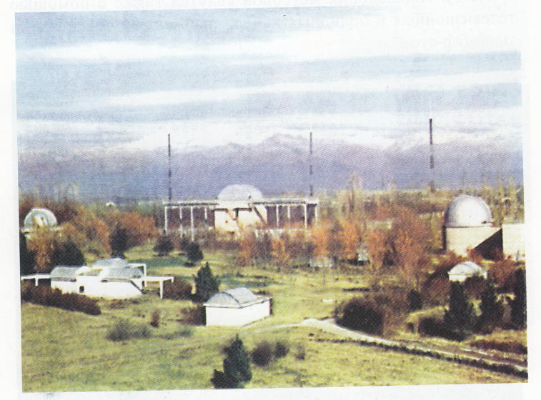
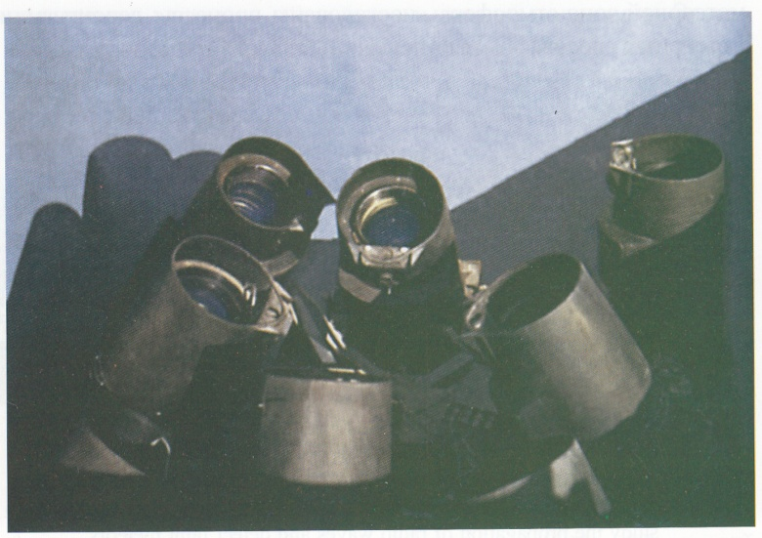
Potential meteorite-dropping fireballs observed in Tajikistan
Hissar astronomical observatory Instantaneous meteor cameras,
(HisAO), Tajikistan. equipped with long-focused apertures.
In Figure 3, the black arrows indicate the dates of appearance of four potential meteorite-dropping fireballs observed in Tajikistan in the previous years; and one can see, the dates of three of them fall within the specified periods of annual occurrence.

Slide 7
Groups of meteorite-dropping meteoroids observed in Tajikistan
The existence of groups of meteoroids that contain meteorite-dropping bodies has been investigated in (Halliday 1990) based on the analysis of the precise orbits of fireballs performed by the Canadian project (MORP).
For the fireballs observed in Tajikistan we searched for the members of their groups according to the orbital similarity as determined by Dsh-criterion.
Table 1. Atmospheric and orbital data for fireball TJ058D8 and members of Group I.
No | Date y m d | αR (°) | δR (°) | V∞ kms | He km | me kg | M_{m} mg | q a.u. | e | i (°) | ω (°) | Ω (°) | DSH
Group I
T058D8 | 800805 | 308.4 | 31.6 | 16.6 | 33.1 | 0.17 | -9.0 | 0.791 | 0.258 | 17.9 | 270.7 | 133.6 | ‒
154F1 | 670828 | 298.5 | 32.6 | 14.1 | 36.4 | - | -5.8 | 0.945 | 0.289 | 12.5 | 224.4 | 154.6 | 0.12
1999CV |  |  |  |  |  |  |  | 0.841 | 0.352 | 15.3 | 279.3 | 132.0 | 0.10
2001DF |  |  |  |  |  |  |  | 0.767 | 0.371 | 18.5 | 260.2 | 146.7 | 0.12

Slide 8
Table 2. Atmospheric and orbital data for fireball TJ062D3 and members
of Group II.
No | Date y m d | α_{R} (°) | δ_{R} (°) | V∞ kms | H_{e} km | m_{e} kg | M_{m} mg | q a.u. | e | i (°) | ω (°) | Ω (°) | D_{SH}
Group II-4 [1] 11 23 336 -5 13.4 ‒ ‒ |  |  |  |  |  |  |  | 0.990 | 0.590 | 1.0 | 185.0 | 241.0 | ‒
T062D3 | 621030 | 332.6 | -12.3 | 13.7 | 35.2 | 0.47 | -7.3 | 0.984 | 0.583 | 0.2 | 15.3 | 36.7 | 0.14
190F1 | 671121 | 330.6 | -10.6 | 13.5 | 27.0 | >0.2 | -9.3 | 0.988 | 0.591 | 0.3 | 180.9 | 239.3 | 0.06
406PN | 711125 | 326.7 | -5.9 | 13.3 | 30.9 | >0.2 | ‒ | 0.990 | 0.600 | 2.0 | 179.0 | 242.0 | 0.06
160E1 | 851020 | 333.6 | -1.6 | 15.1 | 38.3 | >0.2 | -9.1 | 0.959 | 0.675 | 2.3 | 204.5 | 207.5 | 0.16
289F1 | 711112 | 327.3 | -5.5 | 13.7 | 30.9 | - | -6.9 | 0.987 | 0.604 | 1.5 | 178.4 | 242.8 | 0.05
169I1 | 801125 | 340.7 | 1.7 | 13.5 | 33.5 | 0.77 | -7.1 | 0.980 | 0.576 | 1.1 | 191.5 | 243.4 | 0.09
291103 | 031129 | 344.6 | -12.0 | 12.9 | 46.7 | - | -4.9 | 0.986 | 0.543 | 1.0. | 3.4 | 67.2 | 0.08
SL189 |  |  |  |  |  |  |  | 1.022 | 0.566 | 1.4 | 63.0 | 347.9 | 0.16
2011VB |  |  |  |  |  |  |  | 1.044 | 0.618 | 1.3 | 107.9 | 305.3 | 0.15

Slide 9
Superbolide TJ230708 (-20.3 mag) and NEAs
In Table 3 we listed the orbital elements of the TJ230708 superbolide as well as the corresponding orbits of 13 NEAs with small D-values.
As can see, 2006SV19, 2012VE82 have similar orbits with the bolide.
The orbits given in Table 3 was integrated numerically backward in time for the interval -20 KA.
Table 3.
No Object a [AU] e Inc [deg] Node [deg] Peri [deg] DSH DD
1 D230708 2.130 00 0.52300 9.57000 120.988200 175.30000 0.000 0.000
2 2006SV19 2.131754 0.516778 7.362205 116.2899753 182.24732 0.048 0.017
3 2012VE82 2.107963 0.546075 9.957000 110.5467804 186.27807 0.071 0.039
4 (212546) 2.131754 0.516778 7.362205 116.2899785 182.24731 0.048 0.017
5 (439313) 2.107963 0.546075 9.957000 110.5467802 186.27807 0.071 0.039
6 1998OP4 2.252189 0.539855 13.412829 126.7154055 167.52032 0.077 0.030
7 2001QD34 2.135400 0.510873 8.251561 149.0828890 147.13696 0.084 0.033
8 2004QA2 2.124528 0.515724 8.360894 132.8759678 159.41951 0.056 0.020
9 2012HS15 2.110059 0.497433 8.364191 134.7451078 157.24365 0.078 0.038
10 2014MJ26 2.011908 0.502031 6.451906 111.2081402 188.66364 0.072 0.031
11 2014OQ207 2.143694 0.510338 8.822560 130.1120242 167.69177 0.048 0.023
12 2014SV141 2.130317 0.522795 7.796652 158.6994887 141.63829 0.107 0.037
13 2014WD201 2.095726 0.503014 8.476103 105.814684 199.716950 0.101 0.039
14 2015MO89 2.118597 0.522681 7.743720 86.297138 212.860115 0.099 0.034

Slide 10
Parent bodies of the studied meteor-dropping fireballs
Near-Earth Objects contained in the NeoDys database (NEODyS-2) were investigated in search for the parent bodies of analyzed meteorite-dropping fireballs observed in Tajikistan. First the Southworth and Hawkins similarity criterion D_{SH} was used to find potential parent bodies and several candidates from the NeoDys database have been found, all of them satisfying the condition D_{SH}<0.2.
To analyze the relationship of the studied meteoroids with their potential parent NEO’s we studied the object’s orbital evolution backwards in time over large intervals. The results have shown the orbit similarity criterion Dsh to remain below the critical value of 0.2 (Fig. 4,5) (Konovalova, Madiedo and Trigo-Rodriguez, 2015).
Figure 4. Evolution of Dsh criterion meteoroid Figure 5. Evolution of Dsh criterion meteoroid
058D8 and NEAs 1999CV8, 2001DF47. 062D3 and NEA 2011VB.

Slide 11
Figure 6. Evolution of the 1998OP4 (red) and TJ230708 bolide (green) for 20 KA. In case of the orbital elements the blue curves represent the differences between corresponding elements of the NEA and bolide orbits.

Slide 12
Conclusions
The studied meteoroids with close, dynamically linked orbits appeared in groups (clusters). Such groups still could also contain large meteoroids—potential meteorites—that upon entering the Earth's atmosphere would produce bright fireballs.
To the observers of fireballs as the Chelyabinsk this could be of interest in relation to targeted monitoring of the indicated areas of radiant planes in the identified periods of increased annual occurrence of meteorite-dropping fireballs and meteorites.

Slide 13
THANK for ATTENTION

