Slide 1
The CAMSS Meteoroid Elemental
Abundance Application and
Modeling Development
Pete Gural¹
Peter Jenniskens²
Melissa Hannan²
¹ Gural Software Development; ² SETI Institute
Meteoroids 2016, June 6-10

Slide 2
Cameras for All-sky Meteor Surveillance Spectroscopy
CAMSS
Purpose is to obtain meteoroid elemental abundances
  Both relative ratios and absolute #atoms
Sample across a diverse set of comets and asteroids
  Measure Mg, Fe, Na as well as other elemental species
Scale up the number of high resolution spectra obtained
  All sky coverage with year round collection
  16 Objective grating cameras with 0.6 nm/pixel resolution
Automate the labor intensive spectral analysis process
Requires an Integrated Suite of Hardware & Software Tools

Slide 3
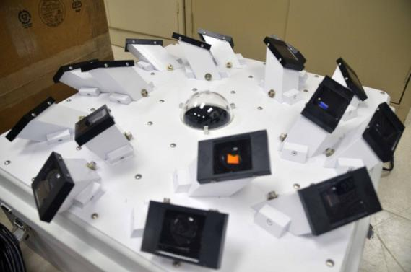
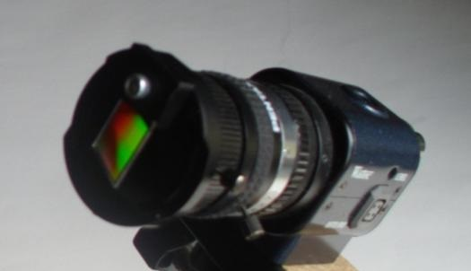
CAMSS Collection System
1379 grooves/mm
Pentax 12mm f/1.2
Watec 902H2 Ultimate
0.6 nm / pixel 1st order
0.3 nm / pixel 2nd order
HP i7-3770 Quad-core
w/16 channel capture/detect/store
Operating in Sunnyvale, CA every clear night since April 2013
Over 1000 spectra ready to be analyzed

Slide 4
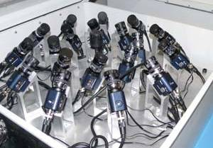
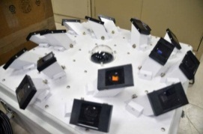
Software Tools and Applications
CAMS - Atmospheric Track and Keplerian Elements
  Capture, Compress, Detect, Calibrate, Coincidence, Trajectory, Orbit
CAMSS - Spectral Analysis
  Responsivity and Extinction calibrations
  Space-time coincidence relative to CAMS derived trajectory
    Spectra extraction, Element selection/fitting, Parameter tuning
    Abundance ratios and atom number density
Software development complete → Ready to process spectra
Trajectory
Orbit
q e i Ω ω
CAMS
Spectral Capture
Detection
Space-Time
Coincidence
Spectral
Model Fitting
Column
Densities
Elemental
Abundances
Astrometric
Calibration
Sensor Cal
Responsivity
Atmospheric Cal Extinction
CAMSS

Slide 5
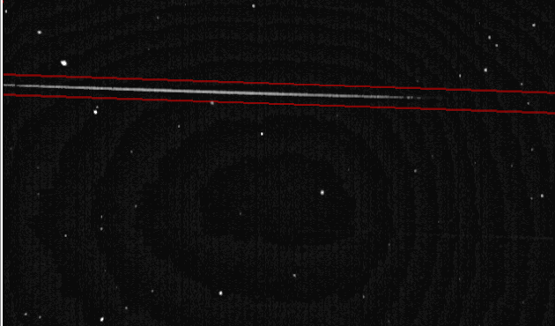
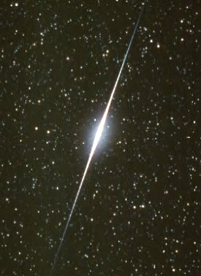
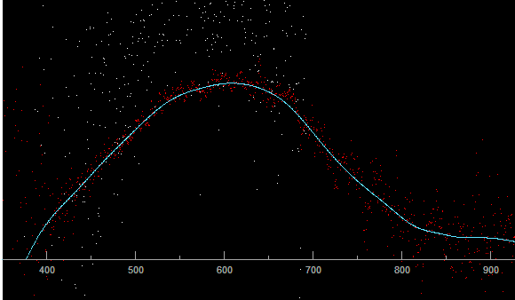
Calibration: Responsivity of the Camera System
Captured Star Spectrum
Adjust Grating Roll and Yaw
Star Spectrum Provides Response
Lab used as an Optional Response
Airmass < 1.5
TBD: Planet or
Iridium Flare
Lab Measured Responsivity
Catalog Star Spectrum
1st Order
Arcturus m_{v} = -0.1
2nd Order
1st Order Responsivity
Response(λ) = { Σ_{star_rows} [ StarPix(r,c(λ)) – Backgnd(r,c) ] / Vignetting(r,c) }
/ StarSpectrum(λ) / ExtinctionApprox(λ) = ADU * m² * nm / Watt / Δλ_{pixel}

Slide 6
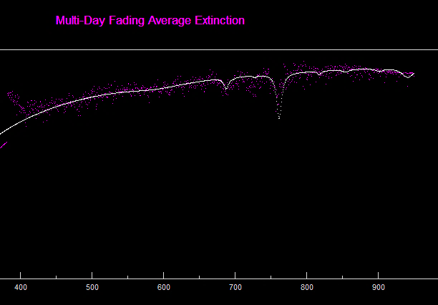
Calibration: Extinction and Vignetting
Watec 902H2 w/12mm f/1.2
O2
O2
Vignetting correction is
applied in focal plane space
Image / cos⁴ ( 0.095°/pixel * ρ )
Use star spectra for any air mass
Average over multiple stars/days
Extinction model fit components:
Rayleigh
O₂
Ozone
Dust
Water
Extinction(λ) = A_{Scale} * exp{ - A_{R} τ_{R} - A_{O2} τ_{O2} - A_{O3} τ_{O3} - A_{D} τ_{D} - A_{W} τ_{W} }
τ* ≡ Optical Depth at λ

Slide 7
Meteor Modeling Assumptions
METEOR
Plasma Radius
MODEL
Nominal Warm
4500° K
Warm Wake
Nominal Hot
10,000° K
Assume Element’s Abundance
is the same in both
Hot and Warm regions
Nominal Hot/Warm Volume Ratio = 10⁻⁴
Hot Shock
HTW = N(ε_{atom} , T_{hot}) / N(ε_{atom} , T_{warm})
Optically Thin Hot Plasma
Electron density n_{electron} via Jones
Assumes electron loss only from 1st air collision
Provides first guess for iterative n_{electron}
Optically Thin Warm Plasma
Column Density of Ions (or Neutrals) via Saha
Assumes thermodynamic equilibrium
Use fit elements + cosmic abundances → n_{electron} via iteration on warm neutrals
N_{Ion} / N_{Neutral} = β_{Jones, Neutral} / ( 1 – β_{Jones, Neutral} )
β = ξ / ( 1 + ξ ) ξ = c(ε) [ V∞ – V_{o}(ε) ]² V∞ ^{0.8}
N_{Ion}/N_{Neutral} = Saha[ n_{e}, T_{warm}, IonEnergy(ε_{Neutral}, T_{warm}),
PartFunc(ε_{Neutral}, T_{warm}),
        PartFunc(ε_{Ion}, T_{warm}) ]

Slide 8
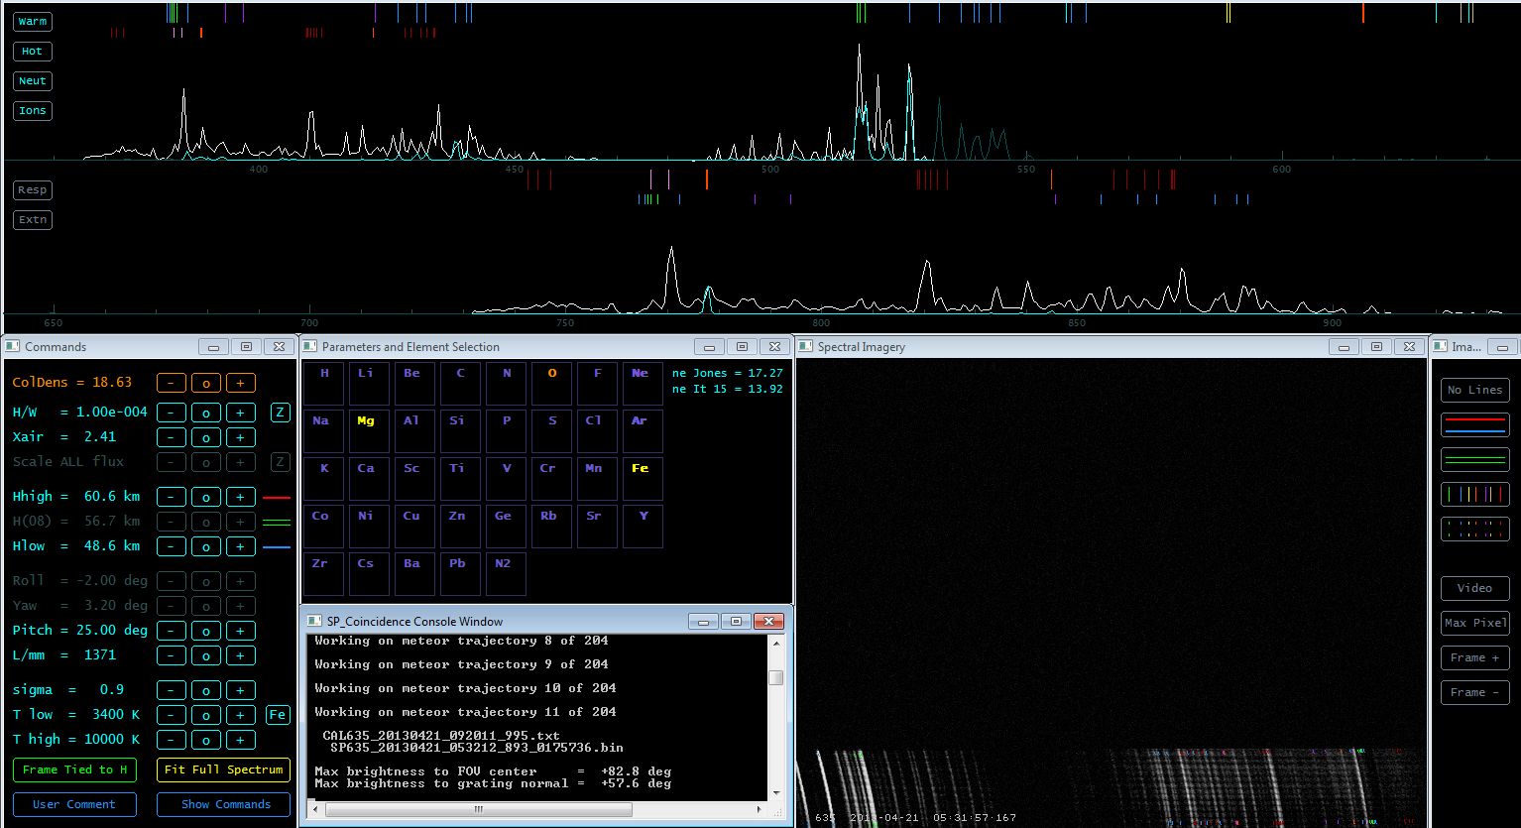
SP_Coincidence Interactive View
Warm / Hot / Neutral / Ion
Responsivity / Extinction
Emission Line Fiducials
1st and 2nd order
Measured Spectrum
Model Spectrum
350-660 nm
640-950 nm
Imagery:
Single-frame, Multi-frame, Movie
Selection: Column Density, Hot/Warm, X_{air}
H_{b}, H_{tie}, H_{e}, Grating Roll, Pitch, Yaw
Lines/mm, Line width, T_{warm}, T_{hot}
Element Selection
CAMSS ↔ CAMS Coincidence Info

Slide 9
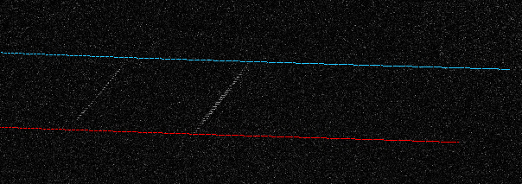
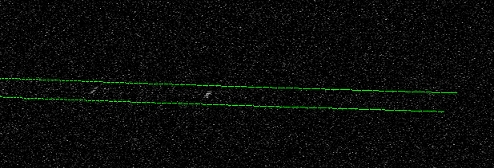
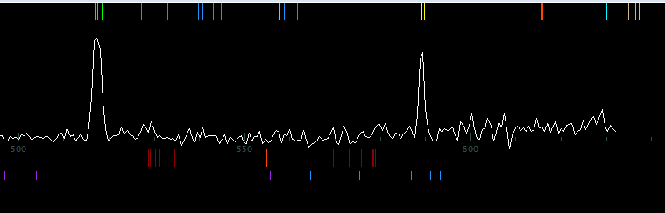
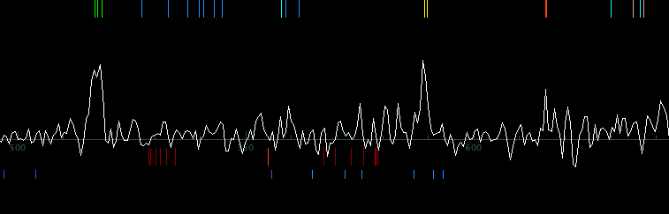
Work Flow: Trajectory and Spectrum Coincidence

[1] Trajectory obtained from standard CAMS processing on ALL cameras

[2] Temporally meteor must be within clock synchronization
[3] Geometrically feasible to be within grating camera FOV in
1st or 2nd order wavelengths
V∞
h_{beg}
h_{end}
Grating Camera
φ_{beg}, λ_{beg}
φ_{cam}, λ_{cam}
φ_{end}, λ_{end}
Define Spectral H_{beg} and H_{end}
For multi-frame integrated spectrum limits
Tie Spectrum Time Slice to Trajectory H_{frame}
For frame-by-frame abundance vs height

Slide 10
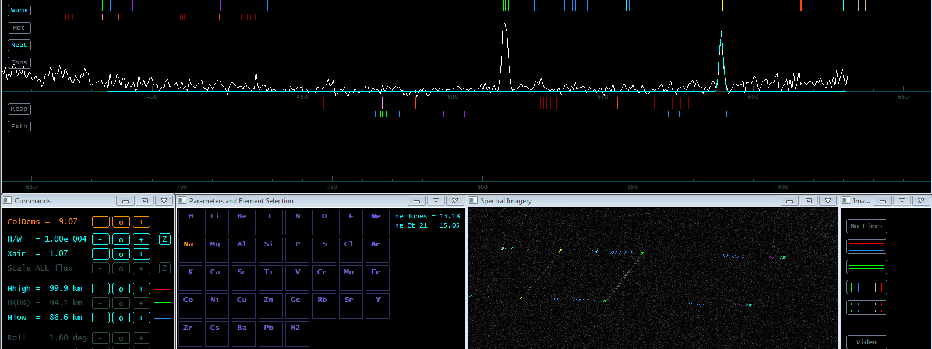
Work Flow: Select Element and Fit Model Spectrum
Adjust Grating Pitch, Lines/mm, Select Reference Element (e.g. Na), Auto Fit
Adjust Line Width (PSF σ), Adjust Column Density
SpectralFlux(λ) = N(ε) * Σε_{lines} { 1/σ√(2π) } * exp{ - ( λ(ε)_{line} – λ )² / 2 σ² } * { π PlasmaRadius² / Range² }
* { 2 π h e² / ε_{o} m_{e} λ³ } * gf(ε) * exp{ – E_{up}(ε)_{line} / kT } / U(ε,T) = Watts / m² / nm
1st Order
ε ≡ Element’s Neutral or Ion N(ε) ≡ Column Density = # / m² T ≡ T_{warm} or T_{hot}

Slide 11
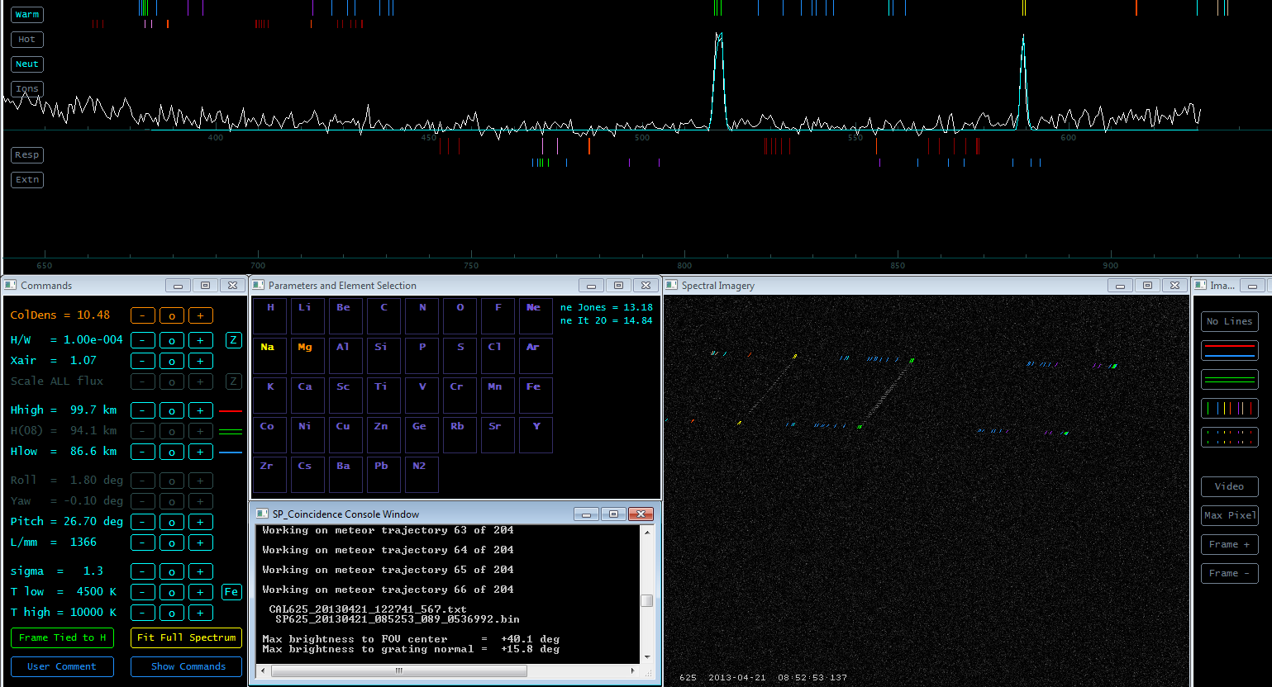
Work Flow: Add Additional Elements, Molecules
Add Element (e.g. Mg), Cosmic Abundance for Initial Flux, Adjust Column Density
n_{electrons} = 6.9e+14 N_{Na} = 3.6e+8 N_{Mg} = 3.0e+10 Na / Mg = 1.2%

Slide 12
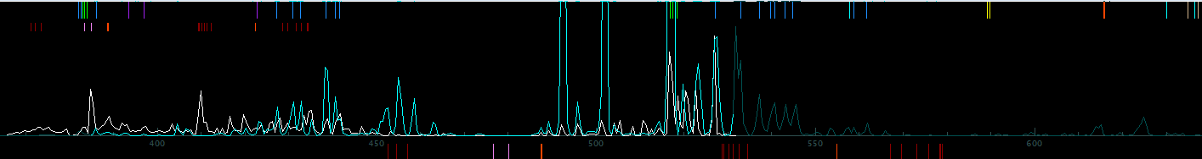
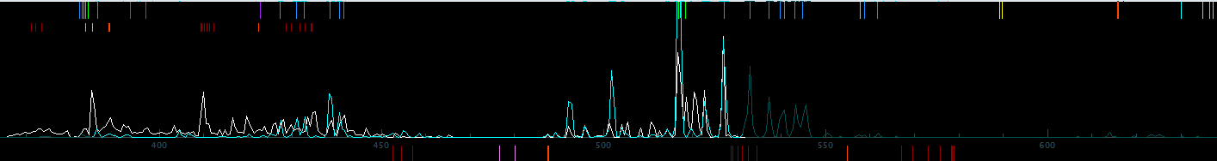
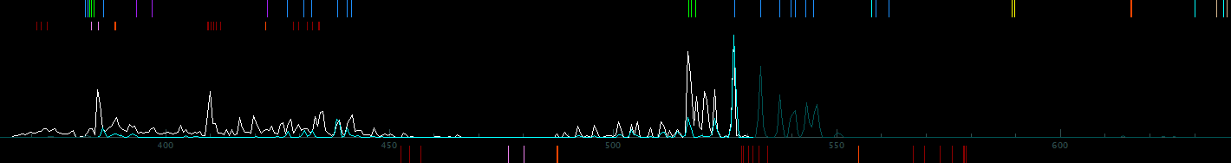
Work Flow: Examine Neutrals & Ions, Warm & Hot
Adjust T_{warm}, T_{hot}, Hot/Warm Volume Ratio, and Column Densities
T_{warm} = 5700° K
T_{warm} = 4500° K
T_{warm} = 3300° K
Focal Plane Image

Slide 13
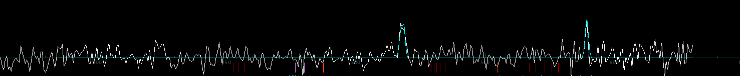
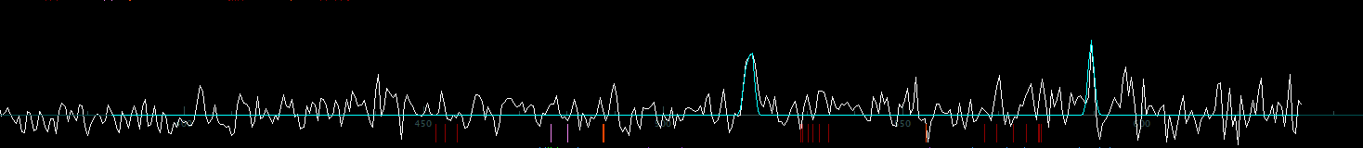
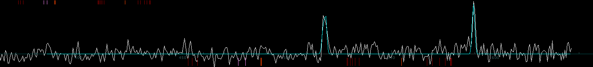
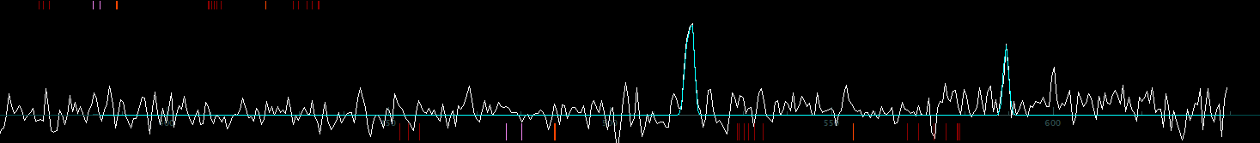
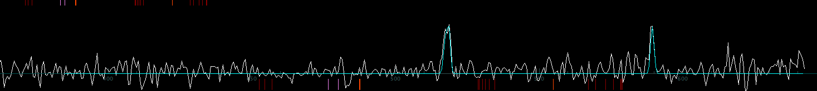
Work Flow: Frame-by-Frame Abundance Adjustment
Re-Adjust Column Densities per Element, per Frame
Na / Mg
1.6 %
1.5 %
1.4 %
1.0 %
1.2 %
Column Density “N” → Number Density “n” → #atoms per element

Slide 14
Next Steps
Begin analysis of the 1000+ spectra
Modify procedures as we process a variety of spectral cases
Solicit feedback on meteor emission modeling

