Slide 1
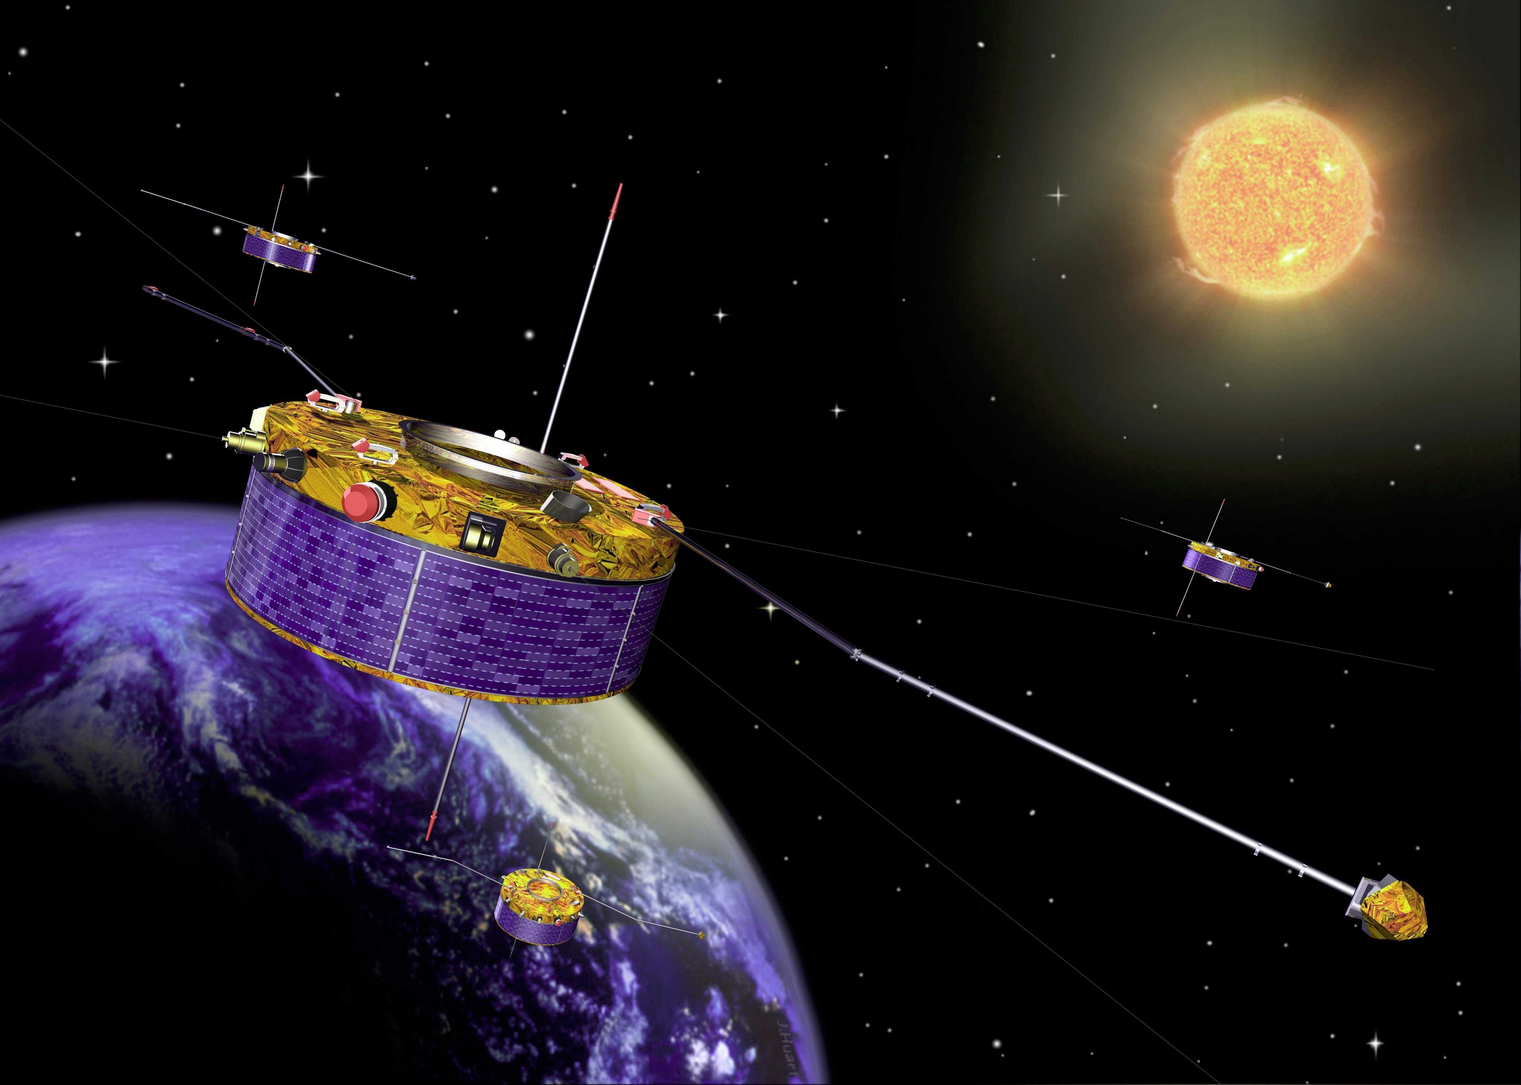
Properties of meteoroids observed by the Earth-orbiting Cluster spacecraft
Jakub Vaverka¹ Asta Pellinen-Wannberg^{1,2},
Johan Kero², Ingrid Mann^{3,1}, Carol, Norberg¹,
Maria Hamrin¹,Timo Pitkänen¹,
and Alexandr De Spiegeleer¹
¹Umeå University
²Swedish Institute of Space Physics
³EISCAT HQ
Meteoroids 2016, ESTEC, Noordwijk, the Netherlands, June 6-10, 2016

Slide 2
Background
Large uncertainty about the global extra- terrestrial matter influx into the atmosphere
Voyager 2 was the first spacecraft to detect dust grains at Saturn’s rings with the plasma wave instrument [Scarf et al., 1982 etc]
The method has not been applied to similar instruments on magnetospheric satellites
The Cluster satellites have been in orbit for 16 years – can the method be employed on them?

Slide 3
Why not Cluster so far?
Magnetospheric scientists not interested in micro-meteoroid/dust hypervelocity impacts
Several observers have though mentioned signals similar to dust impacts observed close to comets such as P/Borrelly by Tsurutani et al., 2004
Some Cluster people even asked why do “we” not do anything for this!
Hired postdoc Jakub Vaverka for searching for hypervelocity impacts on Cluster satellites

Slide 4
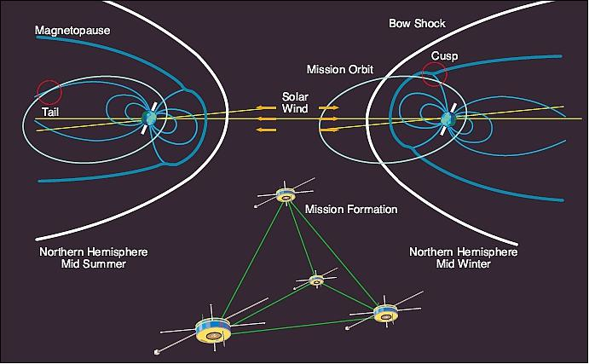
Cluster orbits
from the magnetospheric scientist’s point-of-view:

Slide 5
Cluster orbits
from the meteoroid/dust scientist’s point-of-view:

Slide 6
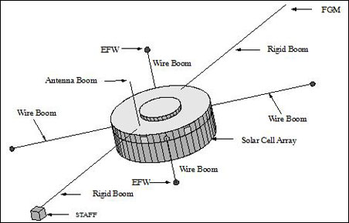
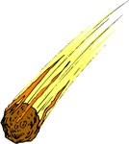
The instrument for observing the hypervelocity impacts: Electric Fields and Waves (EFW)
with two sets of 44 m long booms and a 8-cm sphere at the end of the antennas at each side
The signals from the antennas are processed by the Wide-Band Data (WBD) instrument
44m
44m
ΔV
44m
44m

Slide 7

Cluster 1 in November 2009 (?):

Slide 8
Monopole antennas generally detect much stronger signals than dipoles since they measure the potential difference between the spacecraft body and one probe [Meyer-Vernet et al., 2014]
Cluster 1 – only one boom left from Nov 2009
1x44m ΔV

Slide 9
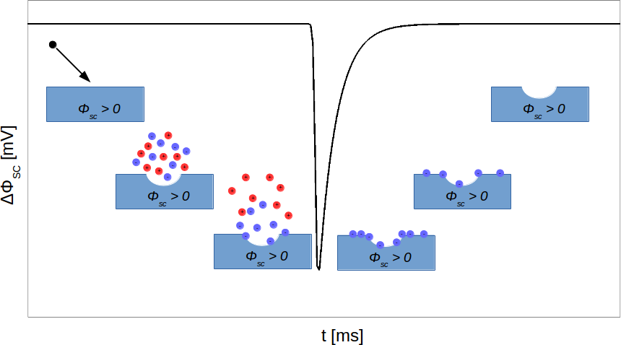
The method:
Vaverka et al.,GRL in rev 2016
A sketch of the plasma cloud generation by the hypervelocity dust impact and consequent
electron recollection by the positively charged spacecraft body. The black line represents dip in the temporal evolution of the spacecraft potential, Φ_{SC} caused by this impact according to a model by Zaslavsky et al., 2015.

Slide 10
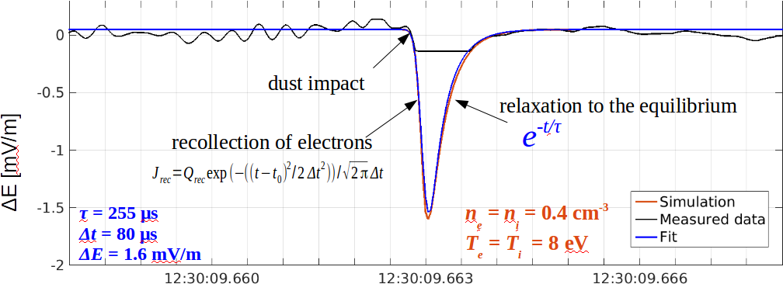
One of the first identified impacts
occurred on December 10, 2009:
Vaverka et al.,GRL in rev 2016
Fit (blue) and simulation (red) of the theoretical pulse to the measured data (black). The best fit parameters are Δt = 80 μs, τ = 255 μs, and ΔE = 1.6 mV/m. Parameters for the simulation are n_{e} = n_{i} = 0.4 cm⁻³, and T_{e} = T_{i} = 8 eV. The saturation in the measured electric field is caused by the automatic gain control. The expected amplitude (ΔE = 1.6 mV/m) is cut of at 0.14 mV/m (gain level = 55 dB), the duration of the saturation is about 700 μs.

Slide 11
Cluster method opportunities
Has collected data for 15 years
Dust presence can be observed
    in the solar wind
    inside the magnetosphere
Separate between different dust sources
    Solar wind
    Interstellar wind
    Sporadic dust in planetary orbits
    Dust from cometary swarms

Slide 12
Limitations of the method for Cluster
The WBD is recording when Cluster passes regions of magnetospheric interest
    => ~ 4% of an orbit covered
The automatic gain control provides 75 dB dynamic range for 8-bit resolution
    16 levels with 5 dB steps
      => saturation level range: 0.014 mV/m (gain 75 dB) - 78 mV/m (gain 0)
    Influences the dust impact detection
      if reaching the saturation at high gain levels or
      if reducing the sensitivity at low gain levels
The gain control generates pulses when changing the gain level
    => removed data around the gain level changes
Even natural waves can be mistaken as dust impacts

Slide 13
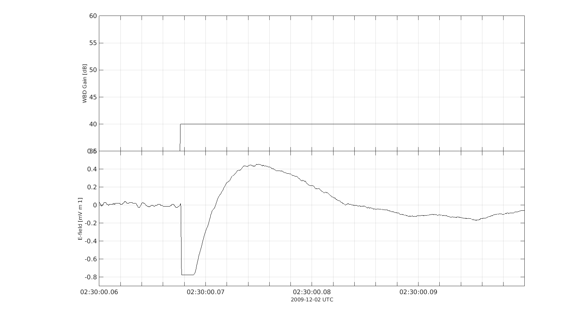
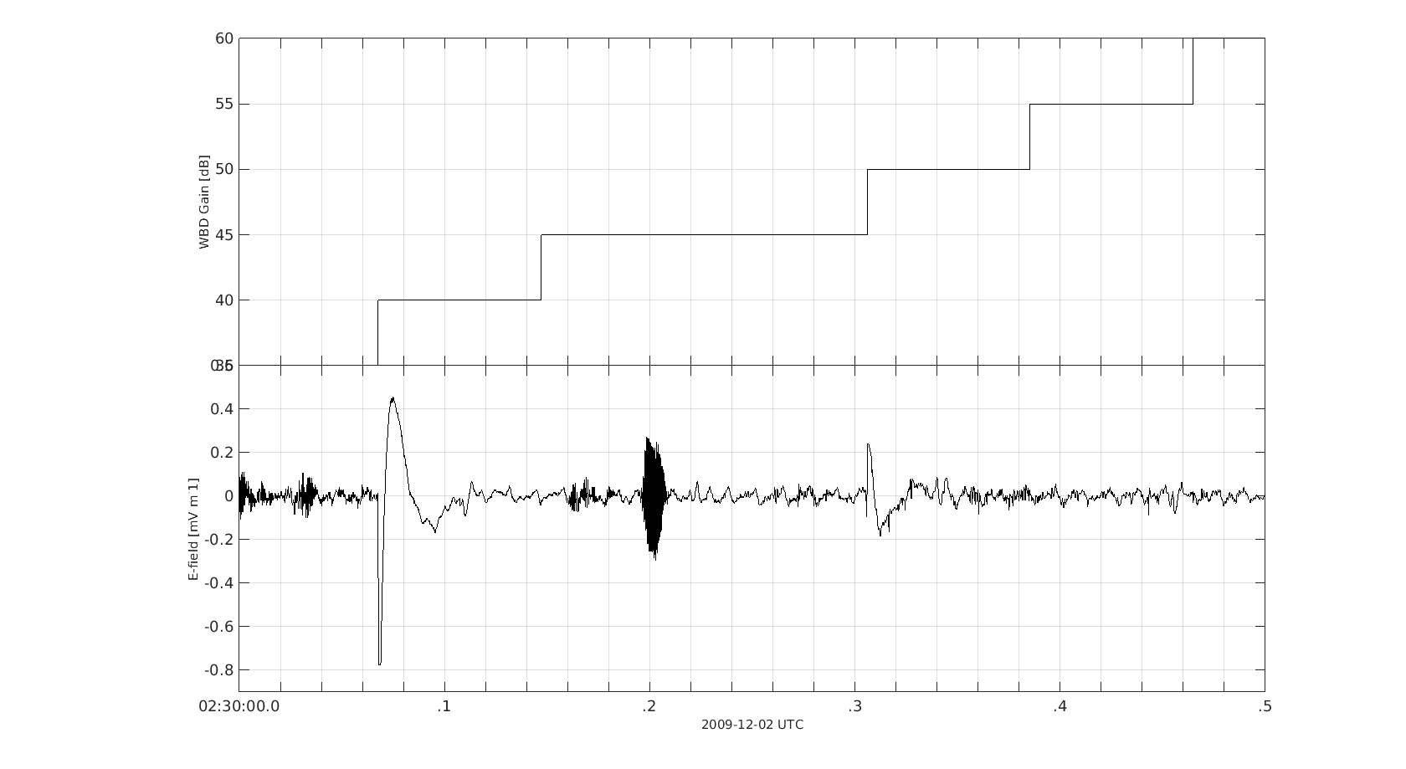
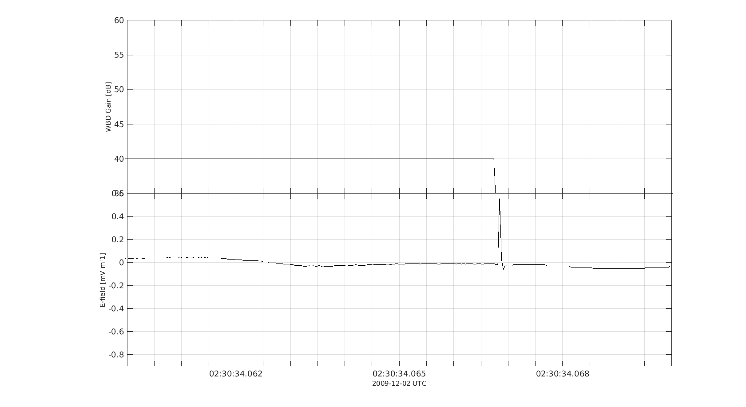
Pulses generated by the change of the gain level:
Gain level
Gain level
40 ms
ΔE [mV/m]
500 ms
ΔE [mV/m]
10 ms

Slide 14
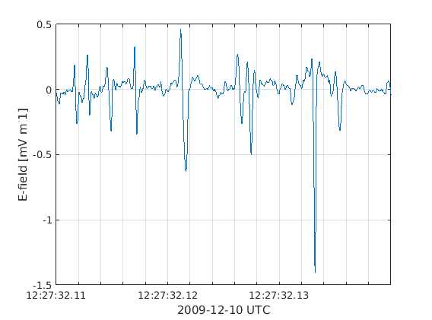
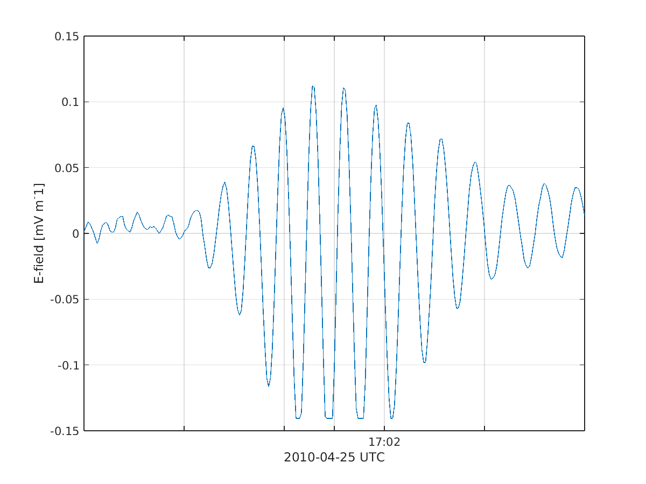
Natural waves
ΔE [mV/m]
ΔE [mV/m]
ESW - electrostatic solitary waves
AMEW - amplitude modulated electrostatic waves

Slide 15
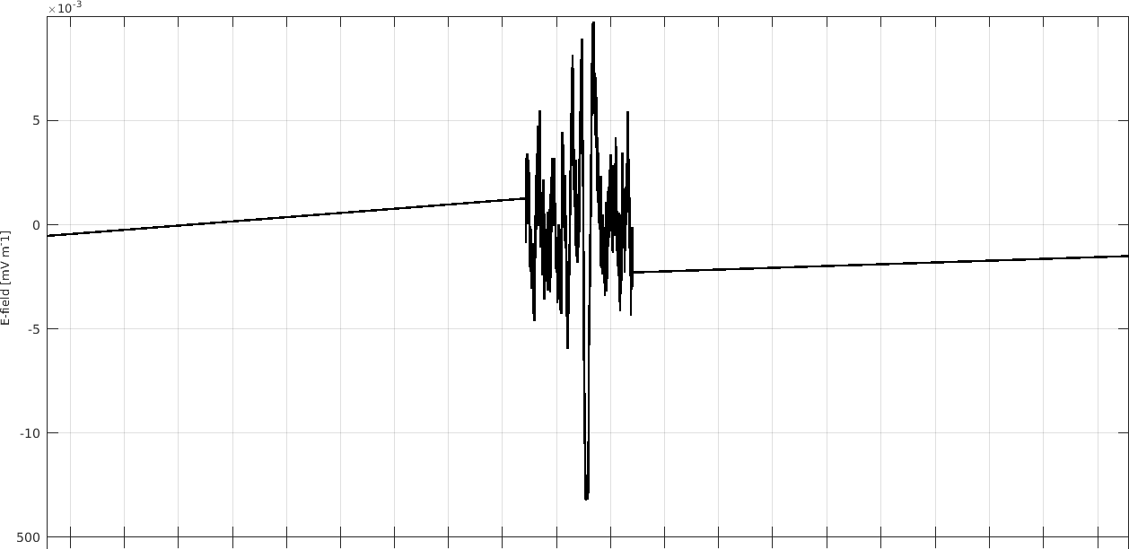
WBD instrument sampling
Sampling frequency | 27.4 kHz | 54.9 kHz | 219.5 kHz
Time resolution | 36 μs | 18 μs | 5 μs
Signal resolution | 8-bit | 4-bit, 8-bit | 1-bit, 4-bit, 8-bit
 |  |  | 1-bit 100%
 |  | 4-bit 100% - continuous | 4-bit 25%
Total data coverage | 100% - continuous | 8-bit 50% - half time | 8-bit 12.5%

Slide 16
Conclusions and future work
We have shown that hypervelocity impacts can be found in old magnetospheric satellite data
There exists a lot of such data to be evaluated
Since the instruments were not built for this purpose there are many limitations in the old data
The electric field instruments could be better applied even for dust impact purposes in future missions

Slide 17
Properties of meteoroids observed by the Earth-orbiting Cluster spacecraft
Thank you!
Jakub Vaverka¹ Asta Pellinen-Wannberg^{1,2},
Johan Kero², Ingrid Mann^{3,1}, Carol, Norberg¹,
Maria Hamrin¹,Timo Pitkänen¹,
and Alexandr De Spiegeleer¹
¹Umeå University
²Swedish Institute of Space Physics
³EISCAT HQ
Meteoroids 2016, ESTEC, Noordwijk, the Netherlands, June 6-10, 2016

