Slide 1





AGATA
SCAR Scientific Research Programme
Lucilla Alfonsi, Wojciech J. Miloch, Nicolas Bergeot
Istituto Nazionale di Geofisica e Vulcanologia
University of Oslo
Royal Observatory of Belgium
On behalf of the AGATA Team

Slide 2
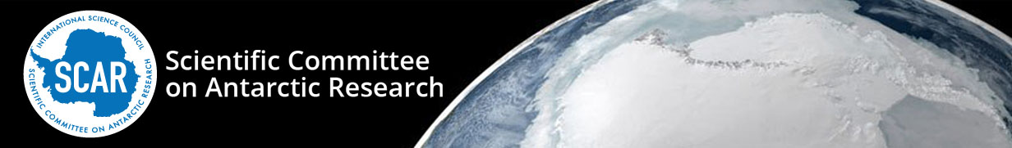
The Scientific Committee on Antarctic Research (SCAR) is a thematic organisation of the International Science Council (ISC). It was created in 1958. SCAR has a mandate and goal to initiate, develop and coordinate high quality international scientific research in the Antarctic region (including the Southern Ocean), and on the role of the Antarctic region in the Earth system.
The Science within SCAR is carried out through the permanent Science Groups (SGs):
GeoSciences
Life Sciences
Physical Sciences
Scientific Research Programmes (SRPs) are established by the three permanent Science Groups to focus efforts on high priority topical areas. They are large, overarching programmes in scope, are often multi-disciplinary and have a lifetime of around eight years.
scar.org

Slide 3
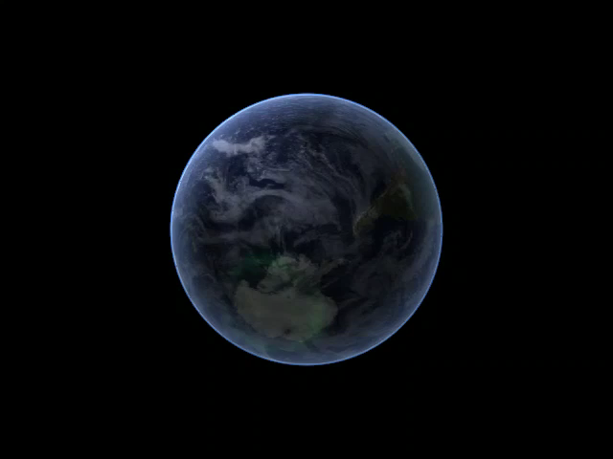
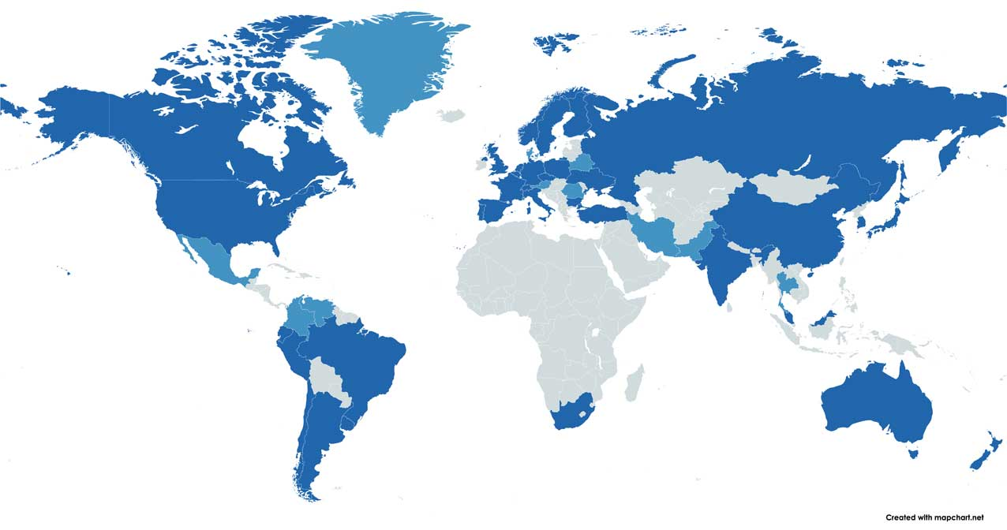
AGATA SRP approved in 2024
Until August 2024 SCAR was running 3 SRPs, none of them on dealt with upper atmosphere physics and solar-terrestrial relationships. In August 2024, during the Delegates Meeting the AGATA Scientific Research Program was approved.
SCAR full members in dark blue
SCAR Associate members in light blue

Slide 4

RATIONALE
The AGATA SRP aims to significantly advance the current knowledge of the Antarctic atmosphere and geospace, also in the global and interhemispheric context.
How are different atmospheric layers coupled in the Antarctic?
How does the Antarctic upper atmosphere respond to increased geomagnetic activity, including energy transfer from space?
How does the whole polar atmosphere impact short- and long-term climate variations?

Slide 5

SCIENTIFIC OPEN QUESTIONS TO ADDRESS
What is the role of coupling between the neutral and the ionized layers in the atmosphere at the poles for the global atmospheric circulation and energy transfer through different atmospheric layers?
How can we improve the modeling of the coupling of the neutral atmosphere to the ionized atmosphere at high latitudes?
Due to the nearly vertical geometry of the geomagnetic field lines, the magnetic reconnection between the Earth’s magnetic field and the IMF results in a prompt response of the high latitude ionosphere to fluctuations in the solar wind. How prompt is that reaction and how does the electric field penetrate to low latitude?
The effects of solar perturbations on the upper atmosphere over the poles are often asymmetric. Do we fully understand the reason for such asymmetries?
Can we interpret plasmaspheric erosion as the signature of electric field penetration from high to low latitudes during geomagnetic storms?
Can we identify when ionospheric plasma structuring at high latitudes appears as fragmentation from large to smaller-scale structures or vice versa as clustering of small-scale irregularities into larger-scale configurations? What are the mechanisms for each of these forms of restructuring?
Can we understand the origin of the long-term behavior of the polar ionosphere and discriminate between natural and anthropogenic contributions to such change?
Is it possible to identify the contribution of anthropogenic and natural sources in the assessment of climate change over the poles?
… MORE TO COME!
Wordpress.com

Slide 6
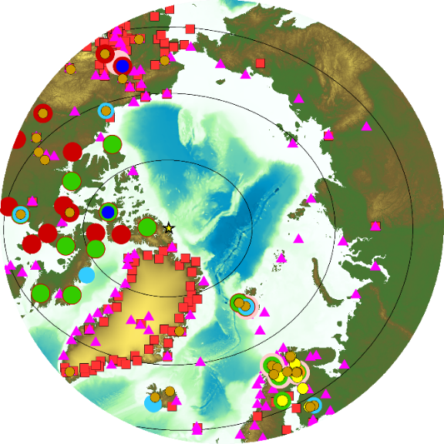
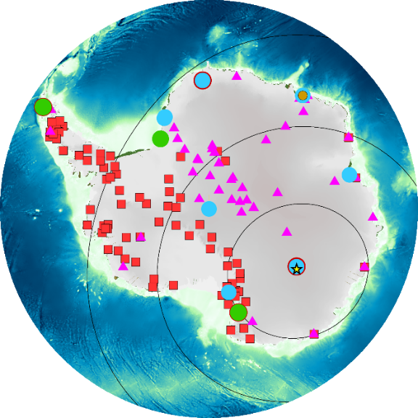
RESEARCH ACTIONS – the list is OPEN!
Water Vapour: the AGATA Team will investigate the water vapour, one of the most important natural greenhouse gases but also one of the most difficult parameters to measure and quantify.
Atmospheric transport, aerosols, and cloud formation: AGATA will facilitate and coordinate international efforts within these topics and will invite scientists from existing groups (e.g., ACA Action Group) to participate in this research action.
Sudden Stratospheric Warming (SSW): AGATA will coordinate and facilitate joint research efforts and provide such measurements tp learn about interhemispheric differences
Atmospheric gravity waves, acoustic–gravity waves, traveling ionospheric disturbances and planetary waves: AGW observations in Antarctica have been improved due to the formation of the SCAR Action Group ANGWIN. AGATA will further consolidate these efforts also in the global context of vertical coupling in the atmosphere. It is envisaged that scientists of ANGWIN will lead the research action within this topic.
Ionospheric irregularities: AGATA will contribute to answering this outstanding question of ionospheric structuring.
Upper atmosphere response to geomagnetic storms: AGATA will focus on peculiar response of the southern hemisphere to geomagnetic activity to study these processes during almost the full solar cycle, also in the interhemispheric perspective.
Upper atmosphere prediction under space weather adverse conditions: AGATA will directly contribute to future models to nowcast, forecast and mitigate adverse space weather events by facilitating data sharing and coordinating research activities within this scope.
… MORE TO COME!
Alfonsi et al., 2022
Coordinate ground-based and satellite-based research infrastructure!

Slide 7
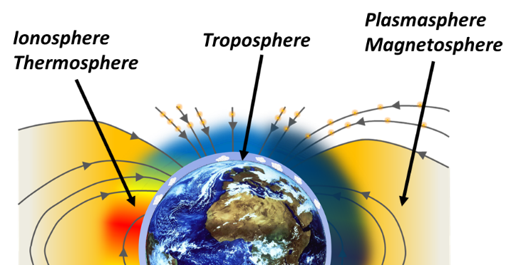
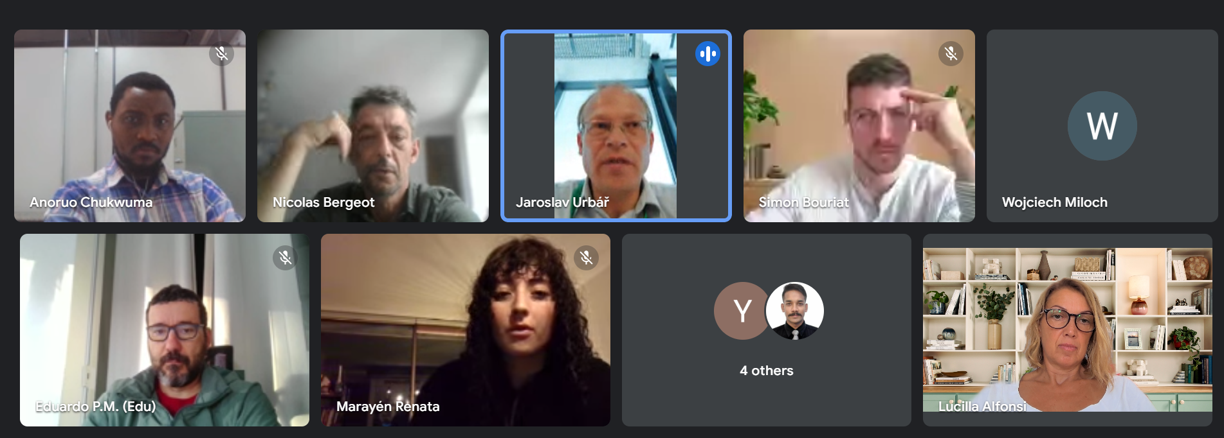
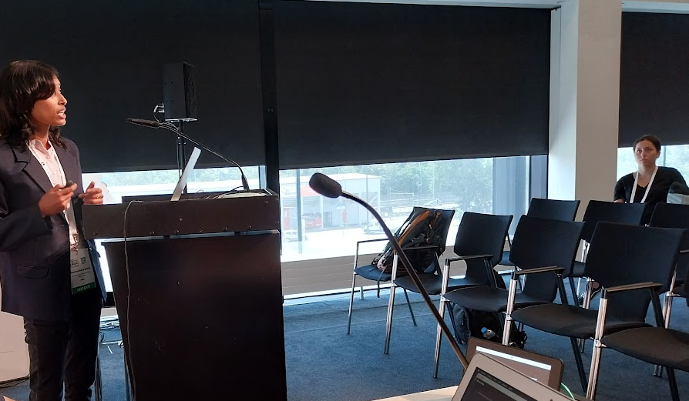
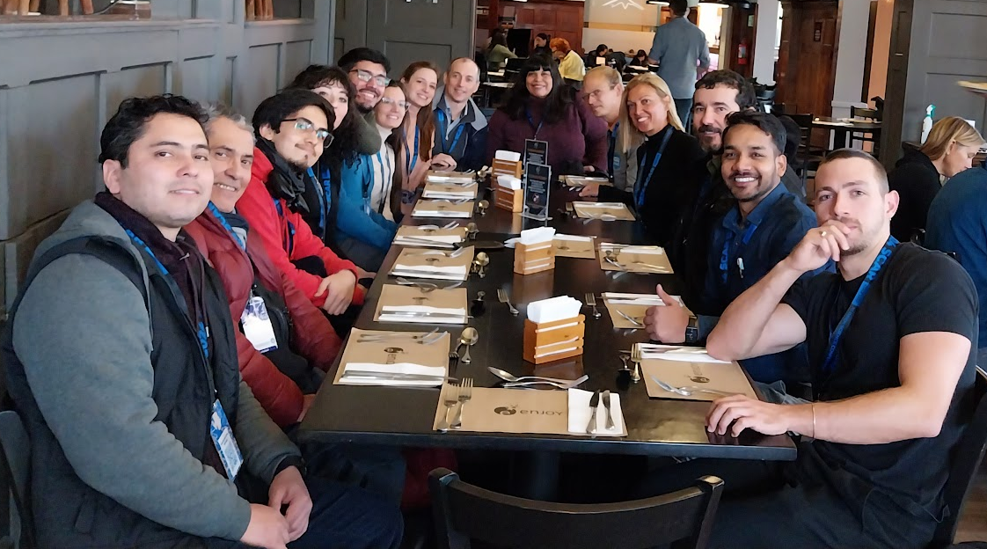
OBJECTIVES
AGATA gathers communities that investigate the polar weather, atmosphere, and geospace to study the coupling between different atmospheric layers and the impact of solar-terrestrial interactions for the conditions in the atmosphere (both lower and upper atmosphere).
This opens for innovating science encompassing different atmospheric layers and near-Earth space.
AGATA:
● Focus on the polar regions (Antarctica and Arctic);
● Strengthens the collaboration between atmospheric scientists and space physics community;
● Facilitates sharing of data, algorithms and models, access to research infrastructure;
● Develops and strengthens the collaboration between the research communities that manage and exploit ground-based and in-situ observations.
● Runs a mentoring program to educate new generation of scientists.
● Is active in preparations for 5th International Polar Year 2032/33.
● Cooperates with other relevant initiatives!
AGATA offers a common research and collaborative
platform always open to new members
Timeframe:
Officiall kick-off meeting: March 26-28 (online)
Lifetime: 2024-2032

Slide 8
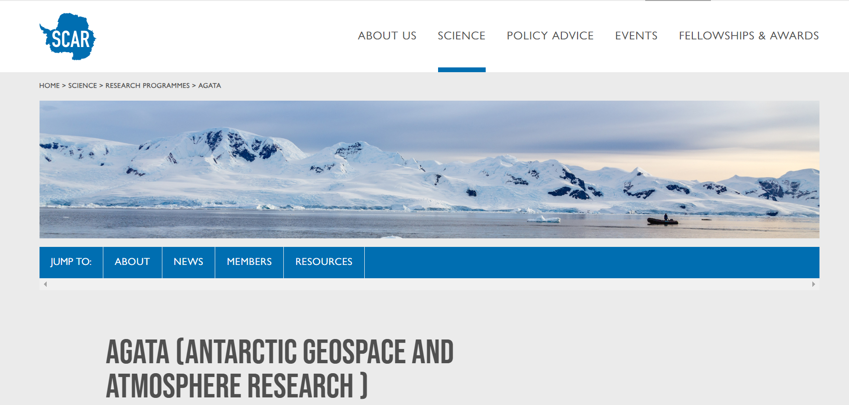
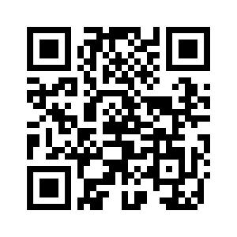
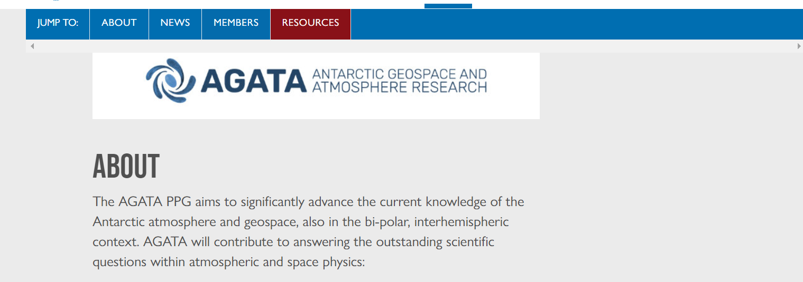
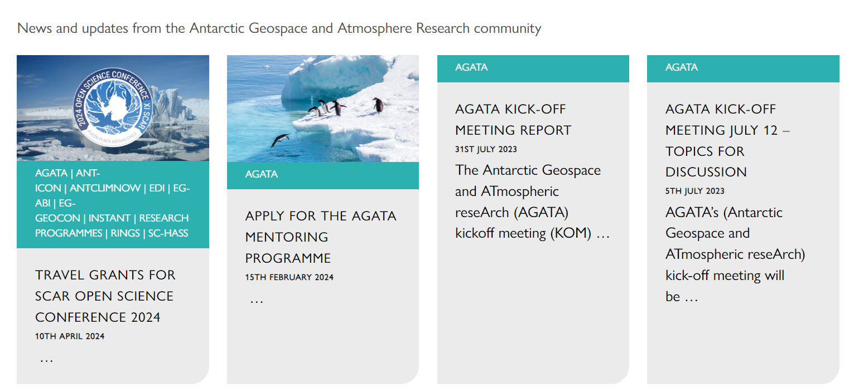
www.scar.org/science/agata/home/
Thanks!
lucilla.alfonsi@ingv.it
w.j.miloch@fys.uio.no
nicolas.bergeot@oma.be
JOIN OUR MAILING LIST!
(please send us an email)

