Slide 1
Heliophysics international data environment coordination in 2024
Arnaud Masson, D/SCI Heliophysics archives science lead
21/11/2024

Slide 2
Outline
International Heliophysics Data Environment Alliance (IHDEA)
Data Analysis and Software in Heliophysics (DASH)
COmmittee on SPAce Research (COSPAR)
  International Space Weather Action Teams (ISWAT): outcome of the Information architecture and innovative solutions working groups since 2020

Slide 3
Introduction
Information architecture is about Science
Data format standards To ease data analysis
Data access protocols To ease data distribution
Metadata registries To find distributed datasets through metadata
Open-source software To grow data usage through open science software
Metadata standards (observations and simulations) To help/boost data-simulation comparision
AI/ML ready datasets To help the use and comparison of AI/ML algorithms
Science platforms and cloud computing To support collaborative (large-scale)
  data processing and analysis
DOI For data citation, discovery and access
INTERNATIONAL COORDINATION

Slide 4
Introduction
Heliophysics international coordination
In the field of heliophysics, international coordination exists since the 1980s where a common data format (CDF) was created, mostly for in situ plasma data. A CDF file has compulsory set of metadata called Global/Variable attributes to be ISTP compatible (ISTP: International Solar Terrestrial Programme).
Data from all NASA heliophysics missions shall respect this standard. Back in 2018, apart from this CDF data format and ISTP metadata standard, there was no organization/platform of discussion to coordinate efforts in the heliophysics data environment

Slide 5

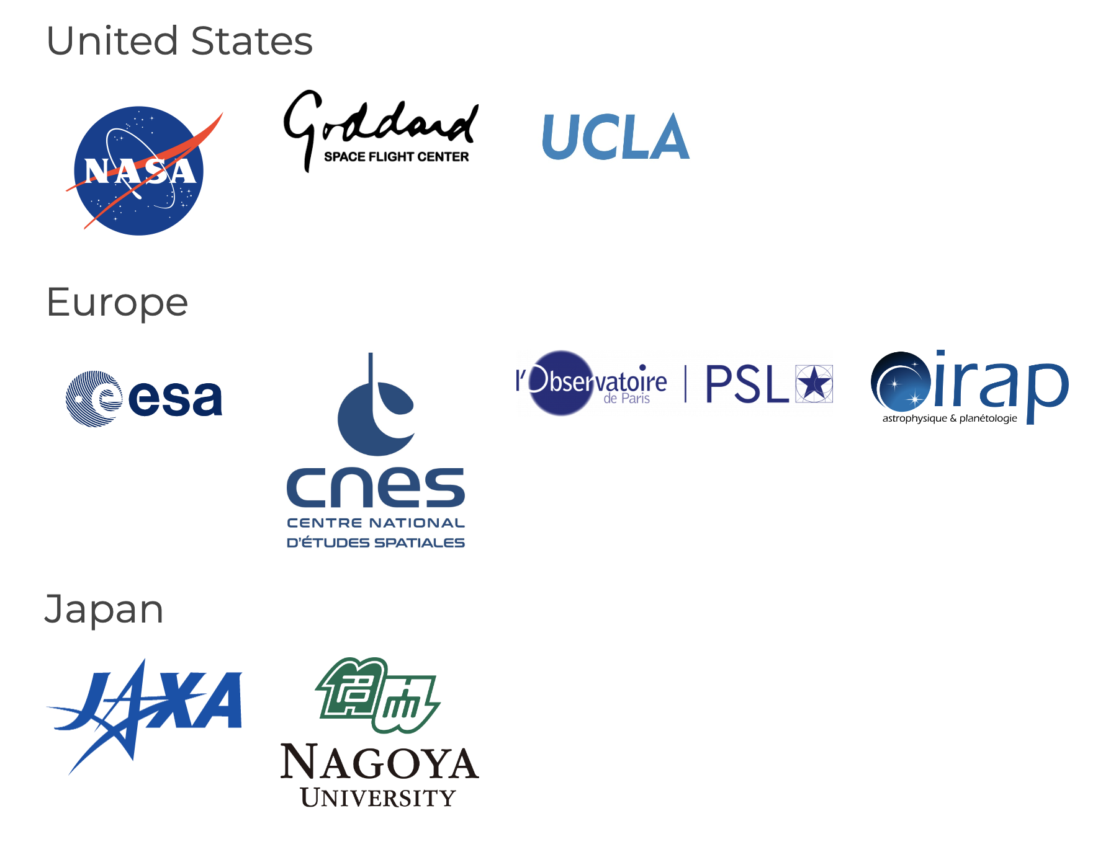
I. International Heliophysics Data Environment Alliance
2019: IHDEA formally created (Charter/Bylaws)
meeting organised by NASA
2020: setup of WGs, organised by Obs. Paris
2021: annual IHDEA meeting, organised by ESA
  WMO/GNSS experts invited
2022: annual IHDEA meeting, organised by JAXA
2023: annual IHDEA Oct. meeting @ APL, USA
participation of DKIST and MADRIGAL
2024: annual IHDEA meeting @ ESAC/ESA
End of 2024: application of ISRO, KASI and NOAA
https://ihdea.net

Slide 6
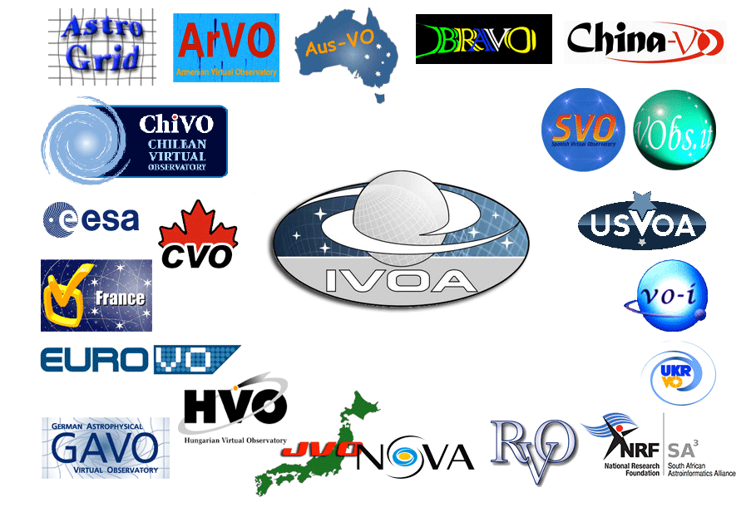
I. IHDEA
Similar to International Virtual Observatory Alliance
In the field of astronomy, the international virtual observatory alliance (IVOA) has led to a number of advances in data model, metadata registry, data access layer, applications…
Created in 2002, it is still highly active with
21 international members worldwide
Some protocols used across D/SCI archives (astro, planetary but also helio)
www.ivoa.net

Slide 7
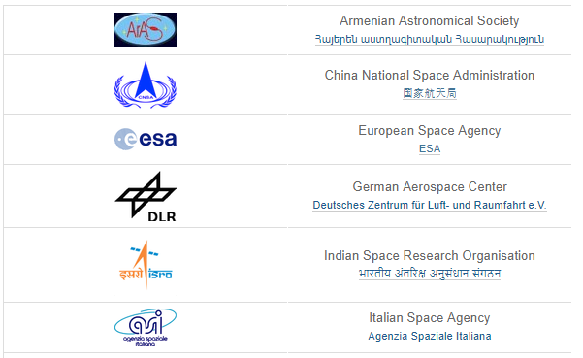
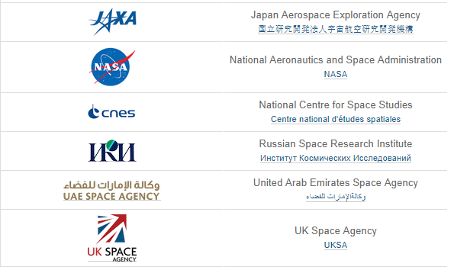
I. IHDEA
Similar to the International Planetary Data Alliance
In the planetary domain, the IPDA adopts standards in particular to ensure planetary data is captured in common formats (PDS4, PDS3).
Created in 2006, it is now composed of 12 space agencies
https://planetarydata.org
IPDA
- Supports the construction of compatible archives.
- Sharing of tools and software services.
- Facilitates global access to, and exchange of, high quality scientific data products managed across international boundaries.
www.ivoa.net

Slide 8
I. IHDEA
The goal of IHDEA is to encourage the use of common standards and
services to boost data sharing and enhance science.
Main goals are to
- Active involvement of international heliophysics and space weather data providers
- Develop Standards-based data systems with uniform and well-defined terminology
- Coordinated, user-friendly data access and analysis tools to serve diverse communities
- Adequate documentation of data products and sources
- Flexible, interoperable (ex. HAPI), and interconnected data archives, modeling centers, and virtual
observatories
- Effective communication among national and international partners, data providers, data
tool developers, and data users
The role of IHDEA is to engage the community, foster communication, and to identify the standards and services which will best serve the science needs.
(courtesy of S. Fung)

Slide 9
I. IHDEA
Example 1: data formats

Slide 10
I. IHDEA
Example 1: Metadata
ESA data conversion open source software : SPace dAta foRmat TrAnslator (SPARTA)
Cluster Exchange Format → CDF ISTP
PDS3 products from Rosetta → CDF ISTP (IES, LAP, MAG, MIP)
=> ESA Cluster data now available via SPARTA in CDF/ISTP (conversion on the fly)
=> ESA Cluster CDF ISTP data now also available at NASA SPDF
CDF ISTP standard limitations discussed within IHDEA to evolve the CDF ISTP (not static!)
Input from variable attribute used by Cluster or Solar Orbiter taken onboard
FITS has metadata standard 4.0, followed by Solar Orbiter, DKIST
based on SOLARNET metadata recommendations, World Coordinate System _WCS standard

Slide 11
I. IHDEA
Example 2: data access protocols

Slide 12
I. IHDEA
Example 2: Data access protocols
All D/SCI Helio archives back-end use the IVOA data access protocol called Table Access Protocol (TAP), created by the International Virtual Observatory Alliance (or IVOA)
Update of the VSO (Virtual Solar Observatory) @ NASA Solar Data Analysis Center
  Completely re-written using python (modernizing a 20 year old system (perl))
  The new VSO will fully support TAP
  All data providers will be able to provide their data via TAP through VSO 2.0
=> Use of interoperable data access protocols improves findability of and accessibility to archives

Slide 13
I. IHDEA
Example 3: connection to data analysis software

Slide 14
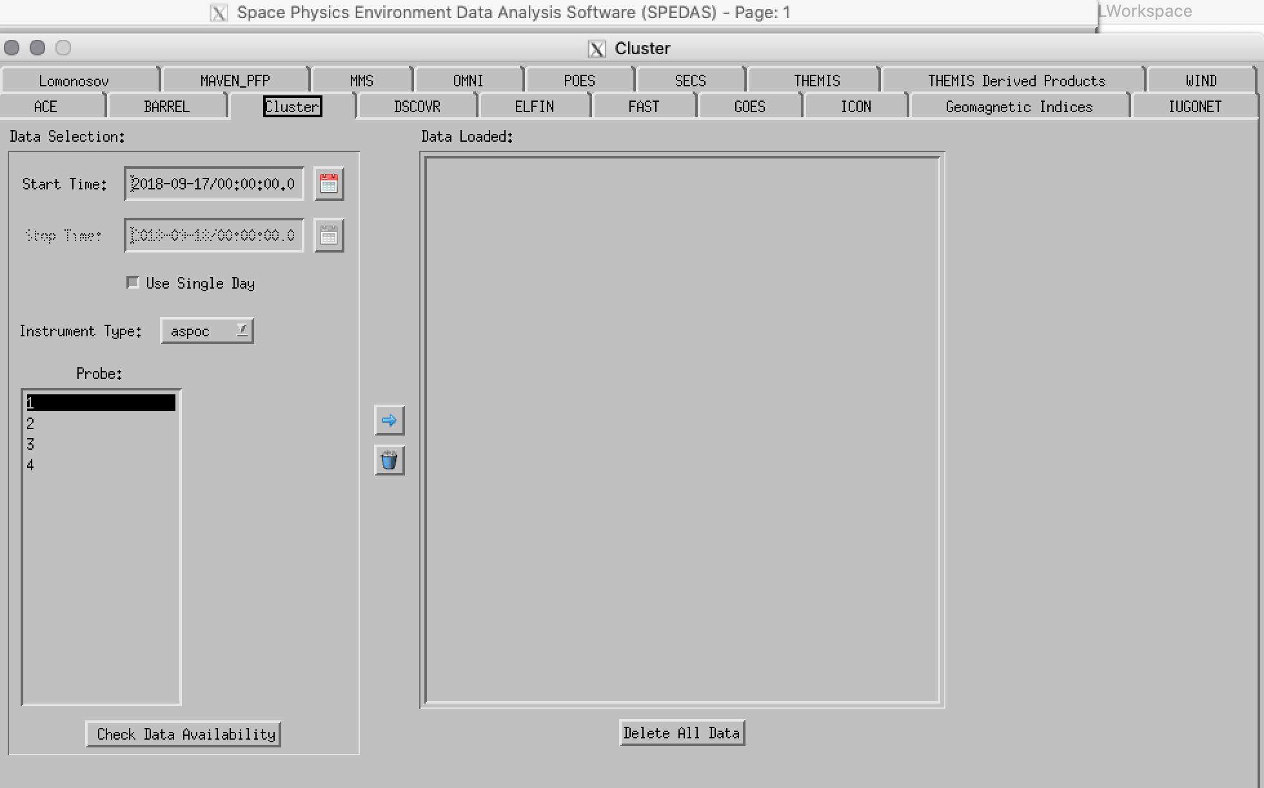
UCLA SPEDAS now connects to ESA TAP server
Cluster data is accessible in SPEDAS, the US multi-missions data analysis software for solar wind, magnetospheric and ionospheric plasma physics
As SPEDAS is able to connect to Table Access Protocol servers

Slide 15
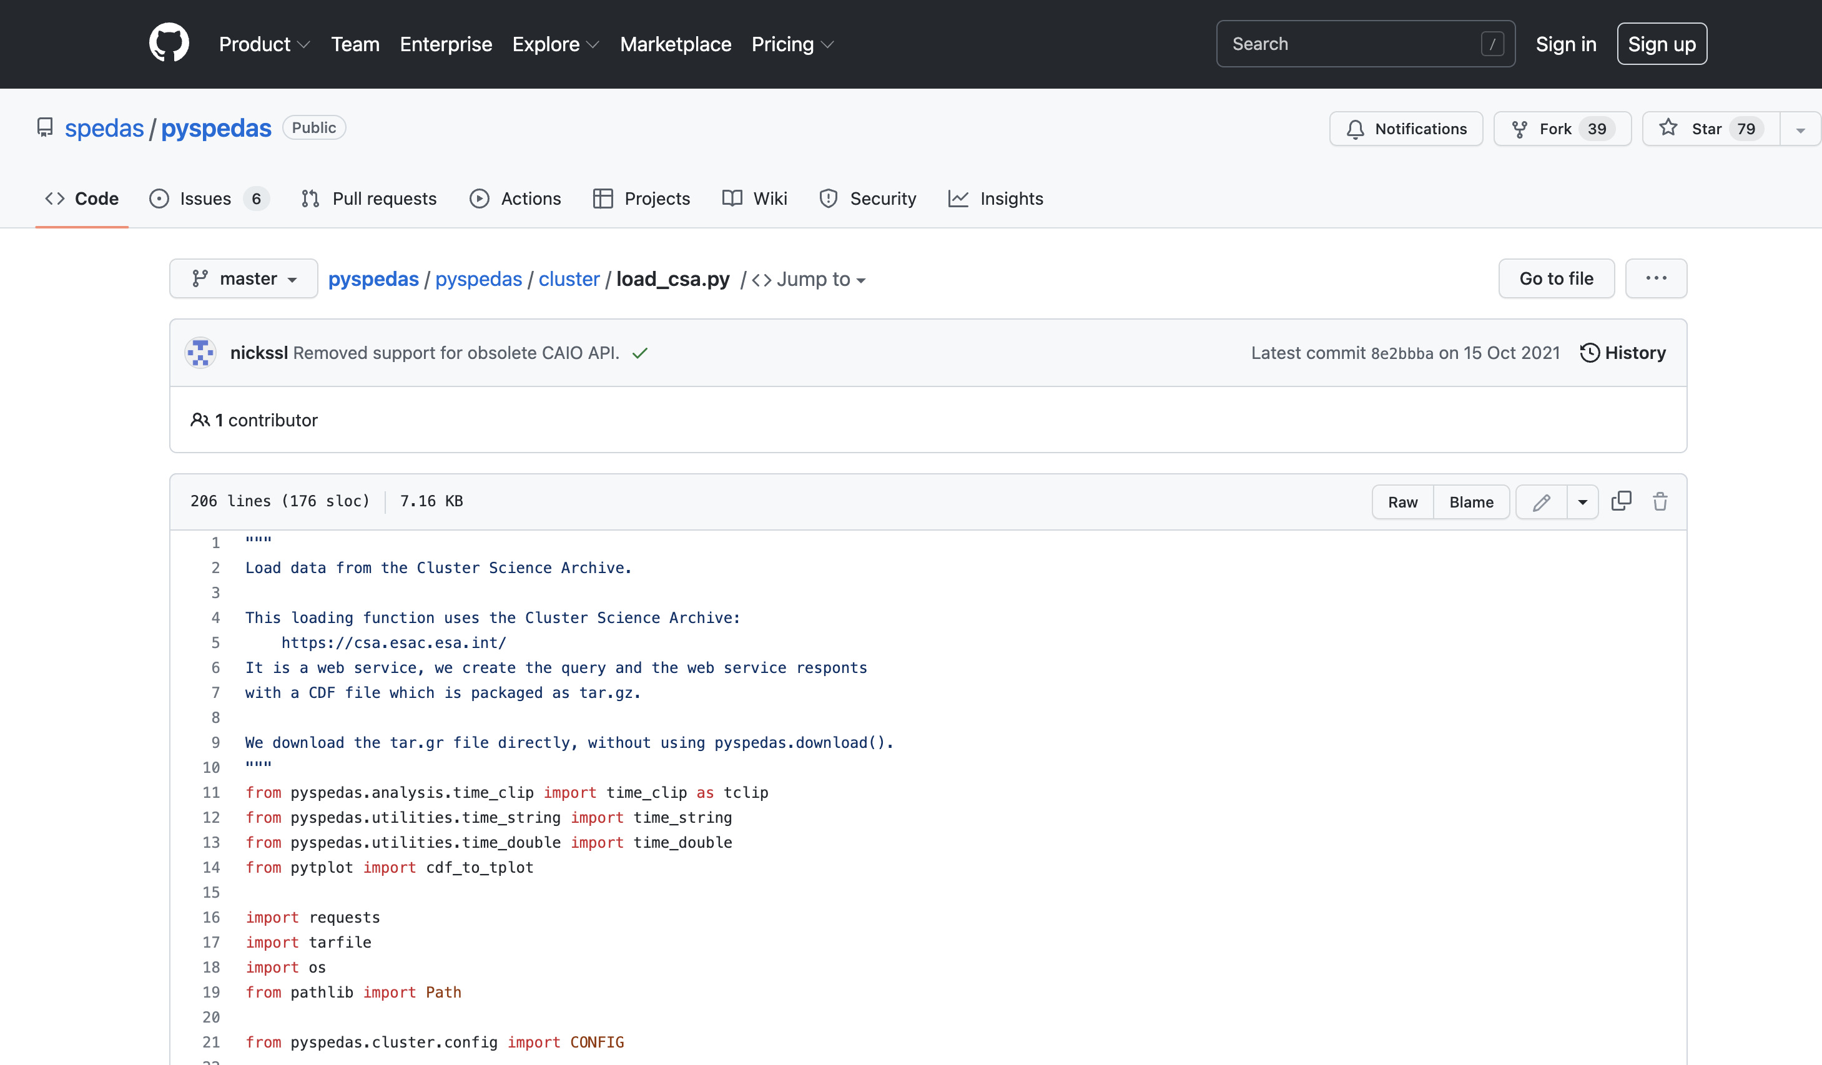
Cluster Science Archive (CSA) accessible through pySPEDAS
Cluster data are also accessible through pySPEDAS

Slide 16
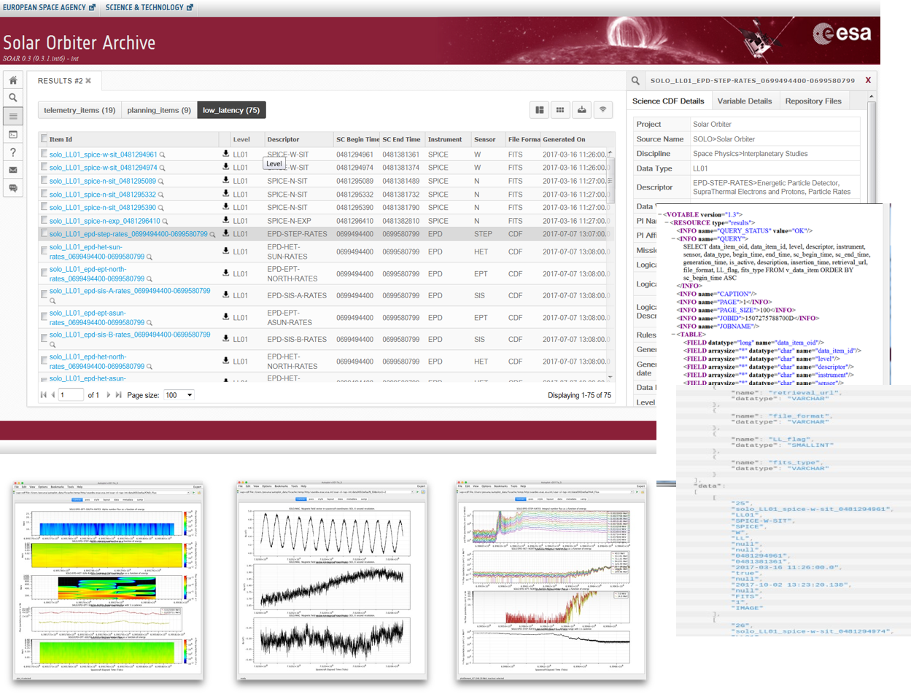
Solar Orbiter: SunPy
https://soar.esac.esa.int/
Solar Orbiter data are accessible through Sunpy (dedicated SOAR module https://github.com/sunpy/sunpy-soar), helio team at ESA in direct contact with the SunPy team
New functionalities like search by solar distance implemented in the Solar Orbiter Archive (SOAR) is available in SunPy
Access to FoV tables for the Solar Orbiter telescopes with FoVs (EUI HRI, PHI HRT and SPICE) are being implemented in SunPy
FoV: Field of View
Sharing Solar Orbiter CDF data with Autoplot (courtesy of J. Cook)

Slide 17
I. IHDEA
Example 4: HEK

Slide 18
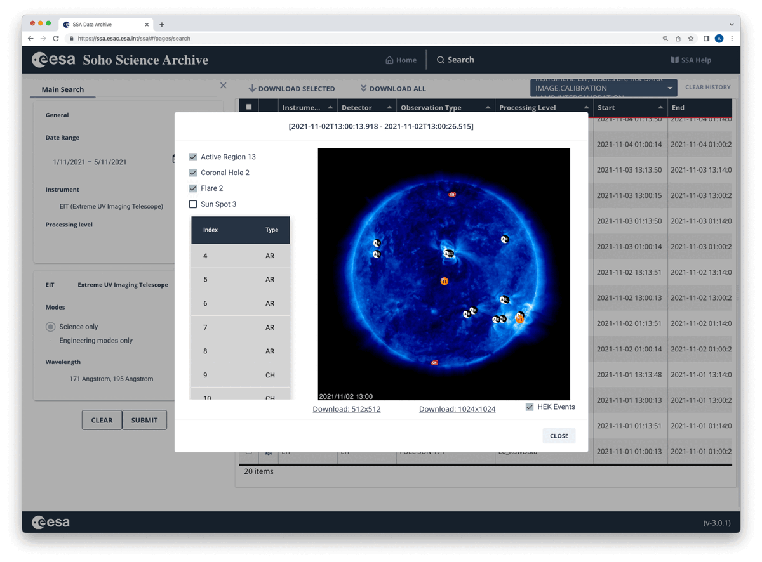
Connection to HEK database
ESA SOHO archive
https://ssa.esac.esa.int
Filtering of the data (e.g., work with PI to tag the engineering modes)
Connection to the HEK database
TAP server as RestAPI
No credentials needed

Slide 19
I. IHDEA
Example 5: science platforms coordination

Slide 20
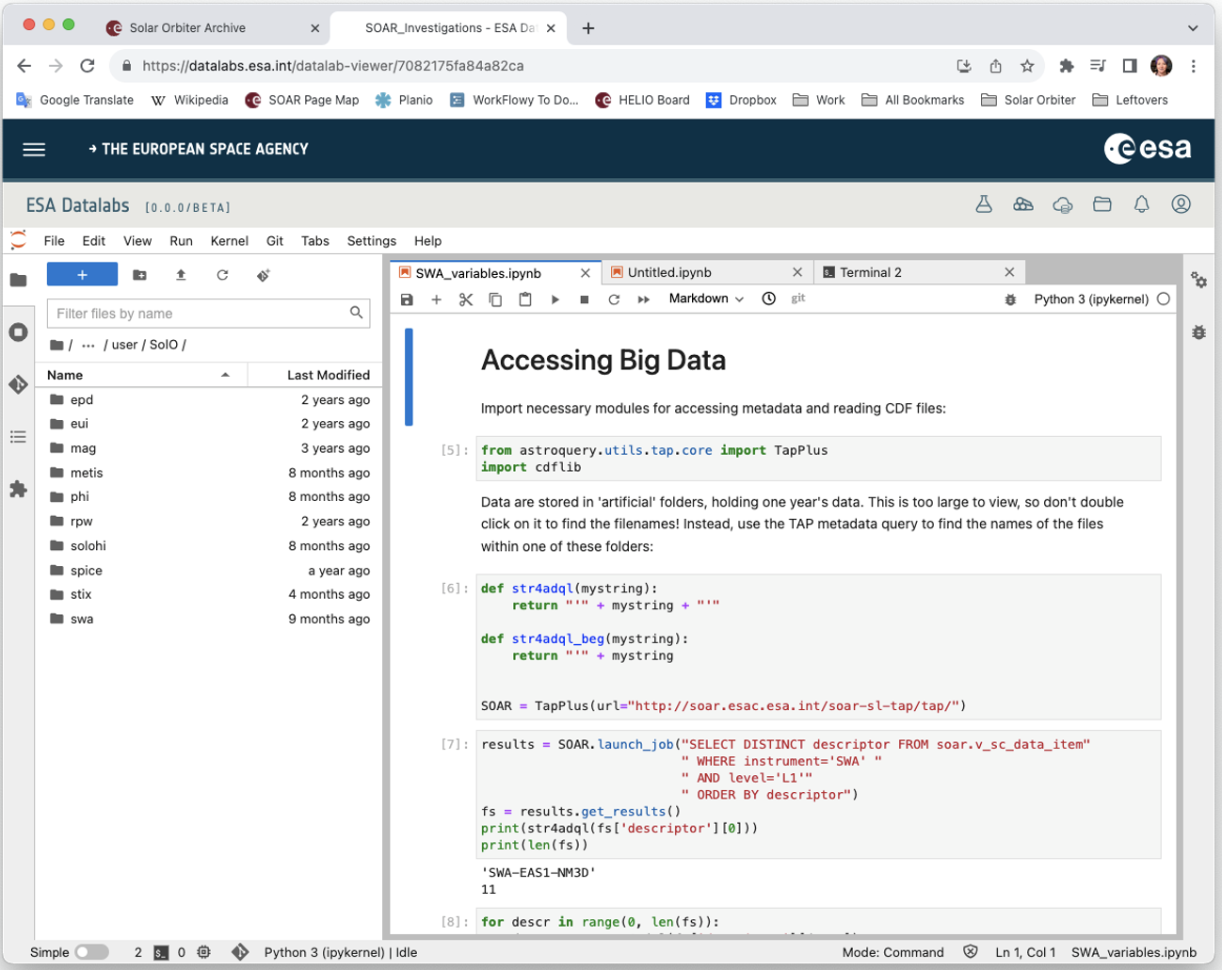
Recent IHDEA activities
Science Platforms
- ESA DataLabs (coming soon)
- NASA HelioCloud (coming soon)
- JAIRO research data cloud
- European Open Science Cloud (EOSC)
- VIRES
IHDEA working group on science platforms
Workshop on heliophysics science platforms in July 2023, organized by Observatoire de Pari
October 2023: agreement at IHDEA level to share stack of interoperable (PyHC) Python packages, a key problem with multiple Python packages.

Slide 21
I. International Heliophysics Data Environment Alliance
Not only an annual meeting
2019: IHDEA formally created (Charter/Bylaws)
meeting organised by NASA
2020: setup of WGs, organised by Obs. Paris
2021: annual IHDEA meeting, organised by ESA
  WMO/GNSS experts invited
2022: annual IHDEA meeting, organised by JAXA
2023: annual IHDEA Oct. meeting @ APL, USA
participation of DKIST and MADRIGAL
2024: annual IHDEA meeting @ ESAC/ESA
End of 2024: application of ISRO, KASI and NOAA
https://ihdea.net

Slide 22
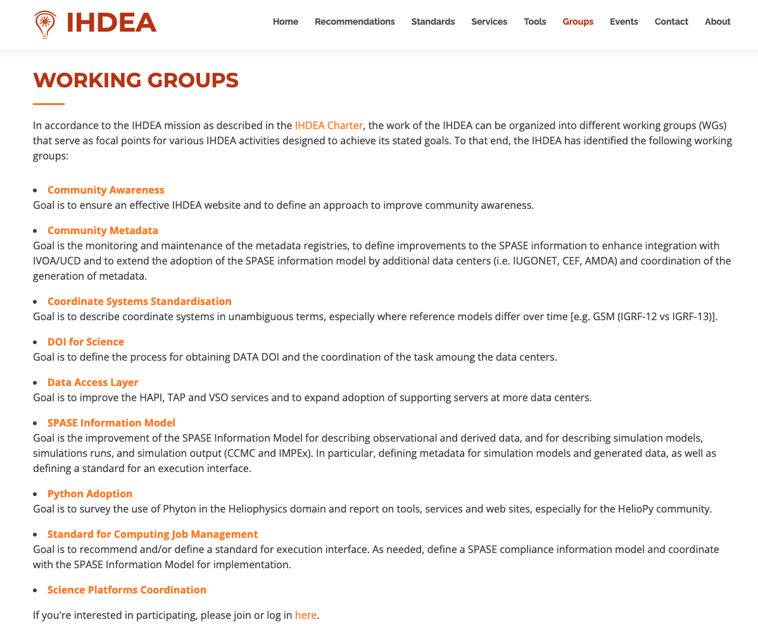
I. International Heliophysics Data Environment Alliance
2019: IHDEA formally created (Charter/Bylaws)
meeting organised by NASA
2020: setup of WGs, organised by Obs. Paris
2021: annual IHDEA meeting, organised by ESA
  WMO/GNSS experts invited
2022: annual IHDEA meeting, organised by JAXA
2023: annual IHDEA Oct. meeting @ APL, USA
participation of DKIST and MADRIGAL
2024: annual IHDEA meeting @ ESAC/ESA
End of 2024: application of ISRO, KASI and NOAA
https://ihdea.net

Slide 23
II. DASH: Data, Analysis, and Software in Heliophysics
Forum for software developers and scientists to share experiences - fairly short presentations to facilitate open discussion (3 days long)
  Community focused – very nice environment – to give a chance to talk/work with ‘external’ colleagues
  Similar to ADASS (Astronomical Data Analysis Software & Systems)
  1st DASH organised together with IHDEA in 2023 at APL, this year at ESAC
Keynotes
  DASH actual and future challenges (C. Arviset, ESA)
  Virtual Space Weather Modelling Center software architecture challenges (C. Verbeke, KU Leuven)
  Challenges and triumphs of end-to-end data systems in support of auroral science (E. Spanswick, UoC)

Slide 24
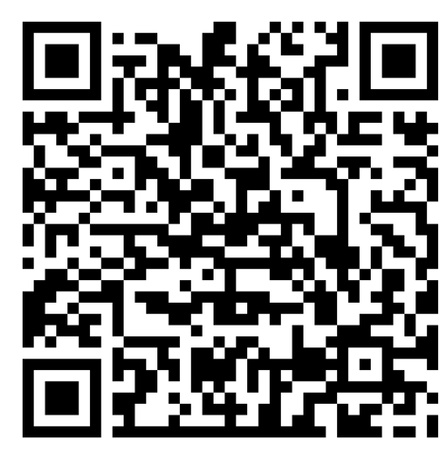
II. DASH: Data, Analysis, and Software in Heliophysics
8 sessions to
Share experience on Mission-specific data pipelines
Report progress or present new Data analysis tools
Multi-mission data analysis tools
Data analysis software for non-programmer scientists
Modern technologies in heliophysics: AI and supercomputing
Actual challenges regarding heliophysics simulations
Interconnected simulation services
Open validation in Heliophysics and space weather modelling
Software discovery in the era of Open Science
General session
https://www.cosmos.esa.int/web/ihdea/

Slide 25
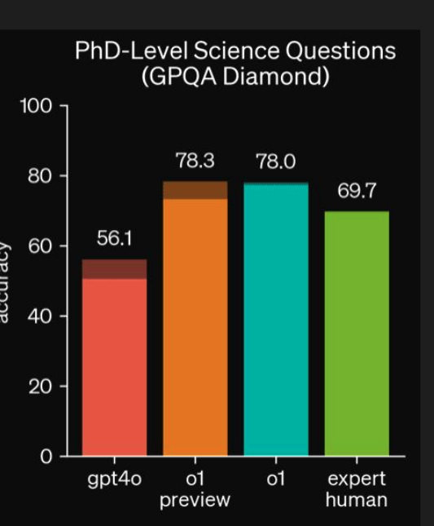
II. DASH: Data, Analysis, and Software in Heliophysics
Modern technologies in heliophysics: AI and supercomputing
  PyHC-Chat – a Chatbot for Python in Heliophysics Community called PyHC
  (ecosystem of 70+ affiliated helio python libraries)
    Explore and ask questions about the PyHC core packages using OpenAI's GPT-4 language model with accurate up to date answers
    Can be used to analyse code
    September 2024 - OpenAI o1 – advanced reasoning
        https://github.com/sapols/PyHC-Chat
        courtesy of Jon Cook, Starion for ESA
How do I download data related to a SOOP?
Show me a snippet of python please to do…

Slide 26
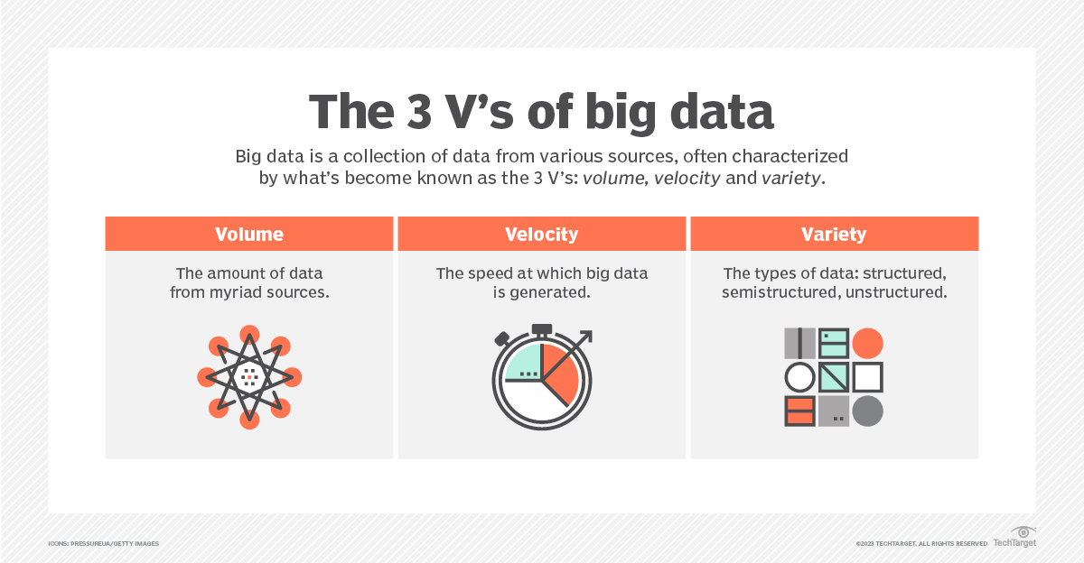
II. DASH: Data, Analysis, and Software in Heliophysics
Importance of data tiering for large volume:
The movement of data between different storage tiers/types based on the type of data and access frequency
Hot data
  Critical and frequently accessed
Cold data
  Inactive data infrequently accessed
Could be important for data storage, especially if (part of the) storage on the cloud is consideredcosts
        courtesy of Jon Cook, Starion for ESA

Slide 27
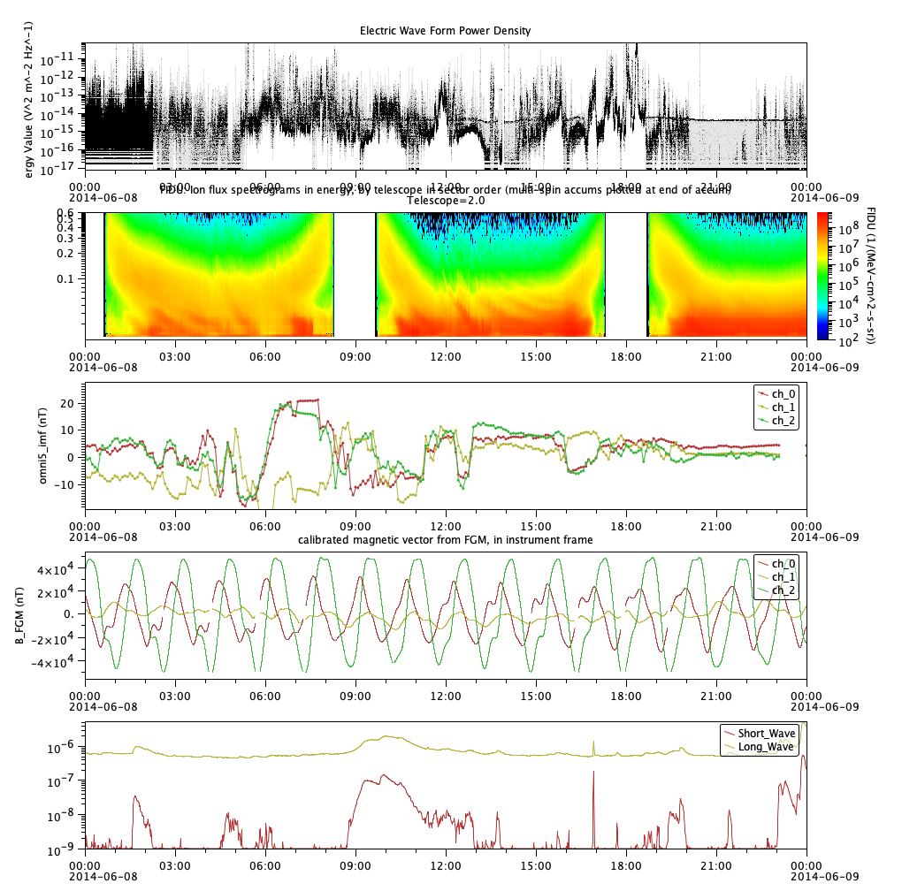

Heliophysics API for time series data
CDAWeb
HAPI
Custom
API
analysis code
Madrigal
HAPI
Custom
common wrangling code
If there is a common access mechanism,
much less wrangling code is needed.
Cluster
HAPI
Custom
The overall, long-term goal of HAPI: enabling common, universal, low-level access to all time series data
VirES / SWARM
HAPI
Custom
Courtersy of J. Vandegriff (JHU/APL)

Slide 28
II. DASH: Data, Analysis, and Software in Heliophysics
The Heliophysics Application Programming Interface (HAPI) is a community specification for a unified interface for accessing data time-series.
When data are available from a HAPI server, there is no need to download data files and write custom file reader programs. Using a HAPI client library, data can be loaded into an array using a single command in IDL, Javascript, MATLAB, and Python.
HAPI servers
CNES/CNRS: AMDA
ESA: Cluster Science Archive, Space Weather Network, ViRES
NASA: CCMC, CDAWeb, SSCWeb
KNMI: space weather service
Others: DAS2, INTERMAGNET, LISIRD
“IVOA may adopt/recommend HAPI for time-series data in the VO”
Data analysis software: Topcat, Autoplot, SPEDAS

Slide 29
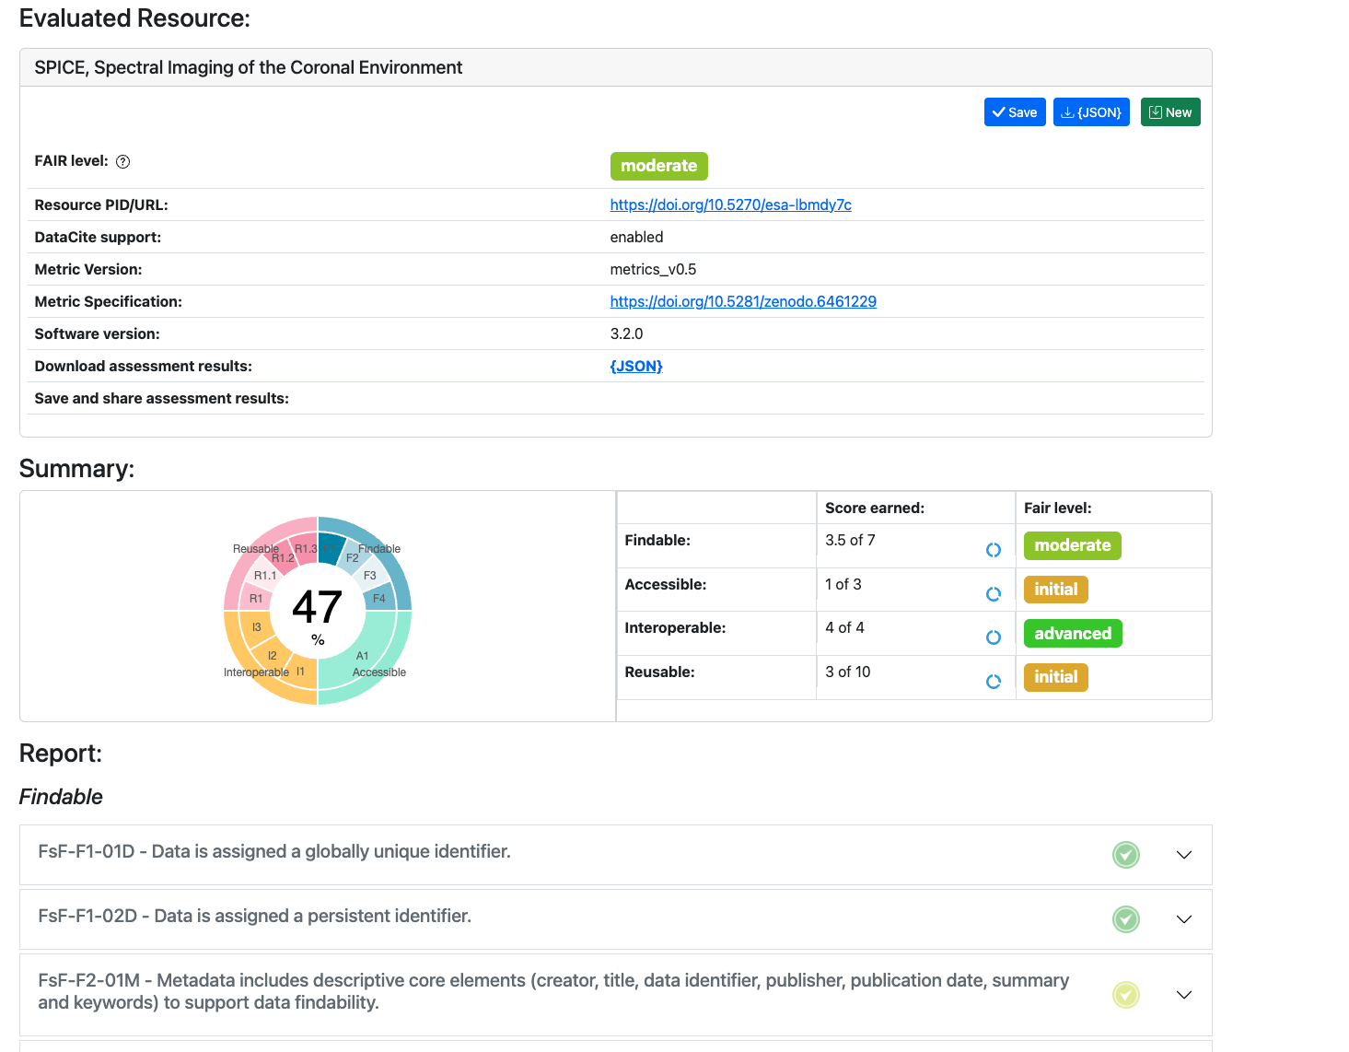
II. DASH: Data, Analysis, and Software in Heliophysics
Open science / Findable Accessible Interoperable Reusable (FAIR)
  https://www.fairsfair.eu/ - Fair data practices in Europe
F-UJI is a web service to programmatically assess FAIRness
  https://www.f-uji.net/
Cookbook and other tools:
  https://faircookbook.elixir-europe.org/content/home.html
  https://fair-checker.france-bioinformatique.fr/check
        courtesy of Jon Cook, Starion for ESA

Slide 30
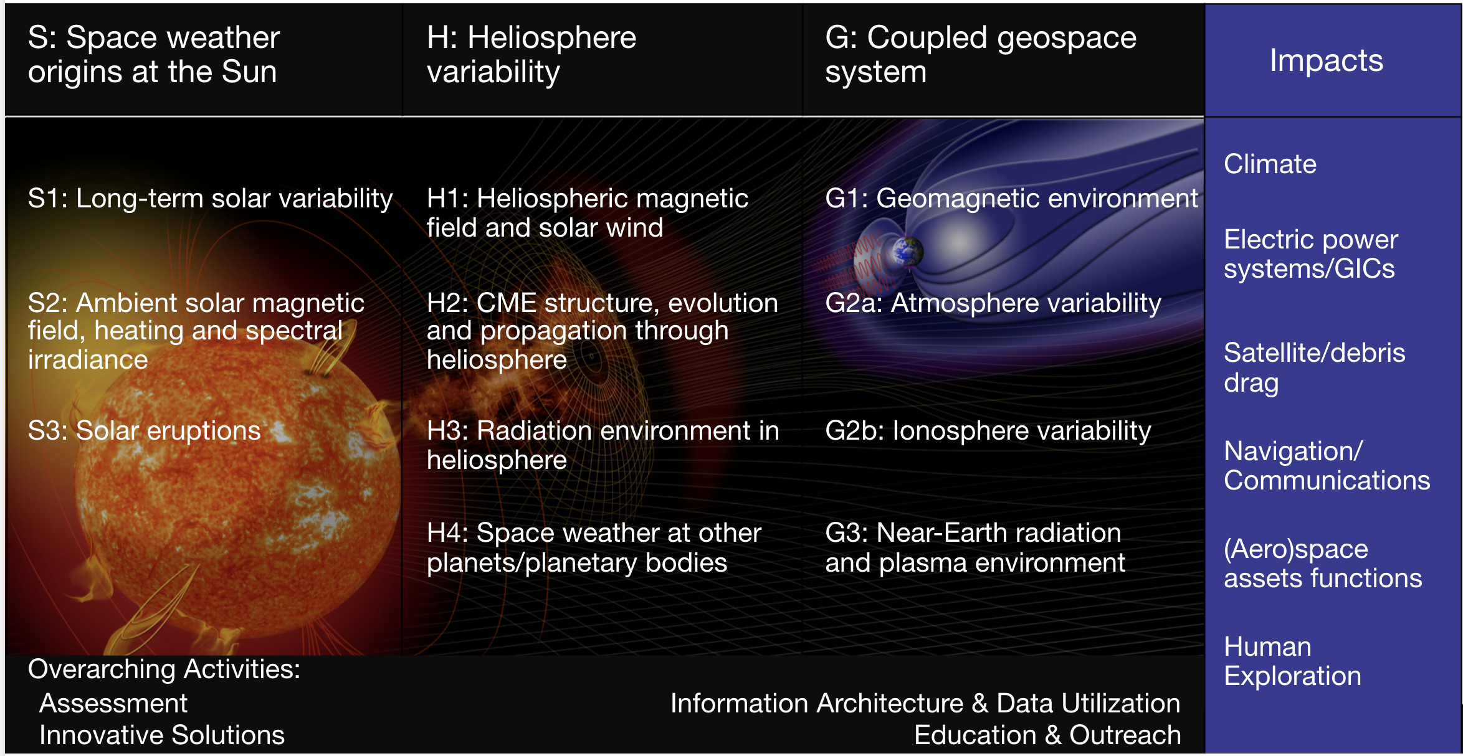
III. COSPAR International Space Weather Action Teams (ISWAT)
A roadmap on space weather for 2015-2025 was published by Schrijver et al. (Adv. Space Res., 2015).
This roadmap was commissioned by COSPAR and the ILWS.
In 2018, the COSPAR International Space Weather Action Teams (ISWAT) initiated community-wide efforts to join forces, in order to advance space weather predictive capabilities, for a better science understanding from source to impact.
ISWAT brings together space scientists (domain experts), computer scientists, software engineers, and experts in space environment impacts.

Slide 31
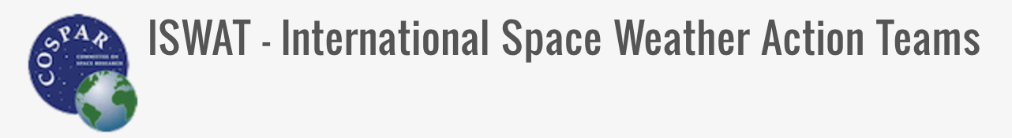
III. International Space Weather Action Teams (ISWAT)
Inaugural meeting in 2020, now 500+ scientists
Release New international space weather roadmap is expeted in 2025.
Note the overarching groups.
https://www.iswat-cospar.org/

Slide 32
2. Information architecture and Innovative solutions: outcome
Information Architecture and Data Utilization (moderators: A. Masson, ESA and S. Fung, NASA)
Outcome of ISWAT: two special issues in Adv. Space Res.
Issue 1, refereed technical papers on Science Res. and Applications (published in 2023)
Issue 2, refereed overarching papers on the Achievements and Future goals (published in 2024)
Issue 1: 6 technical papers
Metadata as key building block to facilitate data science (Fung et al., 2023)
Python in Heliophysics community (Barnum et al., 2022)
First executable paper in Heliophysics (Polson et al., 2022)
Innovative forward looking information architecture (Ringuette et al., 2022c, 2022d)
NASA CCMC Kamodo tool (Ringuette et al., 2023)
  + NASA tech report published in 2021 on PyHC integration strategy workshop report
Issue 2: Overarching paper on information architecture and innovative solutions (Masson et al., 2024)
Notes:
So what is the outcome of ISWAT in terms of publications? Two special issues in the COSPAR journal Advances in Space Research. The first issue is composed of tens of

Slide 33
2. Information architecture: a few recommendations
Issue 2: Overarching paper on information architecture and innovative solutions (Masson et al., 2024)
Information architecture Key buidling blocks (metadata model, data formats, data access protocols, DOI)
Open science tools and infrastructures (collaborative science platforms, simulations services)
Innovative solutions
O2+O3: Information Architecture and innovative solutions
O2: Information Architecture and Data Utilization
Information architecture component | Recommendations | Impacts
SPASE metadata model | Evolve the data model to cover more aspects of the heliophysics community | Better description of simulation, remote sensing and ground-based data
SPASE metadata model | Work in concert with all international partners developing metadata model in relation with heliophysics (e.g., WMO) | Ensures interoperability with other metadata models. Take advantage of experience of terrestrial weather community
Data access protocols | Encourage the adoption of the Heliophysics API | Improves the findability of time series data
Data access protocols | Encourage the adoption of the EPN-TAP protocol | Improves the discoverability of heliophysics data through the Virtual European Solar and Planetary Access (VESPA)
https://doi.org/10.1016/j.asr.2024.05.052

Slide 34
2. Information architecture: a few (more) recommendations
Issue 2: Overarching paper on information architecture and innovative solutions (Masson et al., under review, 2023)
Information architecture Key buidling blocks (metadata model, data formats, data access protocols, DOI)
Open science tools and infrastructures (collaborative science platforms, simulations services)
Innovative solutions
O2+O3: Information Architecture and innovative solutions
O2: Information Architecture and Data Utilization
Information architecture component | Recommendations | Impacts
PyHC | Continue to aggregate all Python open source packages developed by the heliophysics community on the PyHC website | Improve findability of Python packages
PyHC | Provide a stack of compatible heliophysics Python packages for implementation at collaborative science platforms | Facilitate ease of utilization of heliophysics Python packages
Simulation community | Continue expanding and modernizing web-based simulation services. Facilitate rapid implementation of the most advanced modeling capabilities. Explore opportunities to interconnect simulation services provided by different centers (e.g., CCMC and VSWMC). | Enable open utilization of state-of-the-art modeling capabilities by a broader heliophysics community (including non-experts in modeling). Maximize return on investments into model development programs.

Slide 35
2. Innovative solutions: recommendations
O2+O3: Information Architecture and innovative solutions
Information architecture component | Recommendations | Impacts
Machine Learning (ML) and GPU computing | Promote ML challenges, hackathons and summer schools in the heliophysics and space weather communities | Lower the barrier to embrace ML methods
ML ready datasets | Encourage the development of shared ML ready datasets, including the data processing source code | To compare the accuracy of various ML models and reproducibility
O2: Information Architecture and Data Utilization

Slide 36
3. What’s next?
O2: Information Architecture and Data Utilization
In July 2022, the United Nations Office for Outer Space Affairs (UNOOSA) approved unanimously a recommendation inviting WMO-COSPAR-ISES (International Space Environment Service) to lead efforts to improve the global coordination of space weather activities in consultation and collaboration with other relevant actors and international organizations.
WMO-COSPAR-ISES, together, have responded positively to this request (Coimbra declaration Oct. 2022)
An International Space Weather Coordination Forum organised in November 2023 at the WMO
Working groups to be setup by WMO-COSPAR-ISES as a follow up of this forum.
Notes:
OOct.

