Slide 1
Observing Strategies and Constraints
Marco Sirianni
European Space Agency
JWST Info Day – INAF 17 March 2017

Slide 2
Introduction
JWST is very different from HST
It has been designed to be be operated in a more autonomous way
It’s instruments are more complex (more powerful and versatile)
Mosaic
Parallels
Dithering
Template
Visit
ETC
APT
Event Driven
Orient
Visibility

Slide 3
JWST is an event driven observatory
Scheduling is done uploading a queue of activities to be executed sequentially
Event driven commanding allows autonomous operations for 7-10 days
From the list of activities, the on-board computer issues commands in real time to FSW
Telemetry will tell if a command has been completed and allows to start the next one
Automatic response to real time error by skipping affected observations

Slide 4
Program, Observation and Visit
Program [P-1]
Program: one or more observations
Observation: realization of an
Astronomer Proposal Tool APT
template
Visit: single element of an observation
that can be executed with one single
guide star acquisition
(max duration 24hr)
Observation [O-1]
Observation
[O-2]
VISIT [V-1]
VISIT [V-2]
VISIT [V-1]
VISIT [V-2]
VISIT [V-3]
APT
The scheduling system creates a sequence of visits to be executed
[P1/O2/V2, P3/O1/V1, P2/O1/V2…..]

Slide 5
Observing Templates
JWST uses pre-defined observation templates for each supported observing mode (see also APT talk)
Once the user select a specific instruments he/she can work with a specific set of templates

Slide 6
Observing Templates - II

Slide 7
Observing Templates -III
Within a template the user can select
Instrument configuration (Filters, Grating)
Detector configuration (readout patter, number of exposures, exposure settings)
Dither patterns
Target acquisition parameters (if applicable)
The template approach reduces some of the flexibility from the user point of view but allows a more simplified handling of the autonomous operations of the observatory
Templates can and will be updated between cycles

Slide 8
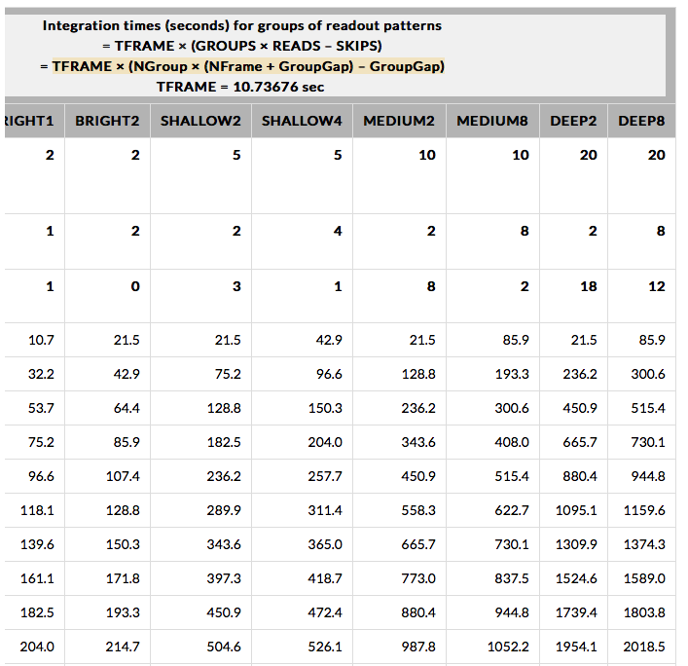
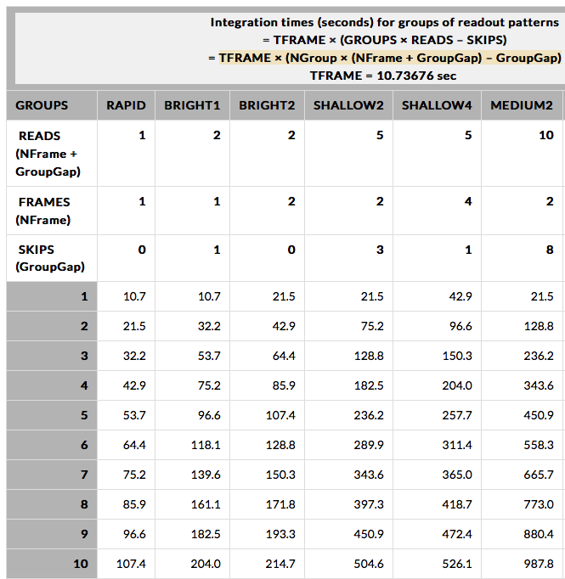
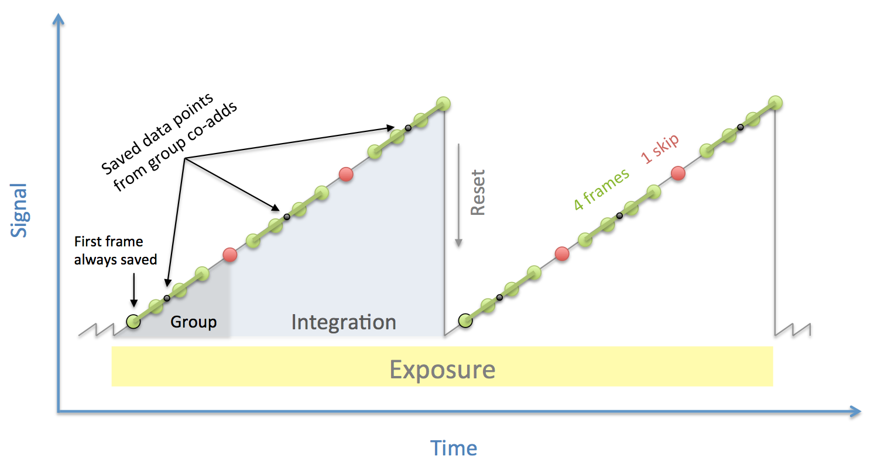
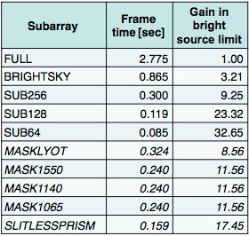
Many possible readout patterns
Each instrument team has defined several different optimal detector readout patterns. Some of them strive to find a balance between maximum S/N and bandwidth limitation by averaging on board multiple reads.
To increase the dynamic range many different subarrays are also defined

Slide 9
Dithering –I
Dithering is now a standard and recommended practice
It allows to:
mitigate detector defects (low frequency flat field error, clusters of bad pixels)
bridge gaps between detectors (for imaging and spectral coverage)
mitigate persistence for bright objects in the field of view
improve spatial sampling
improve spectral sampling
Primary Dither
Sub-Pixel
Dither

Slide 10
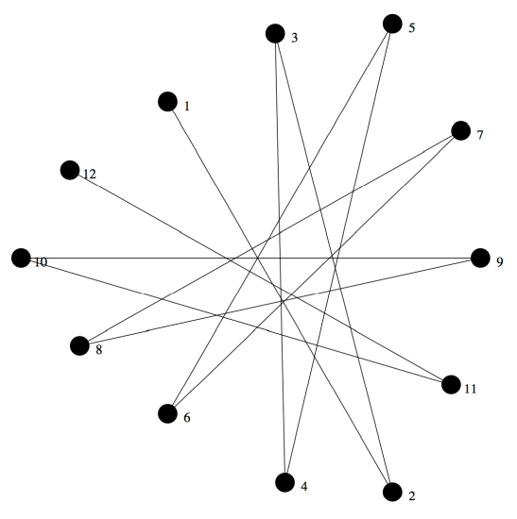
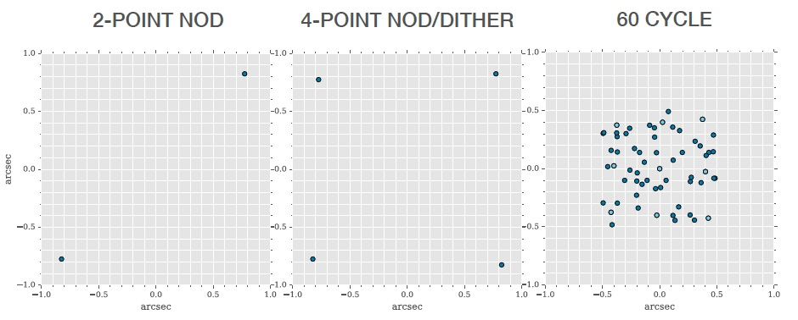
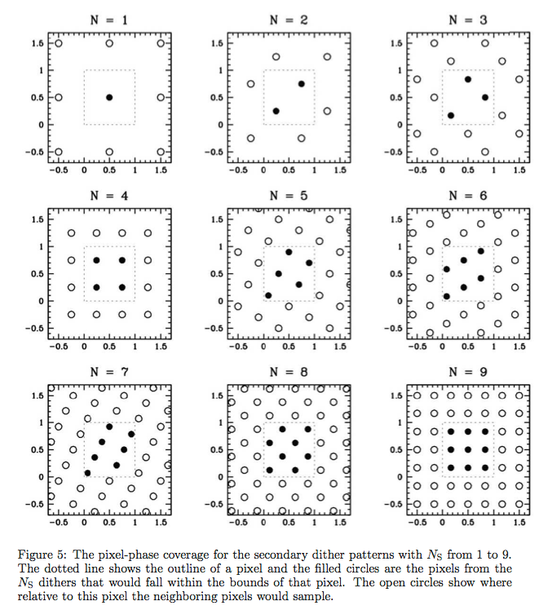
Dithering - II
For all instruments, each observing mode template offers different dithering options for primary and secondary dithers
The Instrument teams are
still working on the dither
pattern definition
and optimization in preparation
for cycle 1 Call.

Slide 11
MOSAICS
Mosaics can be designed directly in APT
At each tile the instrument and exposure configurations are the same
Particular attention should be put in designing mosaics:
APT may divide an observation in multiple visits (example if the distance of the tiles is of greater than 30-60”)
Each visit requires a new target acquisition (~ 10 min overhead)
Depending on the size of the mosaic (number of tiles) and their overlap, it is possible to optimize the visit breakdown so more than one tile is acquired in a single visit

Slide 12
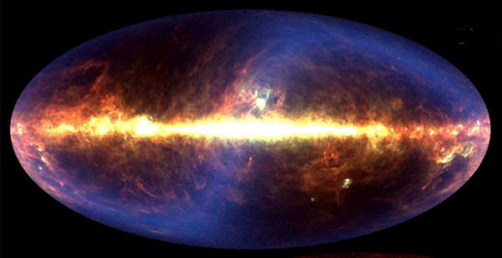
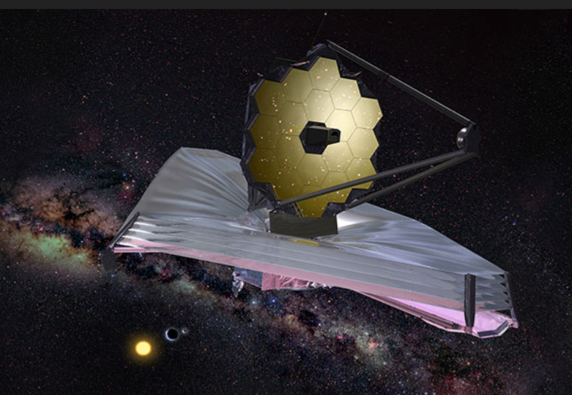
JWST Background sources
NIRISS
NIRSpec
NIRCam
MIRI
0.5
5
10
15
20
25
30 μm
Zodiacal and
Galactic background
Stray light
Thermal Emission
Detector Noise

Slide 13
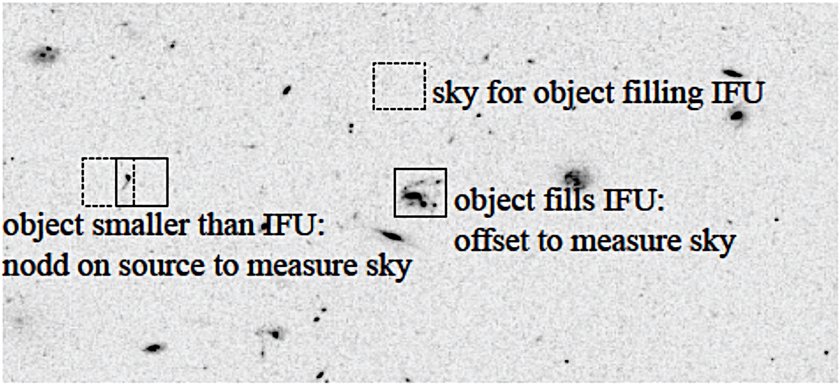
Background -II
All the background sources have been modeled in the ETC
Specific observing strategies (dithers, and “nods”) will help removing the background.
Different techniques are available in each template
Observers should plan to acquire background data in all different epochs of their observations.
Dedicated exposures are used by the pipeline for background subtraction

Slide 14
Parallel Observations
JWST was originally conceived as a “prime-only” observatory
parallel observations were envisaged only for internal calibration
In order to maximize the efficiency of the observatory and the scientific return of the mission parallel science observations have been added to the plan (late)
Some capabilities will be available already in cycle 1, more in the following cycles

Slide 15
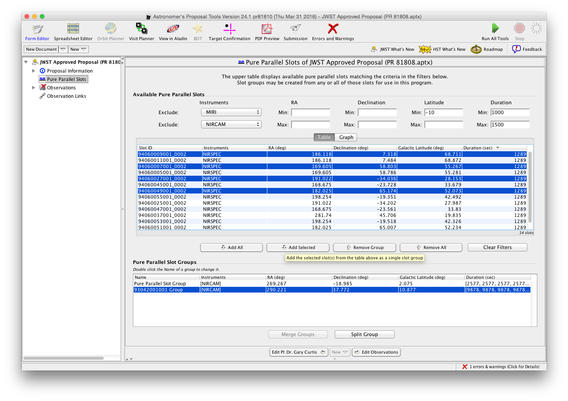
Pure Parallels
Pure parallels are matches against observations from multiple approved programs (i.e. Post TAC)
Pure parallels cannot impact the
observing scheme of the prime
observation (are therefore much
more limited and less optimized
than coordinated parallels)
Zero proprietary time

Slide 16
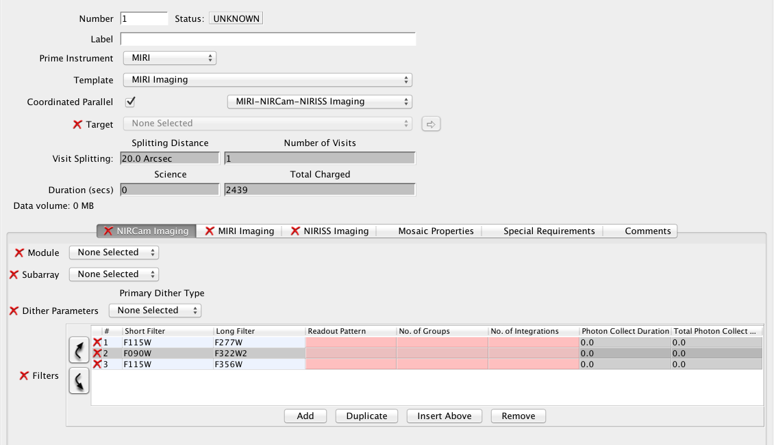
Coordinated parallels
One single proposal (via APT with dedicated templates)
All observations contribute to a single coherent science program
Dedicated APT templates will allow
optimization of the observing
scheme (dithers, filter changes, etc.)
For cycle 1 only 2 SIs in parallel

Slide 17
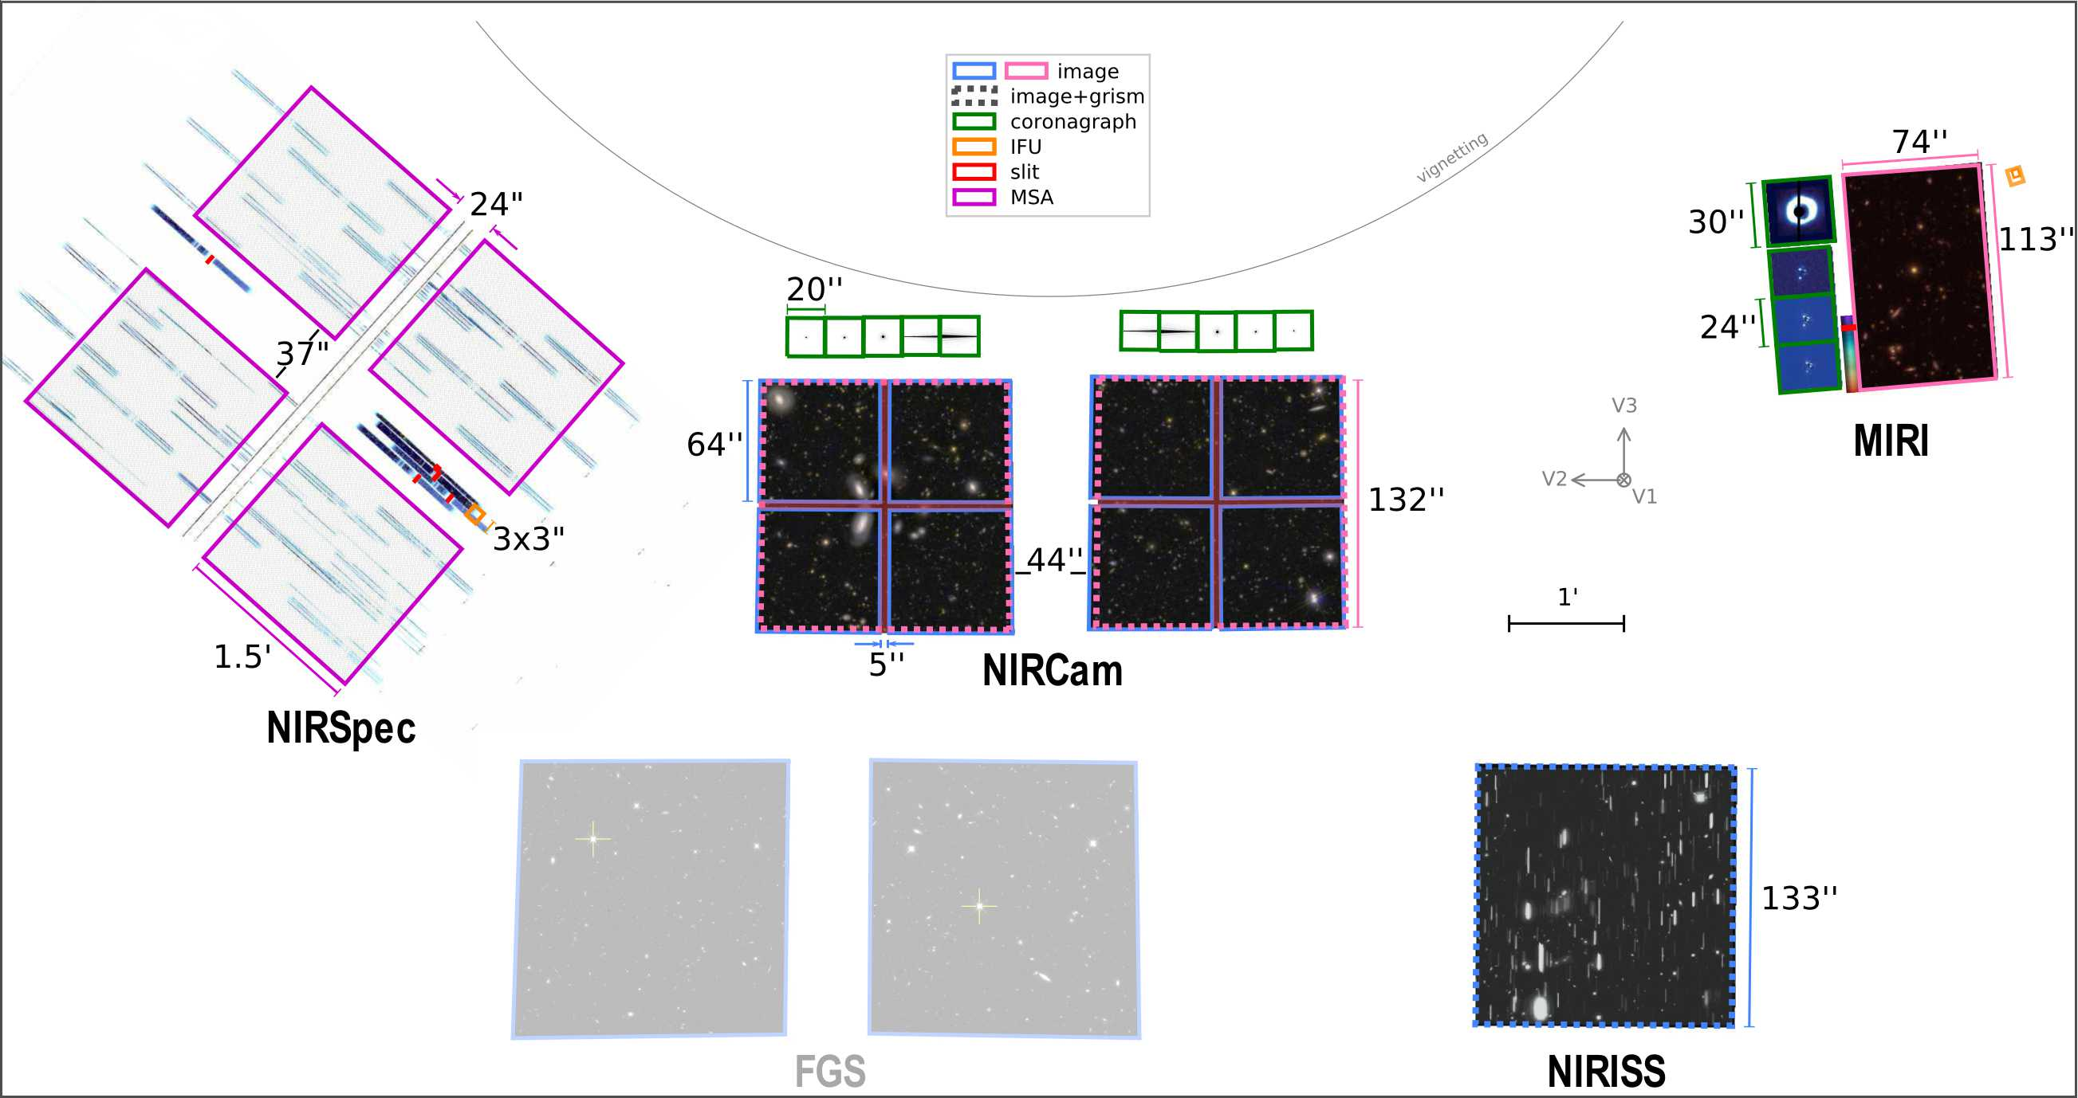
Available coordinated parallels in cycle 1
NIRCam Imaging + MIRI Imaging
NIRCam Imaging + NIRISS slitless spectroscopy
MIRI Imaging + NIRISS slitless spectroscopy
NIRSpec MOS + NIRCam Imaging
NIRCam Imaging + NIRISS Imaging
Not all parallel APT Templates
are yet available

Slide 18
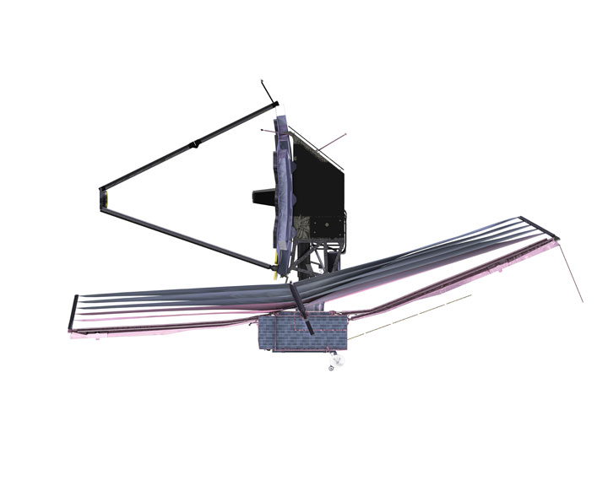
Attitude Constrain
In order to maintain the telescope in the shade of the sunshield the relative attitude of JWST vs. Sun is limited between 85 and 135 degrees and the roll around the OTE line of sight is limited to ± 5 degrees
50º
OTE line of sight
± 5^{O}
360º
135º
85º

Slide 19
JWST Field of Regard
North Ecliptic Pole
North
Continuing Viewing Zone
At any given time field of regard (FOR)
covers about 45% of the sky (vs. 80% of HST)
5º
45º
As JWST orbits the sun the FOR moves across the sky ➔limitation on when a target is visible and for how long
360º
South
Continuing Viewing Zone

Slide 20
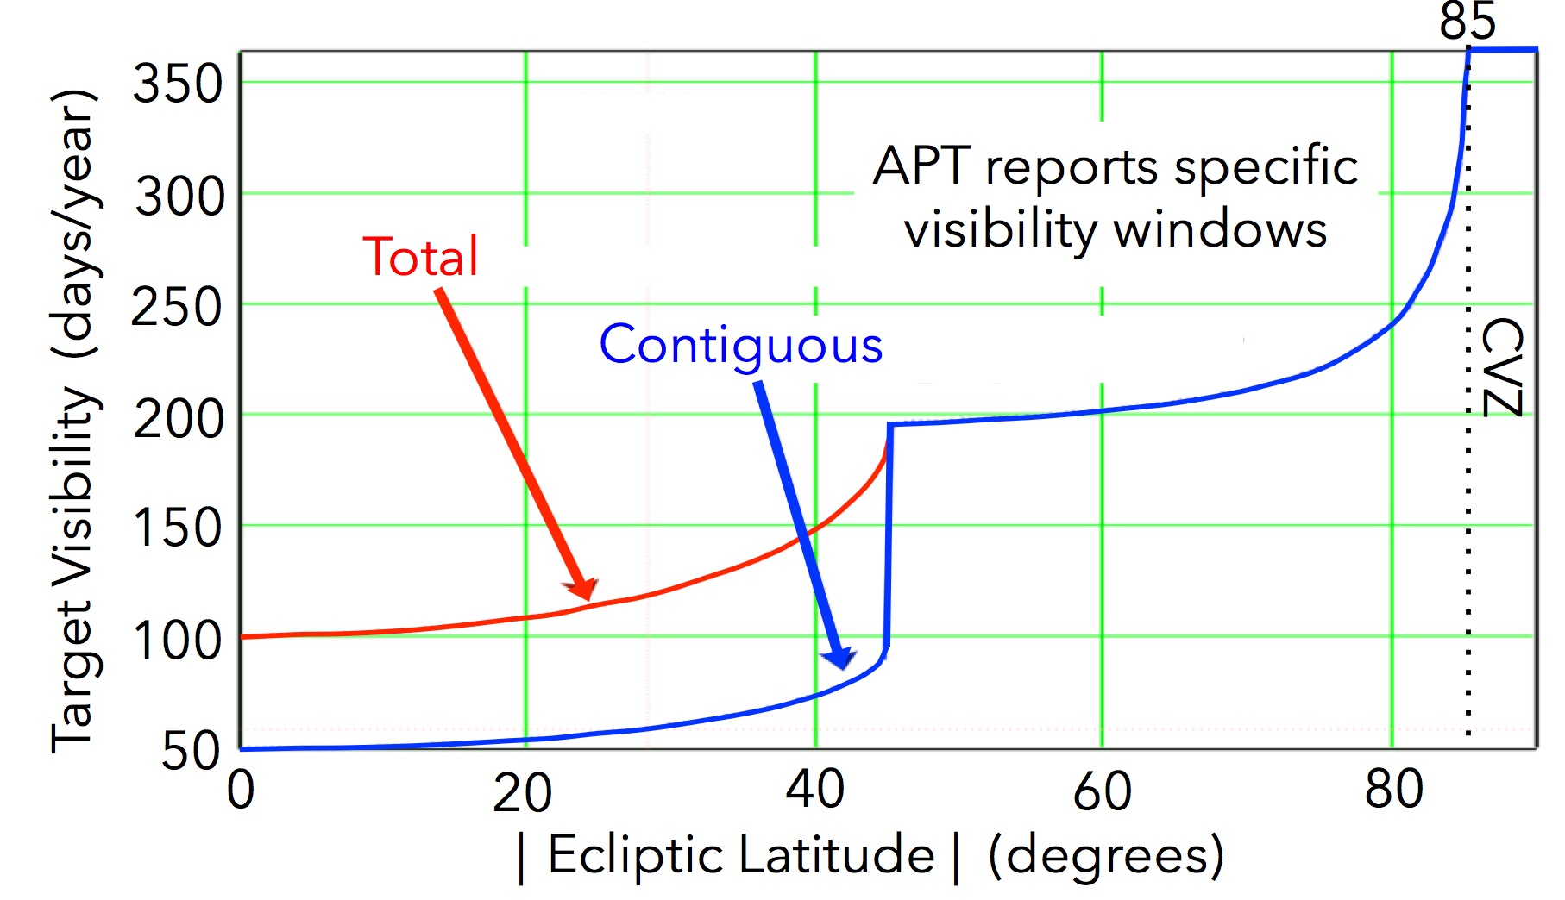
Target Visibility per year
Targets within 5º of the ecliptic poles are always visible
Targets near to the ecliptic poles (45-85º) are visible for over half a year
Targets close to the ecliptic plane (<45º) have visibility of ~53 days every six month visible (with 180º delta roll)

Slide 21
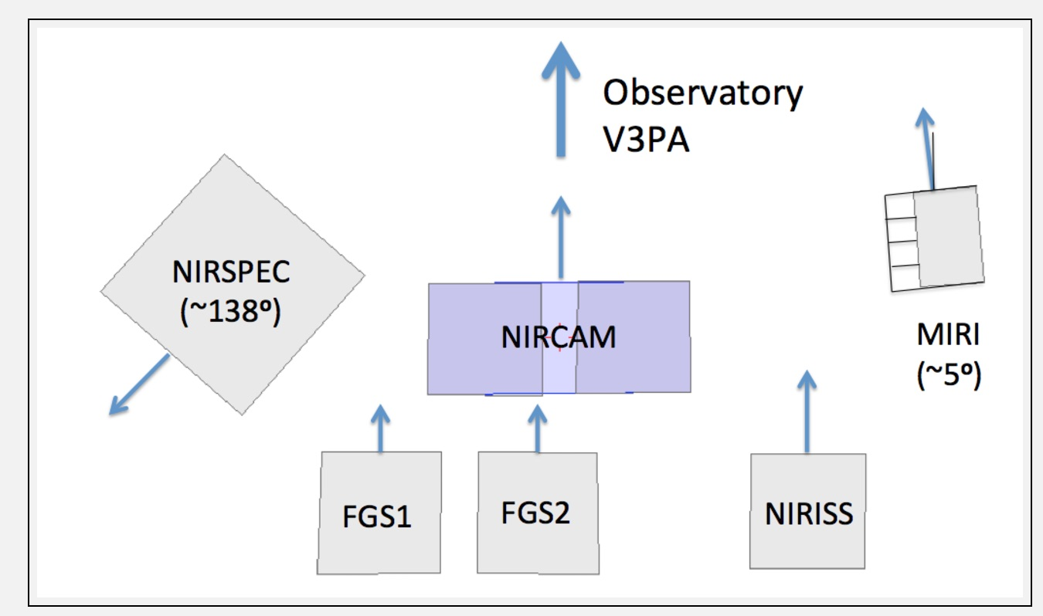
Aperture Position Angle
Sometimes a specific orientation for the instrument Field of view is needed /desired (e.g. Coronagraphy, NIRSpec MOS, Imaging Mosaic )
Not all instruments have their reference y axis aligned with the observatory V3 axis
It is important to know what is the available PA for a specific aperture t as a function of time
a) Specifying strict PA requirements could make the observation un-schedulable
b) User should be careful when linking different observations with the “Same PA as” since different Instruments have different PAs

Slide 22
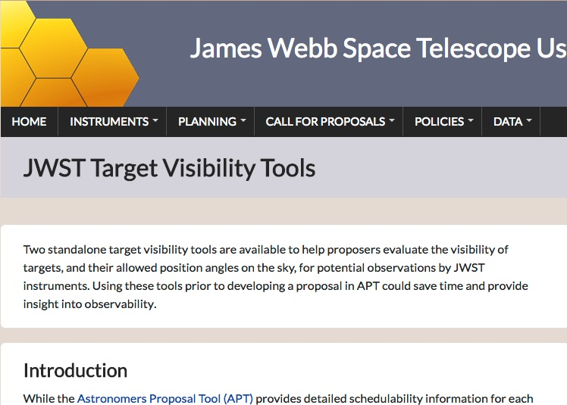
Visibility Tools
It is a very good practice to assess the target visibility and PA flexibility for a target before start planning the observation with APT (in particular for object closer to the ecliptic plane)
STScI has prepared two tools:
General Target Visibility Tool (GTVT)
Coronagraphic Visibility Tool (CVT)

Slide 23
General Target Visibility tool
For a given target it provides visibility windows and PA availability for each SI as a function of time
Python tool available as part of astoconda (conda channel maintained by STScI)

Slide 24
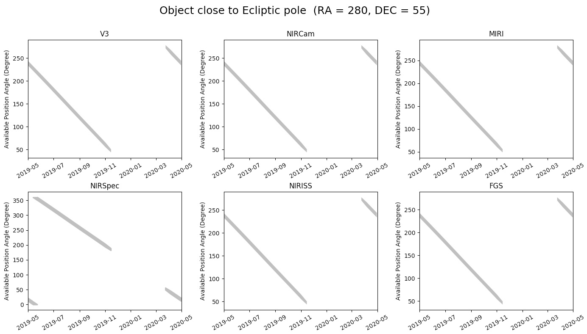
GTVT – Example 1
Visibility in May-2019/May-2020
Good PA flexibility
(but be aware of difference with MIRI and NIRSpec
Not visible for 3 months

Slide 25
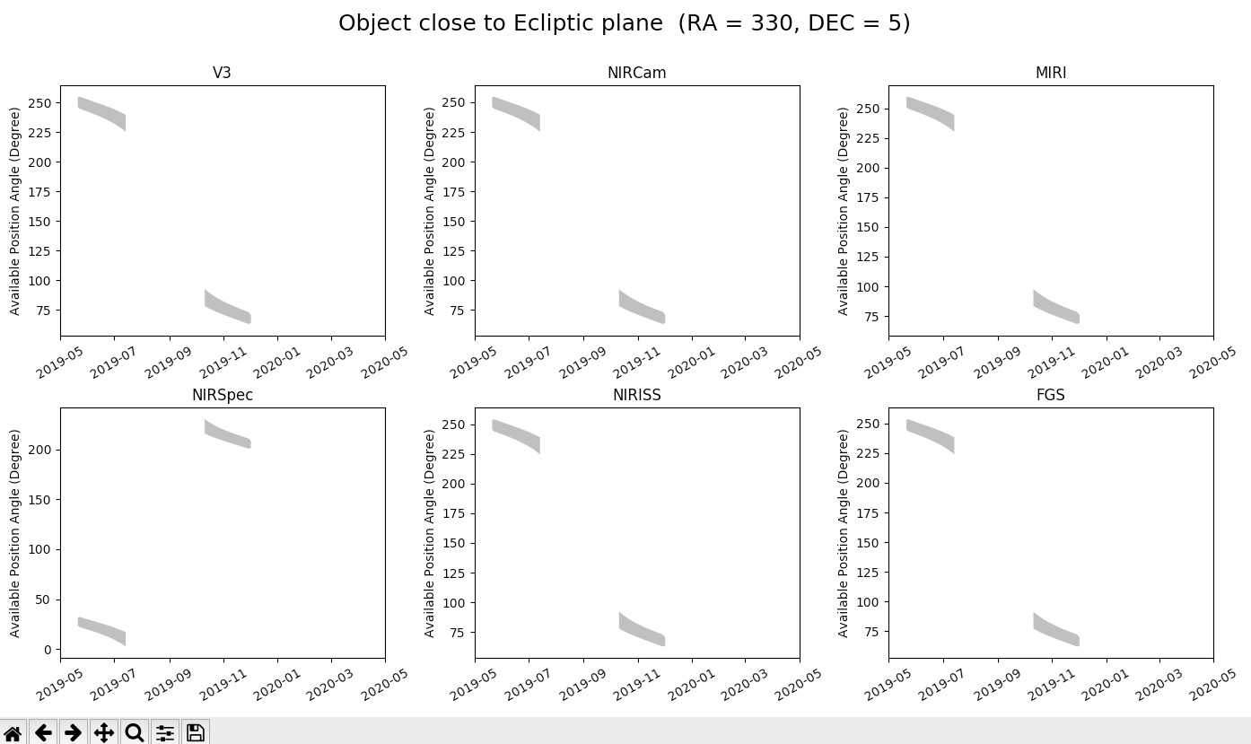
GTVT – Example 2
Visibility in May-2019/May-2020
Limited visibility: 2 periods of ~ 50days separated by 6 months
Very Limited PA

Slide 26
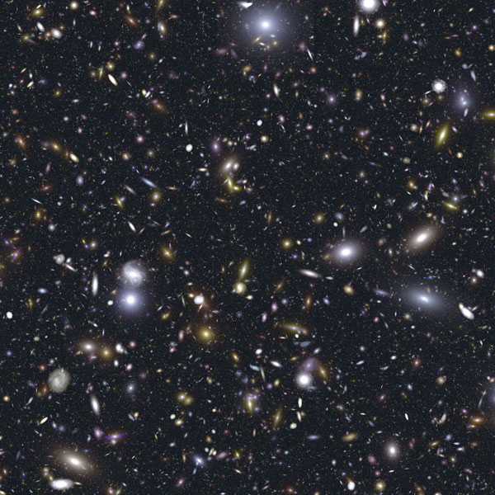
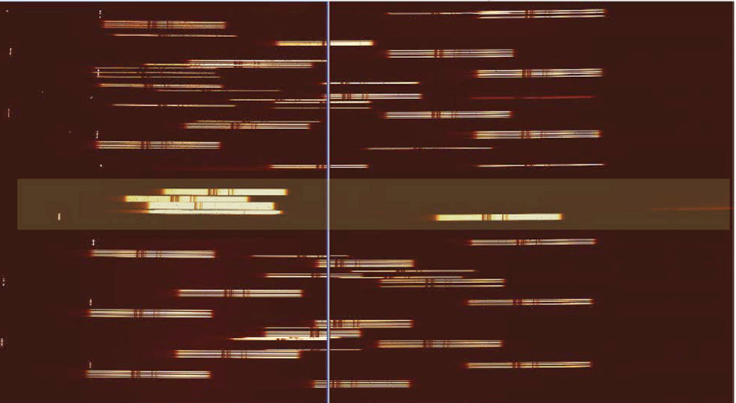
Example
Many NIRSpec MOS observations will require NIRcam pre-imaging (same PA not required but same FOV coverage)
In addition limited roll angle limit multiplexing opportunity (more later)
6 months
6 months
~50d target visibility
~50d target visibility
NIRcam
Pre-imaging
NIRSpec MOS within the same window (if time permits) or 6 months later

Slide 27
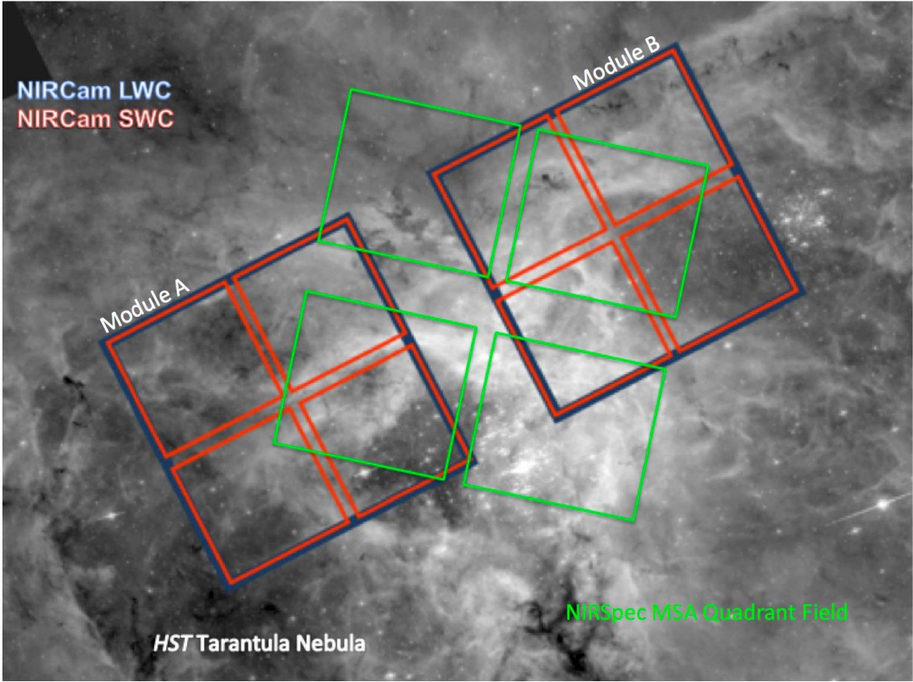
NIRCam Pre-imaging for MOS
A fixed orient assignment is required in order to plan for a NIRSpec MOS observation
Each of the two NIRCam modules covers a 140”x140” area with a 40” gap JWST
MSA Quadrants footprint covers a 3.4’ x 3.6’ area and it is rotated 45 deg
Beck et al. 2016 Proc. SPIE 9910
Ubeda et al.2016 Proc. SPIE 9910

Slide 28
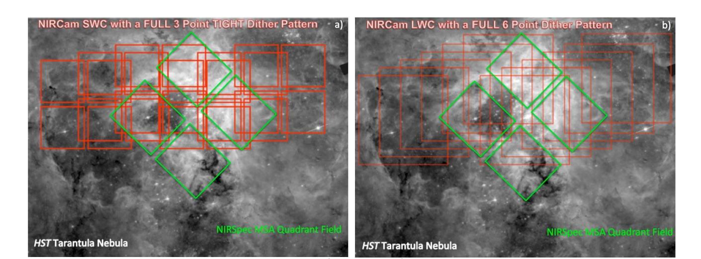
Planning NIRCam Pre-Imaging
Users will be provided with Recommended NIRCam Dithers
for NIRSpec Pre-Imaging

Slide 29
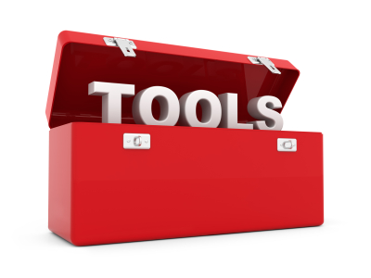
JWST Toolbox

