Slide 1
JWST Imaging
M. Robberto
JWST/NIRCam Team Lead - STScI

Slide 2
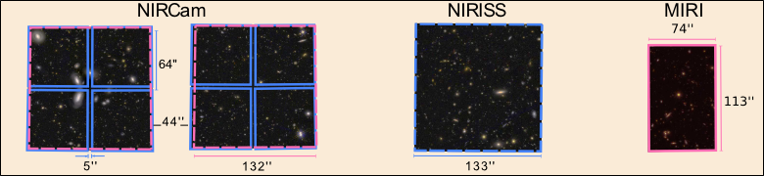
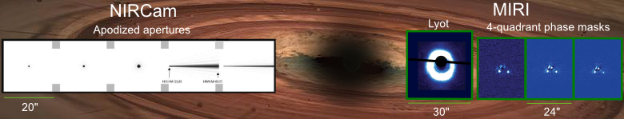
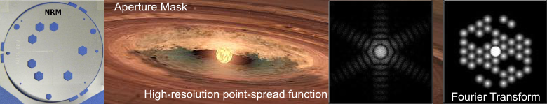
Direct Imaging
High Contrast Imaging: Coronography
High Contrast Imaging: Aperture Mask Interferometry

Slide 3
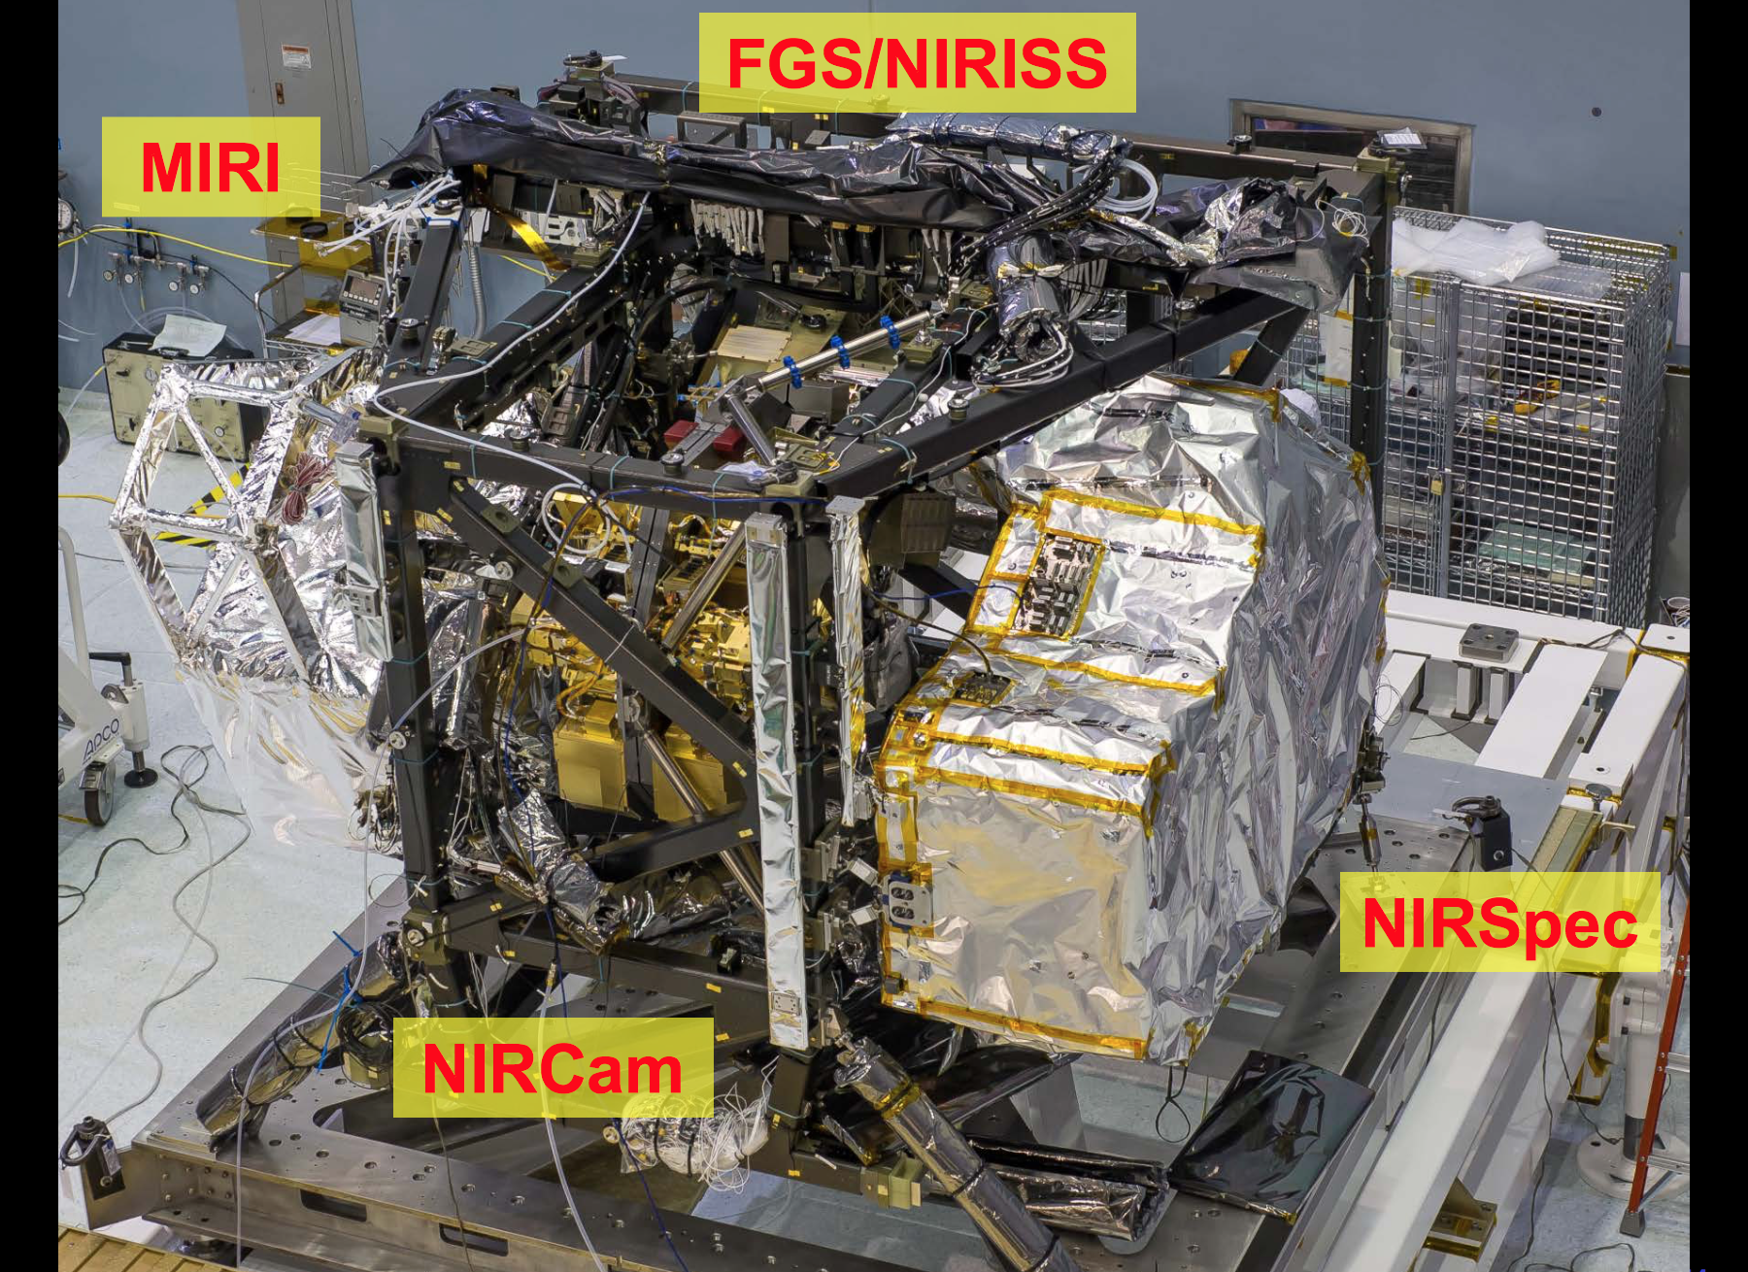

Slide 4
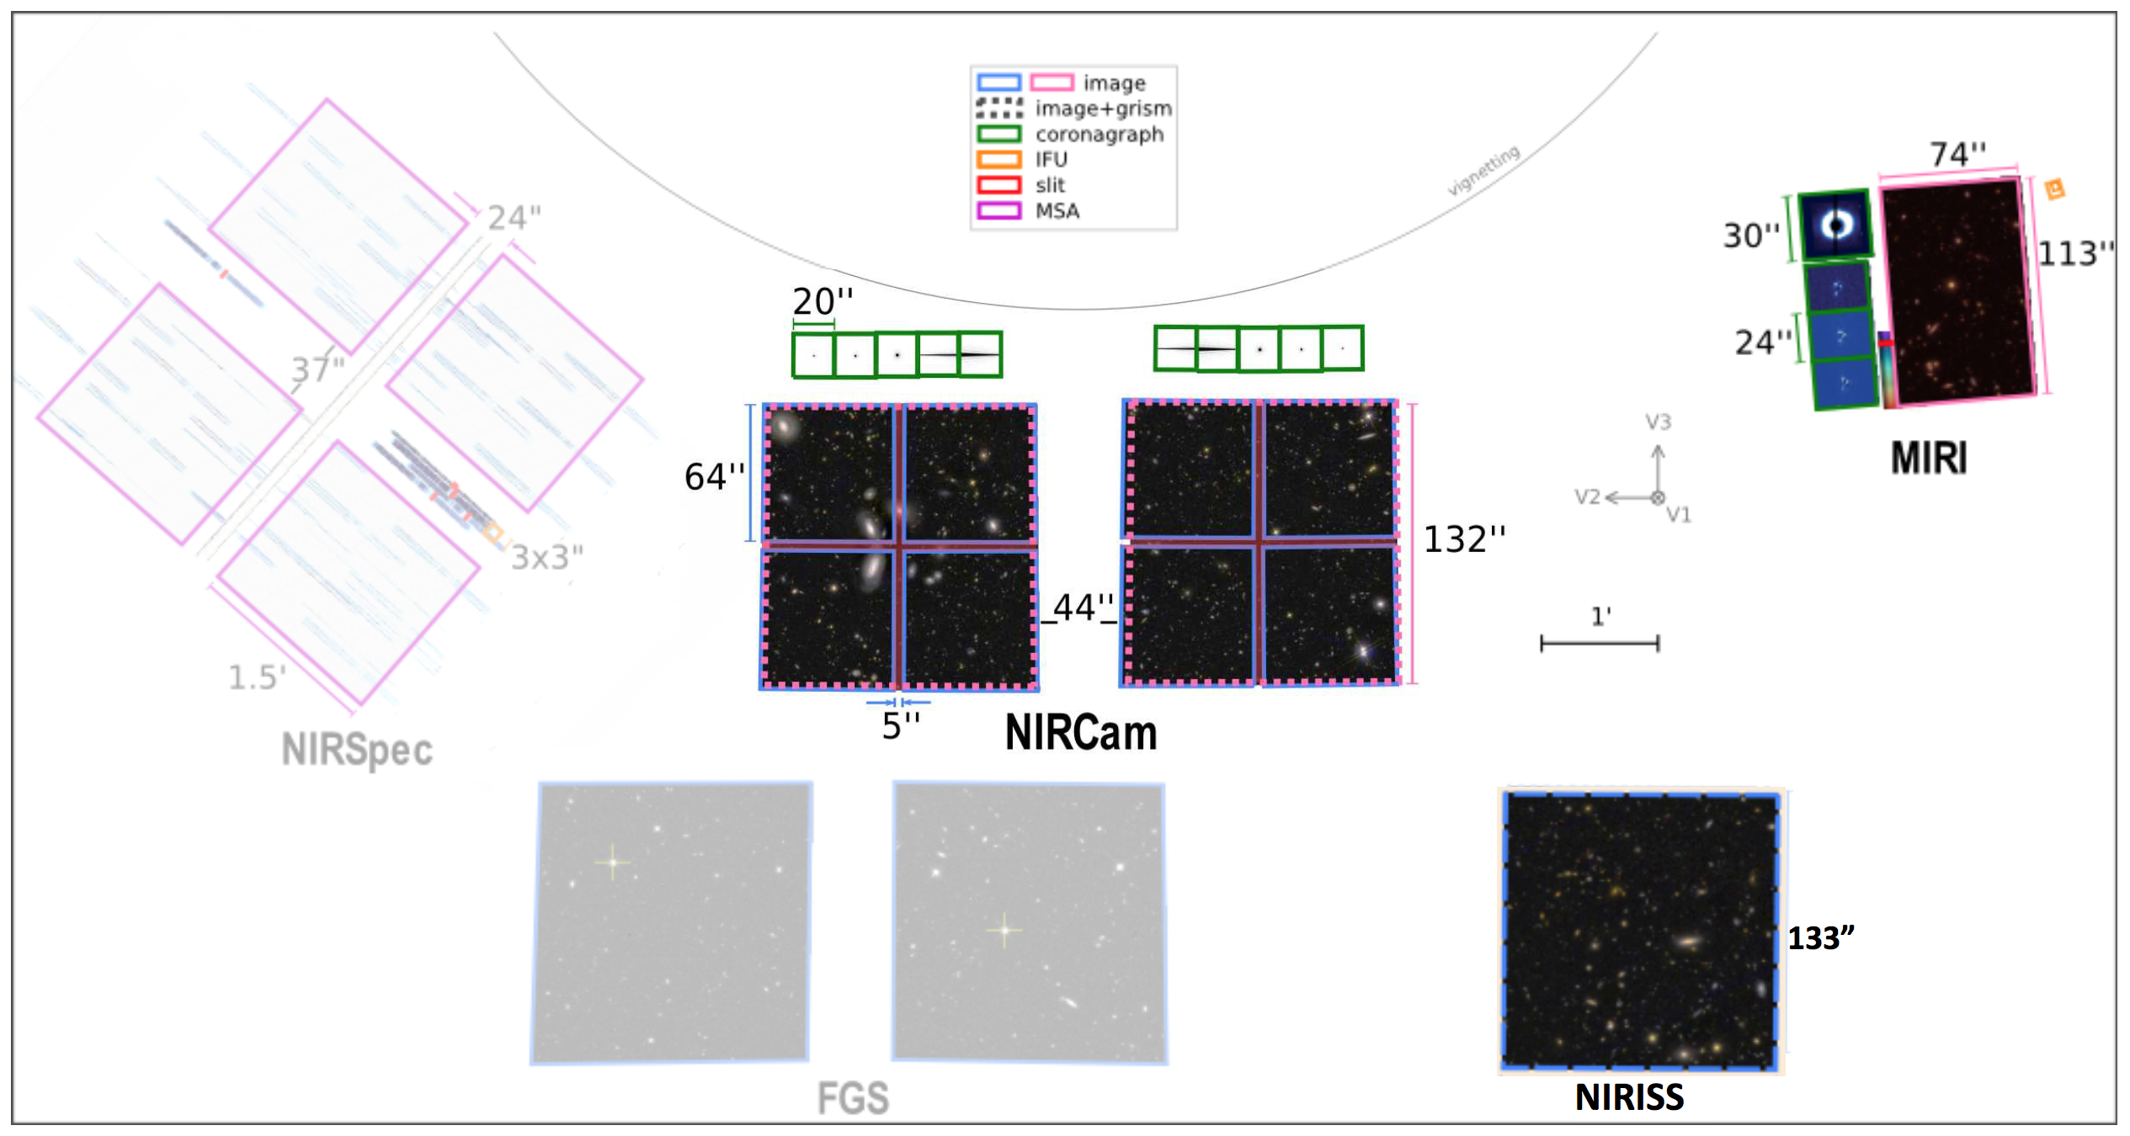
Field of View of JWST Instruments

Slide 5
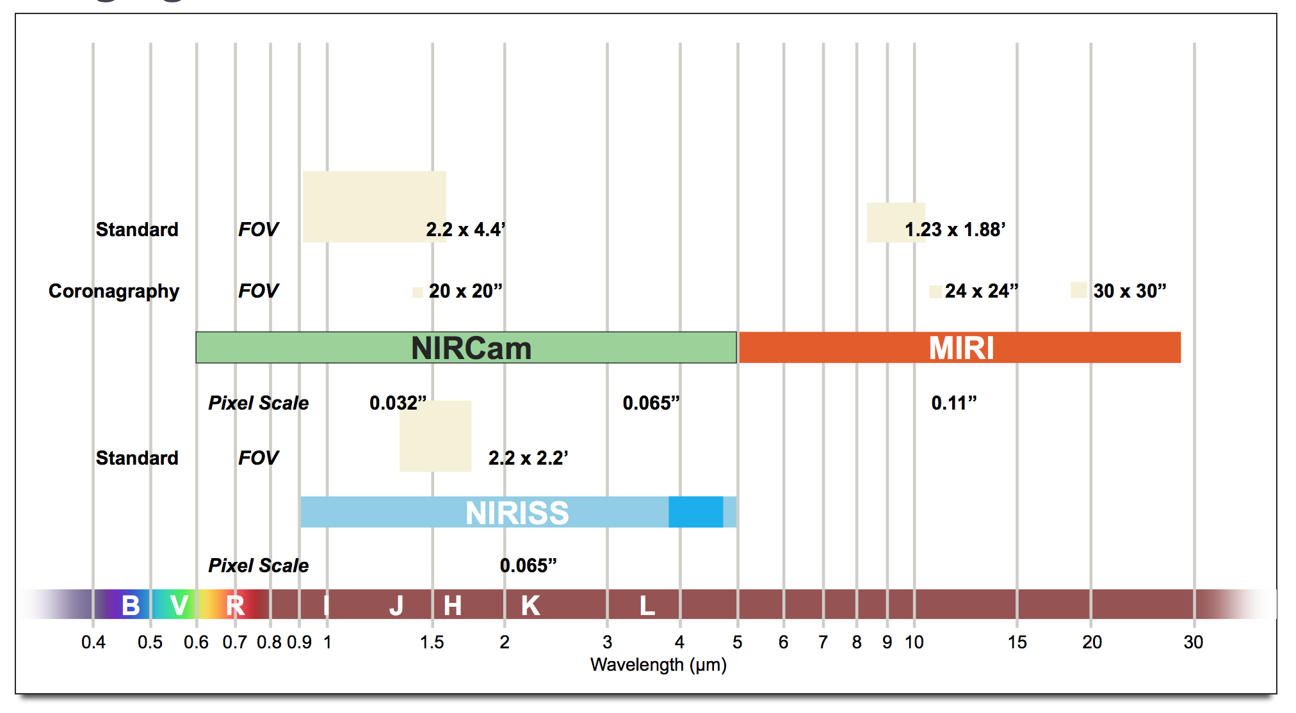
Imaging Modes

Slide 6
Outline
Instrument overviews
Dither patterns
Readout Patterns
Sensitivities
Subarrays
Parallel Observations

Slide 7
NIRCam Terminology
Two fully redundant MODULES A/B mated to opposite sides of optical bench, each 2.2 x 2.2 arcmin² field of view (FOV) separated by 44”
Each module has one SW CHANNEL (0.6-2.3 μm) and one LW CHANNEL and one LW (2.4-5.0 μm) channel that have the same 2 x 2 arcmin² FOV
Each SW channel has four 2048² pixel SENSOR-CHIP ASSEMBLIES (SCAs) separated by 5 arcsec;
Each LW channel has one 2048² pixel SCA
        10 DETECTORS TOTAL

Slide 8
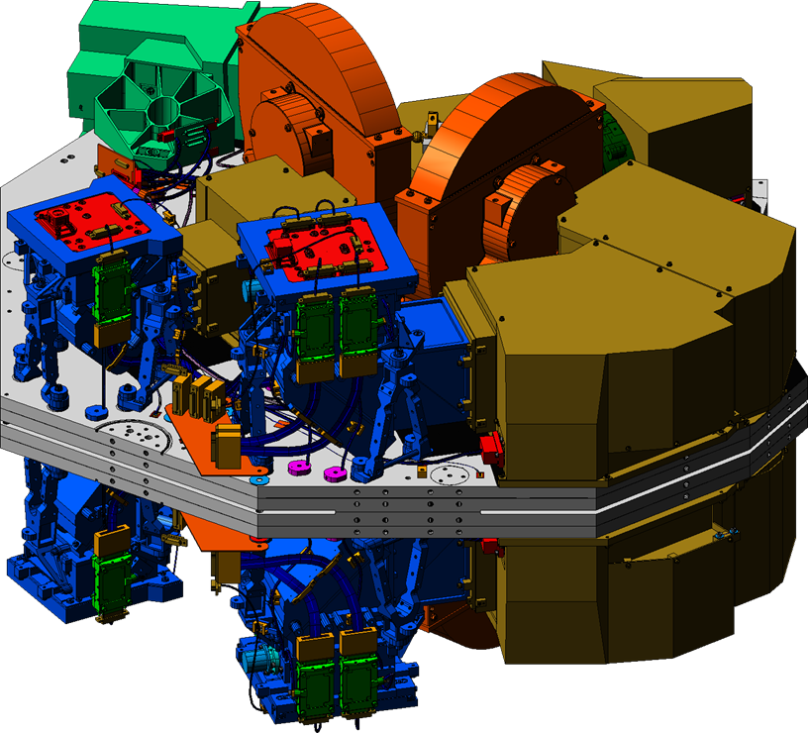
Two Modules x Two channels
5”
132”
}
5” {
} 40”
Two adjacent fields of view (2.2 arcminute)² Both fields in SW and LW bands
Two back-to-back modules
Notes:
WFC3-IR is 123”x136”
Imagine a WFC3 image with 5”/0.13=40 pixels gap between quadrants.

Slide 9
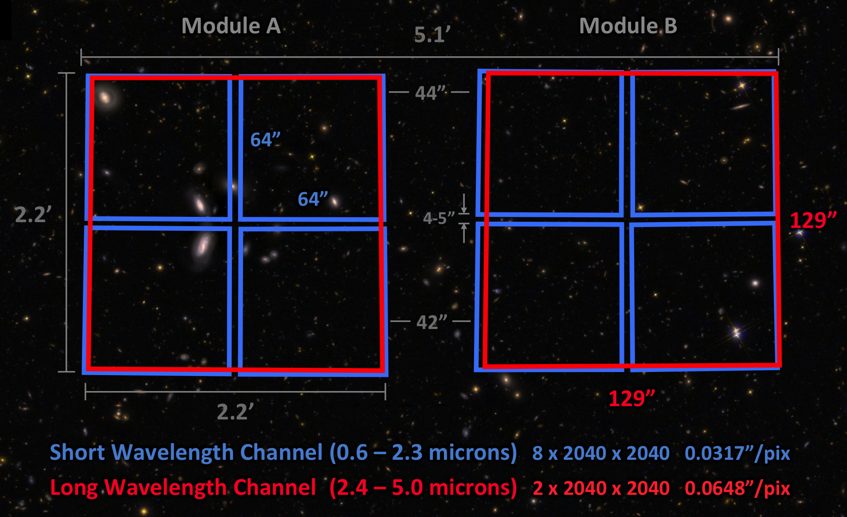
NIRCam Field of View
Notes:
NIRCam's 2 modules operate in parallel to observe a 9.7 arcmin² field of view consisting of two 2.2' × 2.2' fields separated by a ~44" gap. Gaps of ~5" also separate the 4 detectors in each short wavelength module. If full-field imaging is not required, individual modules or smaller subarrays may be used to increase readout speeds and reduce data volumes. To cover larger areas, mosaics are best obtained in combination with primary dithers.

Slide 10
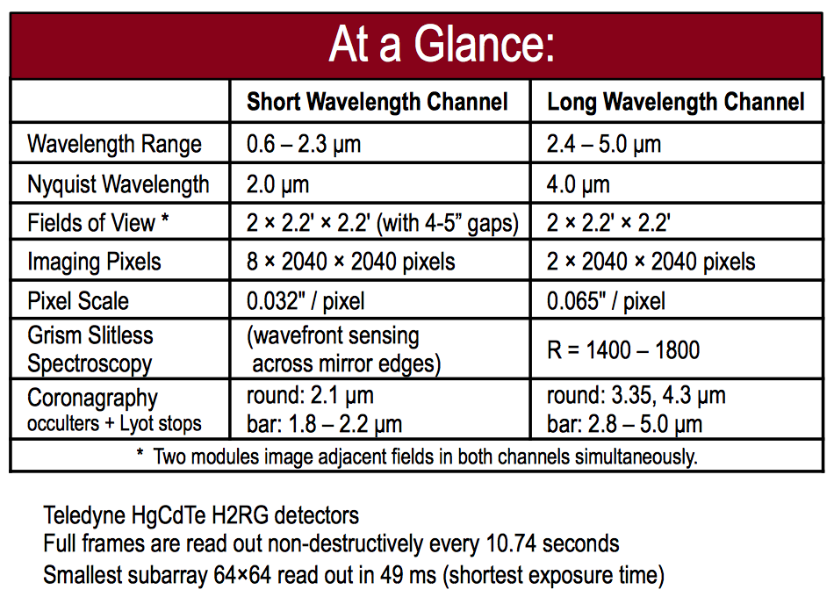
Vital Statistics
Notes:
Field distorsion < 2%

Slide 11
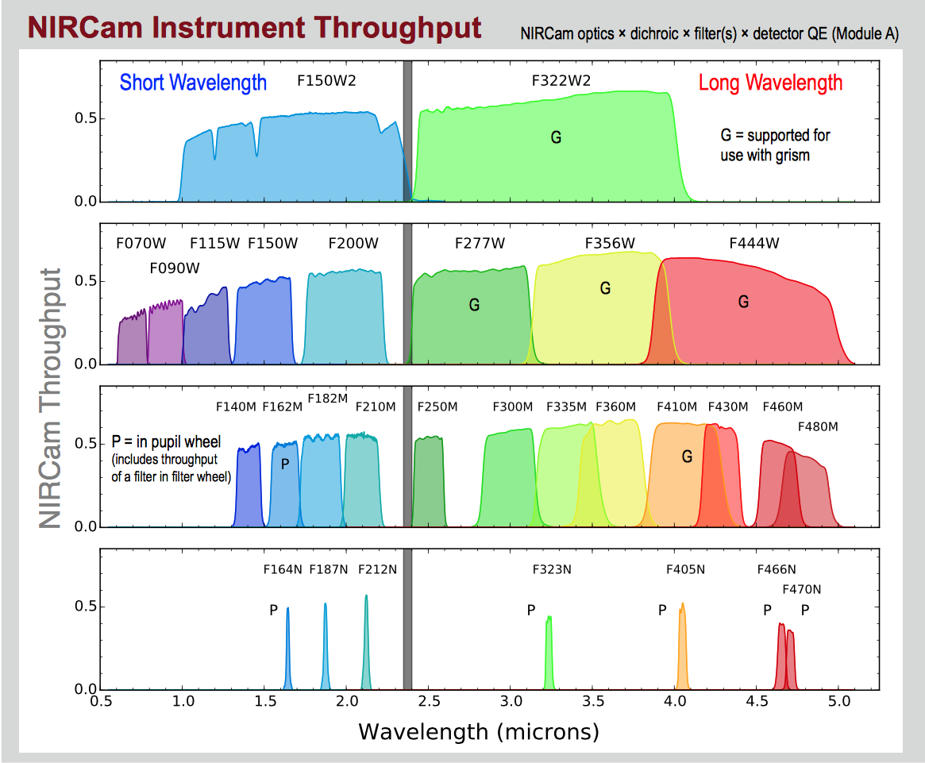
Passbands and Throughput

Slide 12
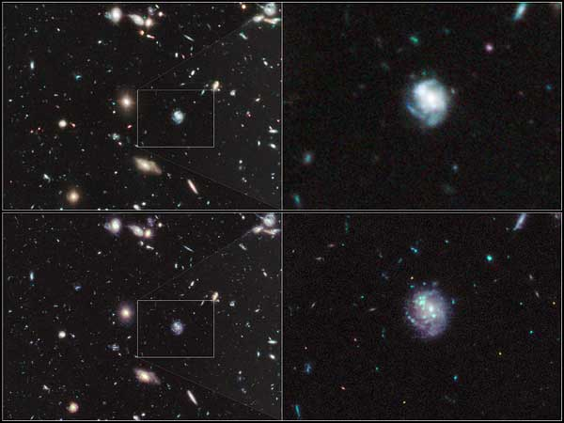
HUDF: WFC3/IR vs NIRCam

Slide 13
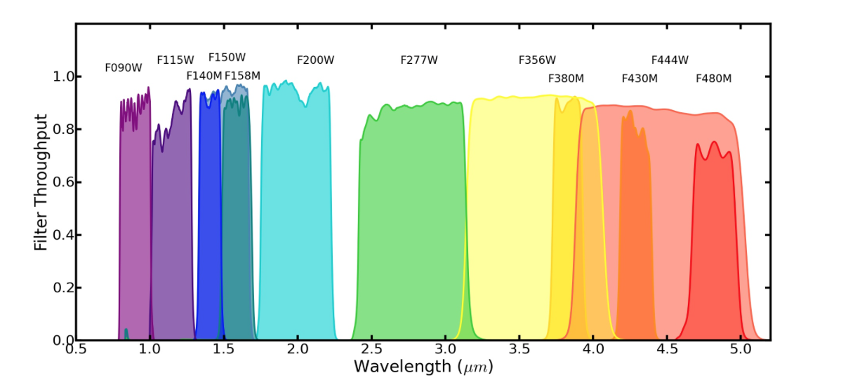
NIRISS
Field of View: 2.2’x2.2’
Plate Scale: 65 mas/pix
Nyquist Sampled at 4 μm

Slide 14
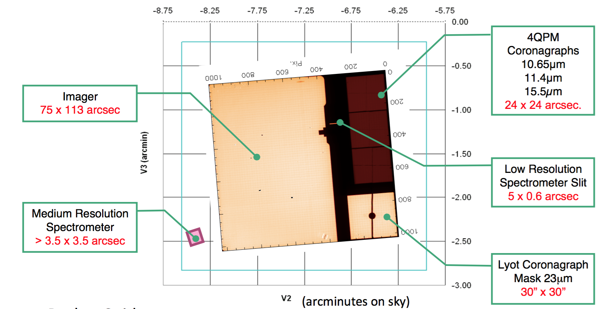
MIRI
(Looking down from M2)
Notes:
Medium Chief Ray coordinates, centered on the middle of NIRCam.

Slide 15
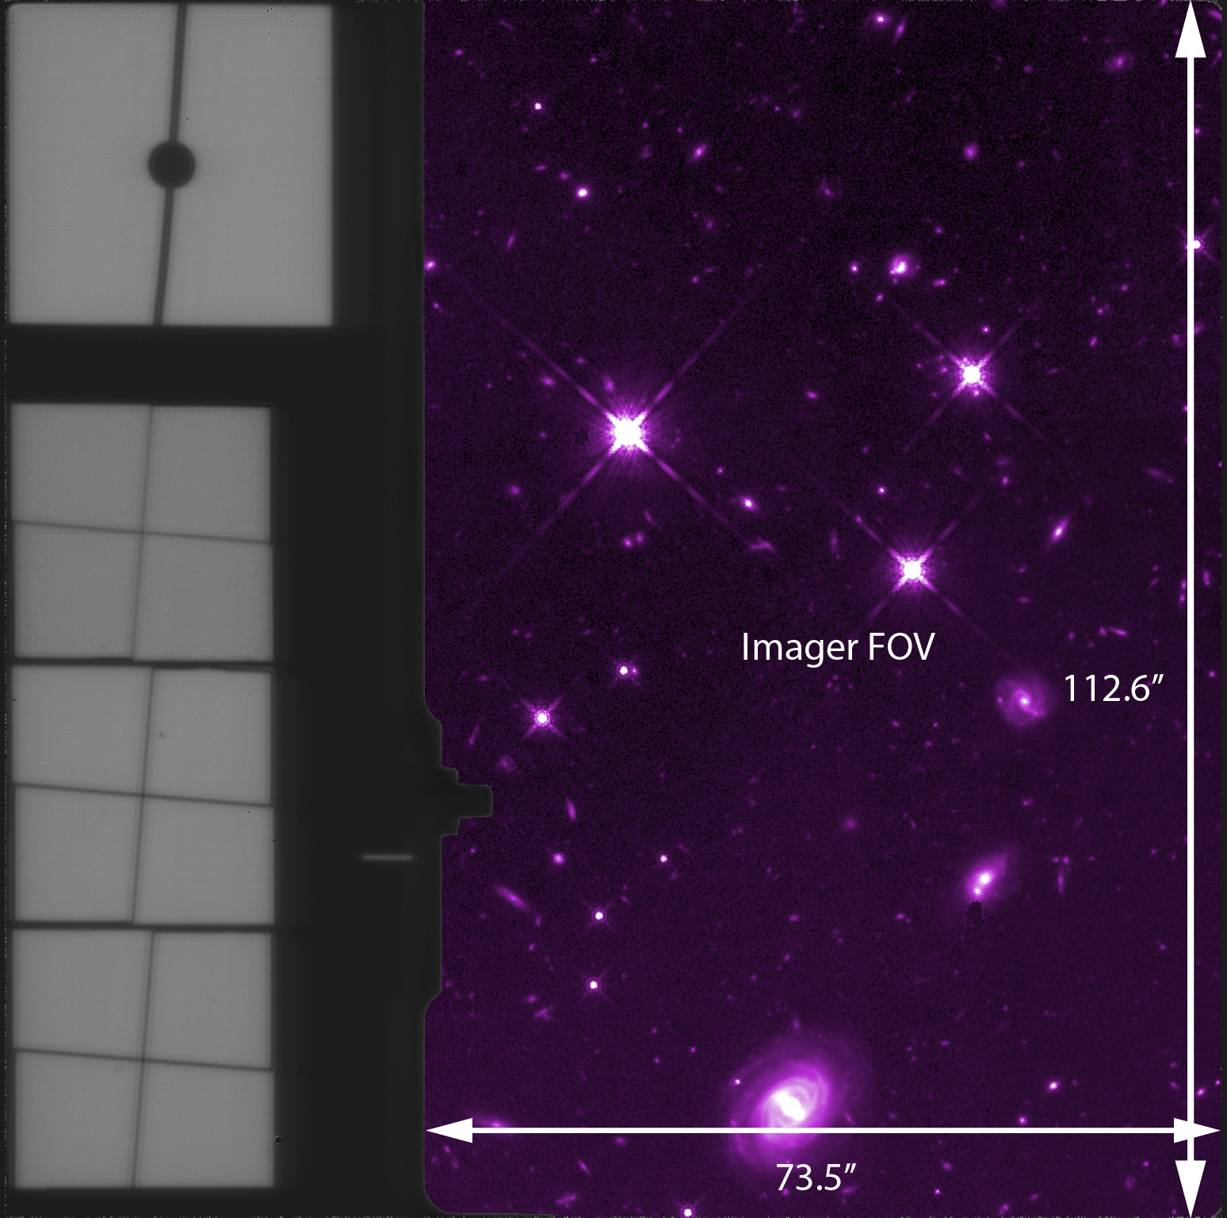

Slide 16
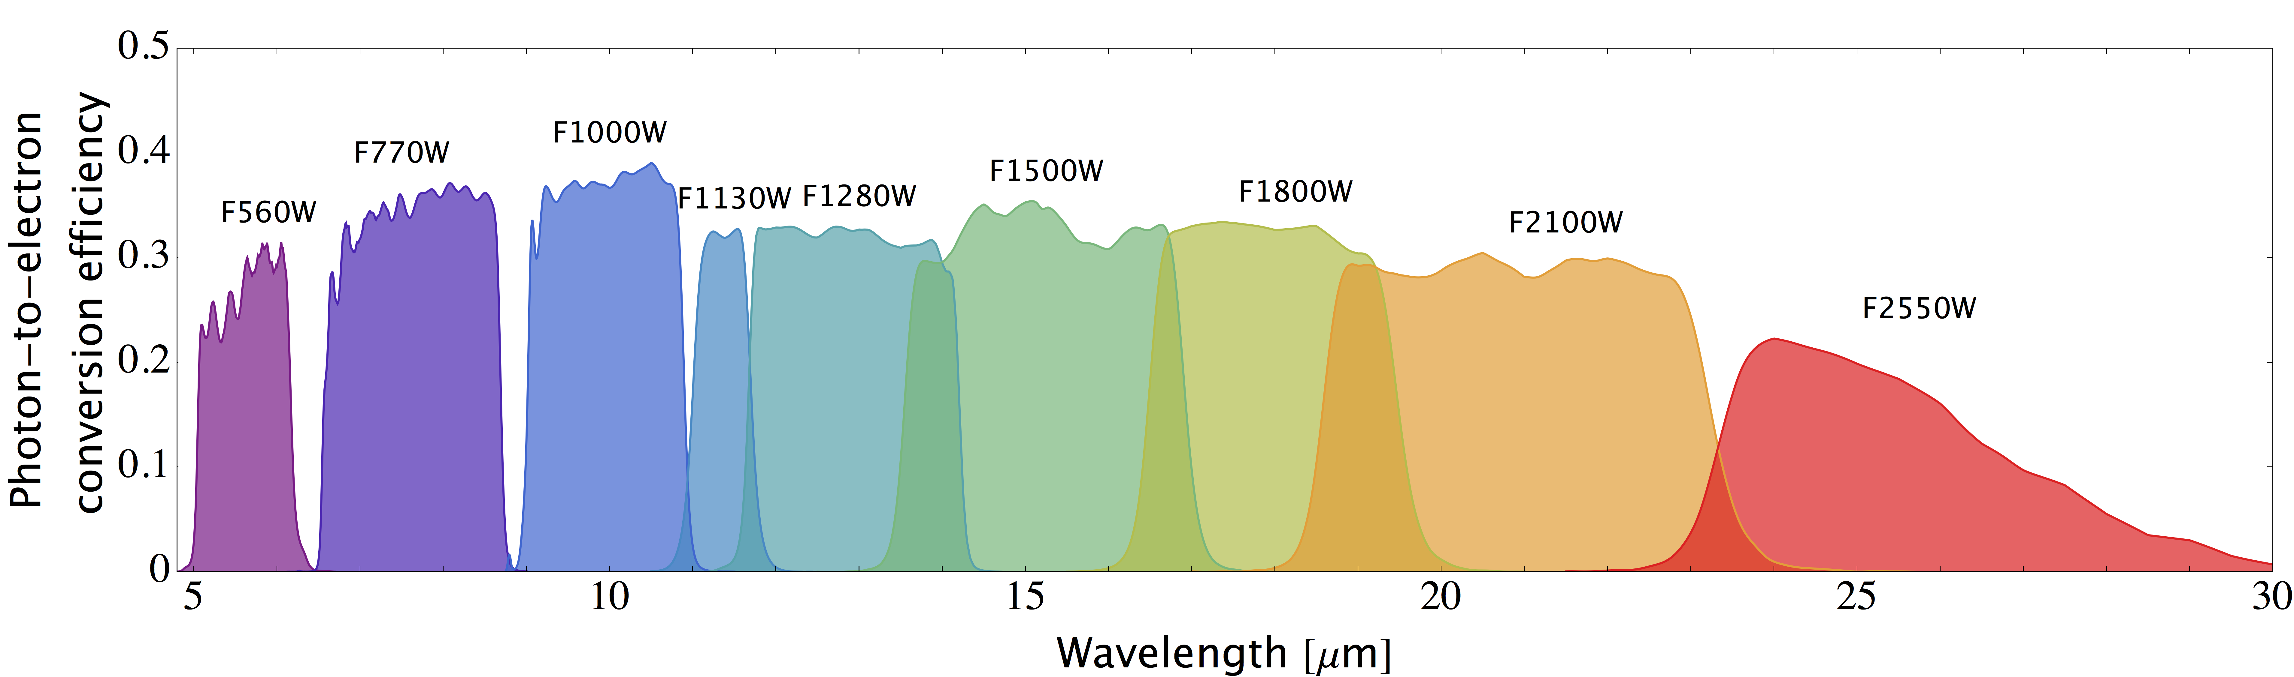
MIRI
Field of View: 74”x113”
Plate Scale: 110 mas/pix
Nyquist Sampled at 7 μm

Slide 17
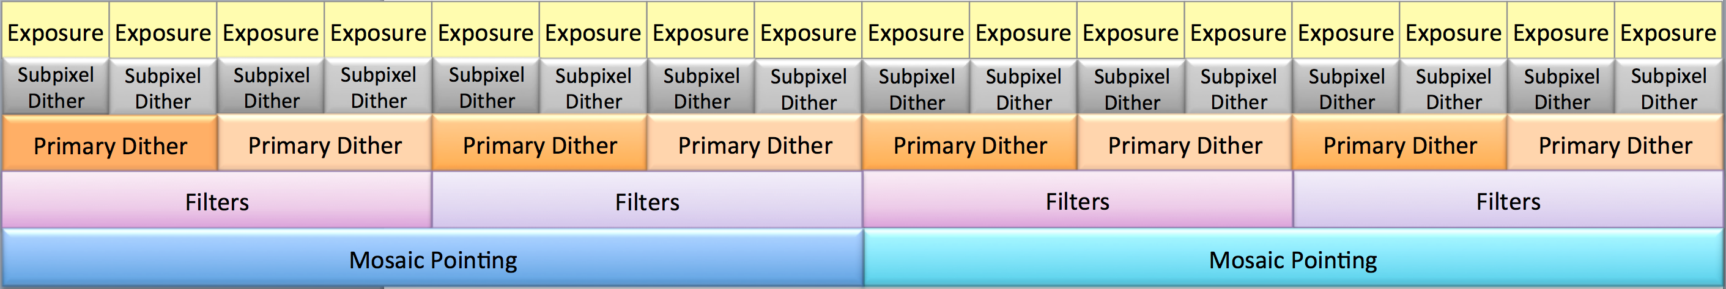
NIRCam imaging
Select Module:
  ALL, [A], B
Select Subarray
  FULL, SUB64P, SUB160, SUB160P, SUB320, SUB400P, SUB640
Select Dither Pattern
Select Filter Pair
  Readout pattern
  Number of groups
  Number of integrations
Operational ordering for dithers, filter changes, and mosaics

Slide 18
Dithers and Mosaics
Primary Dithers
  FULL
  INTRAMODULE
  INTRASCA
Subpixel
Small-grid
Mosaics
Pre-Canned menu
No filter change
User defined
Filter can be changed

Slide 19
NIRCam Primary Dithers
The NIRCam primary dither patterns were designed for three general sizes of targets:
  FULL: Large fields without gaps, including mosaics (tiled pointings) of larger areas
  INTRAMODULE: Objects smaller than the individual modules (< 110" across)
  INTRASCA: Objects smaller than the individual SCA detectors (< 50" or < 100" across when optimizing for short or long wavelength observations, respectively)

Slide 20
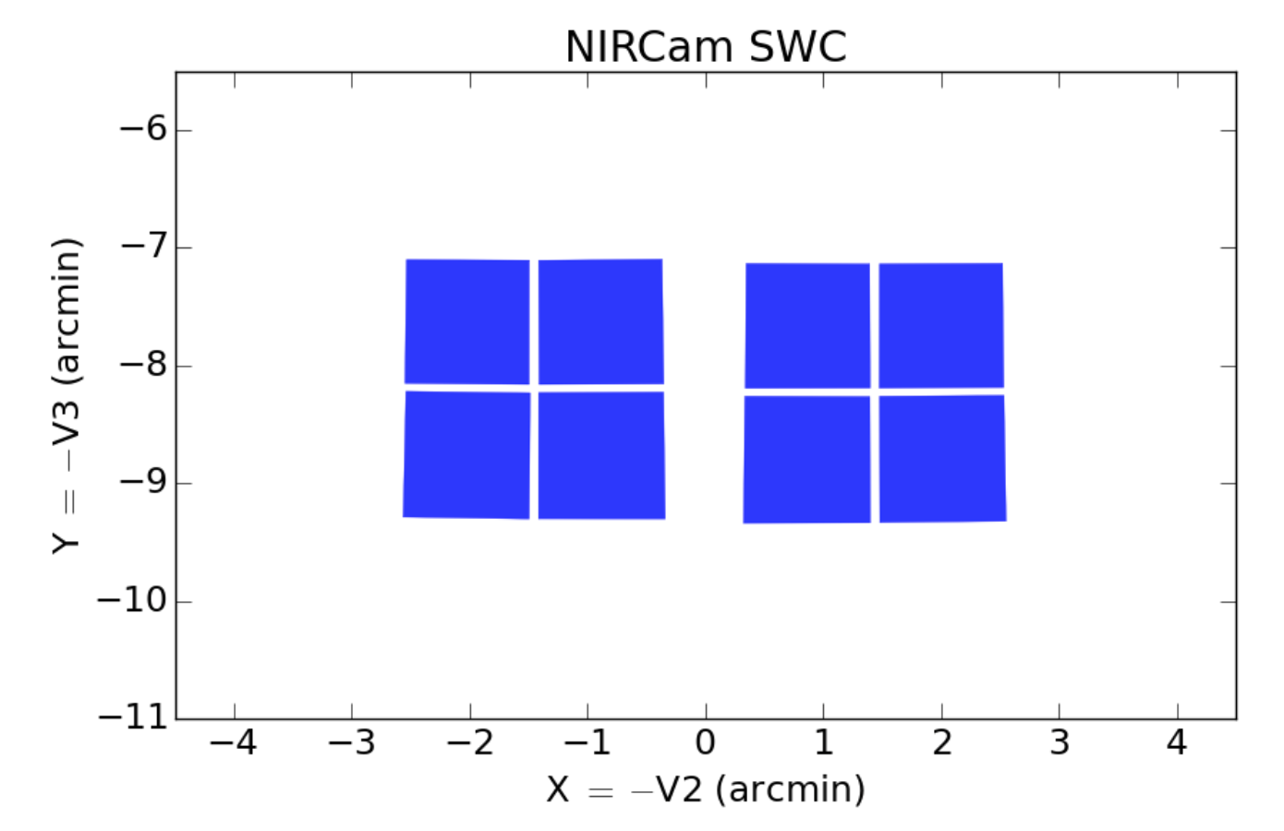
FULL Dither Patterns
The NIRCam FULL dither patterns provide full field coverage filling the ~40” gap between modules.
They require multiple guide star acquisitions, increasing overheads on observing time.
FULL dither patterns may be combined to do mosaics of even larger areas.
Notes:
FULL 3 and 3TIGHT patterns each include two horizontal shifts of 58" (116" total).
They require at least 1 new guide star (58” is ok at l<30deg)

Slide 21
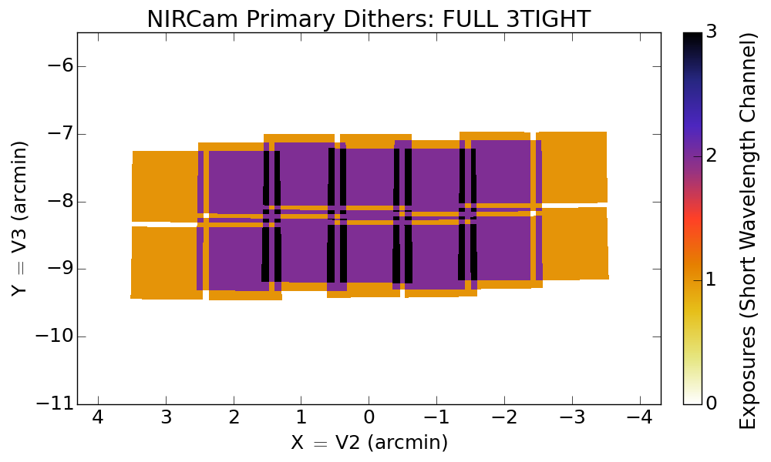

Slide 22
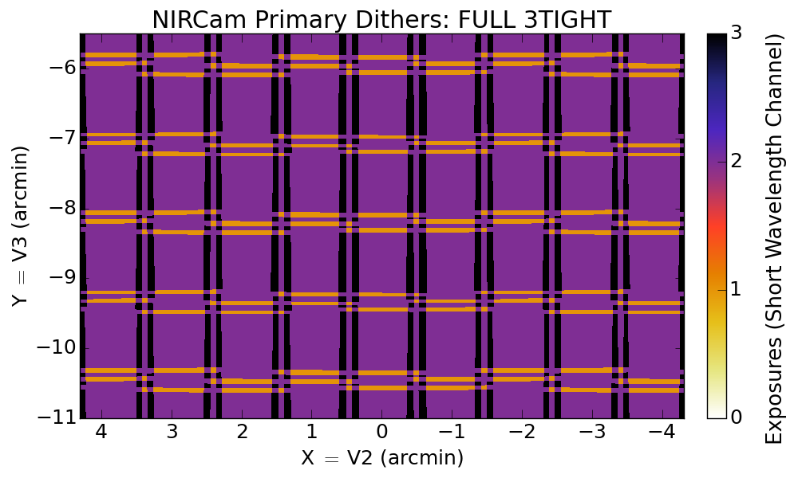

Slide 23
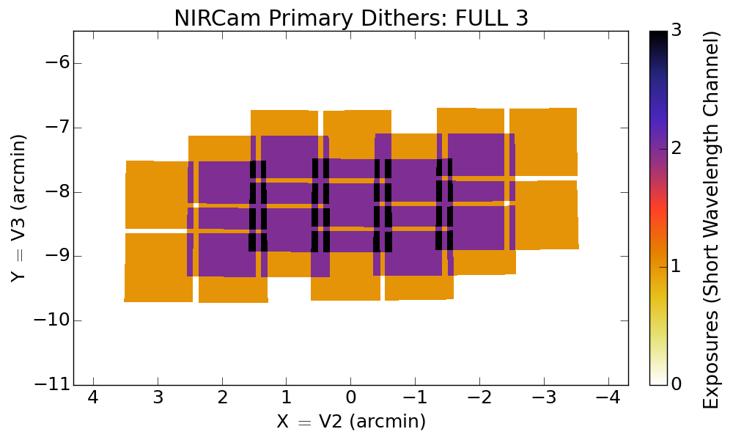

Slide 24
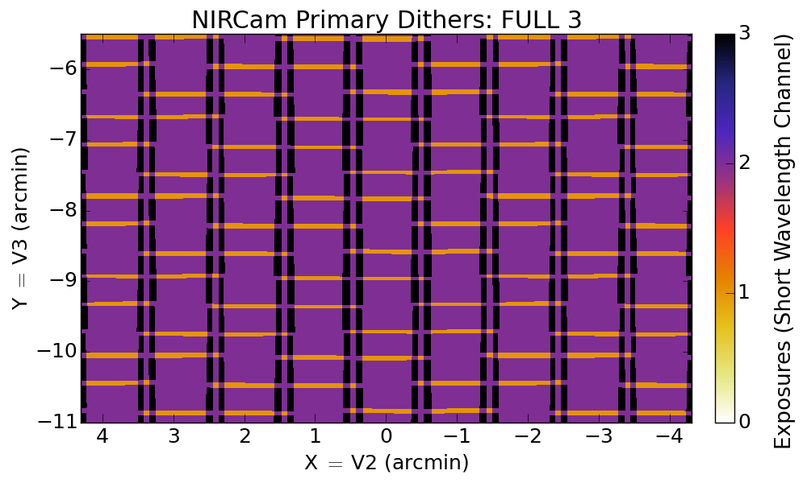
3: 18%
2: 71%
1: 11%

Slide 25
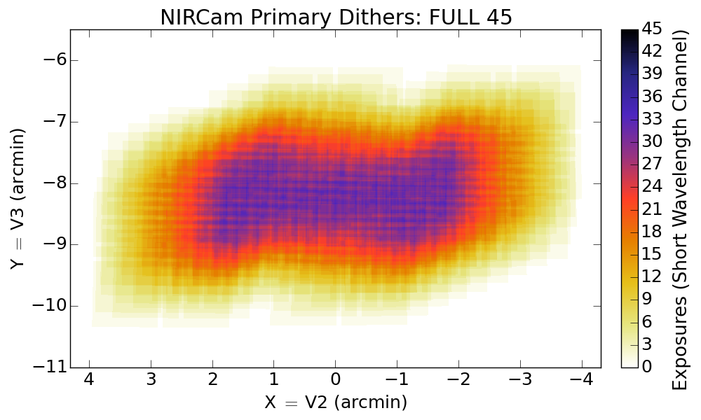

Slide 26
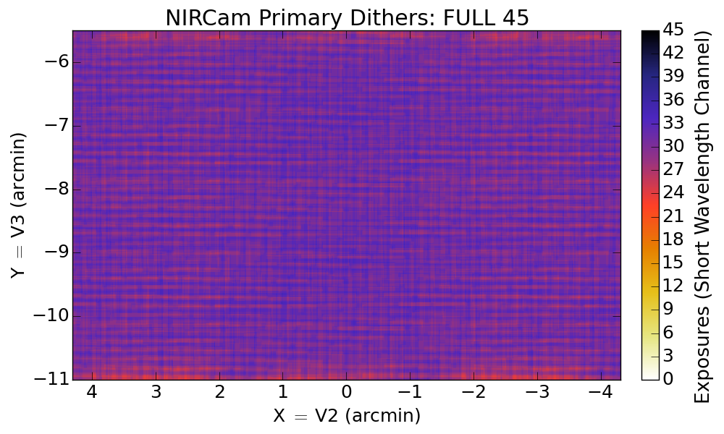
28:1%
29: 6%
30: 23%
31: 38%
32: 25%
33: 7%
34: 1%

Slide 27
INTRAMODULE Dither Pattern
INTRAMODULE dither fills the 5” SCA gaps, but not the 40” gap between modules.
4x4 grid (up to 16 pointings); 22.5” across
Any number of dither positions between 2 and 16 is allowed.
Only one guide star is required, reducing overheads.

Slide 28
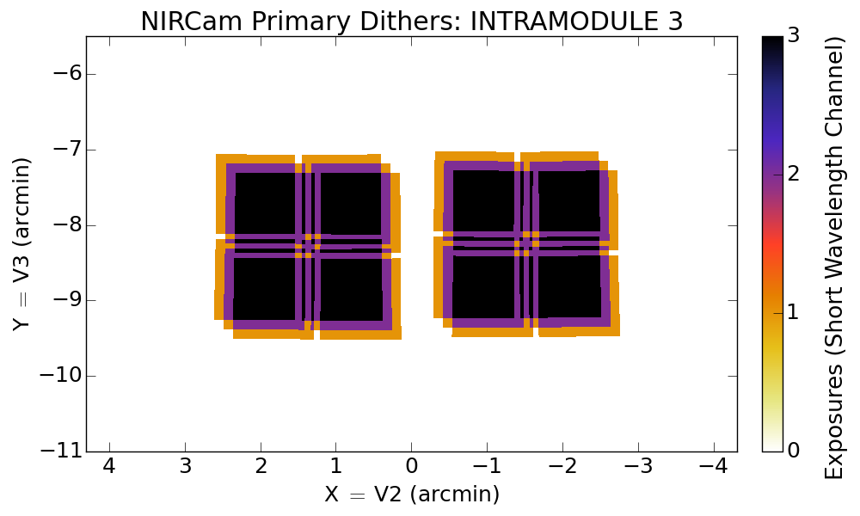
Intramodule 3
1/3

Slide 29
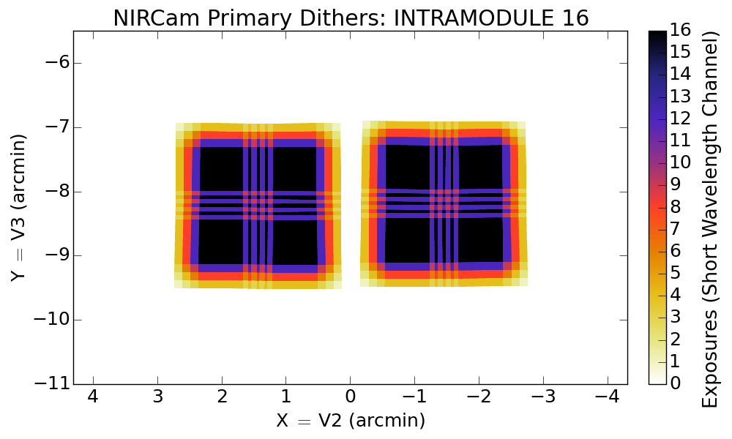
Intramodule 16
9/16

Slide 30
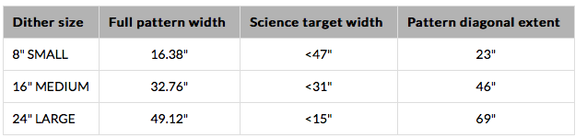
INTRASCA Dither Patterns
INTRASCA dither patterns are designed to observe science targets smaller than ~64”x64” with various parts of a SW detector (SCA) to mitigate flat-field uncertainties.
5x5 grid (up to 25 pointings)
Notes:
SMALL ANGLE MANOUVERS <20” take >20”; accuracy 5mas/pixel

Slide 31
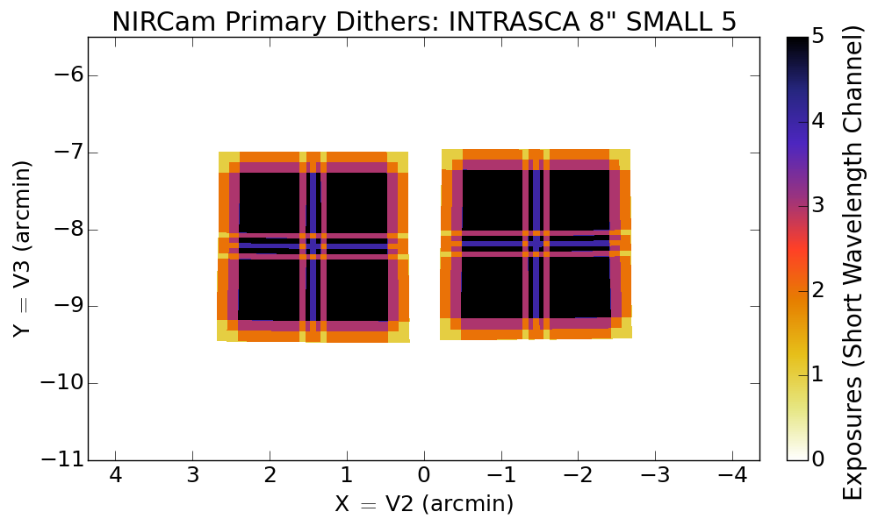
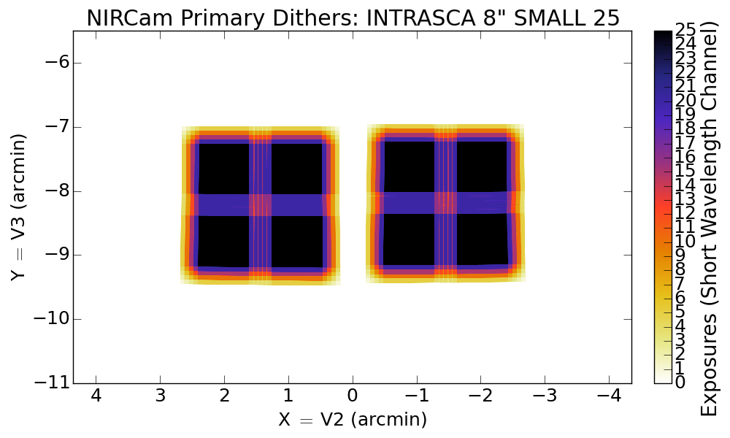
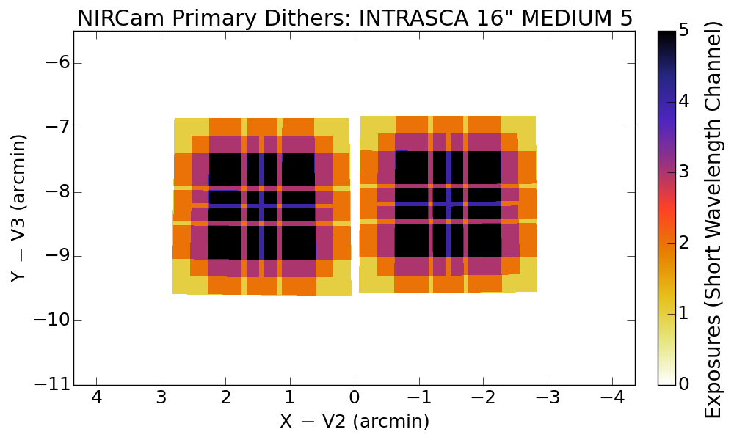
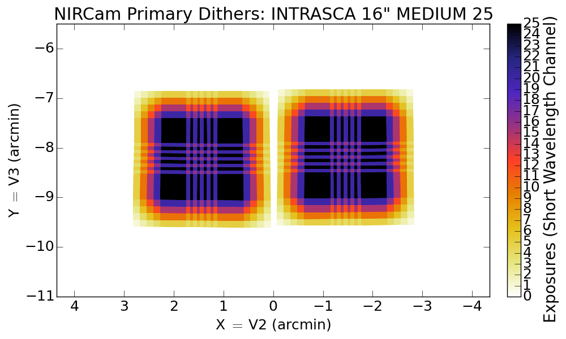
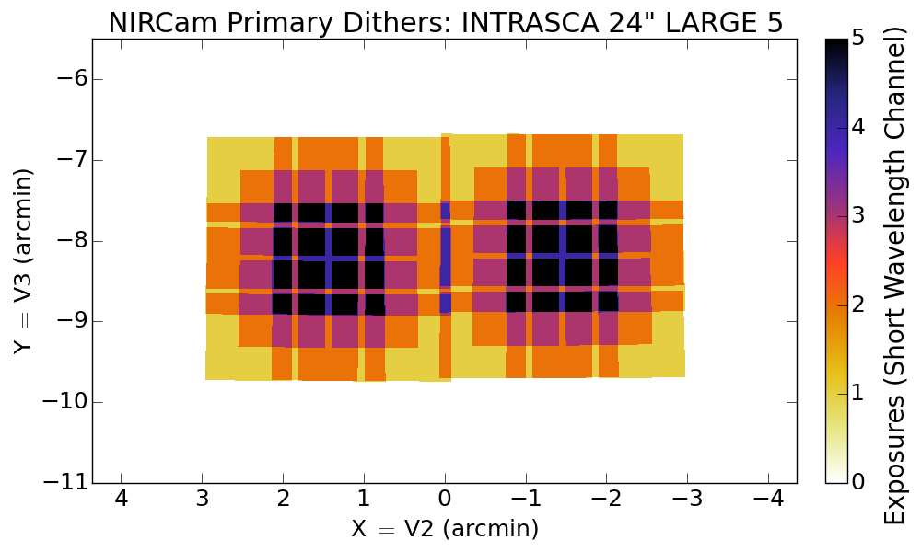
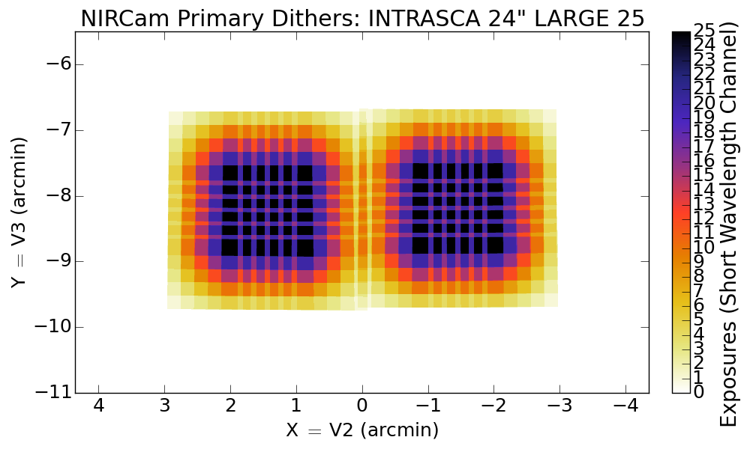

Slide 32
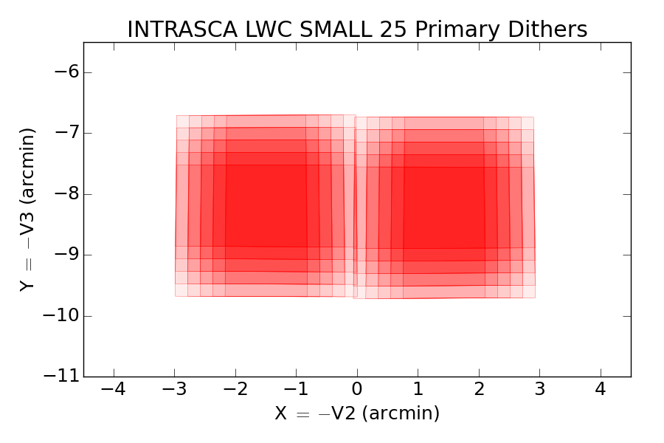
INTRASCA are optimized SW/LW

Slide 33
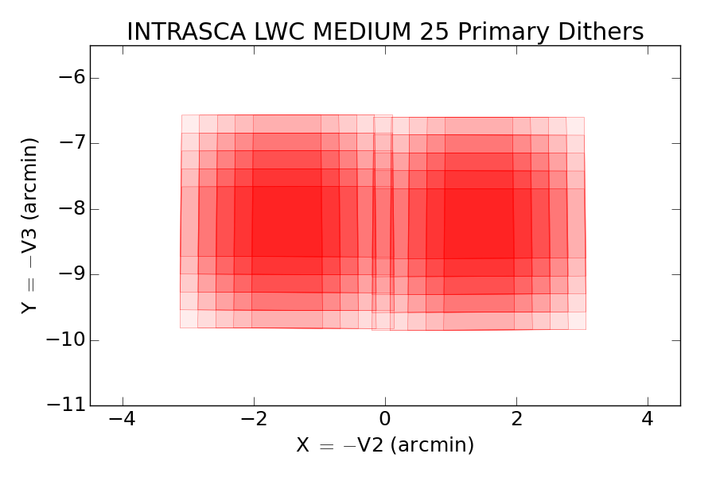

Slide 34
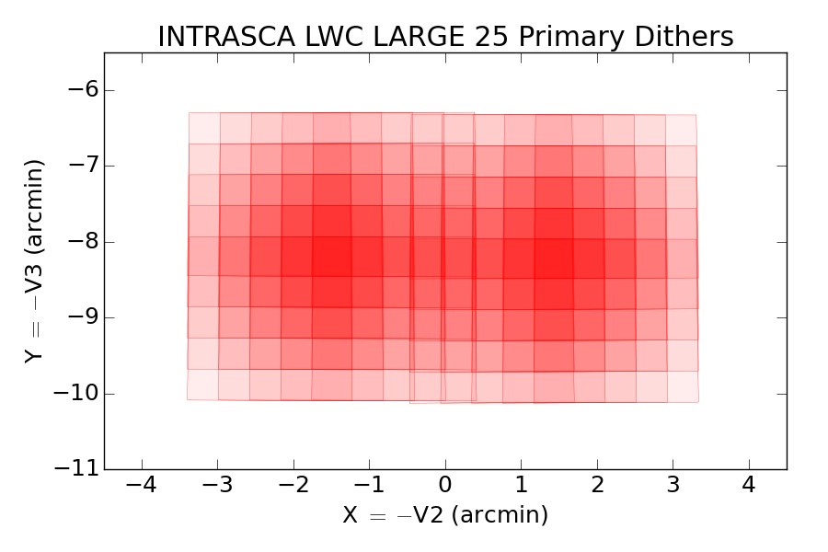

Slide 35
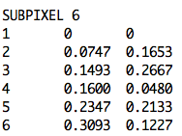
NIRCam Subpixel Dithers
Subpixel offsets for image resampling
Intended for accurate photometry, especially
  < 2micron (SW)
  < 4micron (LW)
Steps are integer+fractional pixels (e.g. 2.5 pixels)
Example:

Slide 36
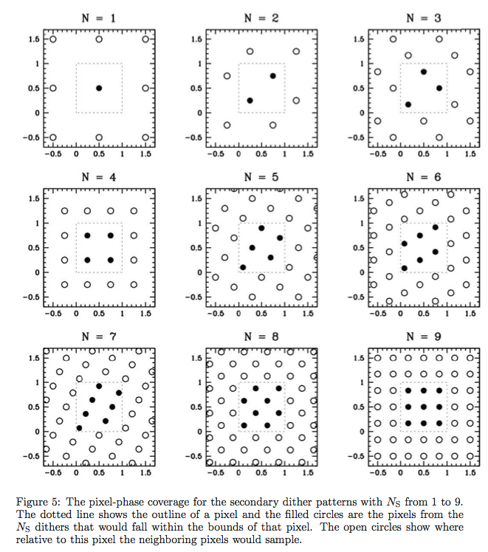
NIRCam Sub-pixel Dithers

Slide 37
NIRCAM small-grid dithers
Very SMALL: < 69 mas (~1 FGS pixel)
Very FAST: few seconds
Very PRECISE: ~2 mas/axis
Performed with Fine Steering Mirror (no telescope move)
Optimal for coronographic imaging
Less than ideal for imaging (clusters of bad pixels)

Slide 38
NIRISS Dithers
NIRISS Imaging is allowed in pure or coordinated parallel mode, since NIRCam is the better choice for all general imaging applications (e.g. bigger field of view, simultaneous blue/red channels, better PSF sampling)
  NIRISS will necessarily follow dither pattern / mosaic strategy of “primary” instrument
  There is no support for the use of subarrays

Slide 39
MIRI DITHERS
MIRI is undersampled at λ<7micron.
Dithering patterns are designed for PSF oversampling, bad pixel removal and self-calibration.
2-Points
4-Points
Reuleaux
Cycling
limited access options:
Sparse
No Dithering

Slide 40
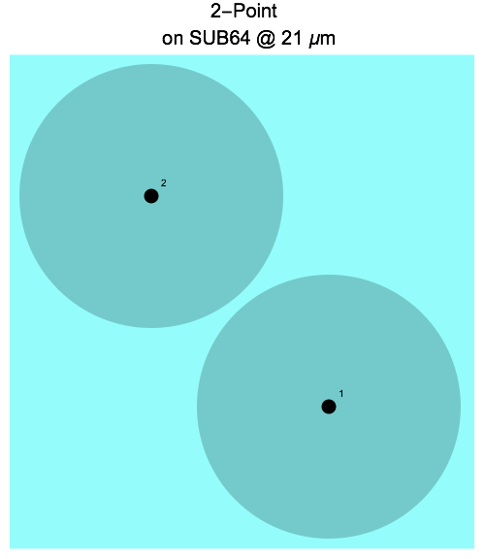
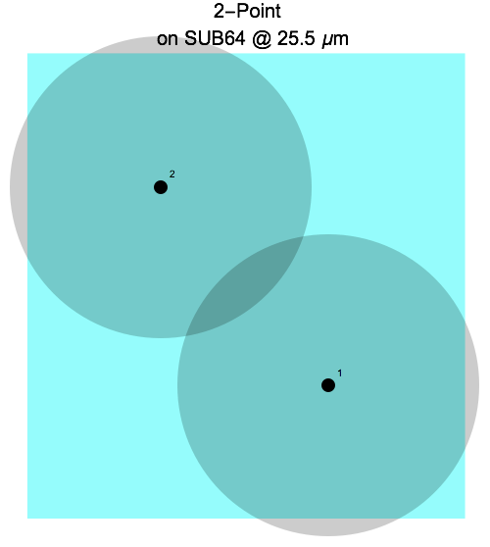
2 point dithers
2 exposures to avoid having the peak of the PSF on the same row or column.
GOALS:
simple background subtraction
minimizes the effects of bad pixels, rows, and columns.

Slide 41
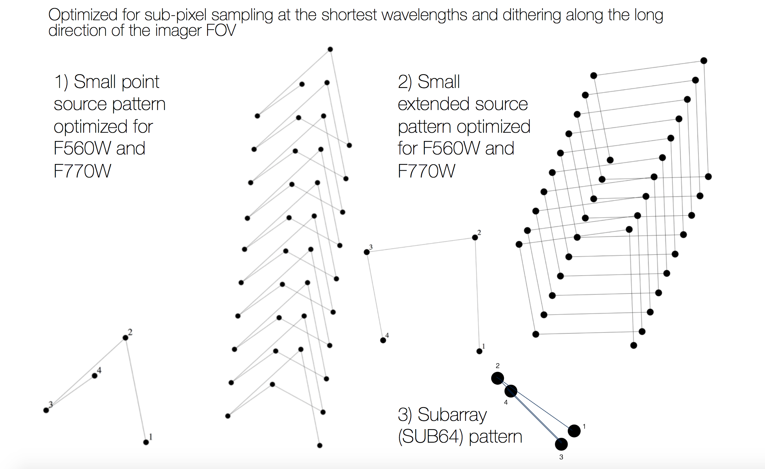
4 points dithers

Slide 42
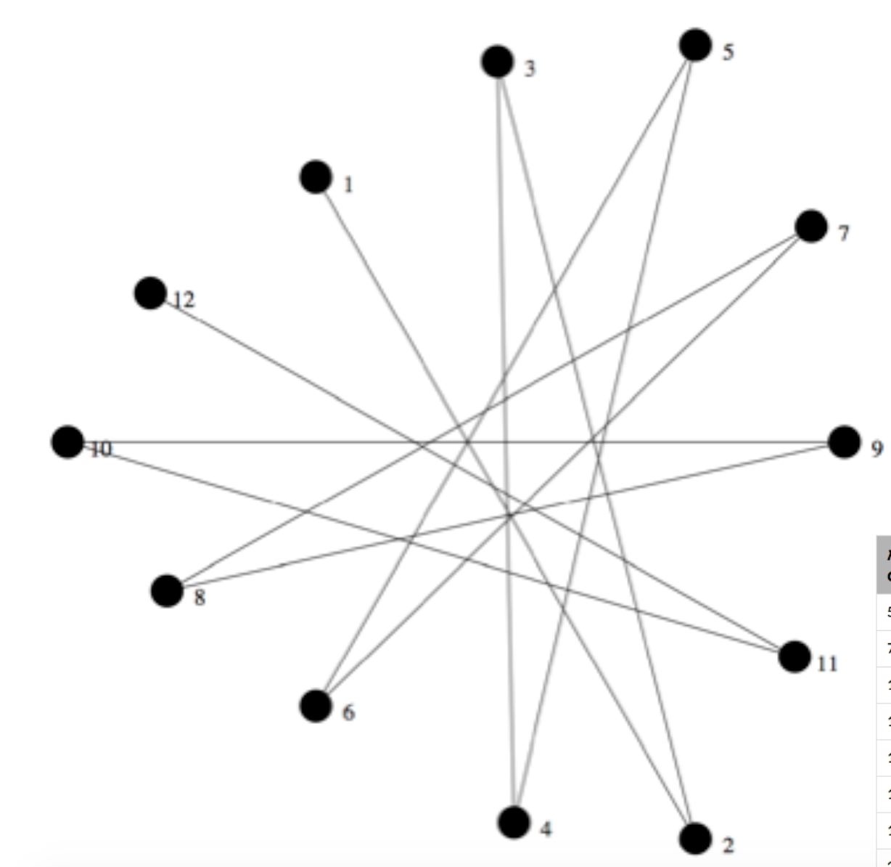
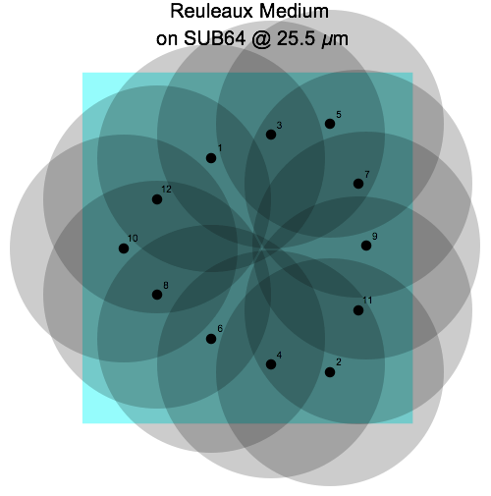
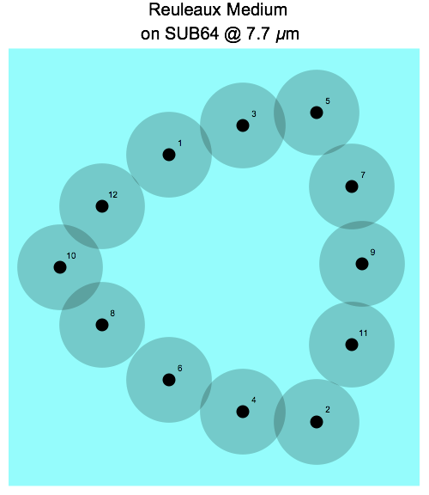
Reuleaux triangle
12 points
- 3 different sizes (or "scales”):
  Reuleaux Large
  Reuleaux Medium
  Reuleaux Small
Suitable for observing unresolved (or barely resolved) sources.
Medium size Reuleaux pattern on the SUB64 array showing PSF diameters for 6λ/D at 25.5 μm
Medium size Reuleaux pattern on the SUB64 showing PSF diameters for 6λ/D at 7.7 μm
This is the longest wavelength that fits entirely on the SUB64 at 6λ/D.

Slide 43
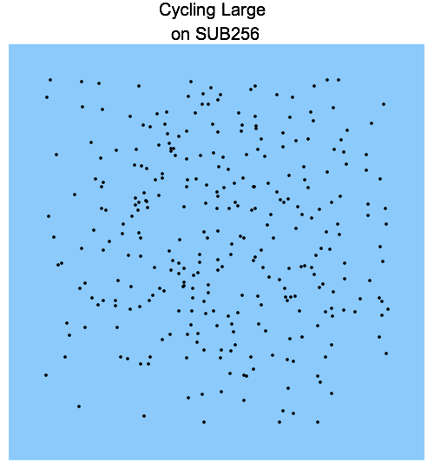
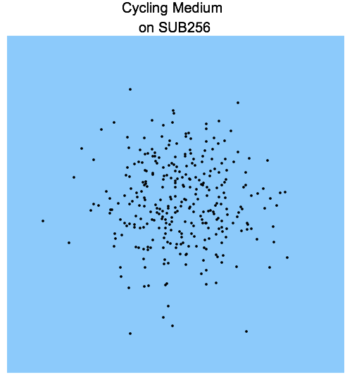
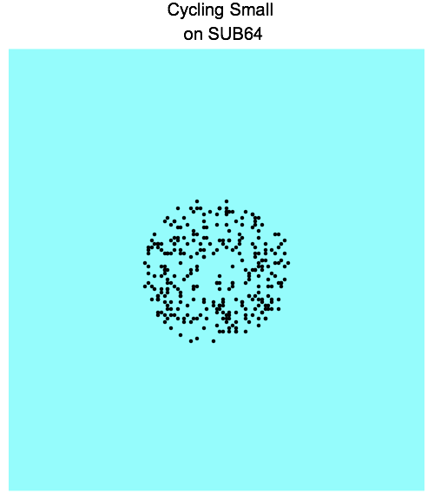
Cycling
The Cycling pattern consists of 311 points, randomly drawn from a gaussian distribution
- 3 different sizes (or "scales”):
1) Cycling Large
2) Cycling Medium
3) Cycling Small

Slide 44
Detectors: NIRCam
Largest defect

Slide 45
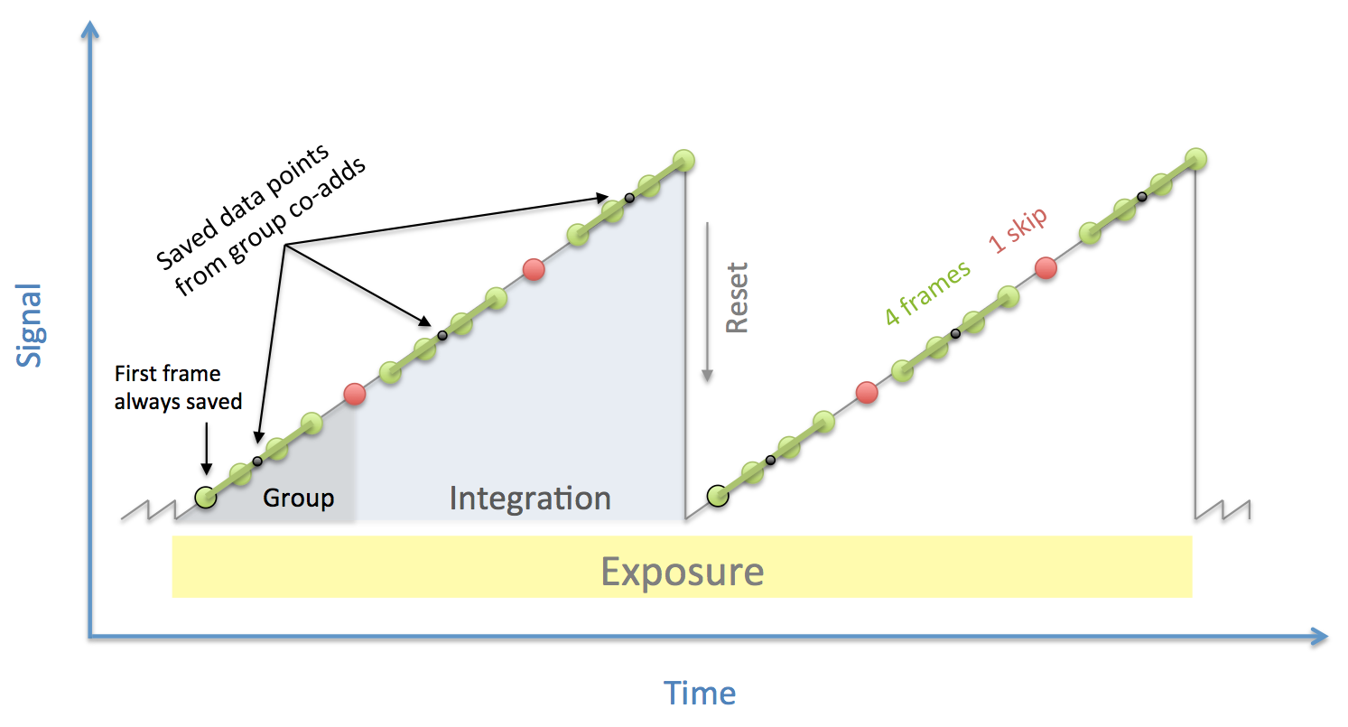
Detectors: Sampling diagram
One Exposure
Two integrations
Three Groups
Four Reads
One Skip

Slide 46
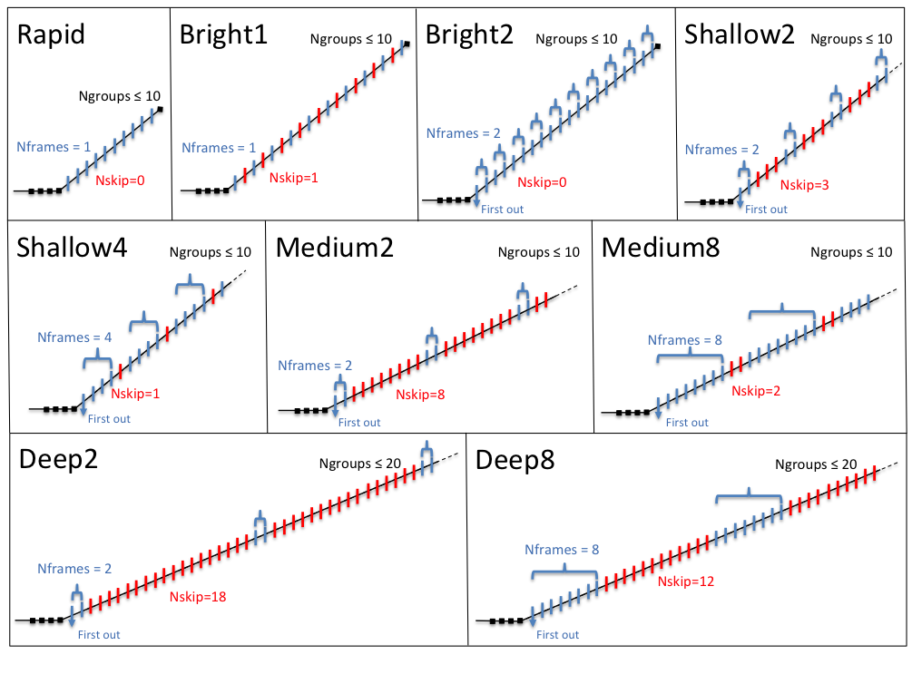

Slide 47
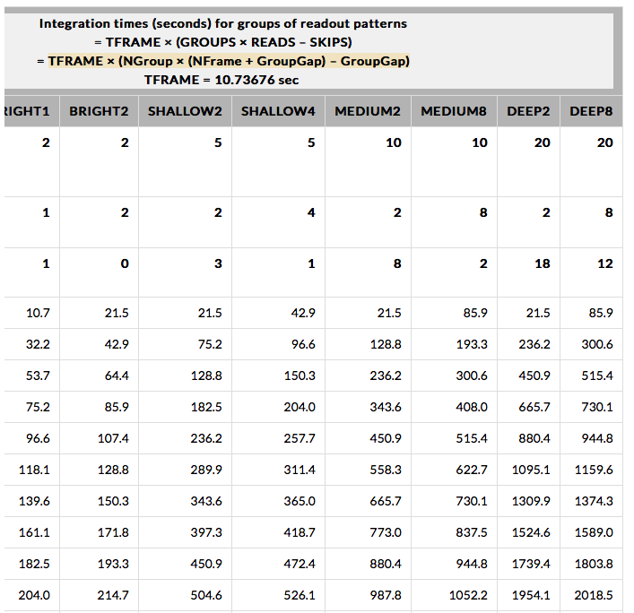
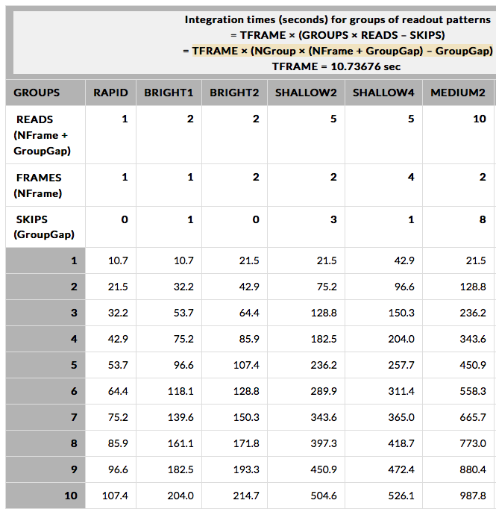
NIRCam Readout Pattern

Slide 48


Slide 49

Optimal Readout Patterns

Slide 50



SCA Performance
CDS noise
CDS noise
Effective
noise
Effective
noise
Notes:
NIRCam noise goes from 20 (CDS) to 12 (effective)

Slide 51

Focal Plane Arrays

Slide 52

NIRISS Readout

Slide 53


Slide 54

MIRI Detector performance
Great cosmetics (<300 dead, hot or noisy pixels in the science field).
PSF well described at long wavelengths by the JWST’s diffraction profile.
  At short wavelengths (F560W, F770W filters) a cruciform pattern appears, at a level comparable to the telescope diffraction spikes. Identified with scattering in the detector.
  A model has been developed using PSF and out-of-field straylight test data which predicts that 22% of the point source light at F560W is scattered into the cross (11% for F770W).

Slide 55
NIRCam Imaging Subarrays
Full Field uses 4 amplifiers, Subarray uses 1
Subarrays are only taken on module B
For imaging subarrays, only SCA B3 for SW
Subarrays have same size in pixels on SW and LW
SW and LW subarrays have the same center on the sky
There are
  Point Source subarrays
  Extended Source subarray

Slide 56

NIRCam Subarrays

Slide 57


Subarrays

Slide 58

MIRI Subarrays
Imager Subarray | Frame time [sec] | Gain in bright source limit
FULL | 2.775 | 1.00
BRIGHTSKY | 0.865 | 3.21
SUB256 | 0.300 | 9.25
SUB128 | 0.119 | 23.32
SUB64 | 0.085 | 32.65
Example: SUB128 subarray has a 14” x 14” FoV and can measure point sources through the F1280W filter with fluxes up to 0.027 Jy x 23.32 = 0.6 Jansky without approaching saturation.
Coronography and time series

Slide 59


NIRCam Sensitivity
Add 6 mag in
Full-array mode
Notes:
Add 256x for full array = 6 magnitudes

Slide 60


MIRI SENSITIVITY

Slide 61
MOSAICS
Mosaic patterns (for any instrument) are intended for covering larger areas of the sky than a single field of view.
Fundamental operational difference between Dither and Mosaic:
  Dithers: all spatial positions in a pattern are imaged through the same filter before making a filter change.
  Mosaics: all filters in an observation (and all dithers) are executed before moving to the next mosaic point.
Thus, dithers with large patterns and large step sizes can incur significant overheads due to spacecraft maneuvers.
This must be balanced against lifetime limitations on filter wheel rotations.

Slide 62

NIRCam MOSAICS
2 rows x 2 columns
306.902" × 133.269" tile spacing
Overlap 0%
row/column shifts: 0/0

Slide 63


Slide 64
Visit Slew Time

Slide 65
Coordinated Parallels
Available Cycle 1:
• NIRCam Imaging and MIRI Imaging
• NIRCam Imaging and NIRISS WFSS
• MIRI Imaging and NIRISS WFSS
• NIRCam Imaging and NIRISS Imaging

Slide 66

Coordinated Parallel Dither Patterns
differences in SI-to-SI orientations and pixel scales
E.g.: MIRI is offset by 4.756 degrees w.r.t. NIRCam
Dither patterns generally keep pixel phases “ideal” to within 0.05 pixel for parallel SI
  • Exception: MIRI at λ > 12 μm (well-sampled anyway)
  • Dither patterns involving MIRI customized for each filter, with offsets >= 3 × FWHMPSF
  • Otherwise typically “Small”, “Medium”, and “Large” dither offsets being offered

Slide 67
Other imaging modes

Slide 68

NIRCam Coronagraphy

Slide 69


Slide 70

Wavefront Sensing

Slide 71
Questions

Slide 72

Optical Layout

Slide 73

NIRCam Pupil and Filter Elements

Slide 74


Slide 75



Slide 76
Observability Constraints

Slide 77

Mosaic Group

