Slide 1
The JWST Exposure Time Calculator
Marco Sirianni
European Space Agency
JWST Info Day – INAF 17 March 2017

Slide 2
Breakdown of the presentation
Introduction of the tool
Demo for NIRSpec FS
Demo MIRI observation (Macarena Garcia Marin)
Demo NIRCAM observation (Massimo Robberto)

Slide 3
Useful Links
First Public Release
Jan 2017
https://jwst.etc.stsci.edu
Webinar
Pandeia – The JWST Exposure Time Calculator (General Introduction)
K. Pontoppidan 27 Jan 2017
https://webcast.stsci.edu/webcast/detail.xhtml?talkid=5387
Webinar
Pandeia – The JWST Exposure Time Calculator (User Interface)
S. Ravindranath 21 Feb 2017
https://webcast.stsci.edu/webcast/detail.xhtml?talkid=5418
Documentation
Released (but still in construction) - MAKE SURE TO READ THE KNOWN ISSUES section -
https://jwst-docs.stsci.edu/display/JPP/JWST+Exposure+Time+Calculator,+ETC

Slide 4
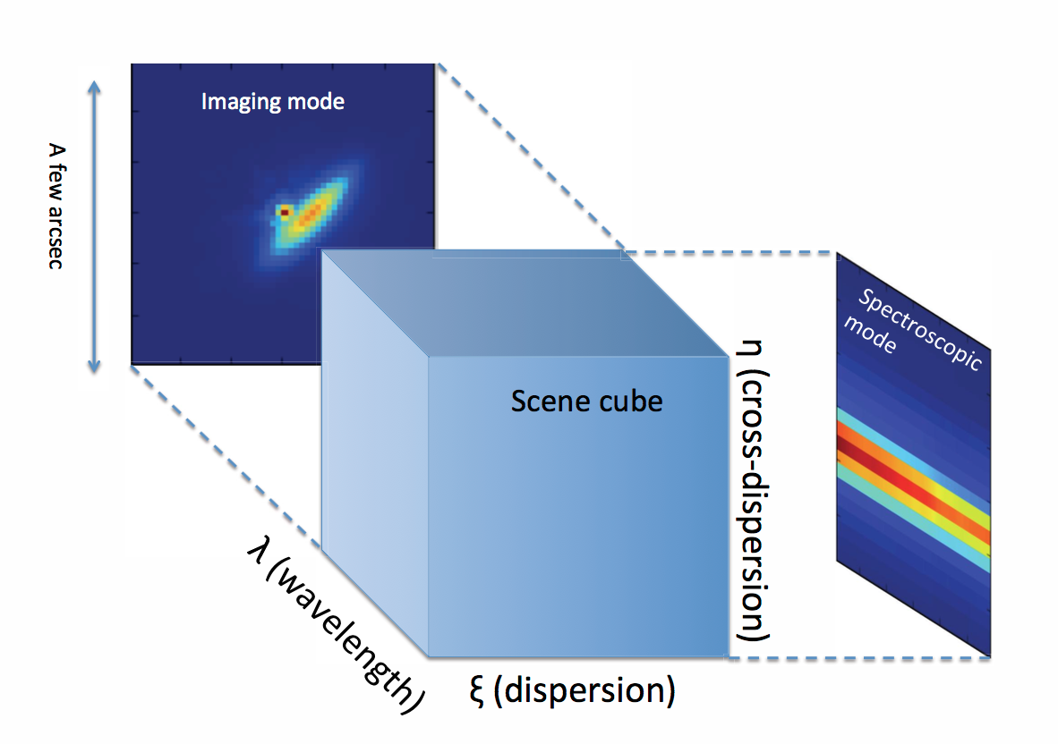
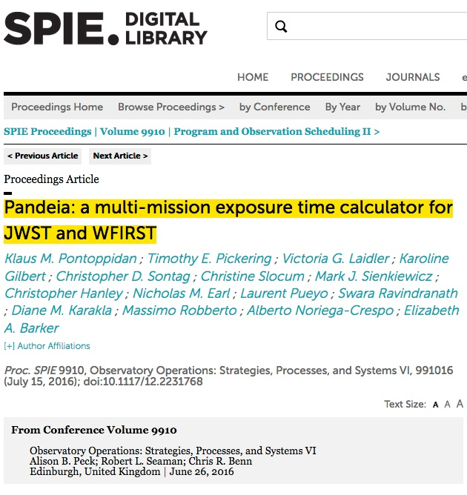
JWST ETC “behind the scene”
Modern Concept:
Signal (source + background) modeled in 3D
Pixel based:
Can model detector (e.g. correlated noise)
final S/N calculation can include data analysis and post processing steps
allows to model complex scene (e.g. estimate contamination from bright sources)
Support all JWST modes
Imaging
Slit, slitless, MOS and IFU spectroscopy
Coronagraphy
Aperture Masking Interferometry

Slide 5
JWST ETC – User Interface
Handle multiple workflows
Interactive handling of plots
Efficient comparison of different sets of calculations
Store and share work with collaborators in workbooks

Slide 6
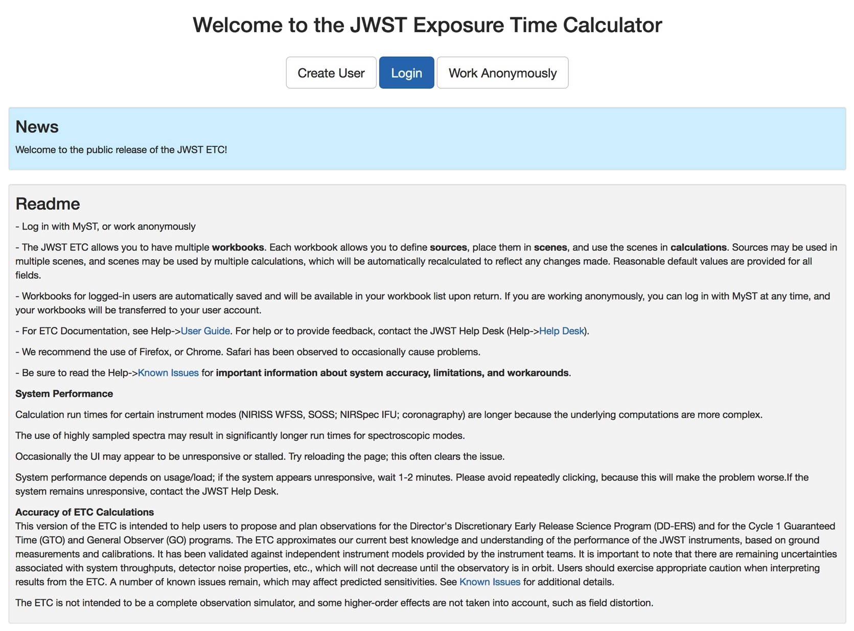
Front Page
https://jwst.etc.stsci.edu/
Very useful links to:
User Guide
Known Issues

Slide 7
Workbook Page – house keeping
When you log in with username/password, workbooks are persistent

Slide 8
3 Step approach
1- CREATE ONE OR MORE SOURCES
The default source is a point source with flat continuum spectrum. For each source, you may specify the SED, normalization, redshift, extinction, emission lines, and shape
2- CREATE ONE OR MORE SCENES
Add one or more sources to the scene: for each source, specify its offset from the center (and orientation, for extended sources)
3-CREATE A CALCULATION
For each calculation, you may specify the scene, the background, the instrument configuration and exposure parameters, and the extraction strategy parameters.

Slide 9
Sorces
Scene can contain multiple sources; source can be included into multiple scenes
Sources can be offset from centre of Scene
How to specify your source
Continuum: flat, black body, power law + templates
Lines: user-specified
Normalise to magnitude/flux in JWST/HST bandpasses or at λ
Upload spectrum: ascii (.dat, .txt) or FITS format. https://jwst-docs.stsci.edu/display/JPP/JWST+ETC+User+Supplied+Spectra for detailed description of file
Extended sources: Flat, Sersic, 2D Gaussian profile

Slide 10
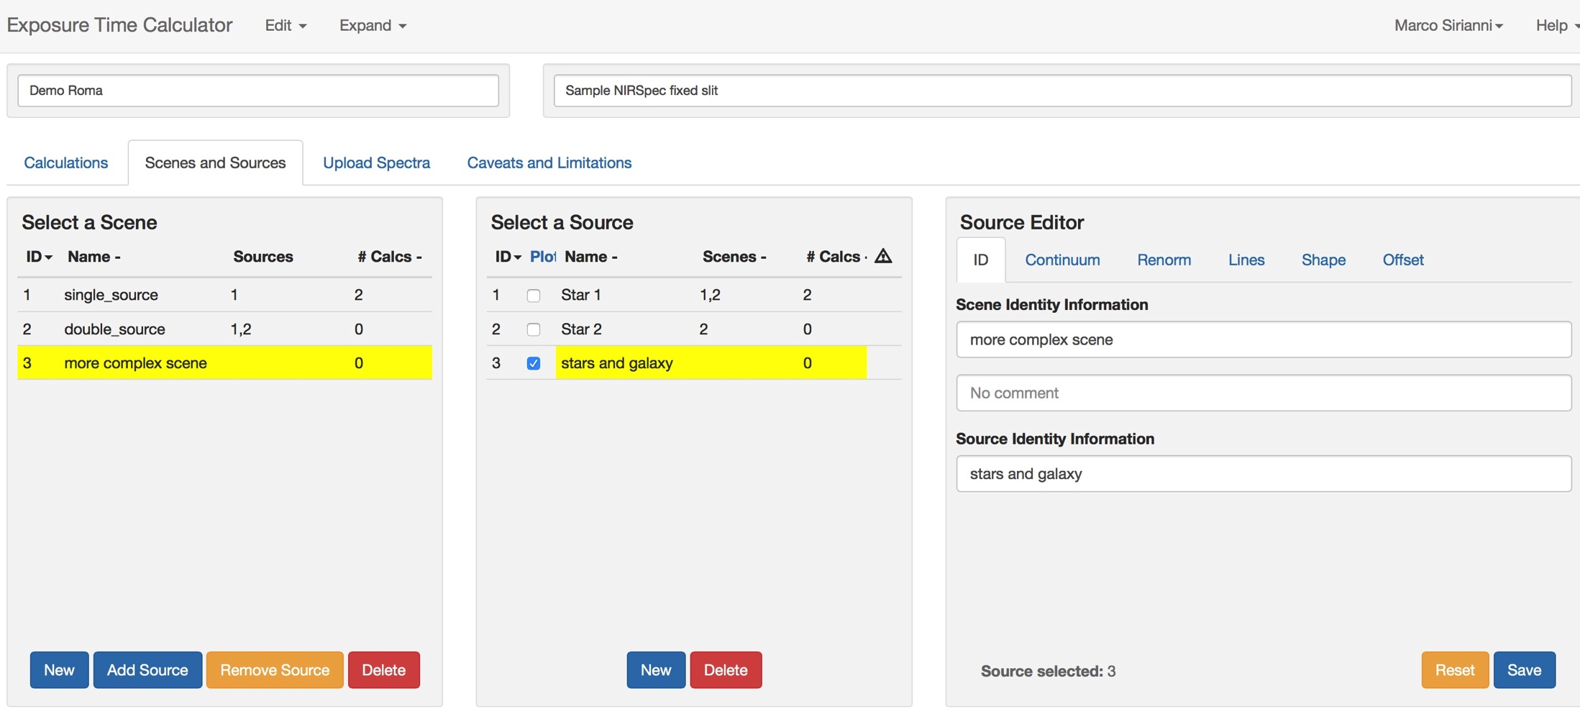

Slide 11
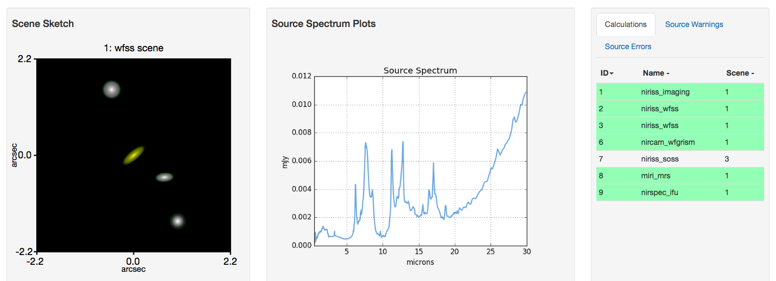
Scene and Source Page

Slide 12
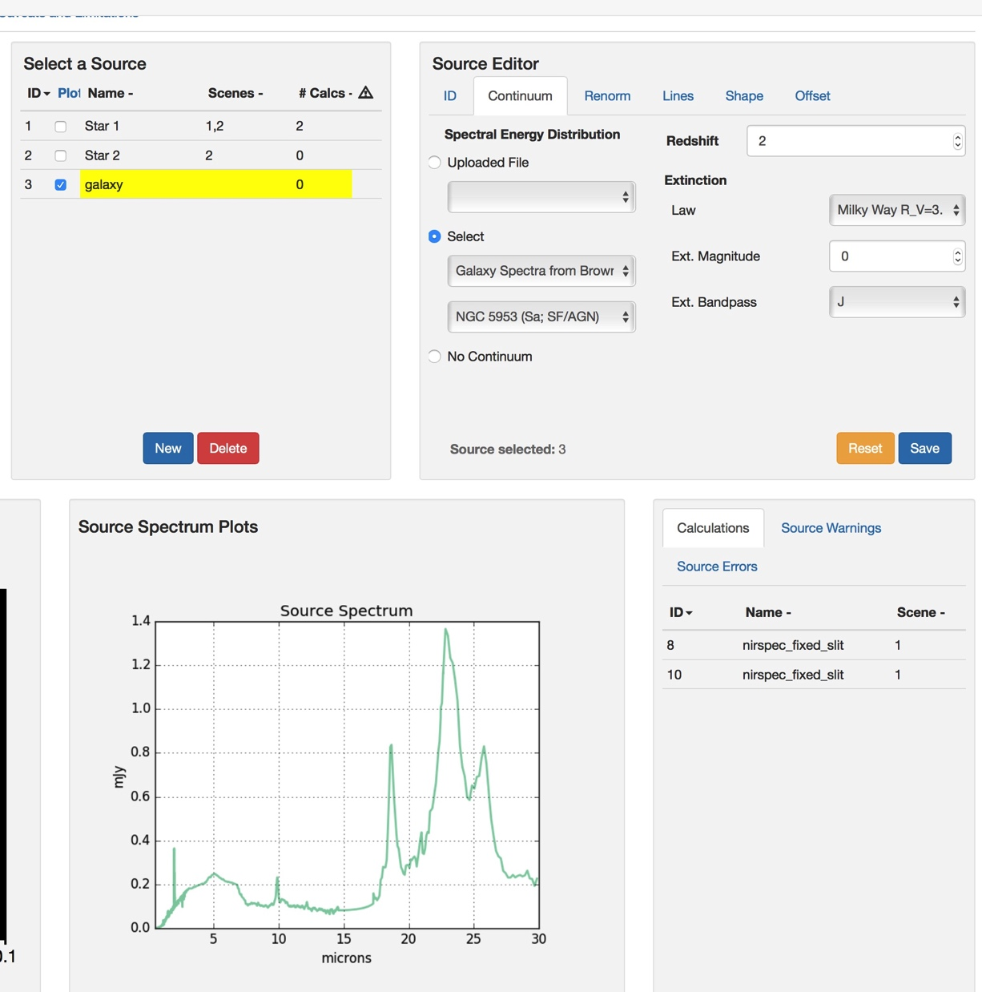
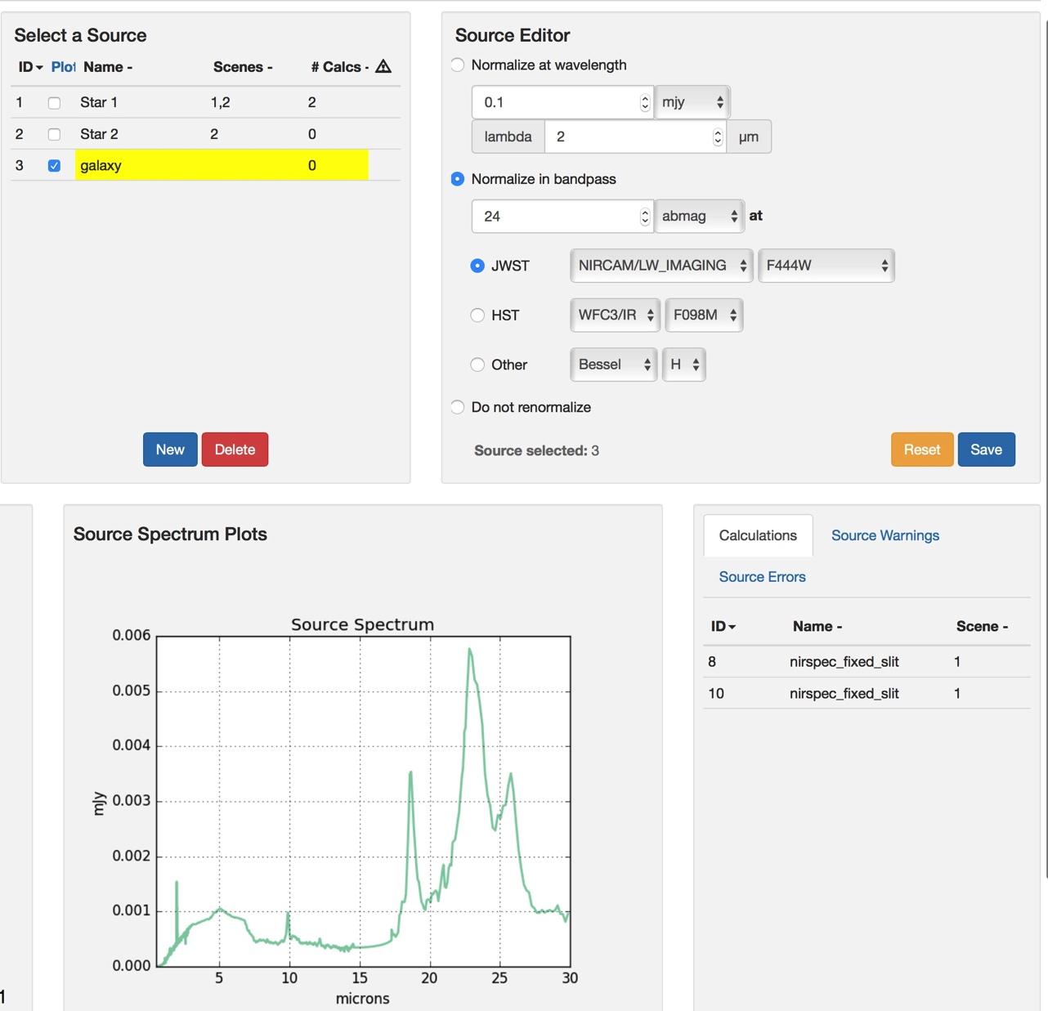
Creating a Source

Slide 13
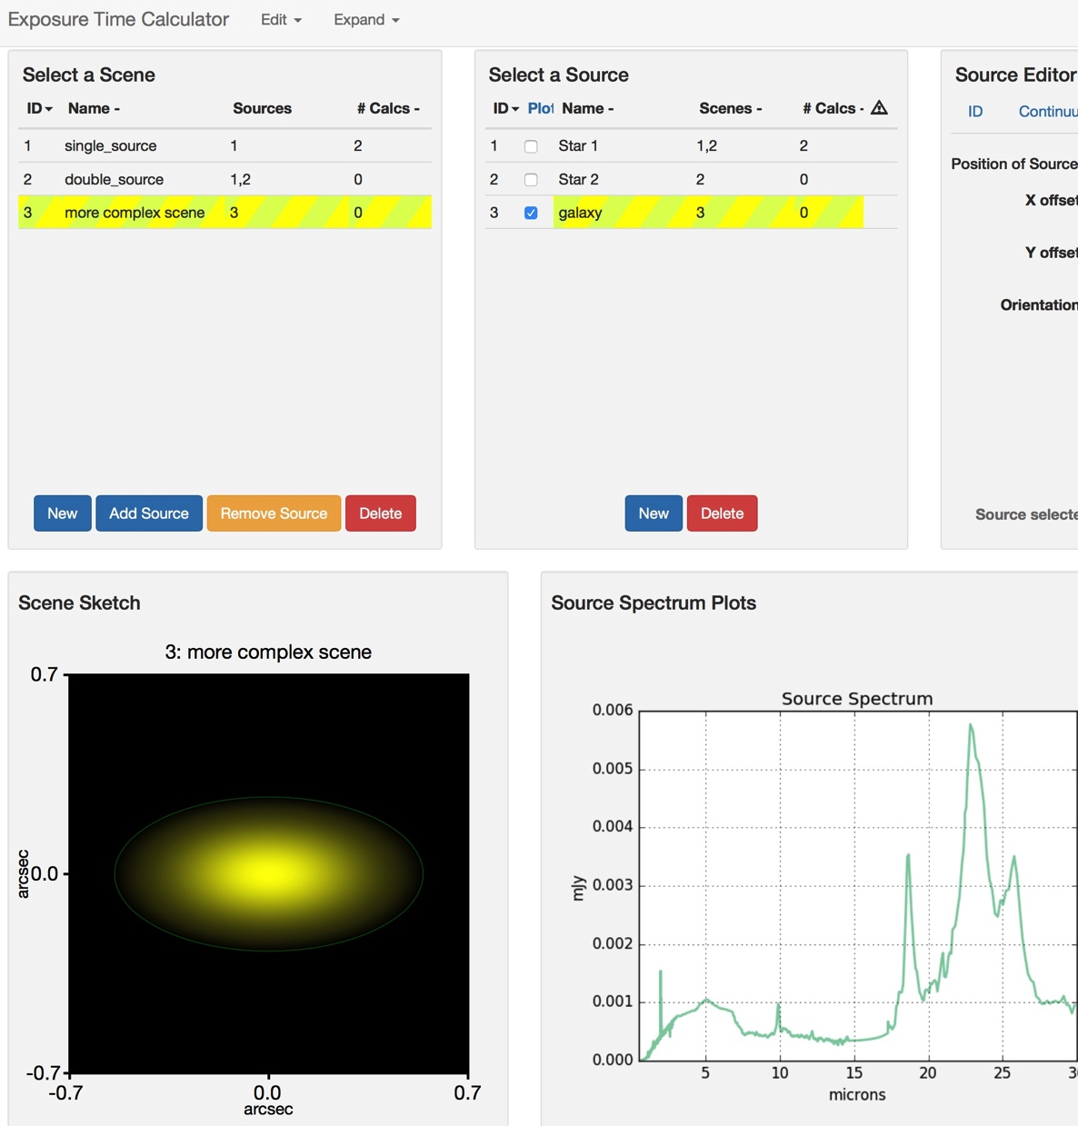
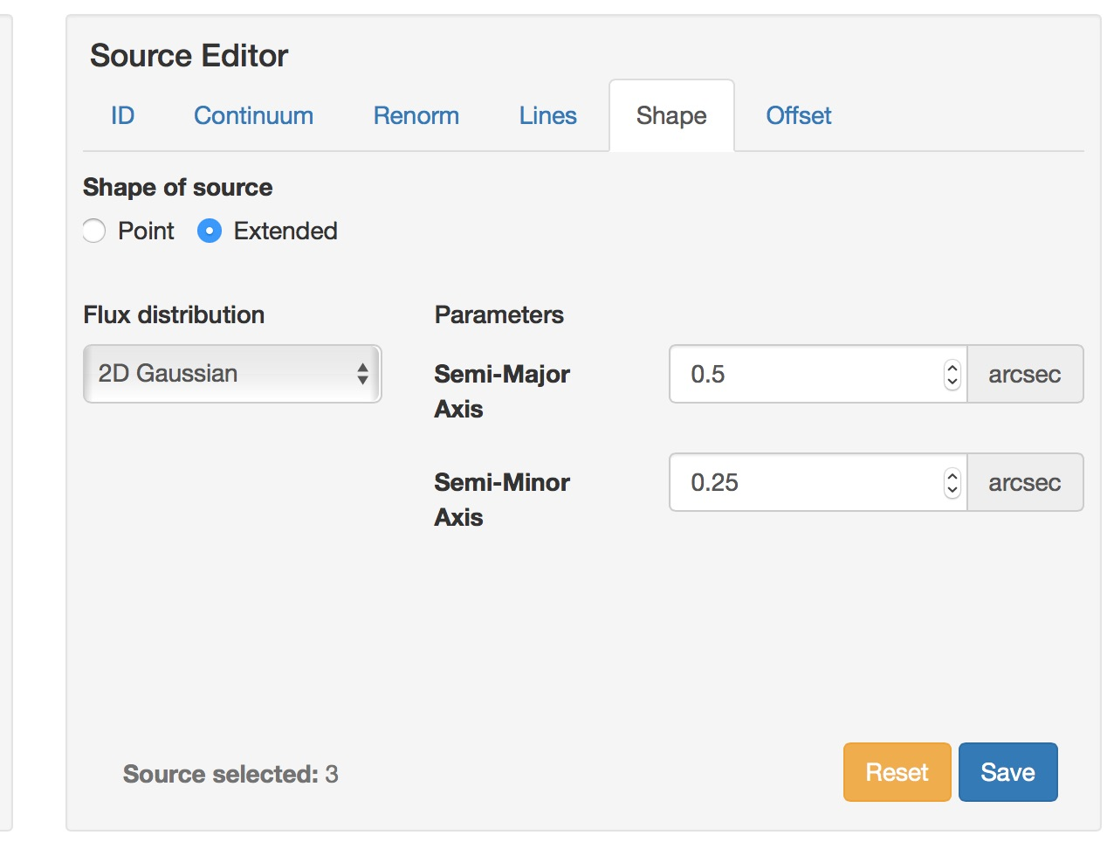
Creating a Source and a scene

Slide 14
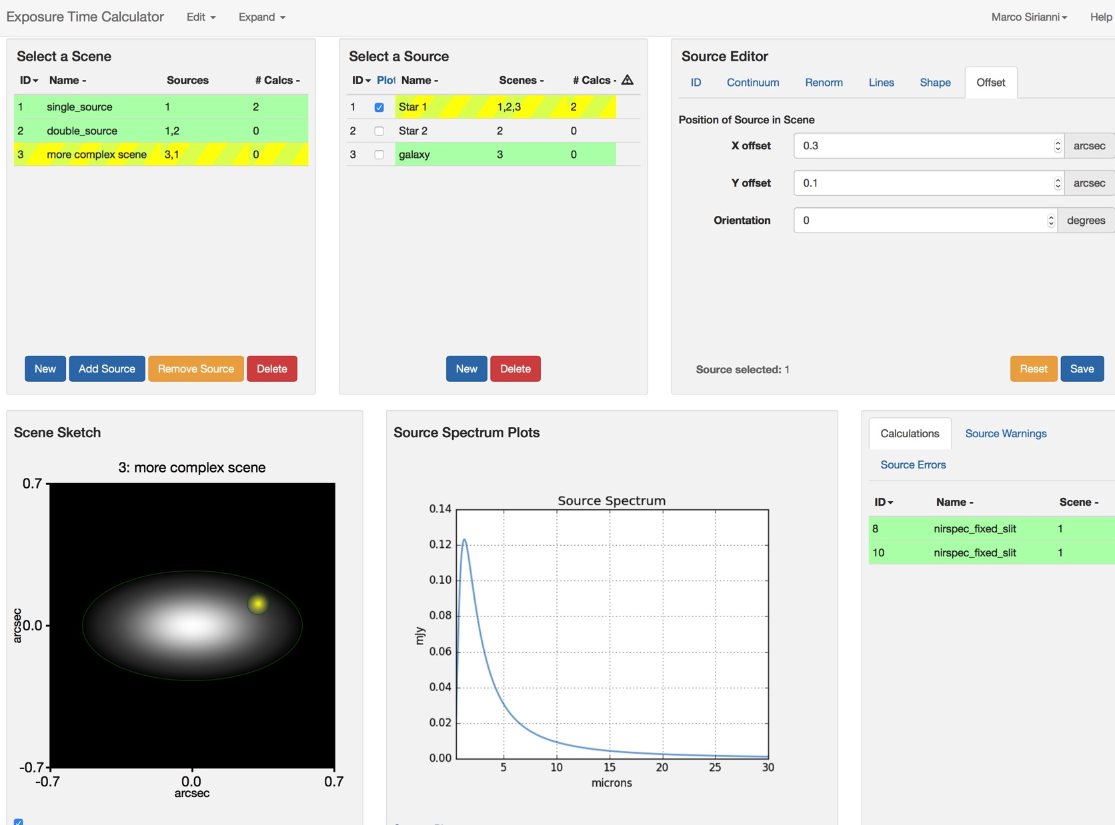
Creating a more complex scene

Slide 15
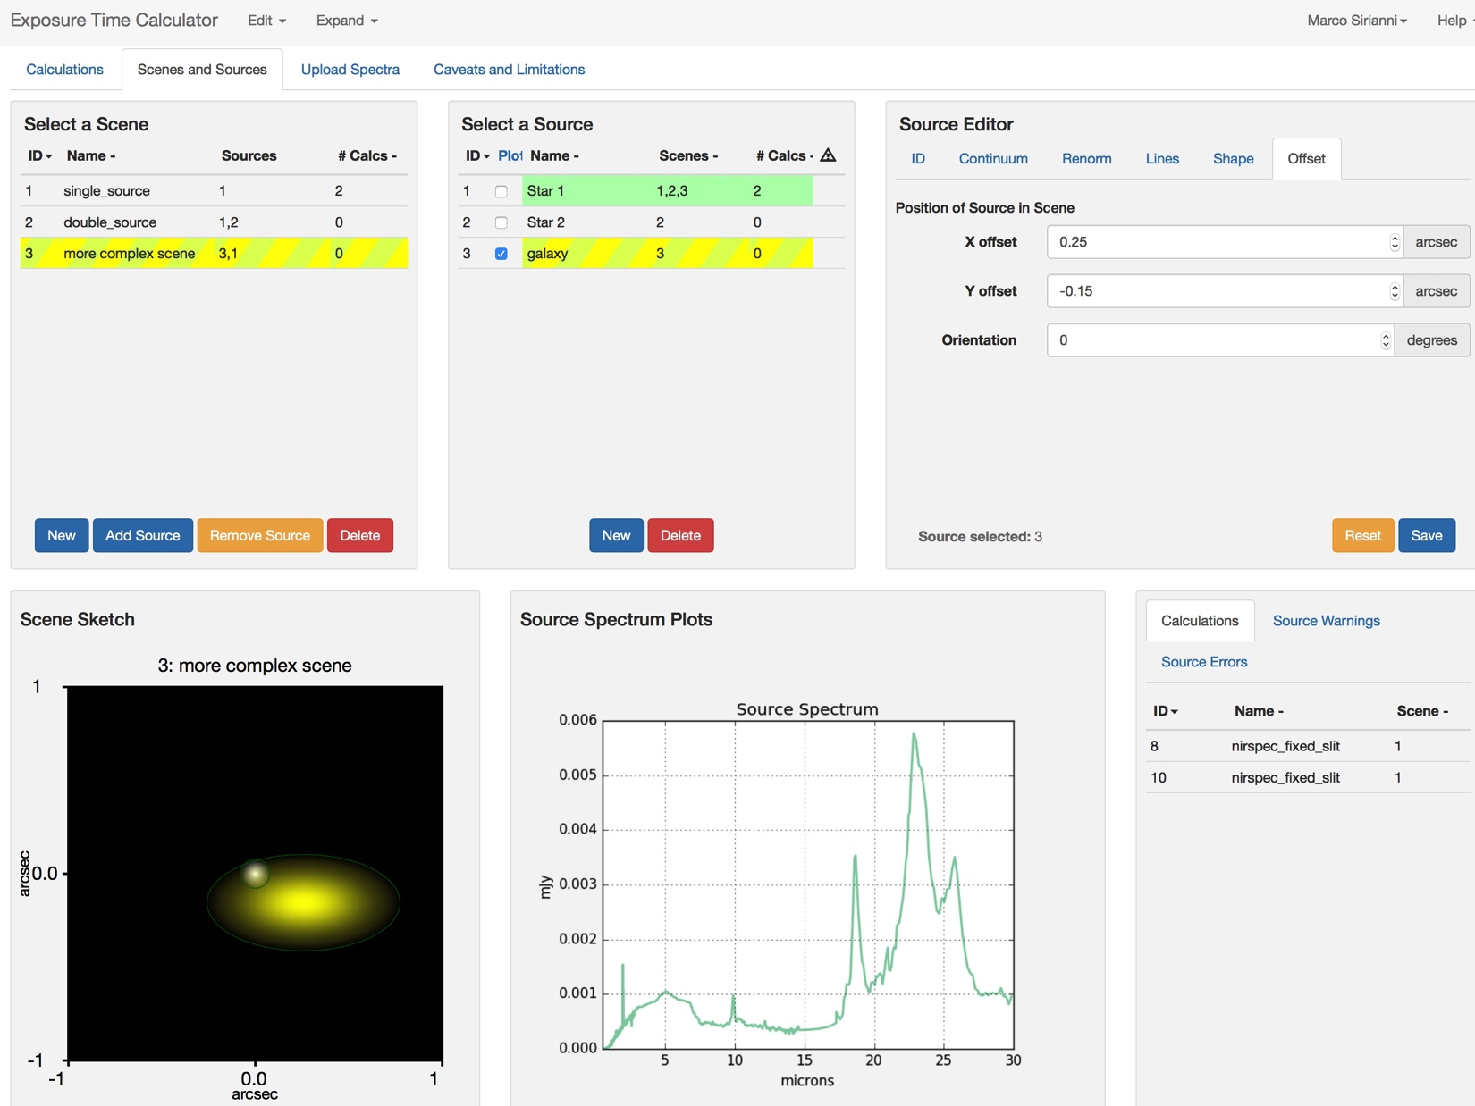
Finalizing the scene

Slide 16
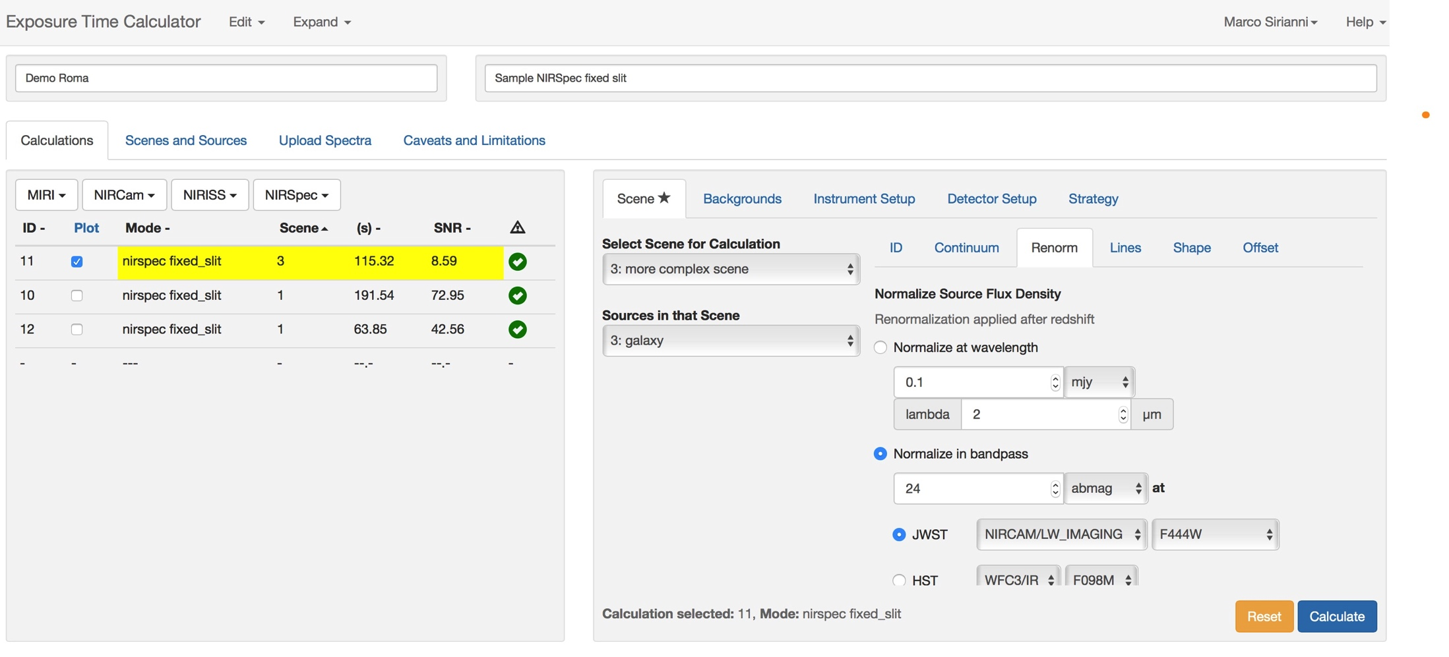
Setting up the scene for the calculation

Slide 17
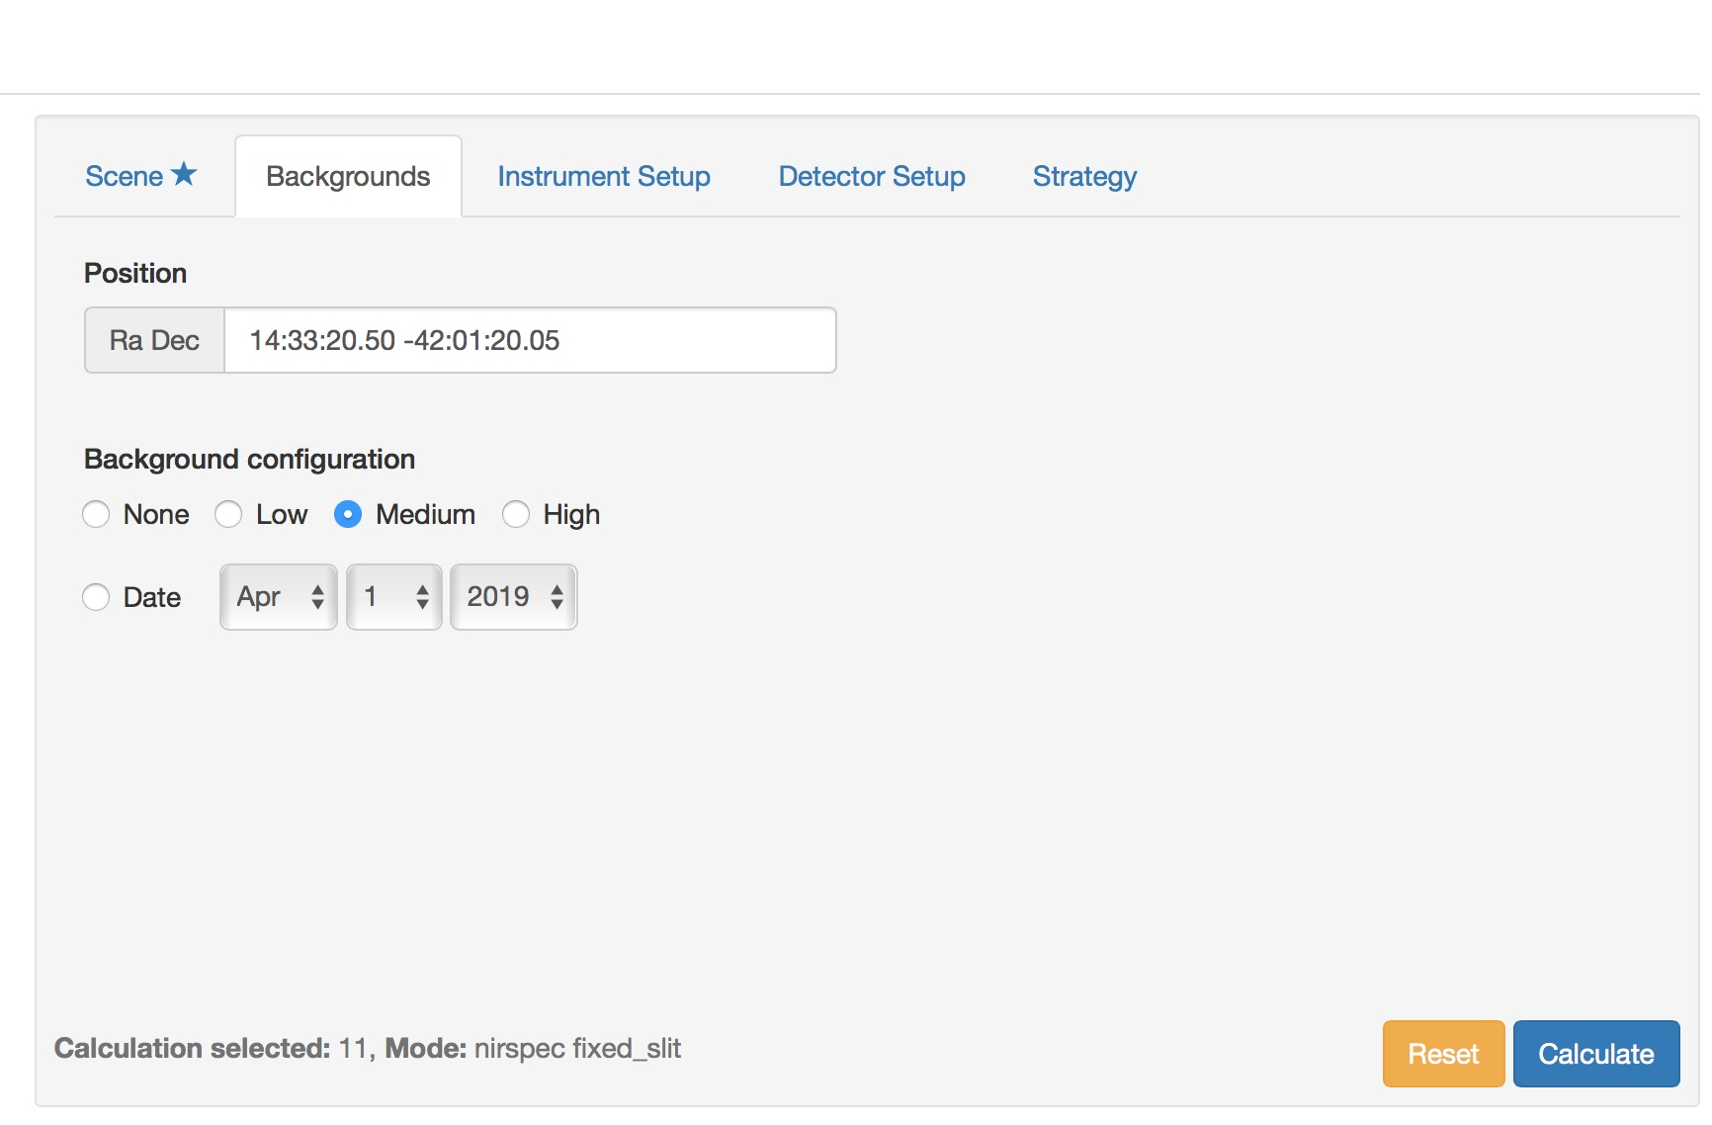
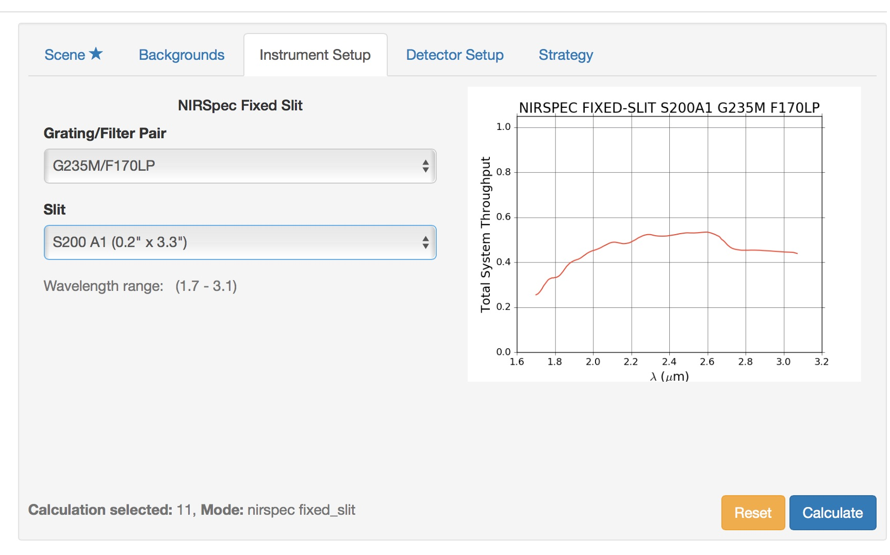
Setting up the calculation and strategy

Slide 18
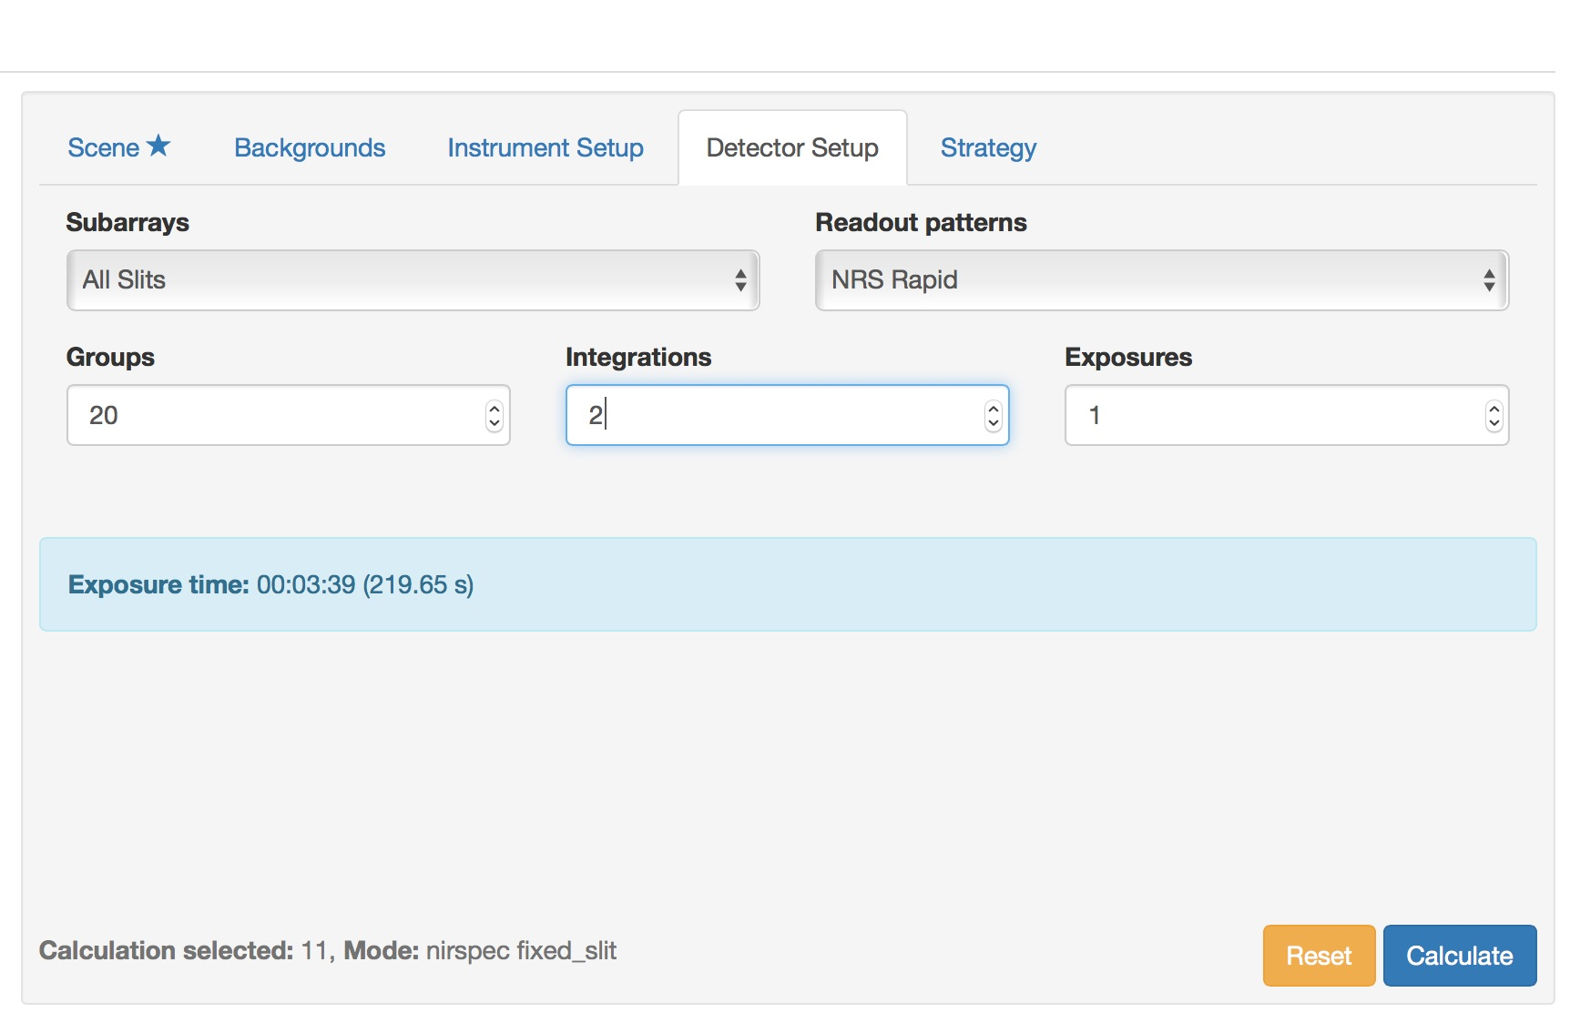
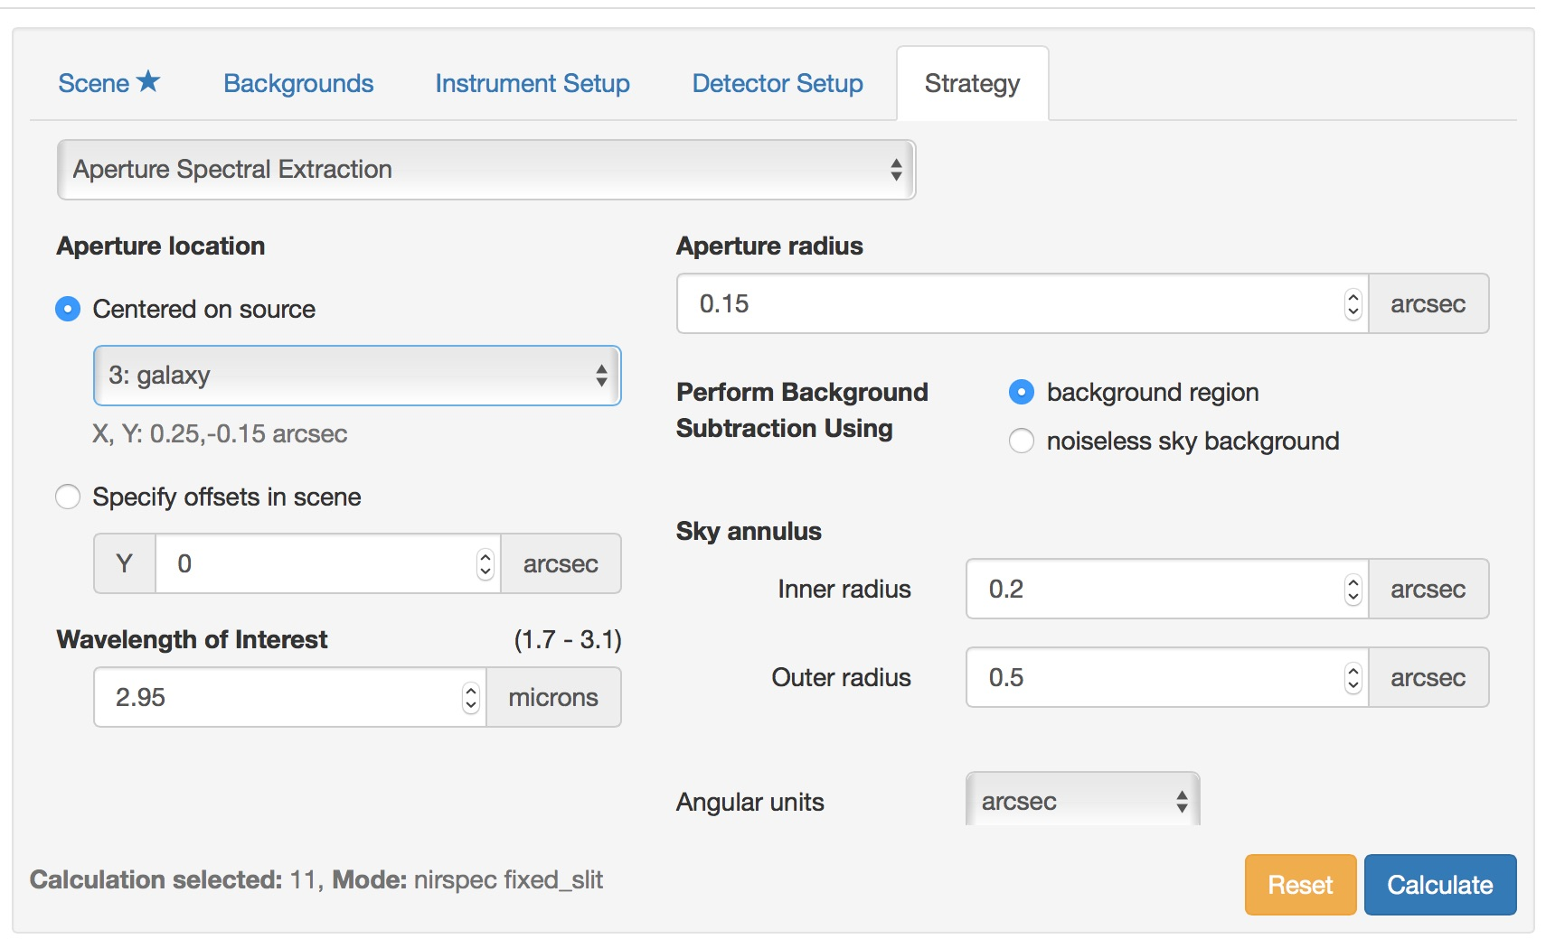
Setting up the calculation and strategy

Slide 19
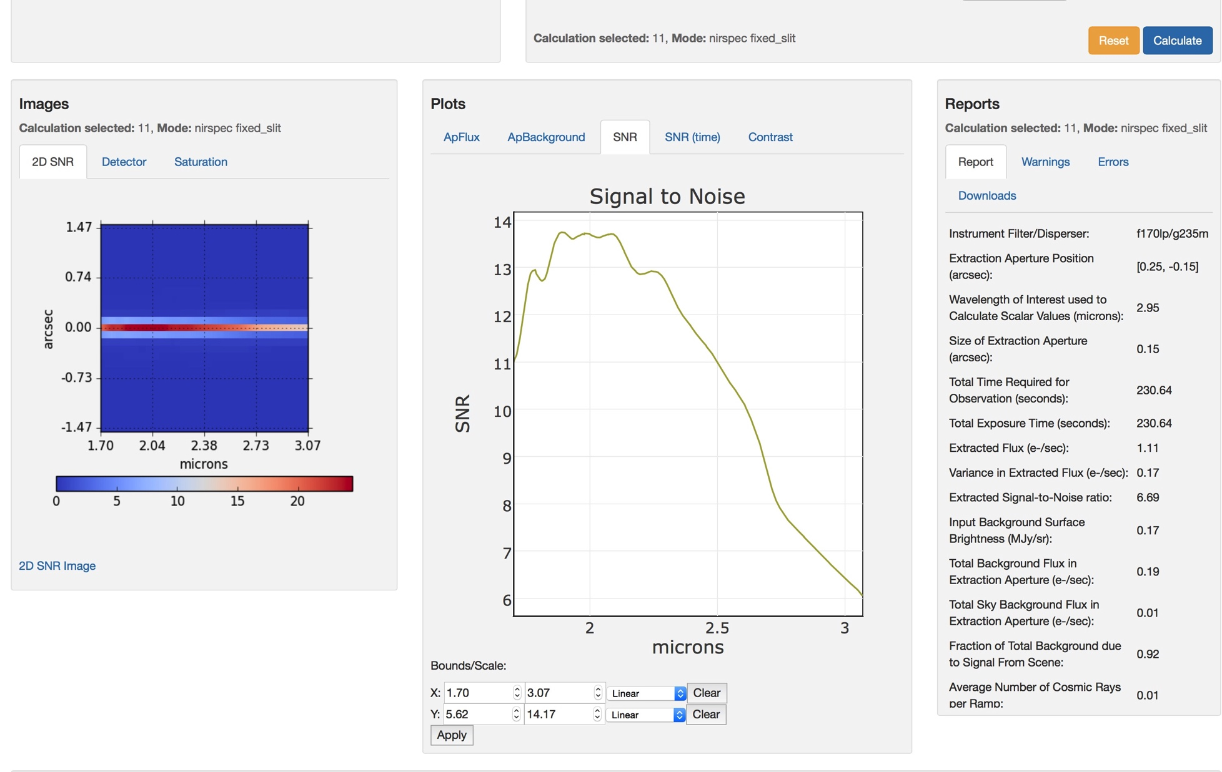
Result of a calculation

Slide 20
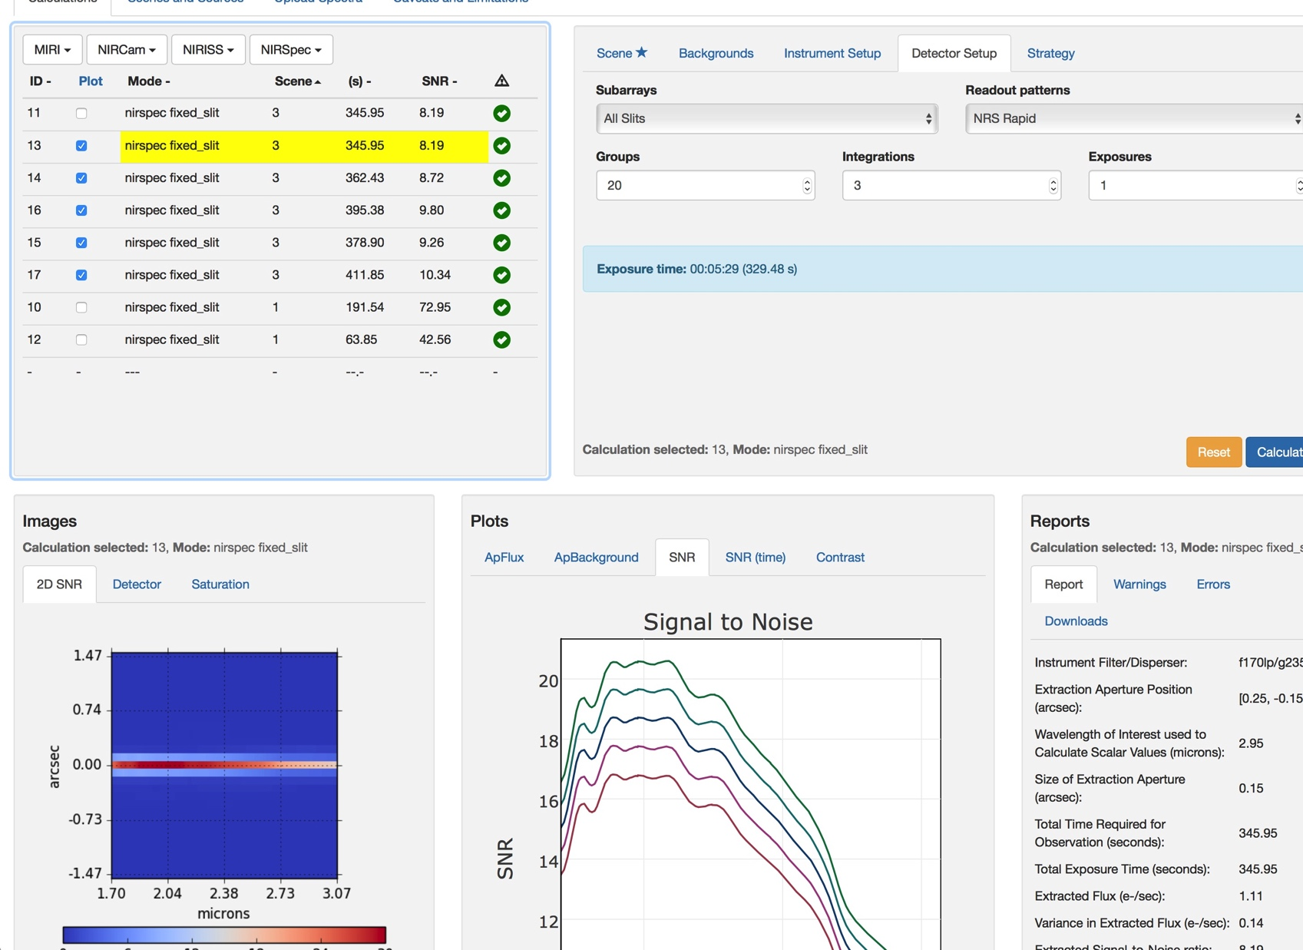
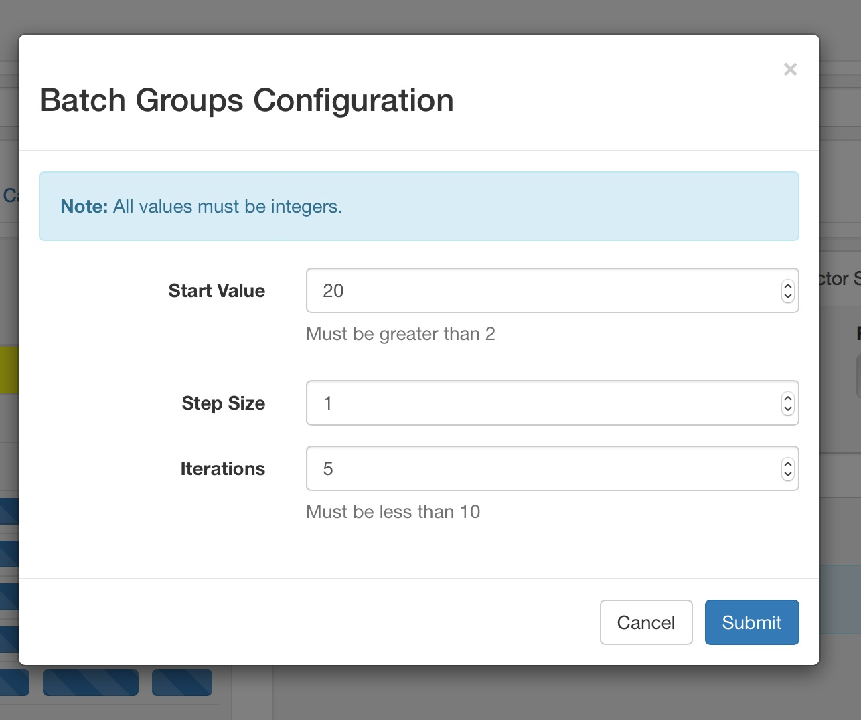
Exploring the parameter space

