Slide 1
APT Examples: MIRI
Macarena Garcia Marin
European Space Agency

Slide 2
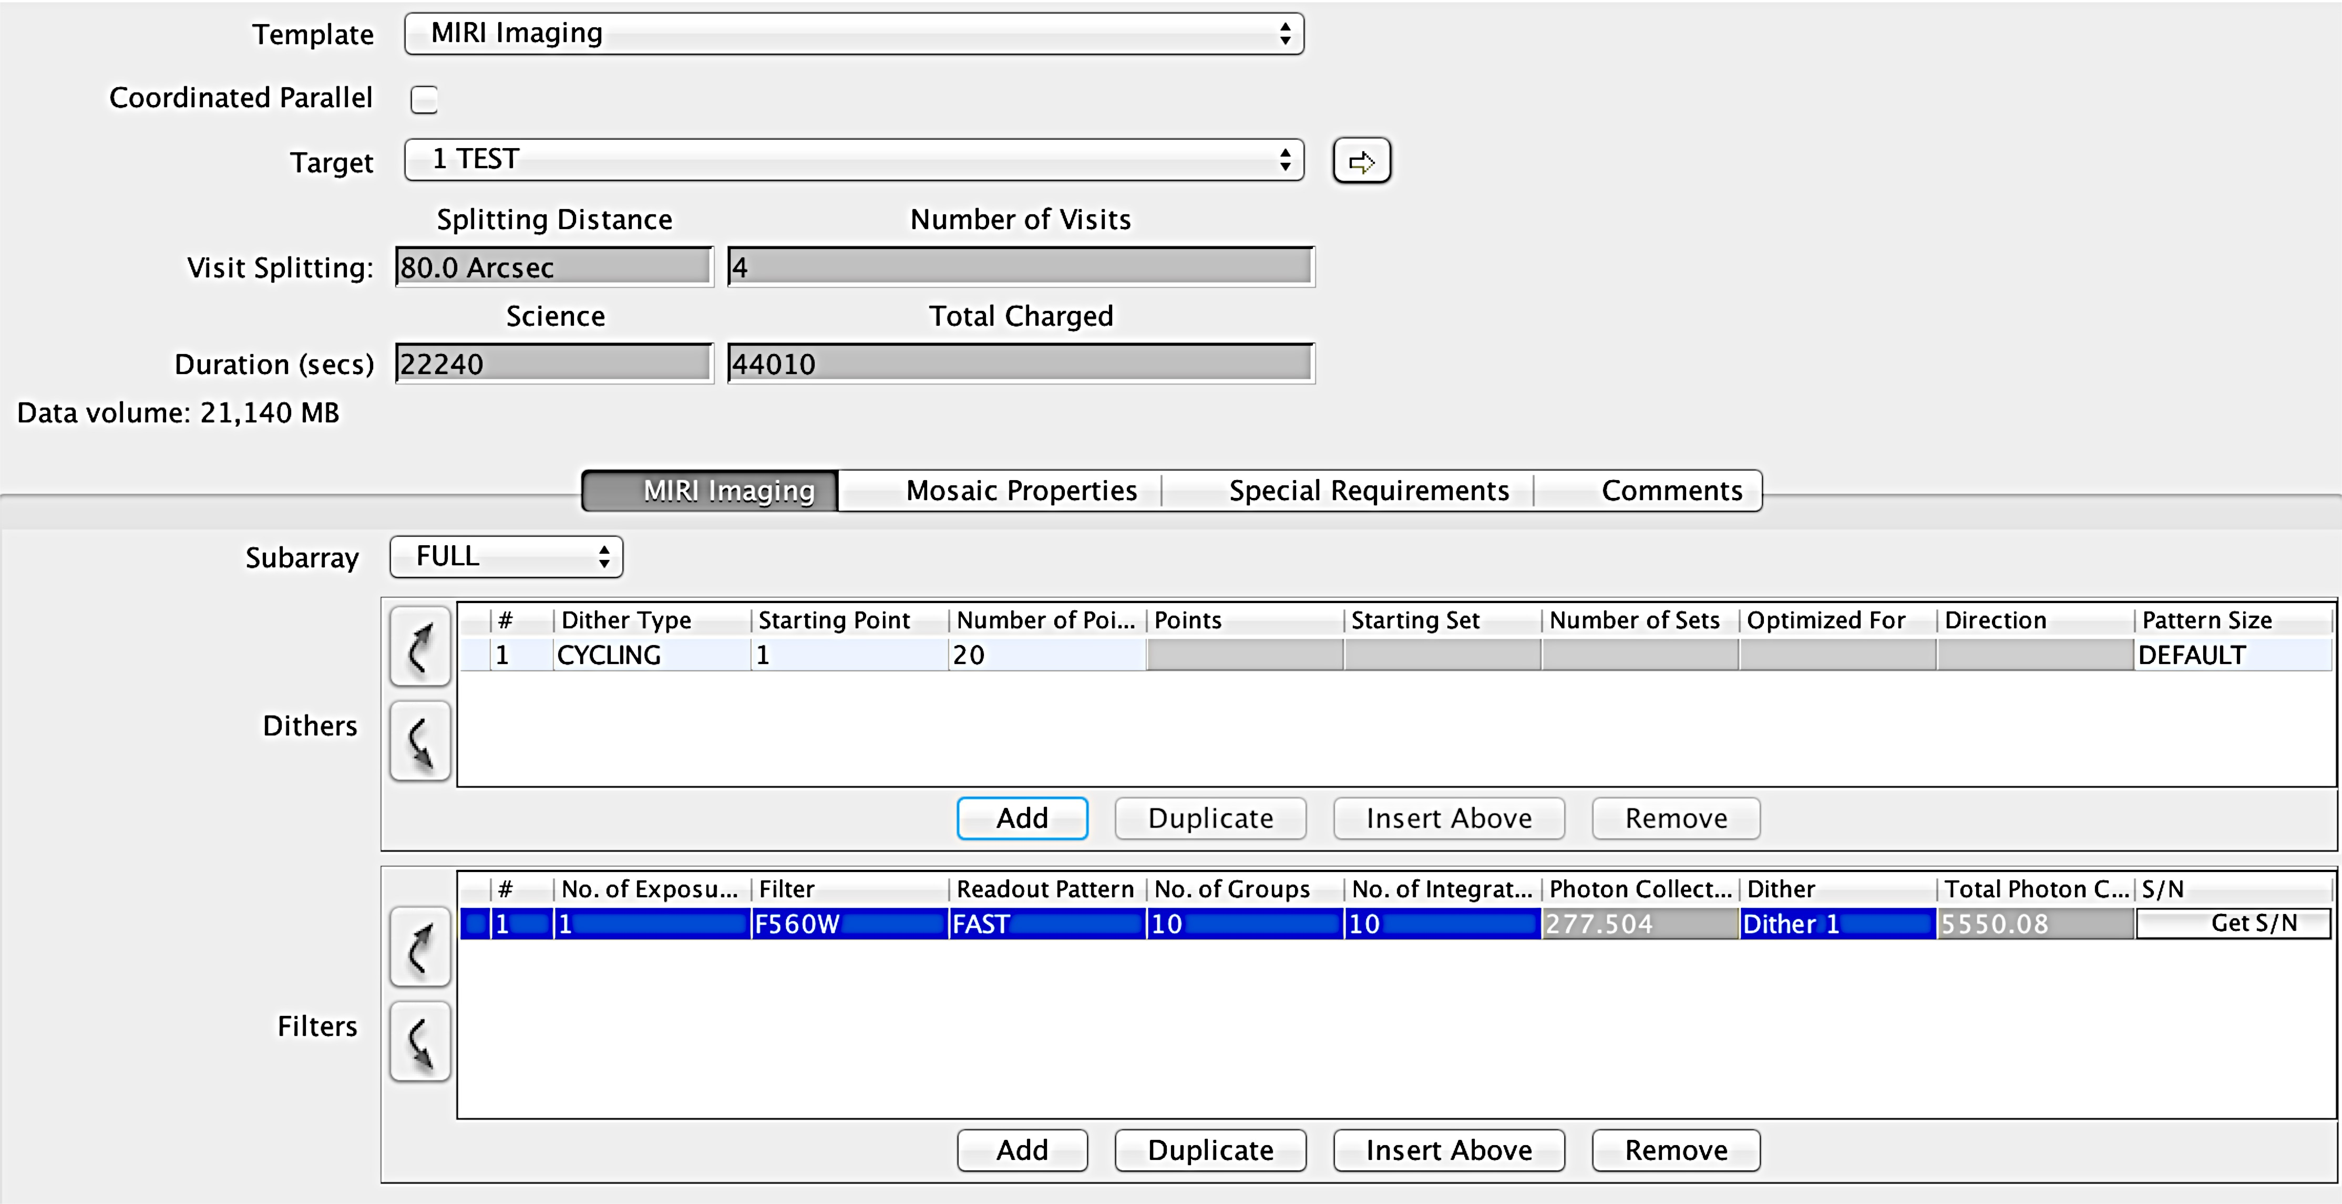
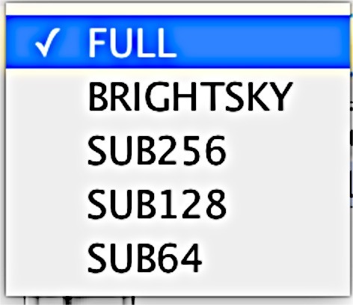
MIRI Imager template
TA not available at the moment.
Expected in upcoming version
Limit 58000 MB

Slide 3
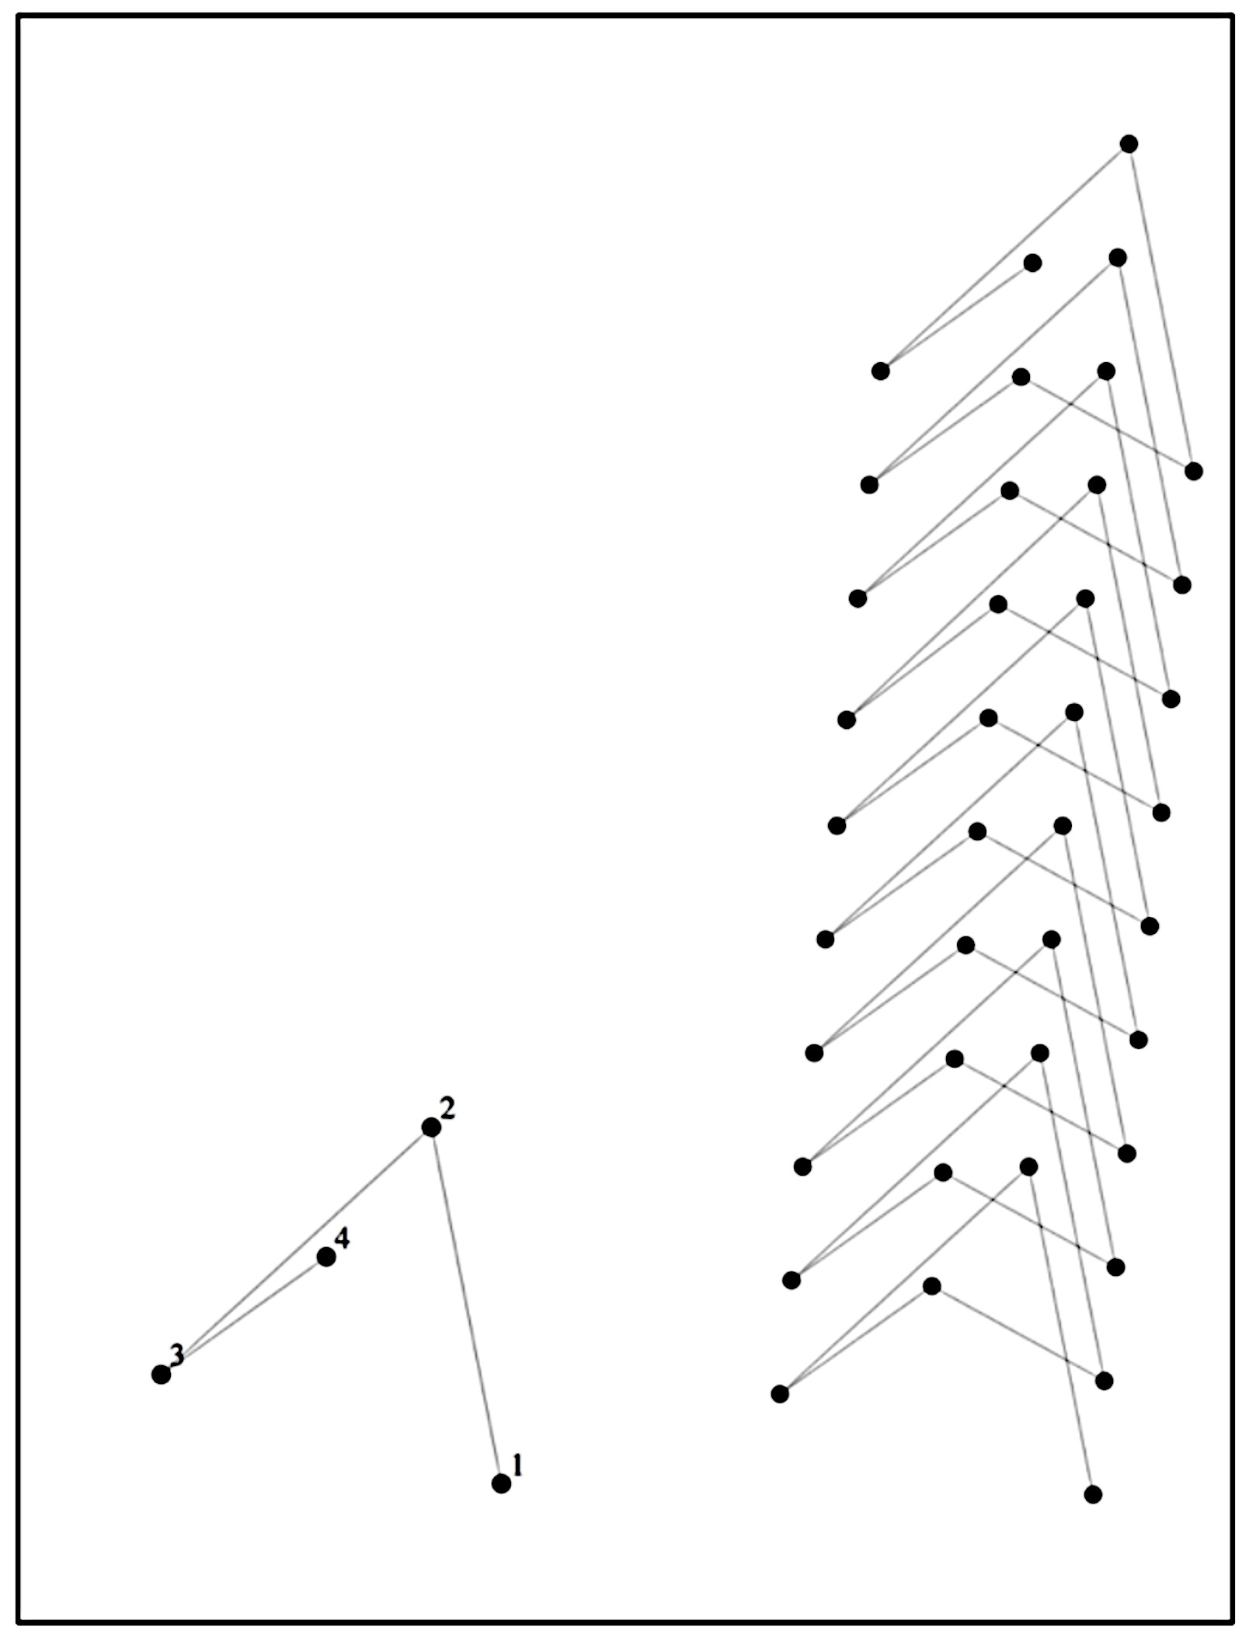
MIRI Imager template: dither patterns
There are 4 (5) dither patterns for the imager
They are optimized for different
Subarrays/wavelength:
• 2-Point pattern:
Allows for a simple image and background subtraction.
Only recommended in certain science cases
• 4-Point pattern
The most basic pattern separating PSF and avoiding sampling the same row column. There are versions for point and extended sources.
This was designed to be repeated in a single direction to avoid overlapping/persistence.
Image Credit: Brendan Hagan

Slide 4
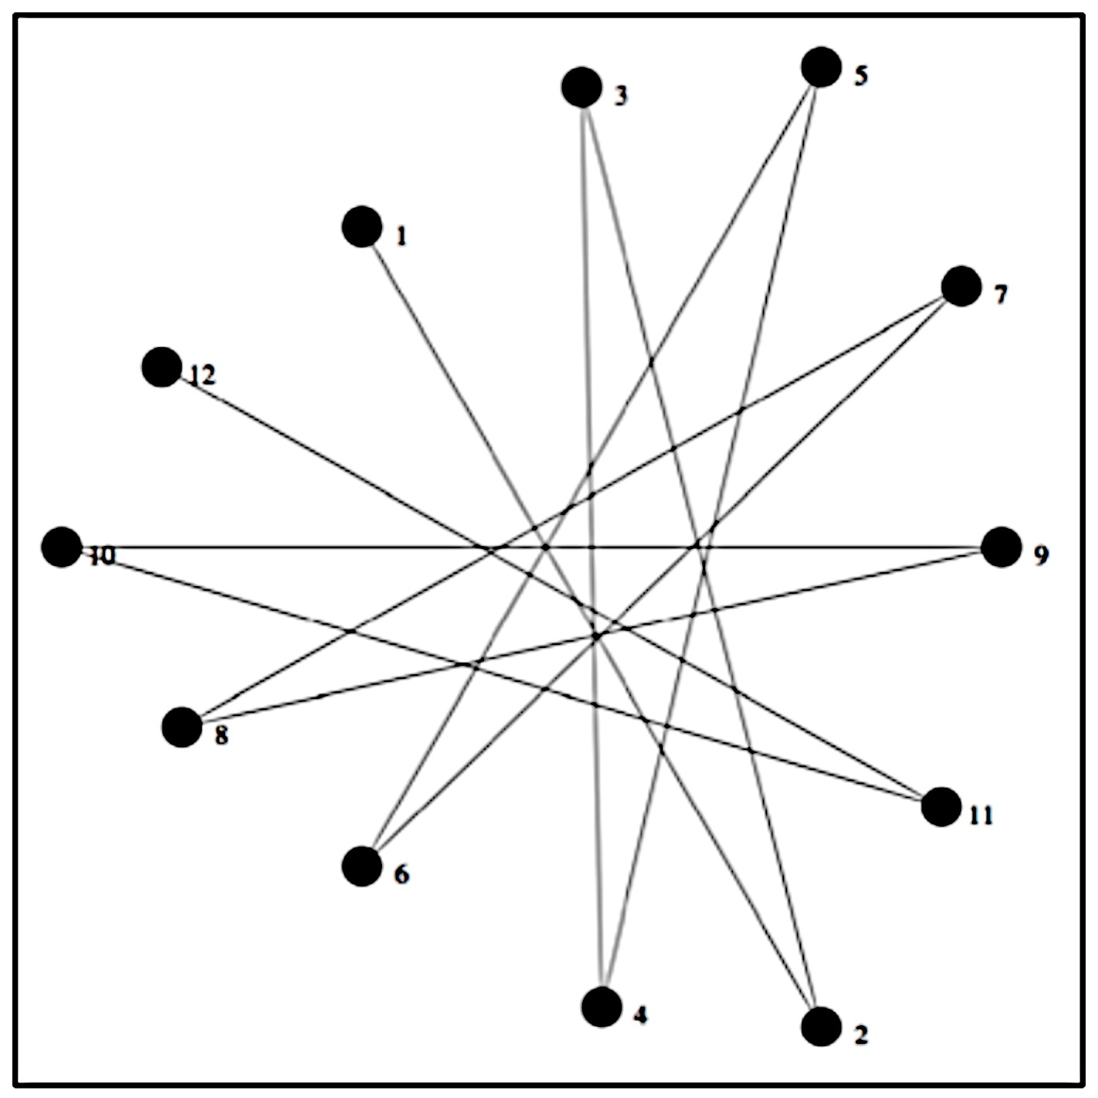
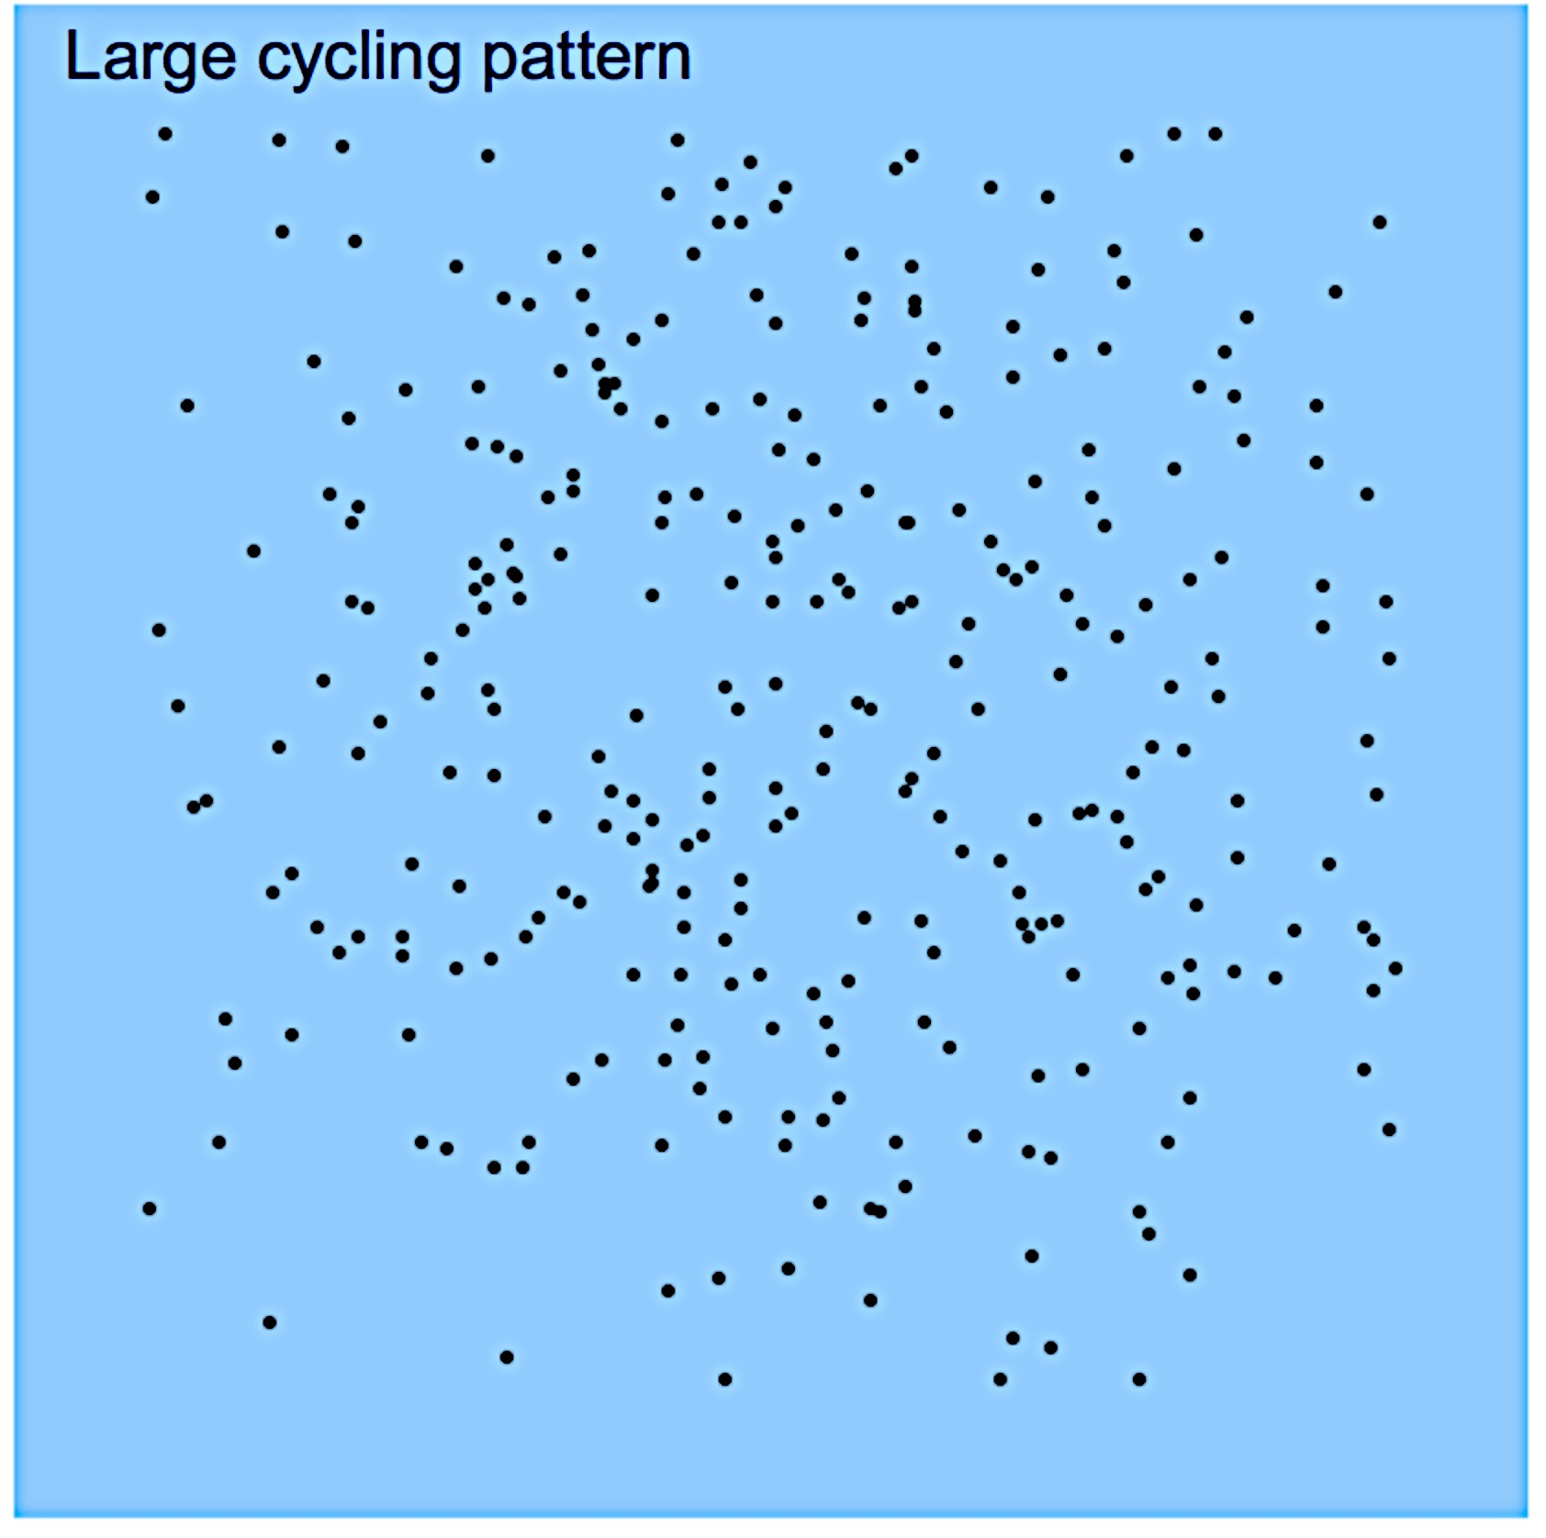
MIRI Imager template: dither patterns
Reuleaux pattern
- A 12 point pattern that originates from Spitzer IRAC
Pattern comes in 3 sizes small, medium and large
  - Some (undocumented) evidence from Spitzer/IRAC that the pattern led to correlated noise due to is uniform repetition.
Cycling pattern
- The current cycling pattern has 311 (proposal to have 312) points and has 3 sizes like the Reuleaux.
- Designed as a truly random pattern to aid optimal calibration steps (self-calibration)
User can choose any start point and any number of dithers. They have to be consecutive points.
Sparse cycling: “restricted mode”. The user can pick any number of point from the cycling pattern (non-consecutive).
Pay special attention to dither patterns for sub-arrays because not all patterns can be used
The most up to date information on dithers can be found on Jdox.
Image Credit: Brendan Hagan
Image Credit: STScI

Slide 5
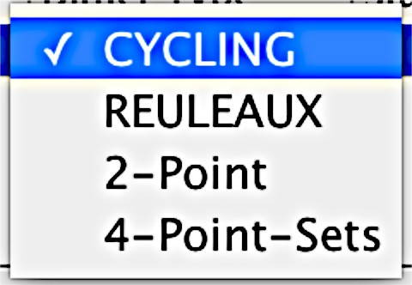
MIRI Imager template: dither patterns
TA not available at the moment.
Expected for APT 25.2
Sparse cycling not shown

Slide 6
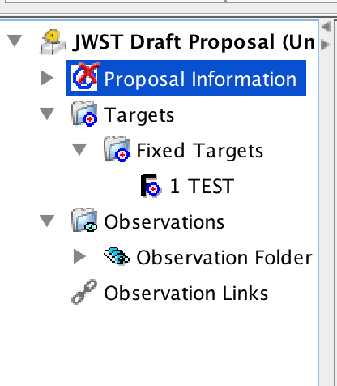
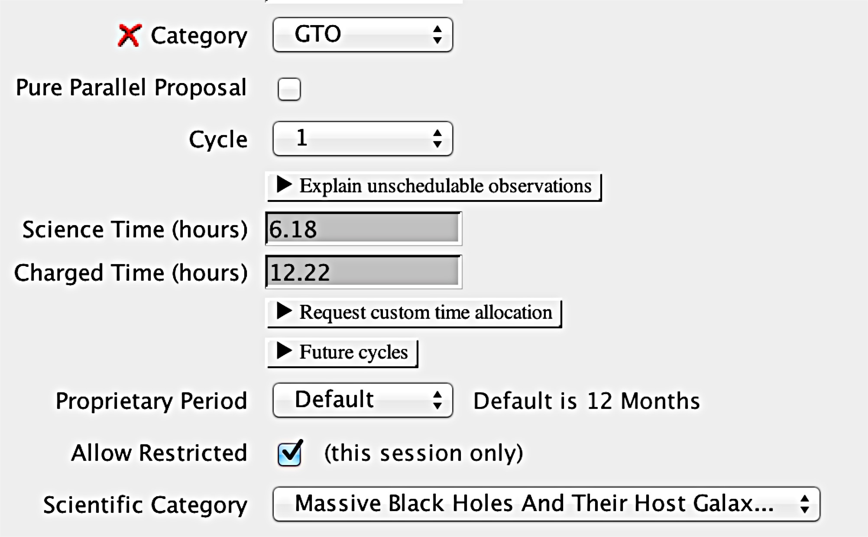
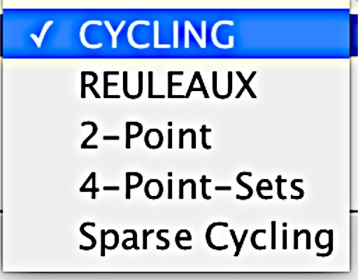
MIRI Imager template: dither patterns

Slide 7
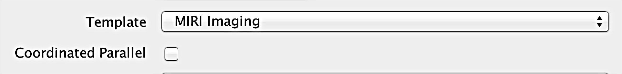
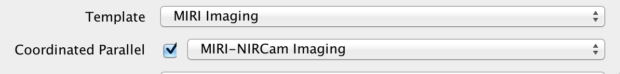

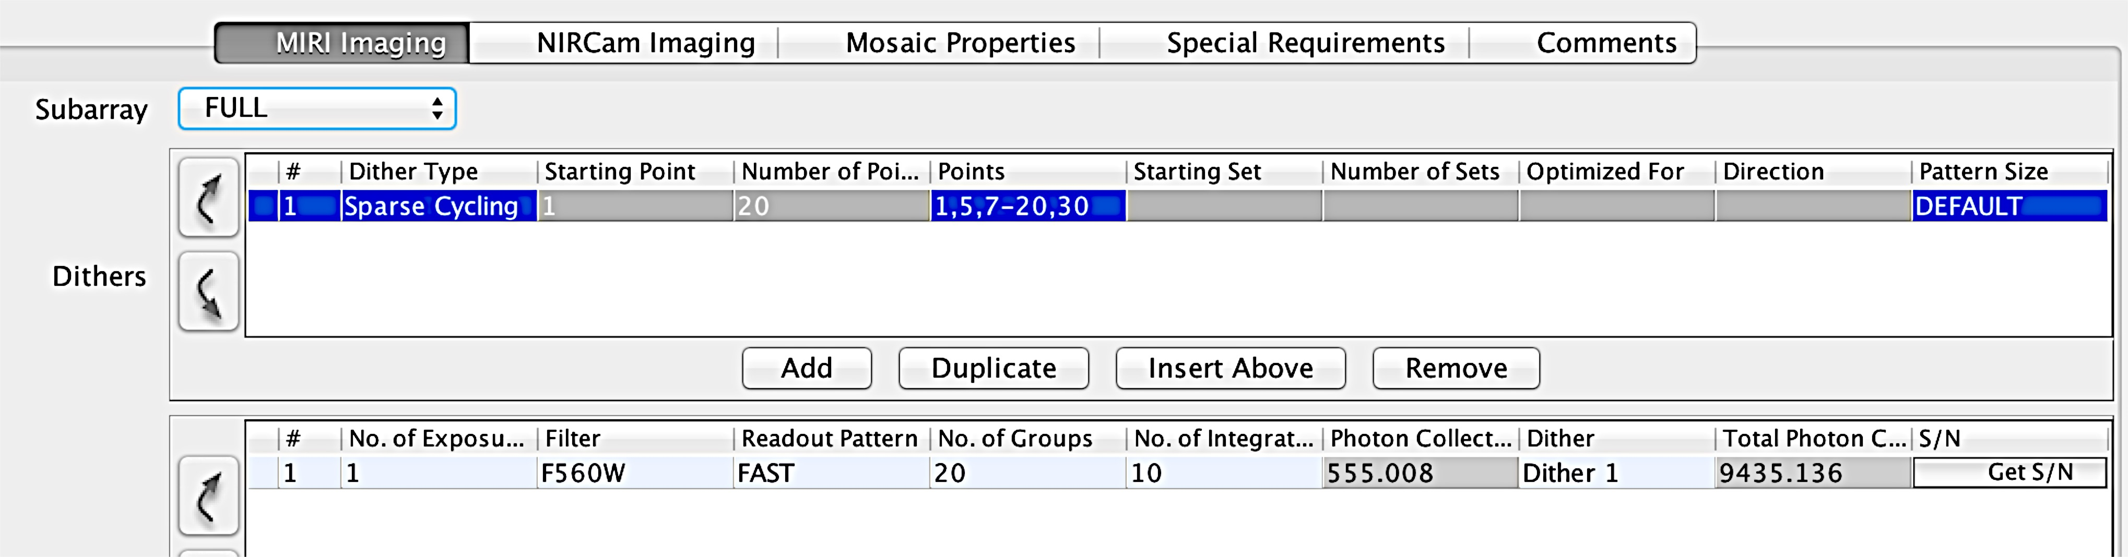
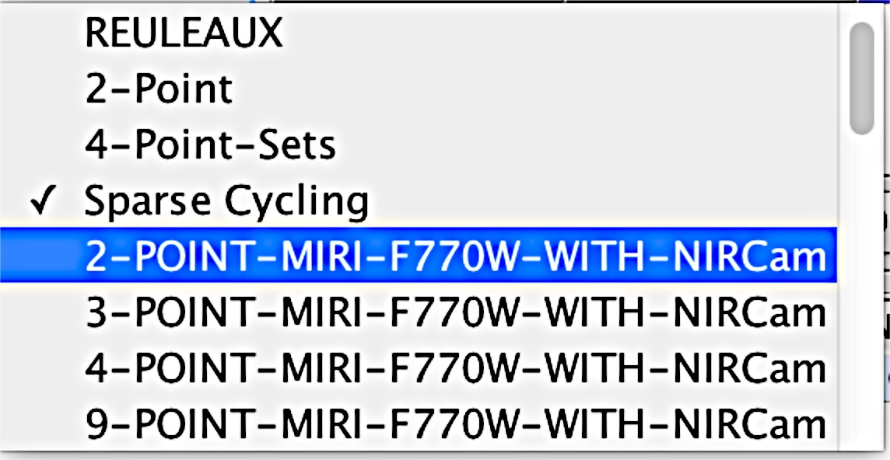
MIRI Imager template: coordinated parallels

Slide 8
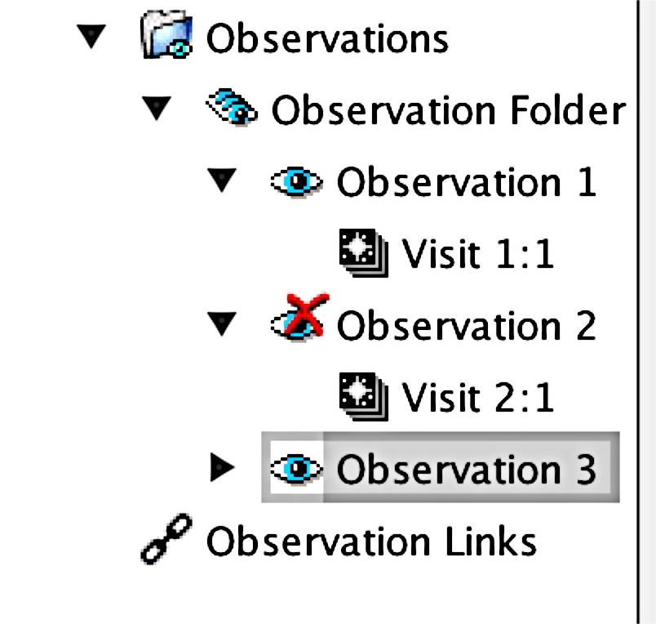
MIRI Imager template: coordinated parallels
MIRI-NIRCam parallel
MIRI-NIRISS parallel
MIRI-NIRCam parallel (different filters and dithers)
Note that the prime instrument drives the observation. The parallel instrument exposure time has to be equal or shorter.

Slide 9
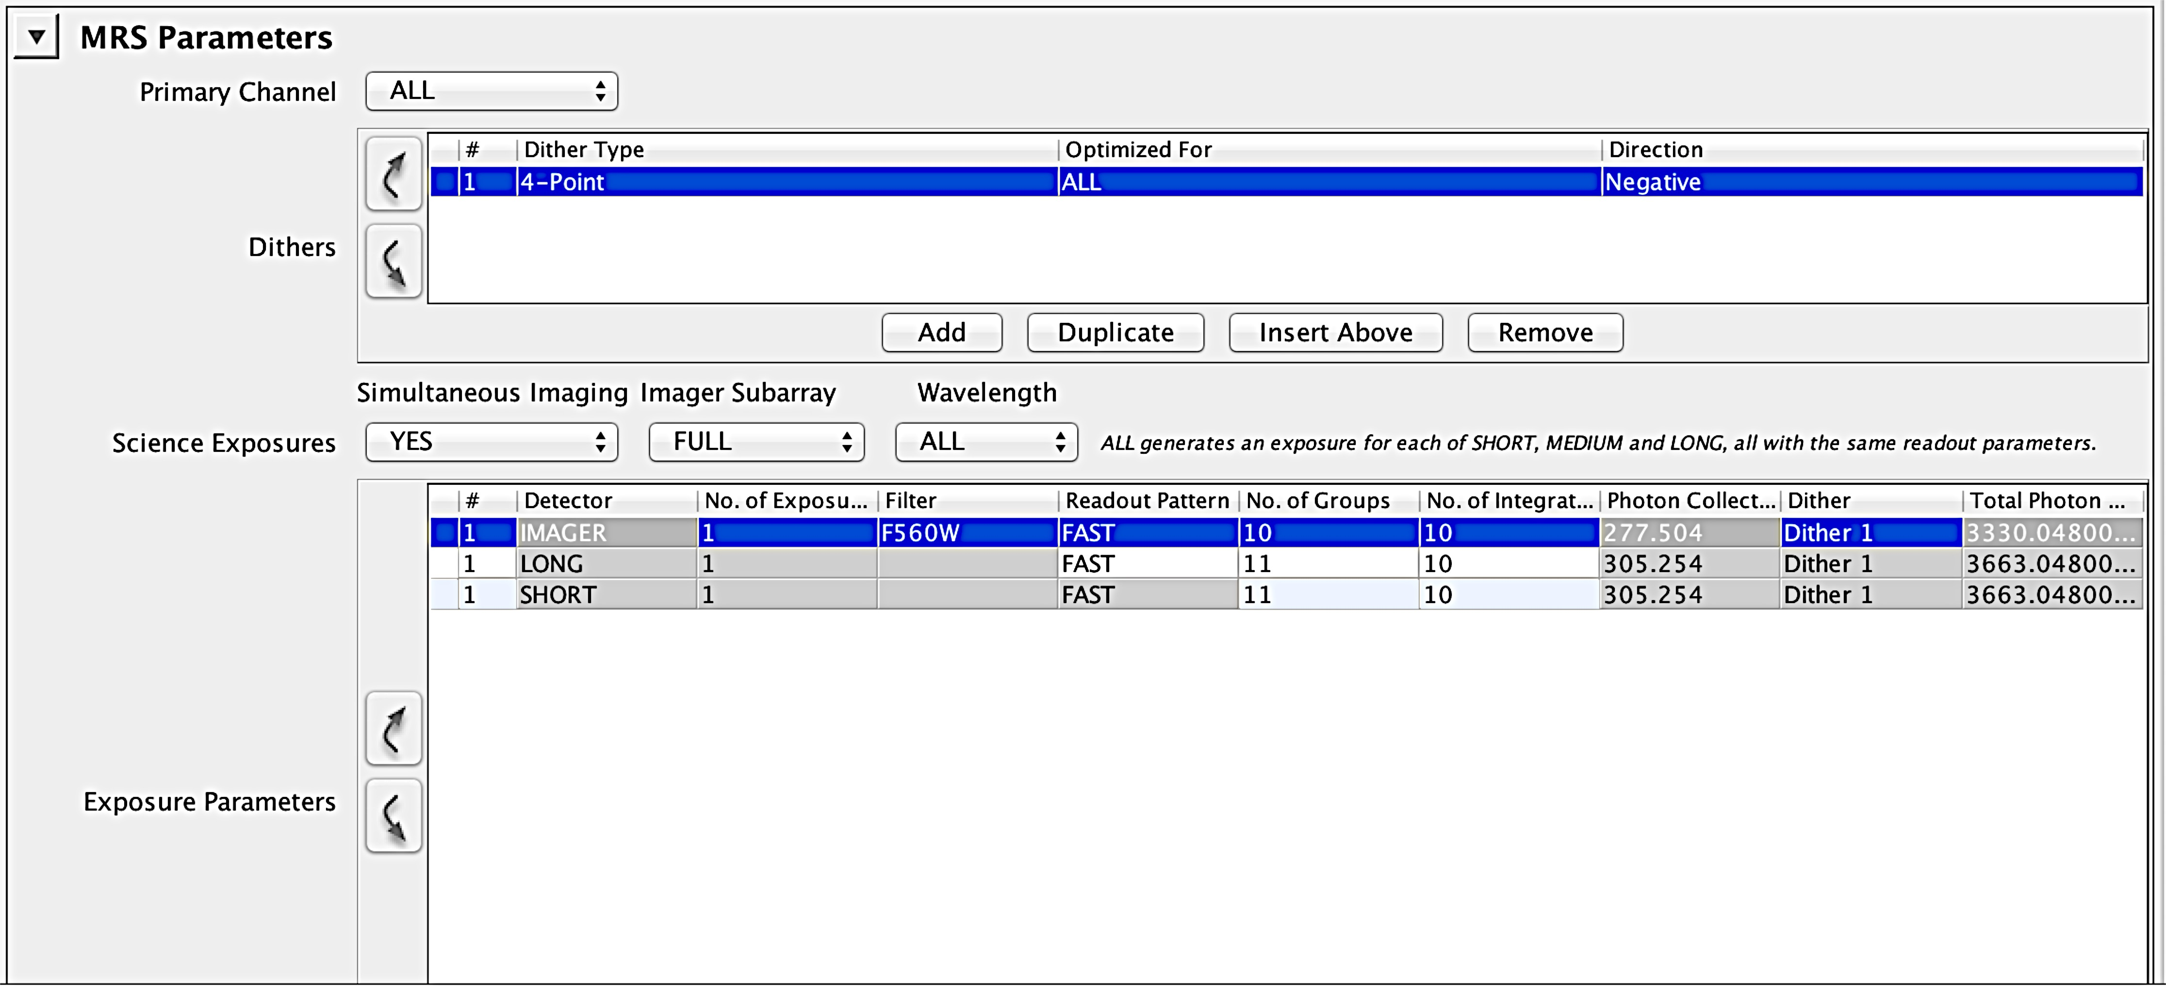

MIRI APT: Simultaneous MRS and Imaging
This is only allowed in the MRS template;

Slide 10
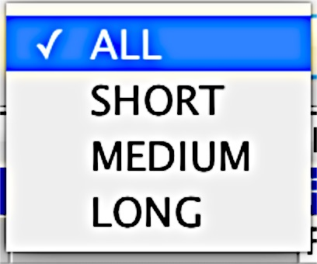
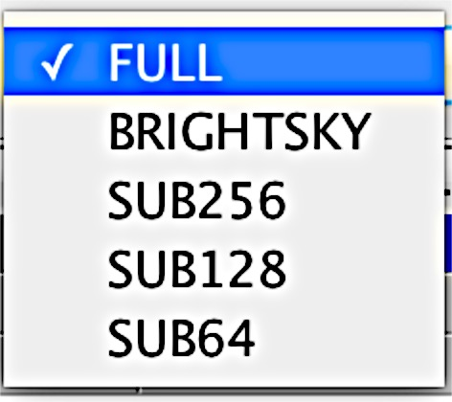
MIRI APT: Simultaneous MRS and Imaging
A
B
C

Slide 11
MIRI APT: Simultaneous MRS and Imaging
You can use any imager-defined subarray (FULL is default)
Any readout mode (defaults are recommendations.
SLOW for MRS, FAST for imager)
Total exptime of the imager must be equal or less than the MRS.
The MRS is driving the dithers (ongoing work on dithers).
There may be some constrain due to data volume, but you’d need to integrate continuously for a long time.

Slide 12
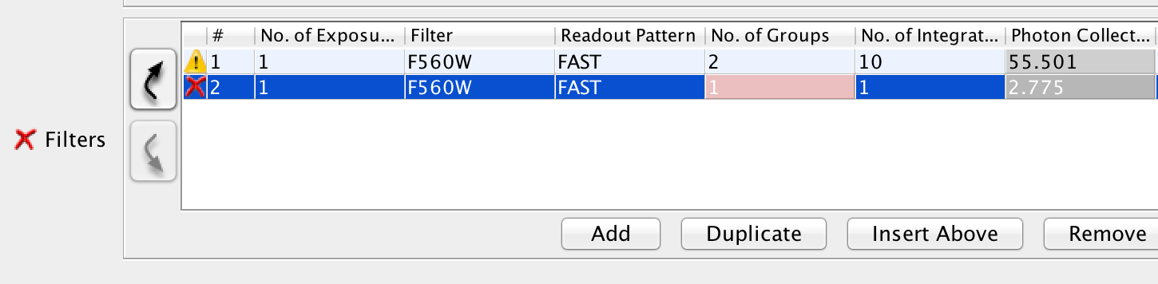
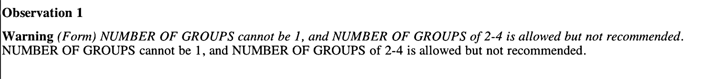
MIRI Templates: a general note
This applies to all templates

