Slide 1
JWST Pipeline Overview
Macarena Garcia Marin
European Space Agency

Slide 2
Outline
The JWST pipeline: Introduction.
Overall pipeline architecture.
Stages of the pipeline development: Baseline, Optimal.
Example of optimal algorithms.
Pipeline availability.
What data will be available? Specific examples of data products.

Slide 3
The JWST Pipeline: Introduction
The pipeline is being developed and coded at STScI. The working group responsible for that work is the “JWST Calibration WG” led by K. Gordon.
The group receives inputs from the JWST instrument teams and experts in specific observing modes:
NIRCam team
NIRSpec team
NIRISS team
FGS team
MIRI team
Coronagraphy WG
TSO (time series observations) WG.
Moving targets
When possible, common steps and code are used for different instruments (e.g. MIRI and NIRSpec IFUs).
.
Instrument experts with science expertise.
Ground testing. Delivery of Calibration data products.
Special cases.
Science experts; includes instruments expertise
Based on original slide from K. Gordon

Slide 4
The JWST Pipeline: Introduction
The pipeline is being developed and coded at STScI. The working group responsible for that work is the “JWST Calibration WG” led by K. Gordon.
The group receives inputs from the JWST instrument teams and experts in specific observing modes:
NIRCam team
NIRSpec team
NIRISS team
FGS team
MIRI team
Coronagraphy WG
TSO (time series observations) WG.
Moving targets
When possible, common steps and code is defined for different instruments (e.g. MIRI and NIRSpec IFUs).
.
Discussion, agreement, steps get accepted and then implementation starts.
Often based on code/algorithms developed by instrument teams. Testing and feedback.
Part of a broader ground system
Instrument experts with science background.
Ground testing. Delivery of Calibration data products.
Special cases.
Science experts; includes instruments expertise
Based on original slide from K. Gordon

Slide 5
Overall Pipeline Architecture
CALDETECTOR1
CALIMAGE2
CALSPEC2
CALIMAGE3
CALCORON3
CALAMI3
CALTSO3
CALSPEC3

Slide 6
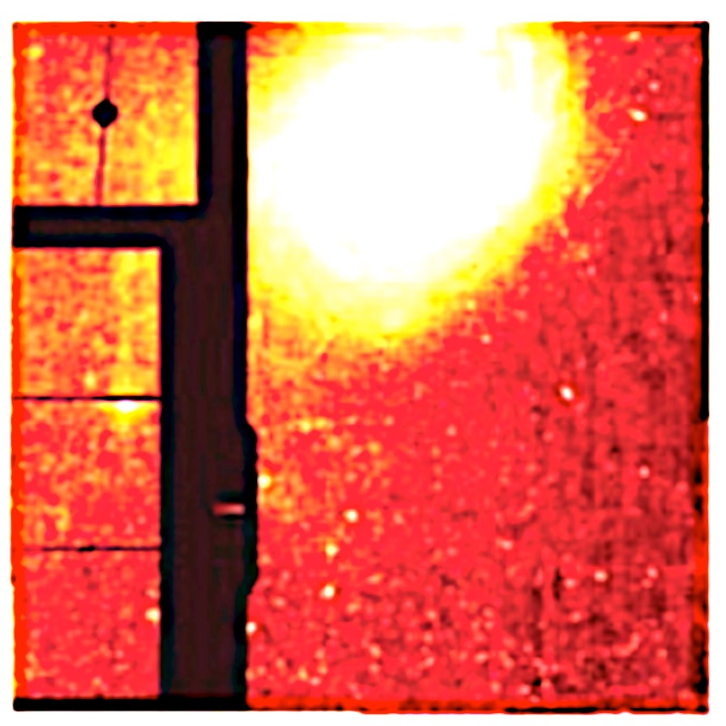
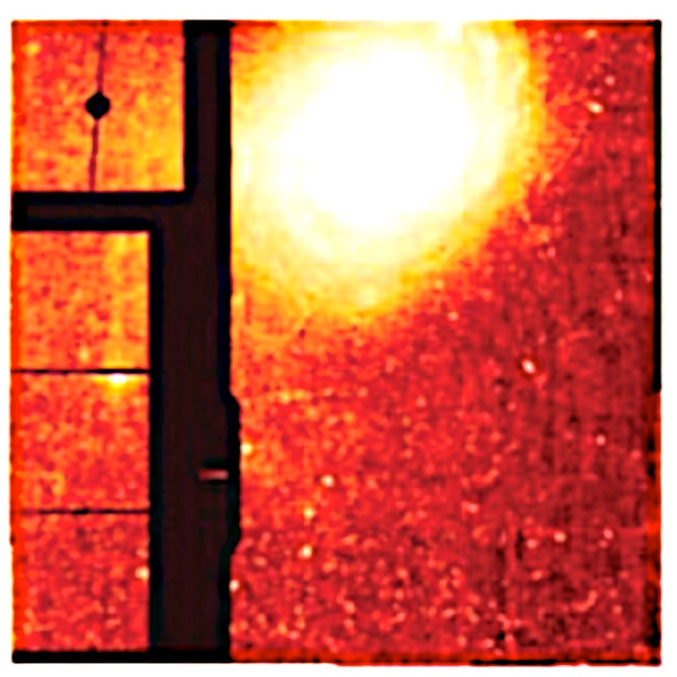
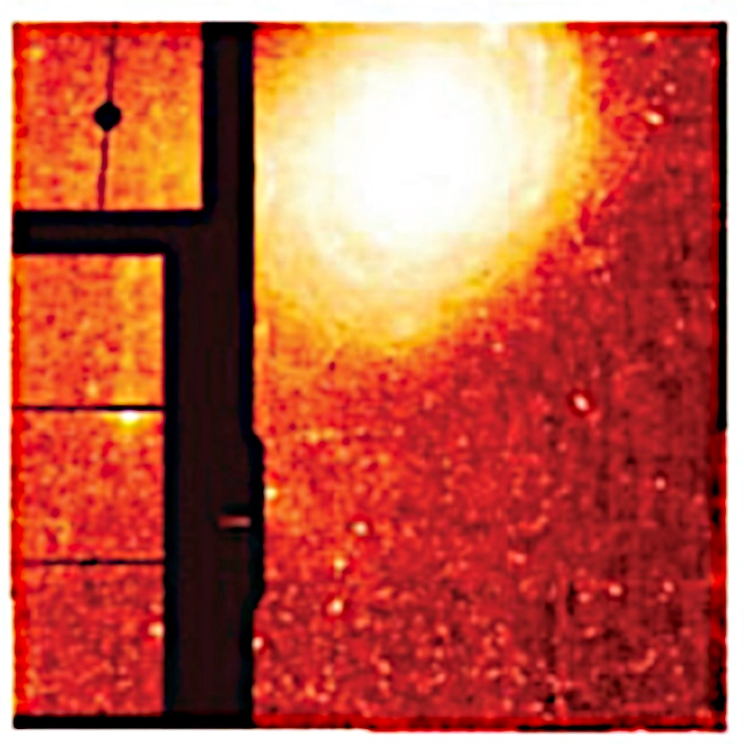
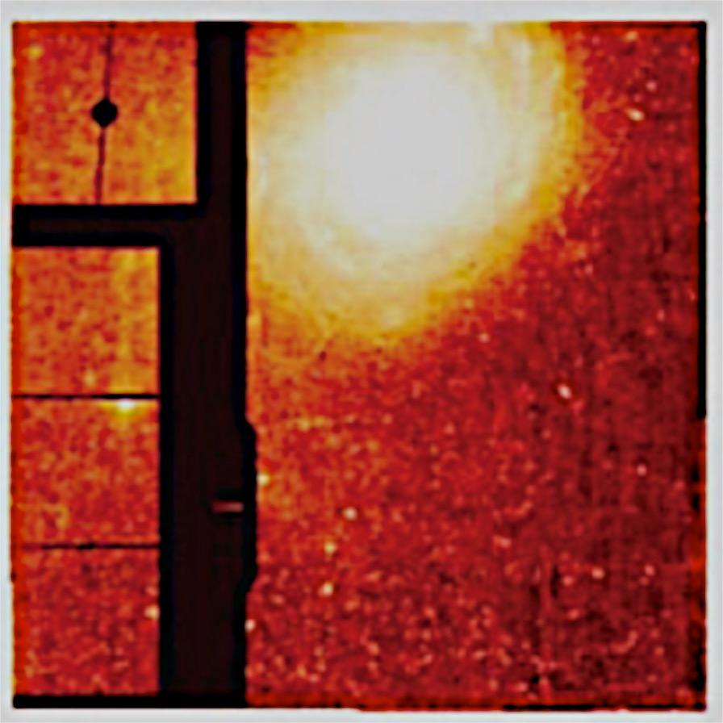
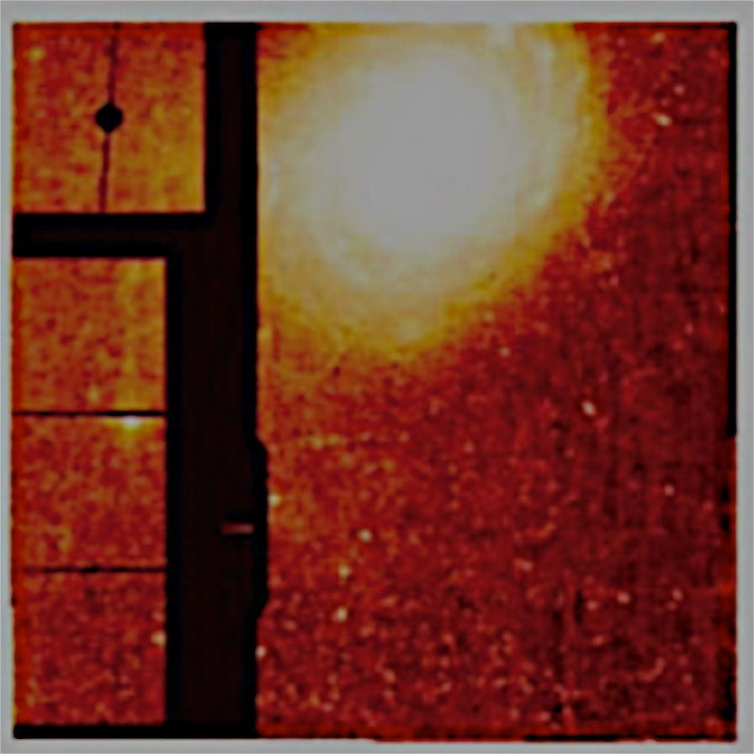
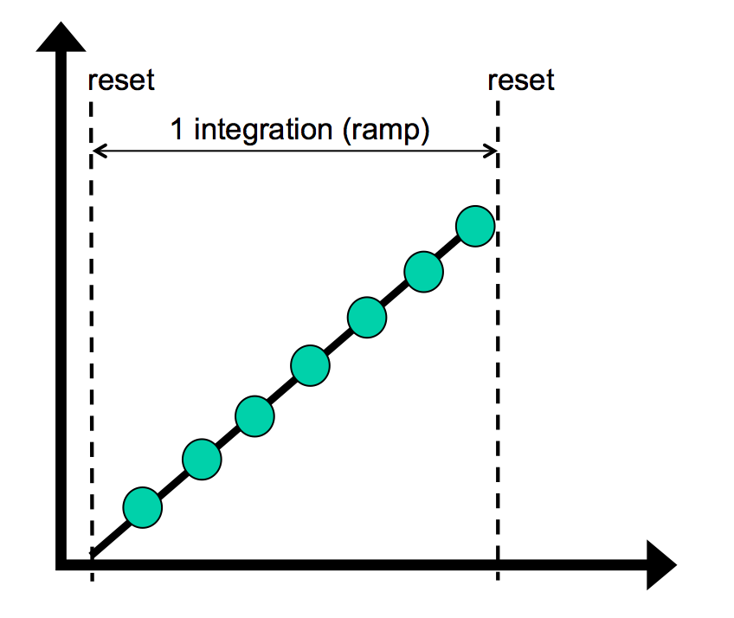
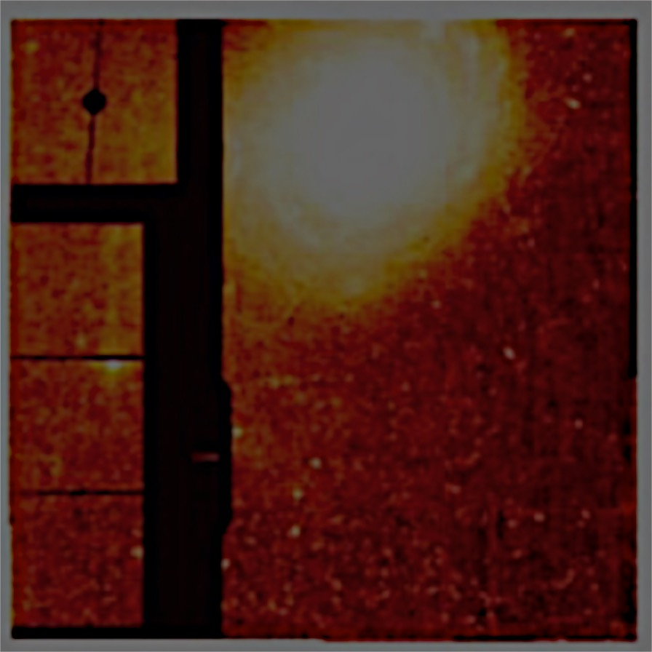
Overall Pipeline Architecture (1)
CALDETECTOR1
Convert raw data into a slope image (units DN/s).
Example steps: BIAS, linearity, cosmic rays…
NIR detectors have all steps in common. MIRI has some specific corrections characteristic to SiAs IBC detectors.
signal
Time (groups)

Slide 7
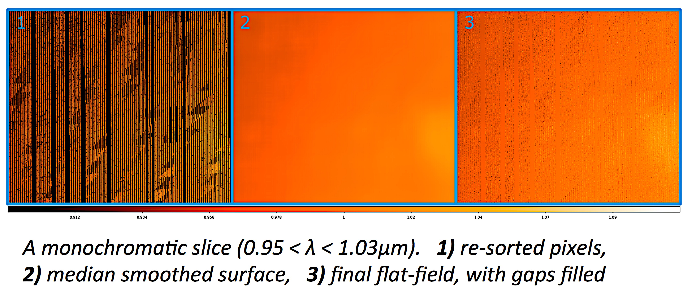
Overall Pipeline Architecture (2)
CALIMAGE2
CALSPEC2
Individual exposures are further processed and calibrated.
Example steps: WCS assigned/distortion coefficients, flat field, fringes, stray light, flux calibration (MJy/Str). Detector plane.
The AMI/TSO/Coronagraph data are processed by these branches (and CALDETECTOR1), but in some case (TSO) skipping some steps.
Image credit: T. Rawle

Slide 8
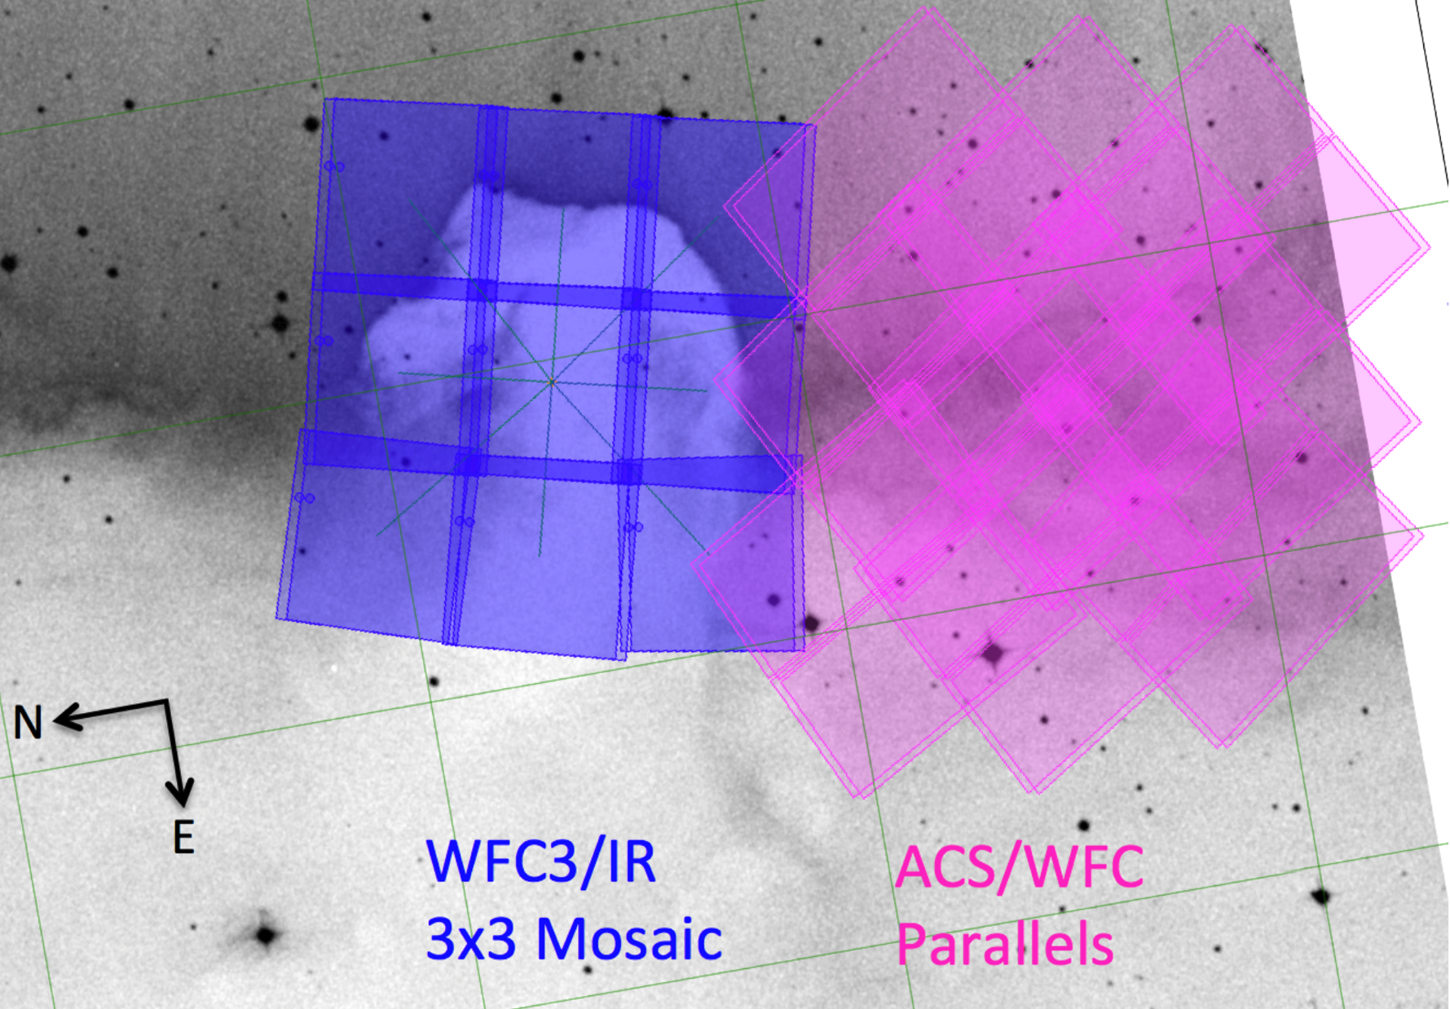
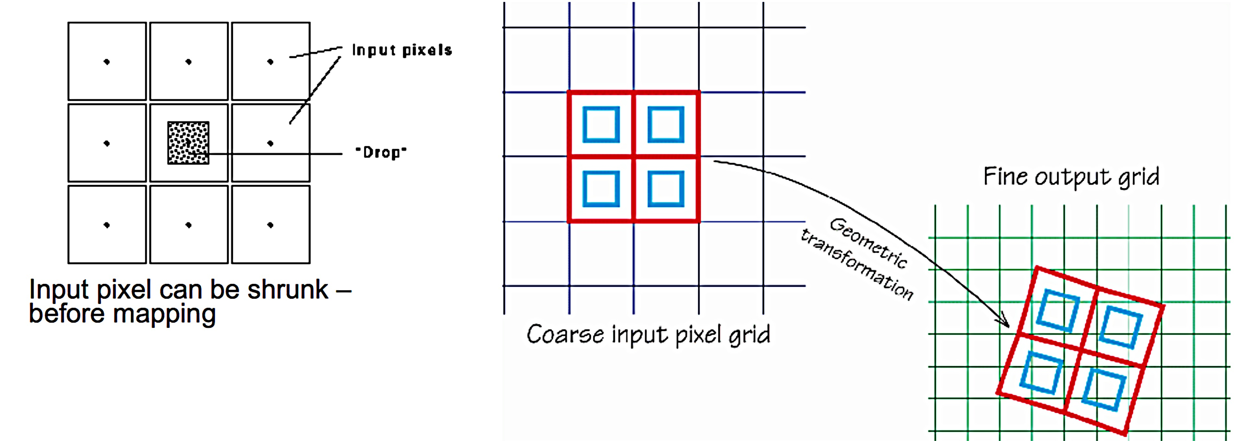
Overall Pipeline Architecture (3)
CALIMAGE3
CALCORON3
CALAMI3
CALTSO3
CALSPEC3
Step 3 of the pipeline builds the datacubes, puts together dithers and mosaics, performs background matching, datacube stitching, and spectral subtraction.
CALIMAGE3
Drizzle Pac. Images Credit: STScI

Slide 9
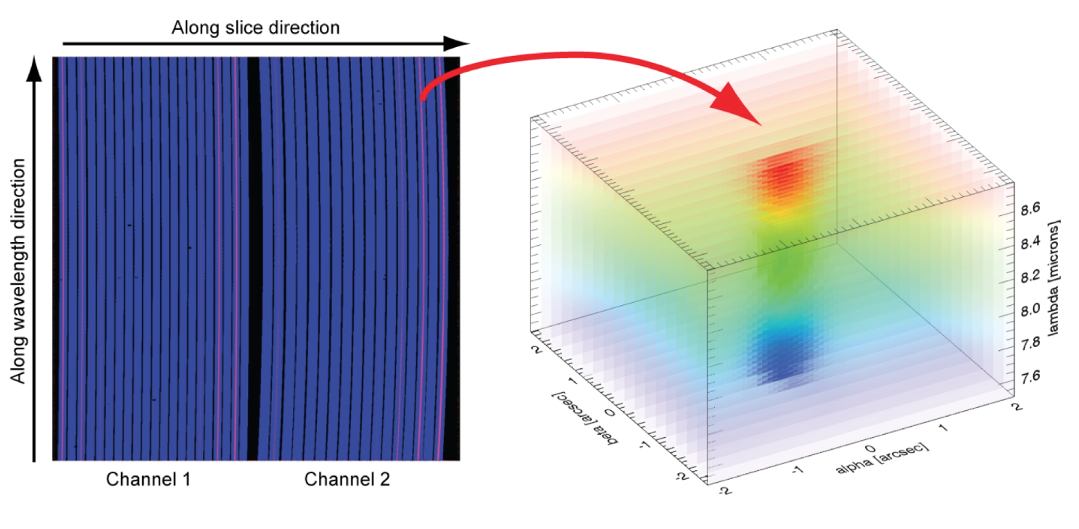
Overall Pipeline Architecture (3)
CALIMAGE3
CALCORON3
CALAMI3
CALTSO3
CALSPEC3
Step 3 of the pipeline builds the datacubes, puts together dithers and mosaics, performs background matching, datacube stitching, and spectral subtraction.
CALSPEC3
Cube building and associations
Images credit: A. Glauser, A. Labiano

Slide 10
Overall Pipeline Architecture
CALDETECTOR1
Convert raw data into a slope image (units DN/s).
Example steps: BIAS, linearity, cosmic rays…
Individual exposures are further processed and calibrated.
Example steps: WCS assigned/distortion coefficients, flat field, fringes, stray light, flux calibration (MJy/Str). Detector plane.
CALIMAGE2
CALSPEC2
CALIMAGE3
CALCORON3
CALAMI3
CALTSO3
CALSPEC3
Step 3 of the pipeline builds the datacubes, puts together dithers and mosaics, performs background matching, datacube stitching, and spectral subtraction.
ARCHIVE

Slide 11
Stages of the pipeline development
Baseline pipeline:
Process data from all instruments and modes.
Delivers good quality science data (i.e. meets requirements).
Algorithms have been agreed and the development is in progress.
Simulated data has been requested to support the correct implementation of steps 3 of the pipeline.
Should be completed by December 2017.
Final testing/iterations will start in early 2018.
Based on original slide from K. Gordon

Slide 12
Stages of the pipeline developement
Optimal pipeline:
Best data reduction.
Optimized science quality data.
The structure of this pipeline is defined, but it is a long term goal.
After launch, the understanding of the data will improve and so will the pipeline. This will be an iterative process.
All archive data will be reprocessed with successive and improved versions of the software.
The work on this will start after the baseline pipeline is finished.
Based on original slide from K. Gordon

Slide 13
Examples of optimal algorithms
Improvements in slope fitting:
Weighted linear to generalized least squares.
Optimal spectral extraction using knowledge of spatial profile.
MIRI self calibration.
Residual fringes.

Slide 14
Pipeline Availability
Written in python (uses astropy).
Freely available.
Configurable
Users can rerun all or part of the pipeline. It can be stopped at any point, some step can be replaced with specialized analysis can be carried out, and the re-start it again.
Hosted on github.
Part of astroconda.
Official release early 2018.
Will include high level and detailed code documentation (documentation work starting now)
Based on original slide from K. Gordon

Slide 15
What data will be available?
Raw data
Intermediate-processed data
Final product:
Best quality from the automated pipeline.
Flux, wavelength and position calibrated.
Mosaics combinations and individual tiles.
Any user can rerun the pipeline offline.

Slide 16
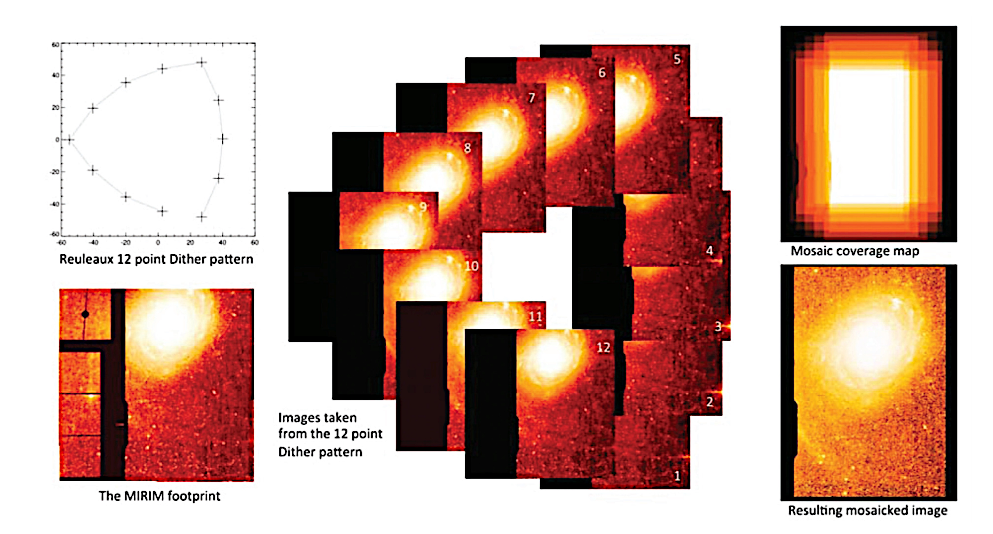
Imaging data products
Mosaic of all images with the same filter using sky coordinates (e.g., ra, dec).
Catalog of sources automated generation.
Integration level.
All images fully corrected with flagging of CRs, etc. In detector & sky(rectified) coordinates
Based on original slide from K. Gordon
Image credit: Gordon et al. 2015

Slide 17
Spectroscopic data products.
Slit & Slitless: 2D spectral image.
Along-slit and wavelength.
Includes MOS targets (each processed separately)
IFU: 3D spectral cube.
Ra, Dec, and wavelength
Extracted spectrum for the target source Integration level. User will specify in APT whether source is point, extended o unknown.
All images fully corrected with flagging of CRs, etc.
In detector & sky(rectified) coordinates.
3D cubes or 2D images depending on observation type
Based on original slide from K. Gordon

Slide 18
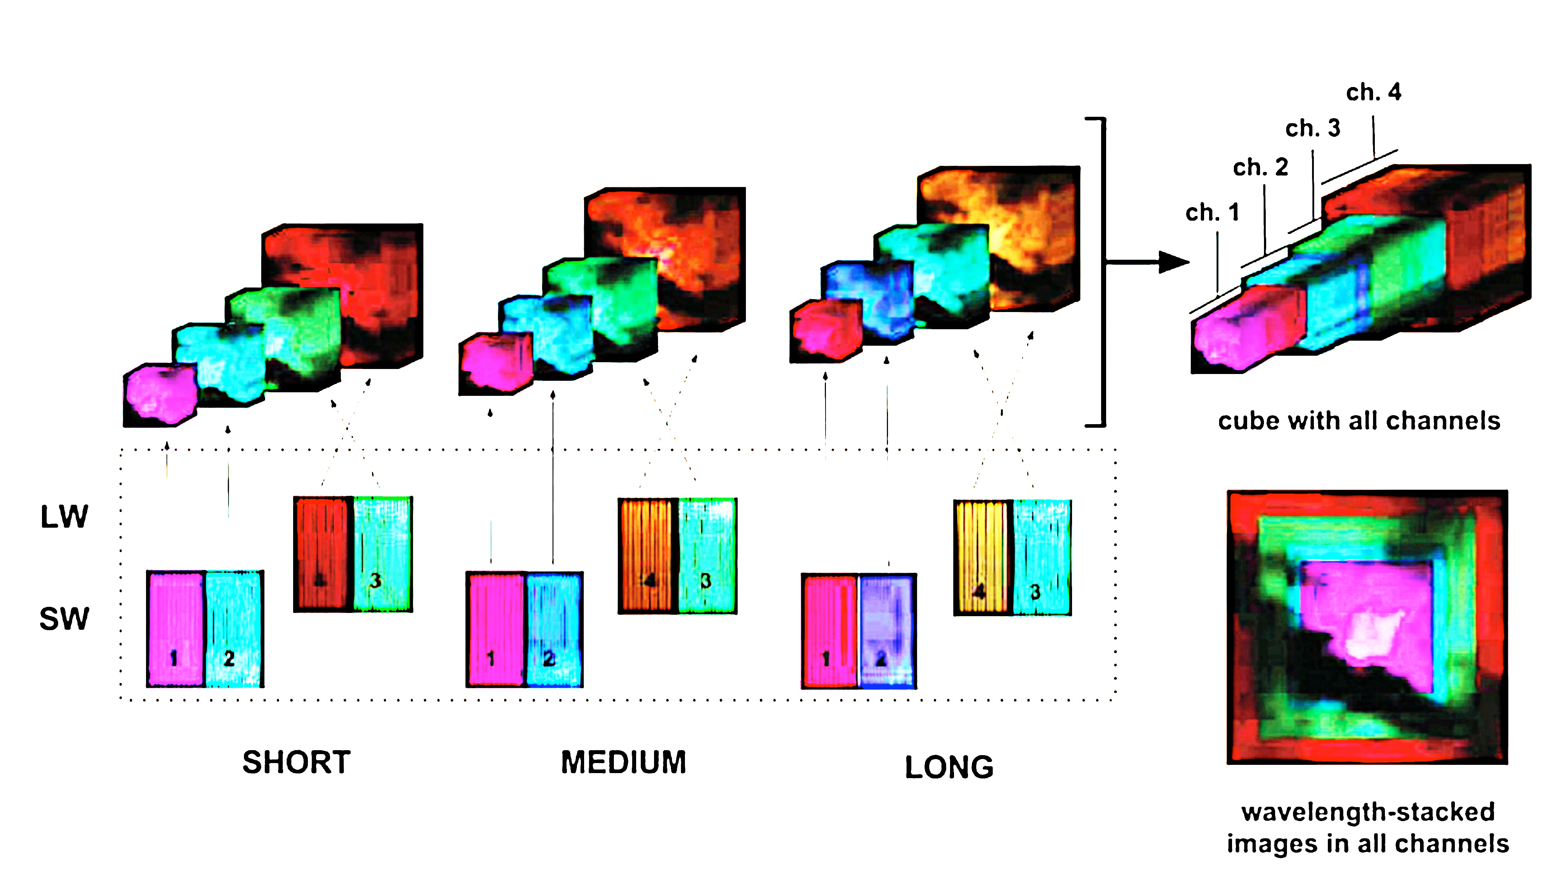
Spectroscopic data products.
Gordon et al. 2015

Slide 19
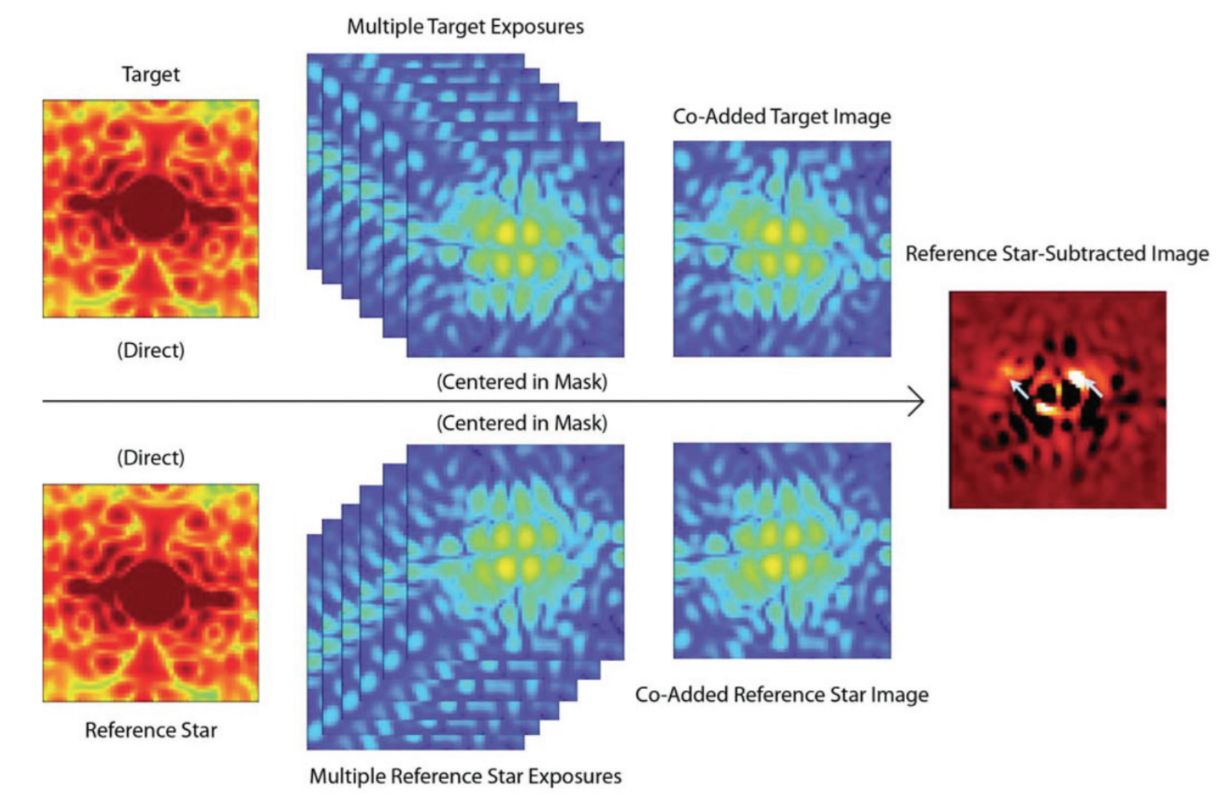
Coronagraphic data products
Coadded images
In detector coordinates.
After PSF subtraction.
Integrations Level
All images fully calibrated with flagging of CRs, etc.
In detector & sky(rectified) coordinates
Based on original slide from K. Gordon
Image credit: Gordon et al. 2015

Slide 20
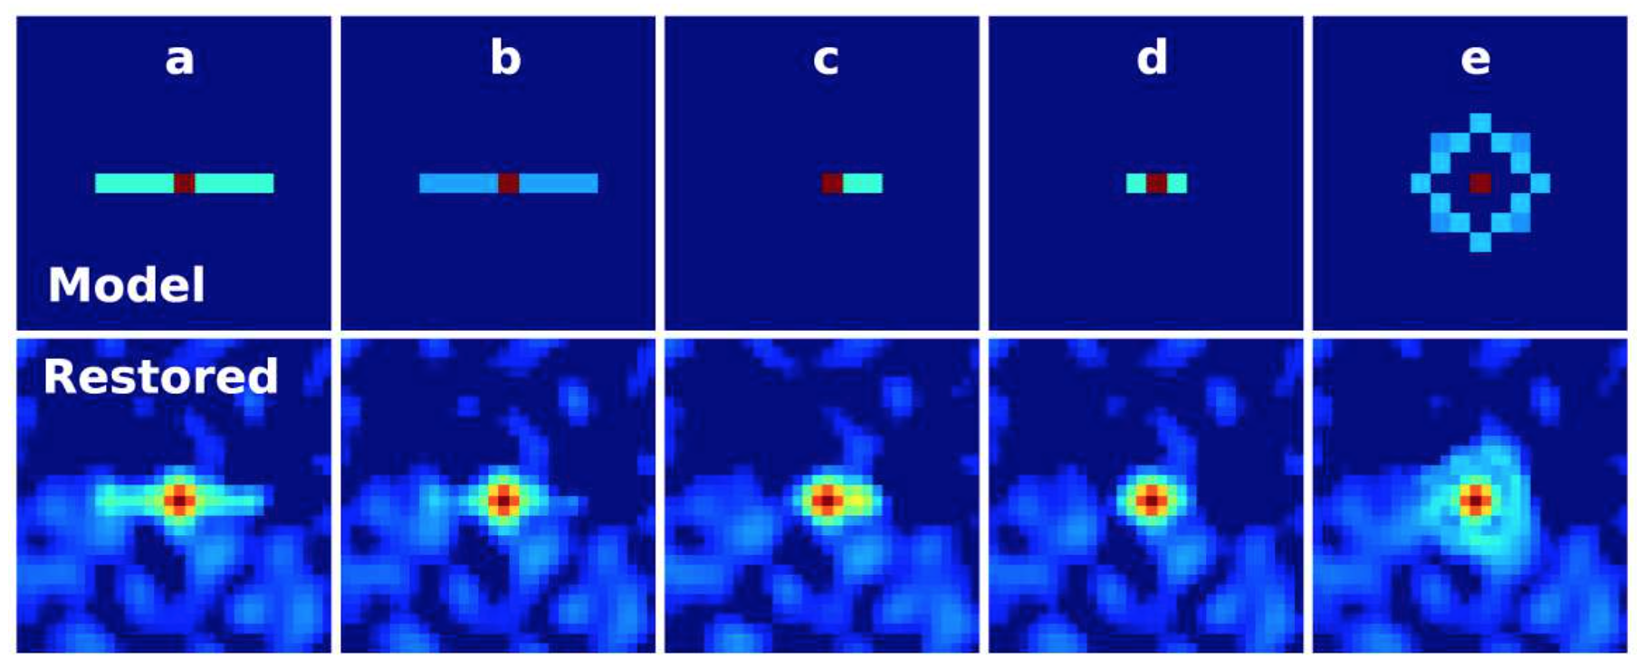
Aperture Masking Interferometry Data Products
Fringe parameters.
Closure phases and amplitudes
Reconstructed images
Images Credit: Artigau et al. 2014
Based on original slide from K. Gordon

Slide 21
Time Series Observation Data Products
Photometry.
Aperture photometry per integration.
Spectroscopy.
Extracted spectrum per integration.
White-light photometry per integration.
Integration level.
Image or spectral image as appropriate fully corrected with flagging of CRs, etc.
In detector & sky(rectified) coordinates
Based on original slide from K. Gordon

