Slide 1


NIRCam Imaging
M. Robberto - STScI

Slide 2
NIRCam Basics
NIRCam is JWST’s primary visible and near-IR wavelength imager
NIRCam offers low-resolution grism spectroscopy and Lyot coronagraphy
NIRCam is JWST monitor of OTE wavefront error
Two fully redundant MODULES A/B mated to opposite sides of optical bench, each 2.2 x 2.2 arcmin² field of view (FOV) separated by 44”
Each module has one SW CHANNEL (0.6-2.3 μm) and one LW CHANNEL and one LW (2.4-5.0 μm) channel that have the same 2 x 2 arcmin² FOV
SW channel has four 2048² pixel SENSOR-CHIP ASSEMBLIES (SCAs) separated by 5 arcsec; LW has one 2048² pixel SCA

Slide 3
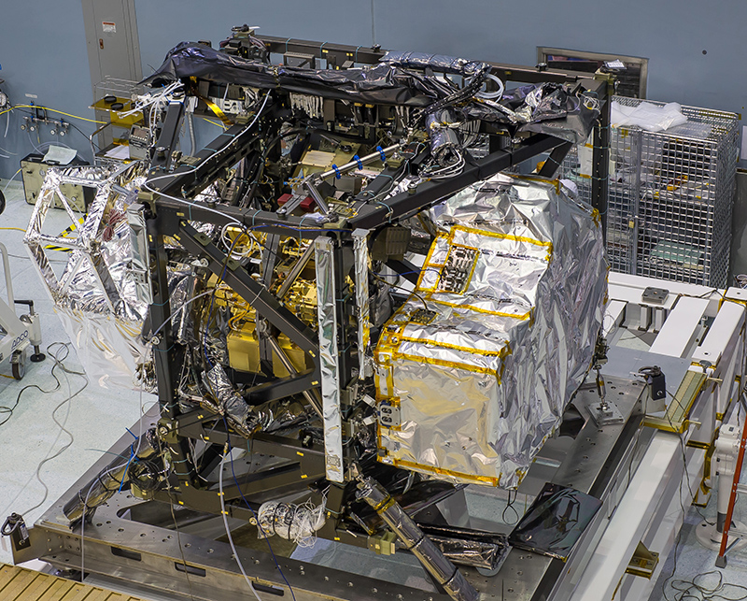
NIRCam in ISIM
NIRCam

Slide 4
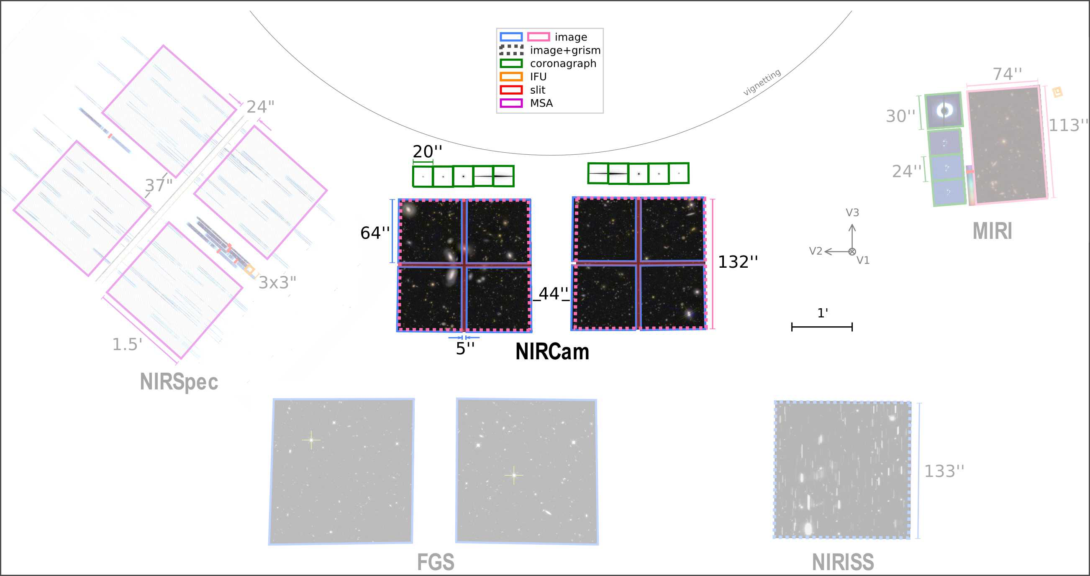
Field of View of JWST Instruments

Slide 5
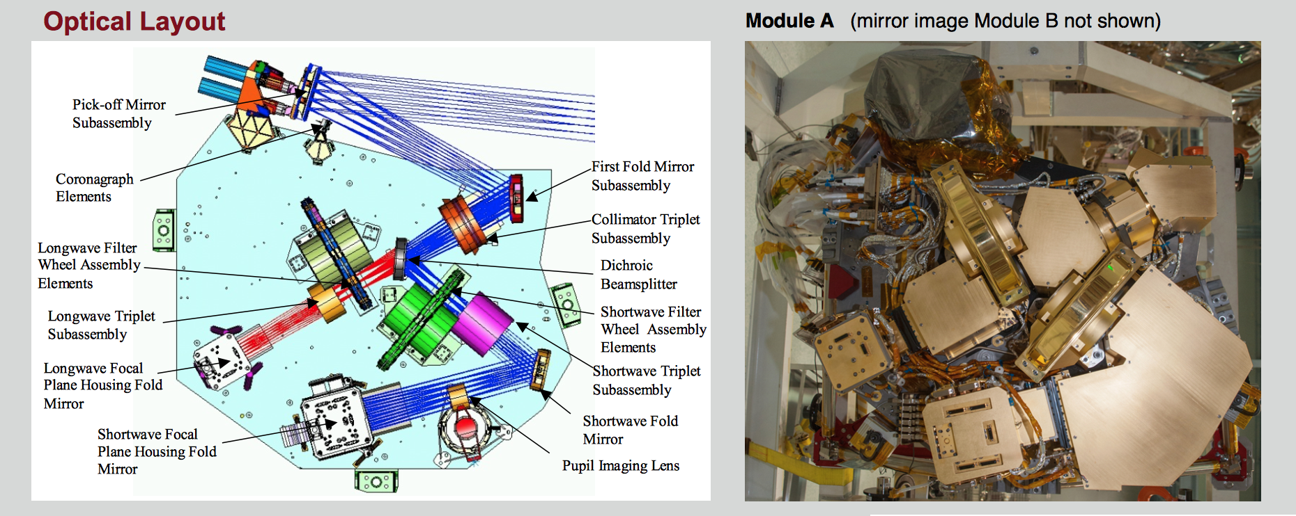
Optical Layout

Slide 6
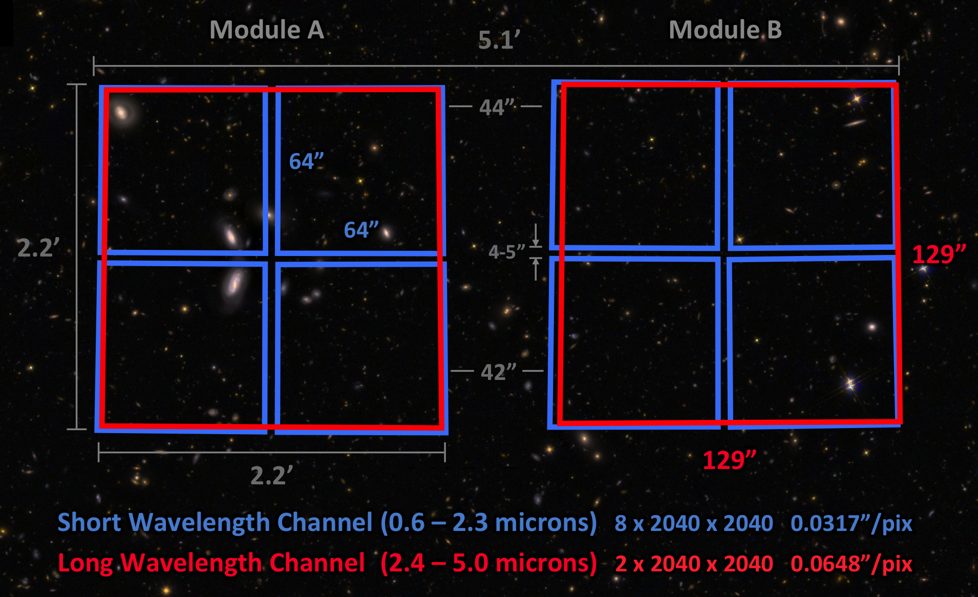
NIRCam Field of View
Notes:
NIRCam's 2 modules operate in parallel to observe a 9.7 arcmin² field of view consisting of two 2.2' × 2.2' fields separated by a ~44" gap. Gaps of ~5" also separate the 4 detectors in each short wavelength module. If full-field imaging is not required, individual modules or smaller subarrays may be used to increase readout speeds and reduce data volumes. To cover larger areas, mosaics are best obtained in combination with primary dithers.

Slide 7
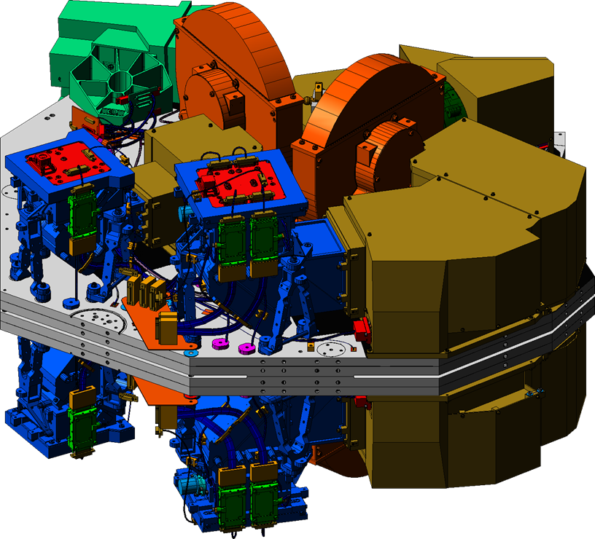
Two Imagers in Two Modules
5”
132”
}
5” {
} 40”
Two adjacent fields of view (2.2 arcminute)² Both fields in SW and LW bands
Two back-to-back modules
Notes:
WFC3-IR is 123”x136”
Imagine a WFC3 image with 5”/0.13=40 pixels gap between quadrants.

Slide 8
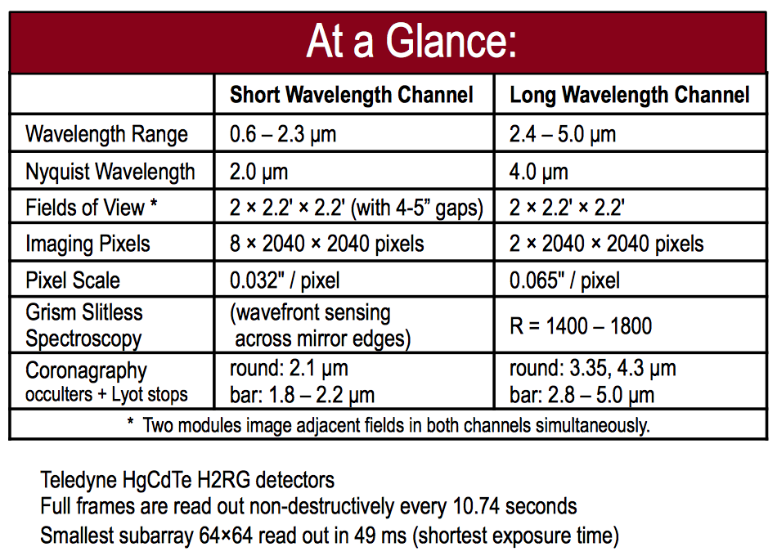
Vital Statistics
Notes:
Field distorsion < 2%

Slide 9
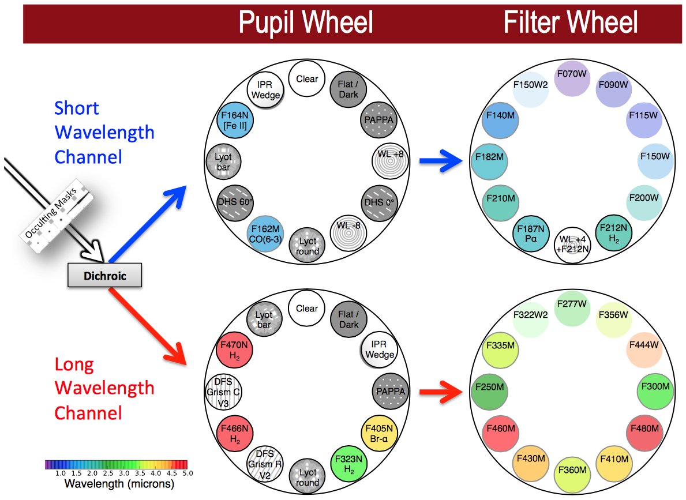
NIRCam Pupil and Filter Elements

Slide 10
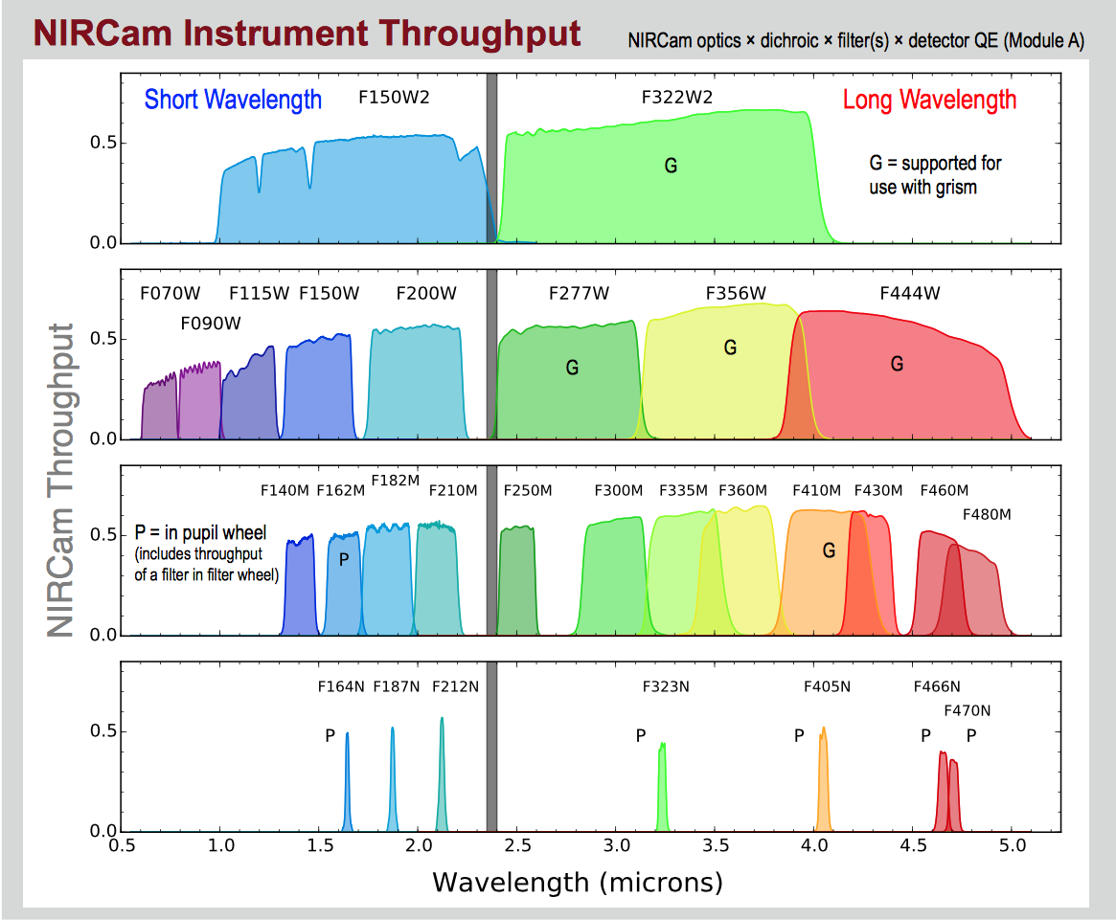
Passbands and Throughput

Slide 11
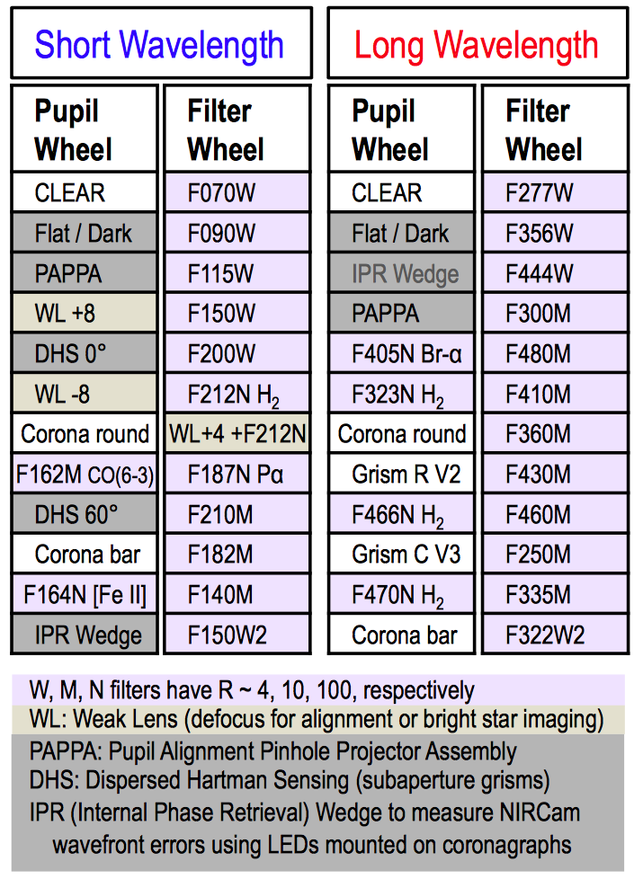

Slide 12
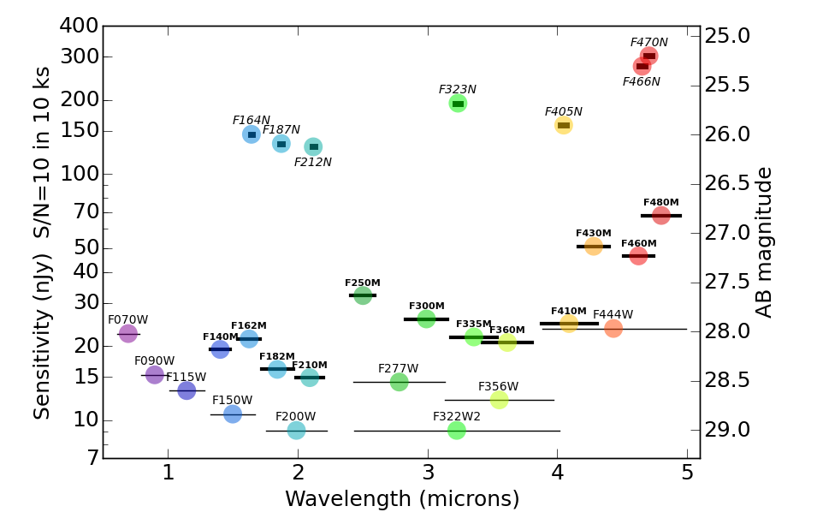
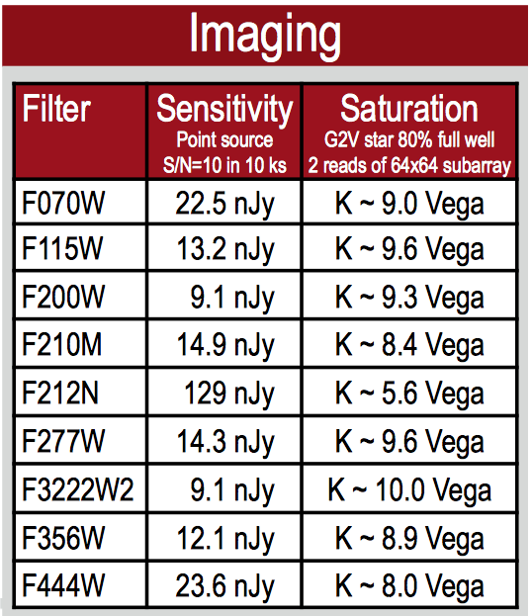
Sensitivity Limits
Add 6 mag in
Full-array mode
Notes:
Add 256x for full array = 6 magnitudes

Slide 13
NIRCam imaging
Select Module:
  A, B, ALL
Select Subarray
  FULL, SUB64P, SUB160, SUB160P, SUB320, SUB400P, SUB640
Select Dither Pattern
Select Filter Pair
  Readout pattern
  Number of groups
  Number of integrations

Slide 14
NIRCam Imaging Subarrays
Full Field uses 4 amplifiers, Subarray uses 1
Subarrays are only taken on module B
For imaging subarrays, only SCA B3 for SW
Subarrays have same size in pixels on SW and LW
SW and LW subarrays have the same center on the sky
There are
  Point Source subarrays
  Extended Source subarray

Slide 15
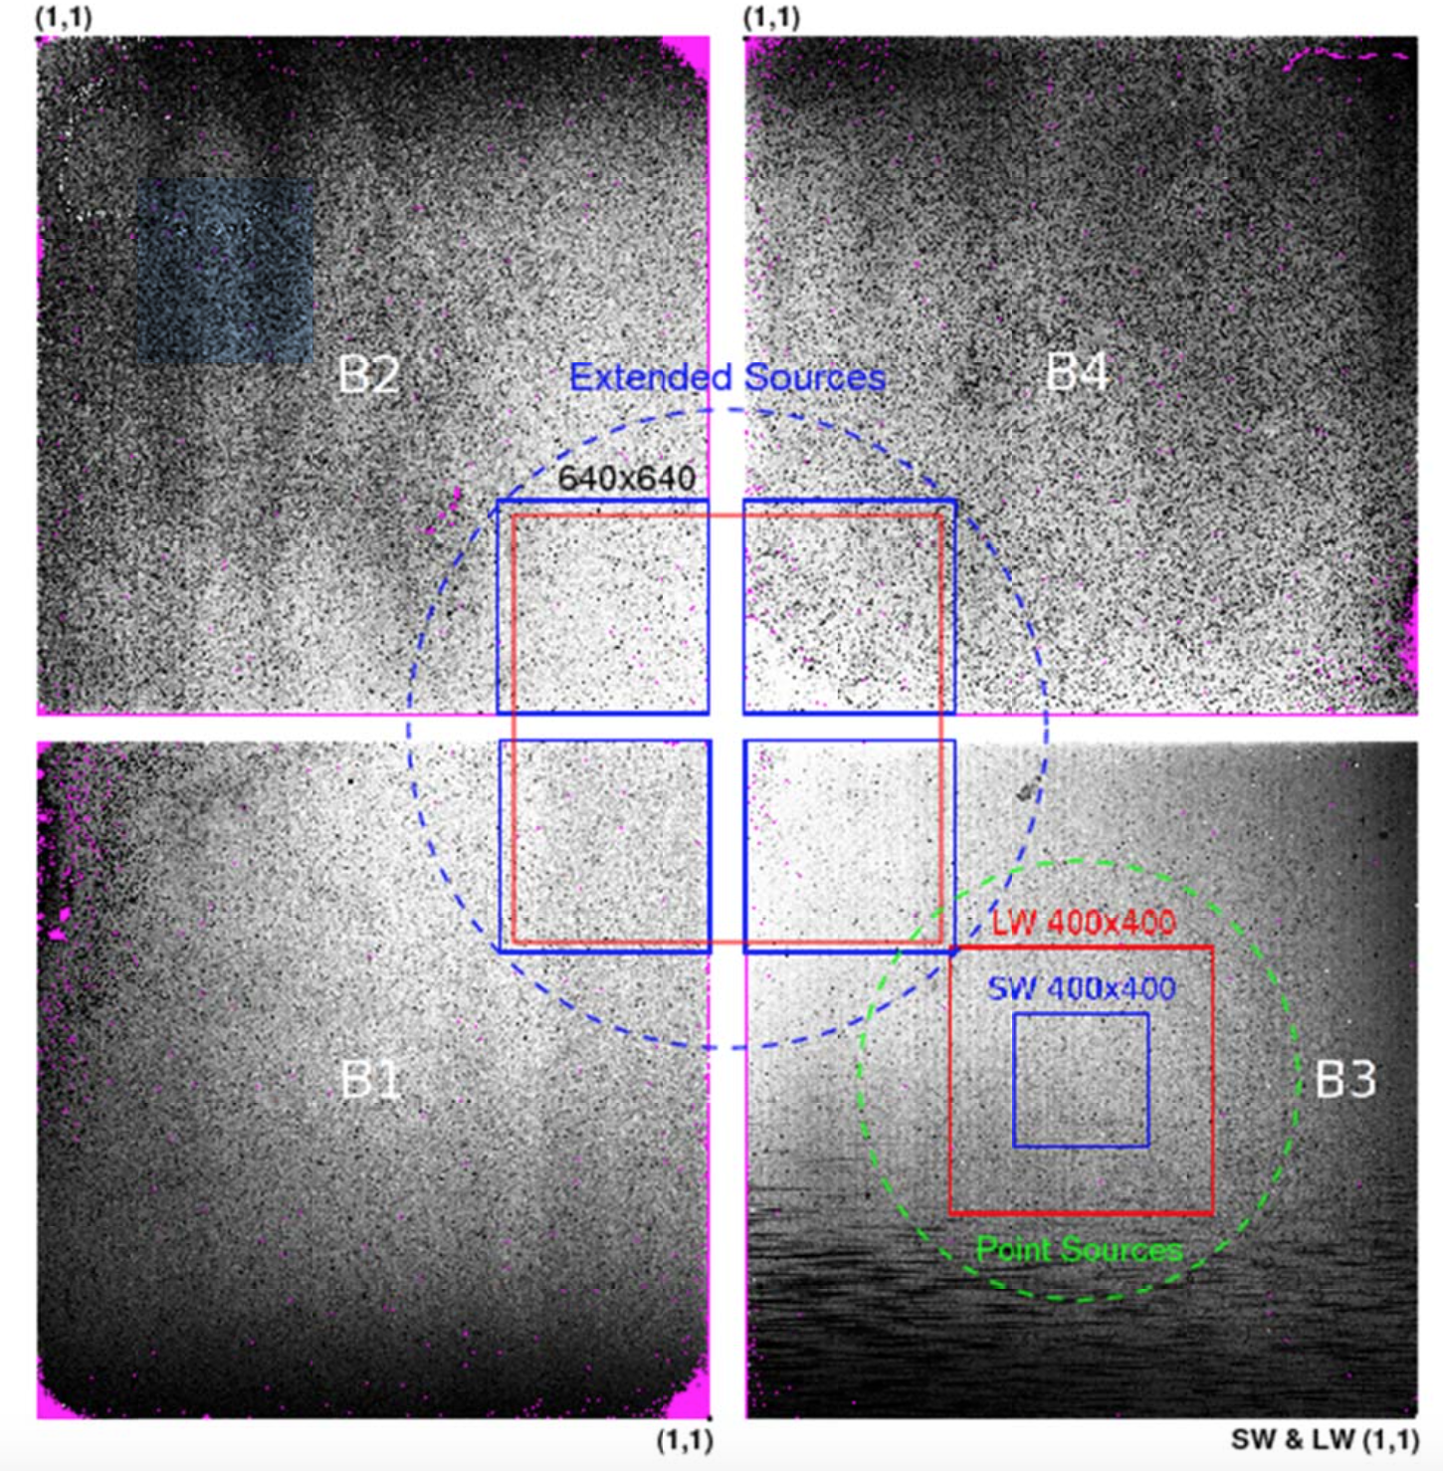

Slide 16
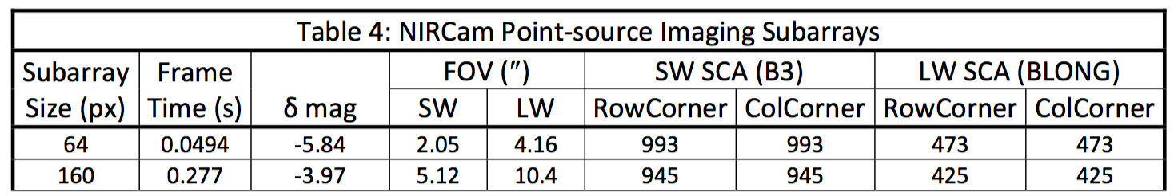
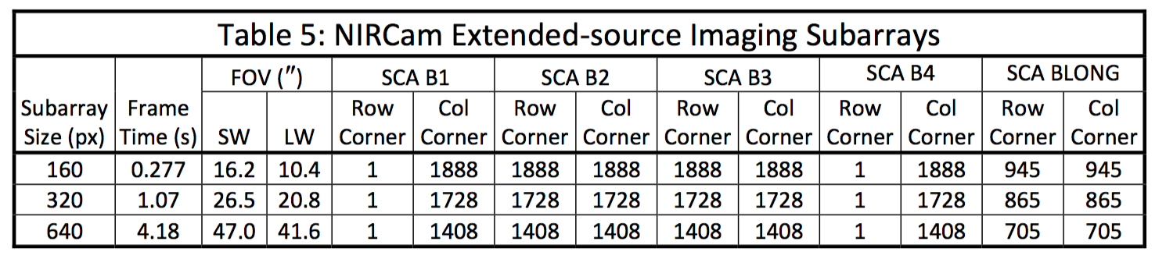
Subarrays

Slide 17
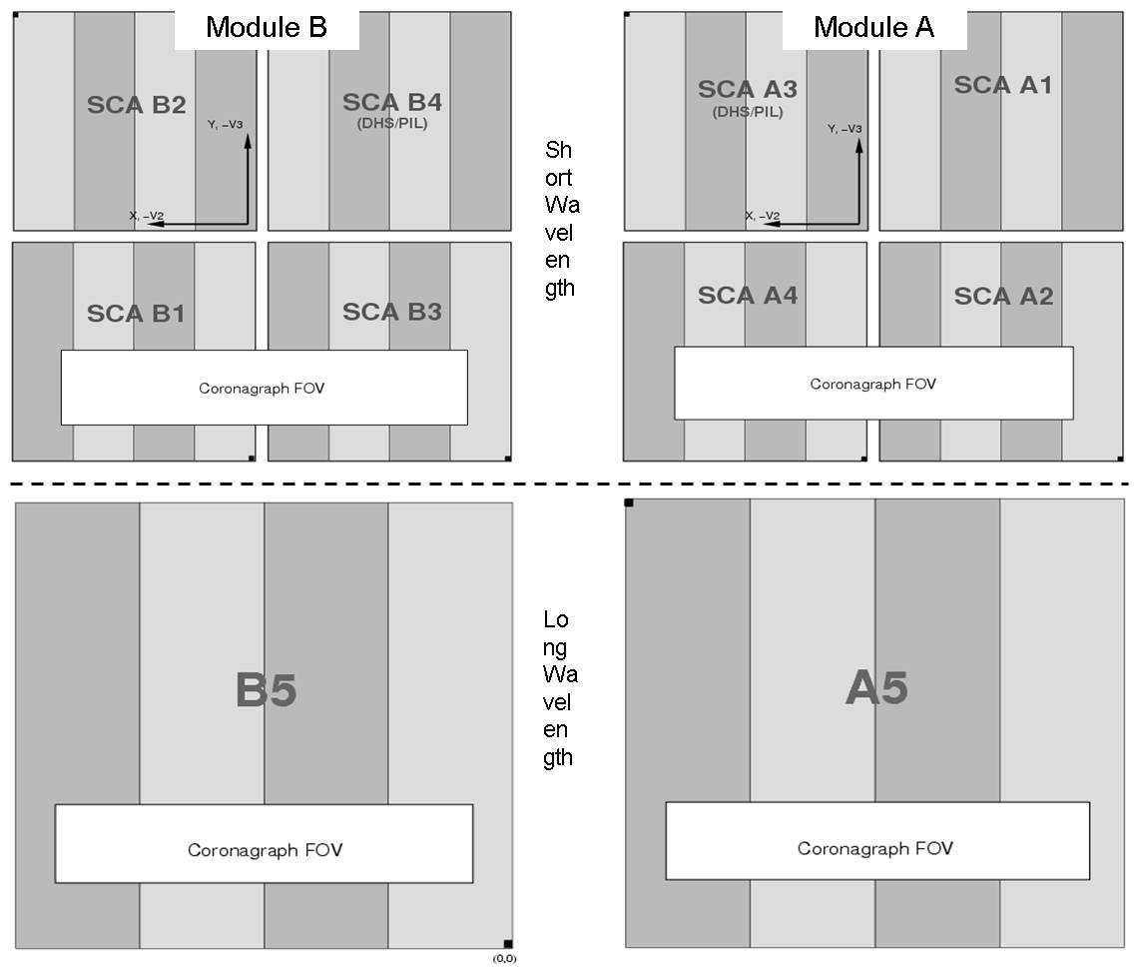
Focal Plane Arrays

Slide 18
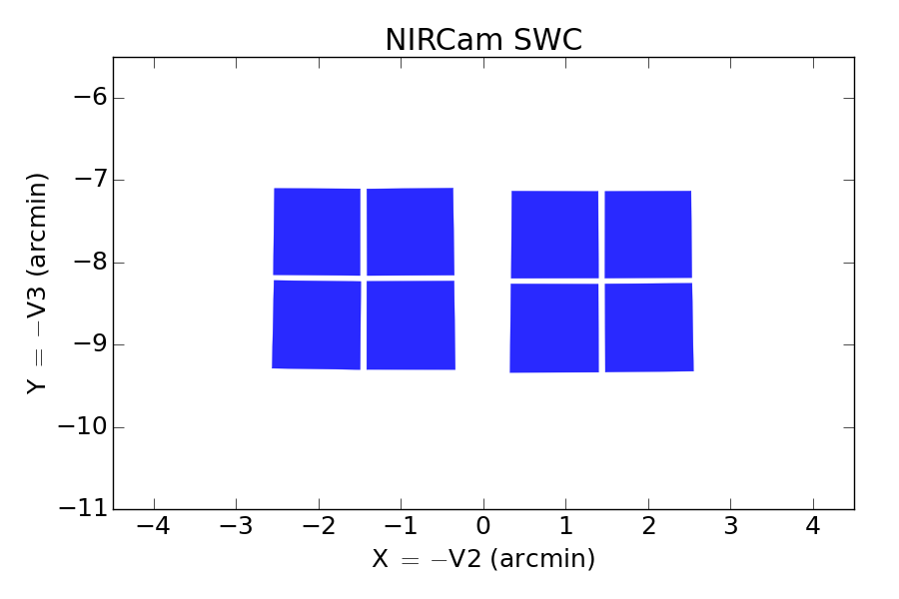
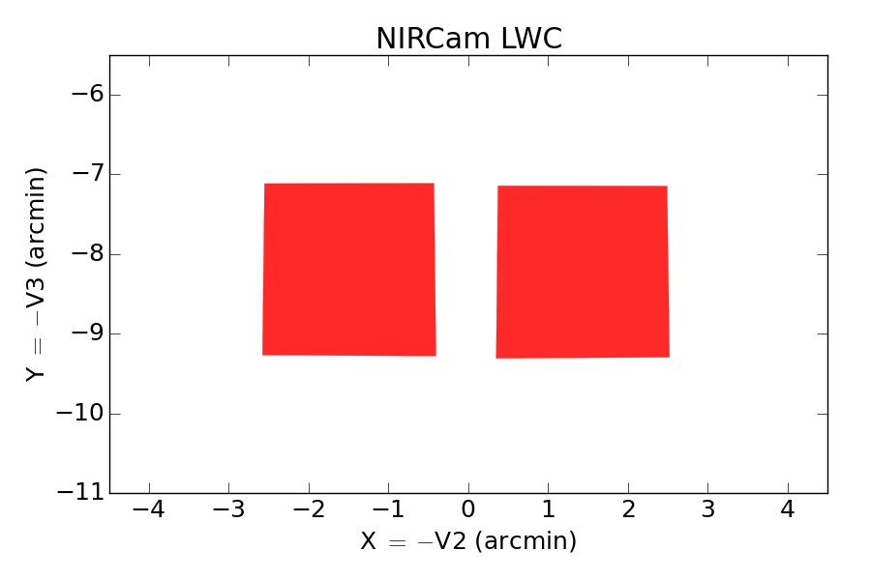
Dithers and Mosaics

Slide 19
NIRCam Primary Dithers and Mosaics
The NIRCam primary dither patterns were designed for three general sizes of targets:
  FULL: Large fields without gaps, including mosaics (tiled pointings) of larger areas
  INTRAMODULE: Objects smaller than the individual modules (< 110" across)
  INTRASCA: Objects smaller than the individual SCA detectors (< 50" or < 100" across when optimizing for short or long wavelength observations, respectively)

Slide 20
FULL Dither Patterns
The NIRCam FULL dither patterns provide full coverage with no gaps between modules.
They require multiple guide star acquisitions, increasing overheads on observing time.
FULL dither patterns may be combined to do mosaics of even larger areas.

Slide 21
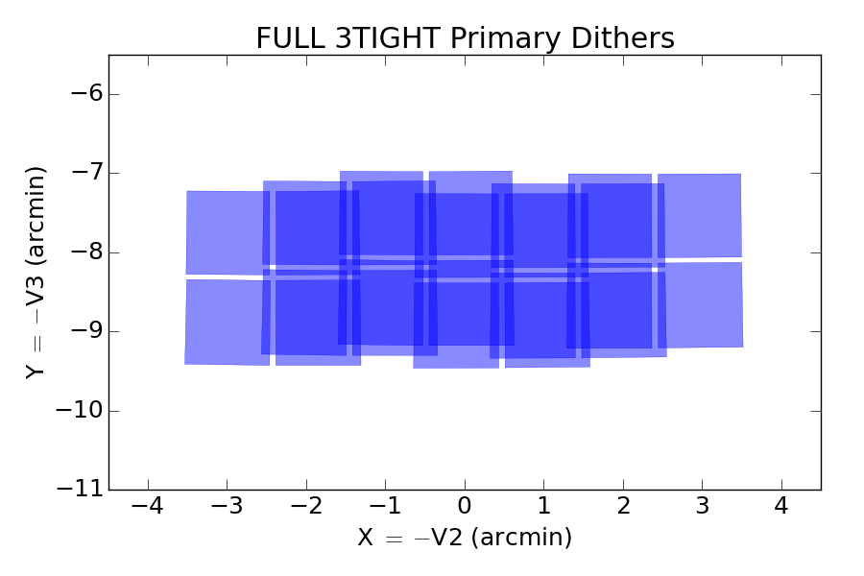

Slide 22
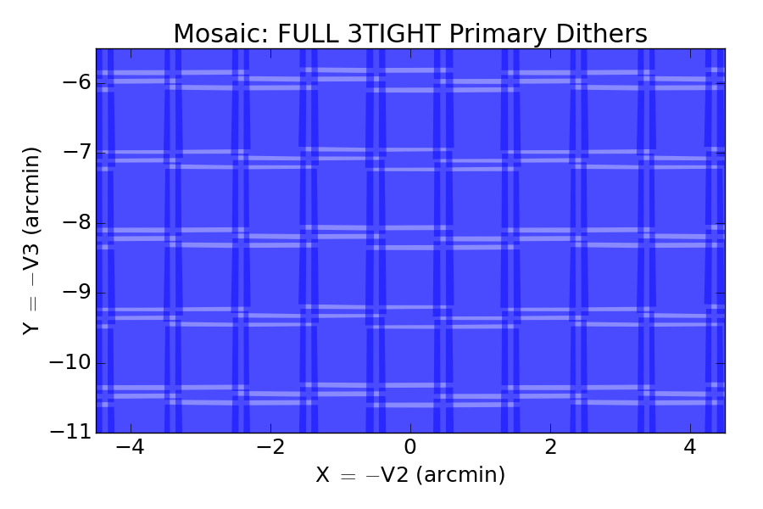

Slide 23
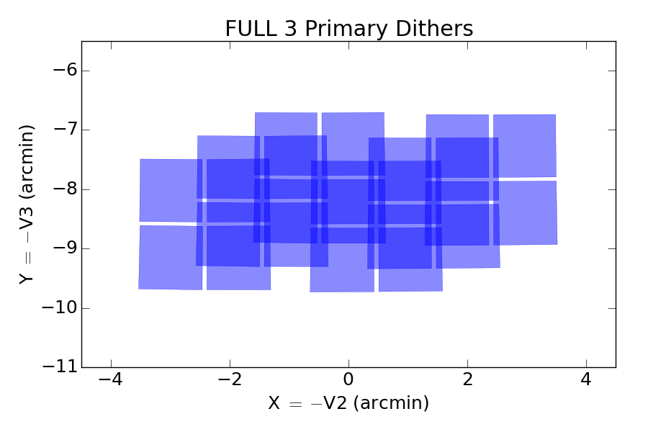

Slide 24
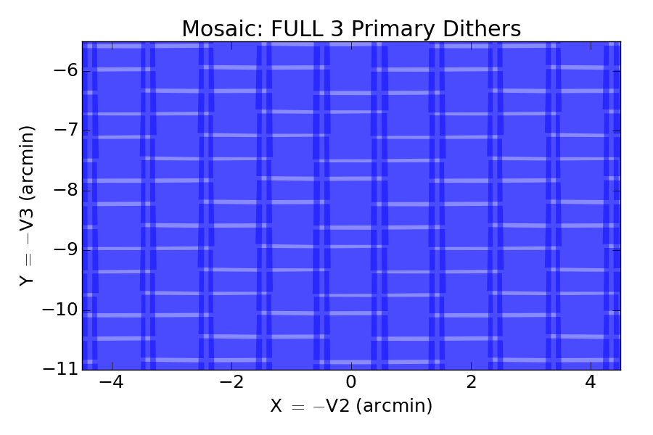
3:18% - 2:71% - 1:11%

Slide 25
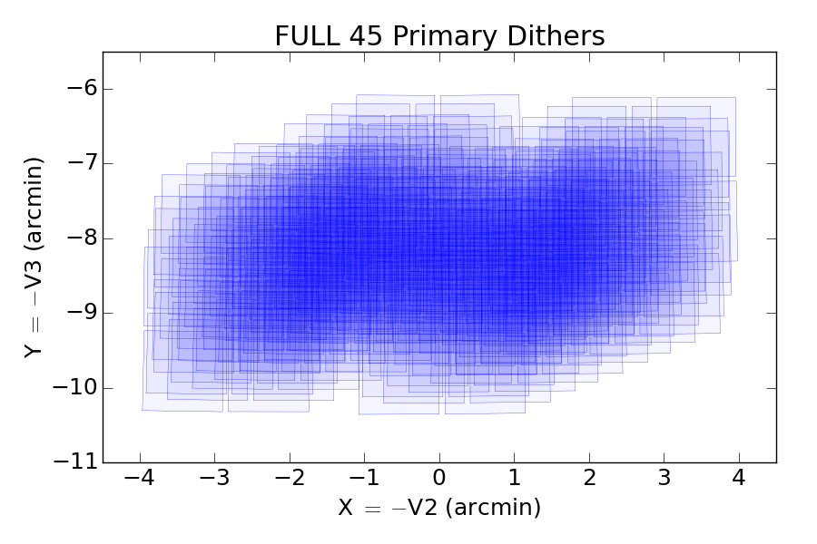

Slide 26

28:1%
29: 6%
30: 23%
31: 38%
32: 25%
33: 7%
34: 1%

Slide 27
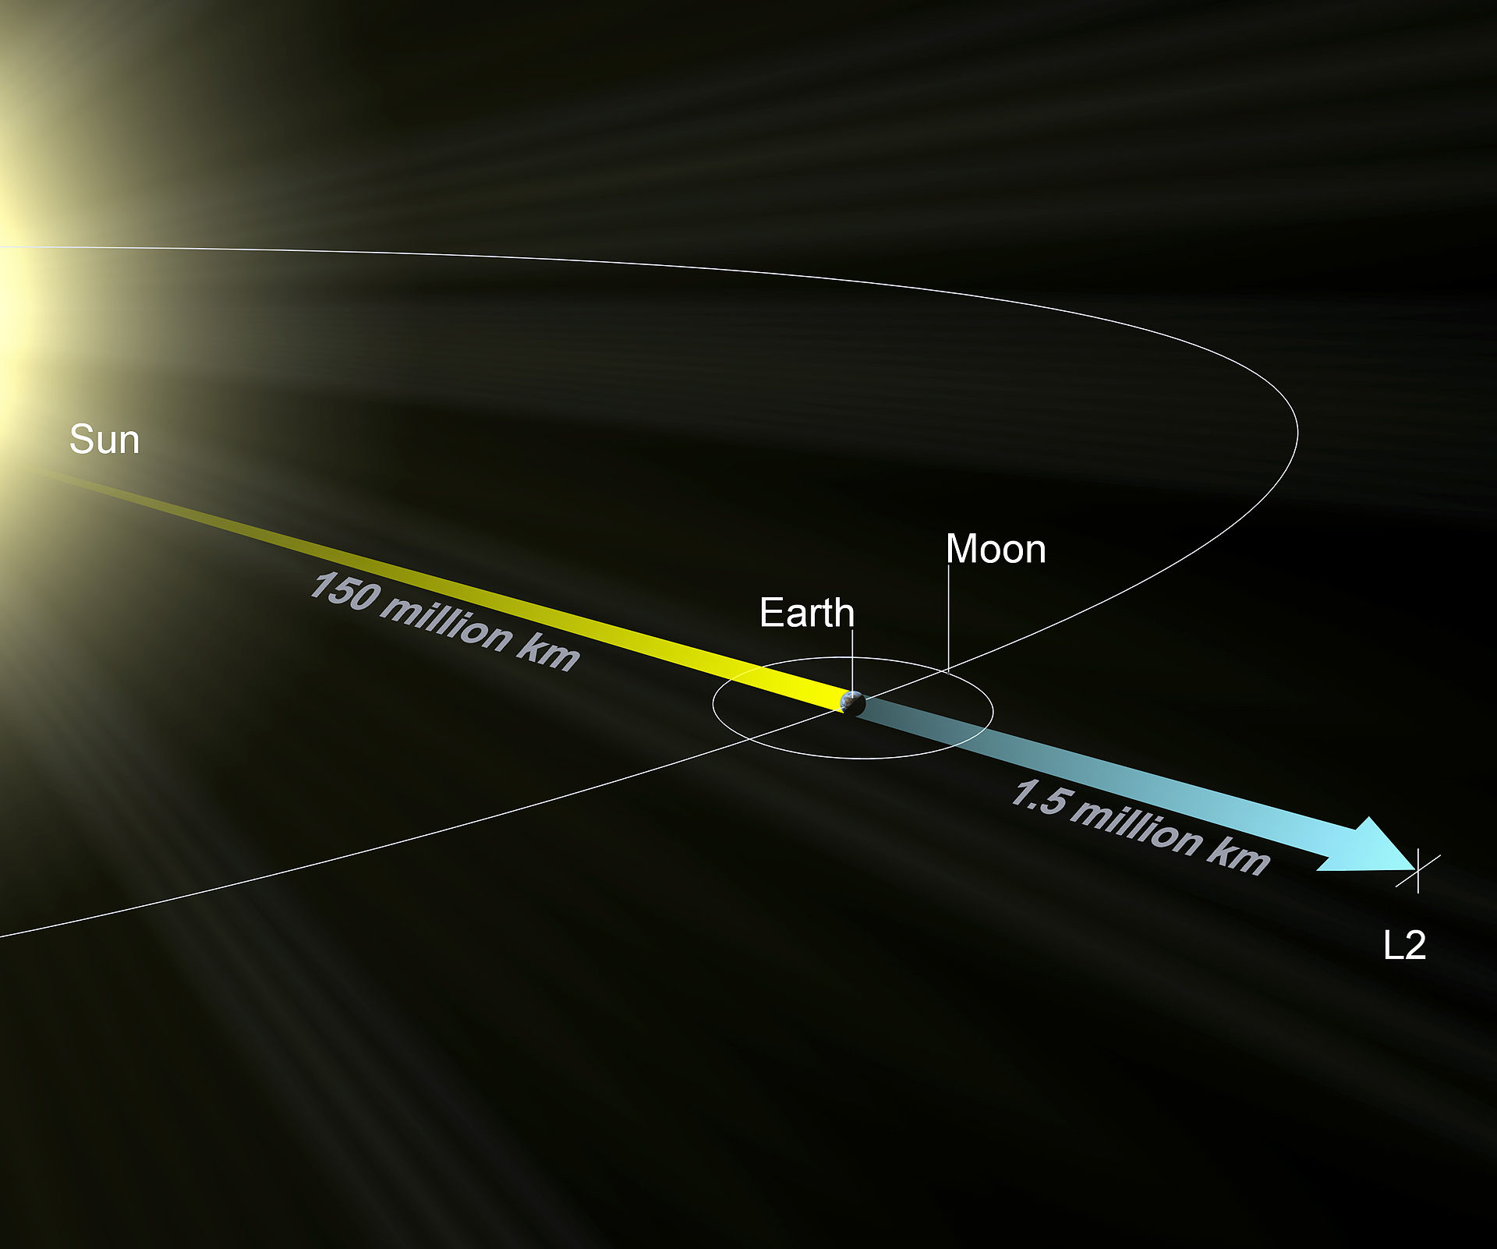
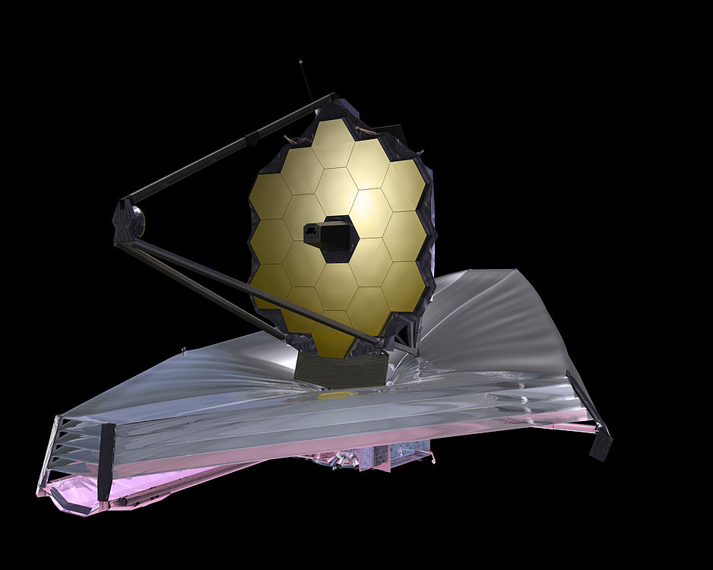

Slide 28
Observability Constraints

Slide 29
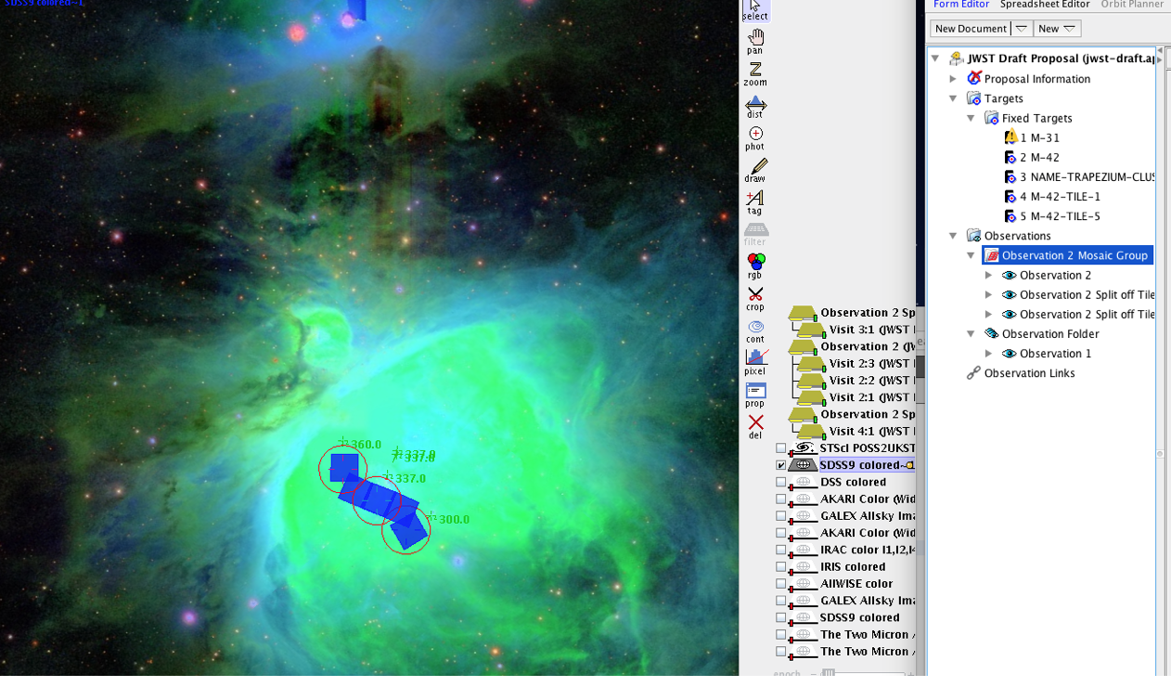
Mosaic Group

Slide 30
INTRAMODULE Dither Patterns
INTRAMODULE dithers are smaller, covering the SCA gaps, but not the gap between modules.
Only one guide star is required, reducing overheads.
Any number of dither positions between 2 and 16 is allowed.

Slide 31
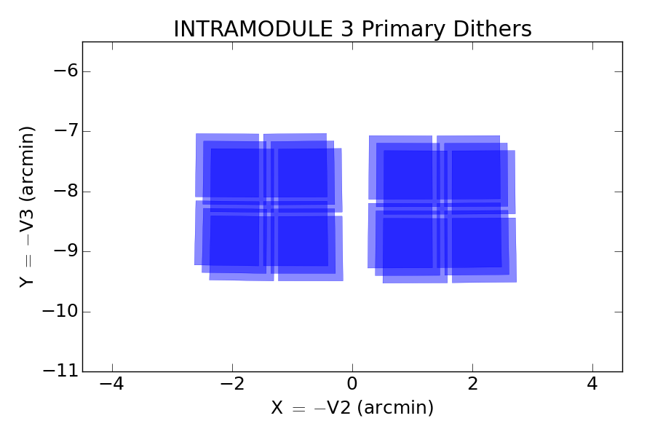
Intramodule 3
1/3

Slide 32
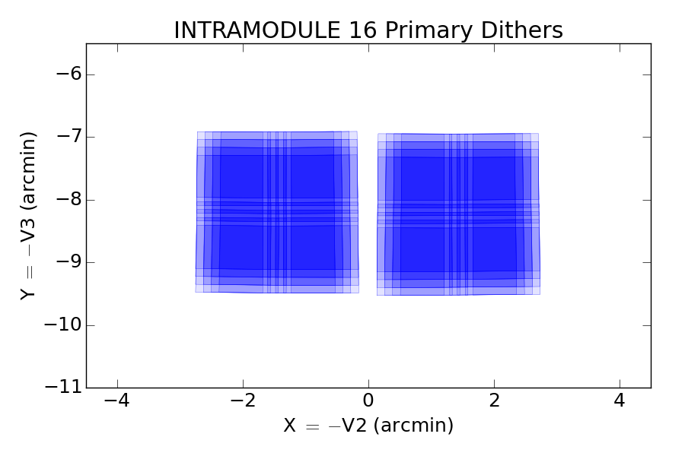
Intramodule 16
9/16

Slide 33
INTRASCA Dither Patterns
INTRASCA dither patterns are designed to observe small science targets with various parts of a SW detector (SCA) to mitigate flat field uncertainties.
The science target is considered to be “small", “medium", or “large” if it fills < 25%, 50%, or 75% of the detector, respectively.
Dither step sizes are optimized for either the short or long wavelength channel (SWC or LWC) detectors, with the latter allowing for larger dither steps.

Slide 34
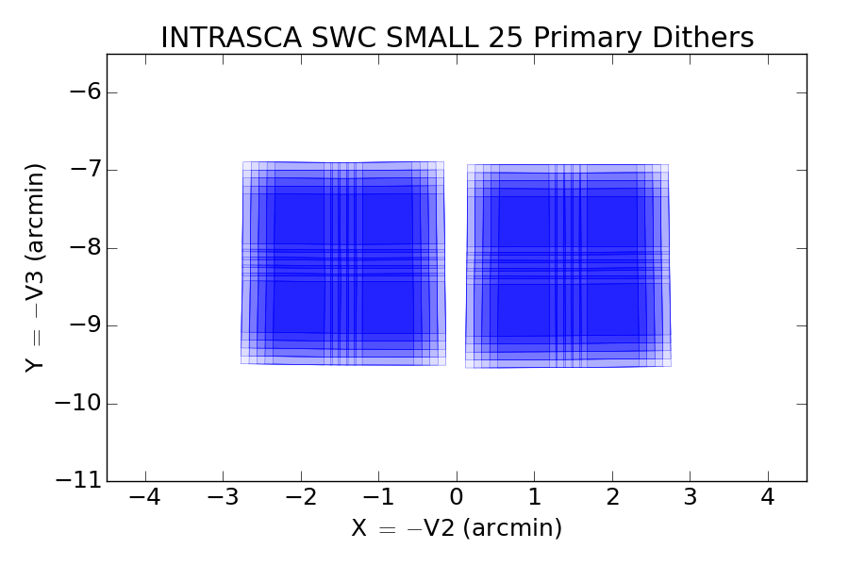

Slide 35
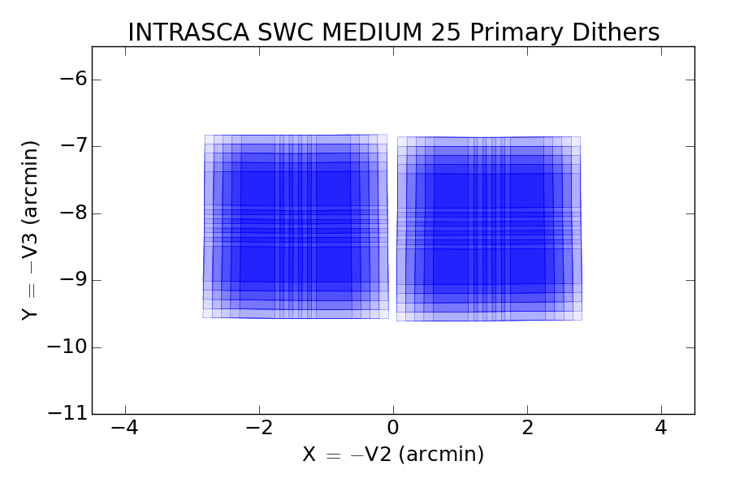

Slide 36
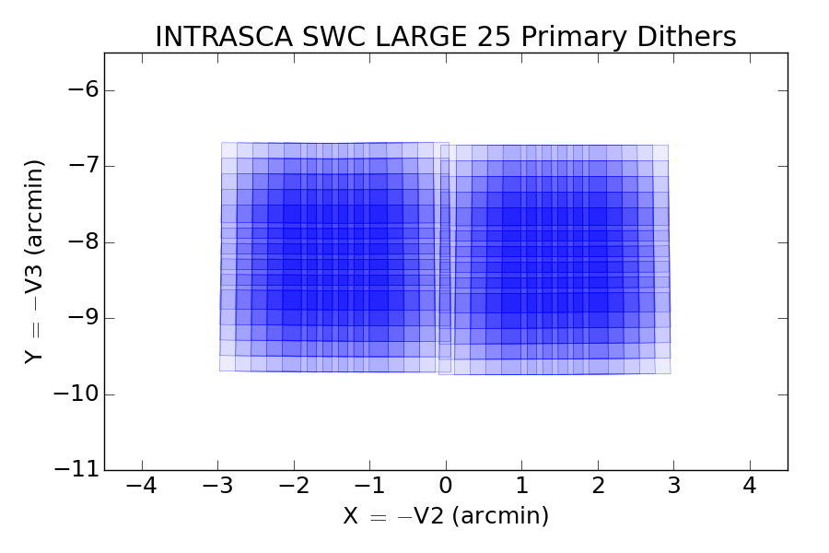

Slide 37
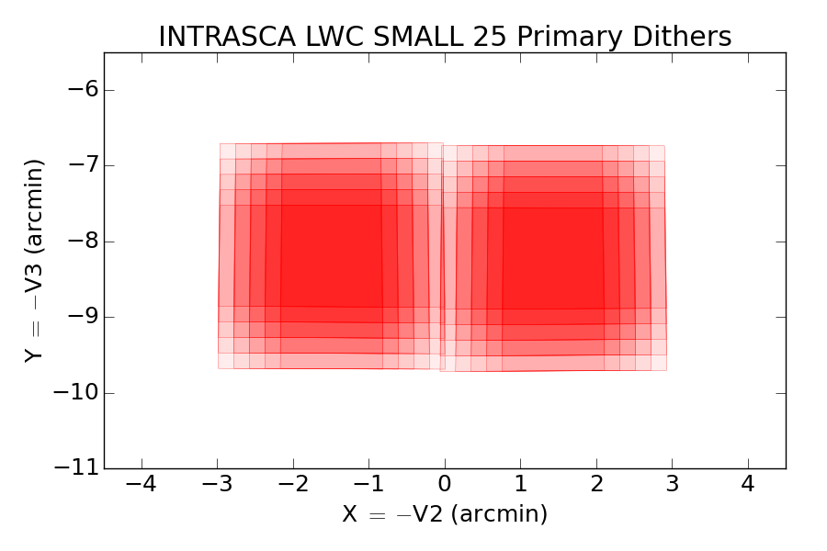
INTRASCA are optimized SW/LW

Slide 38
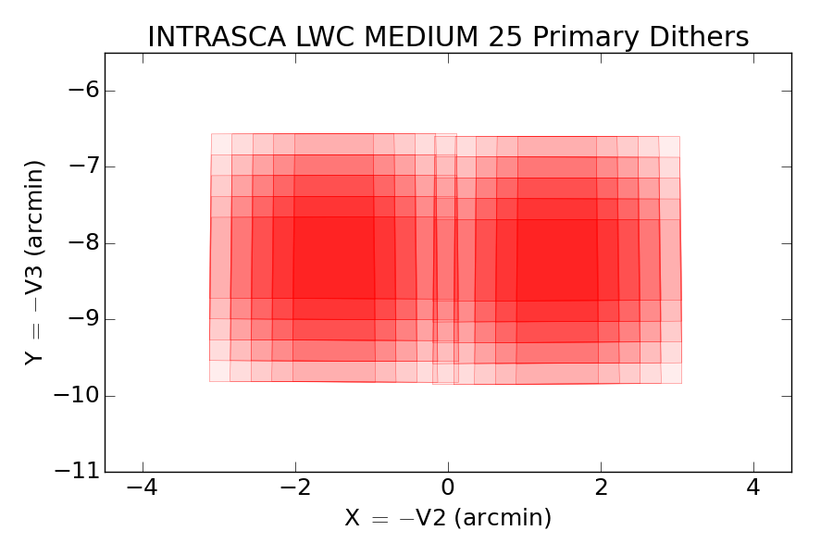

Slide 39
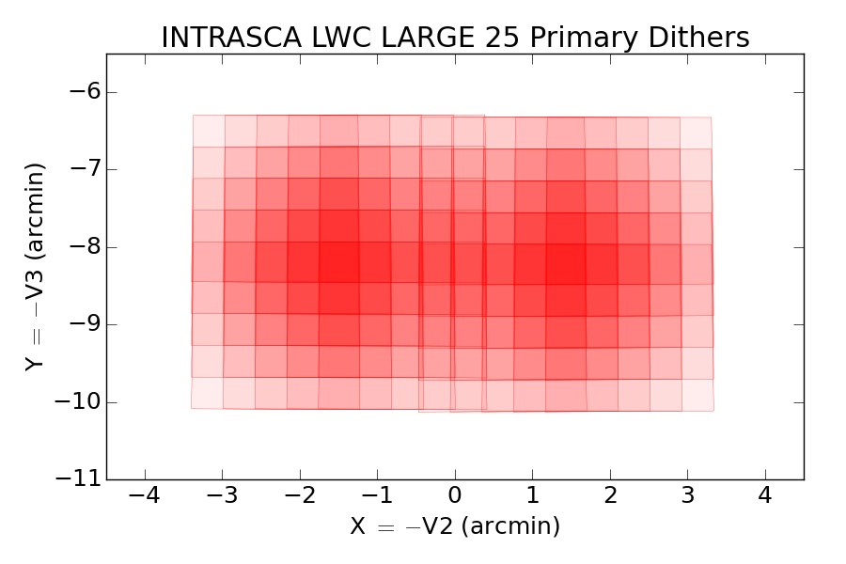

Slide 40
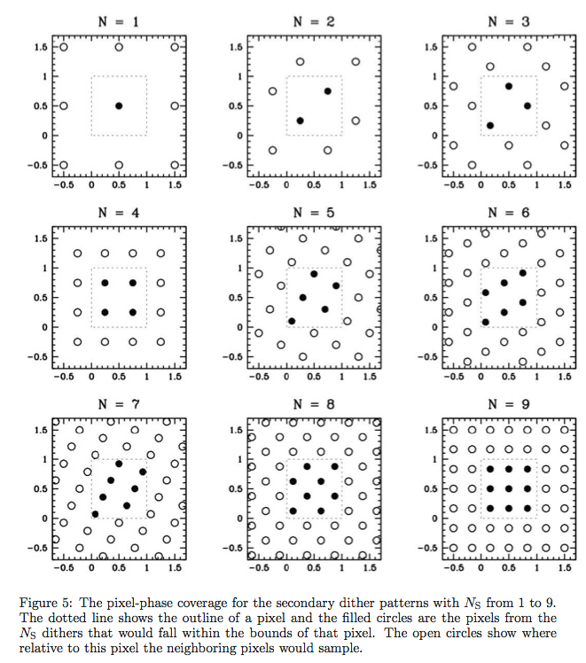
NIRCam Secondary Dithers

Slide 41
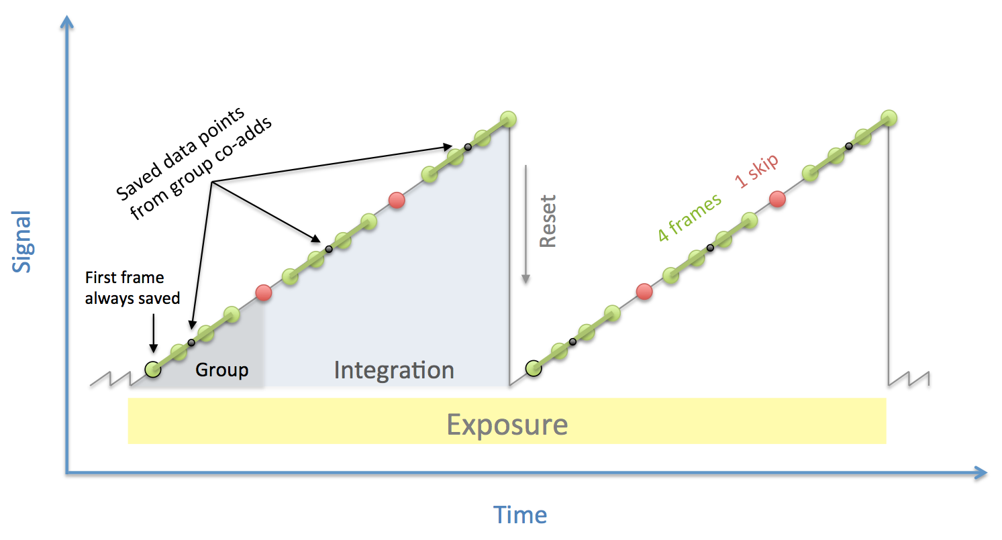
Sampling diagram
One Exposure
Two integrations
Three Groups
Four Reads
One Skip

Slide 42
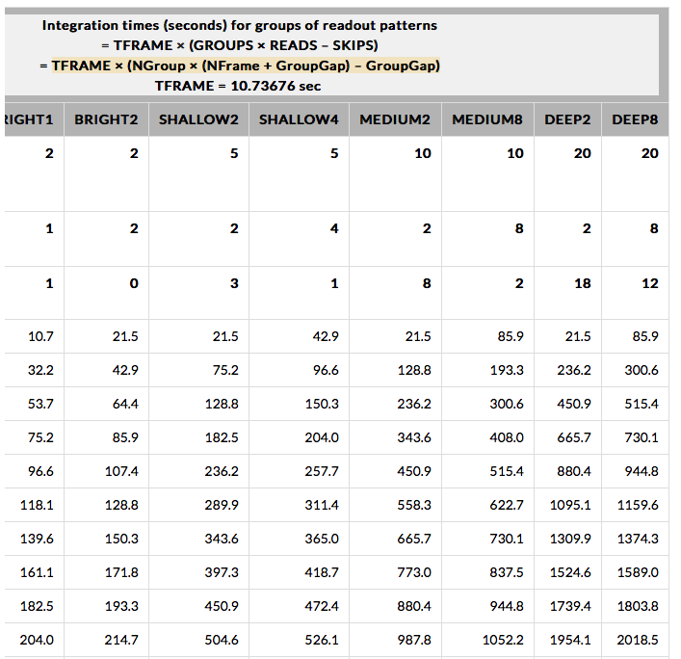
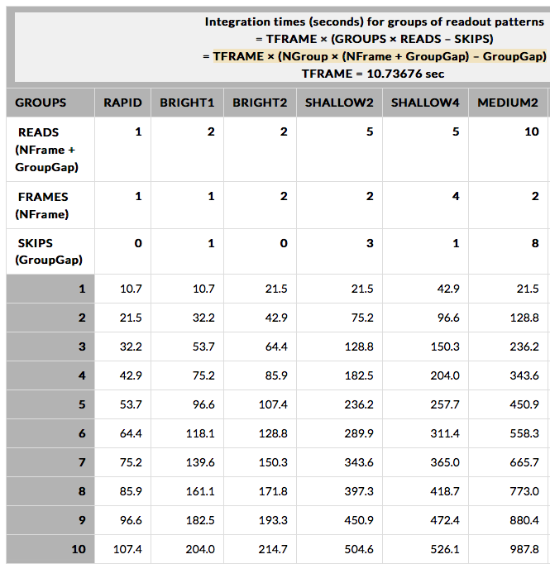
NIRCam Readout Pattern

Slide 43
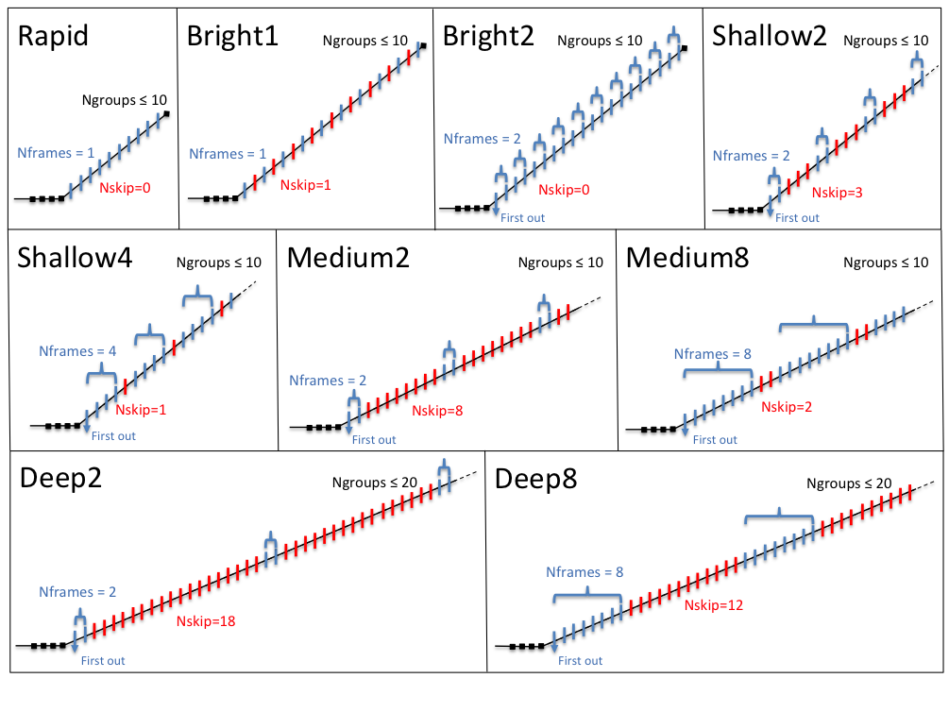

Slide 44
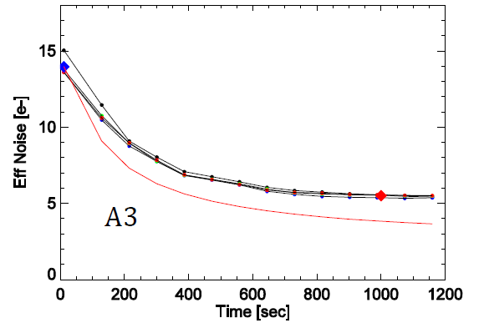
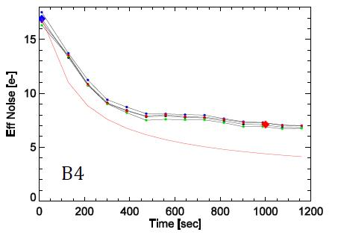
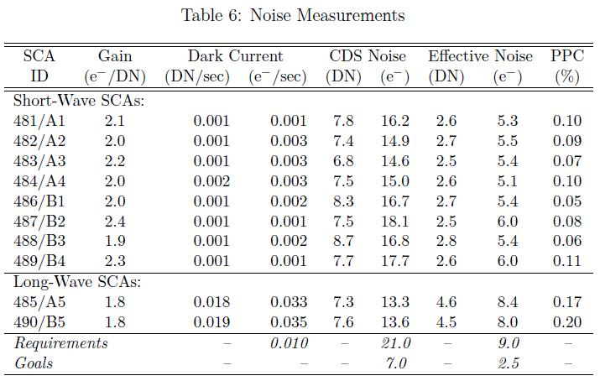
FPA Performance
CDS noise
CDS noise
Effective
noise
Effective
noise
Notes:
NIRCam noise goes from 20 (CDS) to 12 (effective)

Slide 45
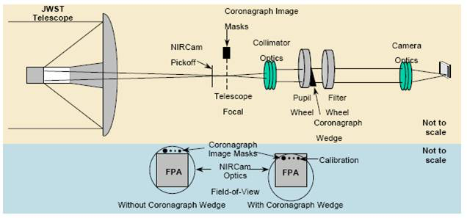
NIRCam Coronagraphy

Slide 46
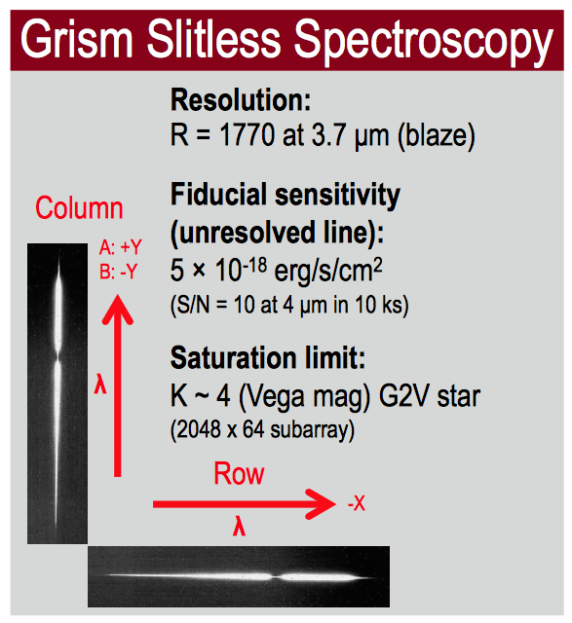

Slide 47
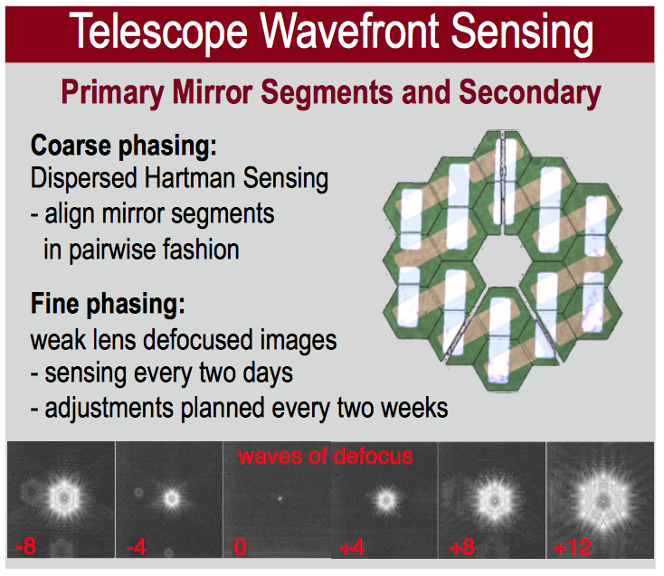
Wavefront Sensing

Slide 48
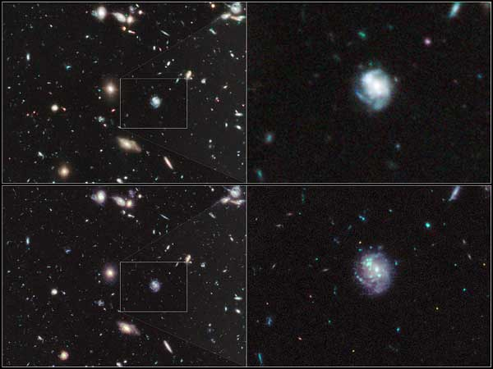
HUDF: WFC3/IR vs NIRCam

