Slide 1
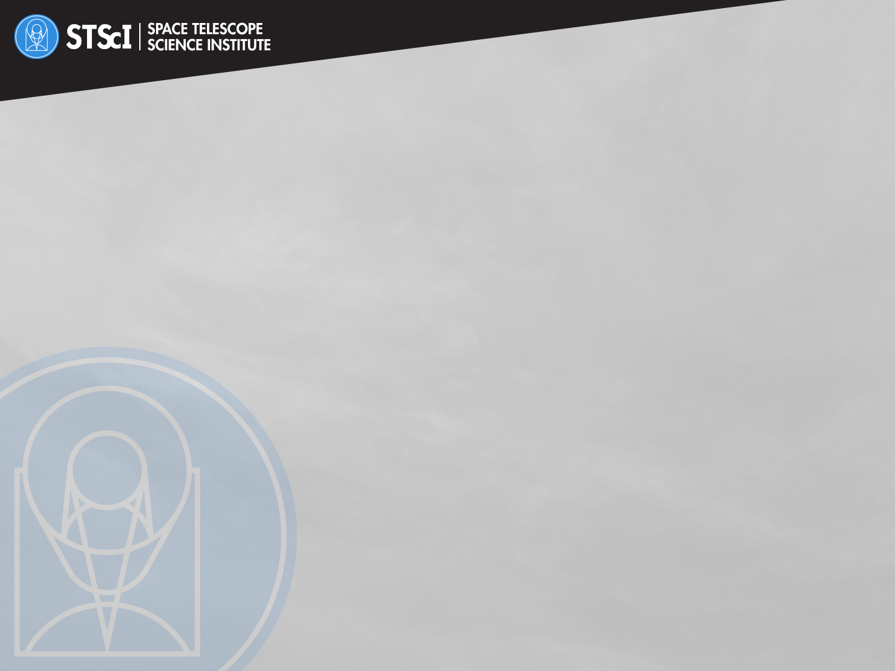

Near-InfraRed Imager and Slitless Spectrograph:
Imaging and Interferometry
Alex Fullerton
STScI / NIRISS Team Lead
OUTLINE
Introducing NIRISS
Imaging
Aperture Masking Interferometry

Slide 2

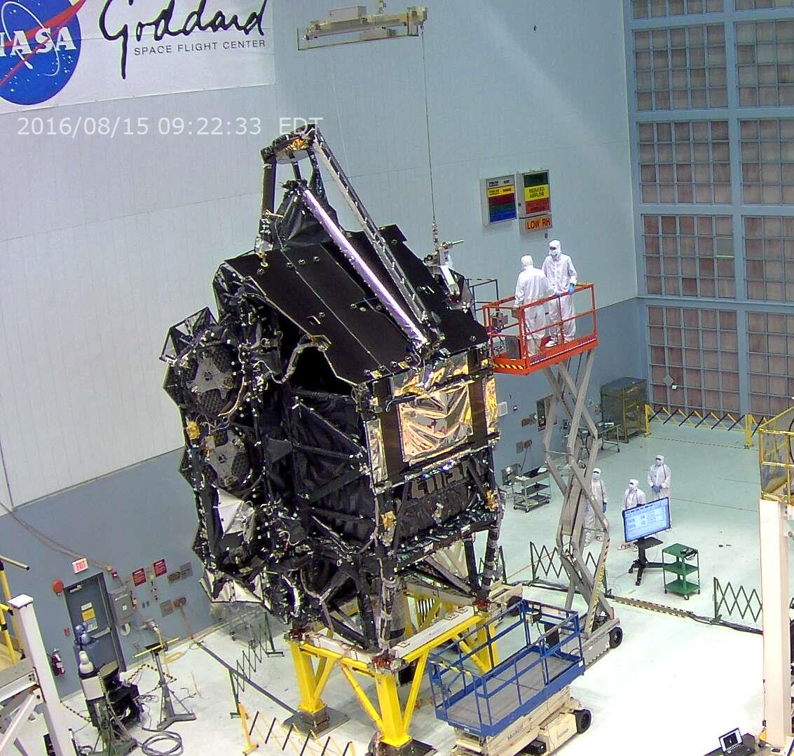
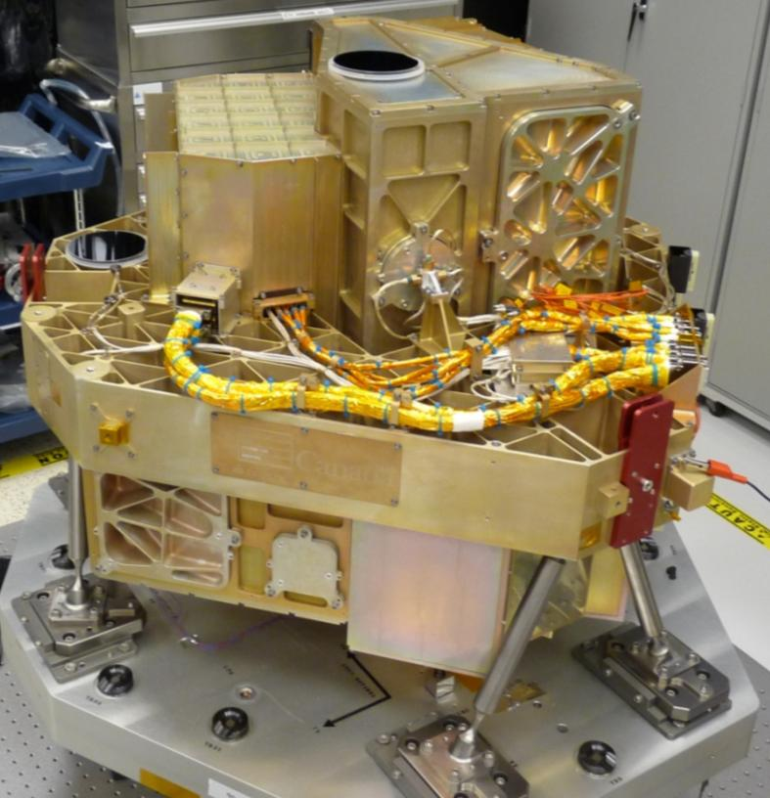
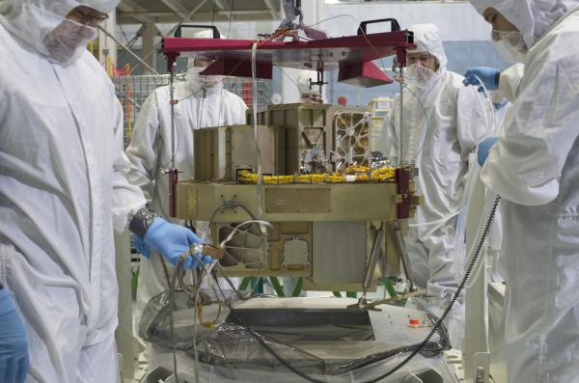




A Bit About NIRISS
Developed / Provided By:
  Canadian Space Agency
Principle Investigator:
  Prof. René Doyon
Prime Contractor:
  Honeywell
Technical Development:
  National Research Council
  of Canada
NIRISS is packaged with the Fine Guidance Sensor.
FGS is the camera used to acquire targets and guide on them during observations. Independent functionality from NIRISS.

Slide 3
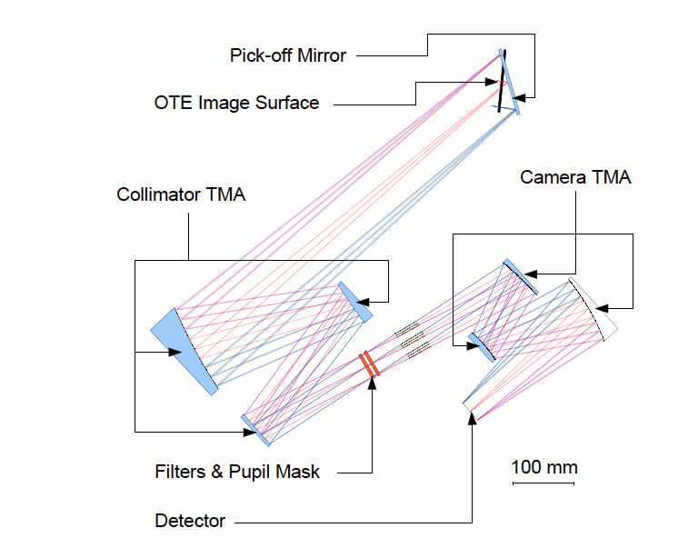
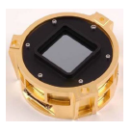
Optical Layout of NIRISS
Efficient, All-Reflective Design
Hawaii 2RG Detector
HgCdTe with 5.2 μm cut-off
Parameter | Value
Array Size | 2048 × 2048 (2040 x 2040 active)
Pixel size | 18 μm × 18 μm
Dark rate | < 0.04 e⁻/s
Noise | 16.3 e⁻ (correlated double sample)
Gain | 1.6 e⁻ / ADU
Field of View | 2.2´ × 2.2´
Plate scale in x | 0.0654 arcsec/pixel
Plate scale in y | 0.0659 arcsec/pixel

Slide 4
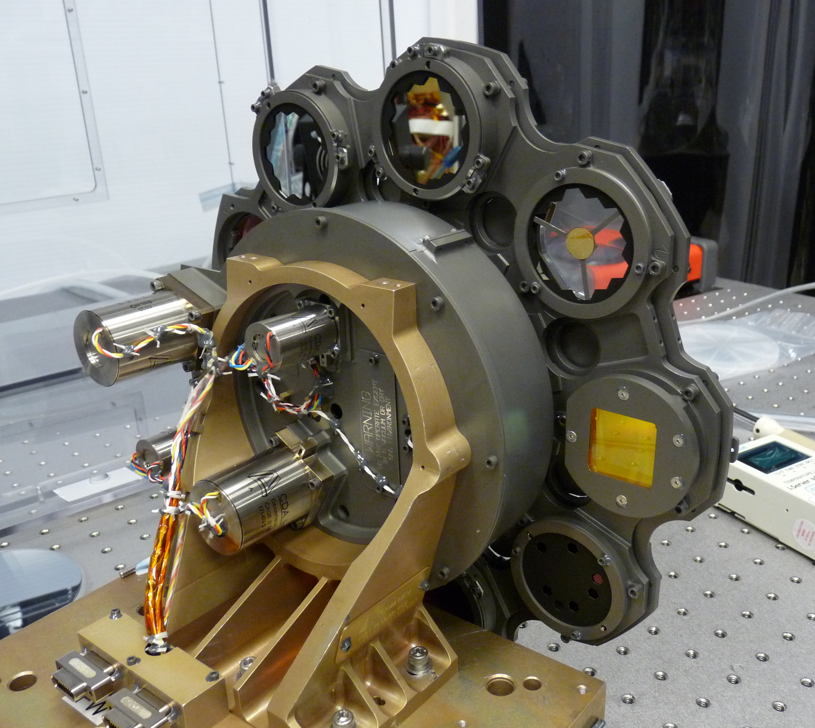
Pupil / Filter Wheel Combinations Enable
Four Observation Modes
Imaging (Imaging)
Aperture Masking Interferometry (AMI)
Wide-Field Slitless Spectroscopy (WFSS)
Single-Object Slitless Spectroscopy (SOSS)
Pupil Wheel
Filter Wheel

Slide 5
Imaging: “Blue”
Imaging: “Red”
All filters except F158M are NIRCam flight spares
All filters except F380M are NIRCam flight spares

Slide 6
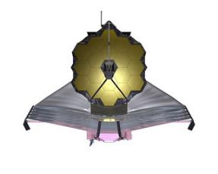
NIRISS Filter Transmission & Sensitivity
Filter | nJy | m(Vega)
F090W | 11.28 | 28.28
F115W | 11.22 | 28.06
F140M | 14.80 | 27.43
F150W | 9.19 | 27.83
F158M | 12.88 | 27.39
F200W | 7.81 | 27.54
F277W | 6.63 | 27.09
F356W | 6.89 | 26.56
F380M | 18.74 | 24.34
F430M | 28.32 | 24.65
F444W | 12.29 | 25.49
F480M | 36.85 | 24.14
S/N = 10 in 10 ks
NOTE:
These filters are very
closely matched to the
filter set of NIRCam.

Slide 7
Caveats and Counselling
Near-IR Imaging with NIRISS:
Is an essential part of data collection in the WFSS mode; optional for AMI
Provides a powerful “parallel” capability
  Matched NIRCam filters; comparable sensitivity
  Increases areal coverage of the sky when paired with NIRCam
  Provides near-IR imaging at lower data rate than NIRCam
However: NIRCam is the JWST instrument of choice for near-IR imaging!
Twice the field of view of NIRISS
Simultaneously images “short” and “long” wavelengths
Better sampling of the PSF at wavelengths < 2.5 µm
4× multiplex advantage
compared to NIRISS
Accordingly, the NIRISS Imaging template:
Only supports “parallel” observations
Does not support the use of subarrays
Will necessarily follow dither pattern / mosaic strategy of “primary” instrument

Slide 8
Aperture Masking Interferometry
Un “ami” des astronomes
NIRISS provides the first space-based implementation of aperture masking

Slide 9
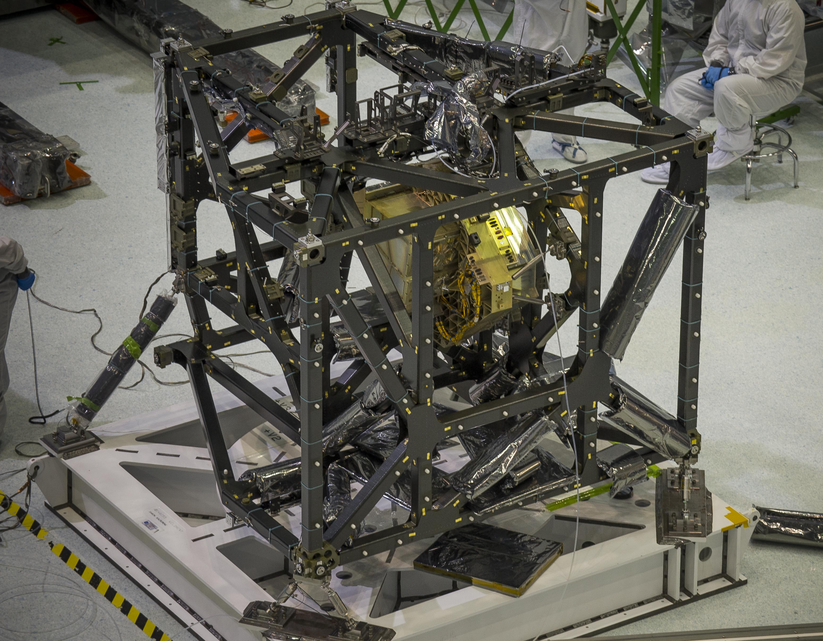
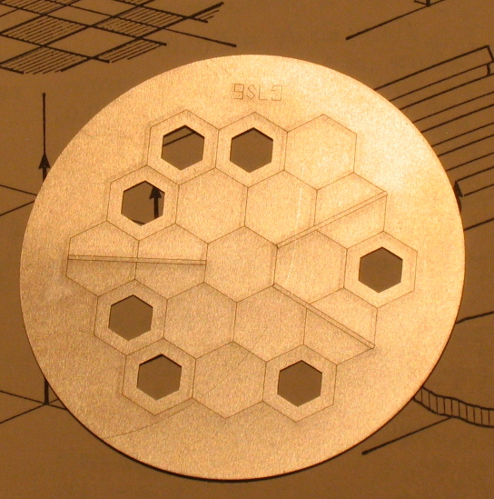
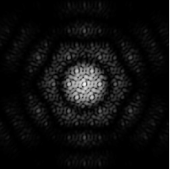
The Non-Redundant Mask (NRM)
Point source through F430M
Modeled by WebbPSF
80 pixels
5.2”
Oversampled ×11
Logarithmic “stretch”
7 undersized apertures: ~15% throughput
n × (n−1) / 2 = 21 distances (“baselines”) between pairs of apertures
Apertures placed so that all vectors between them (angles and baselines) are unique (“non-redundant”)
Terminology:
NRM PSF / Interferogram
Flocon de neige / Snowflake

Slide 10
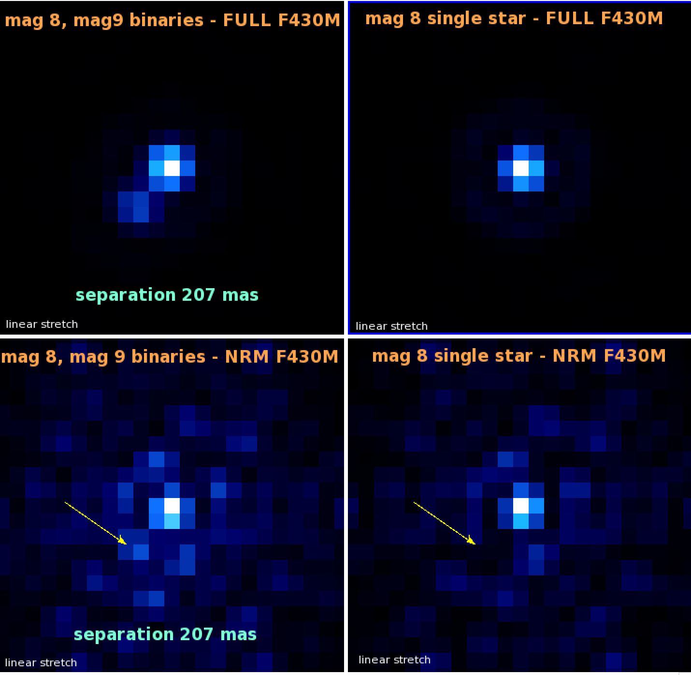
AMI in [Simulated] Action
Direct
Simulations Include:
Read Noise
Poisson Noise
Dark Current
Background
Flat-Field Error
AMI
Slide courtesy of D. Thatte

Slide 11
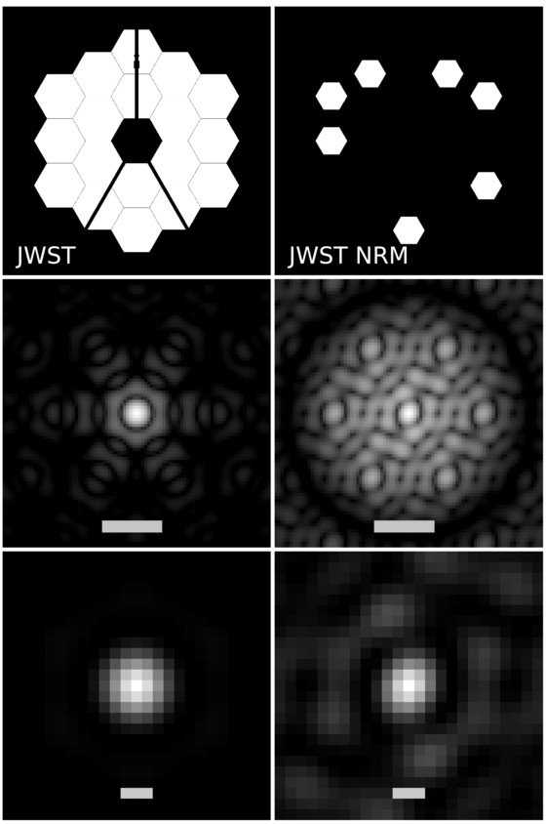
The Interferometric Advantage
Pupil
PSF
Dynamic Range: 10⁴:1
5 λ/D
PSF core
Dynamic Range: 100:1
Sharper Core!
0.75 λ/D
Simulations by: Ford et al. 2014, ApJ, 783, 73

Slide 12
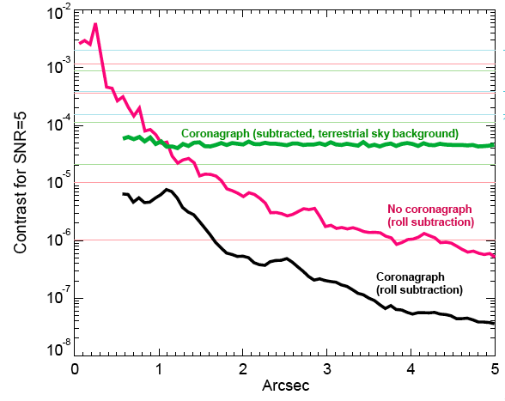
A Niche for AMI
70 mas
400 mas
Inner Working Angle @ 4.4 μm
NIRCam / Wedge | 4.0 λ/D | 560 mas
NIRISS / NRM | 0.5 λ/D | 70 mas
IWA NIRCam Wedge Occulter

Slide 13
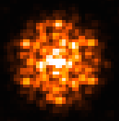
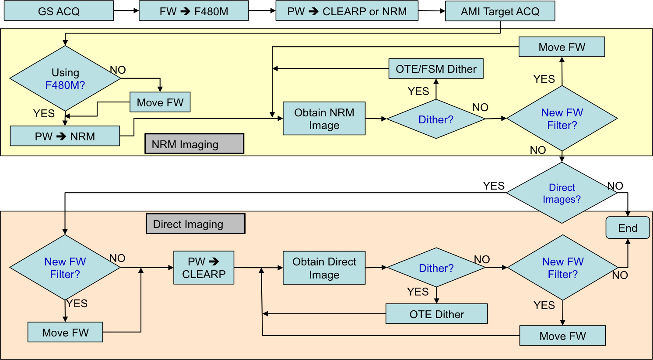
Operational Flow of An AMI Visit
Subarray
80 pixels × 80 pixels
(5.2″ × 5.2″)
Visit 1: Science Target
Target Acquisition
Configure
Expose
Dither
Repeat with New Filter?
Obtain Reference PSFs?
Visit 1: Science Target
Target Acquisition
Visit 1: Science Target
Target Acquisition
Configure
Visit 1: Science Target
Target Acquisition
Configure
Expose
Visit 1: Science Target
Target Acquisition
Configure
Expose
Dither
Visit 1: Science Target
Target Acquisition
Configure
Expose
Dither
Repeat with New Filter?
Obtain Reference PSFs?
Visit 1: Science Target
Target Acquisition
Configure
Expose
Dither
Repeat with New Filter?
Visit 2: Reference Star
Must Be Contemporaneous
Must Repeat Sequence
Used to derive
  Closure Phases
  Closure Amplitudes
NIRISS Operations Concept Document (P. Goudfrooij et al.)
Visit 1: Science Target
Target Acquisition
Configure
Expose
Dither
Repeat with New Filter?

Slide 14
Predicted Performance of AMI
Figure courtesy of É. Artigau (U de Montréal)

Slide 15
Synthesis Imaging with AMI
Multiple visits ~ 3 months apart
Use Case: Structure in the Nuclei of AGN
Bar
Fainter Bar
Asymmetric Bar
Short Bar
Ring
9 × 1 pixels
Δm = 1 mag
(integrated)
9 × 1 pixels
Δm = 2 mag
(integrated)
3 × 1 pixels
Δm = 1 mag
(integrated)
3 × 1 pixels
Δm = 1 mag
(integrated)
5 pixel diameter
Δm = 1 mag
(integrated)
After Ford et al. 2014, ApJ 783,73

Slide 16
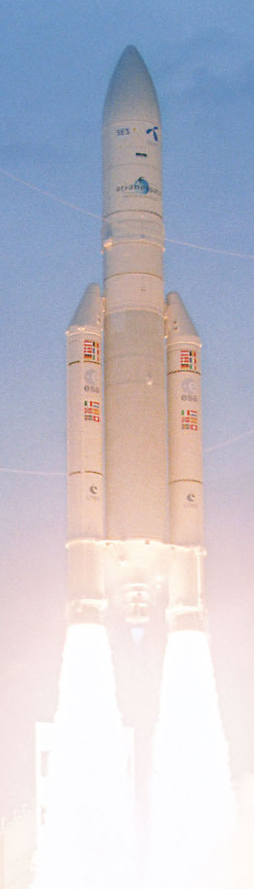
Near-InfraRed Imager and Slitless Spectrograph:
Imaging and Interferometry
SUMMARY:
L−734 Days and Counting!
NIRISS has imaging capability with a filter set closely matched to NIRCam.
  Integral part of observing sequence for WFSS; optional for AMI
  Powerful mode when used as a science “parallel”
  But otherwise you should use NIRCam for near-IR imaging
Aperture Masking Interferometry (AMI) is a powerful capability.
  Provides very high spatial resolution and good contrast
  Very stable, self-calibrating
  Can be used for synthesis imaging
  AMI is a friend! Use it!

