Slide 1
A Summary of the Imaging Capabilities of
James Webb Space Telescope
Jerry Kriss
STScI
9/27/2016

Slide 2
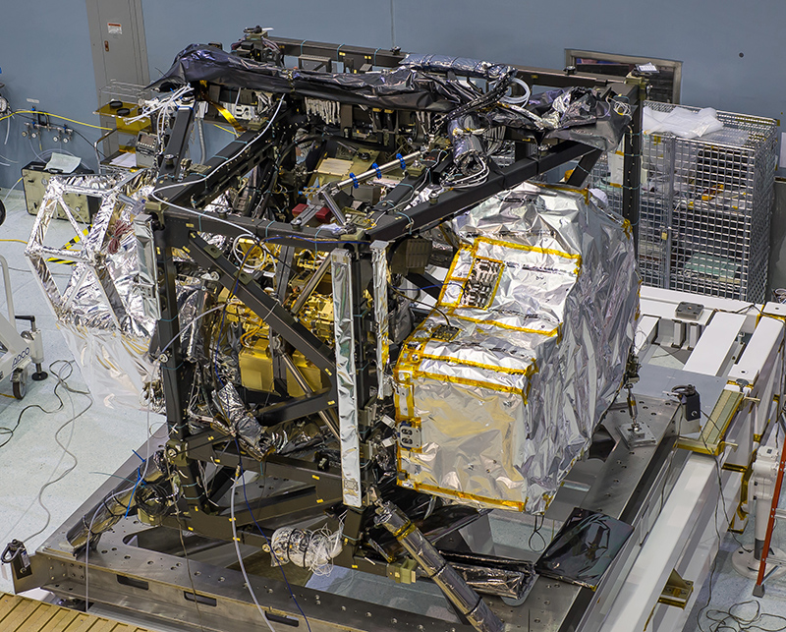
JWST Imaging Instruments Integrated into ISIM
MIRI
NIRISS+FGS
NIRCam
(NIRSpec)

Slide 3
JWST Sensitivity Comparisons
5-sigma, 50,000 secs
Ground
Spitzer
JWST MIRI
HST
JWST NIRCam
Galaxy models:
Wavelength (Microns)
Notes:
We are fortunate to live in a remarkable era.
The James Webb Space Telescope will provide 1 to 2 orders of magnitude increased sensitivity compared to current ground and space-based telescopes.
Not only will you be able to observe known objects faster, and at higher resolution,
but deep observations will undoubtedly reveal completely new phenomena.
In less than three years, it is likely that someone in this audience will discover the most distant galaxy in the universe.

Slide 4
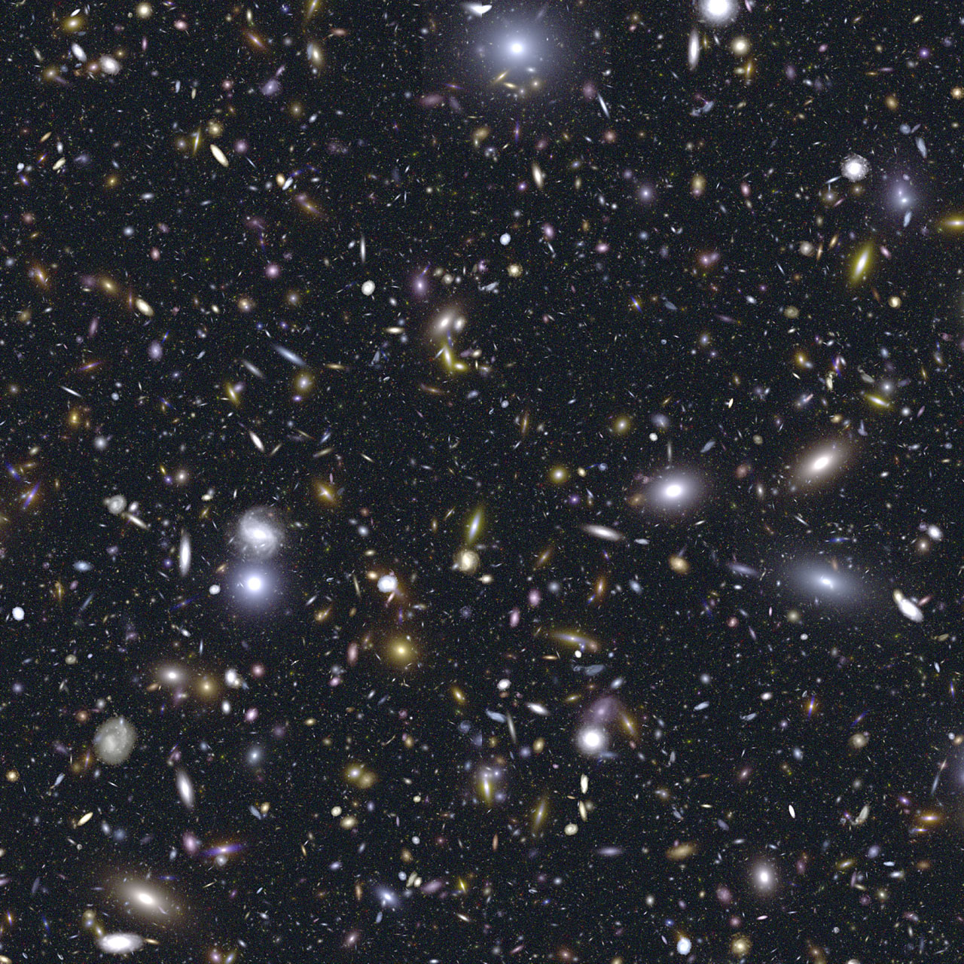
The most distant galaxy will appear as a pale red dot:
Notes:
Not only will you be able to observe known objects faster, and at higher resolution,
but deep observations will undoubtedly reveal completely new phenomena.
In less than three years, it is likely that someone in this audience will discover the most distant galaxy in the universe.

Slide 5
The most distant galaxy will appear as a pale red dot:
Notes:
In less than a year, you will be writing the proposal to do this observation with the James Webb Space Telescope.
That’s the whole reason you are here this week,
and why all of us from the instrument teams and the Space Telescope Science Institute are here to talk to you.

Slide 6
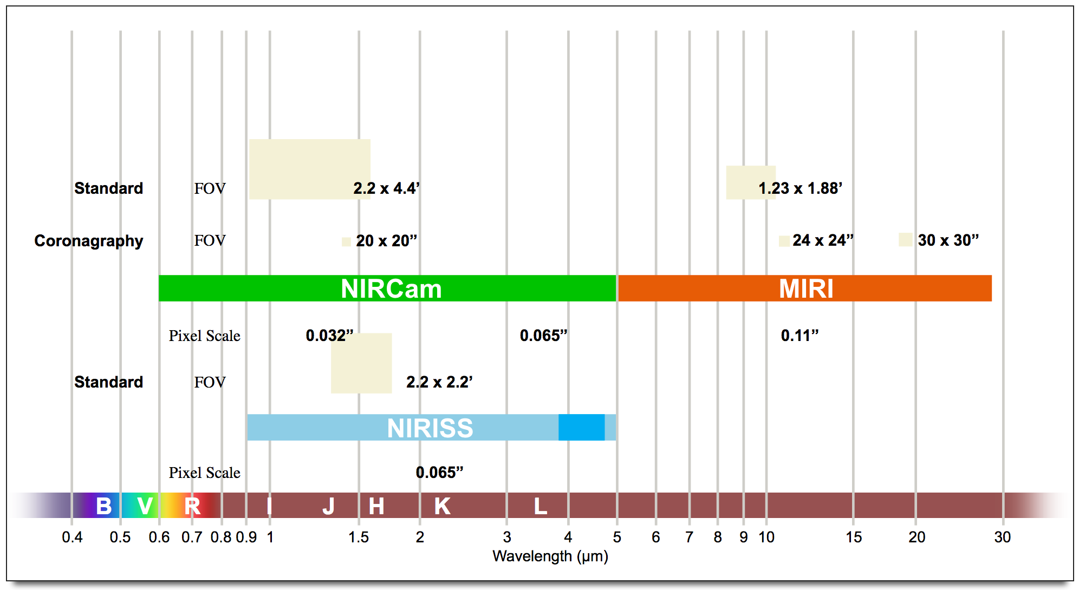
Wavelength Coverage
Notes:
The long and short of it---long wavelengths, use MIRI; short wavelengths, use NIRCam.

Slide 7
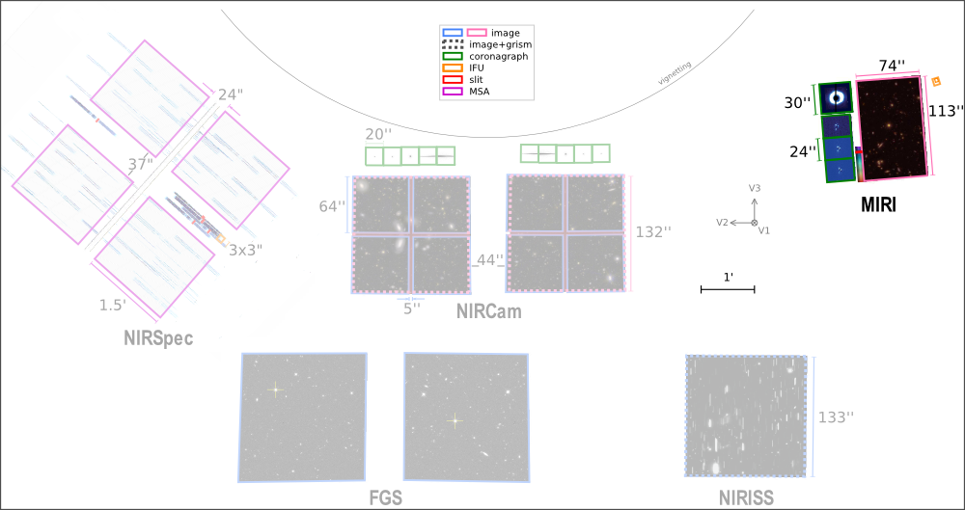
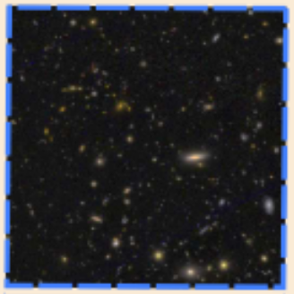
Imaging Instruments in the JWST Focal Plane
133”
NIRISS

Slide 8
Imaging Fields of View Comparison
Short Wavelength Camera
32 mas pixels
65 mas pixels
110 mas pixels
Long Wavelength Camera
65 mas pixels

Slide 9
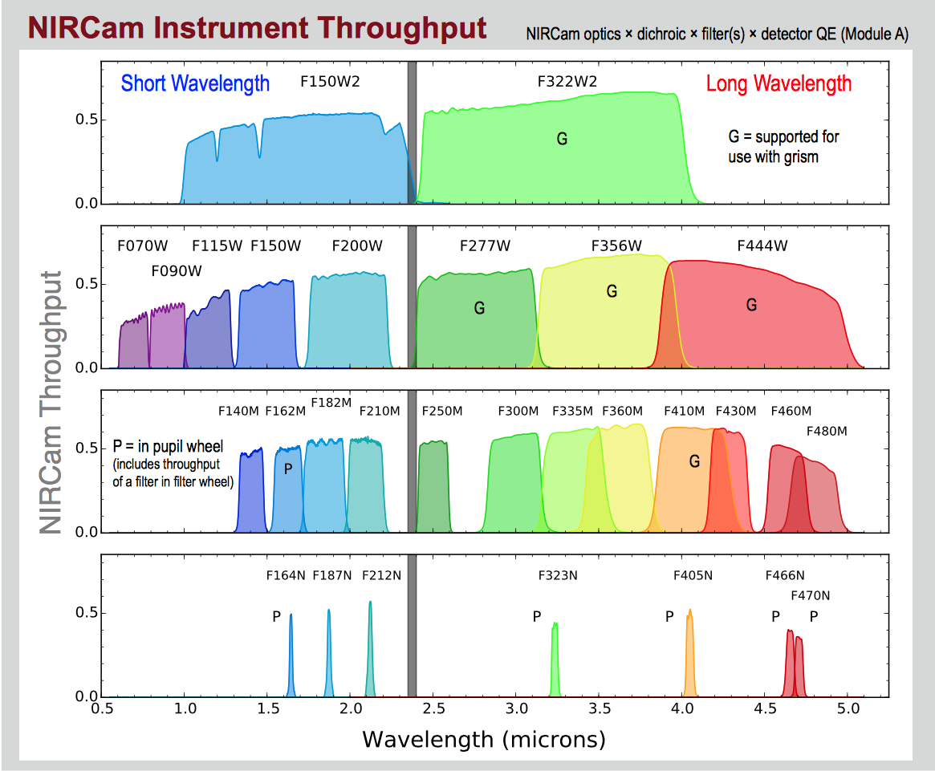
NIRCam Passbands and Throughput

Slide 10
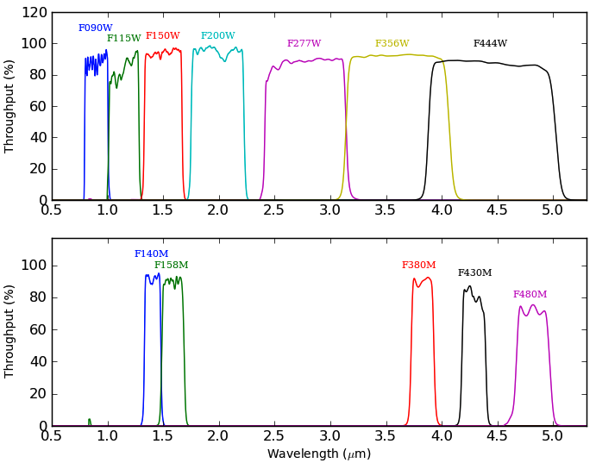
NIRISS Passbands and Throughput

Slide 11
NIRCam / NIRISS Filter Comparison

Slide 12
MIRI Imaging Filter Throughputs

Slide 13
Comparing Sensitivities
Rules of thumb:
For near infrared (<5 μm) think 10s of nano Janskies
For mid-IR (> 5 μm)(MIRI), think 100s of nano Janskies
NIRCam will always beat NIRISS below 2.5 μm because:
2.5-μm devices have lower dark current
NIRCam SW pixels are smaller than NIRISS, so sky background is less (N.B. NIRCam and NIRISS can see the zodi in their wide-band filters).

Slide 14
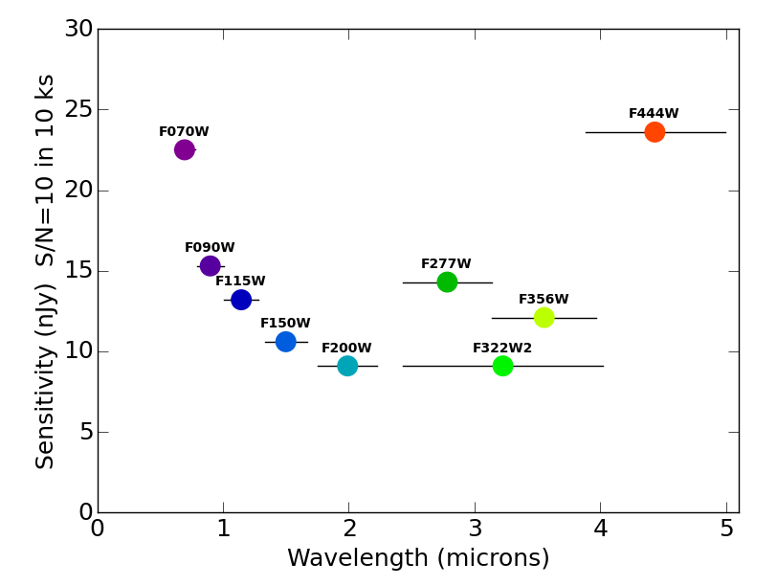
NIRCam and NIRISS Sensitivity
NIRCam
NIRISS
Notes:
To put this in perspective:
A 4-point dither pattern with 1000 s exposures will beat the Hubble Deep Field.

Slide 15
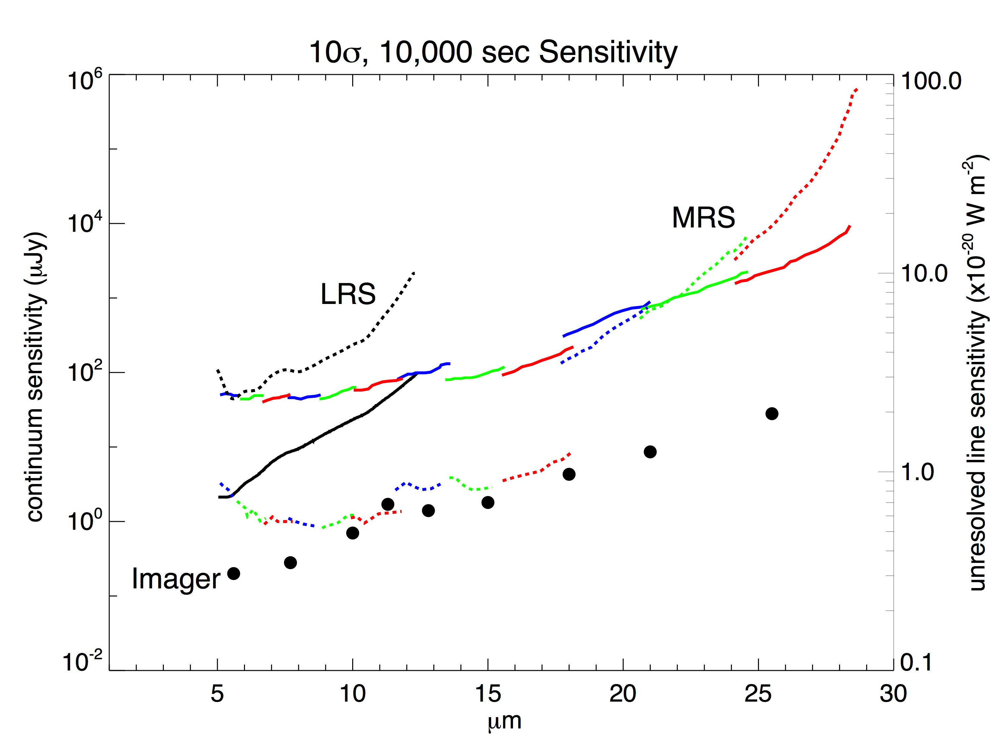
MIRI Sensitivity
Notes:
MIRI is nearly 2 orders of magnitude more sensitive than Spitzer.

Slide 16
Improving your Images with Dithering
Primary Dithers
Mitigate detector defects:
low-frequency flat-field errors
Clusters of bad pixels
Allow for persistence correction for bright objects
Improve CR detection and correction
Bridge gaps between SCAs (SW) and Modules in NIRCam
Secondary dithers
Improve sub-pixel sampling, especially for short wavelengths in each instrument
Additional mitigation of detector artifacts and CRs

Slide 17
NIRCam Primary Dither Patterns
Primary Dither Types:
FULL—Provides coverage of the full FOV, both modules, with as even sky coverage as possible.
INTRAMODULE—Provides coverage of just one module, with as even sky coverage as possible.
INTRASCA—Cover as much detector area on a single SCA as possible, consistent with the source size.
SHORT or LONG camera
SMALL (~8”), MEDIUM (~16”), or LARGE (~24”) pattern sizes
NONE—Allows for using Mosaics to handle large-scale dithers.

Slide 18
NIRCam Sub-pixel Dither Patterns
Sub-pixel Dither Positions:
Allows for phase diversity across pixels uniformly across the full field.
Steps are actually a small integer number of pixels, plus a fraction, to fully move the PSF off the current location.
1 to 64 positions are allowed.
The largest pattern spans a diagonal distance of ~1.6”.
Good PSF sampling requires ≥3 pixels per PSF
Overheads are ~tens of seconds to let the pointing disturbance settle from the small-angle maneuver.

Slide 19
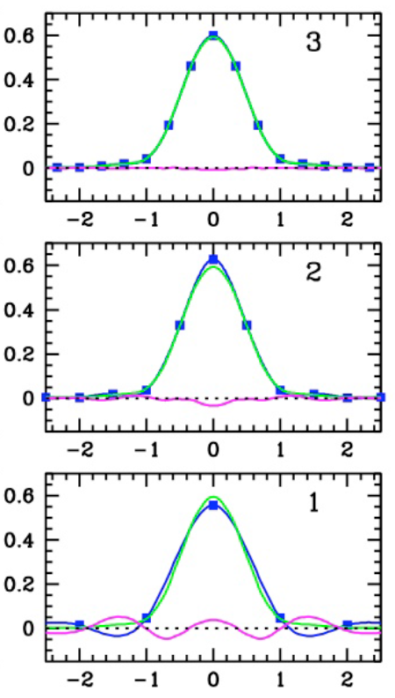
Good Sampling Requires ≥3 pixels per PSF
Green—Optimal PSF
Blue—Reconstructed PSF using
spline at sampled spacings
Magenta—Residuals
From “NIRCam Dithering Strategies II: Primaries, Secondaries, and Sampling”, Anderson 2014, JWST-RPT-002473.

Slide 20
Should I use Dither, or Mosaic?
Mosaic patterns (for any instrument) are intended for covering larger areas of the sky than a single field of view.
Fundamental operational difference between Dither and Mosaic:
Dithers: all spatial positions in a pattern are imaged through the same filter before making a filter change.
Mosaics: all filters in an observation (and all dithers) are executed before moving to the next mosaic point.
Thus, dithers with large patterns and large step sizes can incur significant overheads due to spacecraft maneuvers.
This must be balanced against lifetime limitations on filter wheel rotations.

Slide 21
Imaging Summary
Long wavelengths (>5 μm)—use MIRI
Short wavelengths (<5 μm)—prefer NIRCam
But consider NIRISS for parallel imaging,
or for a special filter (F380M)
Please do Dither. It will greatly improve your image quality.
For large patterns with large step sizes, consider Mosaics.

