Slide 1
Chris Willott, René Doyon, and the FGS/NIRISS Team
Niriss WIDE-Field Slitless spectroscopy
ESAC JWST
27 Sept 2016

Slide 2
Outline
Slitless spectra science with HST/WFC3
NIRISS grisms and filters
Observing sequence
Data analysis
Performance: sensitivity, contamination
Benefits of slitless compared to MOS

Slide 3
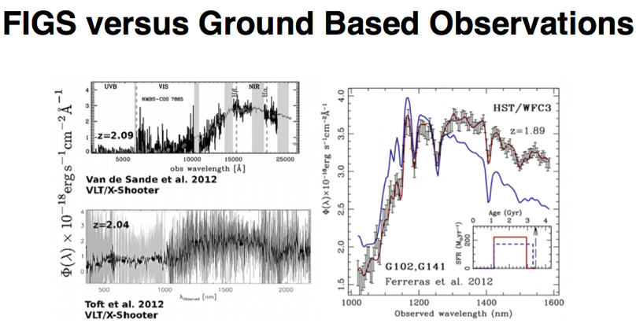
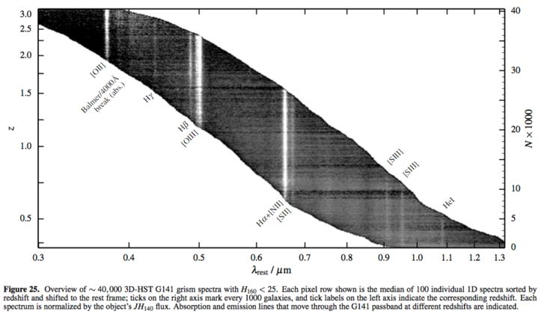
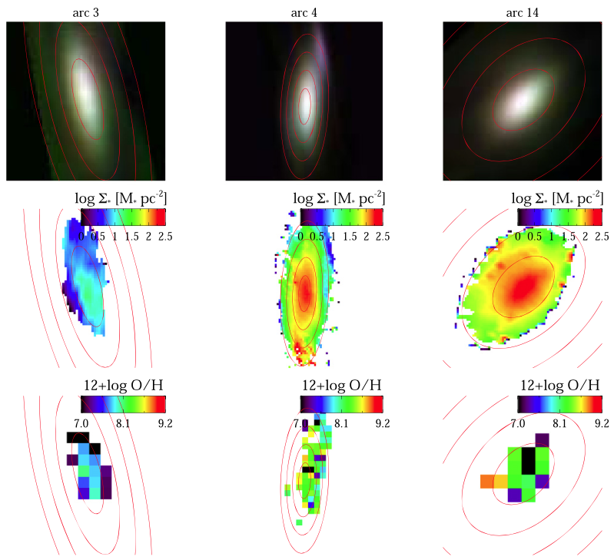
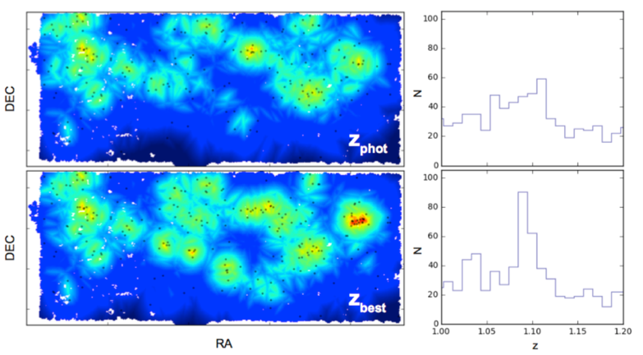
Slitless spectra science with HST
FIGS, Pirzkal+14
3D-HST, Momcheva+15
GLASS, Jones+15
Grism redshifts accurate to ~0.003×(1+z) ➤ Environment

Slide 4
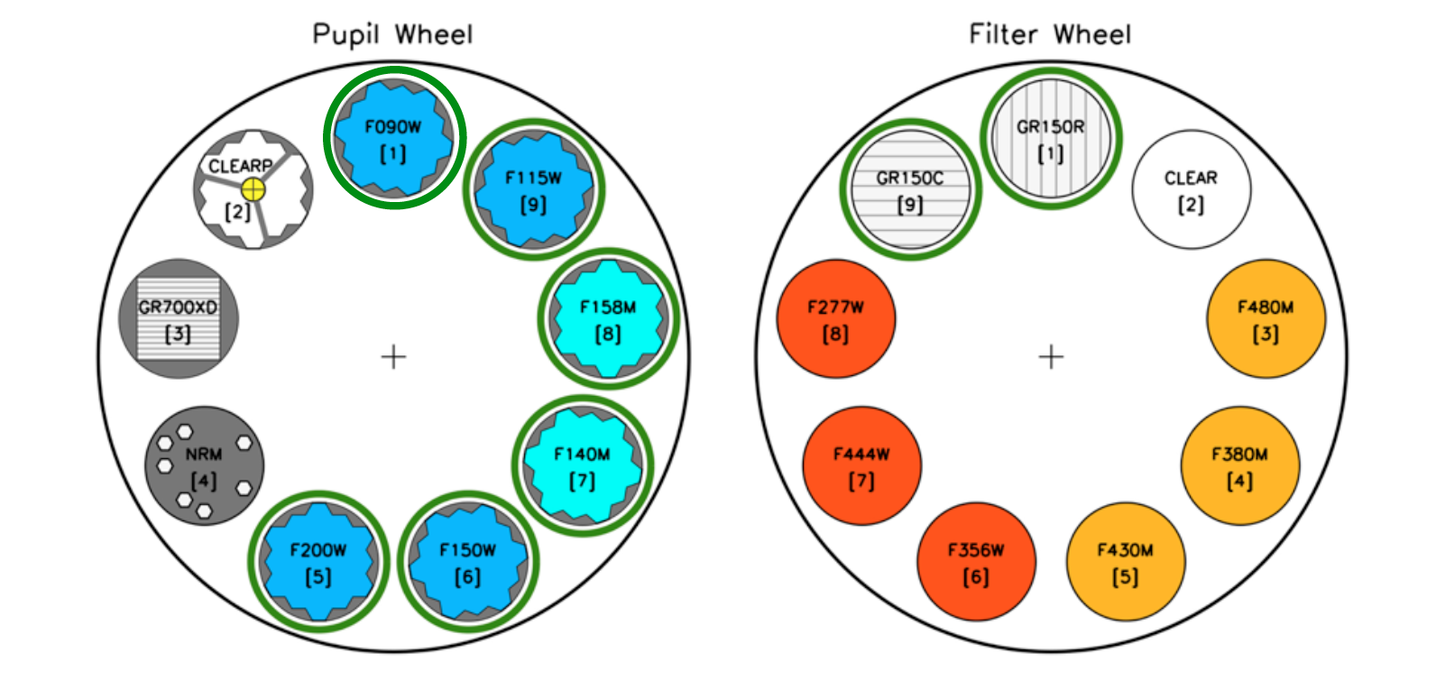
NIRISS grisms and filters
NIRISS wide-field slitless spectroscopy over FOV 2.2’ x 2.2’
6 blocking filters from 0.8 to 2.2 microns & 2 orthogonal R=150 grisms

Slide 5
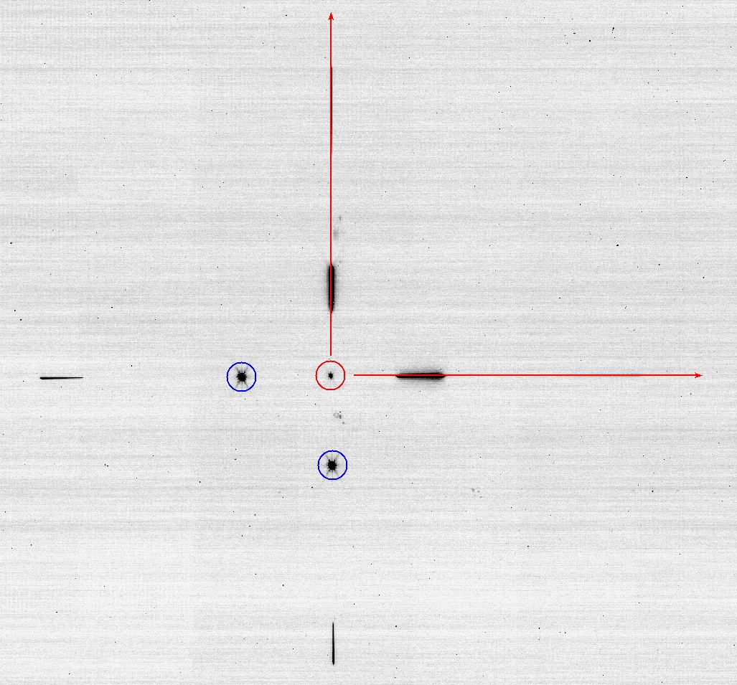
Wide Field Slitless Spectroscopy
What do you get with NIRISS Wide-Field Slitless Spectroscopy?
Spectra of all objects in the field
In a ‘’blank’’ field there are ~3000 galaxies at mag < 28 ➔ high multiplex factor
Almost complete spectral coverage from 0.9 to 2.2 microns
At least one strong emission line from z=0.5 to z=4.9. Lyman-α if present at 6<z<17
Most spectral lines are unresolved, so a map of emission lines
Cross-dispersed grisms to mitigate contamination
Point-and-shoot observing – no target acquisition
Ideal for pure parallels due to simple operation
Resolving power 100 to 200.
Spatial resolution: 0.06’’ ~0.5 kpc
CV3 data

Slide 6
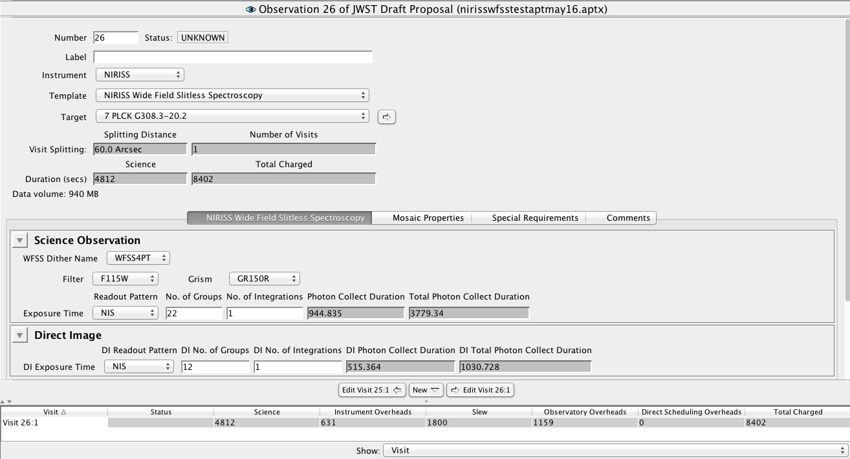
Observing Sequence
Direct images through same filter without grisms essential to interpret the data.
Due to non-repeatability of filter wheel, best to do all dithers before changing grism.
Current version of APT template

Slide 7
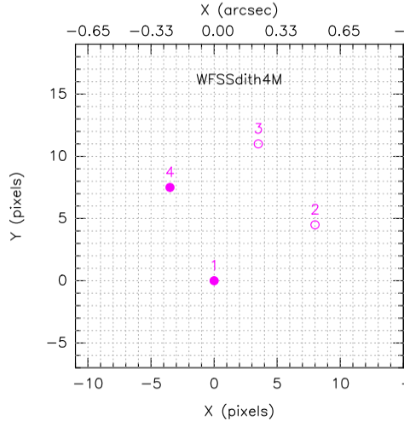
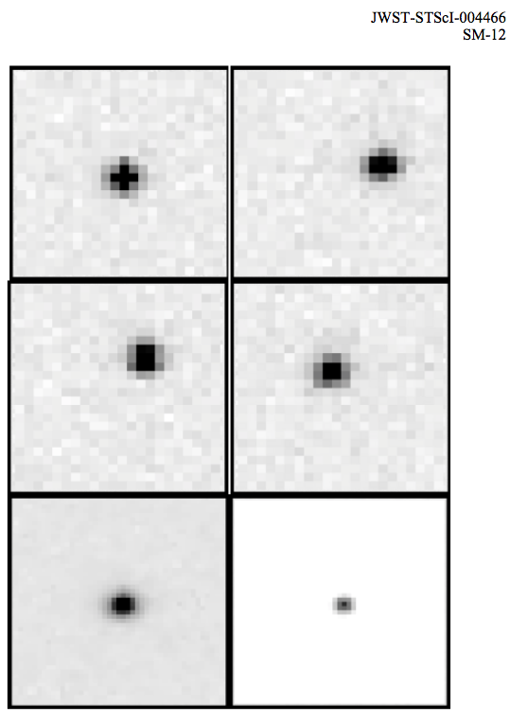
Observing Sequence
Typical use involves four small half-pixel dithers to better sample PSF
F200W
#1
#2
#3
#4
Drizzled
Drizzled
For parallel operation can choose dithers driven by either instrument or a compromise

Slide 8
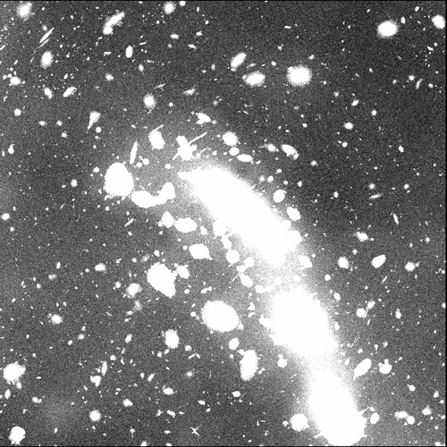
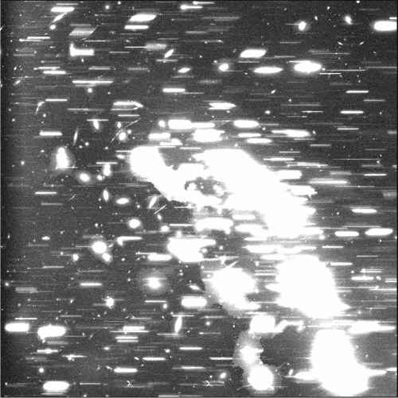
Data Analysis
JWST pipeline will do basic processing steps and some advanced processing for quick look or ‘easy’ cases.
Expert users will reprocess offline using combination of pipeline and other tools.
Full contamination modelling required for most situations.
F200W + CLEAR
F200W + GR150R

Slide 9
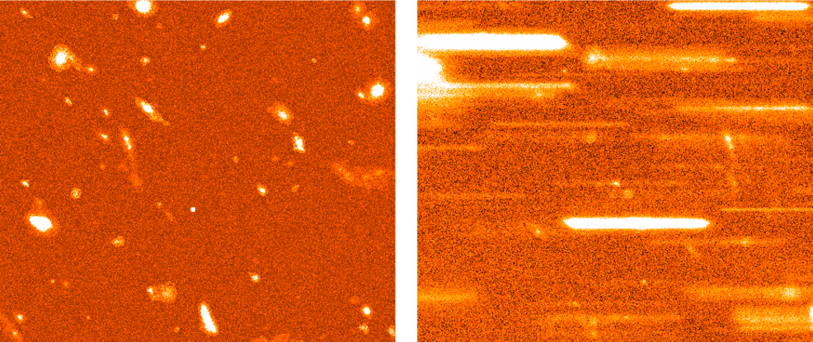
Data Analysis
Zoom-in to 1% of the field shows many faint galaxies with emission lines
F200W + CLEAR
F200W + GR150R

Slide 10
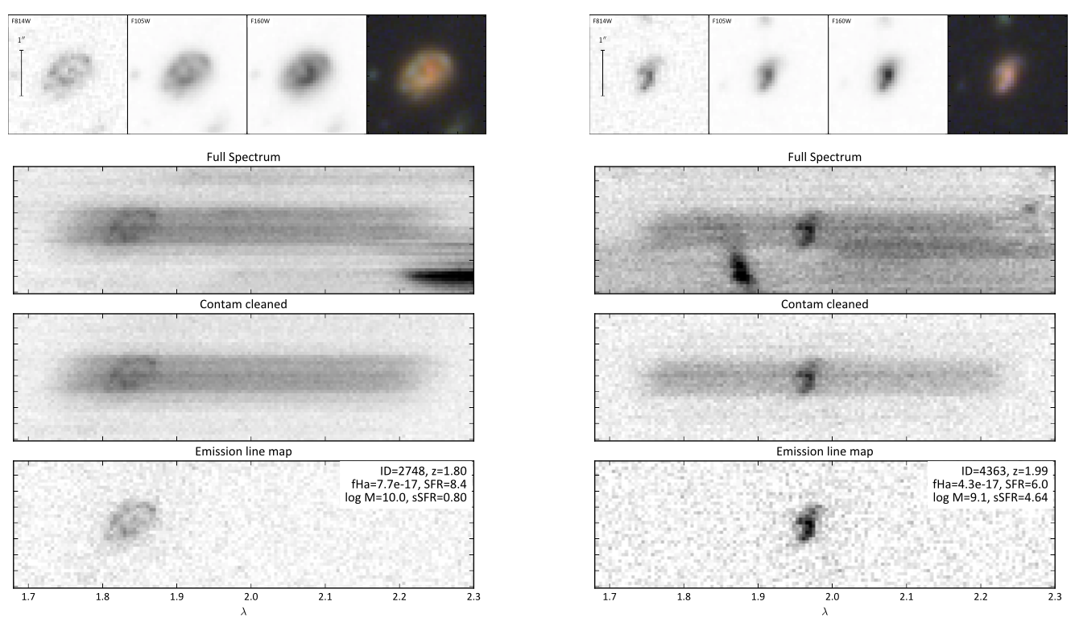
Data Analysis
Example of data processing for contamination cleaning and emission line map generation using open-source ‘grizli’ code (G. Brammer)

Slide 11
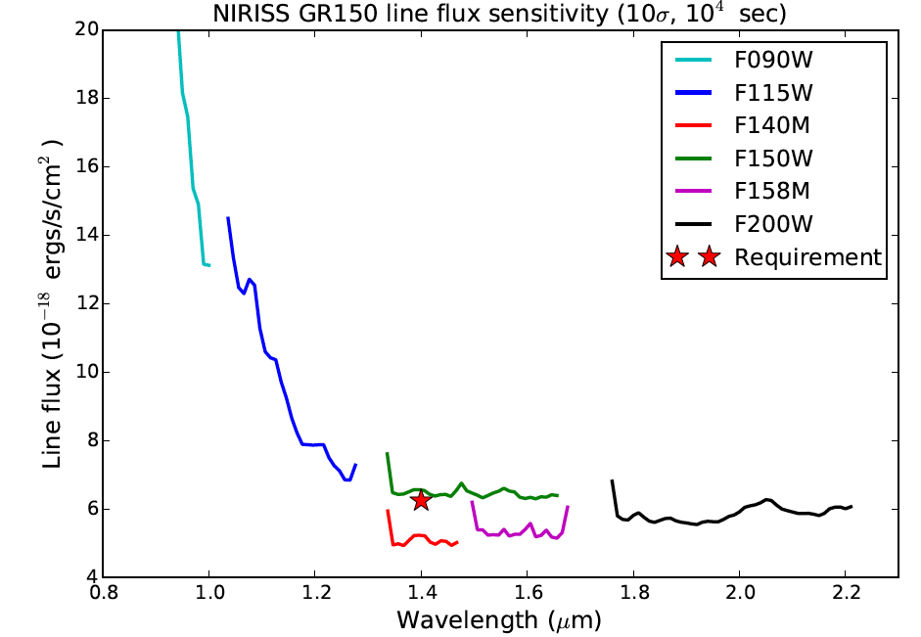
WFSS Line Sensitivity
Model emission line sensitivity with various band-limiting filters

Slide 12
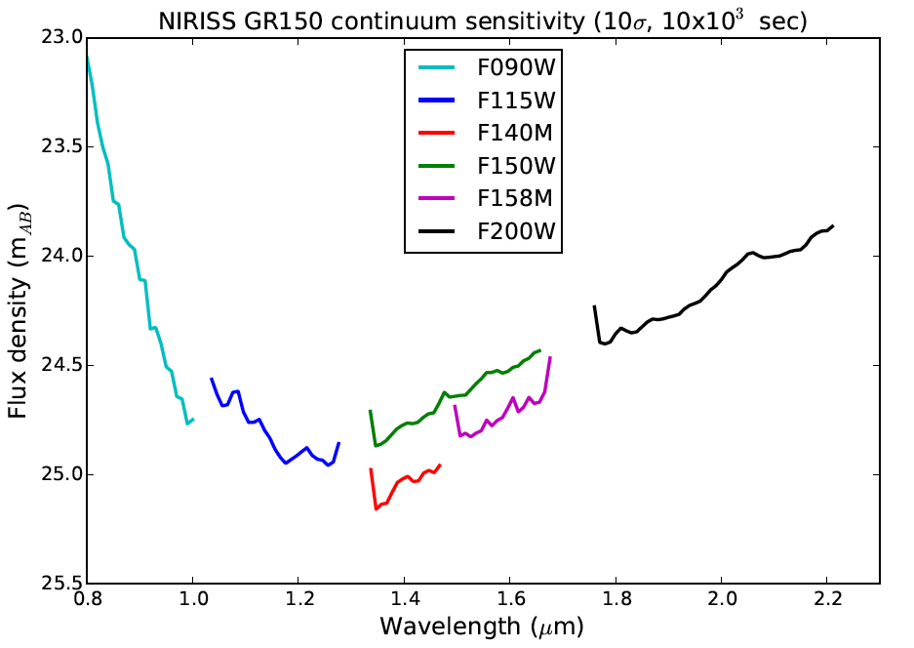
WFSS Continuum Sensitivity

Slide 13
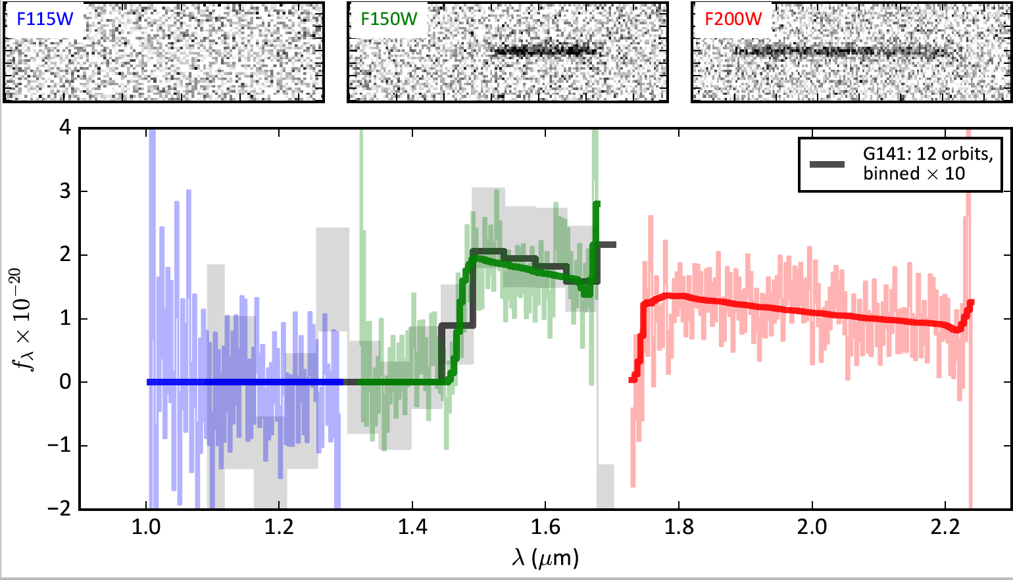
WFSS Simulations of GN-z11
Below is a NIRISS simulation of Oesch et al. (2016) z=11 galaxy
Exposure time: ~3 hours per filter
NIRISS WFSS will get continuum break redshifts even if no Lyman-α
Oesch et al. 2016
Brammer

Slide 14
Summary
NIRISS Wide-Field Slitless Spectroscopy has unique capabilties:
Very high multiplex factor
Maps of emission lines
No slit losses
NIRISS WFSS provides a powerful alternative/complement to NIRSpec MOS when high redshift completeness required.

