Slide 1

The NIRSpec Multi-Object Spectroscopy (MOS) mode
Torsten Böker
“On your mark” JWST Workshop
ESAC, September 26-28, 2016

Slide 2
Outline…
NIRSpec optical and mechanical design overview
The Microshutter Array – design and functionality
Focal plane(s) layout
Example: MOS observations of a deep galaxy field
Wavelength coverage and instrument configurations
Hardware Constraints: failed shutters
Observing Strategy for MOS mode
Data products
Planning the target acquisition and MSA configuration(s)
Sensitivity in MOS mode

Slide 3
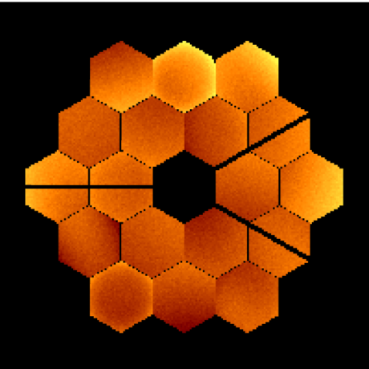
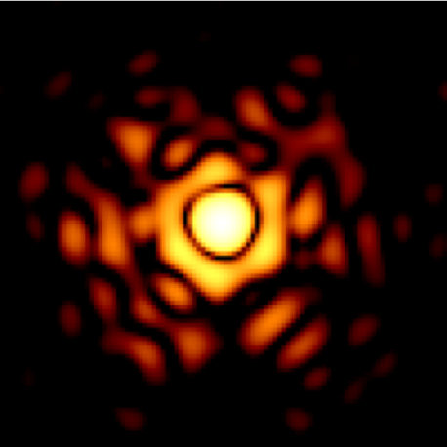
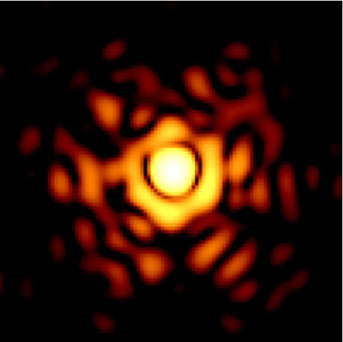
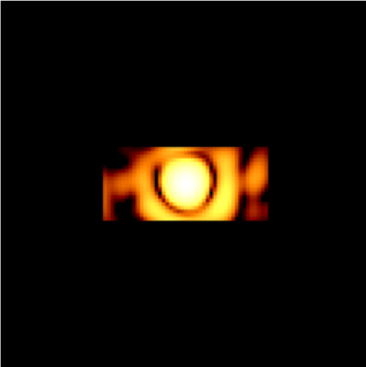
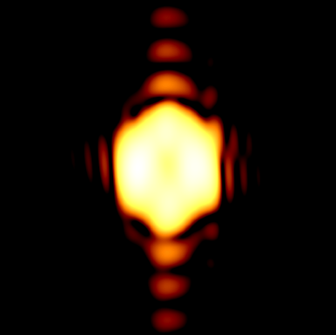
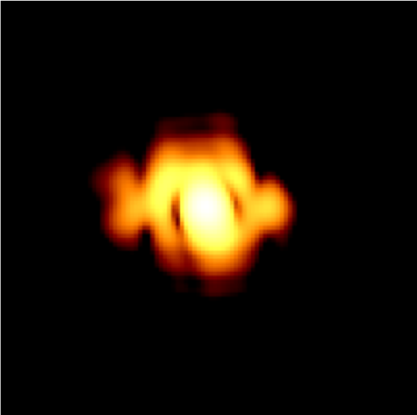

NIRSpec Optical Design
Telescope
Focus (f/20)
Fore-Optics
TMA
Filter
Wheel
Collimator
TMA
Camera
TMA
Pick-off
Mirror(s)
Micro-Shutter
Array (f/12.5)
Grating
Wheel
Focal Plane
Array (f/5.7)
Telescope Focus
Slit Mask
Pupil at Disperser
Detector Array

Slide 4
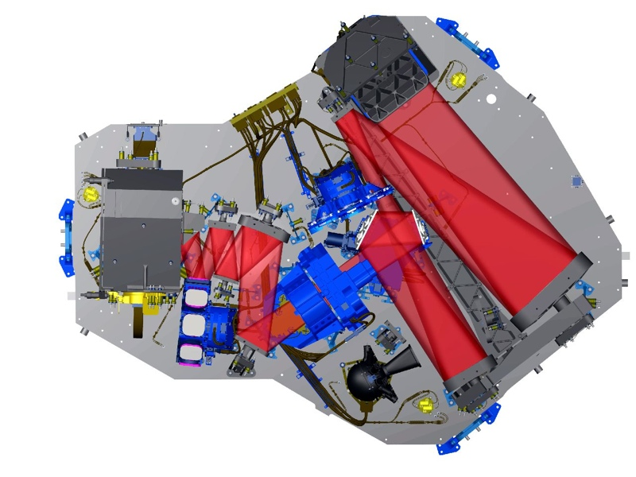
NIRSpec Mechanical Design
Pick-off mirrors
Filter wheel
Camera housing
ReFoc Mech. (RMA)
Detector (FPA)
FORE optics TMA
Grating wheel
Integral-Field
Unit (IFU)
Micro-Shutters
Cal. Lamps (CAA)

Slide 5

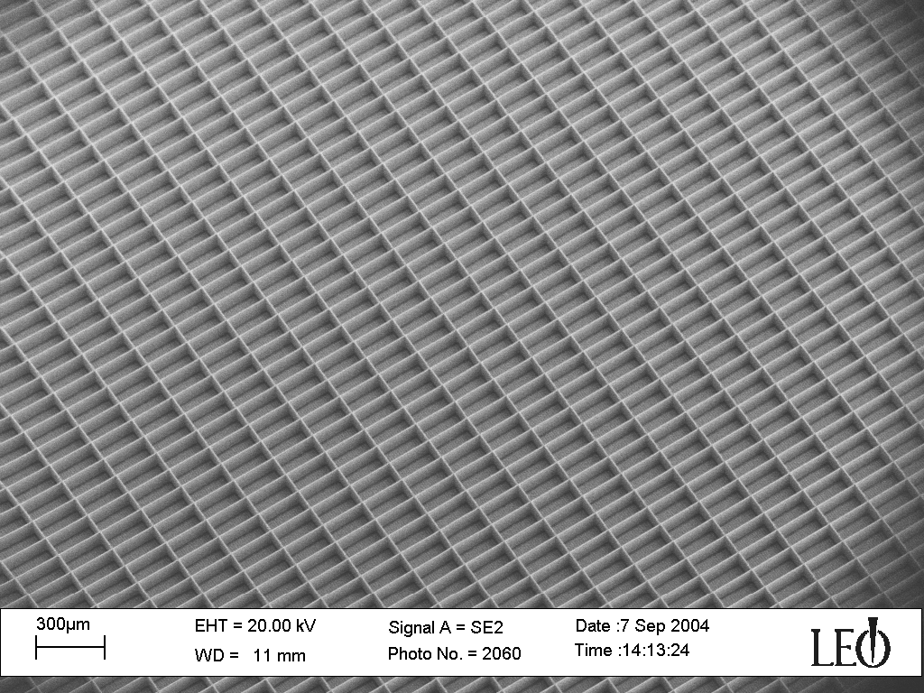
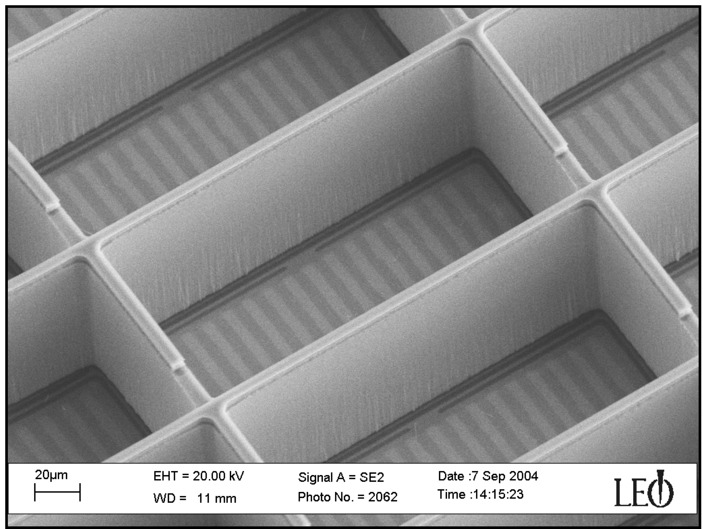
NIRSpec – the first MOS in space
“traditional” slit masks not an option at L2
Instead, use MEMS technology to configure slit mask

Slide 6
How the MSA works

Slide 7
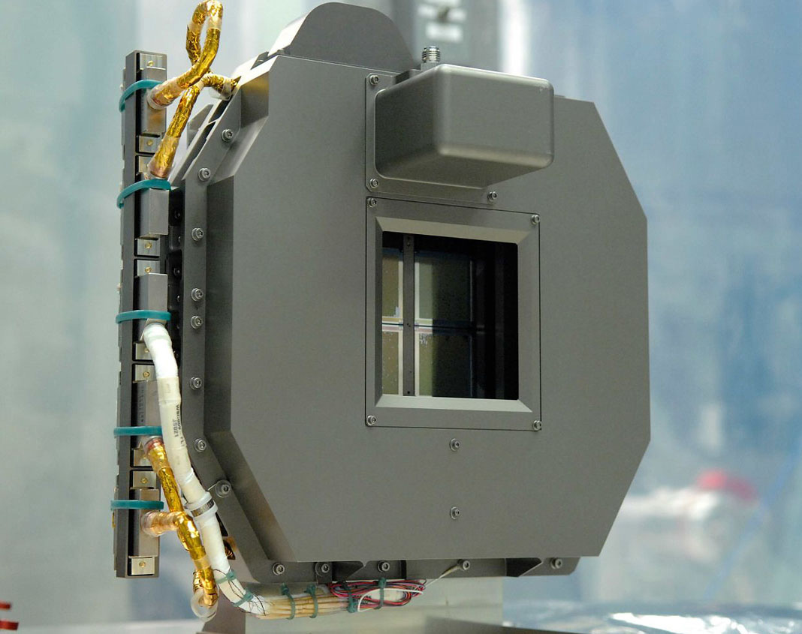
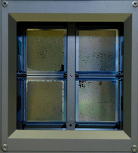
MSA hardware

Slide 8
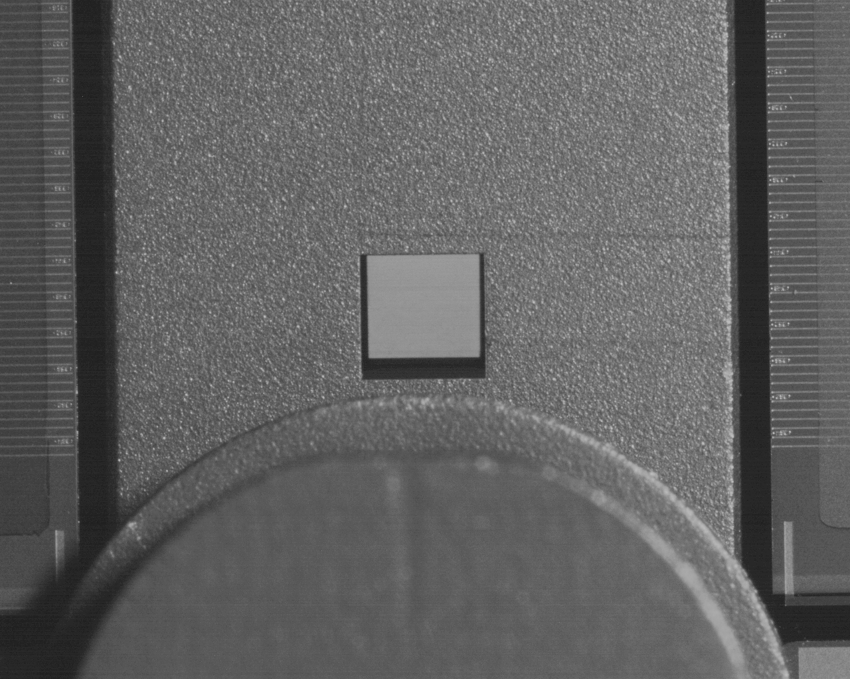
Apertures in the MSA Plane

Slide 9
NIRSpec Focal Plane(s)

Slide 10
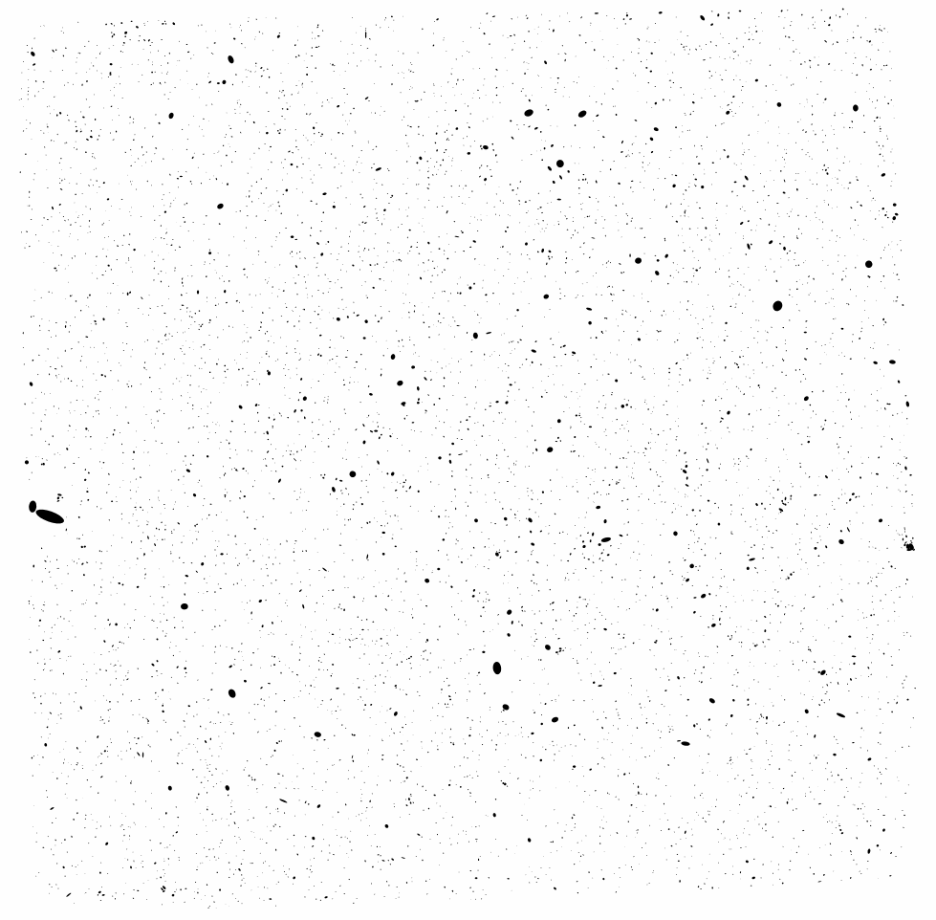
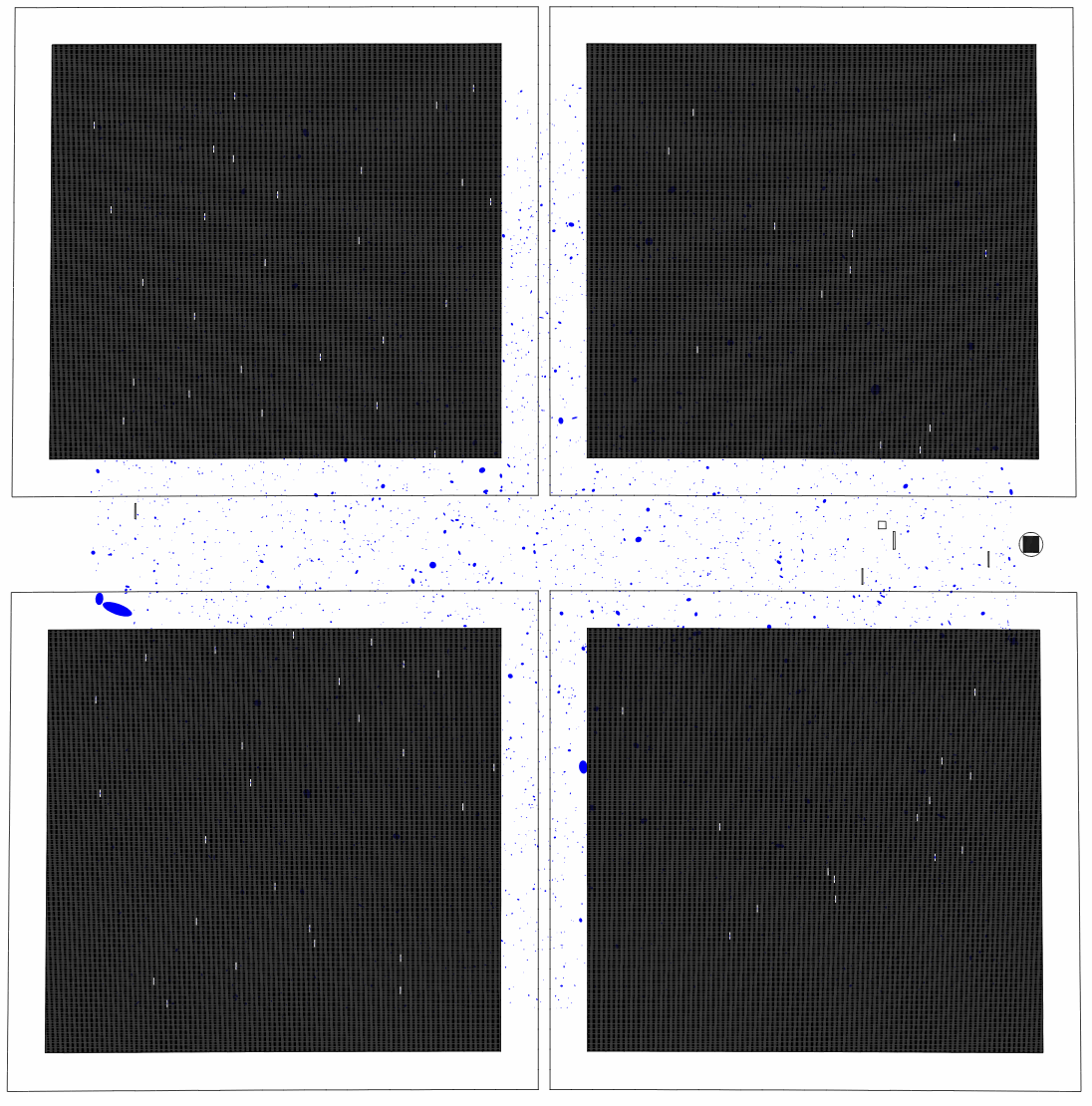
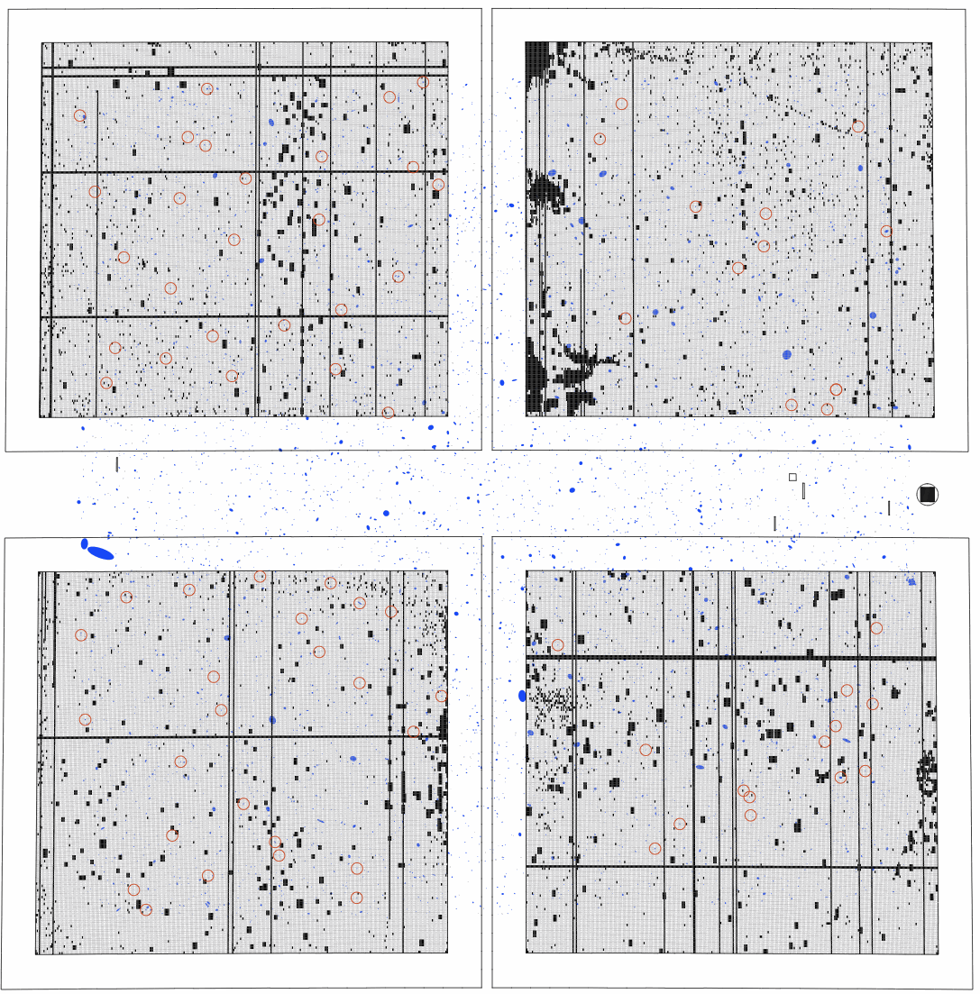
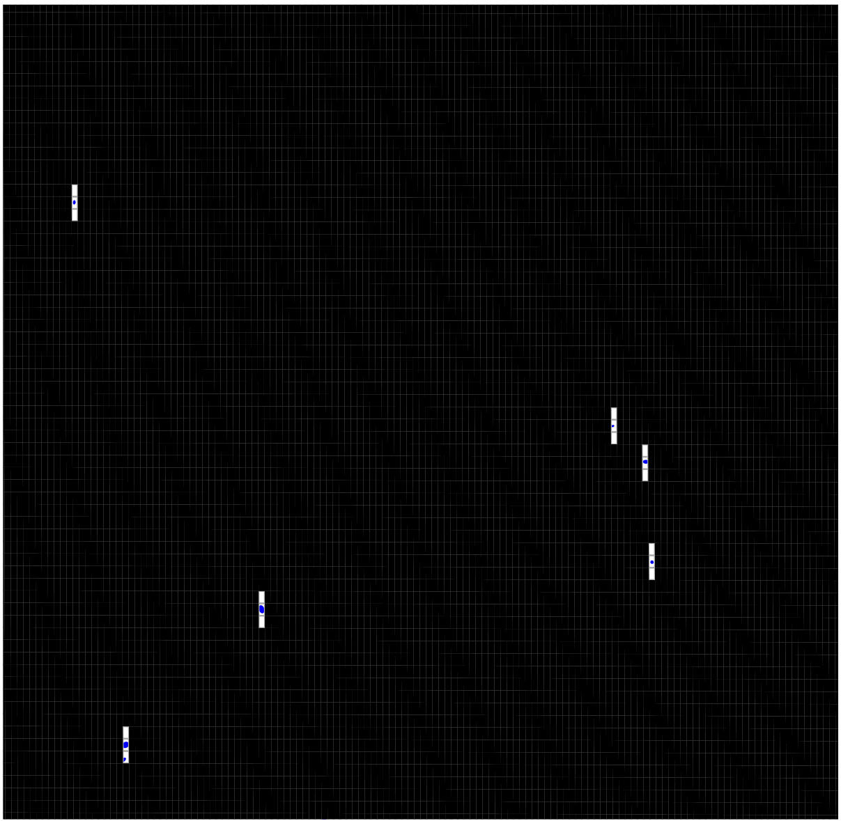
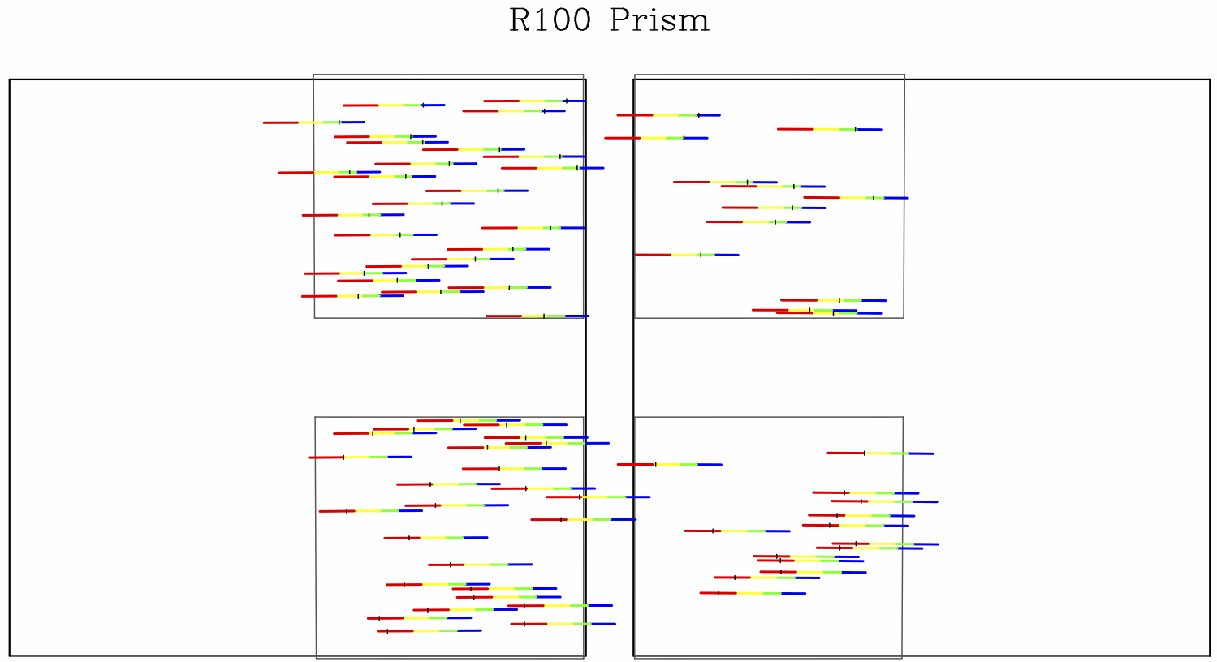
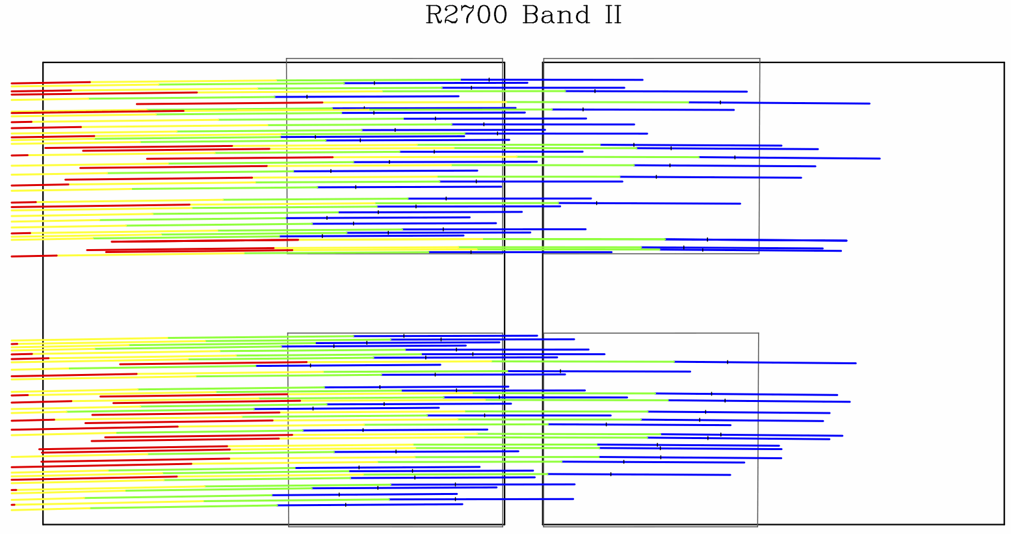
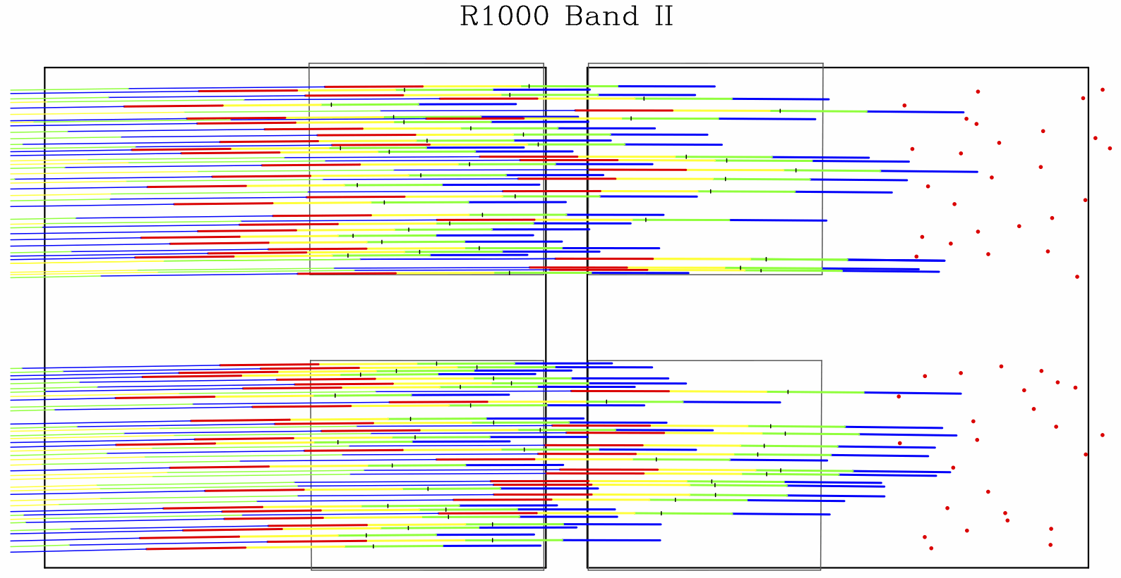
Example: a deep galaxy field
R 100:
R 1000:
R 2700:

Slide 11
Available filter/grating combinations
For R~100, CLEAR/PRISM delivers full spectral range (0.6-5.3 μm) in a single exposure
For R~1000, require 3-4 exposures to cover full wavelength range:
  F100LP/G140M: 0.97 – 1.89 μm
  F170LP/G235M: 1.66 – 3.17 μm
  F290LP/G395M: 2.87 – 5.27 μm
  (F070LP/G140M: 0.70 – 1.27 μm)
For R~2700, require 3-4 exposures to cover full wavelength range:
  F100LP/G140H: 0.97 – 1.89 μm
  F170LP/G235H: 1.66 – 3.17 μm
  F290LP/G395H: 2.87 – 5.27 μm
  (F070LP/G140H: 0.70 – 1.27 μm)

Slide 12
MSA cosmetics
…. welcome to reality ….

Slide 13
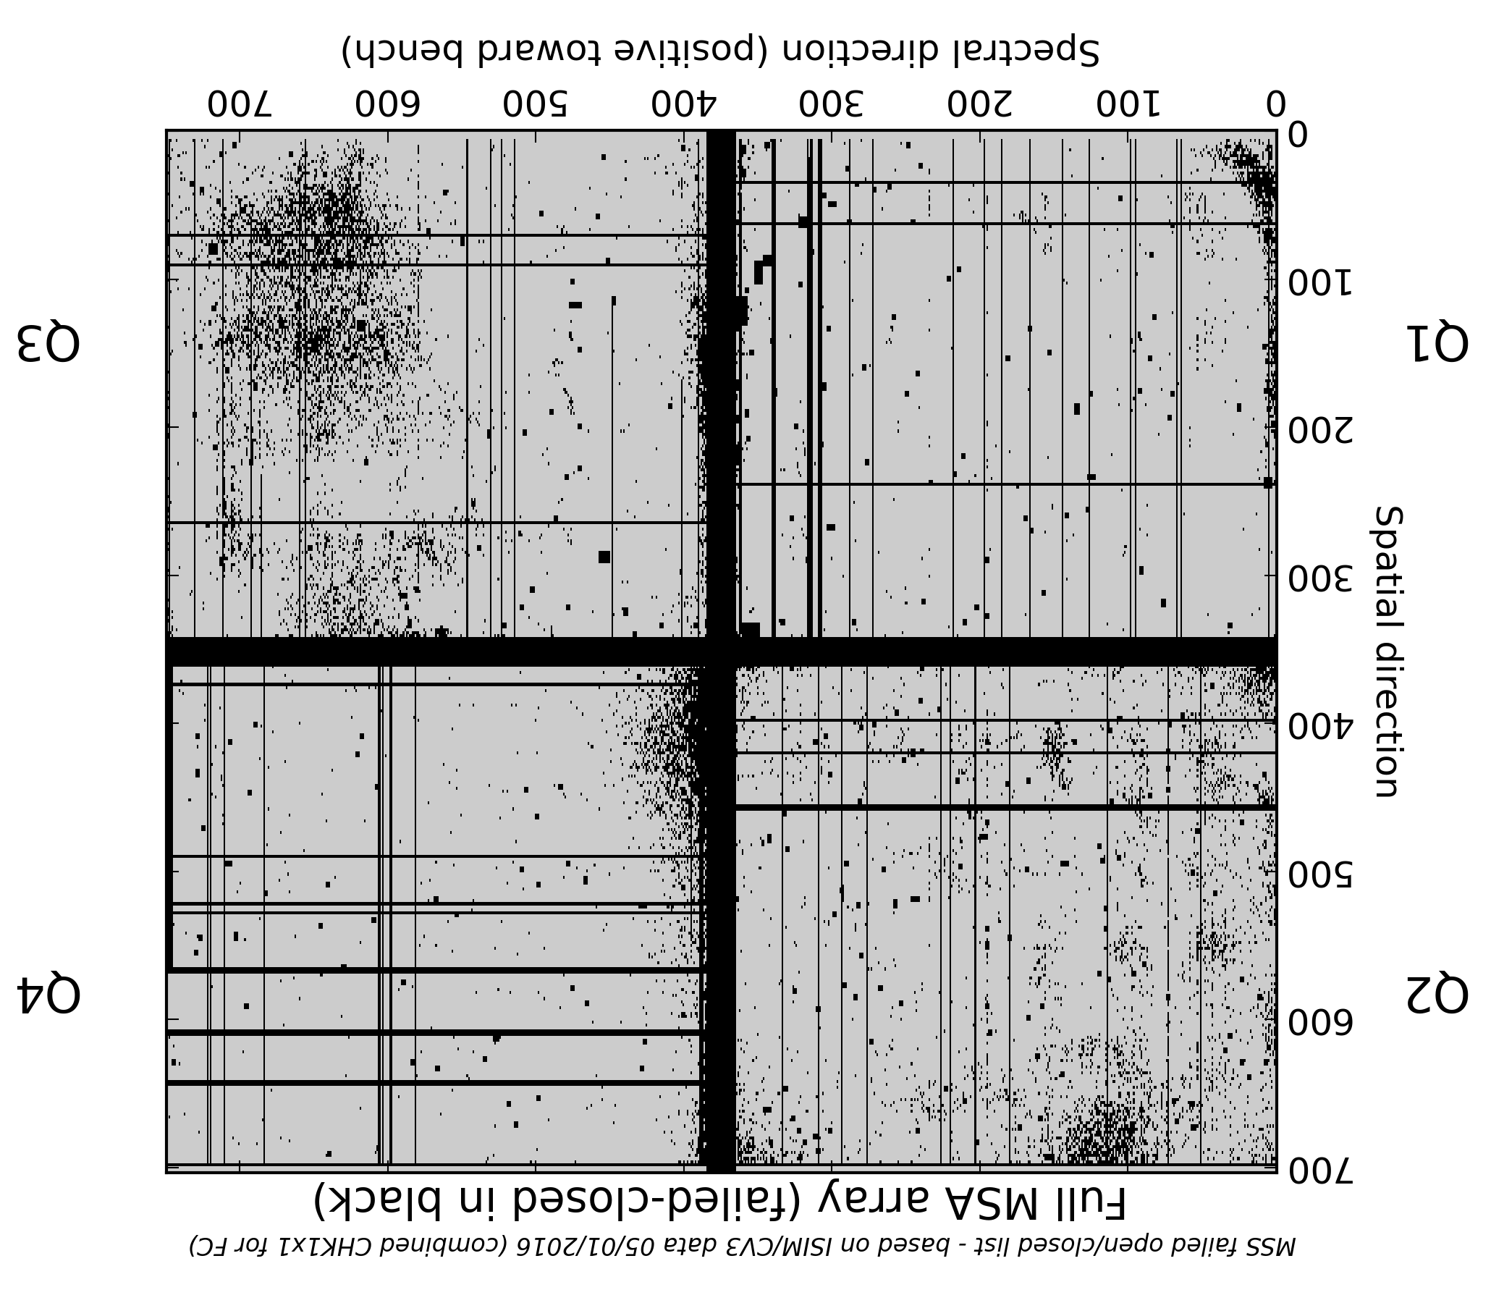
Failed closed shutters
Q3
Q1
Q4
Q2
Dispersion direction ---------------→

Slide 14
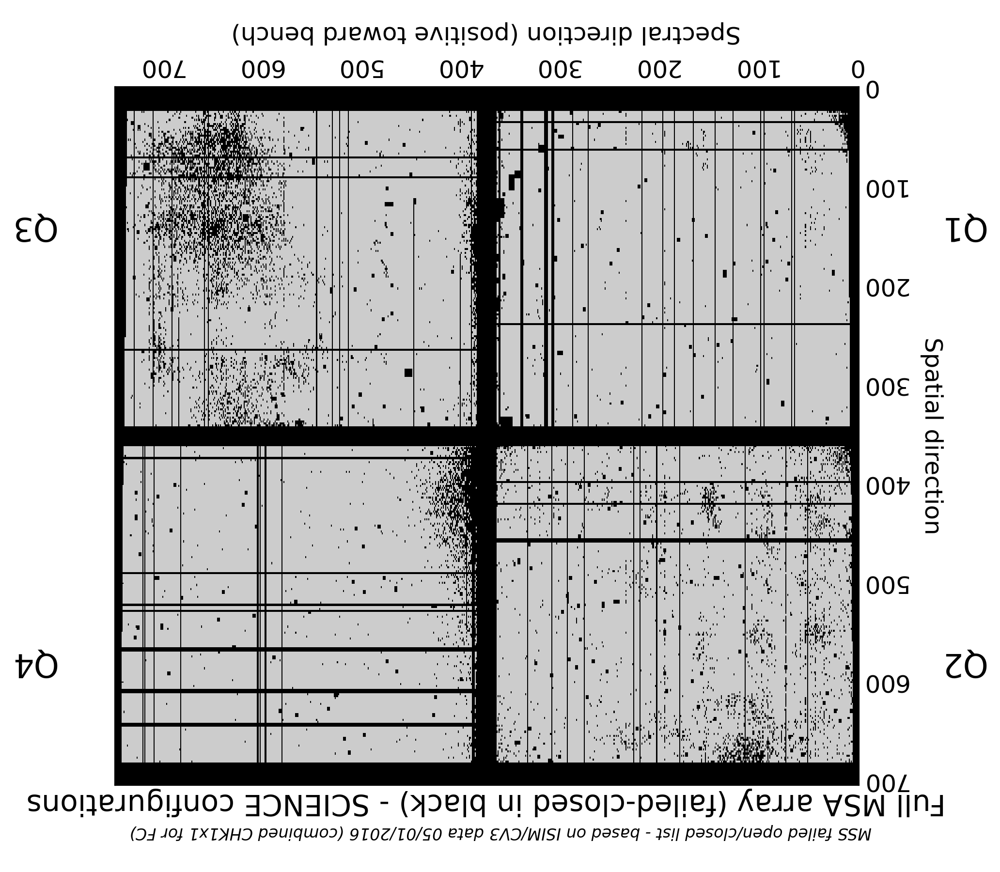
Failed closed shutters (with field stop shadow)
Q3
Q1
Q4
Q2
Dispersion direction ---------------→

Slide 15
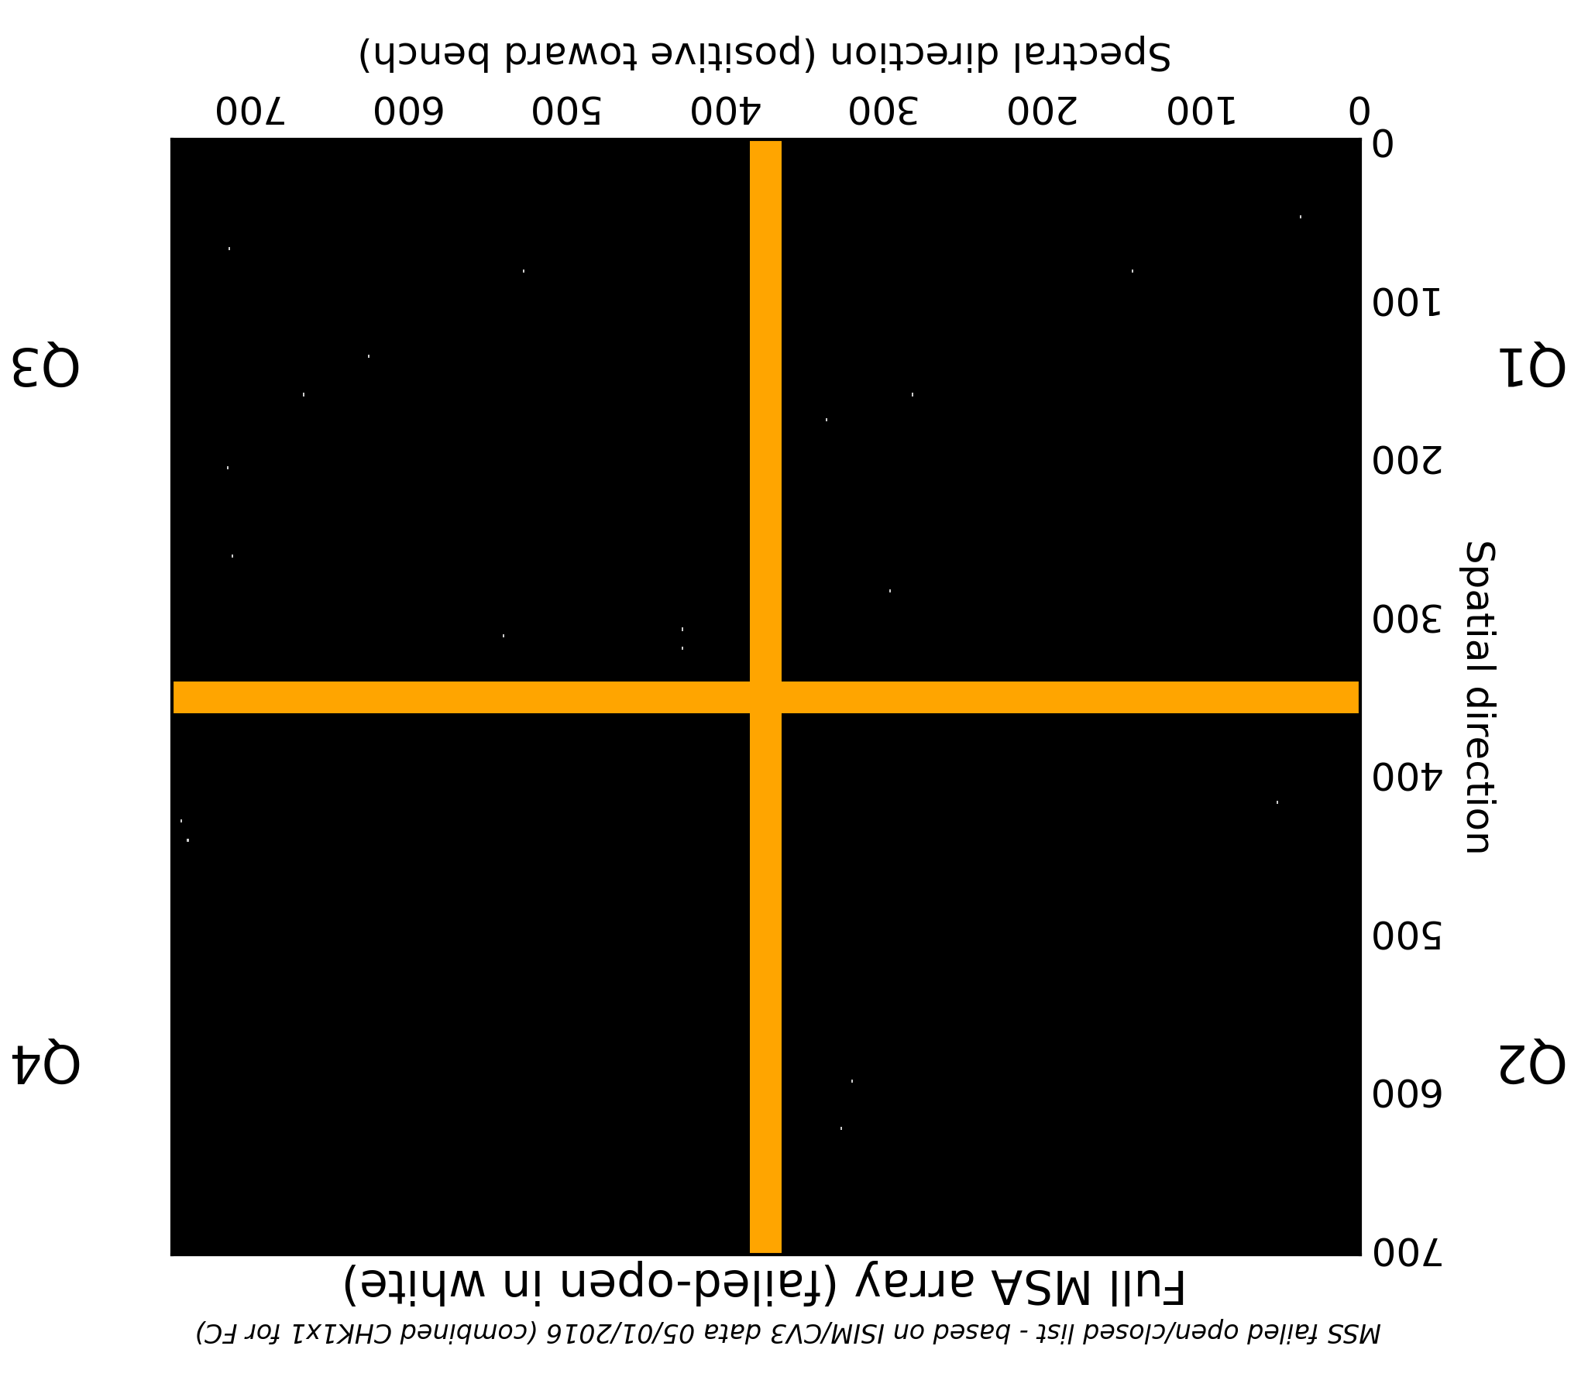
Failed open shutters (all 19 of them)
Q3
Q1
Q4
Q2
Dispersion direction ---------------→

Slide 16
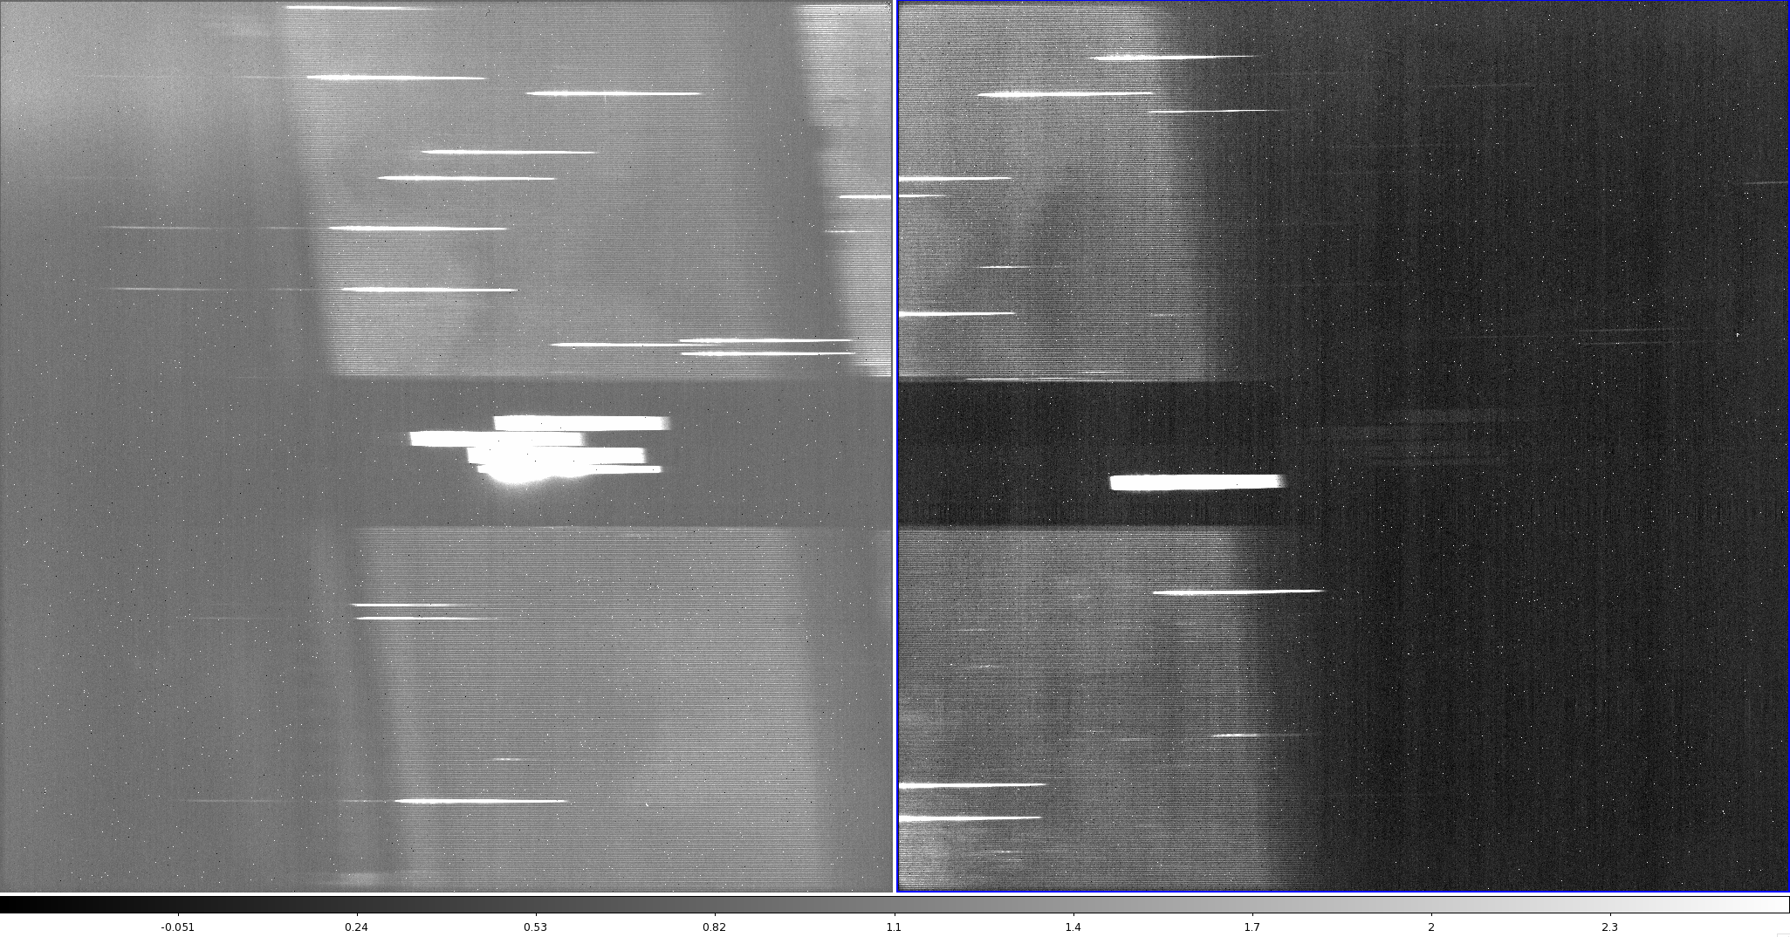
When the MSA is “all closed”…..
Note: effect is highly exaggerated in this figure!
(very bright lamp and narrow color scale)

Slide 17
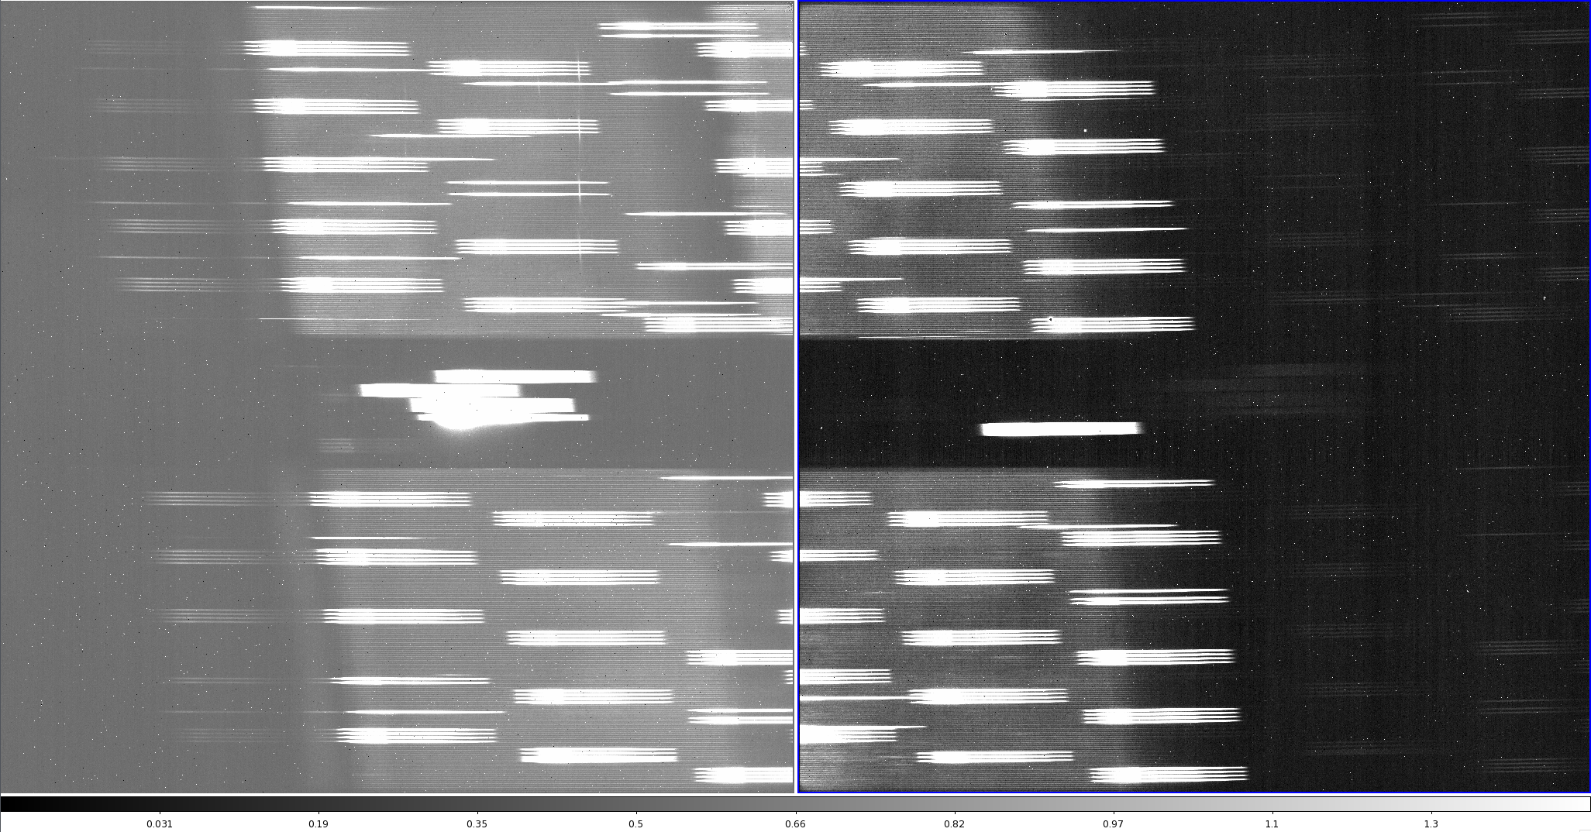
Failed open shutters

Slide 18
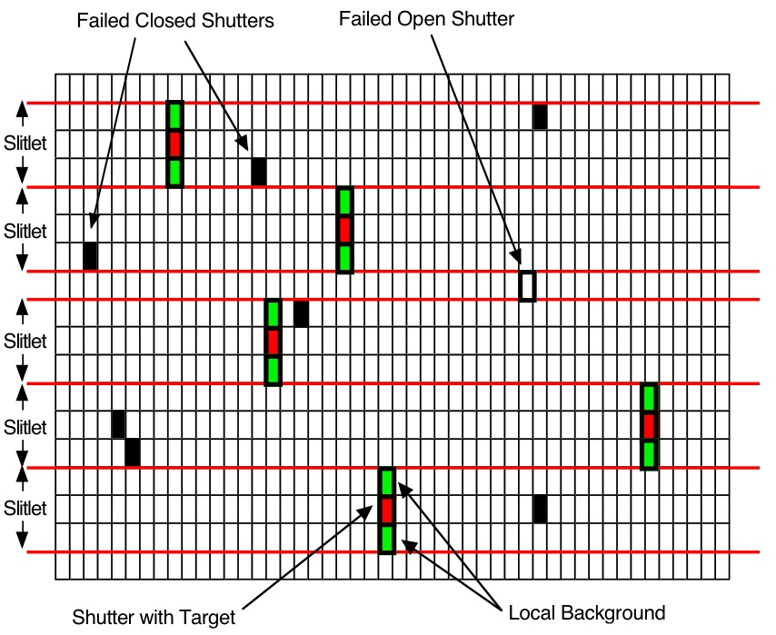
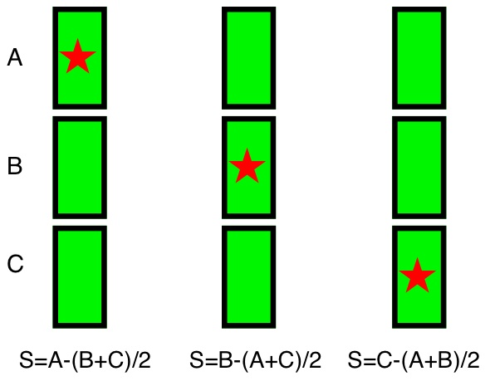
“Default” Observing Strategy
A B C

Slide 19
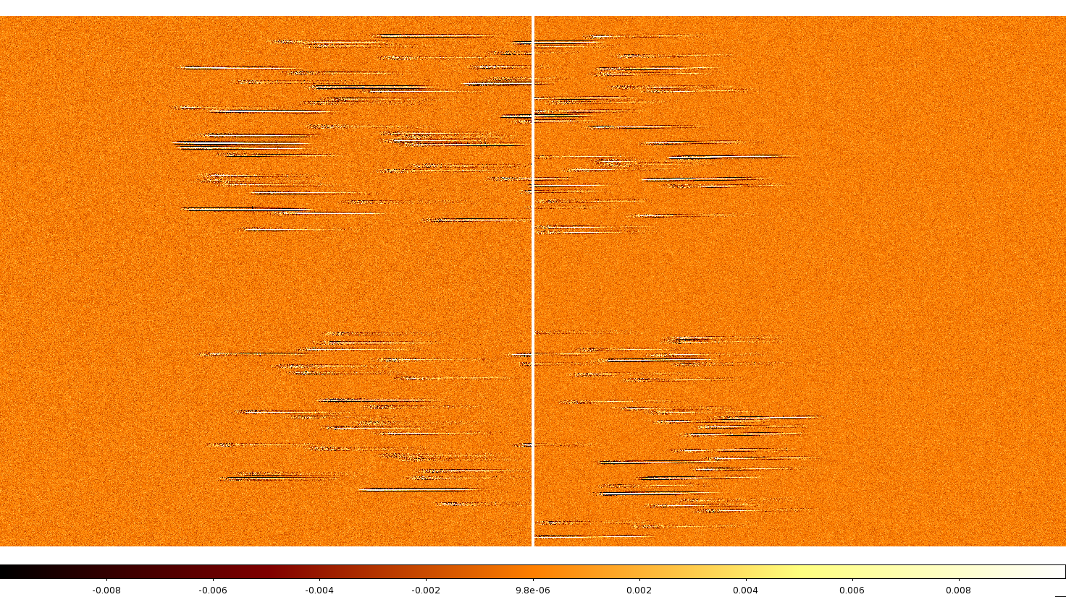
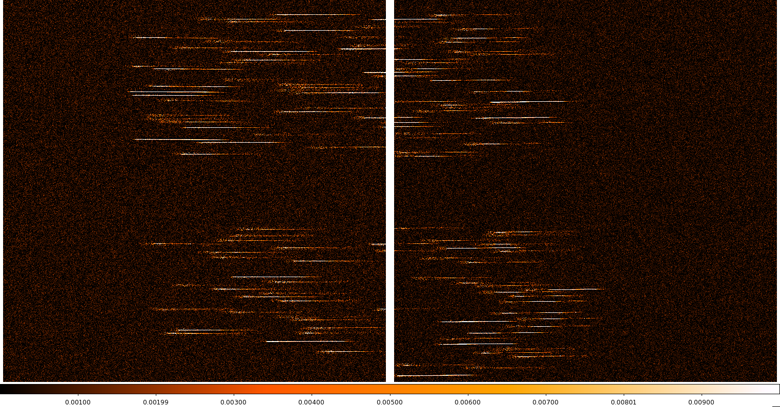
Example exposures
Simulated 100ks exposure:
(created by “nodding” three 33ks exposures)

Slide 20
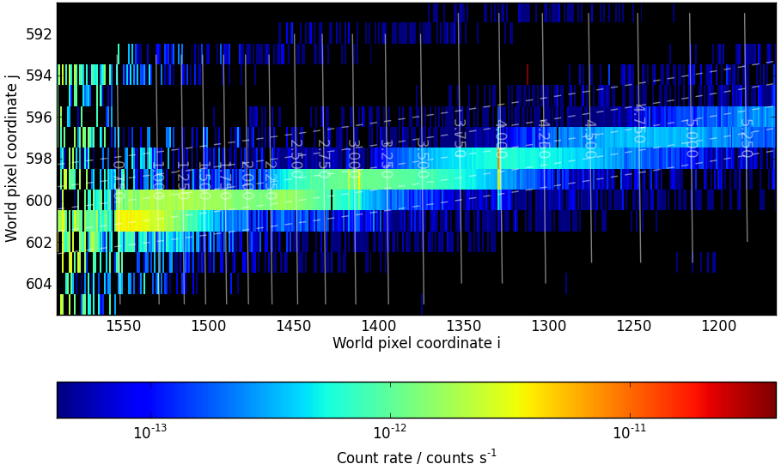
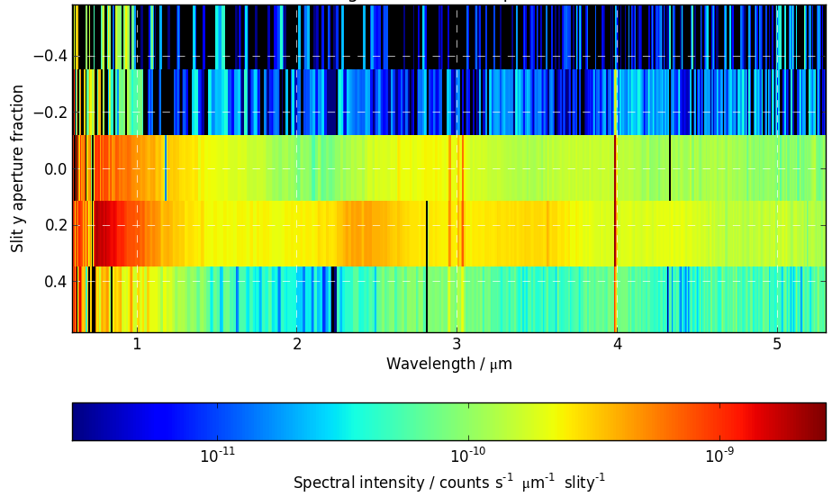
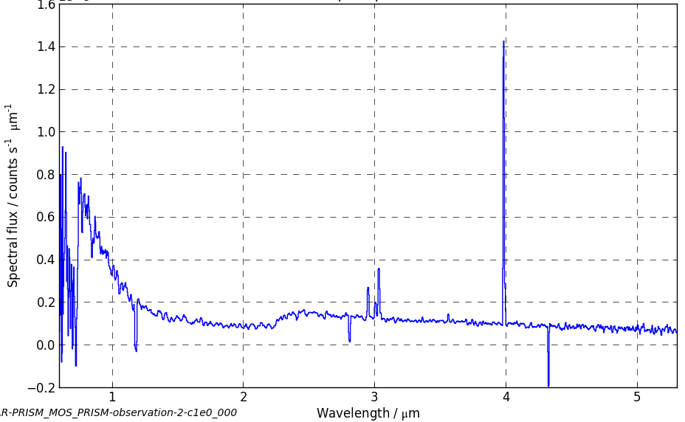
Data Products
Example: CLEAR/PRISM spectrum of XDFV-3953261056
(R.A. 03:32:39.532, Dec -27:46:10.56, m(F160W)=27.0, z=5.1)
‘Trace’:
‘Rectified’ 2-d spectrum
‘Final’ 1-d spectrum

Slide 21
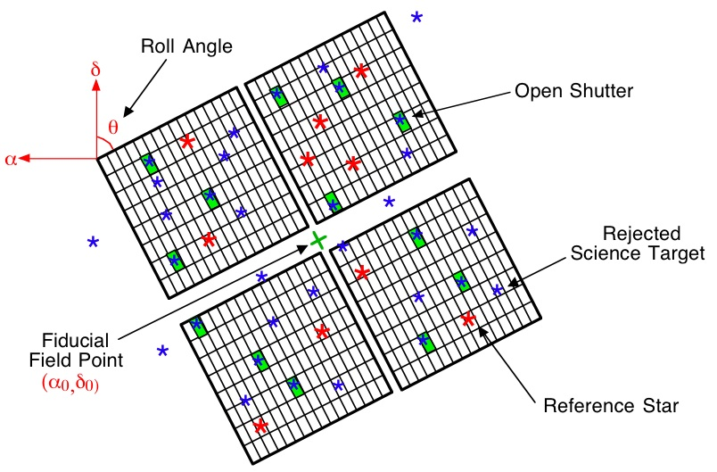
Target Acquisition

Slide 22
TA planning
need source catalog (incl. both science targets and reference stars) with knowledge of relative source positions to within (ideally) 5 mas
Once observations have been scheduled, use the micro-shutter planning
tool (MPT) to optimize the desired MSA position on the sky
(i.e. roll angle and RA/Dec of MSA fiducial point) and to create the
required MSA configuration files (see talk by D. Karakla).
TA data and MSA configuration files will be attached to the visit files and
uplinked for autonomous execution
note that roll angle constraints limit schedulability of observations

Slide 23
MOS Sensitivity – point source continuum flux
R=1000:
R=2700:
Disclaimer:
These estimates are conservative, and are expected to improve.
Always refer to the STScI ETC for up-to-date sensitivity estimates.

Slide 24
MOS Sensitivity – extended source surface brightness
R=1000:
R=2700:
Disclaimer:
These estimates are conservative, and are expected to improve.
Always refer to the STScI ETC for up-to-date sensitivity estimates.

Slide 25
NIRSpec MOS sensitivity
End-of-life (EOL) Sensitivity Requirements
ISIM-153 (JWST-RQMT-000835) | Requirement | Computed | Margin | Compliance
CLEAR/PRISM at 3 microns S/N=10 in 10,000 seconds Point-source, continuum spectrum | 132 nJy | 120 nJy | 9% | OK
F170LP/G235M at 2 microns S/N=10 in 100,000 seconds Point source, emission-line spectrum | 5.7 x 10⁻²² Wm⁻² | 4.76 x10⁻²² Wm⁻² | 16% | OK

