Slide 1



Introduction to the MSA Planning Tool (MPT)
A tool to specify MOS observations with NIRSpec
Diane Karakla
ESAC “On Your Mark” Workshop
Madrid, Sept 27 2016

Slide 2
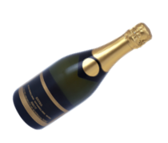
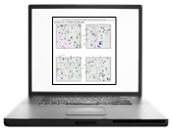


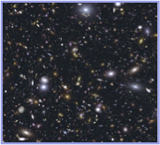
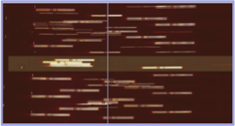
Timeline for MSA Observations
MOS Spectroscopy will require a 2-phase approach:
Idea for
MOS
Survey
TAC
acceptance
Long Range
Plan
NIRCam
Pre-Imaging
Scheduling
MSA
Observations!
Proposal
Submission
Fixed Orient
assigned
Program
Submission
2 Factors:
Most MOS programs won’t need a particular orientation. To allow scheduling flexibility, they will be assigned an orient.
Most science with the MSA will require very accurate relative astrometry (~5 mas). Pre-imaging with NIRCam will be needed.
For Proposal Submission: To estimate observing time (inc. overheads), MPT can be used with simulated or existing catalogs to explore the effects of planning choices and observing strategies(e.g. dithering!) on target success rates. It is highly recommended that you do this!
At Program Submission MPT is used to prepare detailed observing programs at the assigned orient.

Slide 3
Observing Considerations
Does your science require precise positioning delivered by MSA TA with reference stars?
Do you need NIRCam pre-imaging?
TA type | Estimated Delivered TA accuracy | Catalog relative astrometric accuracy | Science Goal
Optimal 5-20 ref. stars | <20 mas (0.1 shutter width) | ~ 5 mas | Best possible photometric accuracy
Relaxed 5-20 ref. stars | <~ 50 mas | < 40 mas | Extended sources, or reduced flux accuracy w/ MSA
Verify Only – no TA, just GS acq | ~100 mas TBD | NO reference stars required. | Limited MSA science
Possible with existing
imaging
w/ HST
Pre-imaging with NIRCAM
Possible in same cycle
MSA TA
Imaging should cover a min of ~5 arcmin square for
Planning flexibility.
MSA TA can be used for IFU and FS science as well.
Wide Aperture TA coming soon for NIRspec science modes.

Slide 4
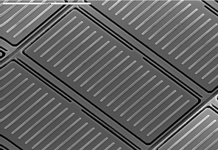
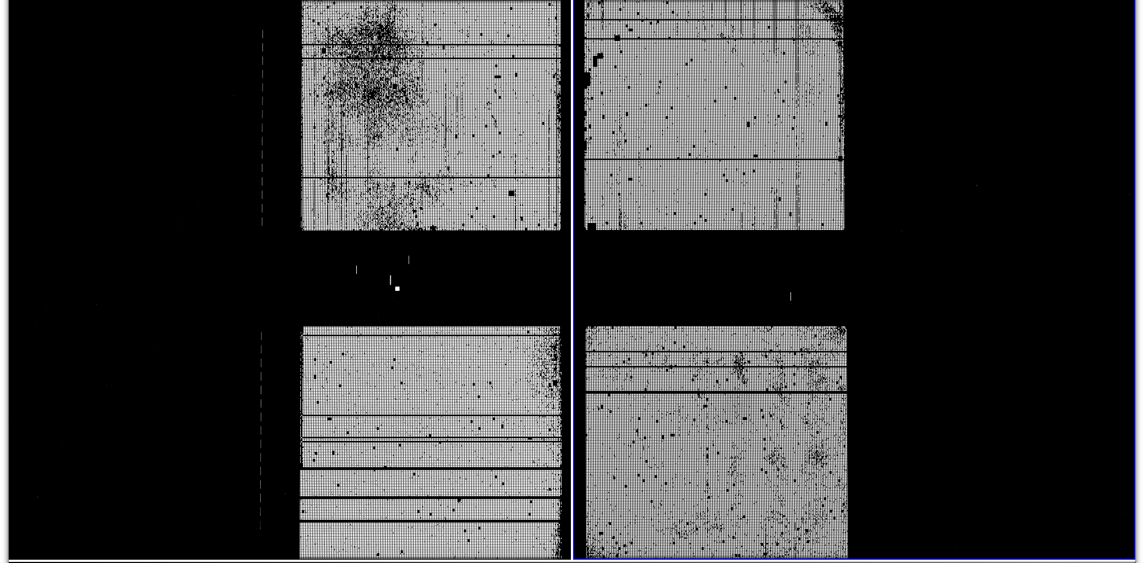
Observation Planning Challenges
Gap (~20”)
The MSA is a fixed grid (with shutter bars that vignette light from sources)
Gap between the 2 detectors means missing wavelengths.
Dither to cover gap, mitigate detector artifacts, improve resolution, observe sources behind bars or mounting plate. But also want to observe as many sources as possible at all dithers!
Quad 3
Quad 1
Failed Closed Shutters
Quad 4
Quad 2
The MSA has Failed shutters, shorted rows & columns. They do evolve!
Accurate source positions in MSA require knowledge of optical distortions from telescope and instrument fore-optics, and velocity aberrations.
Solution → use MPT!
Download Astronomer’s Proposal Tool (APT, including MPT) here
http://apst.stsci.edu/apt/external/downloads/installers/install.html

Slide 5


MPT Planning Selections - Slitlet Shape
Selectable slitlet shape (1, 2, 3, or 5 shutters)
5 choices of shutter margin to limit slit losses.
You’ll need a catalog relative accuracy of <15 mas to effectively constrain source centering.
Perfectly centered
NIRSpec MSA Slit Throughput vs. Wavelength
0.”46
*
0.”2
Unconstrained
Open Shutter Area
Midpoint
Constrained
Tightly Constrained
Figure from T. Beck
Proc. SPIE 9910 July 15 2016
Shutter Planning Constraints

Slide 6
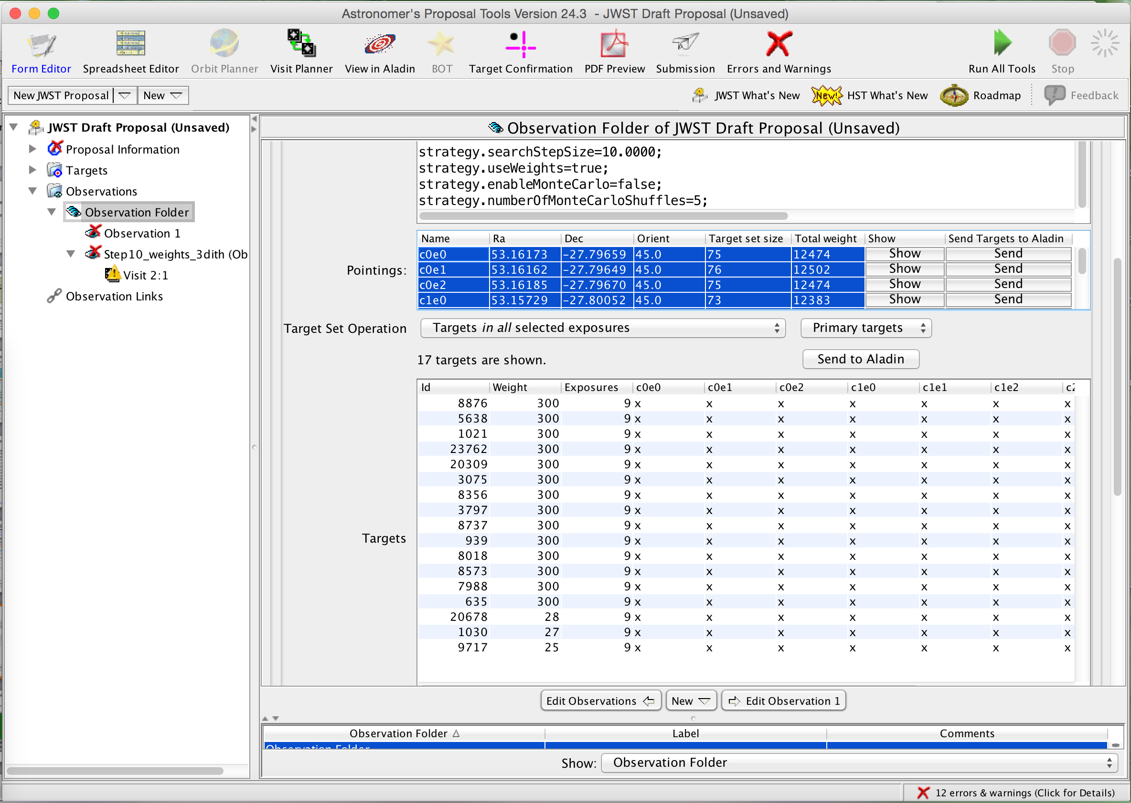
Target Weights
Can use Target Weights (provided in input Catalog)
Observed targets shown in red
Relative weight from catalog
Targets of large weight much more likely to be observed
Generally, ordering the catalog by Weights is also advised.

Slide 7
Monte Carlo optimization of the MSA configuration
Re-ordering the Primary candidate list at a given pointing can increase the number of targets observed at that pointing. Example:
MSA Config 1
After 1 MC shuffle
MSA Config 2
Source ID
1
2
3
4
5
2 successful sources
Source ID
3
4
5
1
2
3 successful sources!
4
4
1
1
2
2
5
5
3
3
Can customize MSA configurations in the manual planner.
It’s tedious! We’re working on usability issues.

Slide 8
MPT Planning Selections - Dithers
In-slit “nods” – re-use same MSA configuration
Fixed (finite) or Flexible (min or max) dither constraints
Fixed dithers: Translate the pattern of open shutters for new dither point.
Flexible Dithers: User specifies a min or max separation between dither points in spectral and/or spatial direction
MSA
Config 1
*
This method handles relative distortions between dithers, so is appropriate for small or large dithers (e.g. across the detector gap)
Multiple possible pointings are tested at each dither step, building families of possible solutions.
The best family is chosen.
(The one that observes the largest
number of highly-weighted sources at
all steps.)
(0,0)
spatial
Config 2
Config 3
(0,-4)
*
*
(5,-4)
dispersion
SMALL dithers only! <~ 10 arcsec

Slide 9
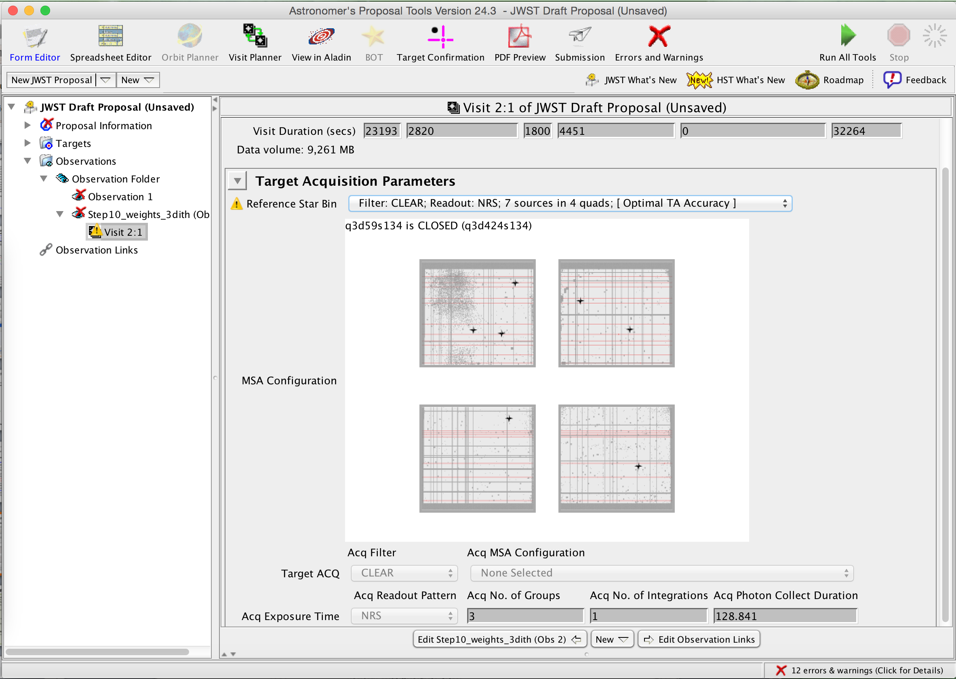
MPT Planning Features
MPT will also assist with MSA Target Acquisition using Reference Stars:
At detailed program submission: Reference star selection for MSA TA happens at the Visit level. The Catalog must contain columns with fluxes in the NIRSpec TA filters. (STScI will provide a script.)

Slide 10
MSA Planning Tool inputs
Catalog of sources (minimum: ID, RA, Dec … at proposal submission). For detailed program submission: Stellarity, Reference (Y/N), 3 NIRSpec filter band brightnesses are also required. Optional columns in catalog: Weights, Redshift, size, etc.
The user must filter the catalog within MPT to define a set of Primary candidates, and Filler candidates (optional).
Select a feasible Aperture Position Angle (MSA orientation wrt N ecliptic pole).
Select a slit shape (1, 2, 3, or 5 shutters)
Select slit margin to limit slit losses
A list of gratings & filters. Use ETC to determine exposure parameters needed to achieve desired S/N. (See ETC Demo tomorrow.)
Specify dithers (nodding in slitlet, primary dither type and constraints). Dithers are optional, but recommended.
Search grid parameters (location, widths and step size)
Select whether to use source weights, or enable MC shuffling.
Number of MSA configurations desired (it will display the number of configurations needed per target set).
Generate a Plan!
INPUTS

Slide 11
MSA Planning Tool outputs
A Plan with:
A list of preferred pointings, associated sources that will be observed, and the MSA configurations required for each pointing.
After assessing plans, select a plan and create an Observation. APT will break an observation into Visits based on pointings (and duration.
NOTE: There are practical limits (affecting memory and run time) on the combination of key parameters:
  Number of sources in primary list
  Number of pointings to test
  Number of dither points
INPUTS
MPT is still under development. Users should expect results to change. Users should not base any scientific decision on the numbers reported by the development versions.

Slide 12
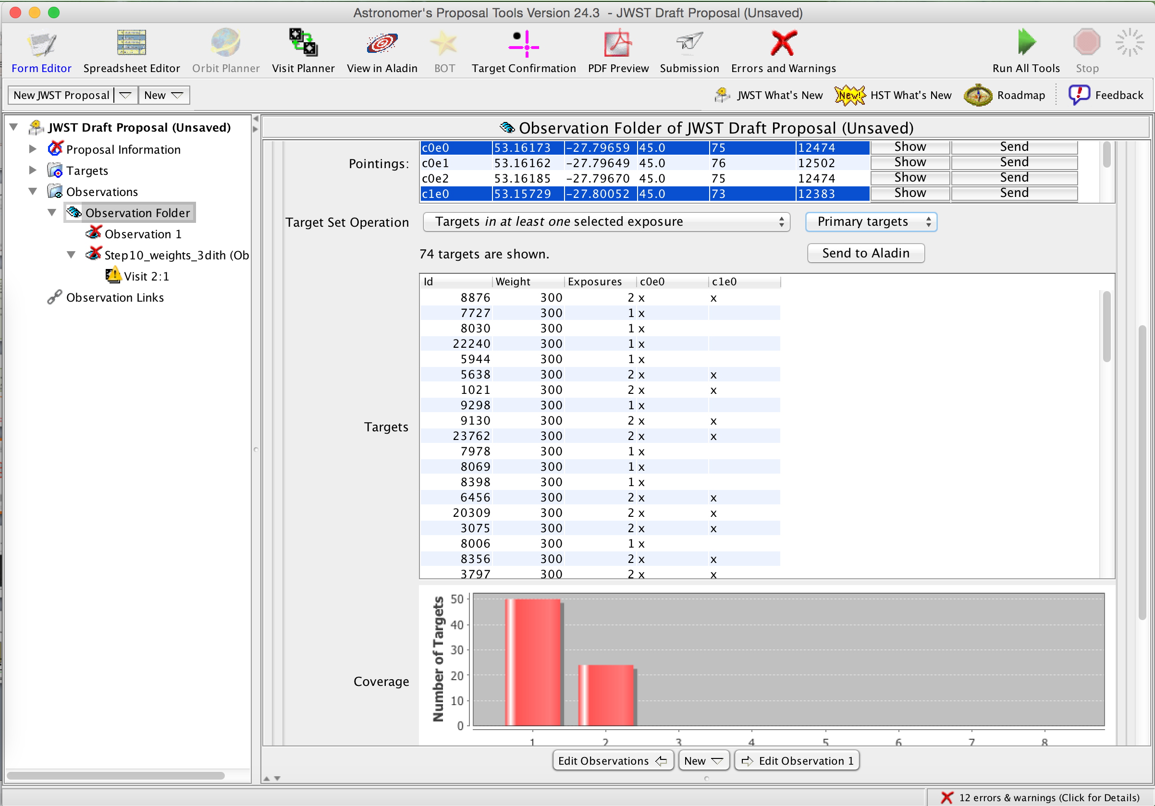
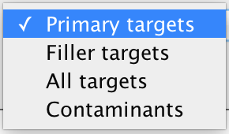
Review Plan Results
Ability to
select one or more exposures and
filter plan results to display only:
Primaries
Fillers
Contaminants
All targets
View target success through all selected exposures
Histogram of targets from the selected and filtered results.

Slide 13
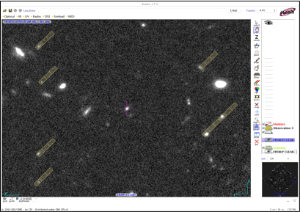
Visualization
MSA slitlets from a single pointing can be displayed on an image of the field in Aladin.
Catalogs or candidate source positions can be plotted in Aladin.
Target positions (observed MSA sources)
can be plotted, also.

Slide 14
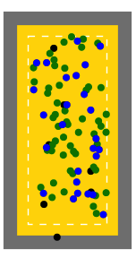
Plan Assessment Tools
In addition, there are some nice built-in tools to assess plans.
Exposure views:
MSA Shutter View
Collapsed Shutter View
Right: MSA shutter view. Targets are shown on a sketch of the MSA for one exposure. Users can click on or highlight targets for cross-examination with other views.
Left: Collapsed shutter view showing target centering results
0.”46
0.”06
0.”2
Green=Primaries
Blue=Fillers
Black=contaminants

