Slide 1
Single Object Spectroscopy and Time Series Observations with NIRSpec
Stephan Birkmann
European Space Agency
“On your mark” JWST Workshop
ESAC, September 26-28, 2016

Slide 2
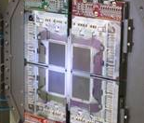
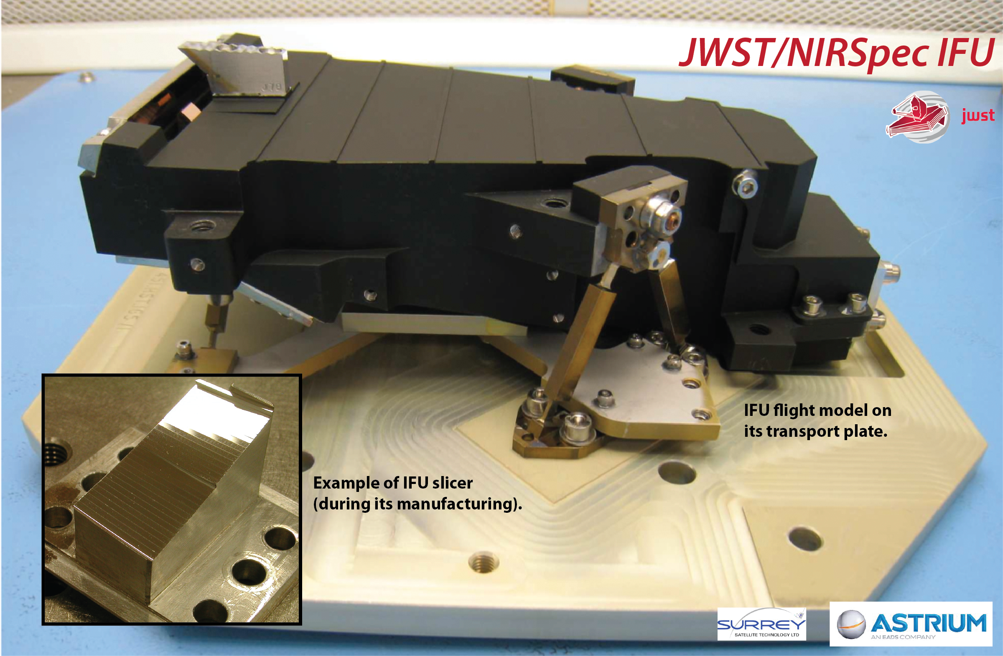
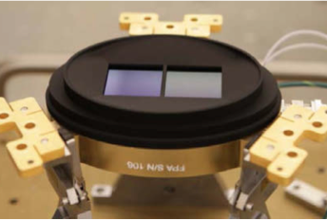
The Near-Infrared Spectrograph (NIRSpec)
Four instrument modes:
Six gratings and one prism are available as dispersers
One mirror for target acquisition in imaging mode
NIRSpec’s Focal Plane Assembly (FPA) consists of two closely spaced HAWAII-2RG sensor chip arrays with 5.3 μm cut-off wavelength and 100 mas pixels on the sky
Mode | Target Type | Aperture Mask
Multi-object spectroscopy | Rich fields or extended objects | Selectable from ~250,000 0.2” x 0.46” micro-shutters
Integral-field spectroscopy | Moderately extended objects | 3.0” x 3.0” IFU with 0.1” spaxels
Fixed slit spectroscopy | Single (compact) object (high contrast) | 0.2″ x 3.2″ slits (3) 0.4″ x 3.65″ slit 1.6” x 1.6” aperture
Bright object time series | e.g. Transit/eclipse spectroscopy | 1.6″ x 1.6″ aperture

Slide 3
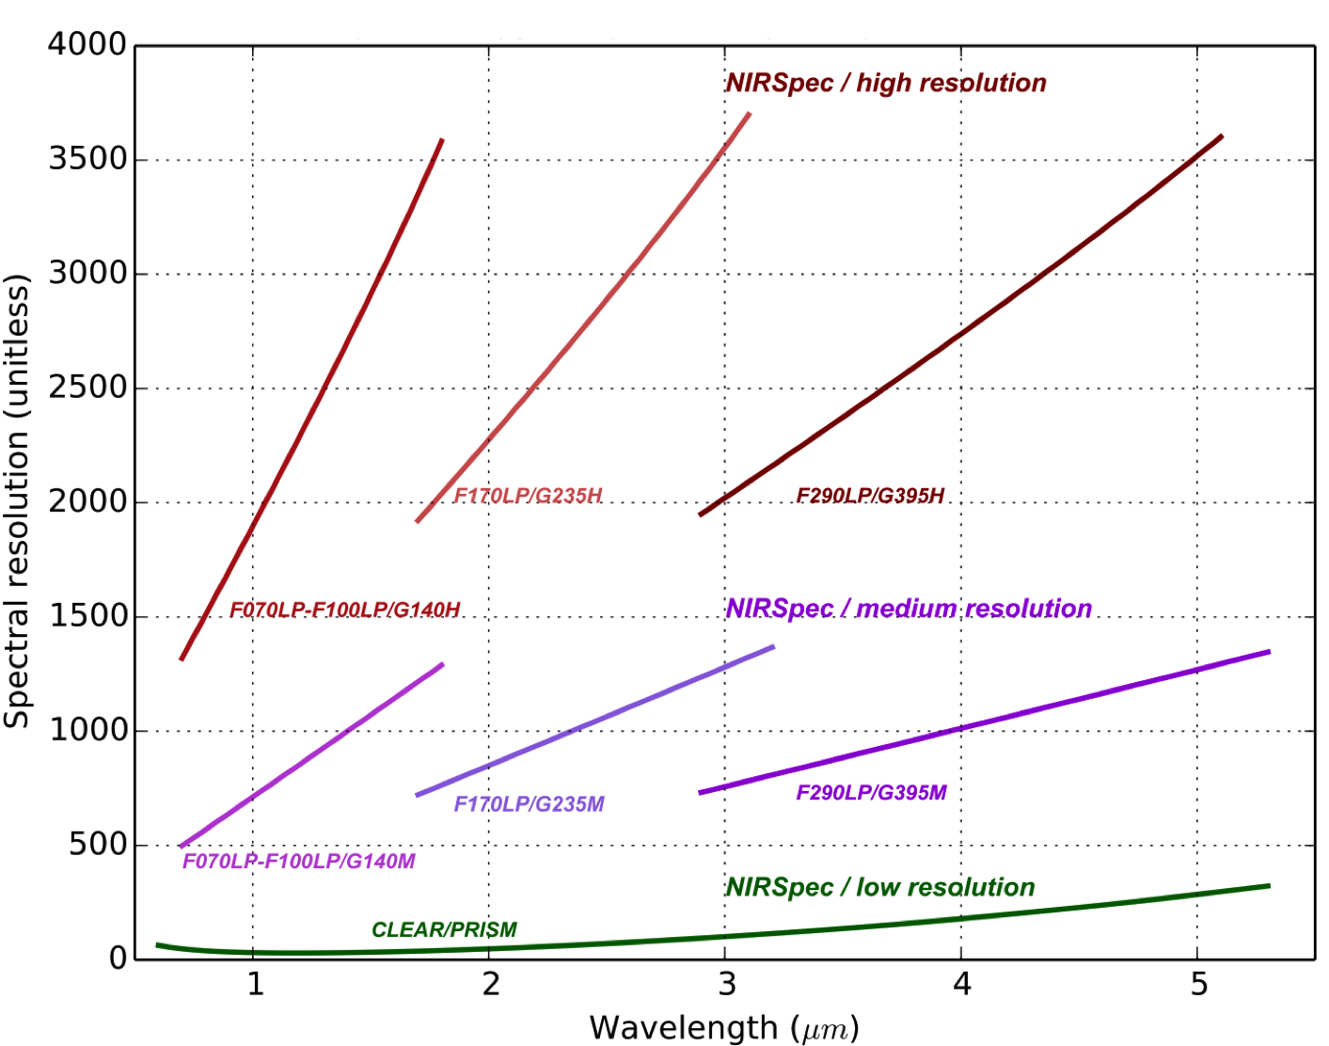
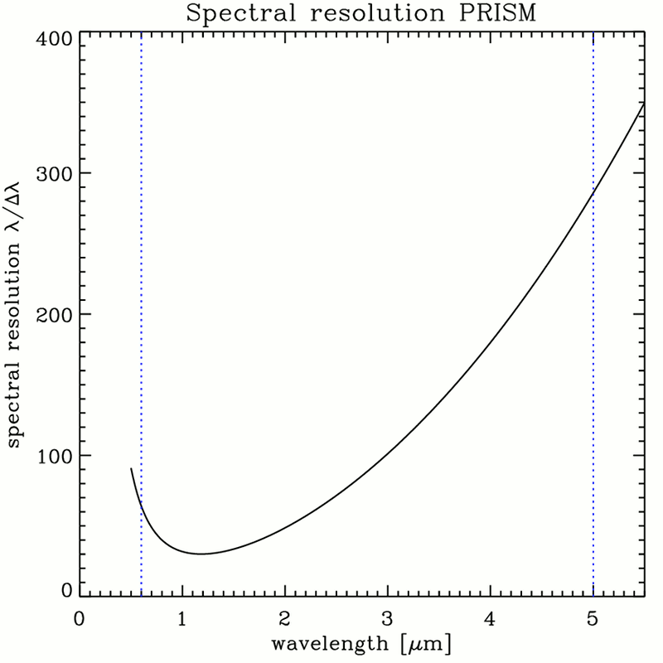
NIRSpec spectral configurations and resolution
1.26 μm
0.98 μm
1.88 μm
3.15 μm
2.88 μm
CLEAR/PRISM

Slide 4
NIRSpec’s Aperture Layout
Detector (SCA) gap
S200A1
S200A2
S400A1
S200B1
(backup only)
S1600A1

Slide 5
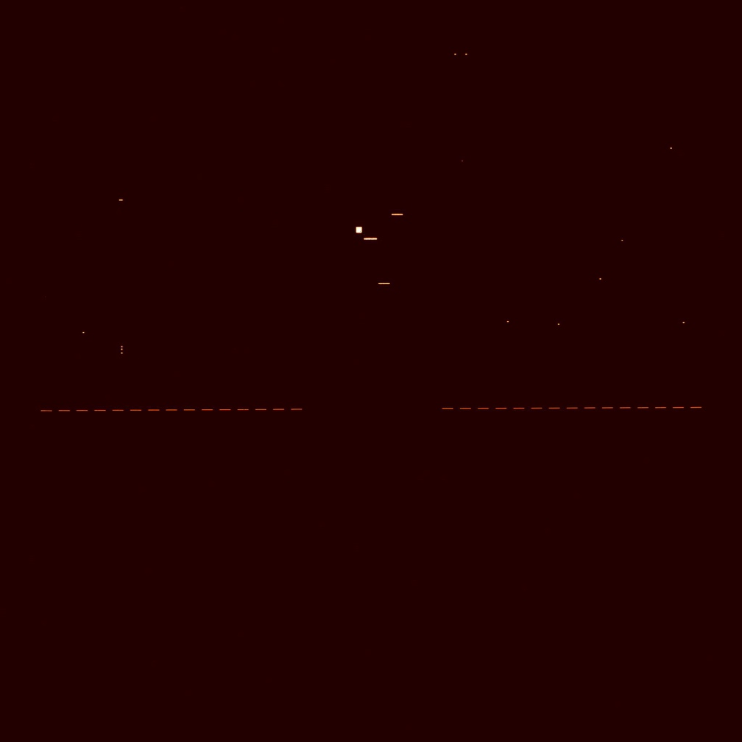

NIRSpec’s Aperture Layout, Real Data
MIRROR

Slide 6


NIRSpec Fixed Slit Data Example (1)
G140H flat field
Fixed slit spectra

Slide 7
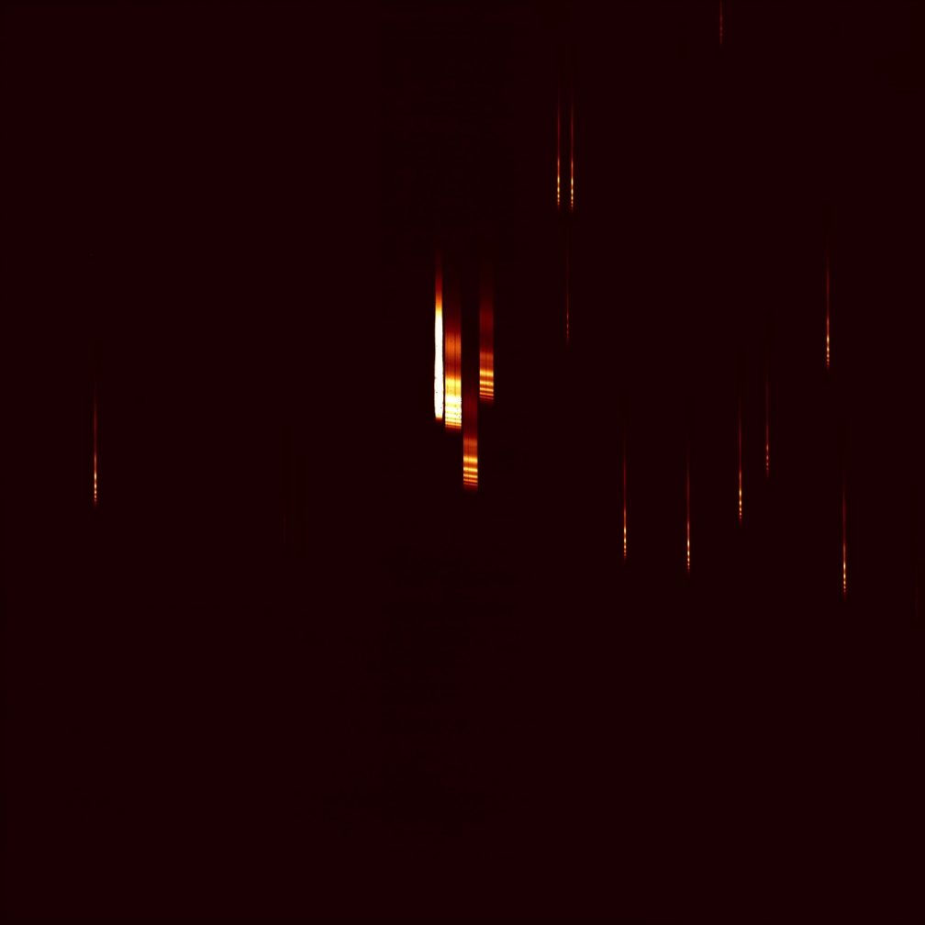

NIRSpec Fiex Slit Data Example (2)
PRSM wavelength calibration lamp
Fixed slit spectra

Slide 8
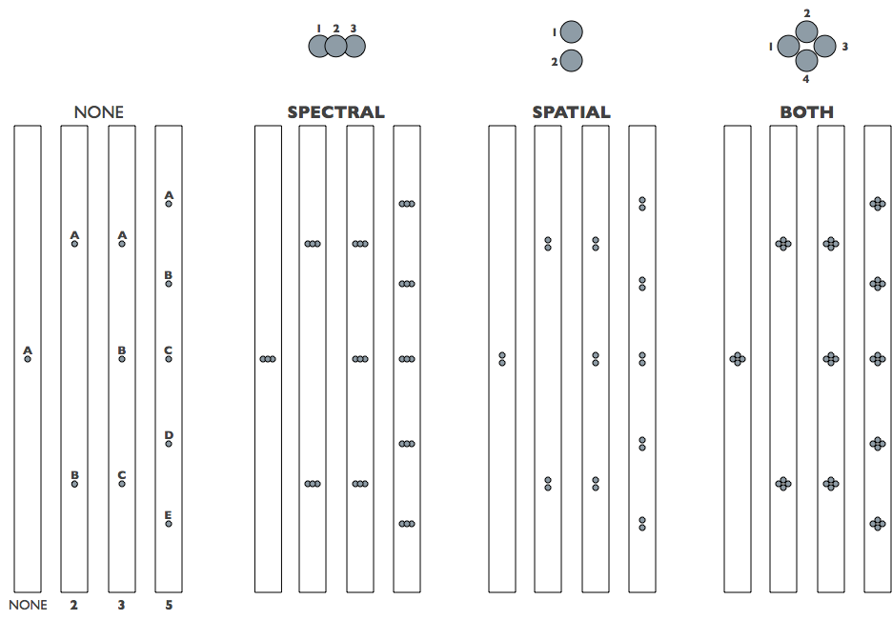
Fixed Slit Observing
Five Slits available:
  S200A1, S200A2, S400A1, S1600A1, S200B1 (backup)
Three subarrays available for the S200/400 slits:
Primary (nods) and secondary dithers available:
  0, 2, 3, or 5 point nod
  Additional dithers for sub-pixel sampling
  S200A1 + S200A2 to cover SCA wavelength gap
All dispersers available, can select multiple per observation
  Selected nods/dithers will be repeated for each
Need target acquisition (TA) to place object in slits
Subarray | Size | Frame Time | Comment
FULL | 2048 x 2048 | 14.58888 s (IRS²) 10.73676 s (non-IRS²) | All slits and MOS region captured
ALLSLITS | 256 x 2048 | 5.49132 s | All slits captured
SX00X1/2 | 64 x 2048 | 1.55724 s | Selected slit fully captured

Slide 9
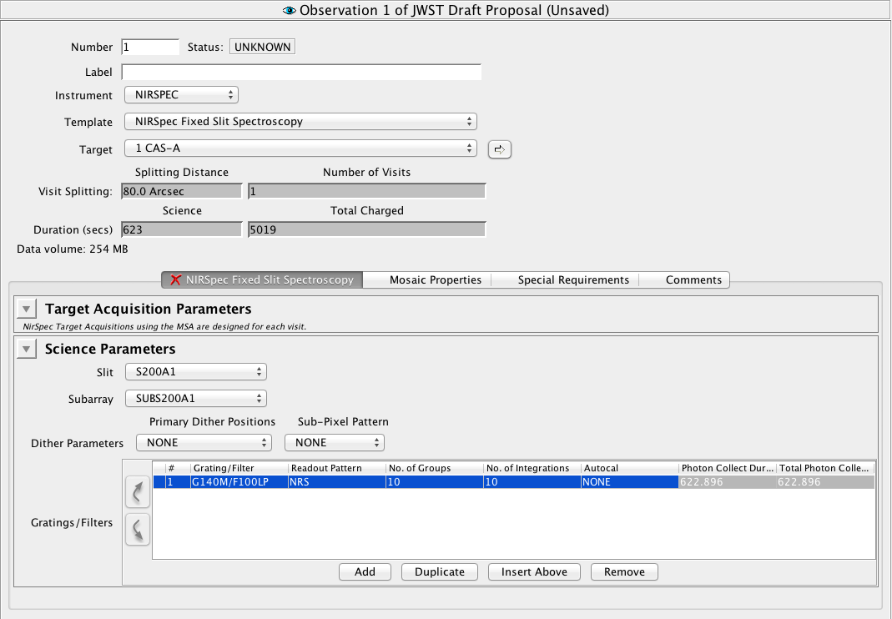
Fixed Slit Observing template

Slide 10
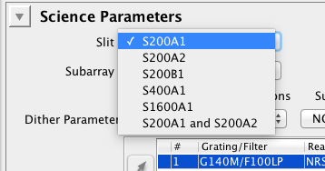

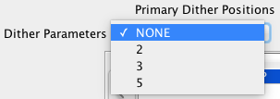
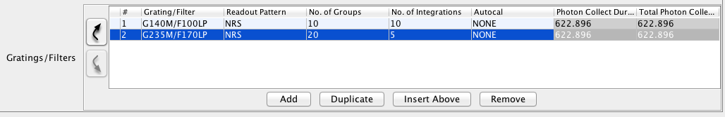
Fixed Slit Observing Template
Select slit/aperture to be used
Select subarray: slit specific (32x2048), ALLSLIT (256x2048), or FULL frame
  IRS² readout mode supported for full frame only
Select nod/dither patterns
  Secondary (sub-)dithers available
  Nods will avoid slit irregularities
Add activity and select grating/filter combination and exposure parameters (readout pattern, ngroups, nints)
  Can have more than one activity per observation
  Nods/dithers will be repeated for each activity
Define TA see next slide

Slide 11
Target Acquisition Options for Fixed Slits
Two ways supported: “full fledged” standard TA and wide aperture (or single object) TA:
Standard TA: same as for multi-object spectroscopy with the MSA (see MOS presentation from Torsten Böker)
Wide aperture TA:
  Acquire single object in S1600A1 aperture (single object can be target itself or a reference object)
  Move target into desired aperture
  Set of options (filter used for TA, detector readout, subarray) that should allow acquisition of virtually all targets, from very bright (think exoplanet host stars) to very faint

Slide 12
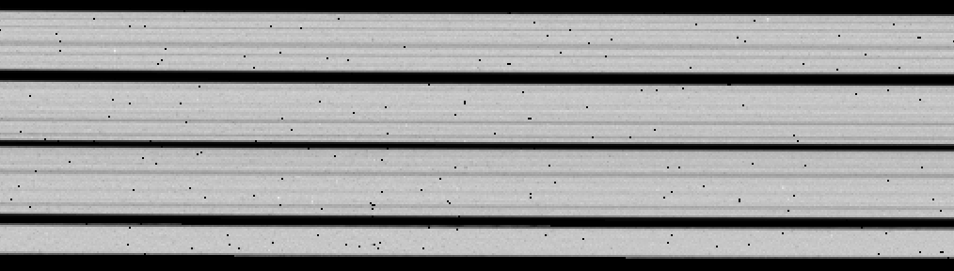
Fixed Slit “Stripyness”
The S200 and the S400A1 slits have width variations of up to 20% (P-V)
Expected to mostly flat field out
Nodding positions will be defined to avoid narrower slit regions where possible
Slit losses (for point sources) will be calibrated at the defined nod/dither positions

Slide 13
Fixed Slit Sensitivities
Fixed Slit sensitivity is basically identical to MOS (for S200xx slits)

Slide 14
Bright Object Time Series (BOTS) Observing
Only S1600A1 available (minimal slit losses and best radiometric stability)
Only one activity (instrument setup, wavelength coverage) and no nods/dithers
  Maximum exposure time (with multiple integrations) can be longer than 10,000 seconds
    No exposure break, best stability from detector standpoint
    Expose through high gain antenna movement (pointing disturbance)
Five available subarrays:
2 TA methods: wide aperture (see fixed slits) and “point-and-shoot”
Subarray | Size | Frame Time | Comment
SUB2048 | 32 x 2048 | 0.90156 s | Full wavelength coverage for gratings
SUB1024A | 32 x 1024 | 0.45100 s | Partial coverage for gratings (low/hi)
SUB1024B | 32 x 1024 | 0.45100 s | Partial coverage for gratings (center)
SUB512 | 32 x 512 | 0.22572 s | Full wavelength coverage for prism
SUB512S | 16 x 512 | 0.14364 s | No pixels outside aperture

Slide 15
BOTS Data Examples
SUB512 (32 x 512) with PRISM
0.6 μm
1.0 μm
2.0 μm
3.0 μm
3.5 μm
4.0 μm
4.5 μm
5.0 μm
5.3 μm
SUB2048 (32 x 2048) with G235H/F170LP
1.7 μm
1.8 μm
1.9 μm
2.0 μm
2.1 μm
2.2 μm
2.3 μm
2.4 μm
2.5 μm
2.6 μm
2.7 μm
2.8 μm
2.9 μm
3.0 μm

Slide 16
NIRSpec BOTS Brightness Limits
below line means observable in without saturation anywhere in band
Current best guess
+/- 0.5 mag uncertainty
Nielsen+ 2016

Slide 17
NIRSpec BOTS Brightness Limits
below line means observable in without saturation anywhere in band
HD 219134
Current best guess
+/- 0.5 mag uncertainty
Nielsen+ 2016

Slide 18
BOTS - Signal to Noise Example, Bright Limit
M4V host star, 9.8 J_{mag}, 3200 s transit time, observed in CLEAR/PRISM

Slide 19
Summary
NIRSpec offers 200 mas, 400 mas, and 1600 mas wide slits/apertures
  All NIRSpec dispersers available (0.6 – 5.3 μm wavelength coverage)
  Slits provide very high contrast and low background
  Excellent sensitivity
  Pre-defined (and calibrated) nod/dither options
NIRSpec offers a dedicated observing mode for time series observations of bright sources through the S1600A1 aperture
  Providing high radiometric stability
  Enabling studies of transiting/eclipsing exoplanets with host stars as bright as ~6.5 mag (J-band, with high resolution gratings)

