Slide 1
Chris Willott, Loic Albert, René Doyon, and the FGS/NIRISS Team
Niriss SINGLE OBJECT Slitless spectroscopy
ESAC JWST
27 Sept 2016

Slide 2
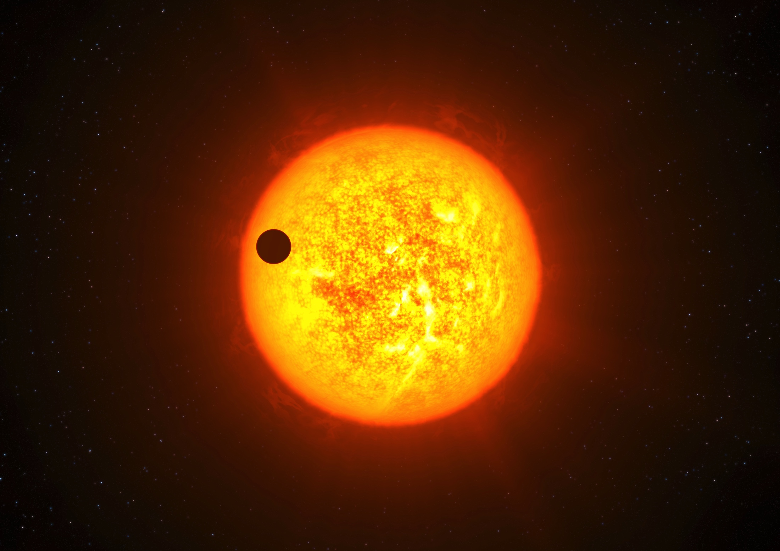
Outline
Grism and spectral traces
Operations concept
Detector sub-arrays and readout modes
Wheel repeatability considerations
Faint and bright limits, example data
Field stars contamination
Spectral orders contamination

Slide 3
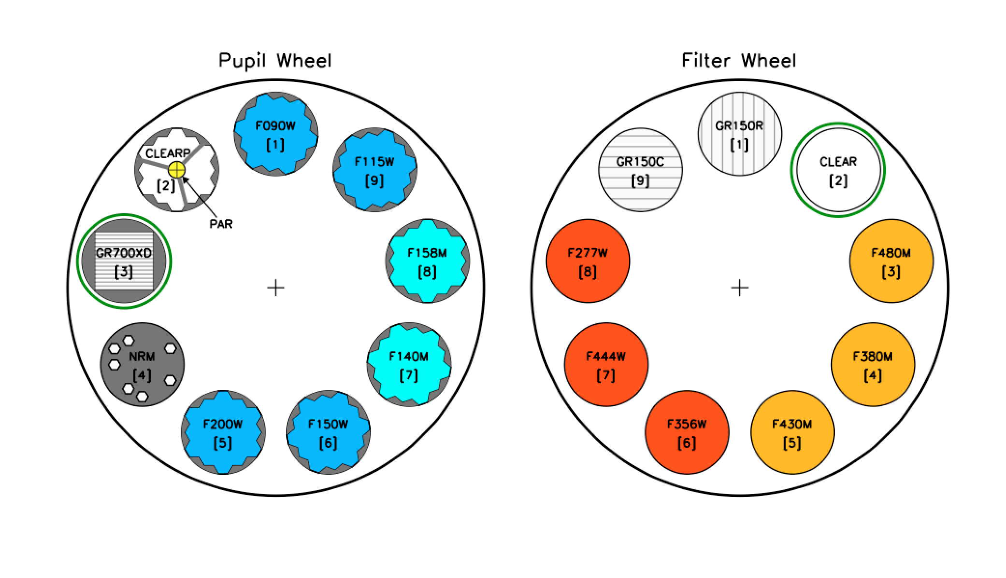
Single Object Slitless Spectroscopy
Uses the GR700XD grism with no filter

Slide 4
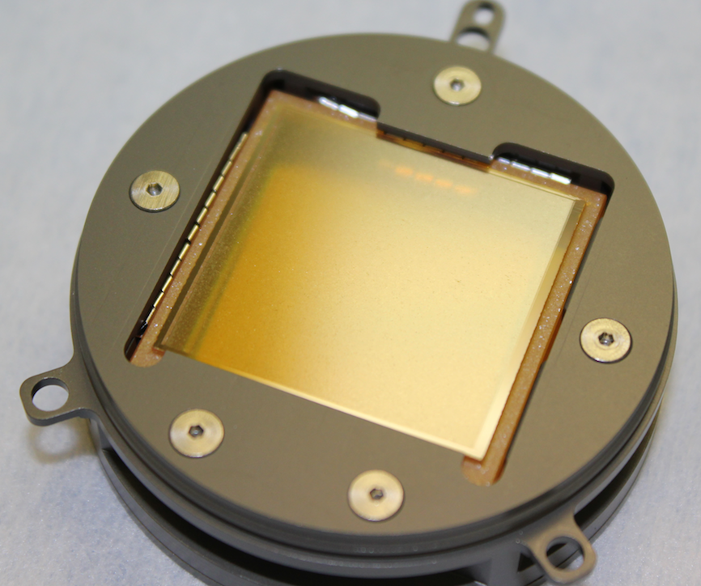
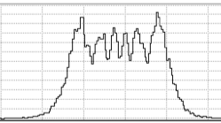
NIRISS GR700XD Grism
  Grism with built-in defocussing weak lens to increase dynamic range and minimize systematic noise due to undersampling and flatfield errors.
  Optical implementation to the successful scanning mode used on HST.
CV3 Observed Monochromatic
PSF (1300 nm)
tilt = 0.6°
λ
15 pixels
99% - 36 pixels

Slide 5
Spectral Traces on the Detector
Two sub-array choices:
256 x 2048 – all orders
1st: 830 – 2816 nm
2nd: 600 – 1409 nm
96 x 2048 – only 1st order
    Gain 1 magnitude in bright limit
R=500 to 2500

Slide 6
Operations Concept – Target Acq.
1. Acquisition through the NRM (T=15%) and F480M filter using a 64x64 sub-array (saturating for J<~5).
2. Single pass acquisition with precision of ~1/10 pixel.
3. Grism in. Repeatability of wheel is 0.15 degrees. Baseline is no fine tuning of the trace position.
4. Observing Sequence: A single exposure (FITS file) containing large number of integrations to maximize efficiency. No loss between integrations beside array reset.

Slide 7
Operations Concept – Contamination
Case of GJ 1214b – Field Orientation.
Contamination can be mitigated
0°
5°
10°
15°
20°
25°
30°
35°
Tool is available to find PAs that minimize contamination

Slide 8
Operations Concept – Wheel Repeatability
Order 1 Trace Position on the Detector
CV3 test moving between CLEARP and GR700XD pupil wheel position
10 repeats per position
Imperfect wheel repeatability introduces a rotation of the spectral traces: θ=tan⁻¹(0.7/2048) = ~0.02 degrees.
Spatial Axis Delta - ΔX (pixels)
blue ← First Order Trace → red
Dispersion Axis - Y (pixels)

Slide 9
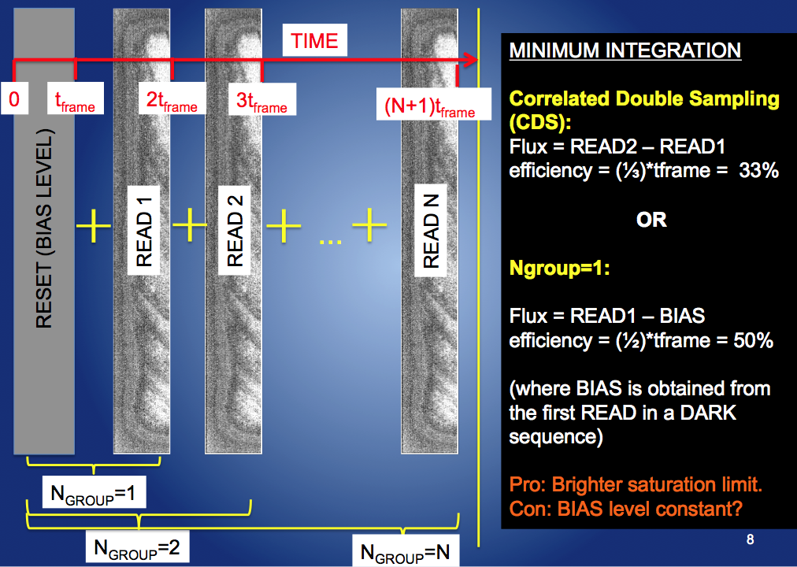
Operations Concept – Detector Readout

Slide 10
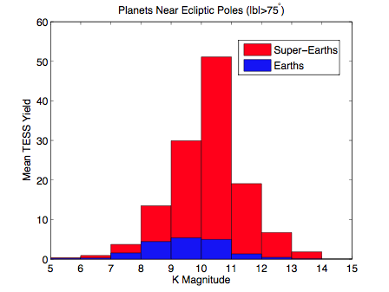
Expected Science Targets
NIRISS Saturation Limit
NIRISS Faint Limit
Figure courtesy of George Ricker (TESS PI)

Slide 11
Target Faint Limit
2nd Order
4 hr clock time
15 ppm noise floor
Teff = 3200
At full spectral resolution
J=14
J=12
J=10
J=7

Slide 12
Target Saturation Limits
Coverage and Risks at Various Magnitudes
J | NG | Sub | Coverage | Warnings
>8.0 | 2+ | 256 | full 0.6-2.8 | None
7.25-8.0 | 1 | 256 | full 0.6-2.8 | Bias drift uncertainty
6.75-7.25 | 1 | 256 | full 0.6-2.8 | Sat. pix. in "horns" for λ=0.96-1.46 μm
6.25-6.75 | 1 | 256 | full 0.6-2.8 | Can recover λ<1.40 μm from order 2
5.75-6.25 | 1 | 256 | 0.6-1.4+2.0-2.8 | Order 1 saturated for λ<2.0 μm
>6.0 | 1 | 96 | 1.0-2.8 (order 1) | Bias drift uncertainty
5.5-6.0 | 1 | 96 | 1.0-2.8 (order 1) | Sat. pix. in "horns" for λ=0.96-1.46 μm
<5.5 | 1 | 96 | Less of blue end | λ=1.2μm@5.25, 1.8@4.5, etc

Slide 13
Simulated Data

Slide 14
Spectral Order Overlap
2nd and 1st orders cross contamination
Requires modeling in spectral extraction
96x2048

Slide 15
Summary
NIRISS Single Object Slitless Spectroscopy has excellent capabilties for exoplanet transits:
  Simultaneous coverage from 0.6 to 2.8 microns with most of spectrum at spectral resolution R>1000.
  Slitless design with extended spatial PSF spreading light over more pixels.
  Two sub-arrays and several readout modes matched to target fluxes.
  Stable operation mode of long exposures containing many integrations.
  Simulation tools available at http://jwst.astro.umontreal.ca

