Slide 1
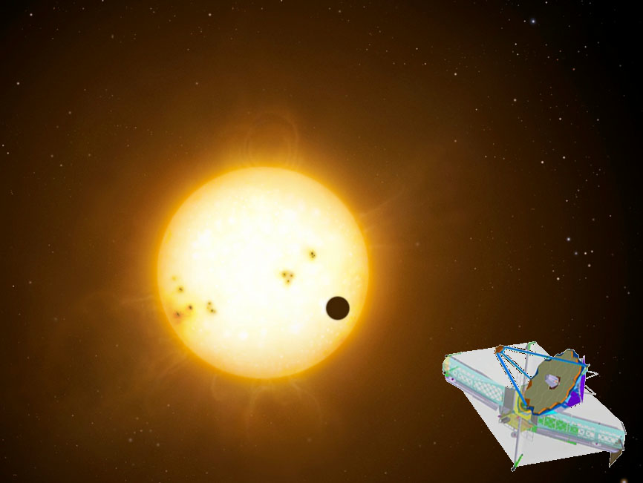
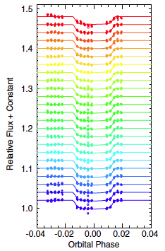
Single Object & Time Series Spectroscopy with JWST NIRCam
Tom Greene & NIRCam Team
ESAC JWST Workshop
September 27, 2016
Line+ (2013)

Slide 2
Contents
NIRCam overview
NIRCam modes and spectra
Spectral resolution and wavelength coverage
Bright star limits and sensitivity
APT template and subarrays
Operations concept
Calibration & pipeline processing
Potential future capabilities (after Cycle 1)

Slide 3
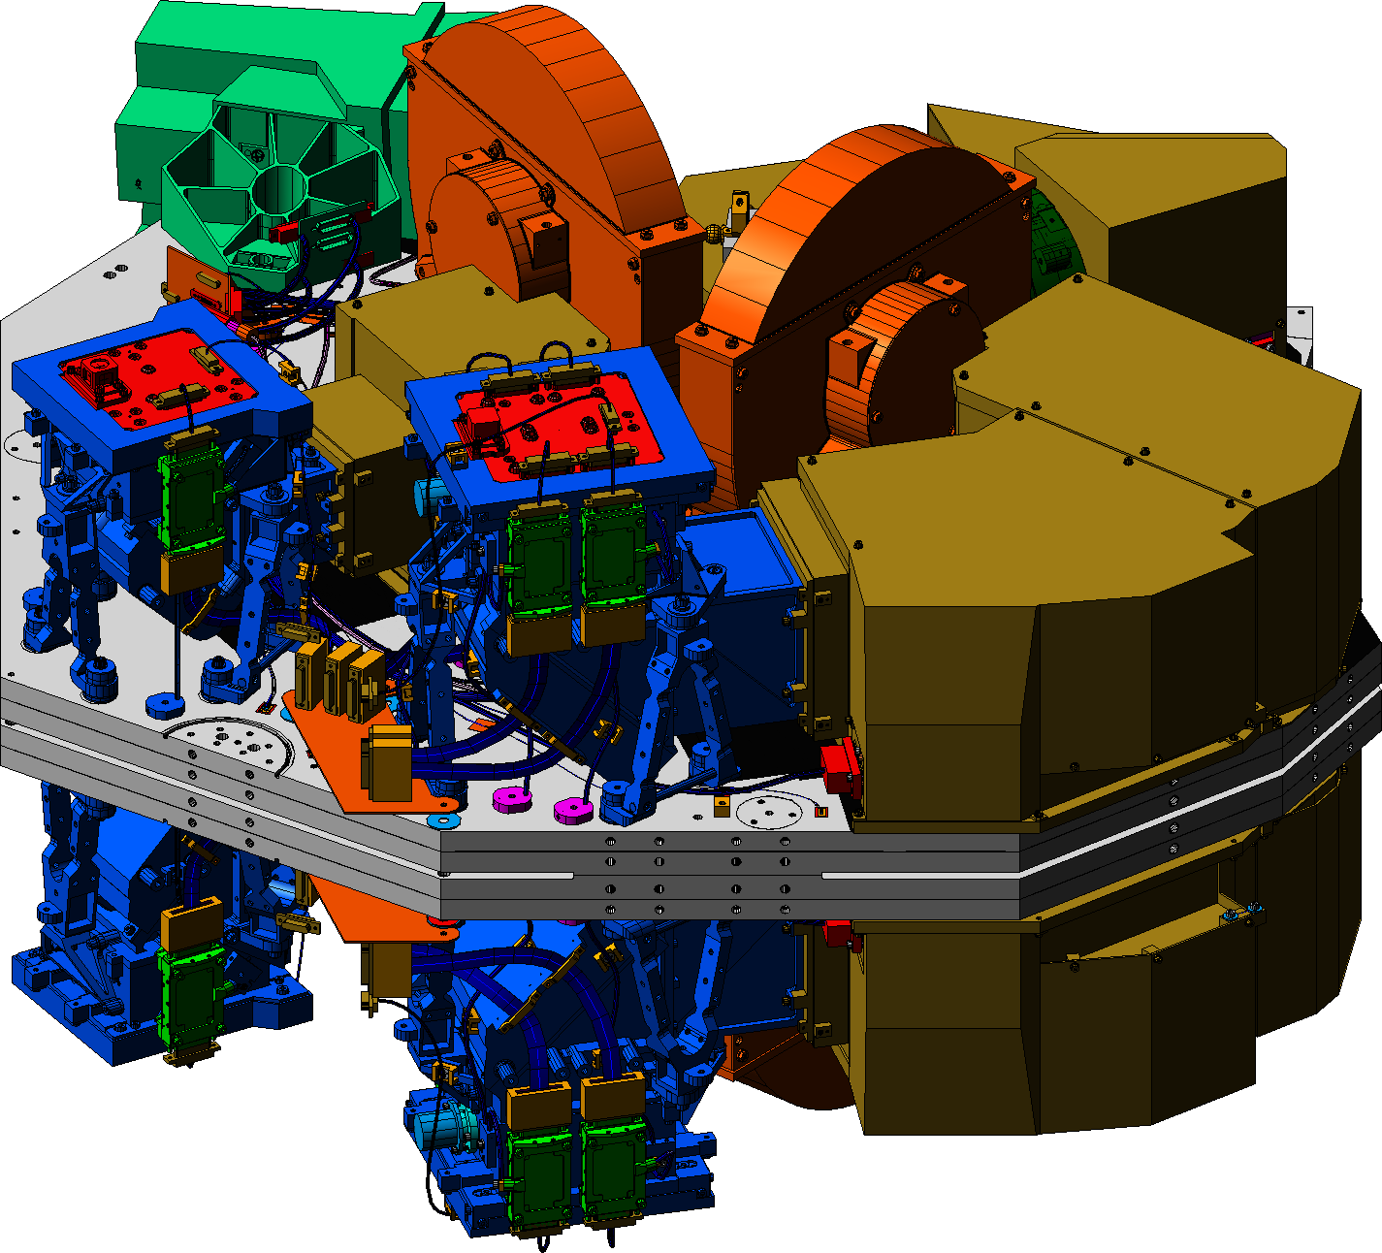
NIRCam: 0.6-5 μm imaging + 2,4-5 μm spectroscopy
NIRCam is the JWST near-infrared camera
for JWST
  Two nearly identical modules (A & B) with refractive designs to minimize mass and volume
  Dichroic used to split range into short (0.6–2.3μm) and long (2.4–5μm) channels
  Nyquist sampling at 2 and 4μm
  2.2 arc min x 4.4 arc min total field of view seen in two colors (40 MPixels)
  Coronagraphic capability for both short and long wavelengths
  Dispersive components in short and long channels allow spectroscopy
NIRCam is also the telescope wavefront sensor

Slide 4
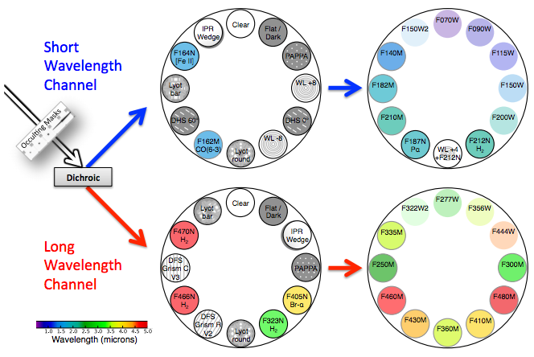
NIRCam modes: selectable with wheels
No Short Wavelength Spectroscopic Capabilities in Cycle 1
0.6 – 2.4 μm
From
OTE
Simultaneous SW imaging is possible!
(LW)
2,4 – 5 μm
2 LW grisms in each module provide R~1500 slitless spectroscopy:
Chose dispersion orientation and filters to suit your science

Slide 5
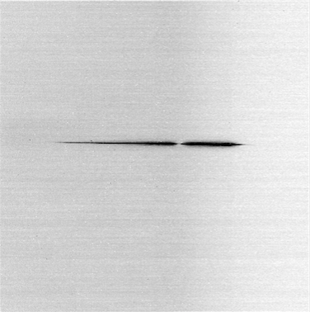
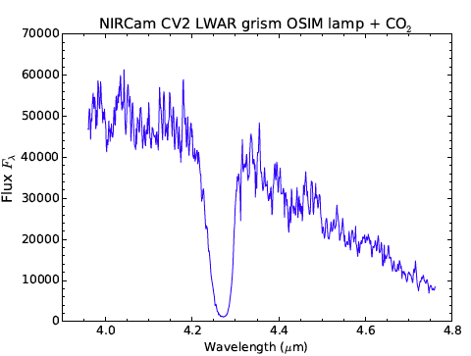
NIRCam LW Grism Spectra
Increasing λ
Left: NIRCam spectral image of the OSIM super-continuum lamp point source taken with the LWA R grism and F444W filter during JWST instrument testing.
Right: Extracted spectrum. The continuum decreases toward longer wavelengths due to low fiber transmittance, and the broad feature near 4.27 μm is due to CO₂ absorption. These are artifacts of the test equipment and not NIRCam itself.
* NIRCam FOV is 2.’2 x 2.’2 with dispersion of 10 Å per 0.”065 x 0.”065 pixel *

Slide 6
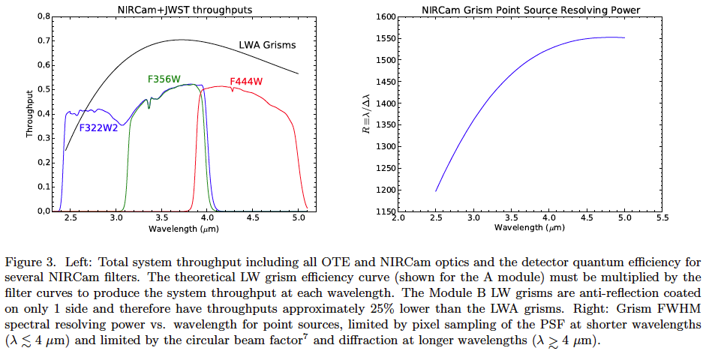
NIRCam Spectral Coverage & Resolution

Slide 7
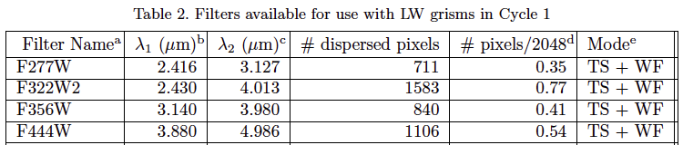
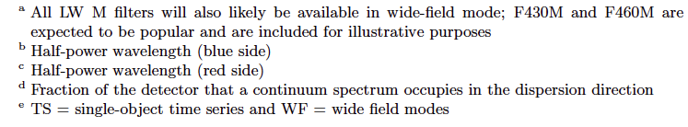
Time Series Wavelength (filter) Options
The 2.4 – 5 μm region can be covered in as few as 2 separate filters:
  F322W2: 2.4 – 4.0 μm
  F444W: 3.9 – 5.0 μm

Slide 8
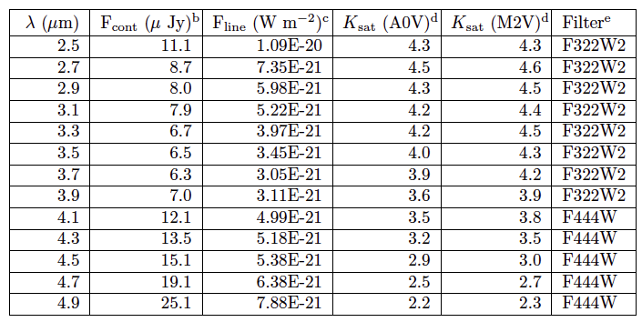
Module A Grism Saturation & Sensitivity
Module B grisms will have sensitivities approximately 1.16 times higher (worse) and saturation limits 0.33 mag brighter.
b, c 10 σ point-source and unresolved emission line sensitivities for 10,000 s integrations
d K-band Vega magnitudes for saturation (80% full well or 65,000 electrons) for 0.68 s integrations (2 reads) of 2048 x 64 pixel regions in stripe mode (4 outputs).
e Narrower filters will have similar saturation values and somewhat better sensitivities
Sensitivities are ~2-5x worse than NIRSpec depending on filter bandpass and zodiacal background

Slide 9
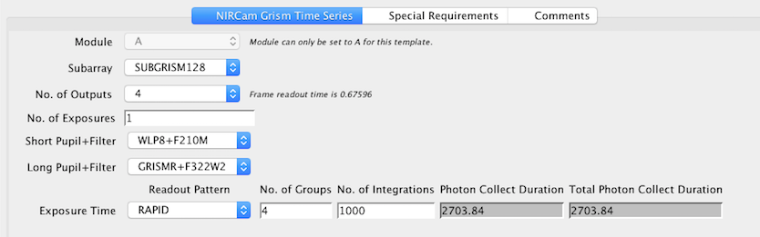
Time Series Spectroscopy APT Template
Can choose from 64, 128, 256, & 2048 x 2048 subarrays
1 or 4 outputs (4 for very bright stars)
Simultaneous short wavelength imaging with weak lens to spread the light over many pixels is possible
No dithering
Flexible detector exposure and readout parameters

Slide 10
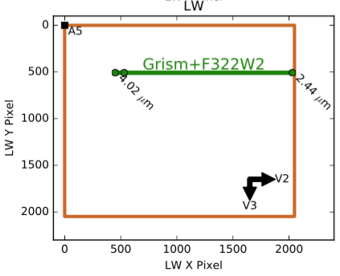
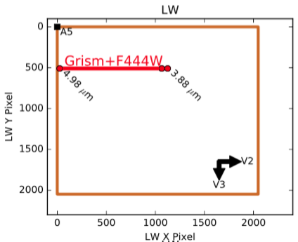
Target Acquisition & Spectral Pixels
** Note: Field point positions may / will be revised before launch **
Target acquisition field points allow significant overlap of same pixels in F322W2 and F444W spectra
Targets are positioned at the undeviated wavelength locations (blue arrow; λ ~ 3.95 μm)

Slide 11
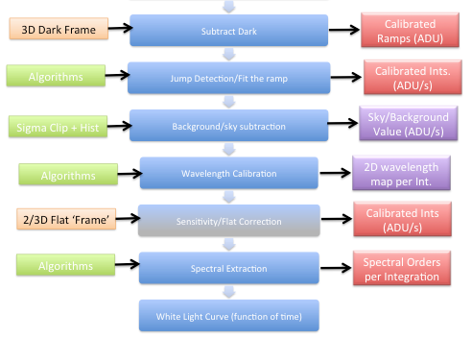
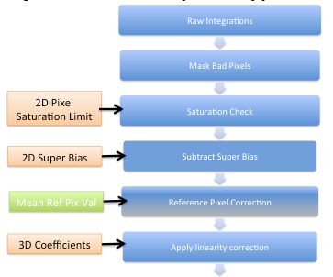
NIRCam uses the JWST time-series data pipeline
• Users can download & re-run the pipeline with different options, additions, or removals

Slide 12
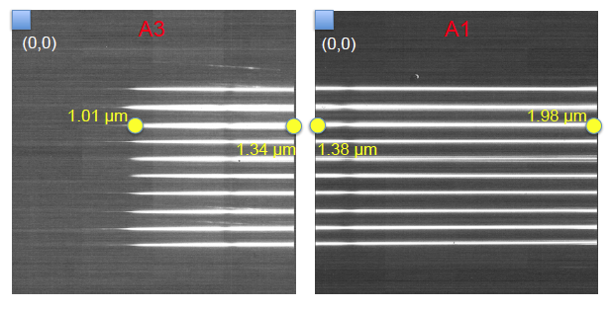
Future Possible Simultaneous 1 – 2 μm Spectra
• DHS elements
disperse ~40%
JWST’s light onto 2 NIRCam SW detectors with a small gap in-between
Dispersed Hartmann Sensor (DHS) elements in the SW channel of NIRCam provide 1 – 2 μm spectra using 10 sub-apertures of the JWST pupil, potentially allowing simultaneous spectra of bright stars during LW grism observations
This is not an approved science mode for Cycle 1; it may be approved for later cycles

Slide 13
Further Information
General NIRCam information: http://www.stsci.edu/jwst/instruments/nircam
Greene et al. (2016) SPIE paper “Slitless Spectroscopy with JWST NIRCam” http://adsabs.harvard.edu/abs/2016arXiv160604161G
STScI User Training in JWST Data Analysis II Workshop, November 9 – 11 (can attend remotely): https://jwst.stsci.edu/events/events-area/stsci-events-listing-container/user-training-in-jwst-data-analysis-ii?mwc=4
Astronomer’s Proposal Tool for planning observations: http://www.stsci.edu/hst/proposing/apt
JWST exposure time calculator is coming in January 2017 with PandExo exoplanet transit simulator afterward.

