Slide 1
The Medium Resolution Spectrometer
(IFS with MIRI)
Alvaro Labiano
on behalf of the MRS team
1
Notes:
Huge team of experts

Slide 2
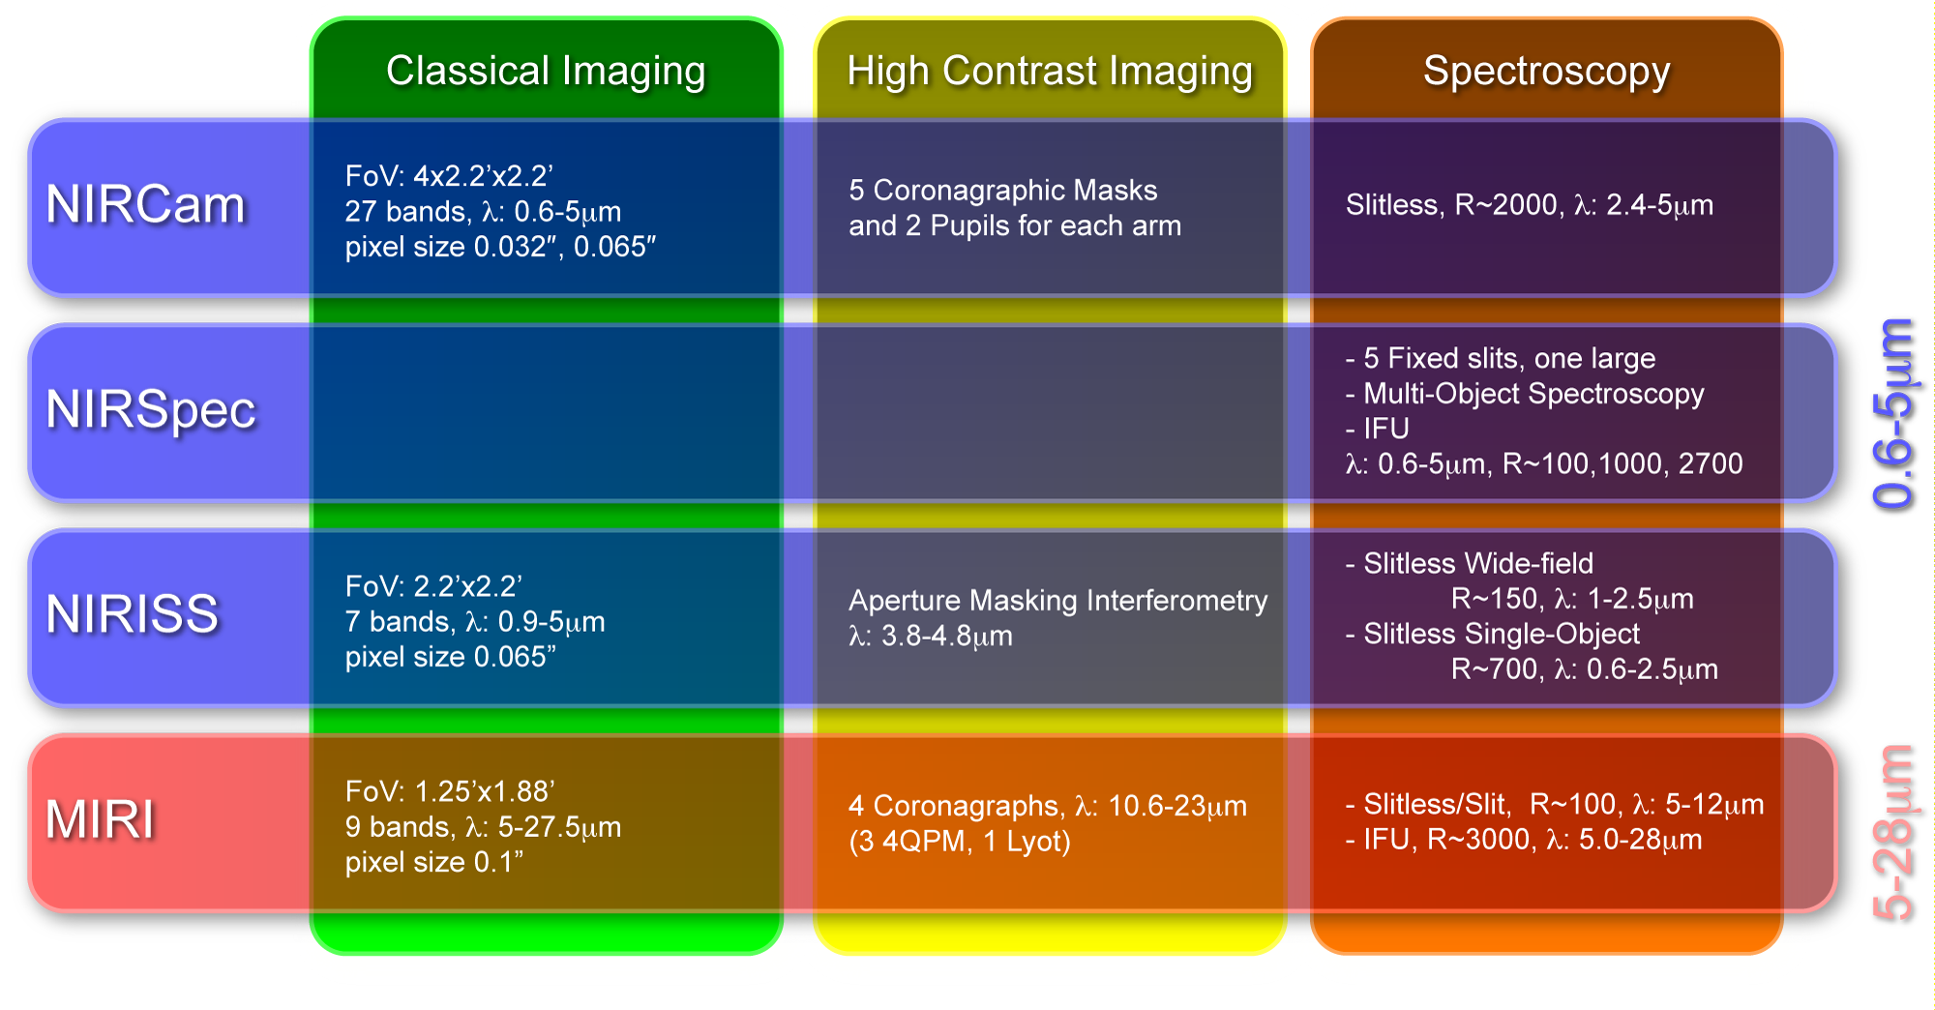
JWST Observing Modes

Slide 3
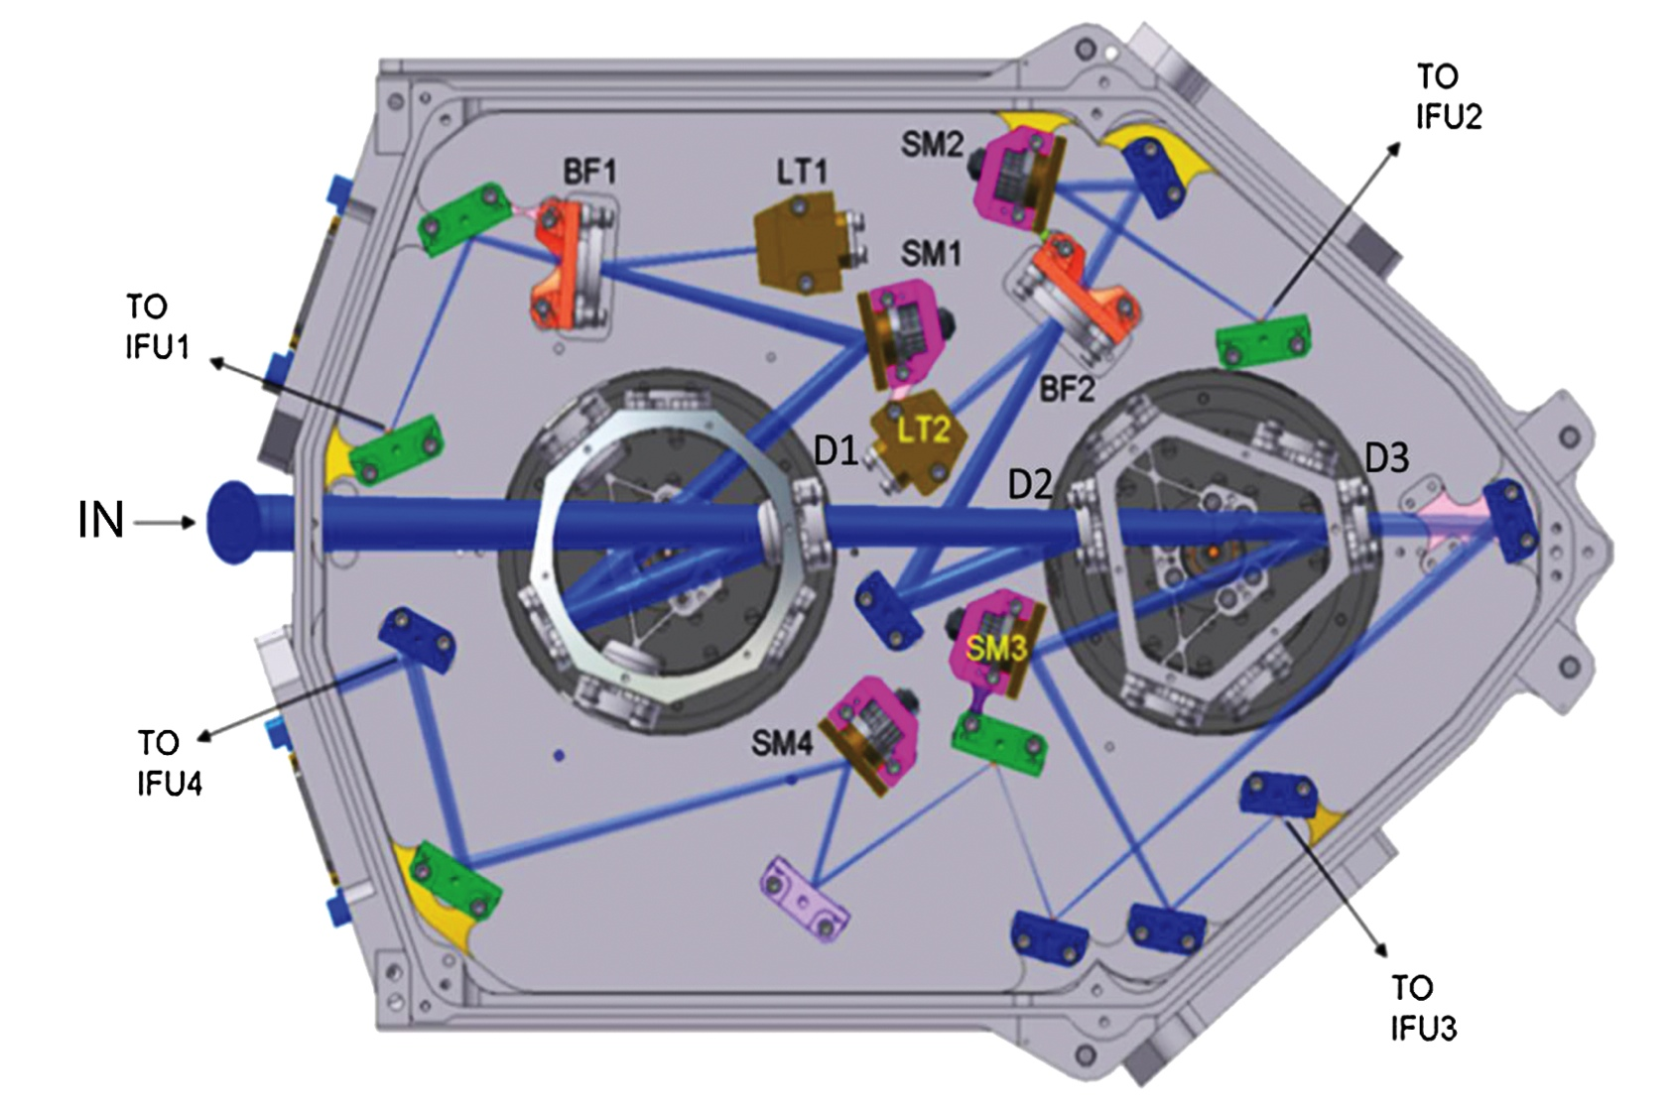
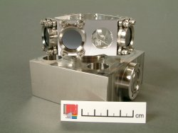
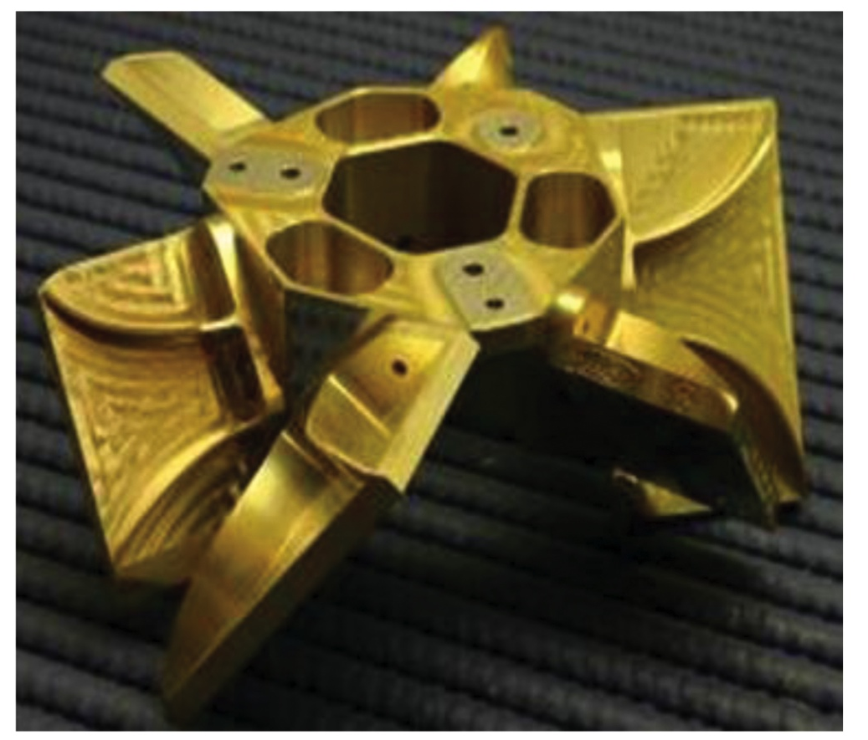
Spectrometer Pre-Optics (SPO)
LT: light trap
BF: blocking filter
Ch. 1: Wheel 1
Ch. 2 & 3: Wheel 1+2
Ch. 4: “Clear”
Notes:
Dichroics on 2 dichroic wheel assemblies
Wells+15

Slide 4
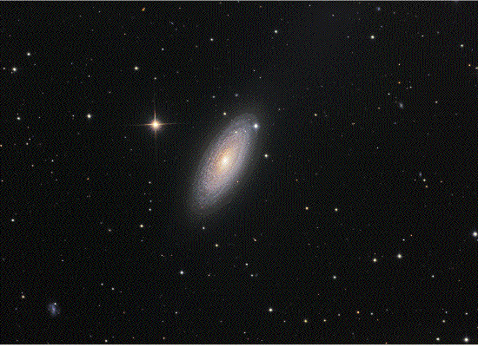
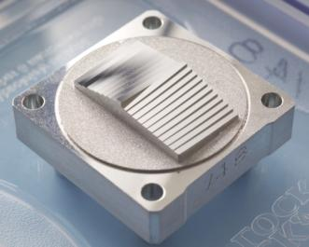
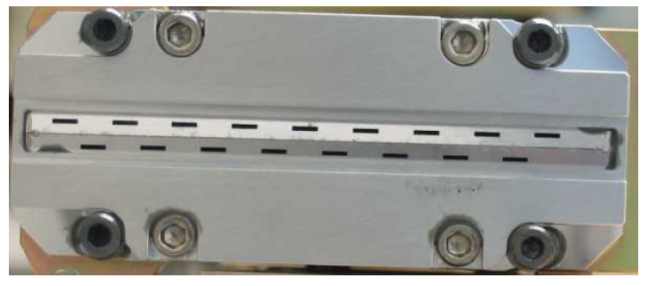
MRS - “slicer IFU”

Slide 5
MRS Parameters
IFUSHORT
IFULONG
Notes:
Updating lam & resol with test data.
Will be refined on orbit

Slide 6
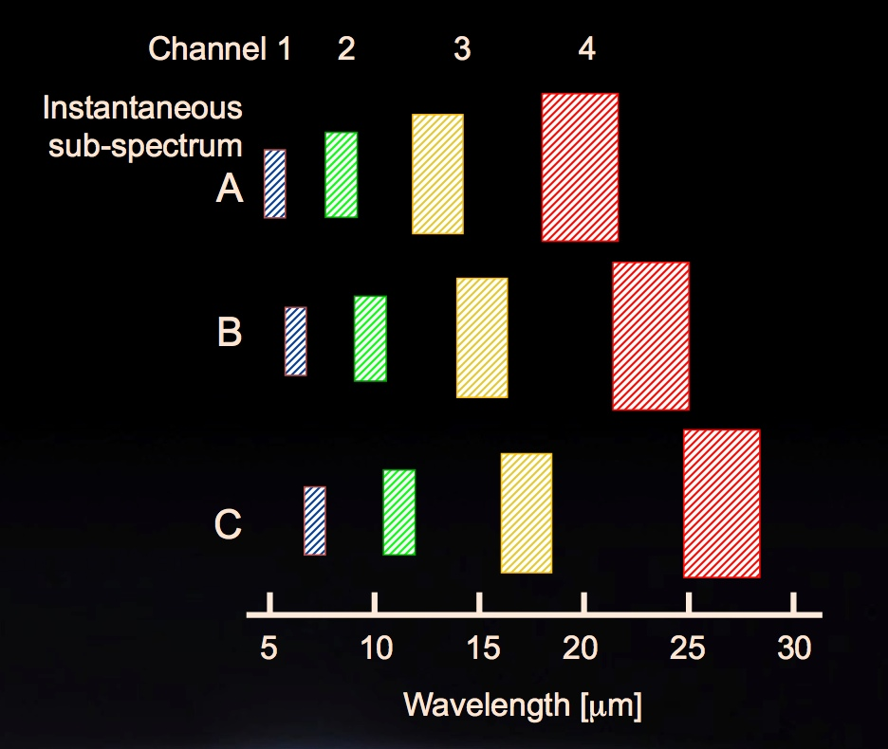
Full wavelength coverage – 3 observations!
Obs #1
Obs #2
Obs #3
Dichroic grating wheels select bands of all channels simultaneously

Slide 7
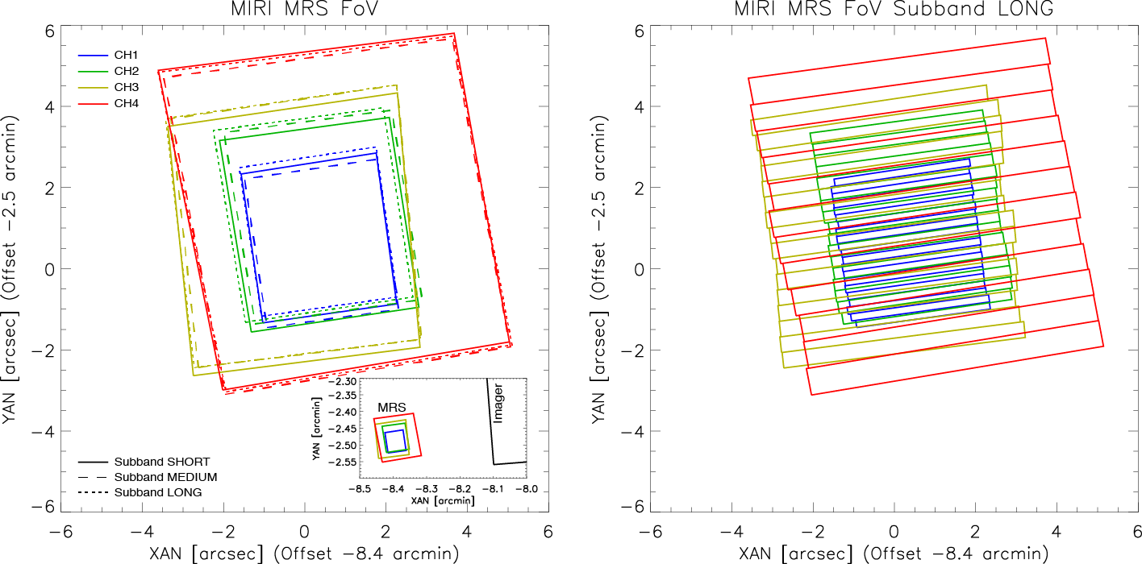
MRS FoV
All channels have concentric fields of view
Notes:
FoVs, diff slice widths (PASP)

Slide 8
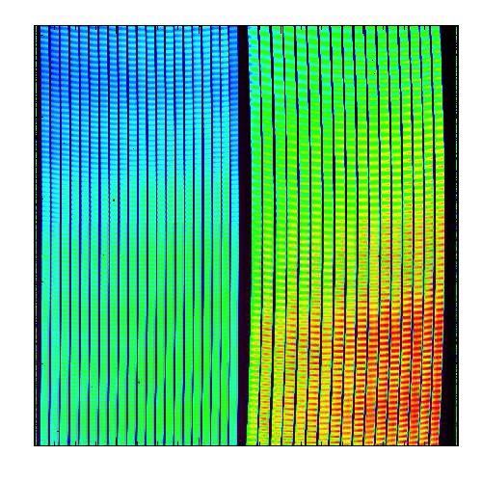
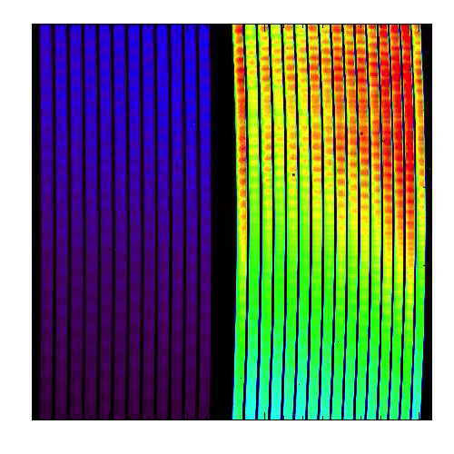
MRS spectrum of a extended source
Channel 1 & 2
Channel 4 & 3
6.7
10.2
20.5
13.3
λ/μm
5.6
8.6
24.5
15.7
IFUSHORT
IFULONG
Notes:
1B, 2B, 3B, 4B Ch 4 lower sensitivity
Non trivial distortions,

Slide 9
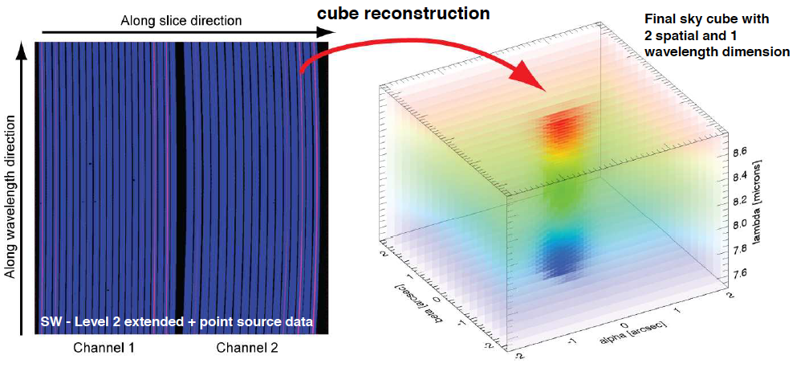
MRS cube reconstruction “cube build”

Slide 10
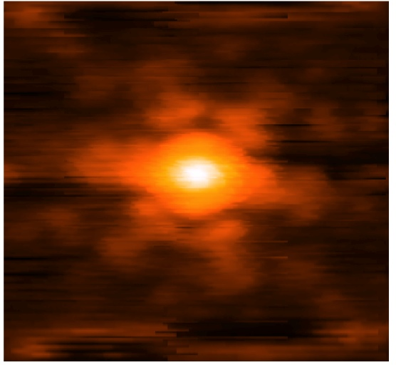
MRS cube reconstruction “cube build”
[CV2 data]

Slide 11
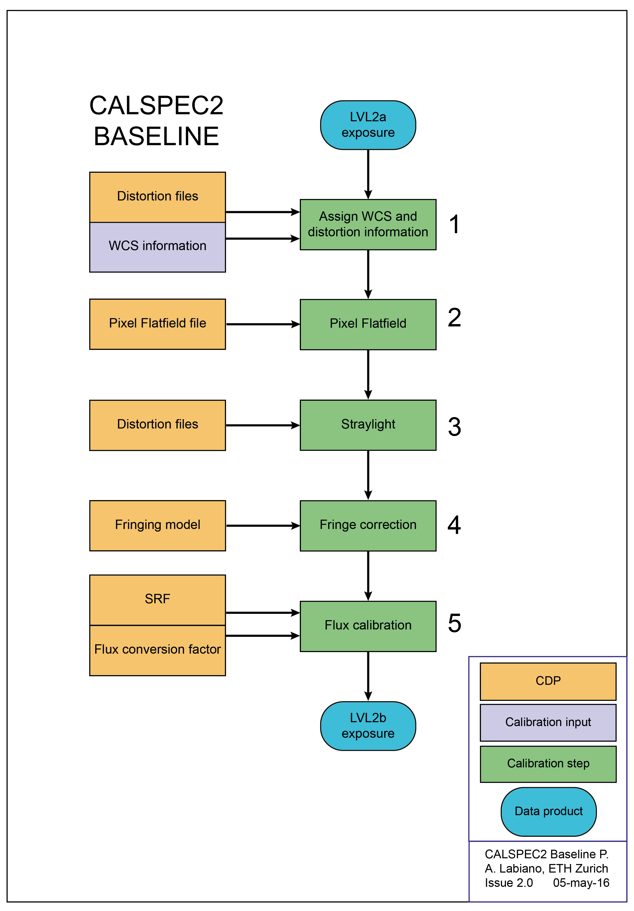
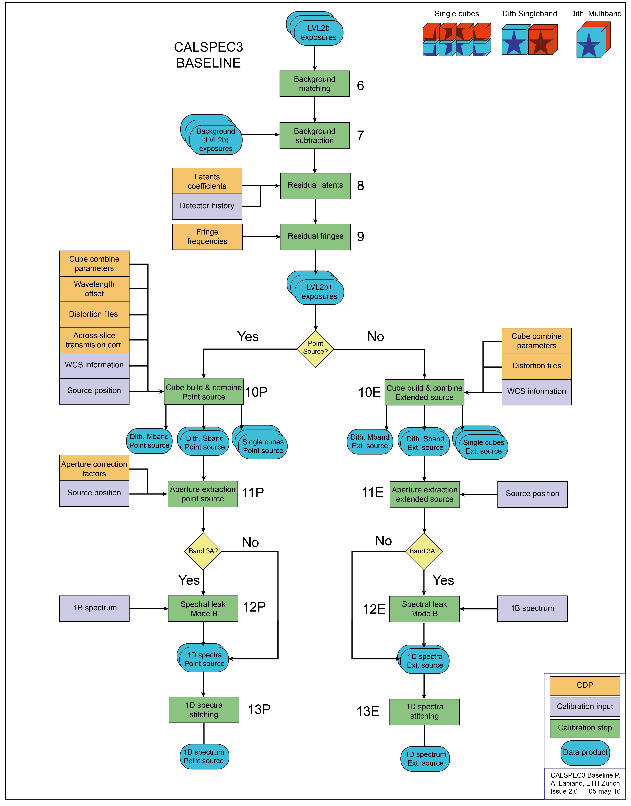
MRS Baseline Pipeline
Notes:
Details in Karl’s presentation

Slide 12
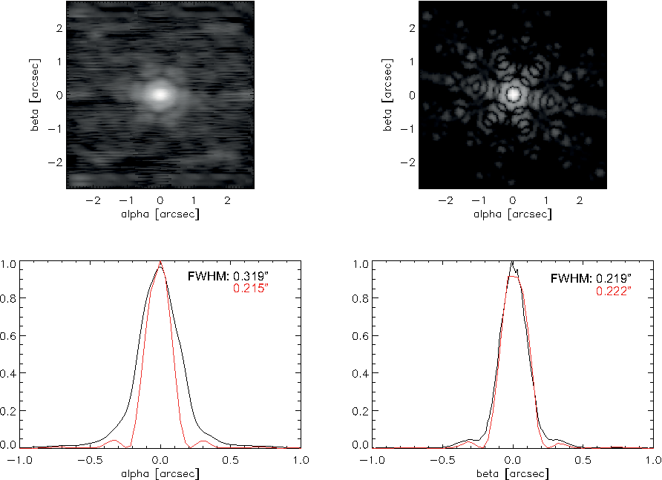
Observing with the MRS - PSF
Along-slice direction (α), the PSF is
diffraction limited for λ > 8 μm
Across-slice direction (β) diffraction
limited except for subband1C
IFU – Reconstruction 5.8 μm
Model
Notes:
Glauser+15

Slide 13
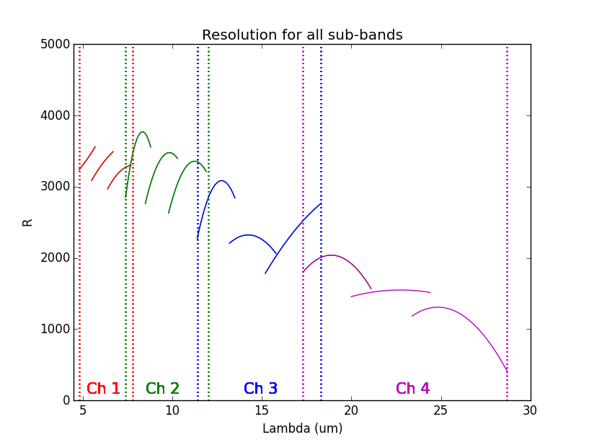
Observing with the MRS – Resolving power
R_{avg}~3500 Ch. 1
R_{avg}~3000 Ch. 2
R_{avg}~2600 Ch. 3
R_{avg}~1600 Ch. 4
Notes:
Labiano+16

Slide 14
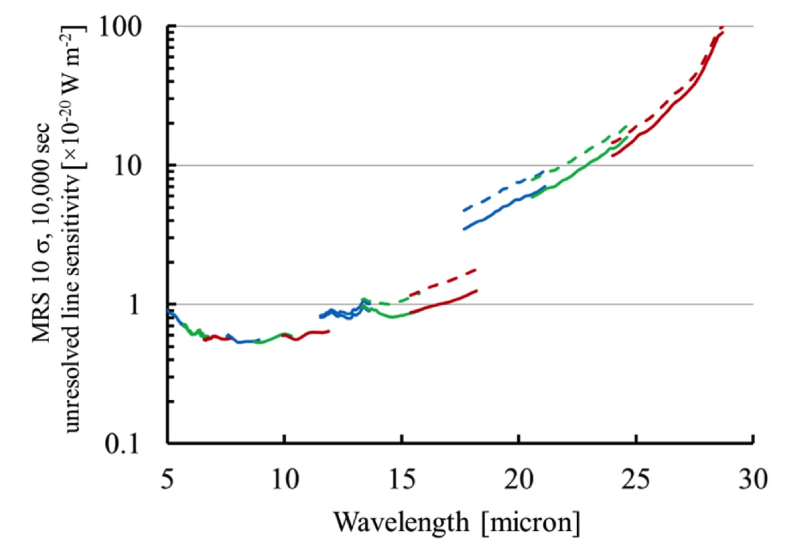
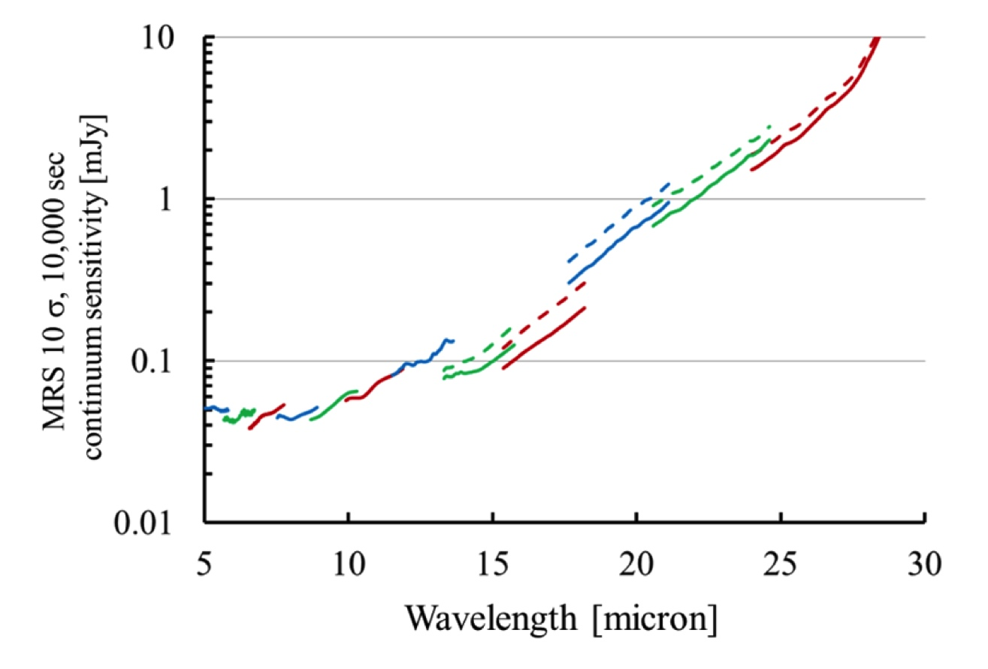
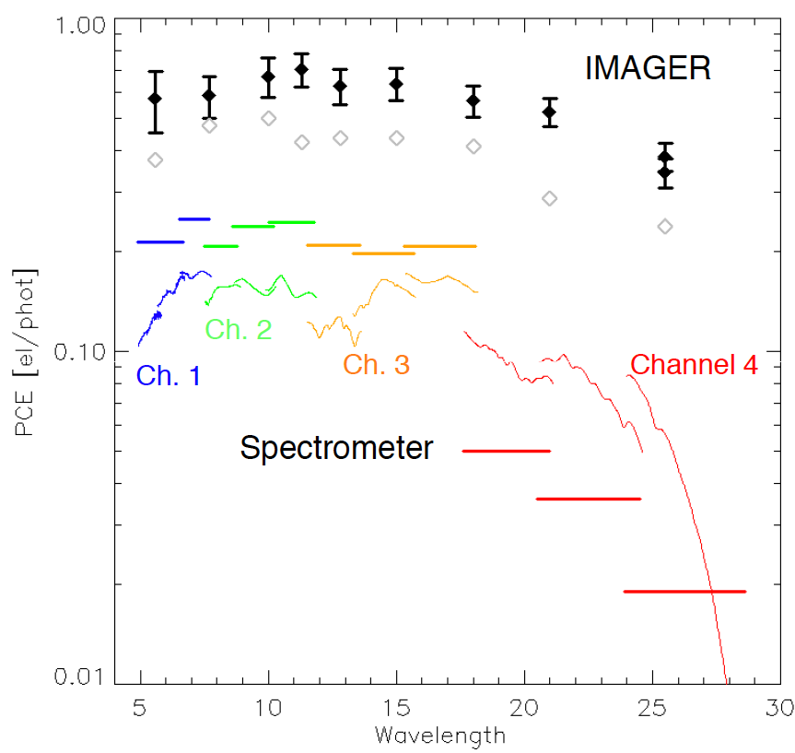
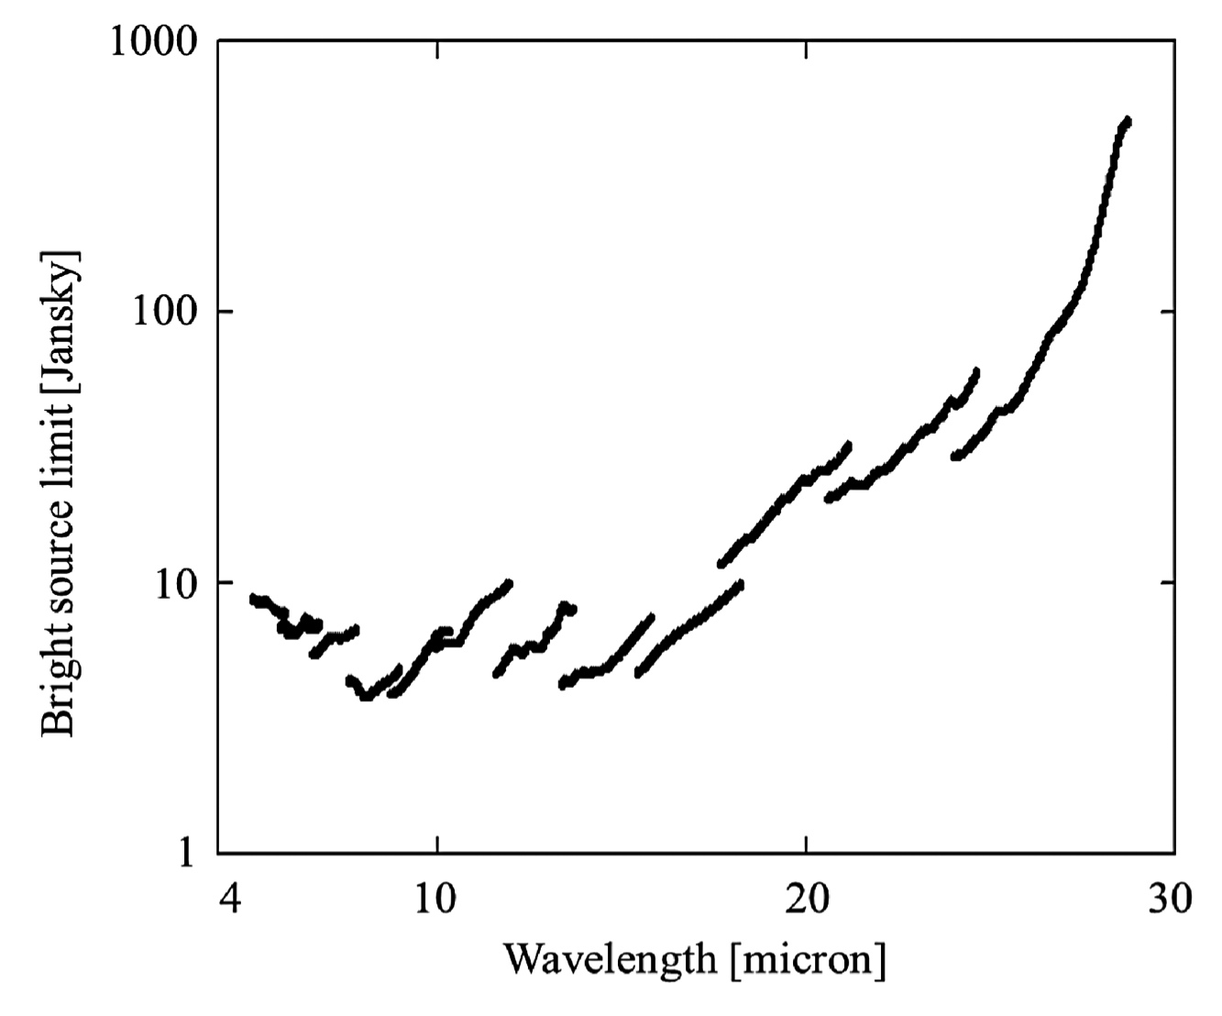
Observing with the MRS – Sensitivity
Currently updating it!
Notes:
George & Alistair reviewing sensitivities

Slide 15
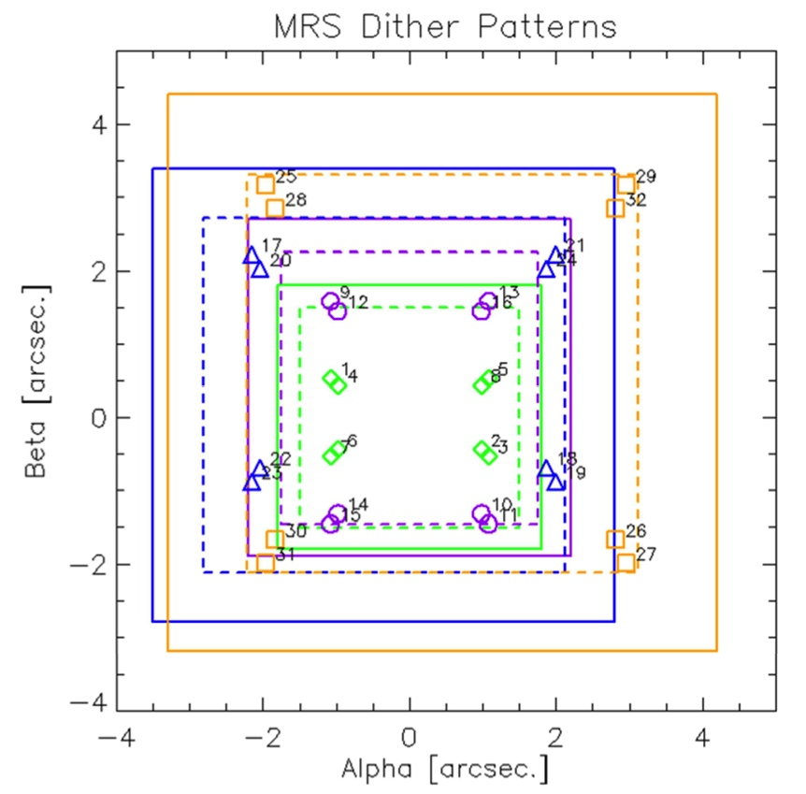
Observing with the MRS – Dithers
Patterns available to optimize each channel (ch1 = all), and in “extended source pattern”: minimum offsets to achieve ideal sampling (instead of α,β based).
2-pt dither pattern: “large” offset, designed to achieve 1/2 integer sampling. For reasonable sampling in all channels.
4-pt dither pattern: includes additional “short” offsets to mitigate some sampling issues due to optical distortions. For best sampling in all bands.
Notes:
Glasse&Glauser 15
Ops Doc

Slide 16
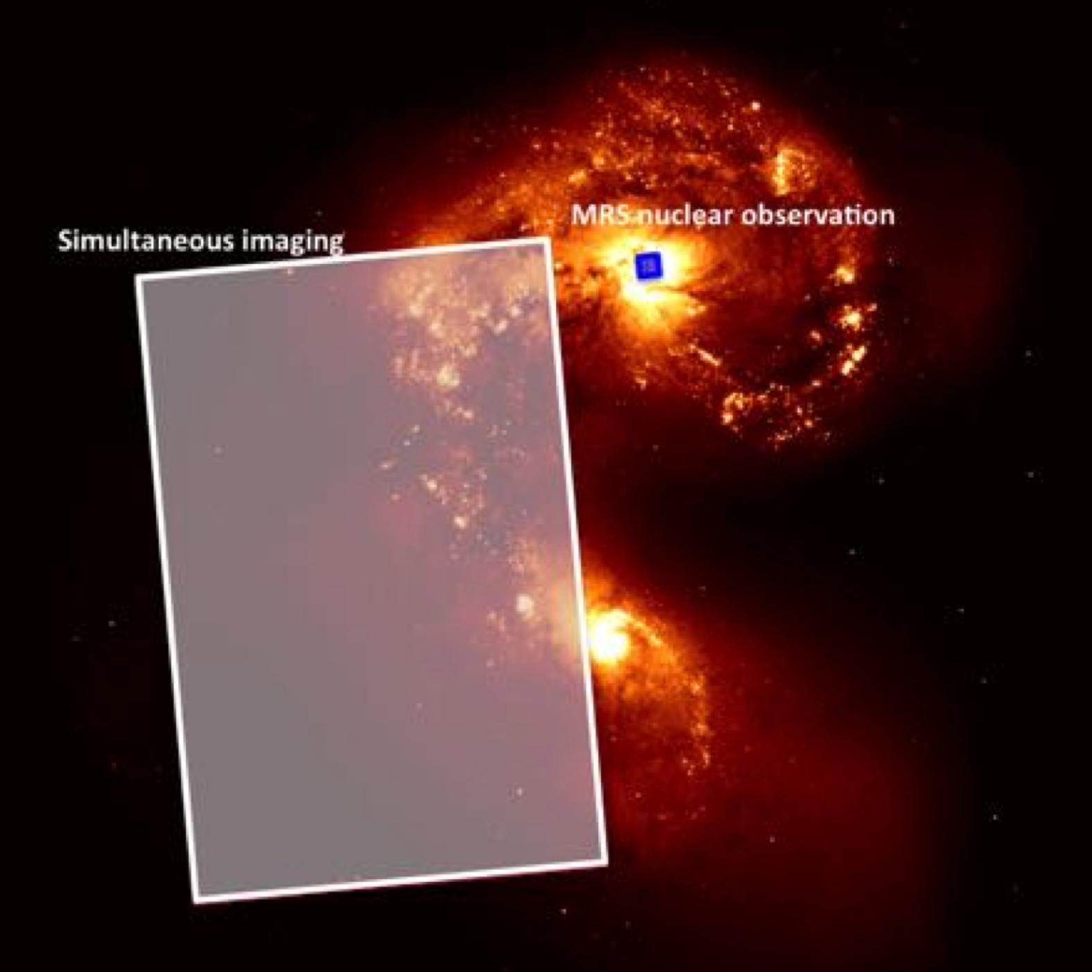
MRS-Imager Simultaneous Observations (SIMO)
[≠ parallel]
Imager has better PSF and larger FoV -> We can refine the MRS astrometry!
Very useful for dithers, mosaics, and deep observations:
Combine cubes of faint or undetected sources from different visits
Mosaics of diffuse emission
Serendipitous discovery of asteroids.
Extra data for only 30 seconds per filter!
Image: STScI
Notes:
Are overheads TBC?
More details on Macarena and Alistair talks

Slide 17
Final thoughts
First IFS for mid-IR in space.
Extremely well characterized instrument.
MRS will meet all of its (your!) scientific objectives as part of JWST.
PASP+SPIE papers, and ask us!
Notes:
(all effects and distortions are corrected to a <5% level)
Mostly diffraction limited
Improving calibrations (even more)

