Slide 1


JWST IFS
Summary Talk
Luis Colina & Santiago Arribas
(Centro de Astrobiología, CAB, Madrid)

Slide 2
JWST IFUs SUMMARY. OUTLINE
SCIENCE CAPABILITES (in an extragalactic context)
  Angular resolution
  Spectral coverage
  Sensitivity
OBSERVING STRATEGIES. COMMONALITIES & DIFFERENCES
  Pointing and target acquisition
  Spectral coverage
  Sampling / Background
  Dithering / Nodding

Slide 3
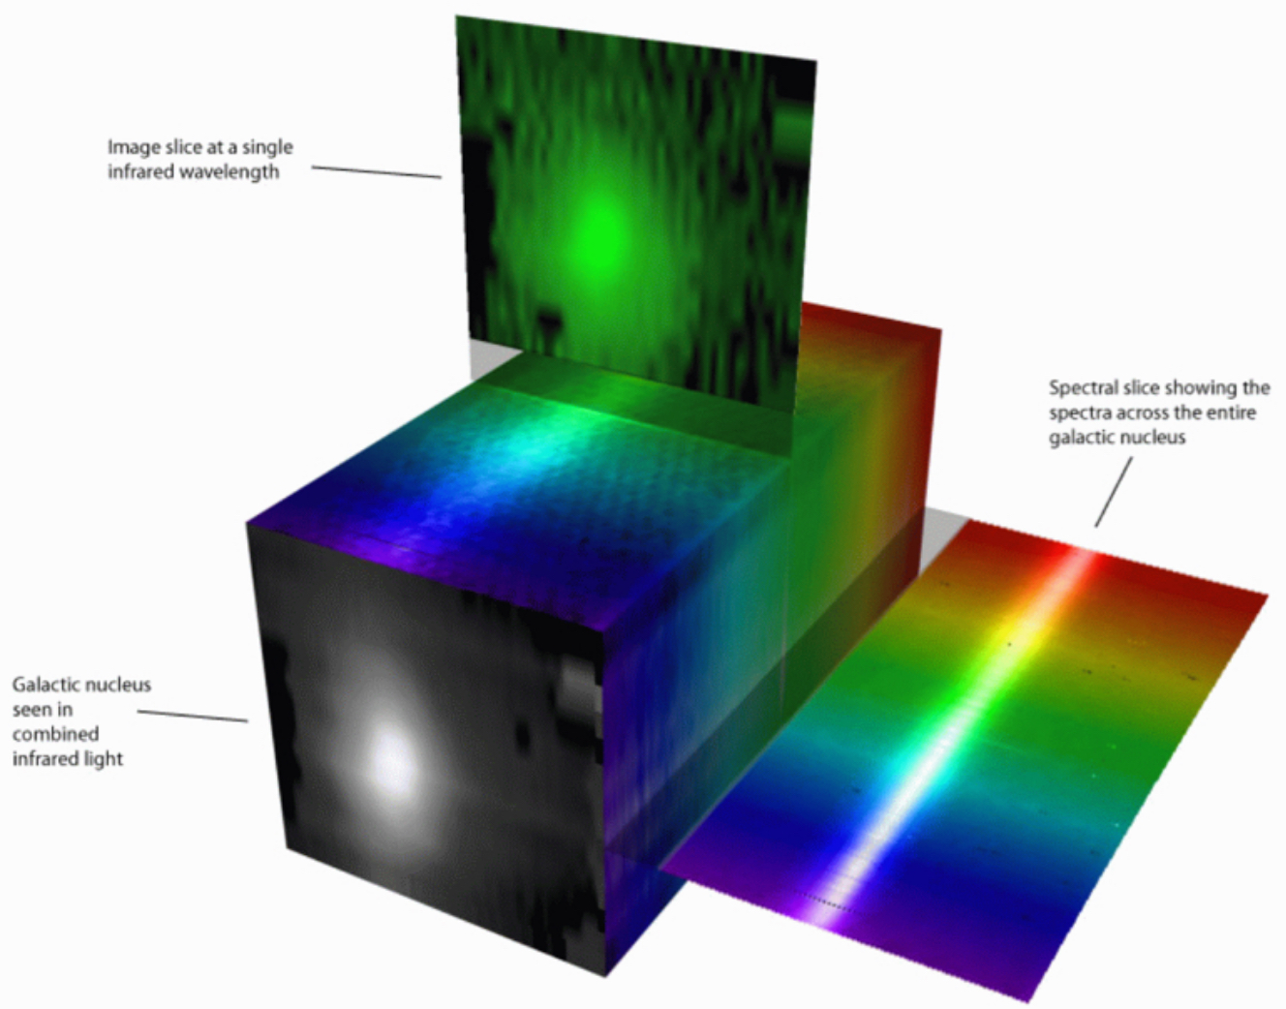
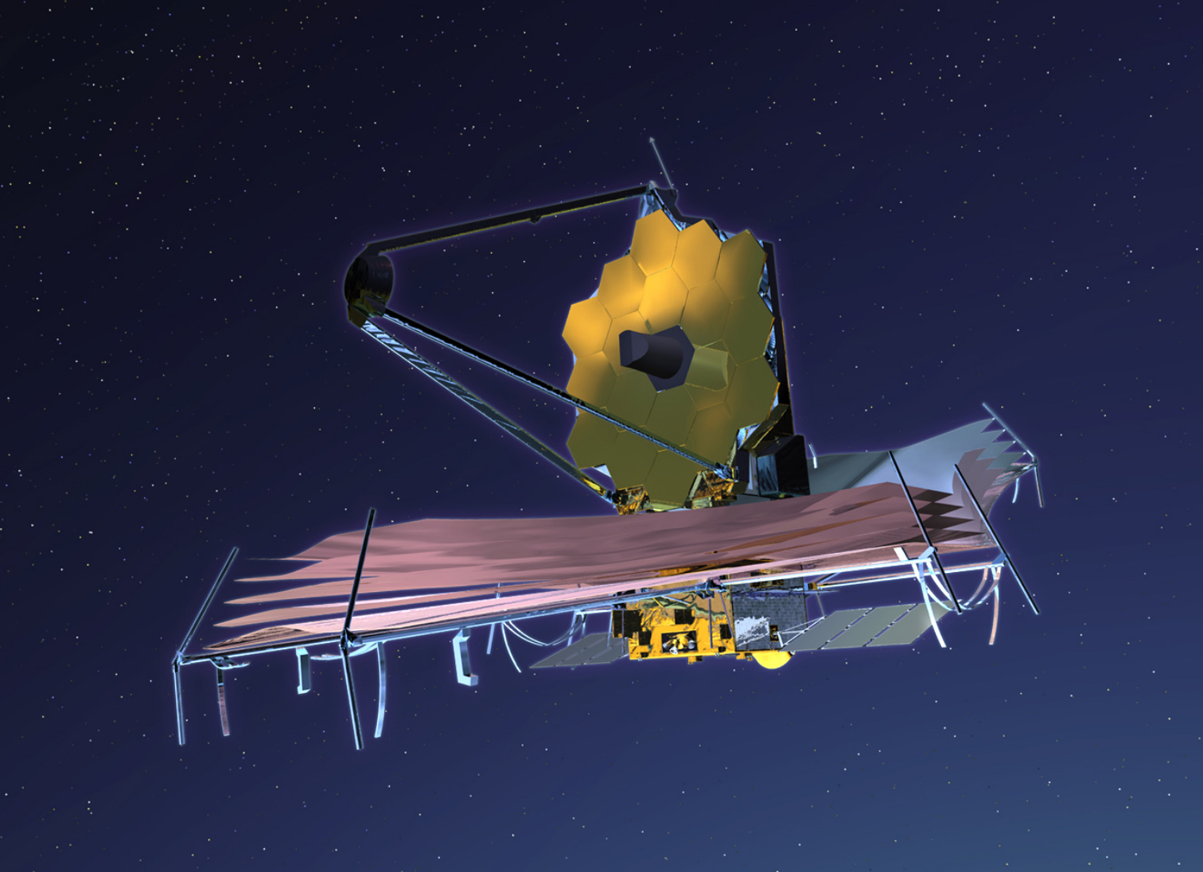
JWST IFUs: SCIENCE CAPABILITIES
First IFUs in space at near- and mid-infrared wavelengths
Inherent potential of IFS + JWST capabilities:
  IFS at high sensitivity ( orders of magnitude improvement)
  IFS at high angular resolutions ( ~ 0.1”-0.6”)
  IFS over a continuous spectral coverage (0.6 – 28.8 microns)
  IFS with a very stable and well behaved PSF
  This at
  .
+
 | NIRSpec | MIRI
R | 3000 (+1000, 100) | 3000

Slide 4
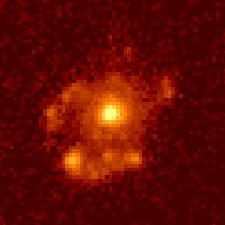
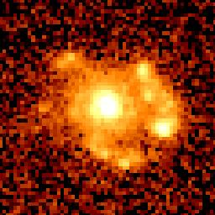
SCIENCE CAPABILITIES:
PHYSICAL COVERAGE AND RESOLUTION
 | NIRSpec | MIRI
FoV | 3” x 3” | 4” x 4” – 8” x 8”
Sampling | 0.1” | 0.2” – 0.6”
NGC 7469
SEYFERT 1 + STARBURST
NGC 7469
NGC 7469
Nearby galaxies (e.g. NGC7469 @ z= 0.016)
  The FoV covers regions of 1-2 kpc
  mapped on < 100pc scales
  not ideal for large scale mosaics
High-z galaxies (e.g. CR7 @ z=6.6)
  The FoV covers regions of 5-15 kpc
  mapped on ~kpc scales
  entire galaxy in one pointing
1 kpc
CR7

Slide 5
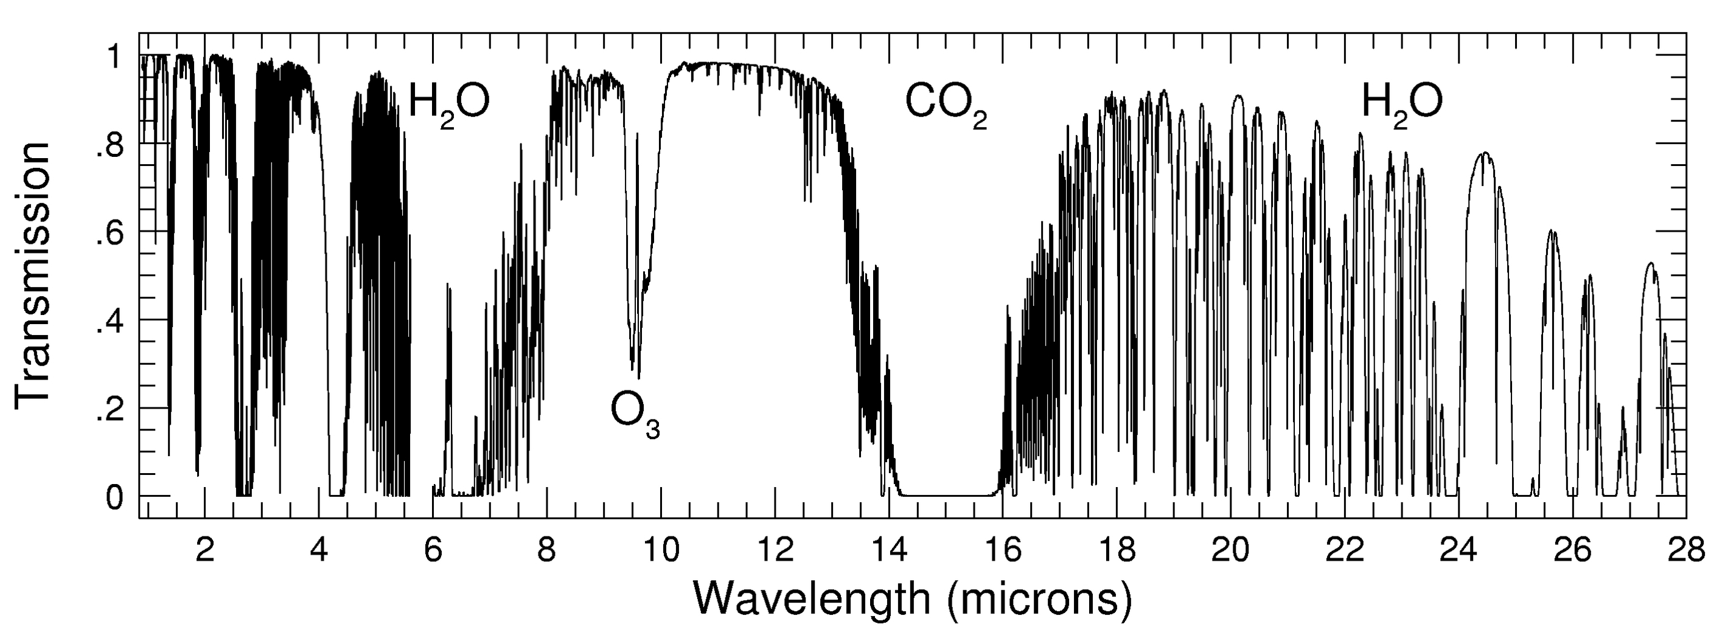
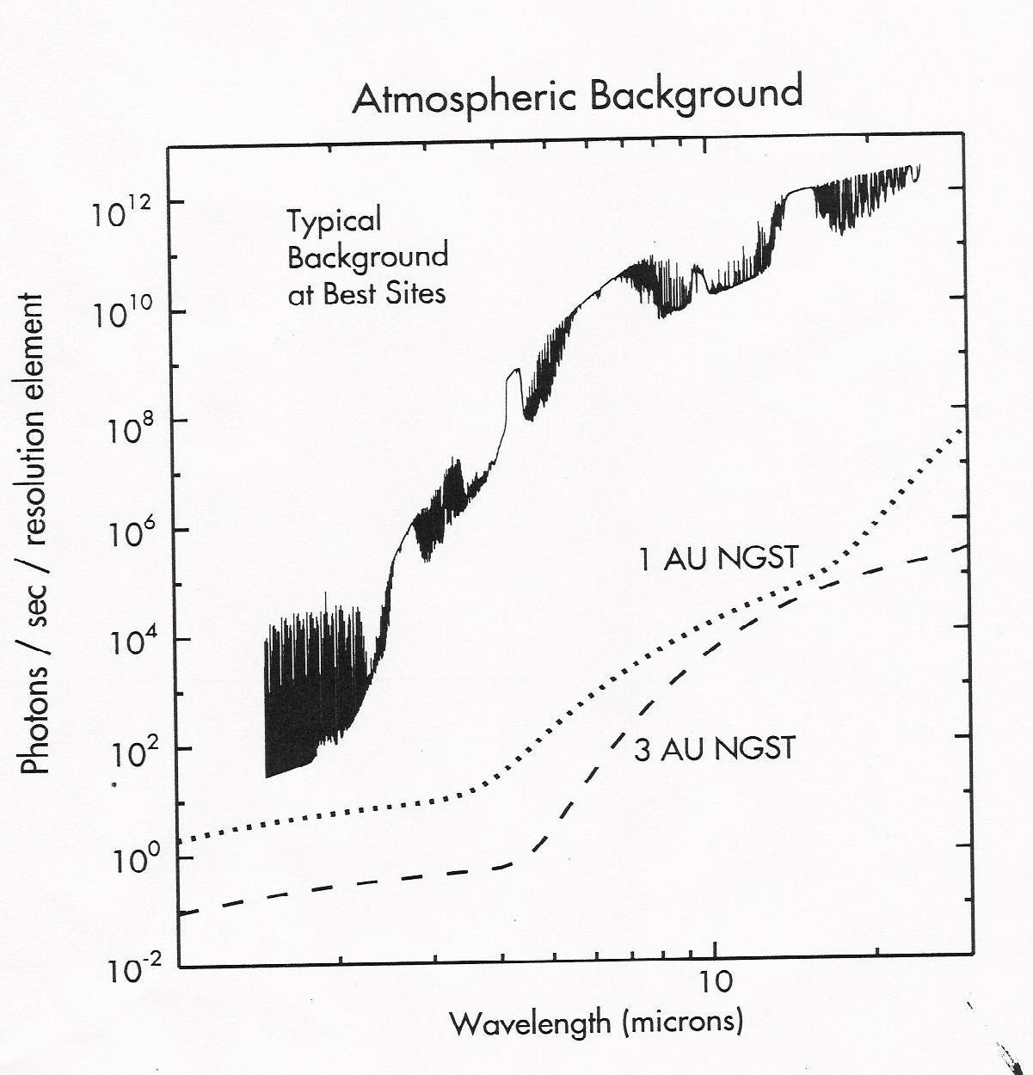
SCIENCE CAPABILITIES. SPECTRAL COVERAGE
Continuous spectral coverage 0.6 – 28 microns
  Clean from atmospheric absorption and emission
 | NIRSpec | MIRI
Range (μm) | 0.6 to 5.2 | 4.9 to 28.8
…and the Near- and Mid- infrared
Is full of diagnostic lines….

Slide 6
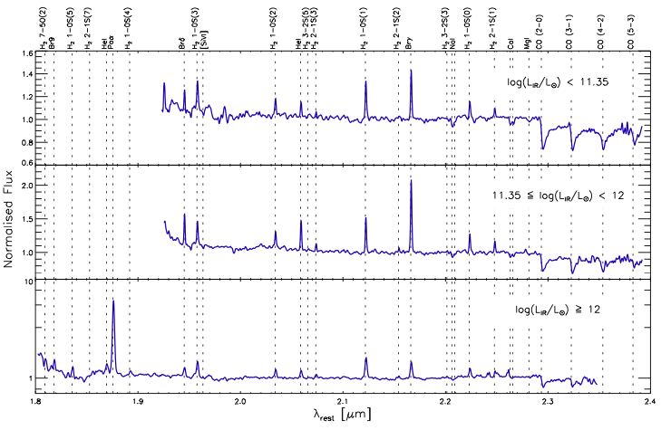
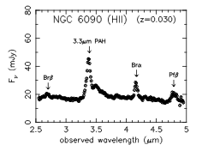
SPECTRAL COVERAGE. NEAR-IR RANGE
Coronal ISM: [SiVI], [CaVIII]
Ionized ISM: Pa & Br H lines
Hot molecular ISM: H₂ lines
Shocked ISM: [FeII] lines
Star formation: PAH 3.3μm
Stellar pop.: CO bands
SINFONI U/LIRGs survey, Piqueras-López et al. 2012
Imanishi et al. 2010

Slide 7
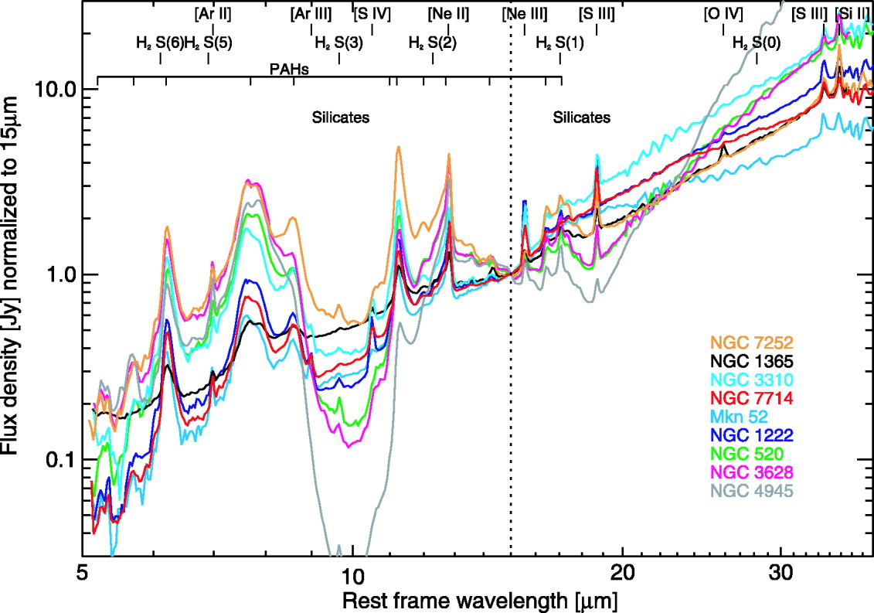
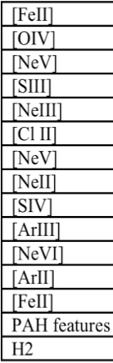
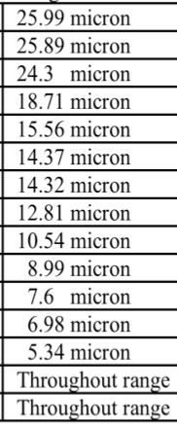
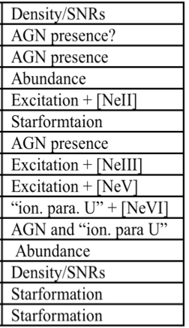
SPECTRAL COVERAGE. MID-IR RANGE
Line
λ
Diagnostic
Brandl et al. 2006

Slide 8
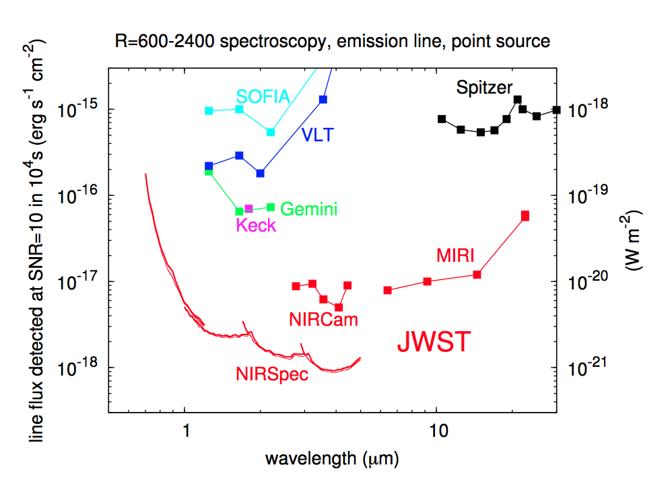
SCIENCE CAPABILITIES. SENSITIVITY
High sensitivity (point source, 10sigma, 10 ksec):
  x100 more sensitive than previous instruments @ similar wavelengths
  NIRSpec (>1μm): Lines ~ 8.E-19 to 5.E-18 erg/s/cm⁻² / cont.(R=100): 0.1-0.4 μJy
  MIRI: Lines: ~8.E-18 to 6.E-17 erg/s/cm⁻² continuum: 0.04 - 10 mJy
Disclaimer:
Refer to STScI ETC for
Updated sensitivities

Slide 9
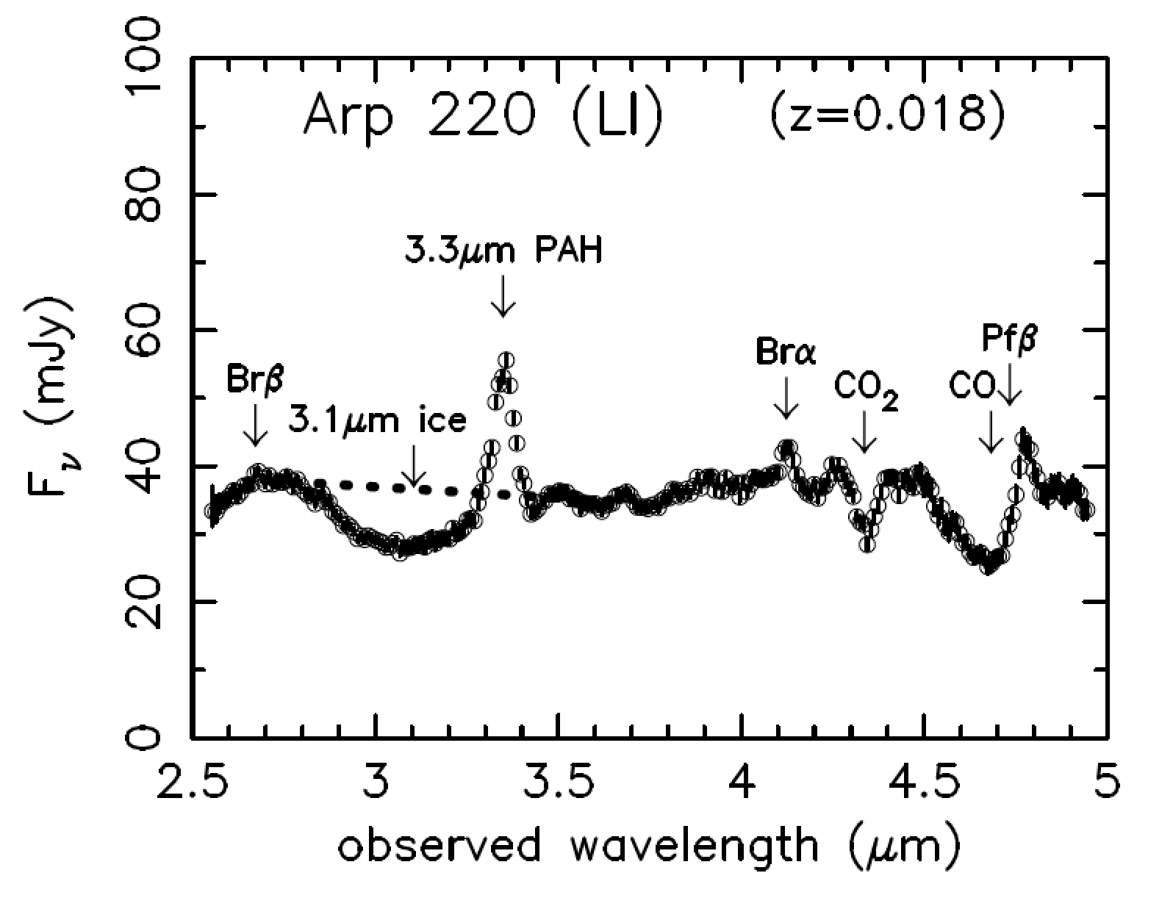
SCIENCE CAPABILITIES. EXPOSURE TIMES
Low-z AGNs and SF galaxies
NIRSpec (e.g. Arp 220)
  Emission lines fluxes in the nuclear region
    Brγ, H2, Paγ, ~ 1. E-15 erg/s/cm² /arcsec²
    Brα (43.E-15) , Brβ (25.E-15)
  Continuum ~ 2-5 mJy/arcsec² at 2μm
  In 15 minutes of integration time (R2700):
    Lines: S/N ~ 10-60 (per spaxel)
    Cont: S/N ~ 4-10 (per spaxel, per sp. pixel)
MIRI (e.g. The Antennae)
  Emission lines fluxes ~1E-13 to ~1E-14 erg/s/cm²
  Σ_{line} ~1E-13 to ~1E-15 erg/s/cm²/arcsec²
  Continuum ~ 1 mJy – 100 mJy/arcsec²
  In 15 minutes of integration:
    Lines & cont: S/N > 10 per sp. pixel (0.2”-0.3”)
Disclaimer:
Refer to STScI ETC for
Updated sensitivities

Slide 10
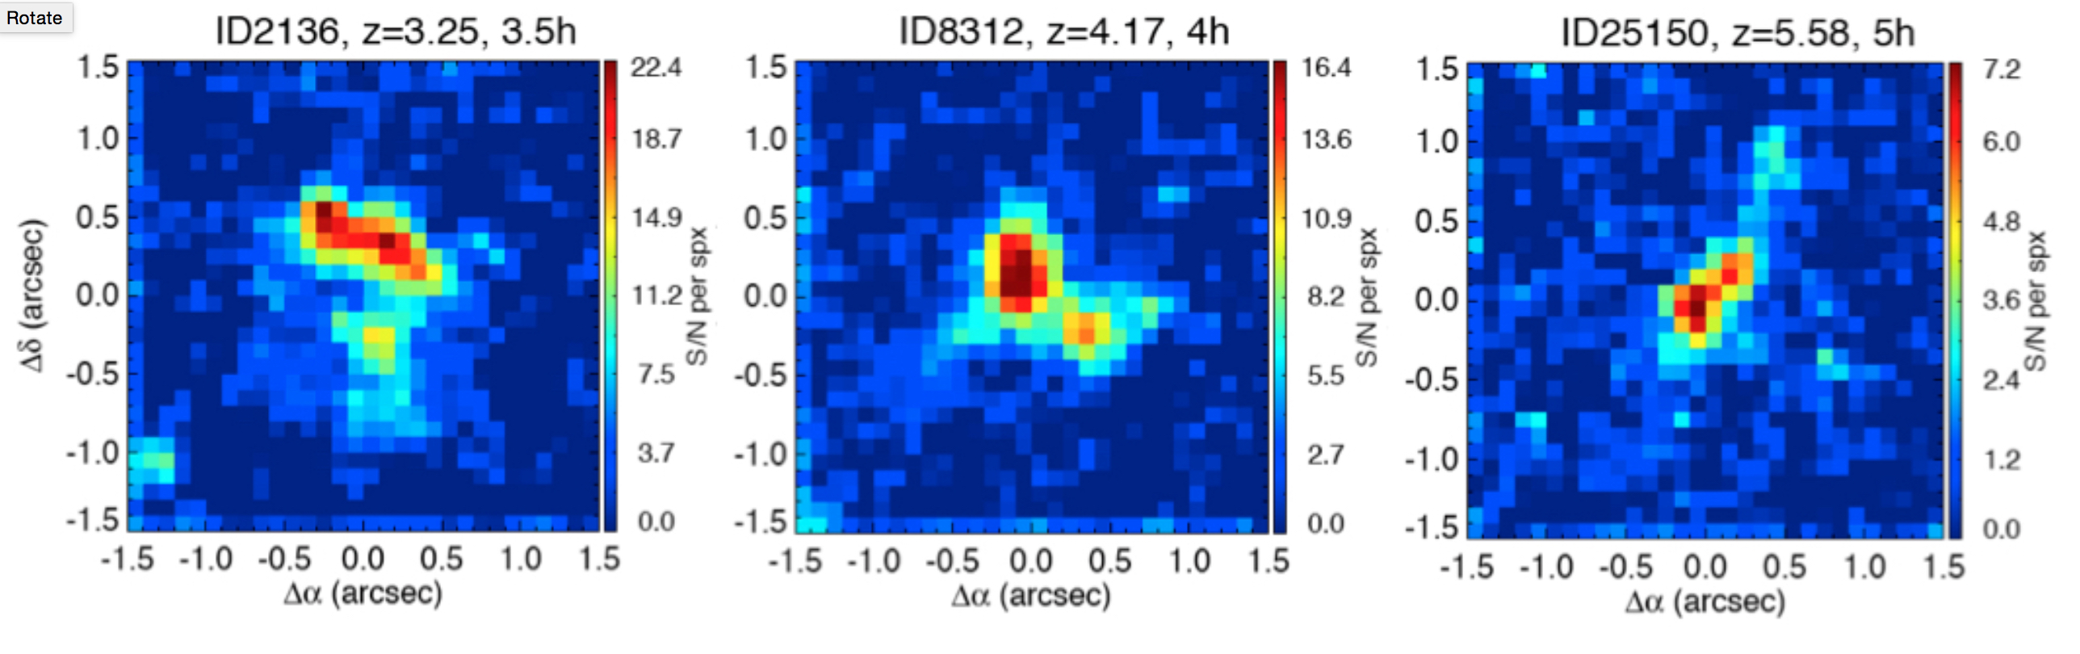
SCIENCE CAPABILITIES. EXPOSURE TIMES
High-z Galaxies
MIRI – Dusty SF Galaxies
  Near-IR emission lines @ z~2-5
  Typical times: ~1-few hours
  for Paα with S/N above 10
NIRSpec
  SFGs @ z=3 – 6
  Optical lines & Halpha maps with t= 3-5 h
  .

Slide 11
OBSERVING WITH JWST
For a given instrument, activities are event-driven
Spectral Coverage / R
Sampling / dithering
Background

Slide 12
OBSERVING STRATEGIES. MIRI + NIRSPEC IFS
JWST very powerful and sensitive …
… exposure times likely short…
… therefore manouvering and mechanisms overheads can be significant
(for weak high-z targets less significant due to the longer exposures)
Observer should identify an observational strategy to optimize the efficiency of the proposal, i.e. increase the fraction of clock time that goes into on-target exposure time.
In practical terms:
Pointing and target acquisition
Spectral Coverage
Spatial sampling / dithering
Background
… some of this depends on instrument

Slide 13
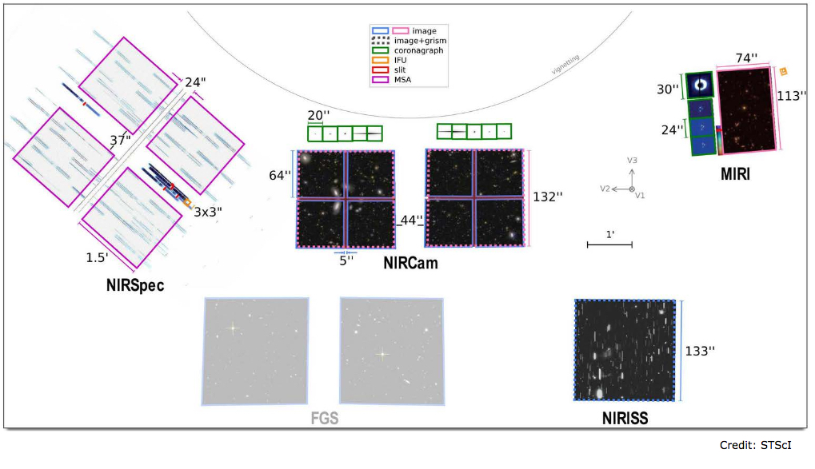
POINTING & TARGET ACQUISITION
MIRI IFU
MIRI & NIRSPEC IFUs separated by about 13.5 arcmin in the JWST plane
Guide star will not be the same for MIRI and NIRSpec
Relative orientation of NIRSpec and MIRI on sky is different
NIRSPEC IFU

Slide 14
POINTING & TARGET ACQUISITION. OVERHEADS
Point and Shoot strategy : possible but pointing accuracy ~ 0.3 – 0.4”
A better accuracy generally needed, then Target Acquisition (TA) required
In a coordinated proposal (one visit): 1 slew + 2 GS+TAs are required
Overheads:
  One large telescope slew: 1800 sec
  2 GS acquisition: 2 x 240 sec
  2 x TA: 2 x 600 sec
  One slew between instruments (13’): ~150 sec
  all this: ~ 1.2h
In a non-coordinated mode (2 visits, dif. epoch to keep orientation): 2 slews
Overheads: coordinated proposal + 32 minutes in addition

Slide 15
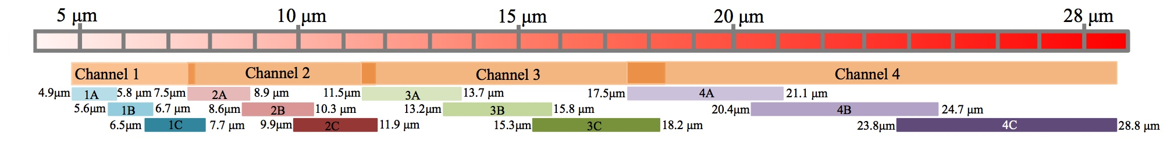
SPECTRAL COVERAGE & RESOLUTION
NIRSpec 0.7 to 5 μm in four contiguous spectral settings (R~1000-3000)
R= 100
R=1000
or
R= 2700
MIRI 5 to 28.8 μm in three settings with four non-contiguous spectral ranges
JWST/MIRI – spectral configurations
R (x10³)= 3.1-3.7 2.9-3.3 1.8-2.9 1.3-1.9
λ (μm)= 4.9-7.8 7.5-11.9 11.5-18.2 17.5-28.8

Slide 16
SPECTRAL COVERAGE & RESOLUTION. STRATEGIES
Need to think about location of specific high-priority spectral features,
carefully selecting the specific settings needed for your science
Note that full 0.7 to 28.8 microns coverage @ R~2-3x10³, is doable but…
… in seven spectral settings
    Overheads involved in moving spectral settings:
    MIRI: 60 seconds / setting
    NIRSpec: 120 seconds / setting
    Overheads: ~13 minutes for full spectral coverage with intermediate R.
    not negligible for nearby bright extended targets
    Note that there is no option of R~100 to get full 0.6 to 28.8 microns IFS
      Covers the 0.6-5.3 microns with NIRSpec
      Covers the 5-12 microns with MIRI but only long-slit (0.5 x 5 arcsec)

Slide 17
DITHERING/NODDING
Main reasons for dithering/nodding:
  Good PSF sampling for NIRSPec and MIRI IFS
  Detector cosmetic/defects/characteristics (minimize)
  Accurate background measurements
  Others: Enlarge FoV
  Relative importance (in general):
MODE | IR_BACKGR. ZODIACAL | IR_BACKGR. THERMAL | IR_BACKGR. INSTR. | PSF SAMPLING | DETECTOR COSMETIC
MIRI-CH1 | ++ | − | − | ++ | +
MIRI-CH2 | ++ | + | − | ++ | +
MIRI-CH3 | + | ++ | − | + | +
MIRI-CH4 | + | ++ | − | + | +
NIRSPEC | +− | − | +− | ++ | +
++ Dominant / + Relevant / +− Subject to science case / − Non relevant

Slide 18
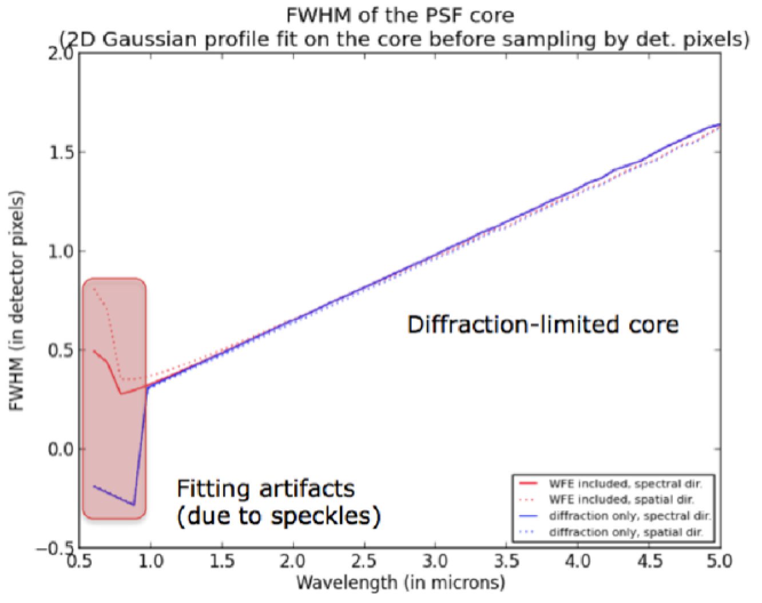
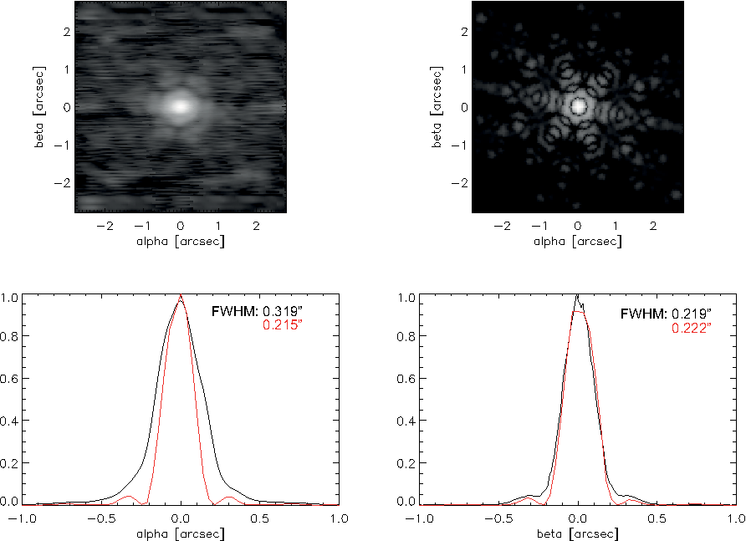
PSF SAMPLING/DITHERING
MIRI and NIRSpec PSF mostly undersampled
MIRI IFU - Reconstruction
Model
NIRSpec
MRS PSF 5.8μm
MIRI Channel | Along Slice FWHM_{PSF}/pix | Accross Slice FWHM_{PSF}/pix
1 | 1.53 | 1.04-1.65
2 | 1.53-2.27 | 1.01-1.61
3 | 1.76-2.80 | 1.11-1.77
4 | 2.41-3.96 | 1.02-1.68
P. Ferruit
NIRSpec PSF undersampled over the entire spectral range

Slide 19
JWST BACKGROUND
Earth/HST versus JWST: from 220-300 K to ~40-50 K environment
  Background reduced by factors 10⁵-10⁶ at lambda > 3 μm
Main sources of background:
(see M. García-Marín presentation)
  SKY: zodiacal + galactic (MIRI, NIRSPec)
  TELESCOPE: thermal (MIRI)
  INSTRUMENT:MSA-imprint
  (NIRSpec)

Slide 20
JWST BACKGROUND. SKY
MIRI. Zodiacal light dominates the background for MIRI at λ < 12 μm
NIRSPec. Importance depends on science case. Things to consider:
  Resolution: At R~1000-3000 dominated by the detector noise.
  At R~100 more relevant (esp. for lambda < 2 μm)
  Emission lines or continuum?
  If emission lines, not so relevant
  Size of the target (wrt FoV)
  MSA-imprint (details later)
JWST Background
10⁶
OTA
10⁵
Sunshield
[photon s⁻¹ μm⁻¹ arcsec⁻²]
10⁴
Zodiacal Dust
10³
5
10
15
20
25
Wavelength [micron]
http://www.roe.ac.uk/ukatc/consortium/miri/index.html

Slide 21
JWST BACKGROUND. TELESCOPE
MIRI specific.
Stable during typical exposure times
Important at λ > 10 μm. Dominant at λ > 15 μm
Strategy. Depends mainly on source´s size
Size of the source small wrt FoV:
Nodding on source, i.e. within the FoV
2) Size of source large wrt FoV:
Nodding off-source, i.e. background
JWST Background
10⁶
OTA
10⁵
Sunshield
[photon s⁻¹ μm⁻¹ arcsec⁻²]
10⁴
Zodiacal Dust
10³
5
10
15
20
25
Wavelength [micron]
http://www.roe.ac.uk/ukatc/consortium/miri/index.html

Slide 22
JWST BACKGROUND. INSTRUMENT
MSA-imprint. NIRSpec specific (see Nora Lützgendorf presentation)
MSA-imprint: As NIRSpec IFU share detector with the MOS, the light leaking through the MSA and failed open shutters implies additional sources of background due to:
  uniform diffuse zodiacal + galactic light
  celestial sources landing in failed open micro-shutters
  own target if extended by more than 10 arcsec
  Strategy: Dependent on science case. Options for calibration:
  -- Dedicated exposure (i.e. IFU closed and repeat dither pattern)
  -- model for the background
  -- Hybrid
    Effect more relevant if interest in the continuum , R~100
    Less relevant if only emission lines are important & R= 1-2.7 x 10³

Slide 23
DITHERING/NODDING
Dithering/nodding for PSF and cosmetic
  NIRSpec: Some predefined dither patterns, but the user may also define patterns
  MIRI: Fixed patterns (optimized as a function of the spectral range of interest) with two- and four-point dithering
Dithering/nodding for background measurements
  NIRSpec & MIRI: at least one pointing away from target by >> 3 arcsec, if extended
Keep in mind
  Dithering involves many small angle manouvers (SAM)
  Time dedicated to SAMs can be relevant for short on-target exposures:
SAM < 3 arcsec: ~25 seconds
SAM > 3 arcsec: ~65 seconds
THINK ABOUT HOW TO OPTIMIZE THE SIZE AND NUMBER OF DITHERS ACCORDING TO YOUR SCIENCE CASE

Slide 24
SUMMARY
JWST NIRSpec and MIRI IFS (coordinated) programs extremely powerful. Open a qualitative new window into studies of extended sources because its unique combination of feaures:
  Increased sensitivity by factors 100 wrt previous instruments
  Wide spectral coverage from the optical (0.6μm) to the mid-IR (28μm)
  Stable sub-arcsec angular resolution over the entire spectral range
  Similar intermediate (R~2000-3000) spectral resolution over spectral range
  … typical on-target times will be short, minutes to a few hours (for faint cosmological sources), and consequently overhead time can be not negligible.
  … Therefore we should think our science and observational strategy carefully, keeping in mind the efficiency of our individual programs, and the overall productivity and science return of JWST.

