Slide 1
The JWST Exposure Time Calculator
Diane Karakla
for K. Gilbert and the
ETC Working Group at STScI:
Leads : Swara Ravindranath, Vicki Laidler
With the help of many others
ESAC 2016 JWST Workshop, Madrid
28 September, 2016
(based on a demo presentation by Vicki Laidler)

Slide 2
Overview
Key Concepts/Features
Quick tour of the JWST ETC User Interface
JWST ETC Demo
Note: The JWST ETC has many observing modes, and many useful features. This talk will cover only some of the features.

Slide 3
Reminder: ETC is still in Development
The ETC is still under development.
What this means to you:
Users should expect results to change. Users should not base any scientific decision on the numbers reported by the development versions.
  We welcome constructive feedback to help us improve the tool!
The development version from July 2016 is currently available and will be used for this demo. (Link shared at the end of the slides.)
All science modes are available (except NIRISS SOSS and NIRCam Coronagraphy).
Still some usability issues & gaps in the implementation of some features.

Slide 4
Caution
The current installation is underpowered.
  If there are too many users running multiple calculations simultaneously it could just hang.
Production installations will have more resources.
To avoid problems during this presentation. Please wait until the talk is finished before starting to try out the ETC.

Slide 5
Key Concepts/Features
Workbooks: Organize your ETC calculations.
  They are Persistent and shareable.
  Scenes: small postage-stamps of sky (a few arcsec square)
Reusable: Sources and scenes can be defined once, used many times.
Copy & Modify approach: Users do not have to start from scratch.
Auto-update: Changes made to the input flow through to associated forms and calculations.
The ETC calculates S/N based on source parameters, instrument and detector setup parameters. Exposure time is an intermediate product.

Slide 6
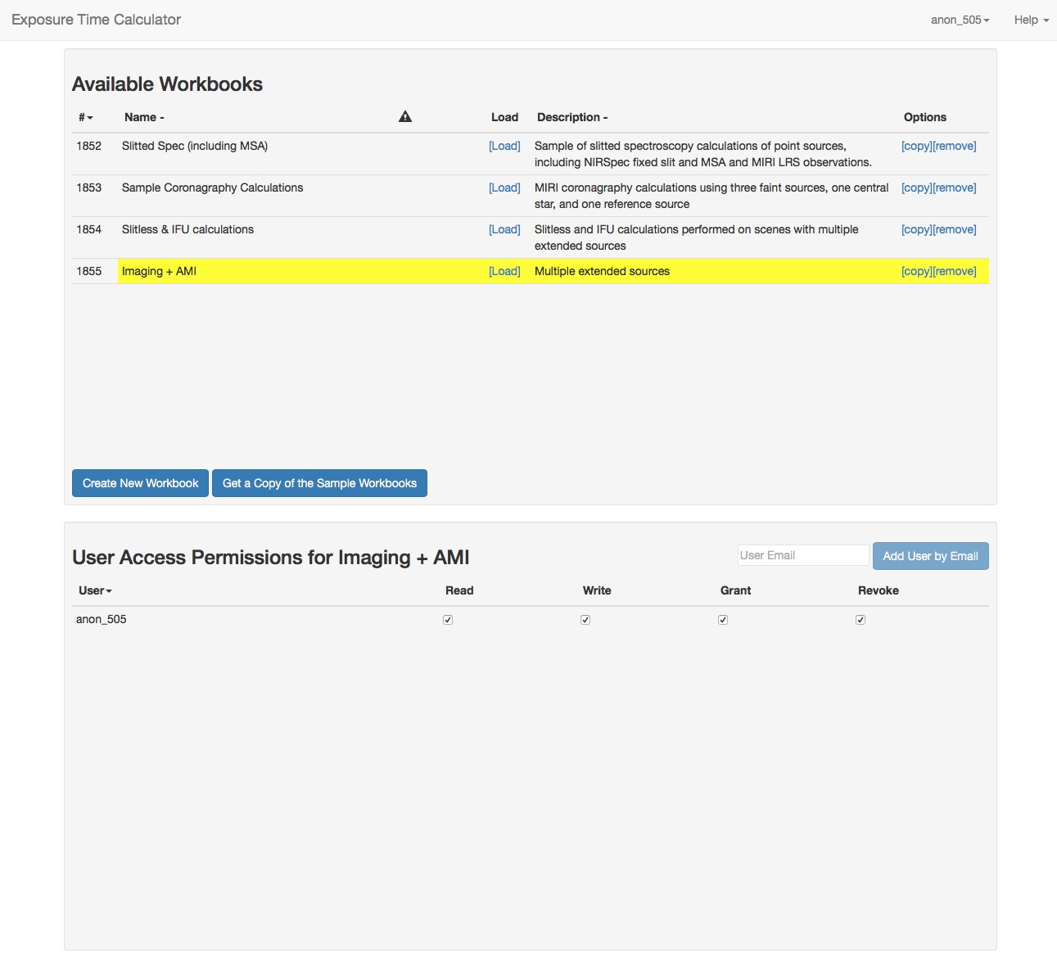
Workbook page
Note: The workbooks you create are persistent - they will be there when you login again (except for anonymous users).

Slide 7
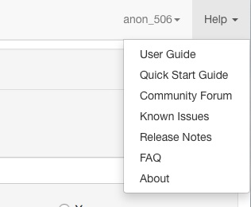
HELP menu
Feedback forum
Provide feedback on the community forum under “Help” menu
Known issues and user guides
User guides and some of the known issues are also under “Help” menu. Full complement of documentation under development.

Slide 8
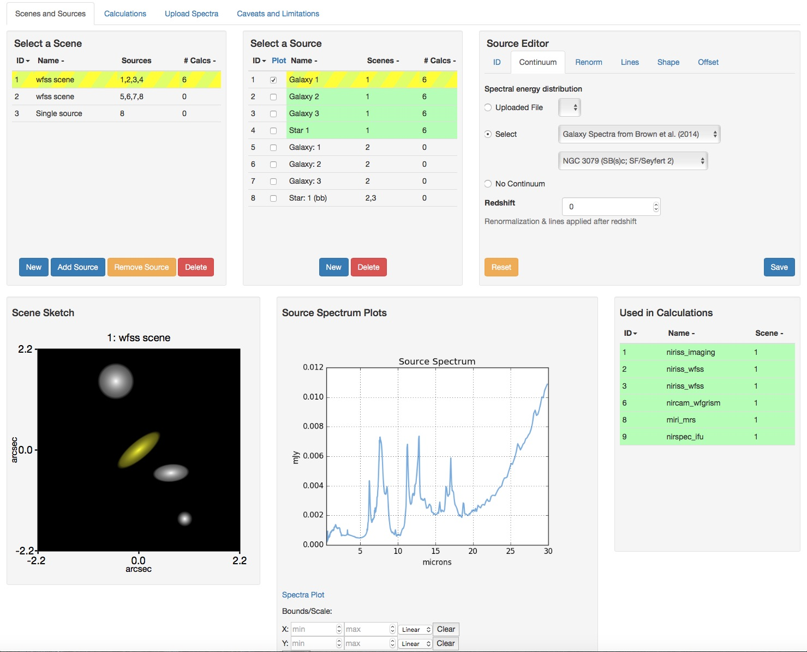
Scenes and Sources page

Slide 9
Scenes and Sources
The Scene list and Source list are interlinked
Selected item, currently active & modifiable
Items affected by selection made in another table
The Scene Sketch is linked to Scene list and Source list
Selected Scene is displayed in the Sketch
Selected source is displayed in yellow
Clicking on a Source in the Sketch selects it in the list

Slide 10
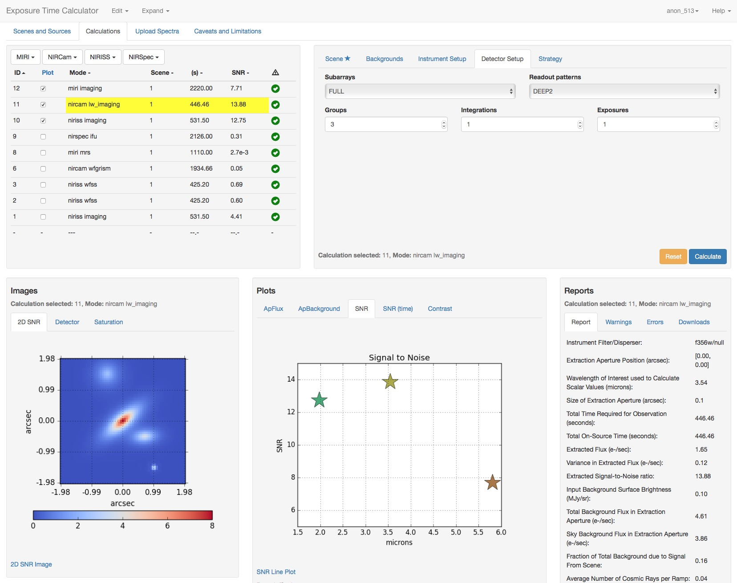
imaging
Calculations page
Outputs

Slide 11
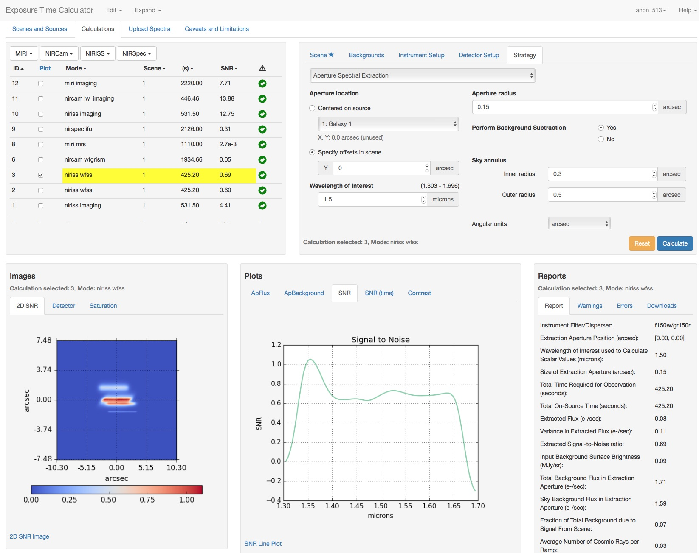
spectroscopy
Calculations page
Note: Once created, a scene is reusable; same scene can be used in multiple calculations

Slide 12
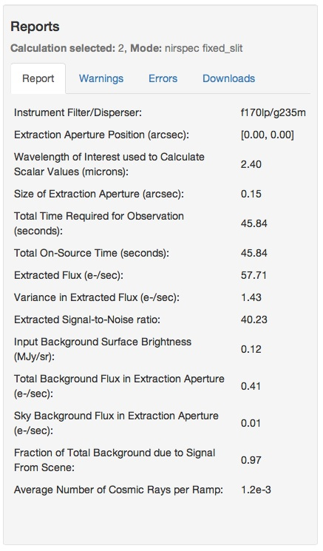
Calculation Page: Reports Pane
Report: Scalar quantities
Warnings: Information that might affect the accuracy or otherwise influence science decisions
Errors: Information about why the calculation did not complete
Downloads: tar file of intermediate & output products
- FITS files of 3D data cube for IFU
- 2D images and spectra
- extracted flux, combined backgrounds, and SNR as FITS tables.
Numerical results at wavelength specified in Strategy tab

Slide 13
HELP menu
Feedback forum
Provide feedback on the community forum under “Help” menu
Known issues and user guides
User guides and some of the known issues are also under “Help” menu. Full complement of documentation under development.

Slide 14
JWST ETC Demo
The JWST ETC can be accessed at the following URL:
devjwstetc.stsci.edu
The next release (in January) will use this same link.

Slide 15
Backup Slides

Slide 16
JWST ETC Demo Script
(for key concepts)
The JWST ETC @ URL: https://devjwstetc.stsci.edu
Create new workbook. Already has single scene with single source
Go to Calculations page
Create a simple calculation – imaging or fixed slit (for short demo)
Copy the calculation
Modify instrument setup or detector setup
Compare the results
Change magnitude of source
See the calculations auto-update
Go back to source page
Add a galaxy to scene and assign a template spectrum
Go back to calculations to see them auto-update
Create a new scene using already available sources (reusability)

Slide 17
Getting Started with the JWST ETC UI
Login
Create new workbook or select from list of sample workbooks (choose latter when using for the first time)
Load a workbook
Workbook opens on Scenes and Sources page. Default Scene and sources are already available. These may be copied and modified.
Use tab to select Calculations page. Here default calculations are available which use the default scenes and sources. These may be copied and modified for the desired instrument and detector configuration.

Slide 18
Persistent Workbooks
- A workbook can contain multiple sources, scenes, and
ETC calculations.
- Workbooks are auto-saved and available when you login
again except for anonymous users. (Updates before
cycle 1 release will erase the existing workbooks.)
Reusable Sources and Scene
- Small “postage stamp” of sky which is few arcsec on a side
- A scene can have no source (just background) or many sources.
- Can define multiple sources and multiple scenes.
- Define once, use many times.

Slide 19
Copy and Modify
- Do not have to start from scratch.
- Calculations in a fresh workbook automatically start with
reasonable defaults
- Users can simply modify inputs as desired and recalculate
Auto-update
- Changing a source or scene automatically updates all affected
calculations

Slide 20
Scenes and Sources
Checkbox selects the spectrum to be plotted
Multiple checkboxes can be selected to compare spectra.
Plot also has a drop down menu to simultaneously plot all the sources or none
- Selecting a row automatically checks its checkbox
- Deselecting the rows unchecks the checkbox except
for the boxes that were checked explicitly
Calculations affected by the selected source or scene are also highlighted in the Calculations list under Calculations tab
Step through the Configuration pane tabs to change the properties of sources (ID, names, continuum, normalization, spectral lines, shapes) and scenes (offsets or placement of the source, and orientation)

Slide 21
Calculation Page
Calculation table:
- Selected row is presently active and modifiable
- Checkbox only controls the plots
Configuration pane:
- Specify the inputs
• choose the scene to use with the calculation
• choose the background (level or for specified position+date)
• Instrument setup: choose filter, disperser, slit, etc
• Detector setup: settings here define the exposure time
• Strategy: set photometric extraction parameters for SNR estimation (for imaging and spectroscopy modes;
more complex strategies for more complicated modes
eg; coronagraphy)

Slide 22
Other features
Users can upload template spectrum file in Ascii 2-column format (microns, mJy)
or as FITS files compatible with pysynphot
Use the options under the Edit menu to (1) copy or delete a calculation,
(2) copy a source or scene
Use Expand to run a batch of multiple calculations by varying only a single parameter
- eg., choose filter or time expansion
- calculation is duplicated N times varying only the selected parameter
- expansion over time parameter offers a way to do the reverse calculation to
find the exposure time required to achieve a desired SNR
Workbook sharing is enabled and coordination is strongly recommended.
- select a workbook from the workbook list page and assign user access permissions
- Read: the assigned collaborator can see but not modify
- Write: the assigned collaborator can see & modify

