Slide 1
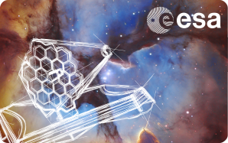
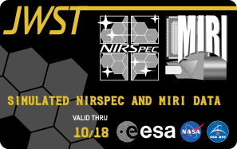
NIRSpec simulation data-package
Giovanna Giardino, Pierre Ferruit, Jacopo Chevallard, Camilla Pacifici
ESAC JWST Workshop

Slide 2
NIRSpec simulations
Ingredients of the simulation
Simulation procedure
Outline of the data package
MOS simulation & IFS simulation

Slide 3
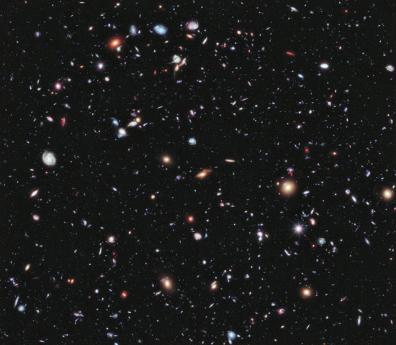
Ingredients for the Sky: sources
MOS simulation - DEEP FIELD
HUBBLE eXDF
(Catalogue Bouwens et al. 2014)
~ 700 objects
WFC3 Field 2.3'x2.0’ - MOS FOV is 3.4’ x 3.6’
Bouwens Catalogue tiled 2x2
~ 2800 objects
Photometry (10 bands - Δλ= 0.4 – 1.6 μm)
BEAGLE
Chevallard & Charlot 2016, MNRAS, 462
BayEsian Analysis of GaLaxy sEds
Mock spectra: z = 4 - 8
Notes:
BEAGLE: This tool incorporates the consistent modeling of stellar radiation and its transfer through the interstellar and intergalactic media, allowing one to derive “phyiscally” plausible galaxy spectra from photomotric and spectral data, in a Bayesian framework.

Slide 4
Ingredients for the Sky: background
Zodiacal light (0.5-5.5 μm):
Blue-part: reddened spectrum
of a solar analogue (Phoenix code)
Red-part: Black-Body T=256.15 K
Parasitic light (open telescope!):
“Galactic sky” straylight.
Zodiacal straylight
Emission from telescope
Worse case!

Slide 5
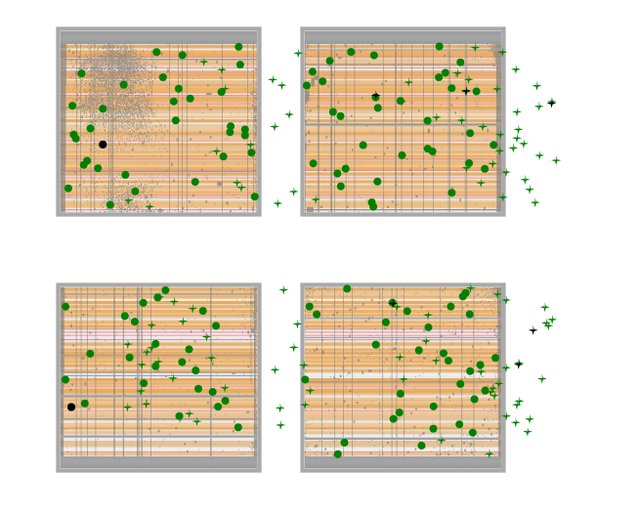
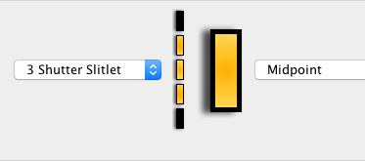
MPT selection of targets and MSA configuration
nod in 1x3 slitlet
2 pointings dither
6 exposures
Disperser: PRISM

Slide 6
Procedure
Sky Scene
Sources (pointlike) + Background
Instrument Performance Simulator
Fourier optics software + coordinate transf. closely matching instrument
Radiometric response
(throughput, slit- diffraction-losses, QE)
Count rate images – 94.9 ks
100 integrations in IRS2 read-out mode
Include photon noise (incl. dark) + read noise

Slide 7
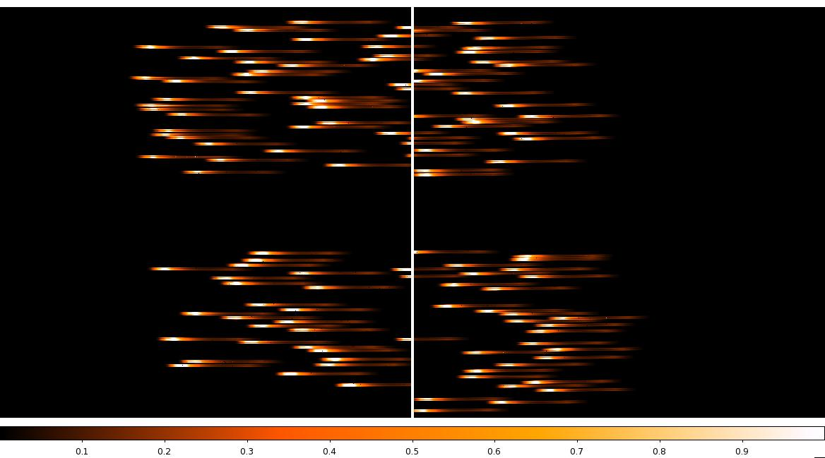
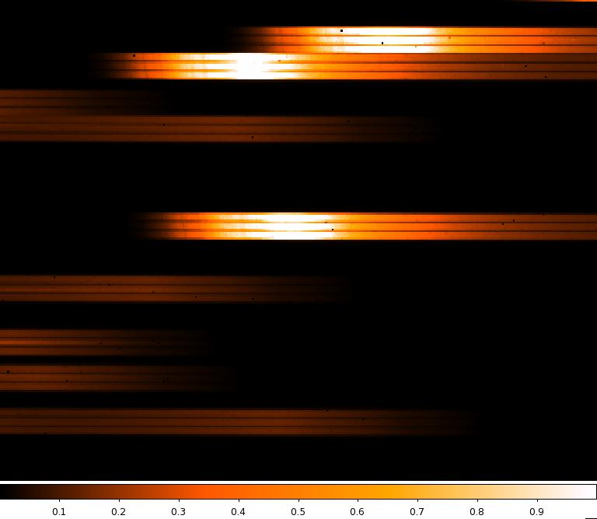
Simulated exposure #1

Slide 8
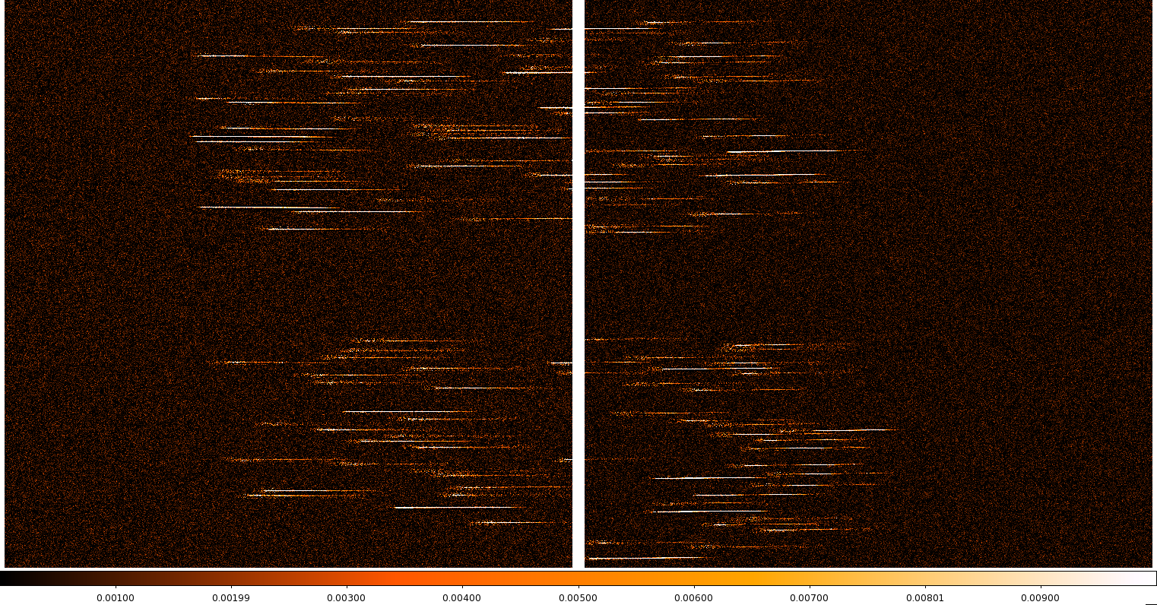
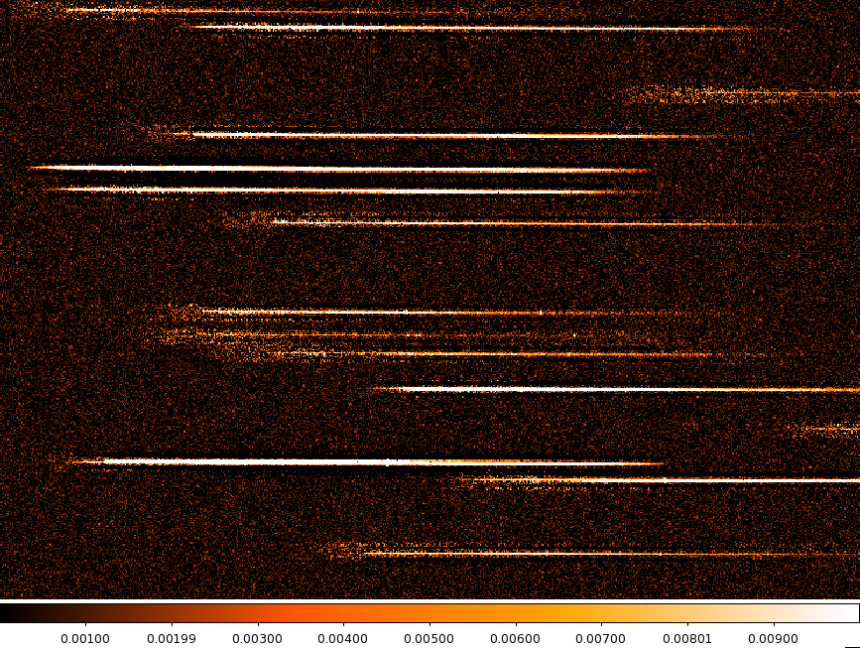
Background subtracted f = A-0.5(B+C) ~ 100 ks integration
Dither 0

Slide 9
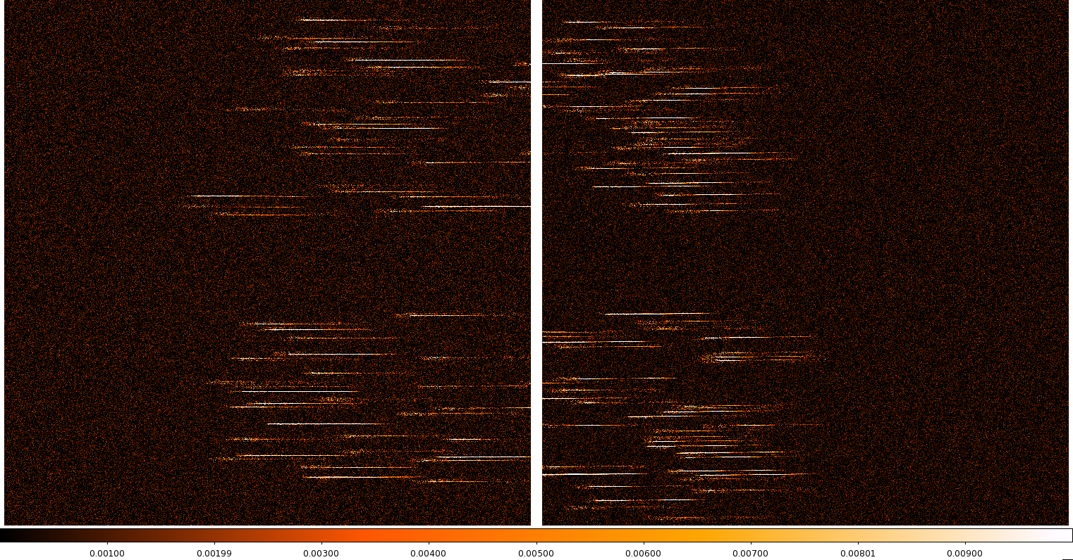
Background subtracted – 100 ks integration
Dither 1

Slide 10
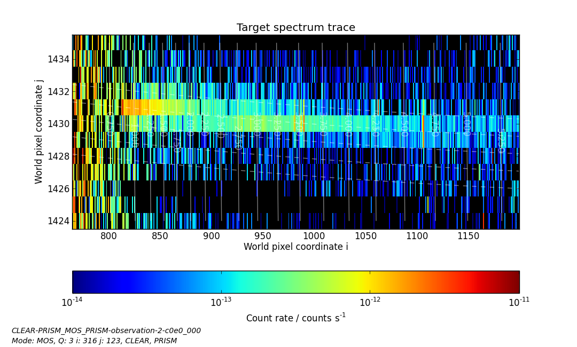
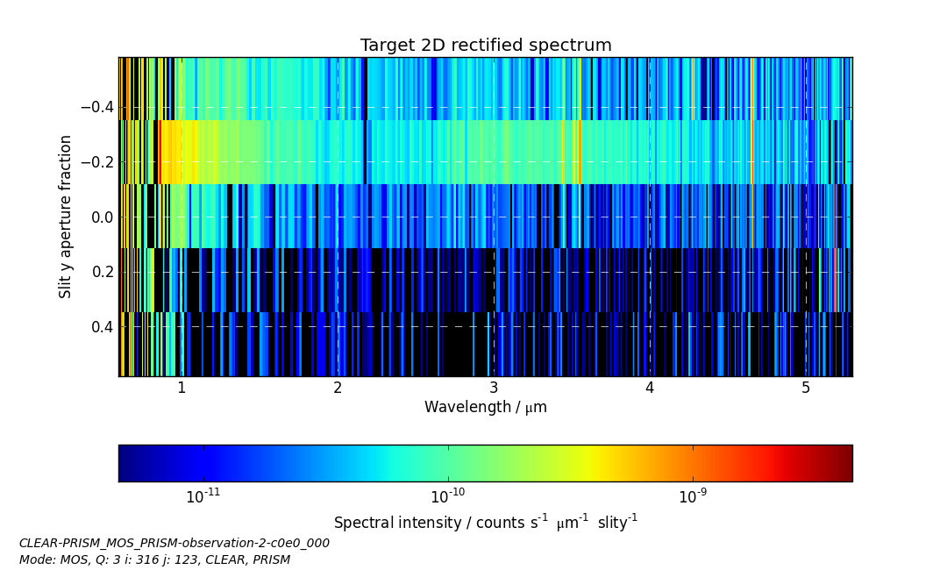
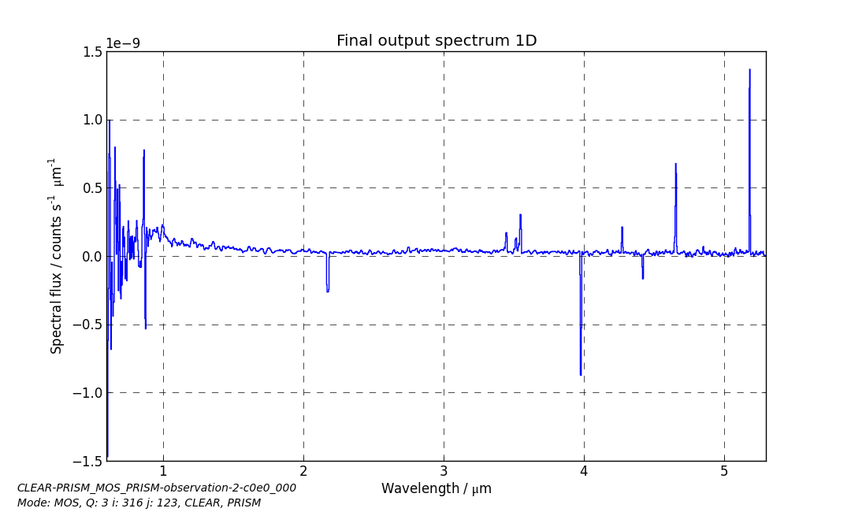
Extracted products (NIPS)
Dorner, Giardino, Ferruit et al. 2016, A&A, 592
Spectral trace
(wavelength and spatial coordinate for each pixel)
2D recitified spectra
(wavelength - spatial coordinate)
1D spectrrum
FITS files
Uncalibrated flux units

Slide 11
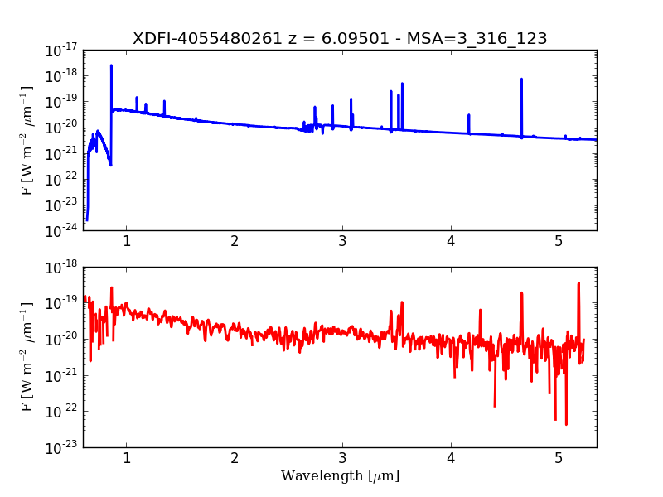
Calibrated spectra
Simulated observation of radiometric standard (1.0 W m⁻² m⁻¹)
➔ Comparison with synthetic input spectra
M_{AB} = 28.4

Slide 12
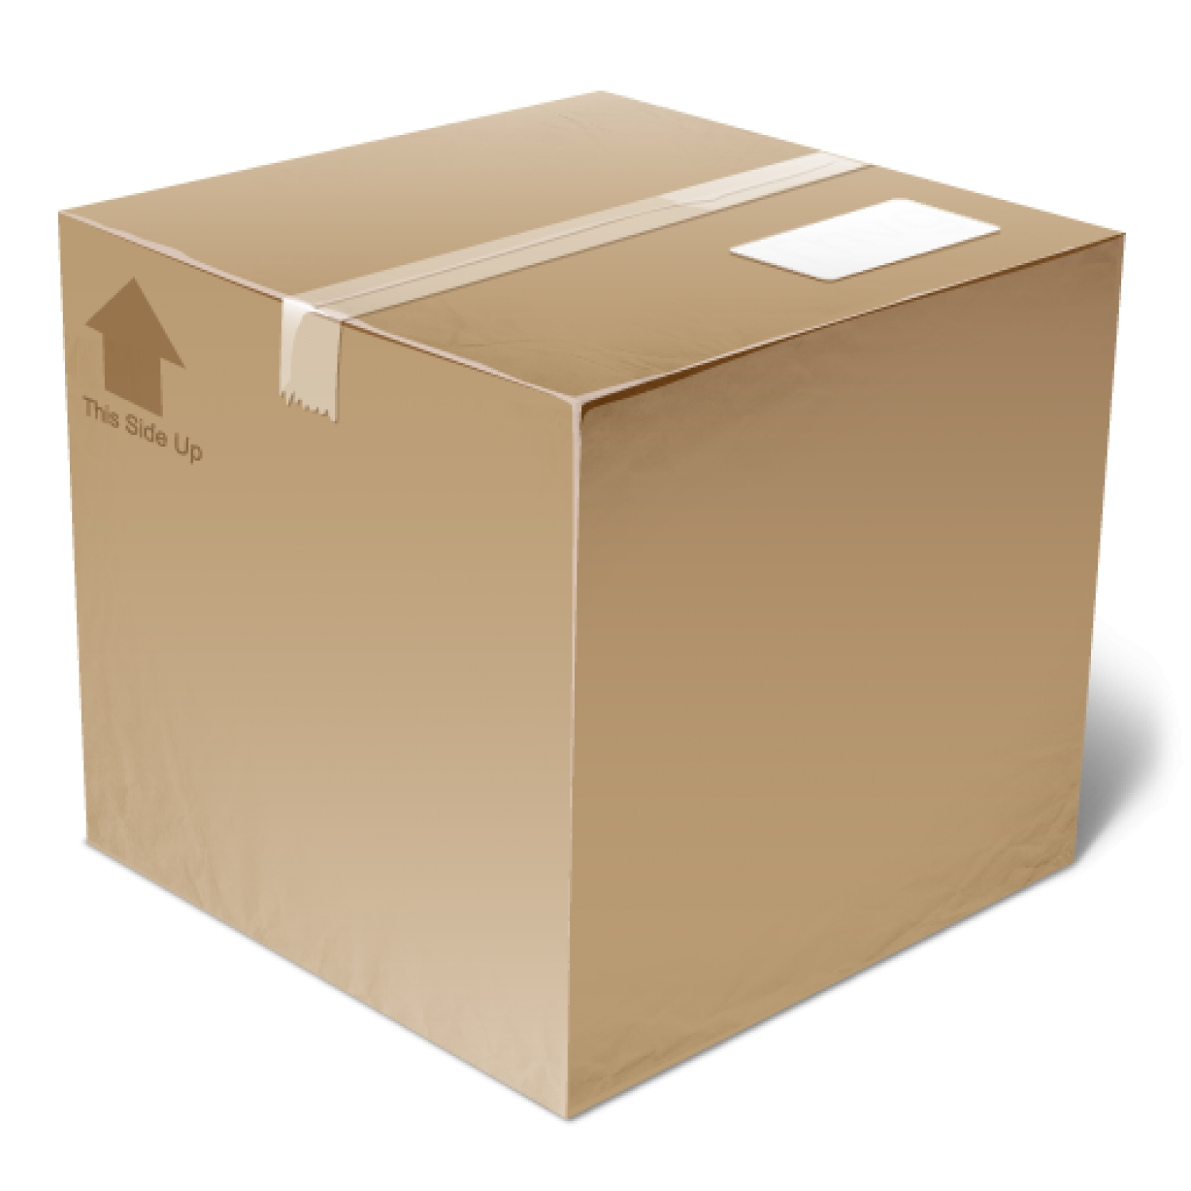

Data package MOSsimulationESAC2016
Input catalogue and Spectra
APT file
Count rate observations:
  Background subtracted count-rate images
  (2 files, one for each dither pointing)
  6 Exposures (3 nodding x 2 dithers), noisy and noiseless
Extracted products
  Data files of Traces, 2D rectified spectra, 1D spectra
  (FITS)
  Plots of Traces, 2D rectified spectra, 1D spectra
  (PNG)
➔ AREDME file

Slide 13
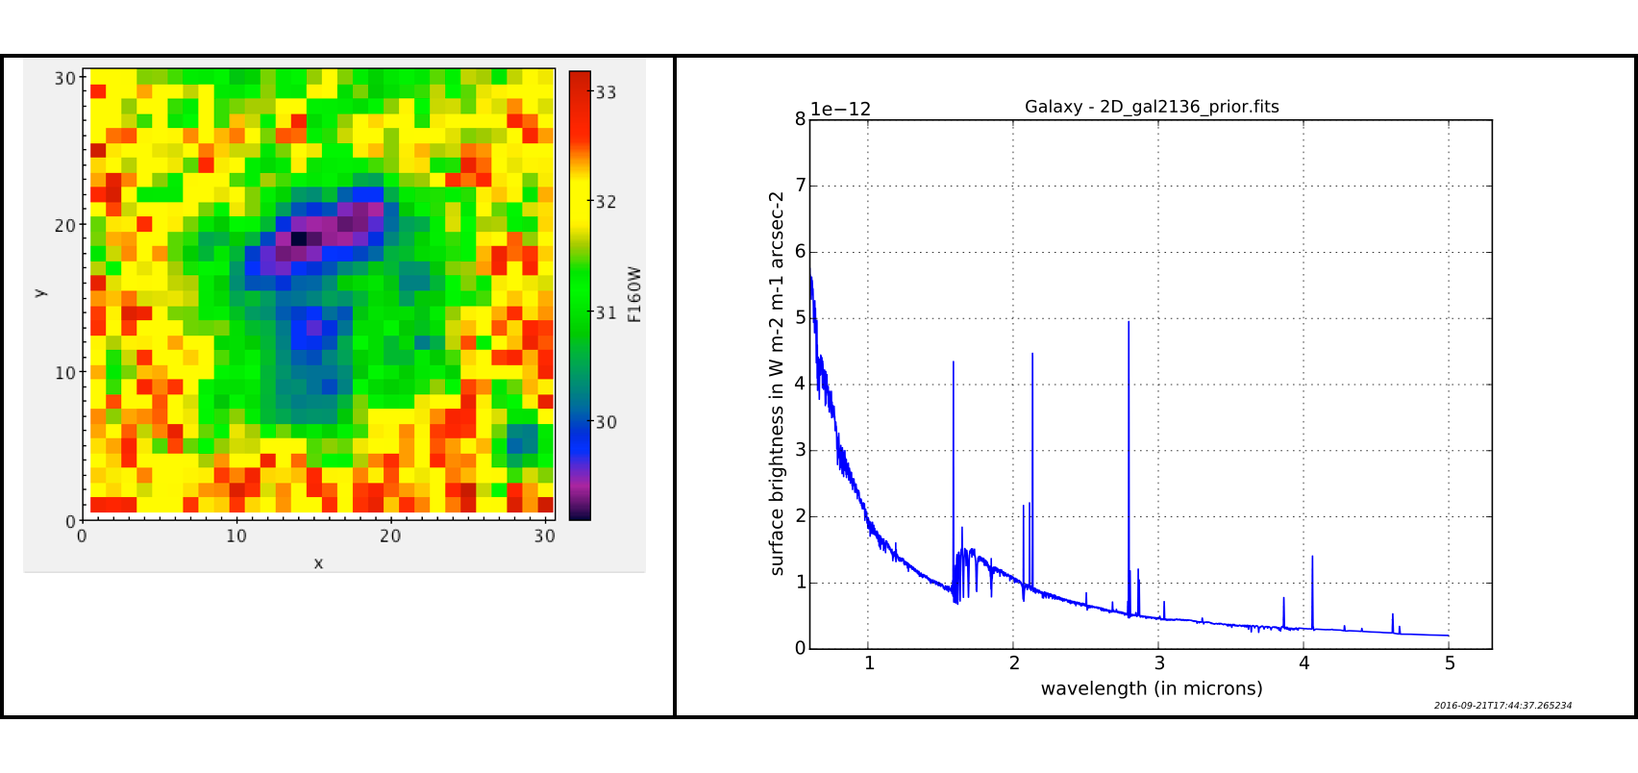
IFS Simulations –Input data
Input data cube (prepared by C. Pacifici): a z~3 galaxy – fit of the (photometric) HST data of one of the sources in the CANDELS program, using a library of spectral energy distribution models.
GAL2136
F160W filter

Slide 14
Sky Scene ➔ IPS input

Slide 15
Simulation output – Count-rate image
11.2 ks - 12 integrations in IRS2 read-out mode
Include photon noise (incl. dark), read noise

Slide 16
Background subtracted – Count-rate image

Slide 17
Data package
JWST-NIRSpec-IFU-simulations-GAL2136-20160923
➔ JWST-NIRSpec-IFU-simulations_20160923.pdf

Slide 18
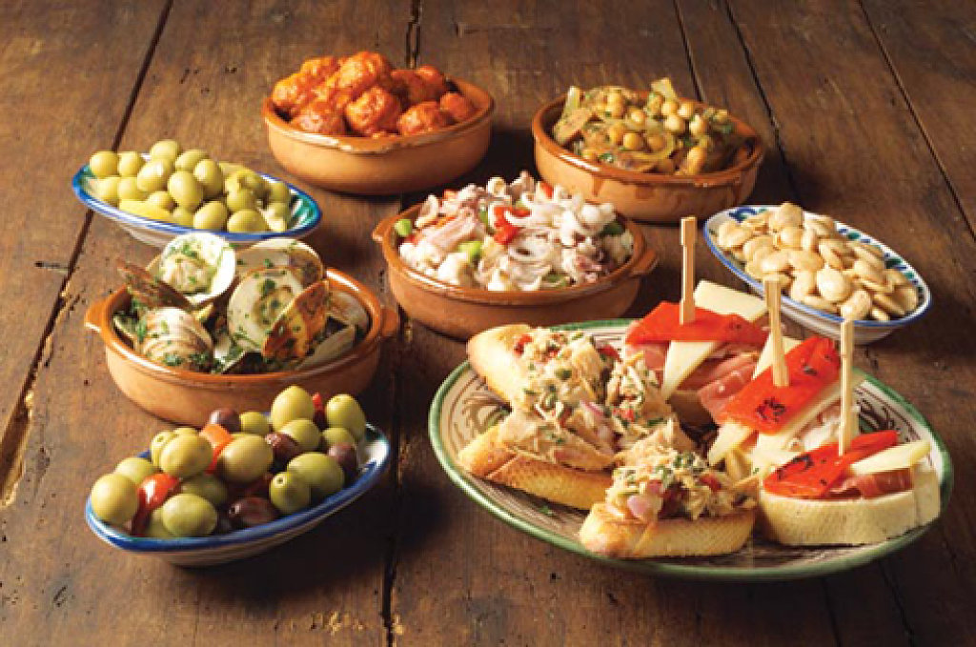
Enjoy your data tapas!

Slide 19
MOS Simulations characteristics
Assumptions: point-sources!
Includes:
zodiacal background, galactic + zodiacal parasitic + telescope emission (uniform!)
Fourier wave optics simulation + radiometric propagation (PSF , slit-effect, slit and diffraction loss, instrument throughput - field dependent)
Ideal Noise: photon noise (incl. ideal dark currents) + read noise
Sort-of-cosmetics (TBD with Pierre)
Does not include:
1/f detector noise
Real dark map
Cosmic rays
Other detector effects (IPC, non-linearity)
MSA failed shutters, leakage, finite contrast
Background variations across the field
Calibration errors/noise: e.g. no flat field noise, perfect flux calibration, perfect wavelength calibration for centered source

