Slide 1
Future workshops and Events
M. Sirianni

Slide 2
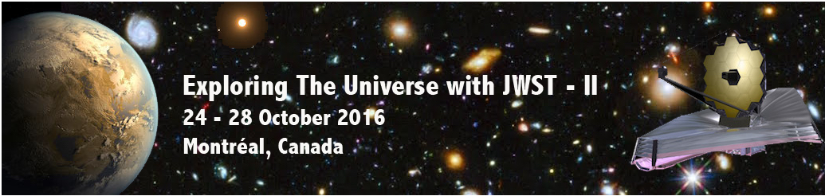


Getting ready to use JWST SciConferences
OCTOBER 2016
http://craq-astro.ca/jwst2016/
Workshop with demos during the last day of the meeting
Abstract submission deadline Oct 1st

Slide 3

Next Events
Nov 7, 2016 JWST Data Analysis Workshop STScI
Nov 14, 2016 JWST Session at the High Contrast Imaging Workshop STScI
Jan 2, 2017 AAS Winter Meeting [TX] / proposal planning workshops
Mar 20, 2017International HST/JWST Conference +mini Workshop Venice, Italy
May 15, 2017JWST Early Release Science - Proposal Preparation Workshop STScI
Jun 12 AAS Summer Meeting / proposal planning workshop [TX]
Oct 4-6 Planning your JWST Observations - [get set]
Dec 14, 2017 JWST Proposal planning workshop Pasadena, Ca

Slide 4


GTO CP release
Jan06
GO Cy 1 CP
Nov30
GTO Cy1
obs release
by Jun15
GO Cy1
props due
Mar02
GTO
props due
Apr01
commissioning
(6 mo)
cycle 1
Obs
begin
Apr
GO Cy1
TAC May
2017
2018
2019
DD-ERS
TAC Oct
DD-ERS initial CP release
Jan06
DD-ERS
props due Aug18
launch
2018Oct
DD-ERS final
CP release
May19
More info
on timeline
and DD-ERS
coming soon:
DD-ERS Notices
of Intent
due Mar03
October 2016 Special Issue
JWST Proposal Planning

Slide 5



ESA pre-launch workshops
26-28 Sep 2016
Getting to know all Instrument and observing modes : What JWST can do for your science
On your Mark
Fall 2017 Oct 4-6 2017
How to prepare the proposal – hands on tools
(ETC, Simulators, PSF, APT, MOS tools)
Get Set
Spring - Summer 2018
How to deal with the science data:
Hands on data analysis tools
Go

Slide 6
First, very preliminary, tentative & ambitious brain storm….
Day1
Day2
Day3
Project status update
Summary mode availability and changes
Documentation and help system
Updated policies
Steps to prepare an observations
ETC(s) Visibility/orient tools
Demo
Hands on
APT
Demo
Hands on
MPT
Demo
Hands on
APT
solar system
Demo
Hands on
APT
Coronagraphy
& Time Series
Demo
Hands on
Simulators and new simulated data packages
Updates on pipeline products
Analysis tools
demo

Slide 7
What next:
What you need to “take home”…
JWST launch in 2018 but you need to get ready now….
First opportunity : ERS – start getting organized
Many differences from HST
  More complex instruments
  More and more powerful (and complex) tools
  Different proposal preparation process
  we hope we scared you a bit…. but not too much
Where you can find information
Material from the workshop will be organized
(including some video editing) and posted on the workshop
web page.
Participant will be notified when it is done.
Short survey will be distributed to help us plan for next

Slide 8
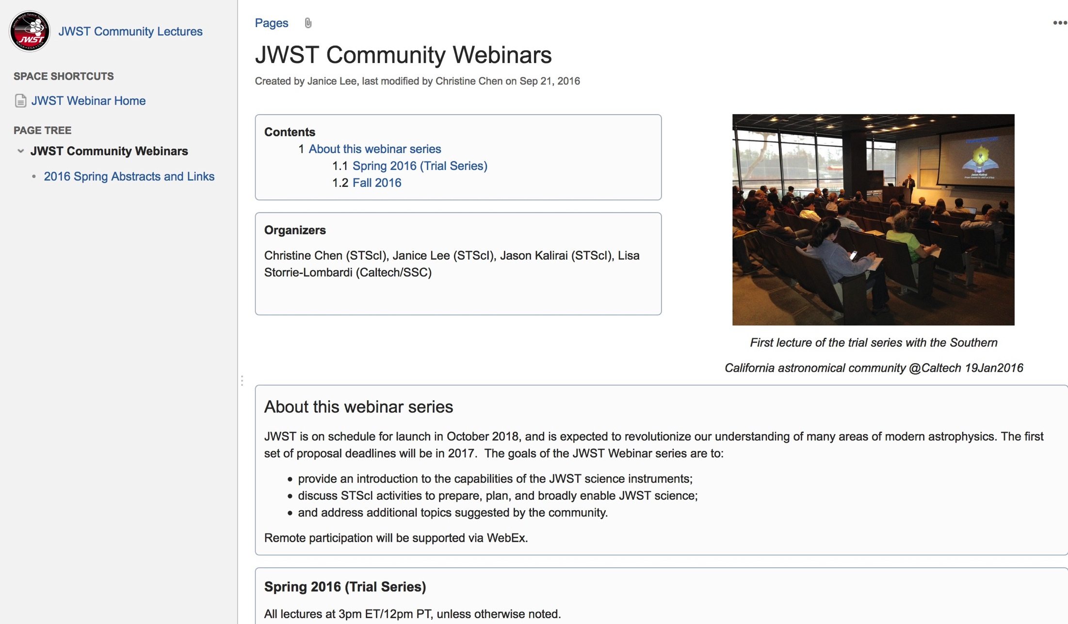
JWST Community Webinars
https://confluence.stsci.edu/display/JWSTLC/JWST+Community+Webinars
Past Events
Preparing for JWST
NIRCAM
NIRSpec
NIRISS
Data Analysis Tools
MIRI
ERS
Mid Oct-mid Dec
[3PM EST - 9PM CET]
JWST Coronagraphs
JWST IFUs
Absolute flux calibration
Astrometric Calibration
NIRSpec MOS
Recorded presentation and material on line

