Slide 1
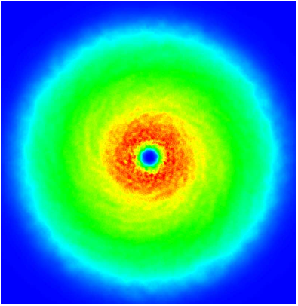
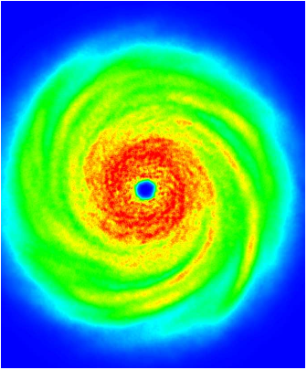
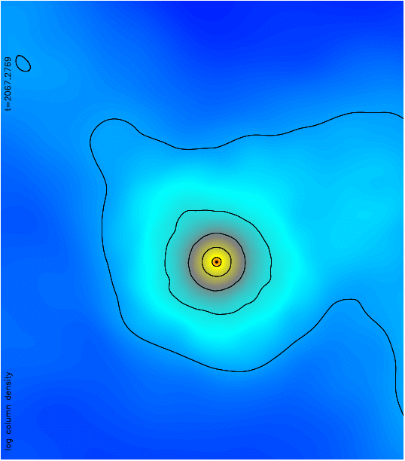
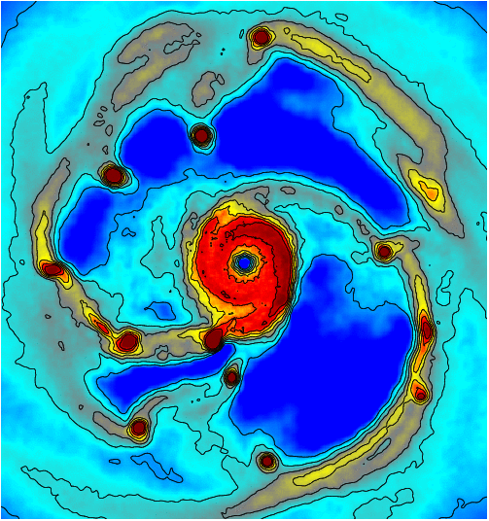
Dimitris Stamatellos
School of Physics & Astronomy
Cardiff University, Wales, UK
The predictions of the disc fragmentation model
Collaborators: A. Whitworth, T. Bisbas, D. Hubber, S. Walch A. Maury, P. Andre
11th September 2009, Noordwijk Brownies

Slide 2
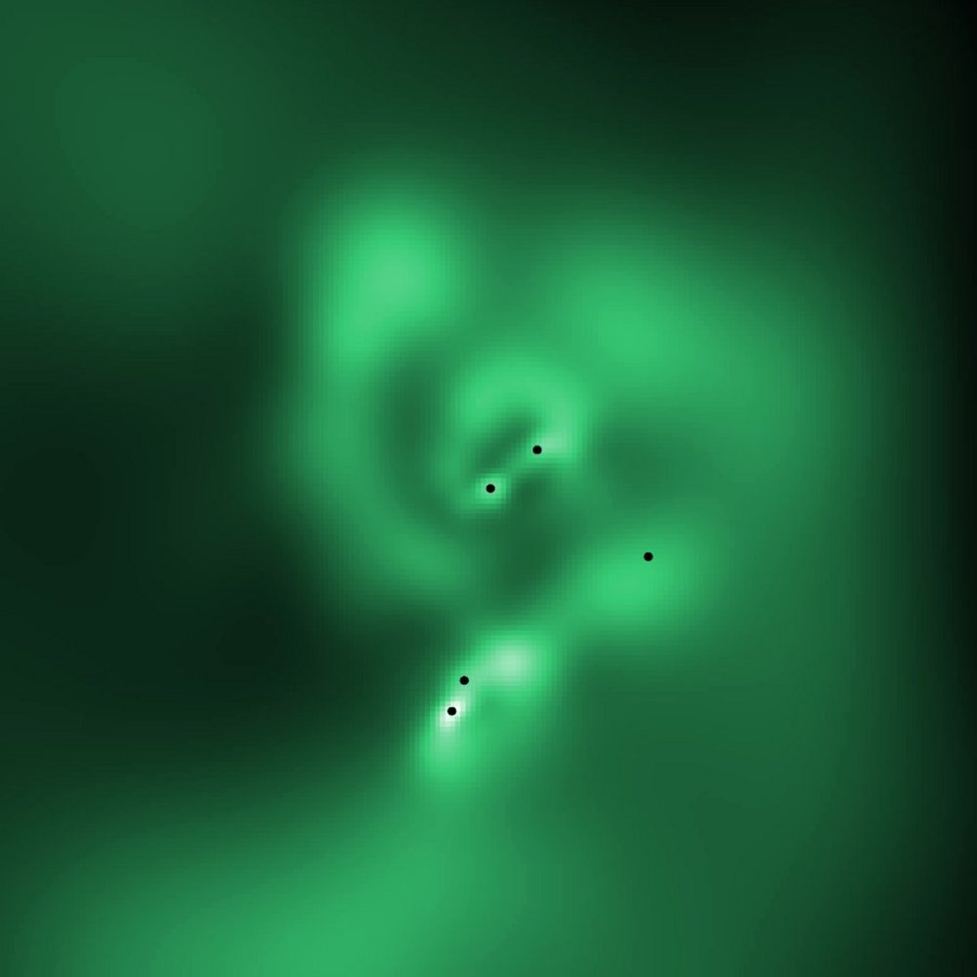
Brown dwarf formation mechanisms
turbulent/gravitational fragmentation of molecular clouds
Padoan & Nordland 2002; Bate et al. 2004; Hennebelle & Chabrier 2008;
premature ejection of protostellar embryos
Clarke & Reipurth, Bate et al. 2003
Bate et al. 2004; Goodwin et al. 2004
disc fragmentation
Bate et al. 2003
Whitworth & Stamatellos 2006, A&A
Stamatellos, Hubber & Whitworth 2007, MNRAS
Stamatellos & Whitworth 2009, MNRAS
photo-erosion of cores
Whitworth & Zinnecker
Cluster fragmentation
Bonnell, Clark & Bate 2009
5000 AU
600 AU

Slide 3
Brown dwarfs form like stars
turbulent/gravitational fragmentation of molecular clouds
Padoan & Nordland 2002; Bate et al. 2004; Hennebelle & Chabrier 2008;
premature ejection of protostellar embryos
Clarke & Reipurth, Bate et al. 2003
Bate et al. 2004; Goodwin et al. 2004
disc fragmentation
Bate et al. 2003
Whitworth & Stamatellos 2006, A&A
Stamatellos, Hubber & Whitworth 2007, MNRAS
Stamatellos & Whitworth 2009, MNRAS
photo-erosion of cores
Whitworth & Zinnecker
Cluster fragmentation
Bonnell, Clark & Bate 2009
5000 AU
600 AU
Star-like formation ≠ “isolated low-mass star formation”

Slide 4
Open questions
the minimum mass of star formation
the low-mass end of the IMF
low-mass binary fraction
extremely low-mass binaries (e.g. close/wide brown dwarf –brown dwarf binaries)
the origin of ‘free-floating planets’

Slide 5
Criteria for disc fragmentation
(i) Toomre criterion (Toomre 1964)
Disc must be massive enough
(ii) Gammie criterion (Gammie 2001; Rice et al. 2003)
Disc must cool on a dynamical timescale

Slide 6
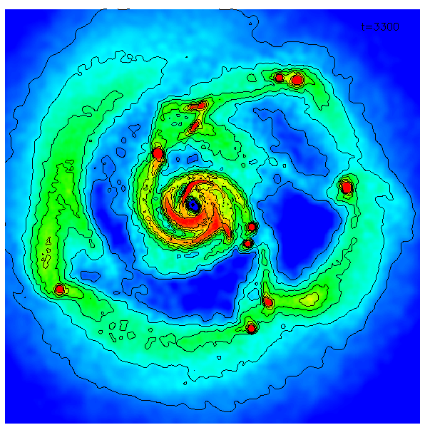
Open questions
An ensemble of 12 simulations:
Initial conditions
the minimum mass of star formation
the low-mass end of the IMF
low-mass binary fraction
extremely low-mass binaries (e.g. close/wide brown dwarf –brown dwarf binaries)
the origin of ‘free-floating planets’
**only 1 set of star/disc initial conditions **

Slide 7
Disc fragmentation
There are hints that massive, extended discs do exist (e.g. Eisner et al. 2005; Eisner & Carpenter 2006; Rodriguez et al. 2005; Greaves et al. 2008; Andrews et al. 2009).
We argue that they could be more common but they quickly fragment (within a few thousand years).
Stamatellos & Whitworth 2009, MNRAS

Slide 8
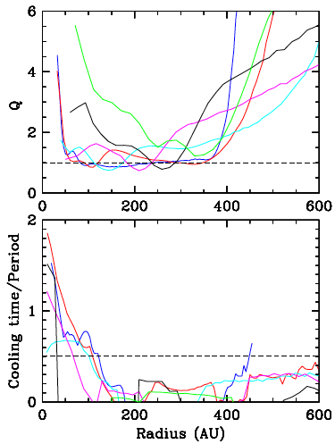
Simulations of disc evolution (outer disc, with stellar irradiation)
300 AU
100 AU

Slide 9
Disc fragmentation: an ensemble of 12 simulations
a typical outcome
20-1000 AU
1-20 AU
200-2000AU
Stamatellos & Whitworth 2009, MNRAS

Slide 10
Properties of ELM stars formed by disc fragmentation: Mass distribution
Most of ELM stars are brown dwarfs (67%).
The rest are H-burnings stars (30%) and planemos (3%).
an ensemble of 12 simulations producing 96 stars in total
ΔN/ΔM~M^{-α}
Brown
dwarfs
Pleiades: α=0.6±0.11
(Moraux et al. 2003)
σ Orionis: α=0.6±0.20
(Caballero et al. 2007)
Low-mass stars
Planemos
α=0.6
This is not an IMF.
It represents the mass spectrum of only one formation mechanism (for one set of initial conditions).
Stamatellos & Whitworth 2009, MNRAS

Slide 11
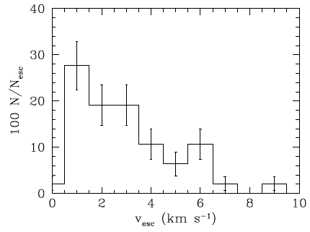
Properties of ELM stars formed by disc fragmentation: Ejection velocities
Most of ELMs are ejected in field (30% of H-burning stars, 65% of brown dwarfs and 100% of planemos)
Stamatellos & Whitworth 2009, MNRAS

Slide 12
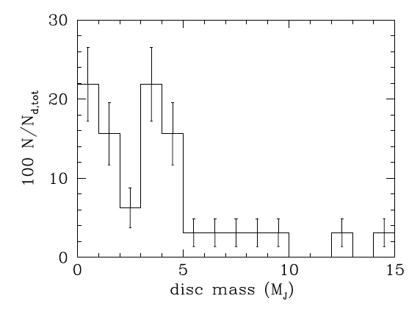
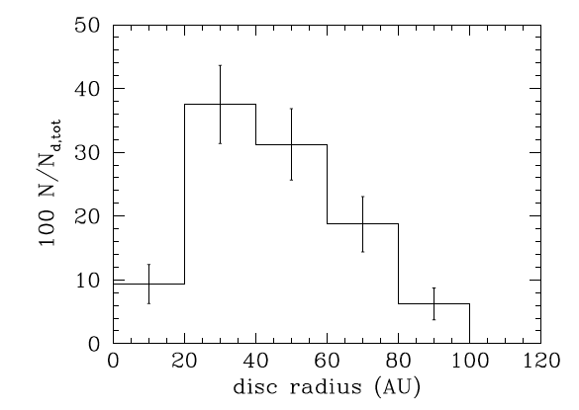
Brown dwarf discs
Most of the brown dwarfs form with discs (as in the core- collapse model, e.g. Machida et al. 2009).
Mass distribution of brown dwarf discs
Size distribution of brown dwarf discs
We predict that brown dwarfs that are companions to Sun-like stars
are more likely to have discs than brown dwarfs in the field.
Stamatellos & Whitworth 2009, MNRAS

Slide 13
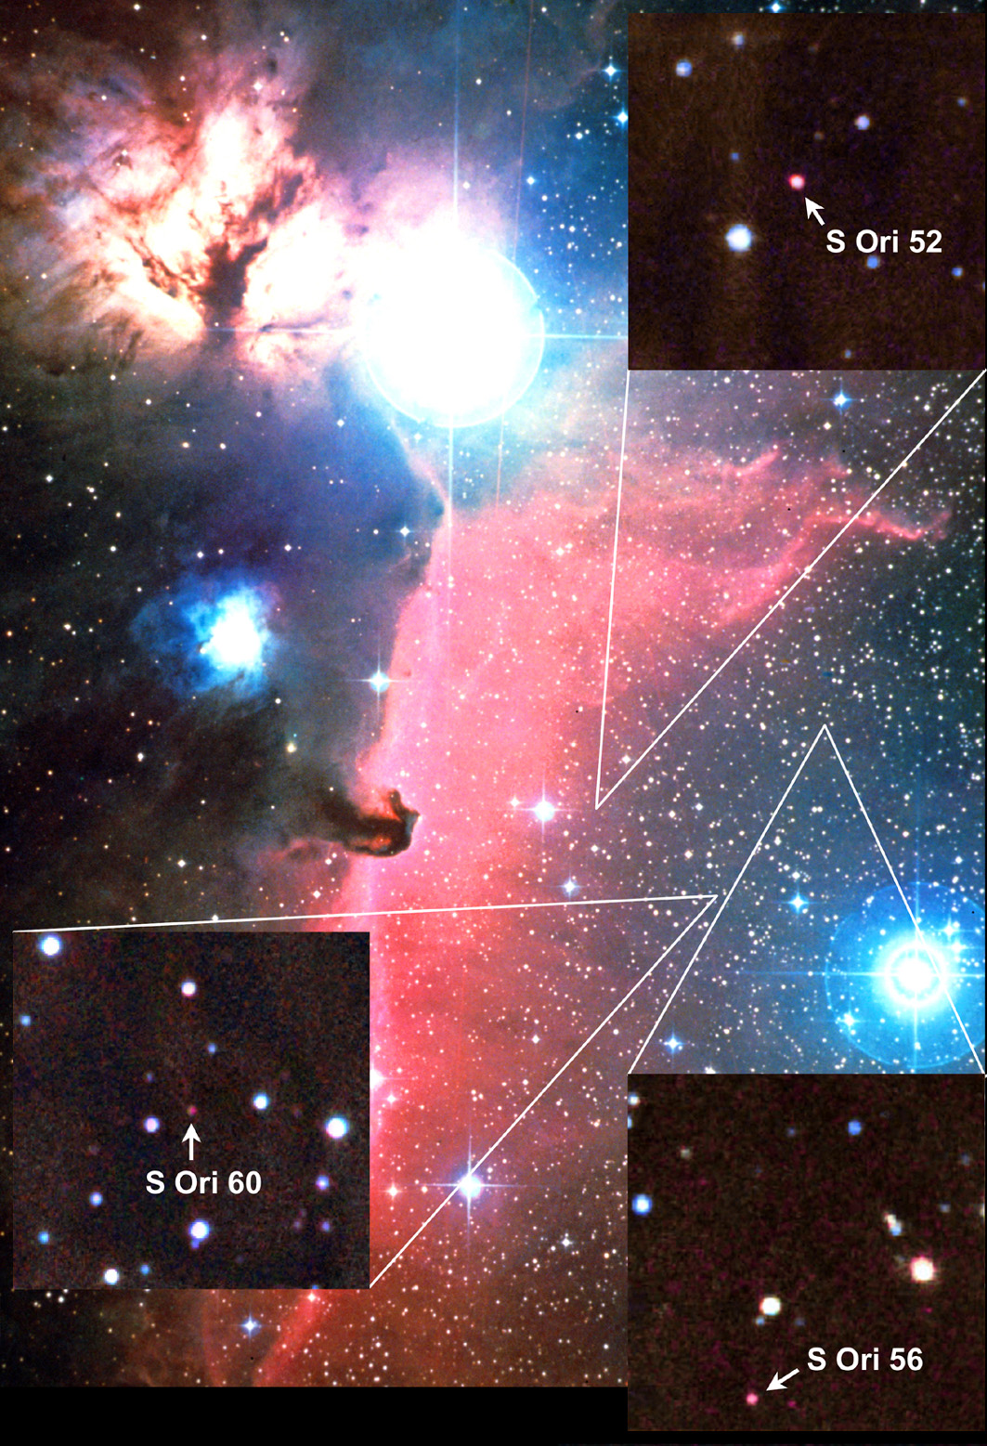
The formation of “free-floating planets”
Planetary-mass objects (e.g. Lucas & Roche 2000; Zapatero Osorio et al. 2000, Lodieu et al. 2007) are formed with this mechanism and subsequently liberated in the field to become “free-floating planets”.
We predict that brown dwarfs outnumber planemos by a factor of at least ~10

Slide 14
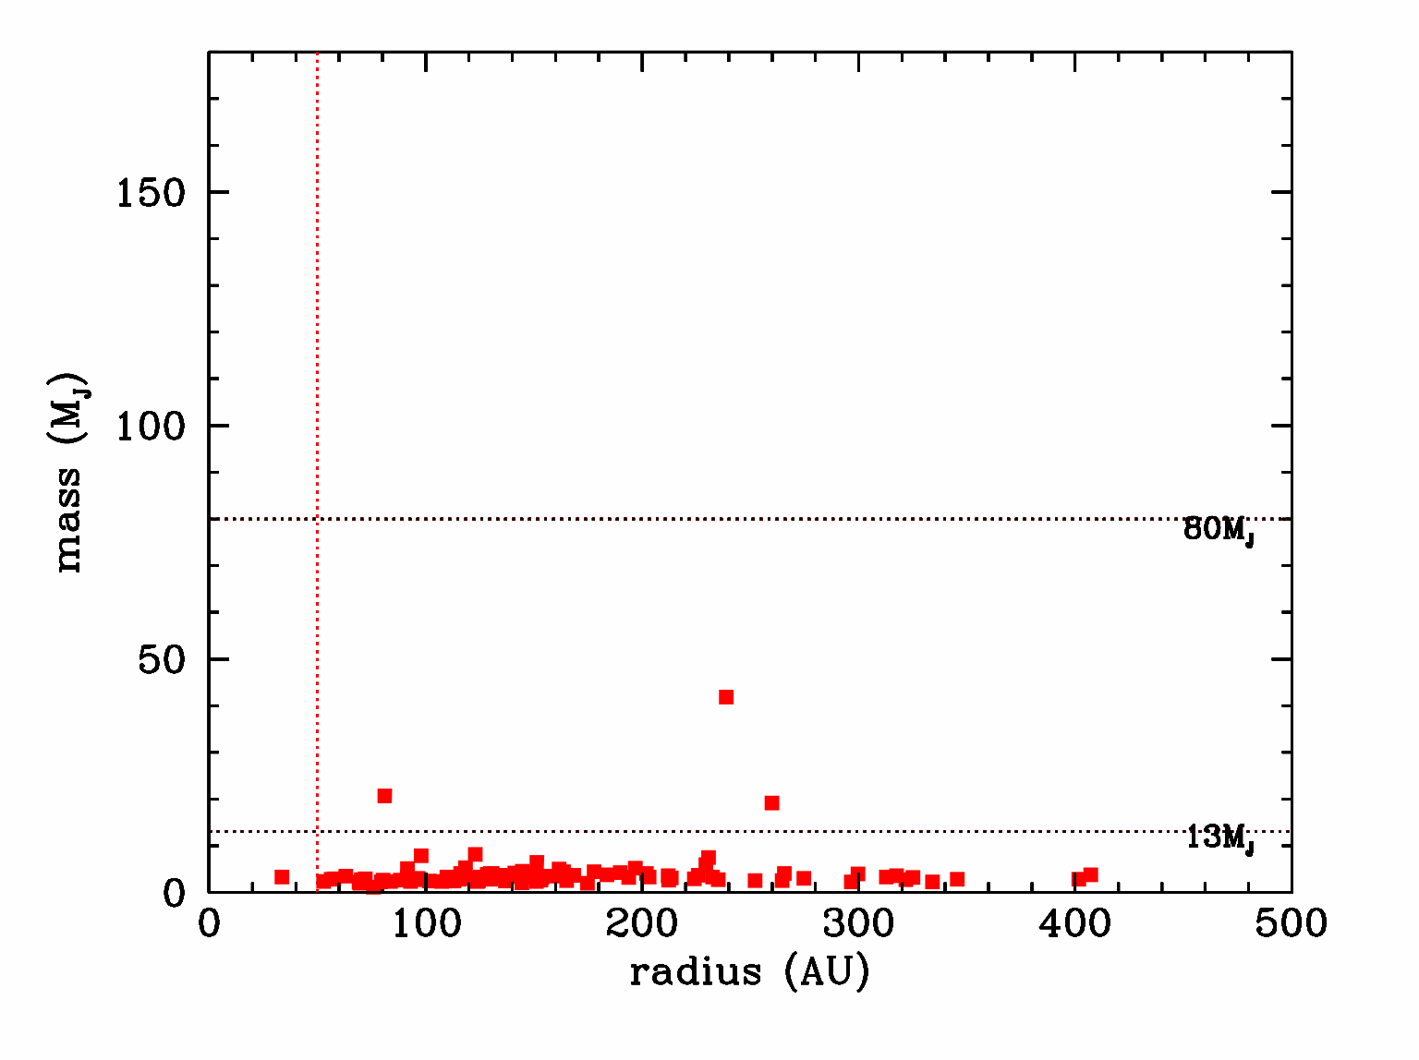
The brown dwarf desert: where did the brown dwarfs go?
There are many planets and low-mass stars close (<5 AU) companions to Sun-like stars, but almost no brown dwarfs (Marcy & Butler, 2000) .
The brown dwarf desert may extend out to ~1000 AU (Gizis et al. 2001) but is less “dry” of brown dwarfs outside ~50 AU (Neuhauser et al. 2003).
time ~ 5,000 yr
an ensemble of 12 simulations producing 96 stars in total

Slide 15
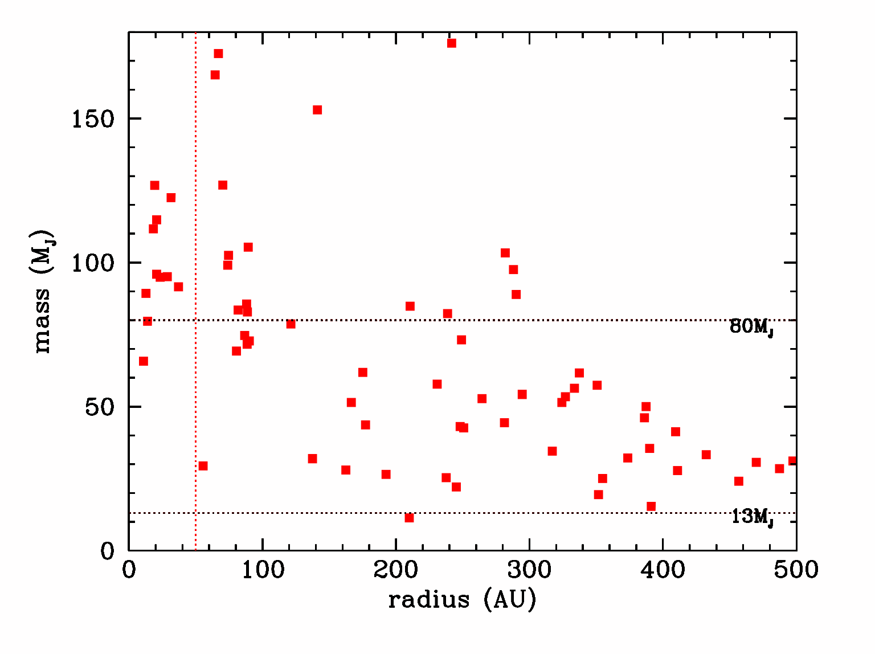
The brown dwarf desert: where did the brown dwarfs go?
There are many planets and low-mass stars close (<5 AU) companions to Sun-like stars, but almost no brown dwarfs (Marcy & Butler, 2000) .
The brown dwarf desert may extend out to ~1000 AU (Gizis et al. 2001) but is less “dry” of brown dwarfs outside ~50 AU (Neuhauser et al. 2003).
time ~ 20,000 yr
an ensemble of 12 simulations producing 96 stars in total

Slide 16
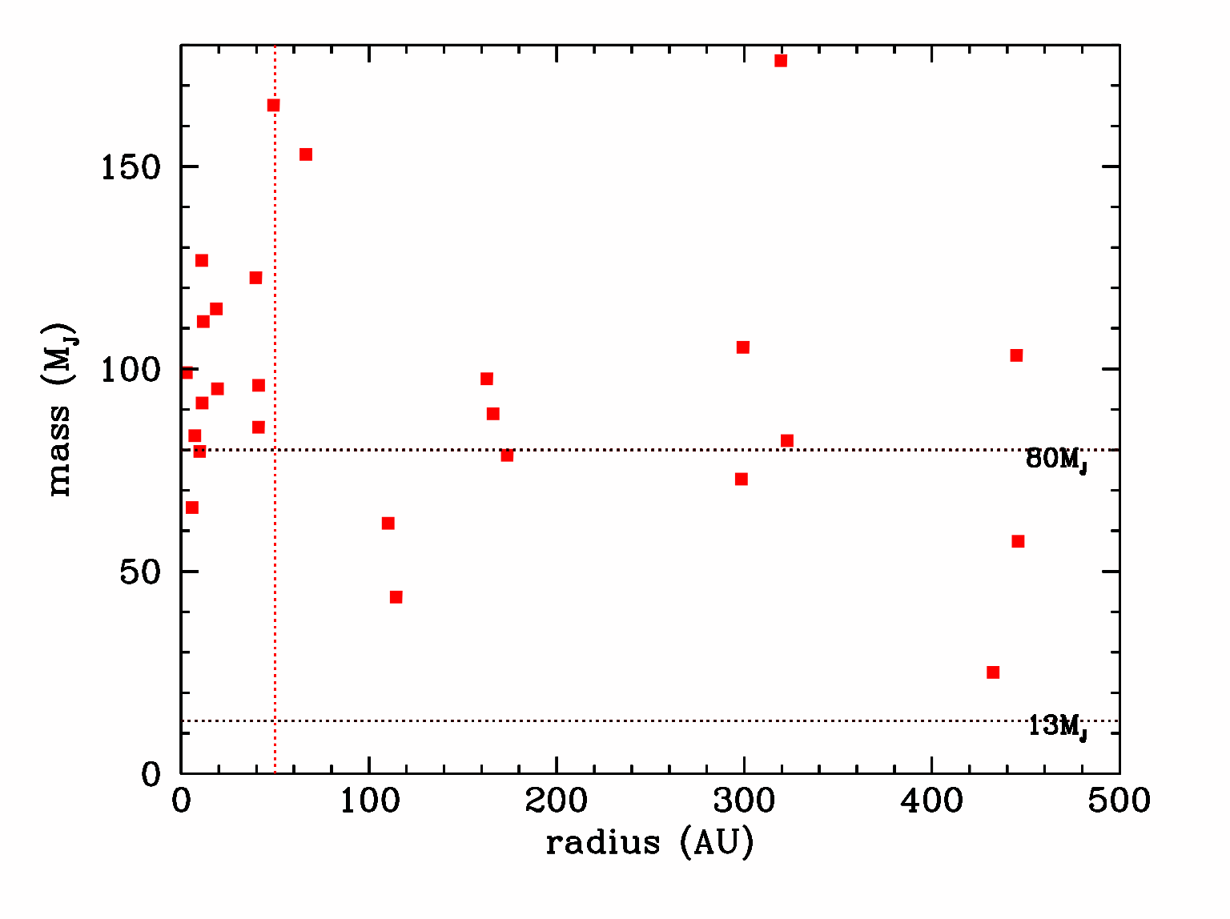
The brown dwarf desert: where did the brown dwarfs go?
There are many planets and low-mass stars close (<5 AU) companions to Sun-like stars, but almost no brown dwarfs (Marcy & Butler, 2000) .
The brown dwarf desert may extend out to ~1000 AU (Gizis et al. 2001) but is less “dry” of brown dwarfs outside ~50 AU (Neuhauser et al. 2003).
time ~ 200,000 yr
an ensemble of 12 simulations producing 96 stars in total

Slide 17
The brown dwarf desert: where did the brown dwarfs go?
All proto-fragments that will become brown dwarfs or H-burning stars are born “equal” but they eventually segregate according
I . Their birth place (in the mass-rich inner region vs the mass-poor outer disc region)
II. Their mass “status”

Slide 18
The brown dwarf desert: where did the brown dwarfs go?
Brown dwarf desert

Slide 19
The binary properties of low-mass objects
Close and wide brown dwarf - brown dwarf and brown dwarf -“planet” binaries are quite common outcome of disc fragmentation, and they may also liberated in the field.
13 binaries form and 4 of these binaries are ejected in the field, including both close and wide binaries.
Low-mass binary fraction of 16%.
Most of the binaries (55%) have components with similar masses (q>0.7).
BDs companions to Sun-like stars are more likely to be in binaries (binary frequency 25%) than BDs in the field (binary frequency 8%).
We predict that of the binaries remaining bound to the central star, the total mass of the binary decreases with distance from the central star.
Taurus- Auriga <20% (Kraus et al. 2006)
Chamaeleon I 5-20% (Ahmic et al. 2007)
Field 10-20% (Gizis et al. 2003)
Pleiades 28-44% (30-75M_{J}) (Lodieu et al. 2007)
(Burgasser et al. 2007)
(Faherty et al. 50%; Burgasser et al. 2005)

Slide 20
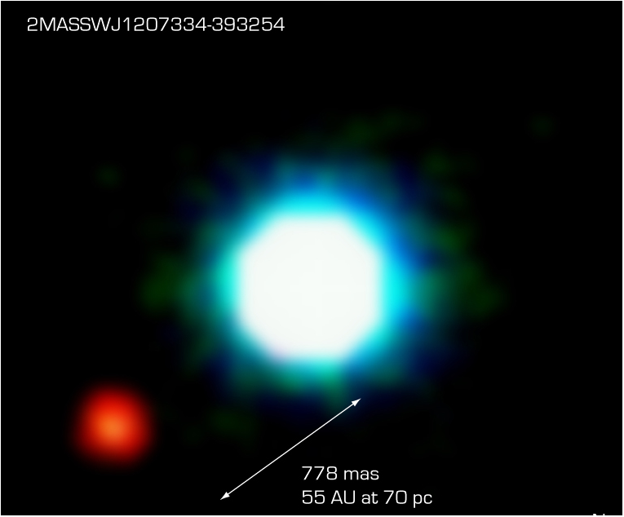
The binary properties of low-mass objects
Chauvin et al. 2005
Core accretion model M_{p}<5M_{earth}
(Payne & Lodato 2007)
25 M_{J}
5-8M_{J}

Slide 21
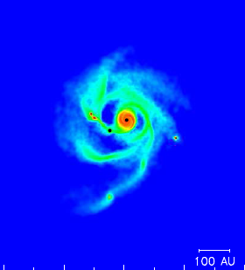
How big (mass, size) does the disc needs to be in order to fragment?
The disc has to be larger than >70 AU and gravitationally unstable
Stamatellos et al. in prep.

Slide 22
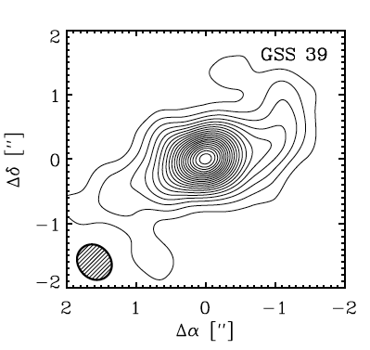
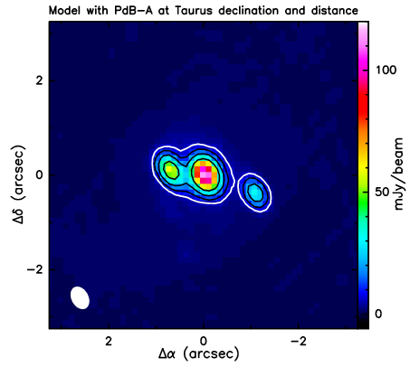
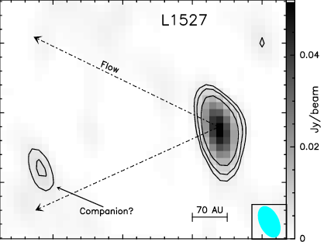
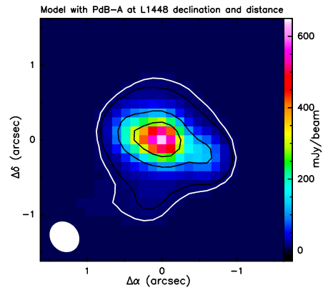
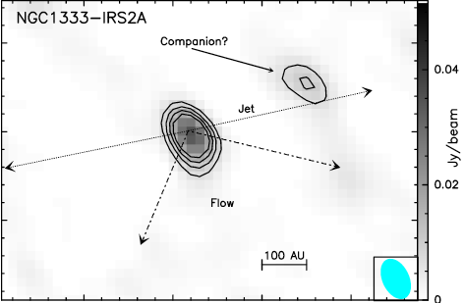
Observing the early stage of fragmenting discs
Maury et al., in prep
Andrews et al. 2009
@ 150 pc
500 AU
Stamatellos, Maury et al. in prep
@ 450 pc
M★=0.6 M
M_{disc}=0.14 M

Slide 23
Limitations
1 set of initial conditions (star+disc mass, disc temperature + density profile)
Initial conditions: discs
Radiative feedback from newly born stars is not included
Despite the above, the model reproduces the brown dwarf desert, the binary properties of low-mass stars and the formation of planetary-mass objects.

Slide 24
Conclusions
Discs can fragment at R>70 AU to form extremely low-mass stars (planetary-mass objects, brown dwarfs and low-mass hydrogen burning stars).
This model can reproduce the brown dwarf desert and the binary properties of low-mass objects.
As one star/disc can produce a few low-mass objects, only 10-20% of Sun-like stars having massive extended discs that fragment can produce most of brown dwarfs and a significant number of low-mass H-burning stars.

Slide 25
Computational method: Smoothed Particle Hydrodynamics with radiative transfer
Equation of state
Vibrational & rotational
degrees of freedom of H₂
H₂ dissociation
H ionisation
Helium first and second ionisation
Dust & gas opacities
Ice mantle melting
Dust sublimation
Molecular opacity
H⁻ absorption
B-F/F-F transitions
Realistic cooling + heating
Capture thermal inertia effects
Modest computational cost (+3%)
Stamatellos, Whitworth, Bisbas, Goodwin, 2007, A&A; Forgan et al. 2009, MNRAS

Slide 26
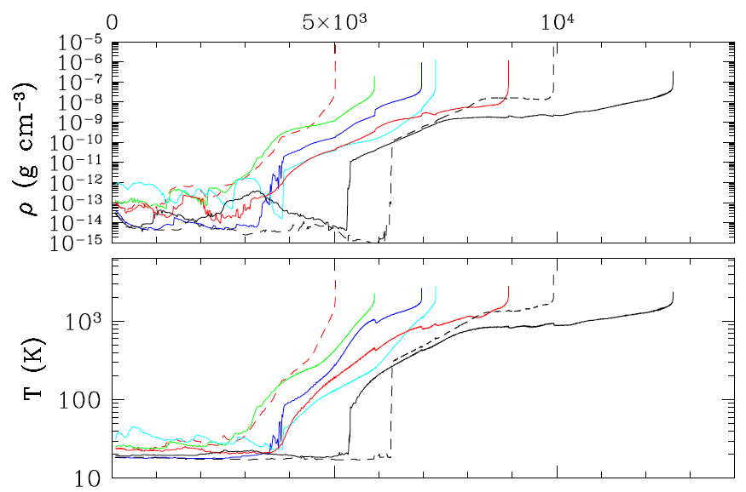
The density and temperature evolution of proto-fragments forming in the disc
Evolution is followed
to densities 10⁻³ g cm⁻³
Stamatellos & Whitworth 2009, MNRAS, in press

Slide 27
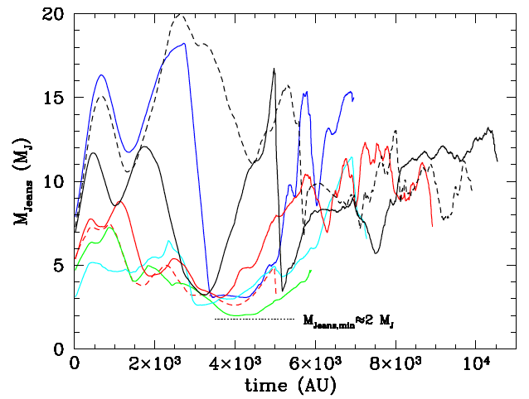
Resolving the Jeans mass
“ The Jeans mass must be resolved by at least ~ 2×N_{NEIGH}”
(Bate & Burkert 1997; Truelove et al. 1997)
✓ 150,000 SPH particles ➔ M_{JEANS,MIN} ≈ 2 M_{J} ≈ 8×N_{NEIGH}

Slide 28
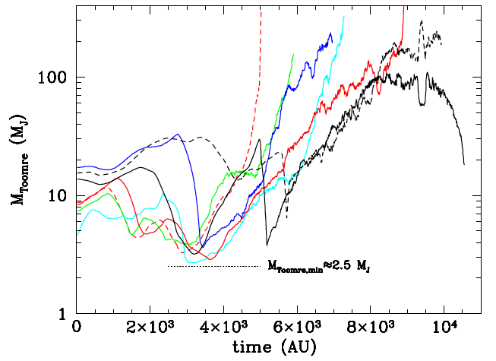
Resolving the Toomre mass
“ The Toomre mass must be resolved by at least ~ 6×N_{NEIGH}” (Nelson 2006)
✓ 150,000 SPH particles ➔ M_{TOOMRE,MIN} ≈ 2.5 M_{J} ≈ 10×N_{NEIGH}

Slide 29
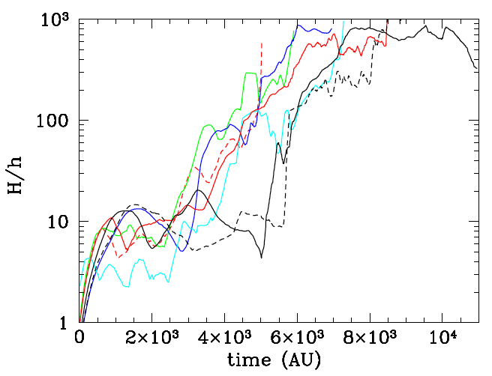
Resolving the disc vertical structure
“ The disc scale-height H must be resolved by at least ~ 4 h ” (Nelson 2006)
5 h

Slide 30
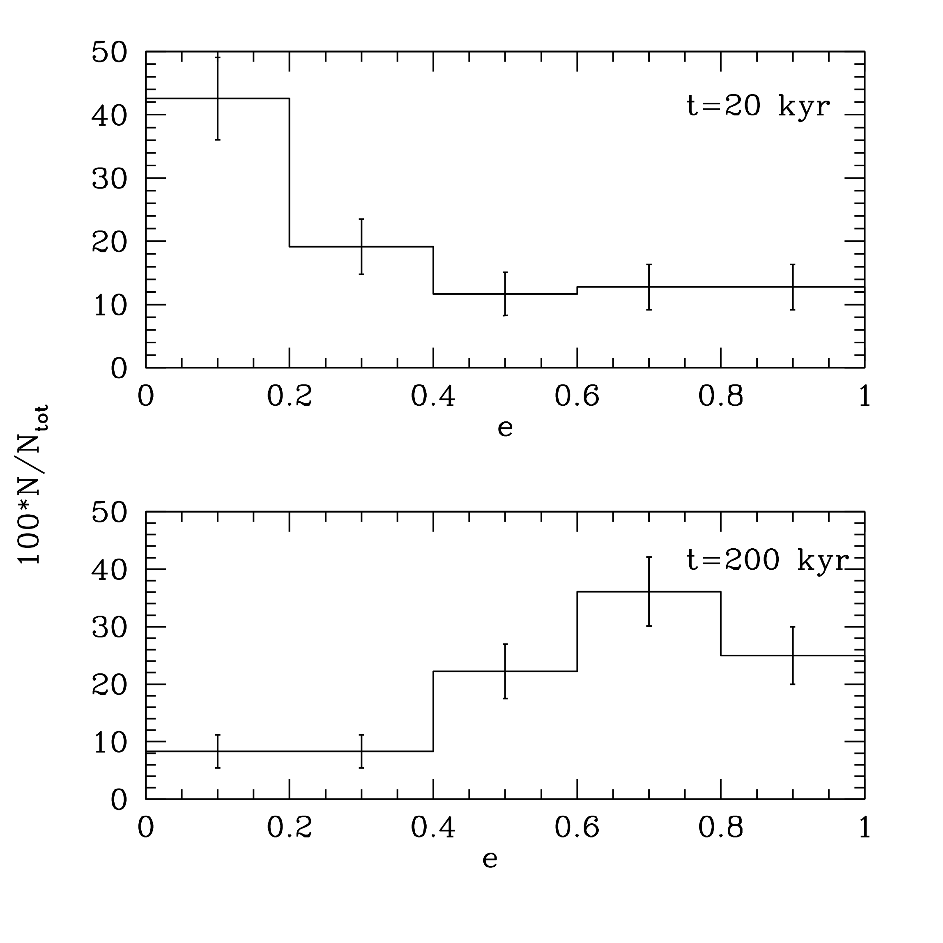
Properties of ELM stars formed by disc fragmentation: Eccentricities

Slide 31
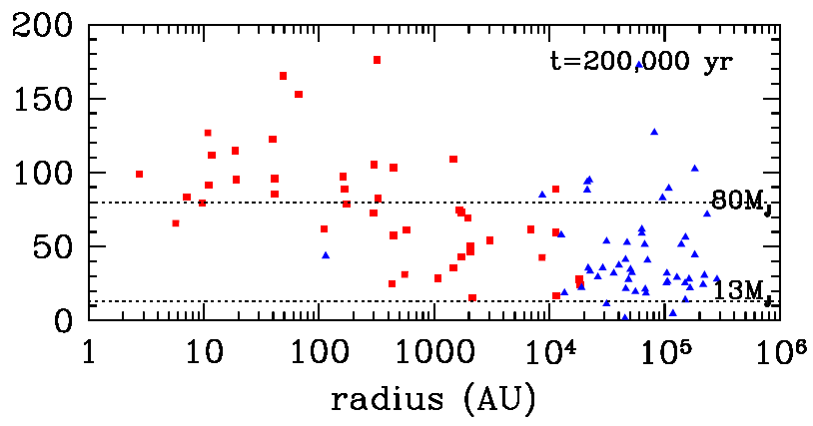
2. The brown dwarf desert: where did the brown dwarfs go?

