Slide 1
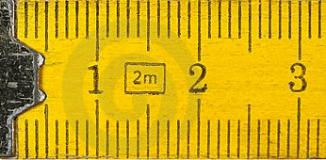
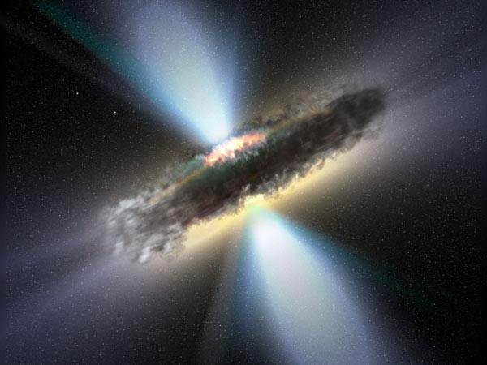
A RULER FOR AGN in X-rays
Matteo Guainazzi (ESAC-ESA)

Slide 2
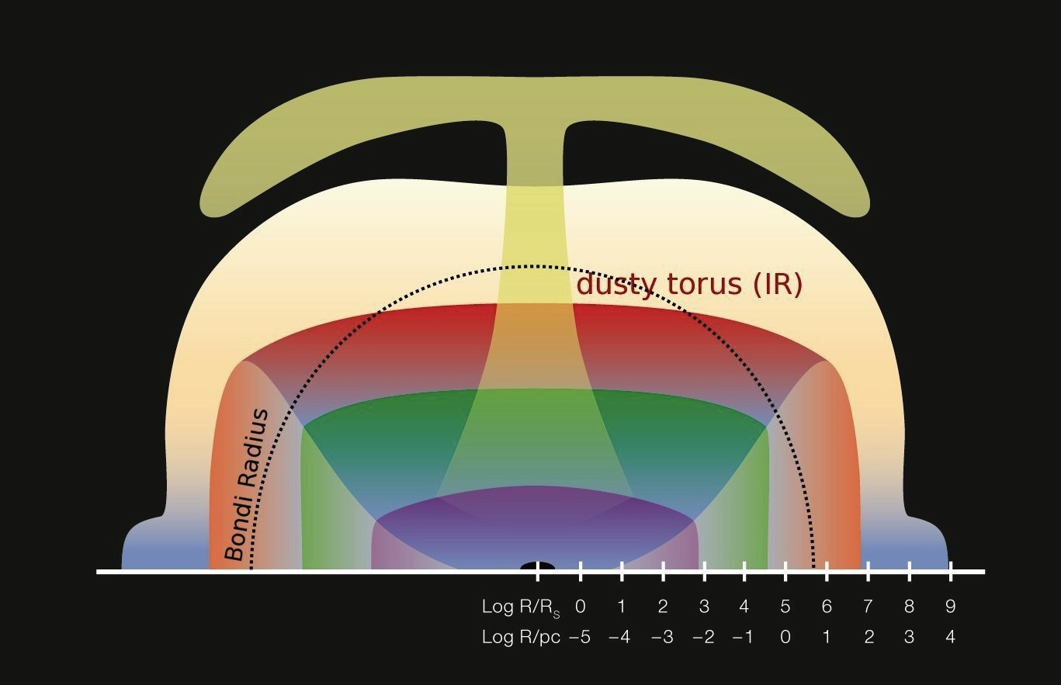
Motivation
(Courtesy A.Merloni & S.Bonoli)
radio jets and lobes
host galaxy
+ NLR
BLR
accretion disk
no disk [talk by W.Yu]
no outflows/jets [talk by N.Schartel]
no lobes

Slide 3
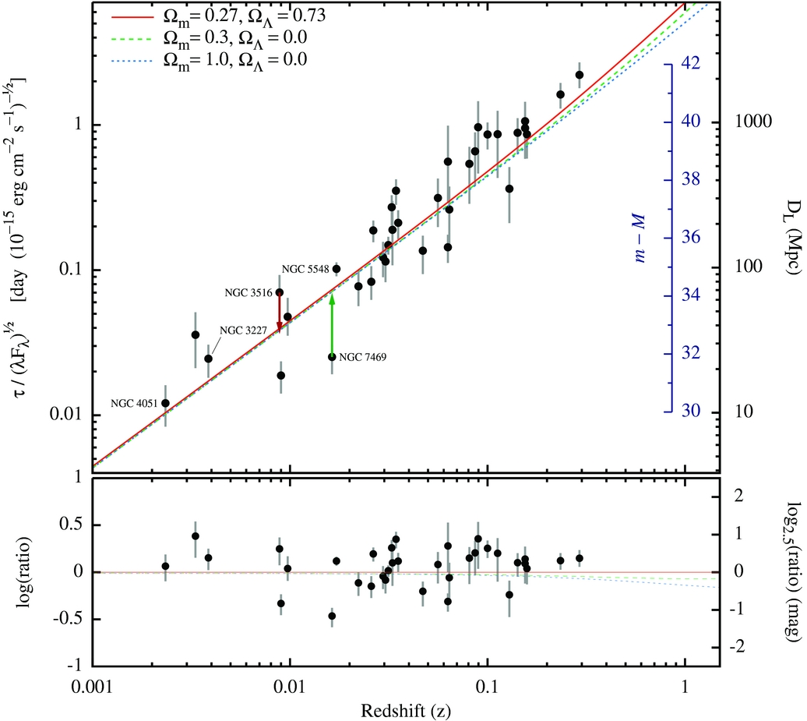
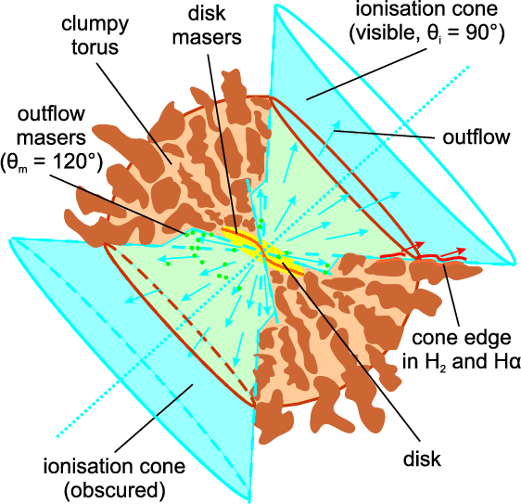
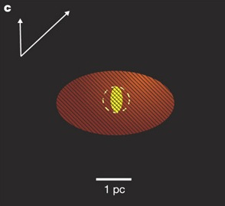
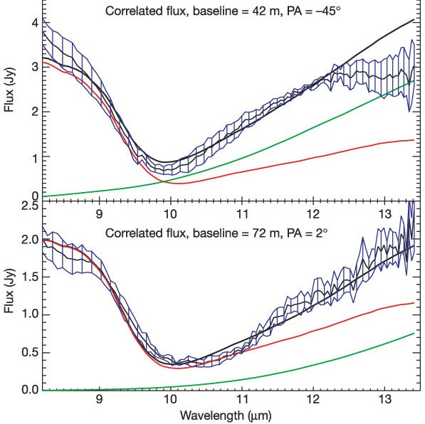
The multi-wavelength context
(Watson et al., 2011, ApJL, 740, L49)
(Jaffe et al., 2004, Nature, 429, 47; Tristram et al., 2007, A&A, 474, 837)
Opt.^{al}-UV Reverberation mapping (BLR)
IR interferometry (torus)
T>800 K
T=320 K
NGC1068
Circinus Galaxy

Slide 4
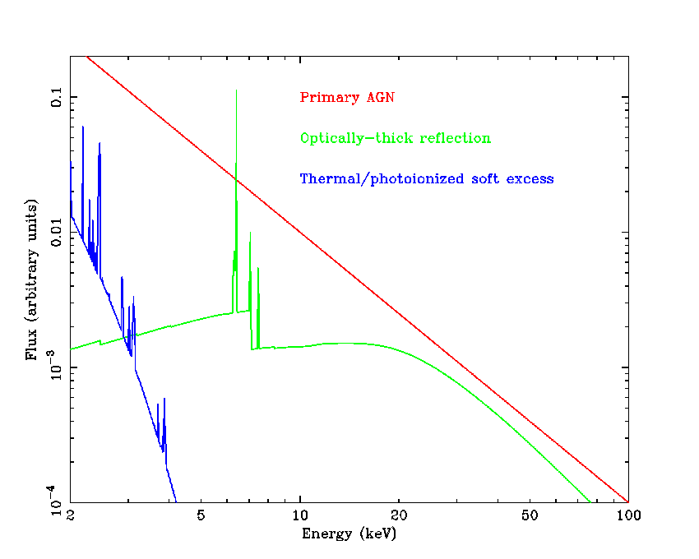
Link to this Workshop: variability (I)
Delayed response of optically thick reprocessing (torus) to changes of the primary

Slide 5
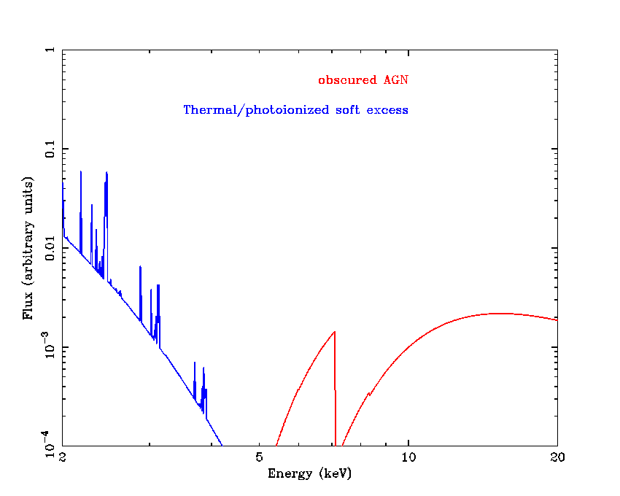
Link to this Workshop: variability (II)
Variability of the (partial-covering) AGN absorber

Slide 6
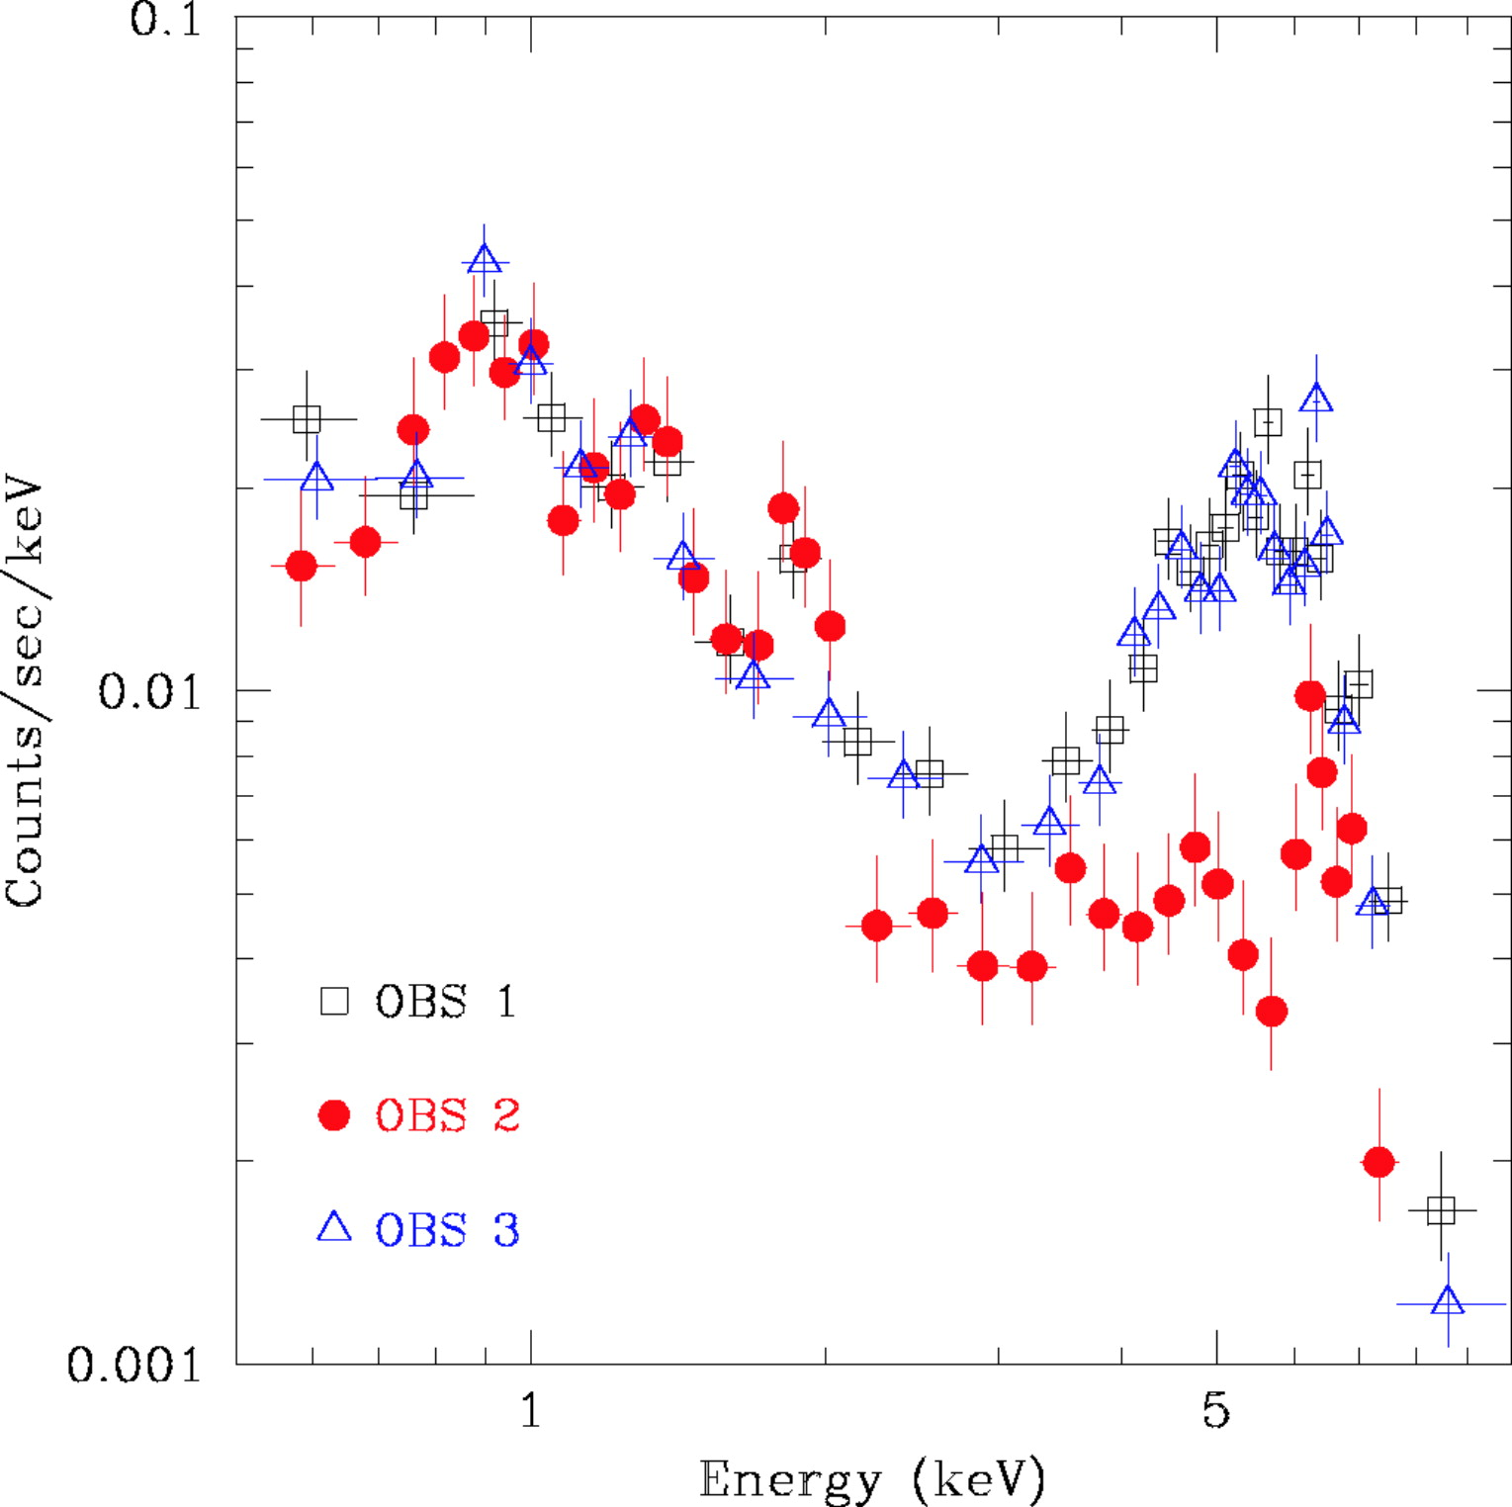
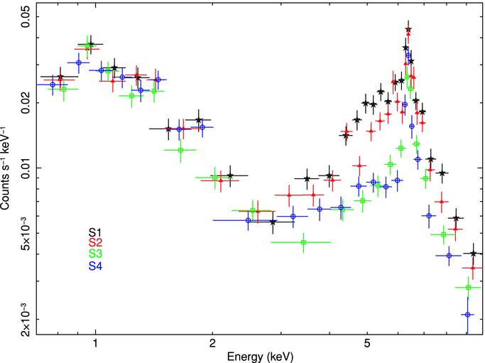
Short-term N_{H} variations
(Risaliti et al., 2007, ApJL, 659, L111)
(Bianchi et al., 2009, ApJ, 695, 781)
NGC1365
NGC7582
1 May 2007
14 April 2006
28 May 2007
9 Nov 2007
16 Nov 2007
16 April 2006
18 April 2006
Similarly: Mkn348 (Smith et al. 2003), NGC3227 (Lamer et al. 2003), NGC4388 (Elvis et al. 2004), NGC4151 (Puccetti et al. 2007)

Slide 7
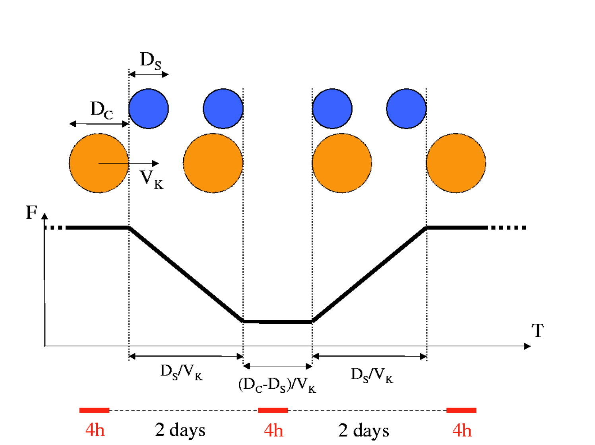
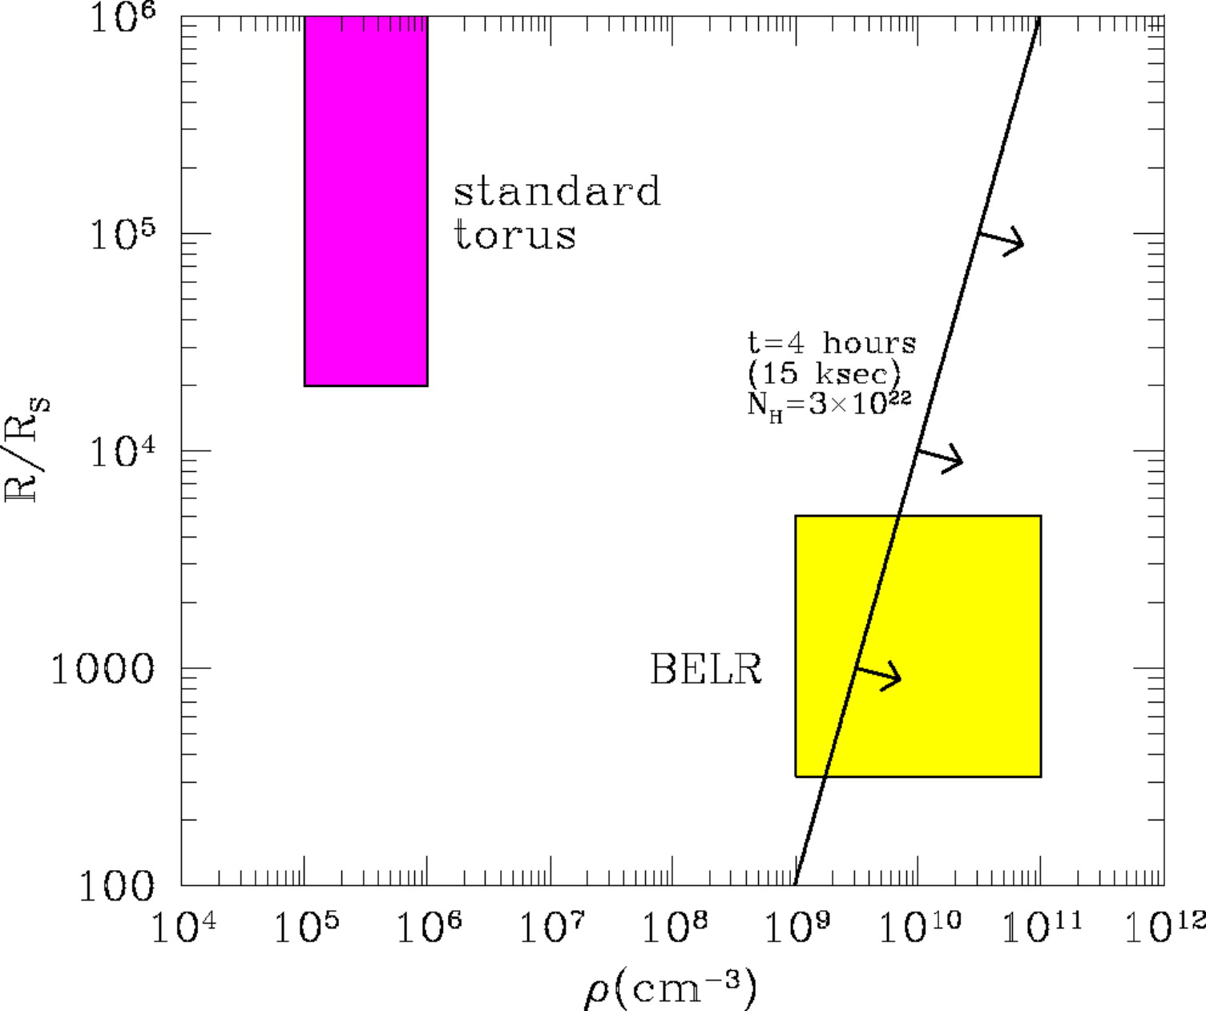
Constraints on absorber location
(Risaliti et al., 2007, ApJL, 659, L111)
(Elvis et al., 2004, ApJL, 615, L25)
X-ray source
Obscuring cloud
NGC4388
d/R_{S}
Keplerian motion: d≈600 t²₁₀₀ n²₁₀ N⁻²_{H.24} R_{S}
  occulting cloud
  physical width of the K_{α} Fe line
Ionization parameter: ξ=L_{X}/(nd²)
[d is the distance X-ray source to cloud]

Slide 8
Properties of the absorbing clouds
Linear dimension ~10¹³⁻¹⁴ cm
Distance from the BH (10⁶⁻⁷ M) ~10¹⁶⁻¹⁷ cm (10³ r_{g})
Velocities ≥ 10³ km s⁻¹
Densities ~10¹⁰⁻¹¹ cm⁻³
Number of clouds along the line-of-sight ~10
Total number of clouds (NGC1365) ~10⁷
⇒ gas in the Broad Line Region
Is this a general case?
N_{H} variability is ubiquitous (Risaliti et al. 2002), but …
… large N_{H} changes are rare (Matt et al. 2003; Guainazzi et al. 2005)

Slide 9
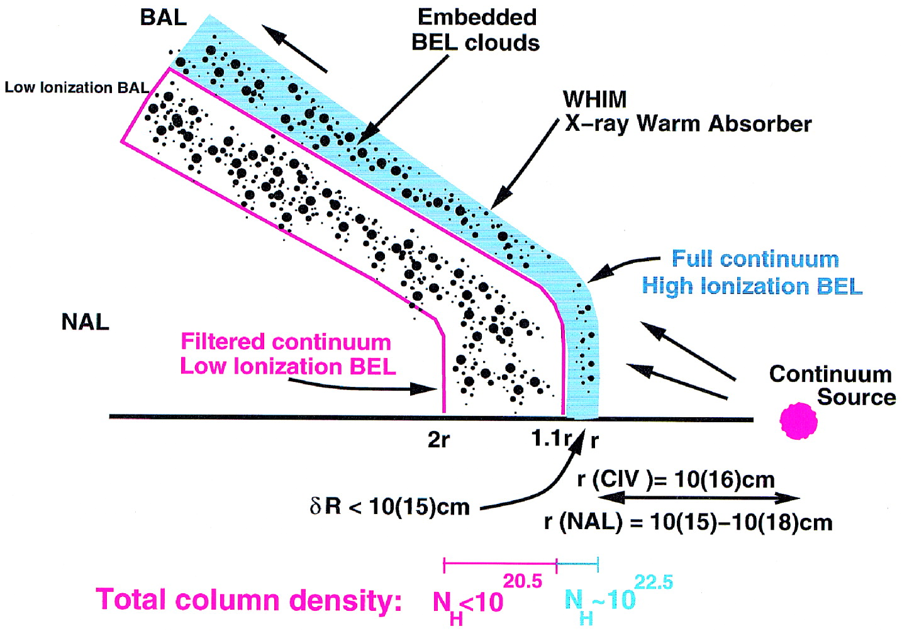
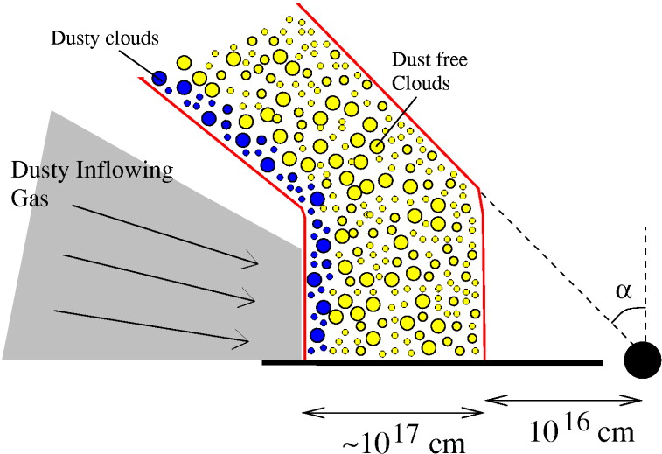
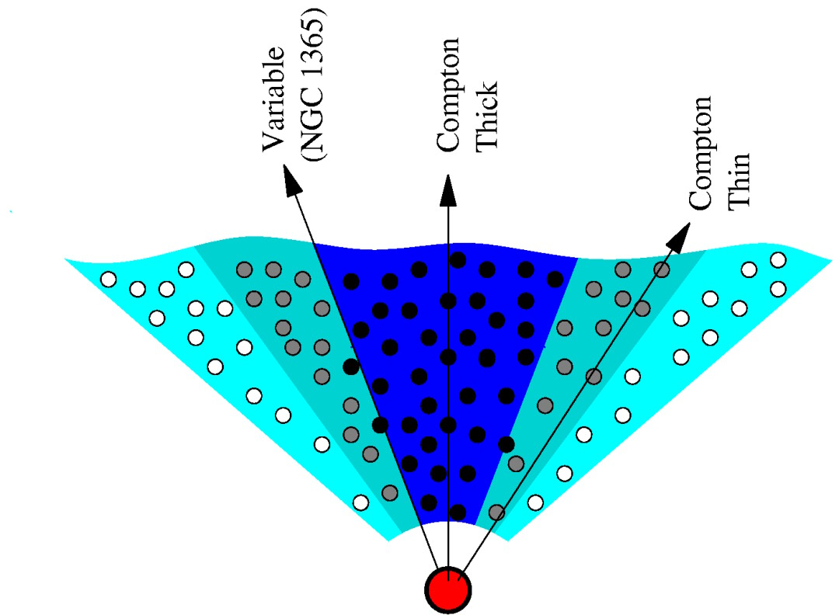
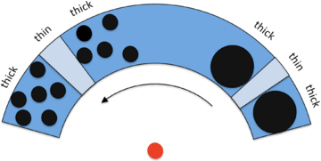
Configurations of the small-scale absorber
Elvis, 2000, ApJ, 545. 63
Risaliti et al., 2002, ApJ, 571, 234
Risaliti et al., 2005, ApJ, 623 L93
Risaliti et al., 2009, MNRAS, 393, L1

Slide 10
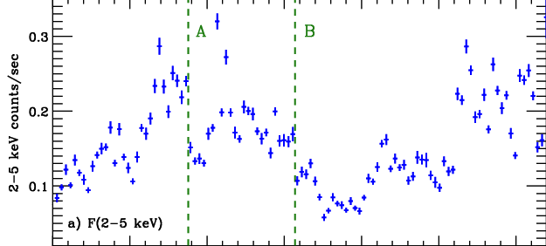
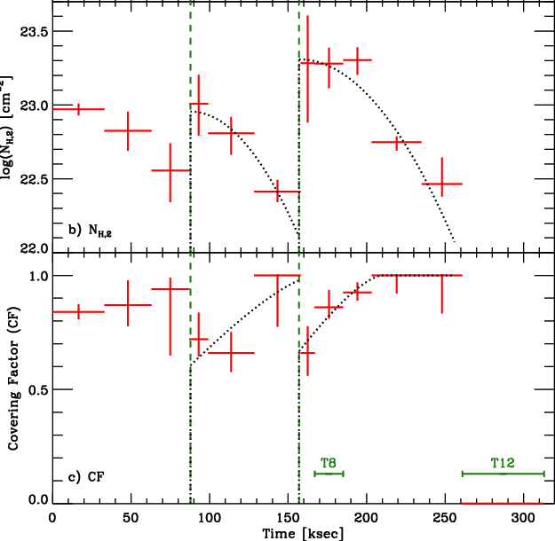
Is the Keplerian hypothesis tenable?
(Maiolino et al., 2010, A&A, 517, 47)
A
B
Long-look (300 ks) NGC1365 observation with Suzaku
2-5 flux light curve
Column density and covering fraction light curves

Slide 11
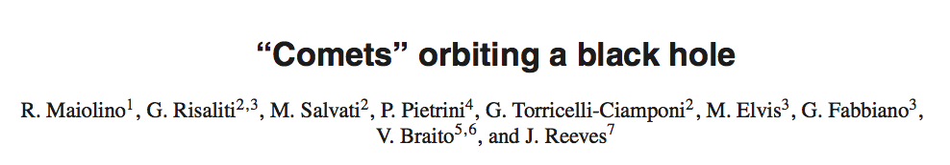
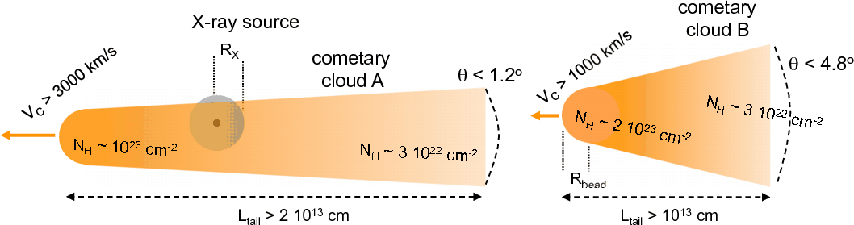
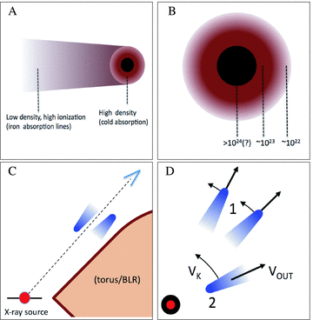
(2010, A&A, 517, 47)
M_{cloud}≈10⁻¹⁰ M
M_{loss,head}≈3×10⁻¹⁰ M
t_{life,cloud} ≈ 2 month
⇓
Continuous BLR replenishment
Similarly: Mkn766 (“head-on” comets)
(Risaliti et al., 2011. MNRAS, 410, 1027)

Slide 12
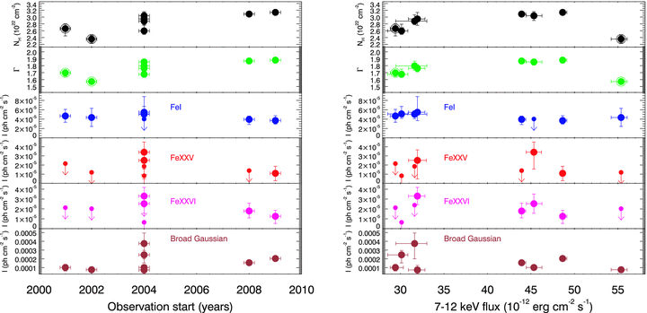
pc-scale reflectors: spectral variability
(Guainazzi et al., 2010, MNRAS, 406, 2013)
Distance to the inner side of the torus ≥2.5 pc (BLR ~ 10 light-days)
Similar cases: NGC2992, d≈3.2 pc (Weaver et al. 1996); NGC4945 d≥30-50 pc (Marinucci et al. 2012)

Slide 13
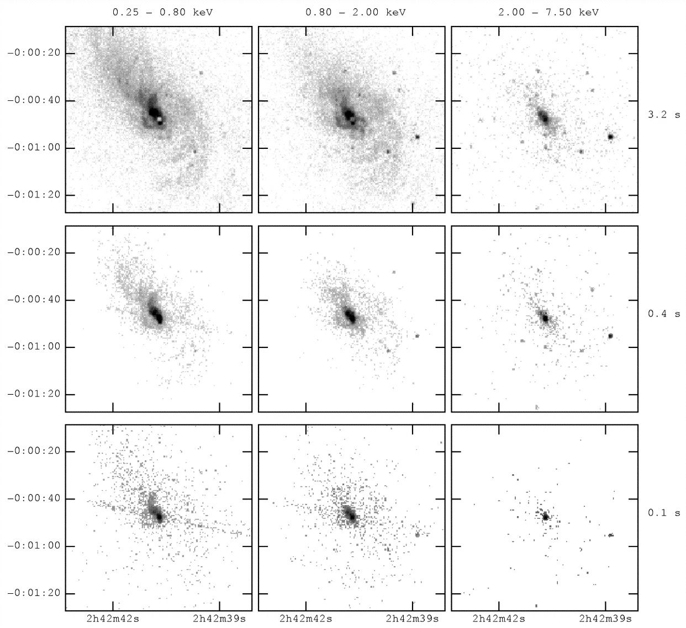
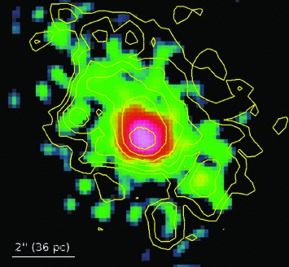
pc-scale reflectors: imaging
(Young et al., 2011, ApJ, 556, 6)
(Marinucci et al., 2012, MNRAS, 423, L6)
NGC1068: ≈2-5 kpc
NGC4945: ≈150 pc
6.2-6.7 keV
Rectangle: torus reflection-dominated band

Slide 14
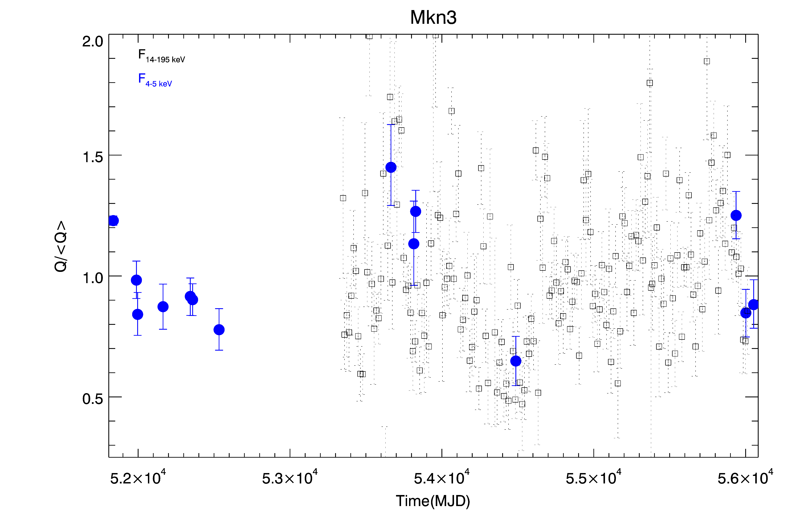
Small-scale reflectors
(Guainazzi et al., A&A, submitted)
= AGN primary (BAT/Swift)
= torus reflection
Torus distance ≥ 0.4 pc
Torus linear size ≤ 0.05 pc
Opening angle ≥ 62º
Similarly: NGC4151 d≈0.03 pc (Perola et al. 1986, Takahashi et al. 2002, Puccetti et al. 2007)

Slide 15
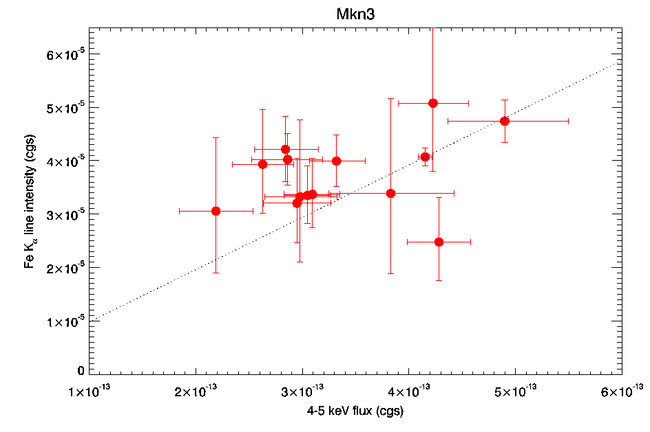
Spectral-spatial complexity
(Guainazzi et al., A&A, submitted)
[Dotted line: locus of constant EW]
Correlation probability <10⁴ (MC simulations)
In addition to that, from Chandra imaging:
Reflection feature extending to ≈300 pc, perpendicular to the NLR

Slide 16
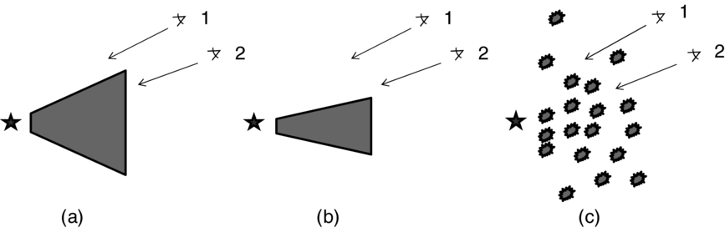
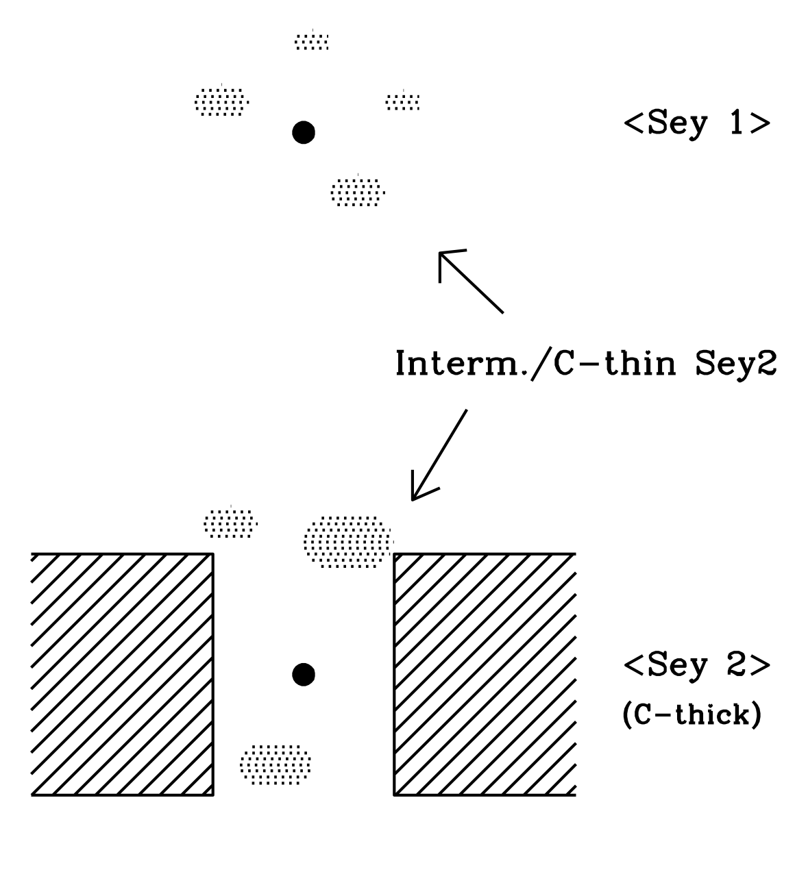
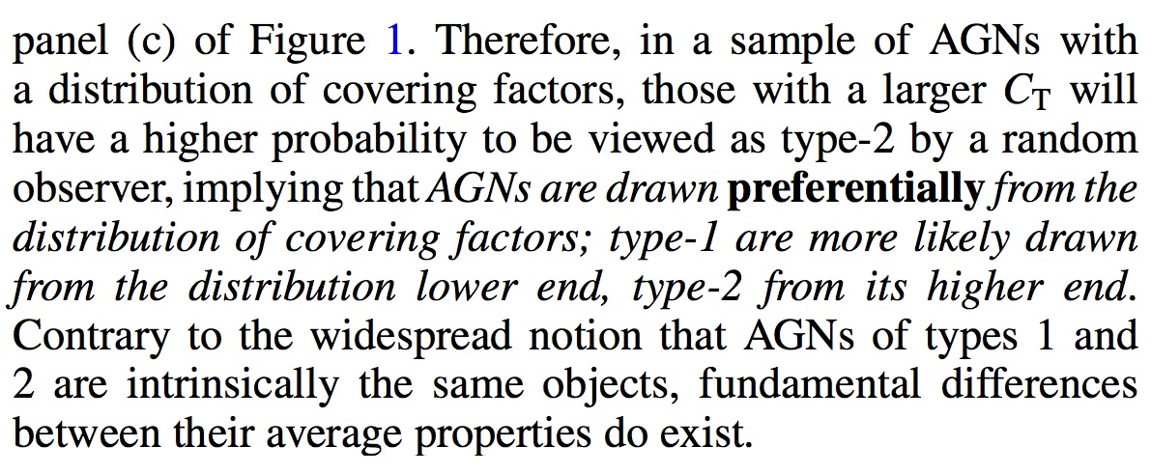
Implications for the AGN structure model
(Matt, 2000, A&A, 355, L31
, Bianchi et al., 2009, ApJ, 695, 781)
(Elitzur, 2012, ApJ, 747, L33)
Standard Unified Scenario
Unified Scenario with clumpy “torus”
BLR-scale clumpy absorbing clouds

Slide 17

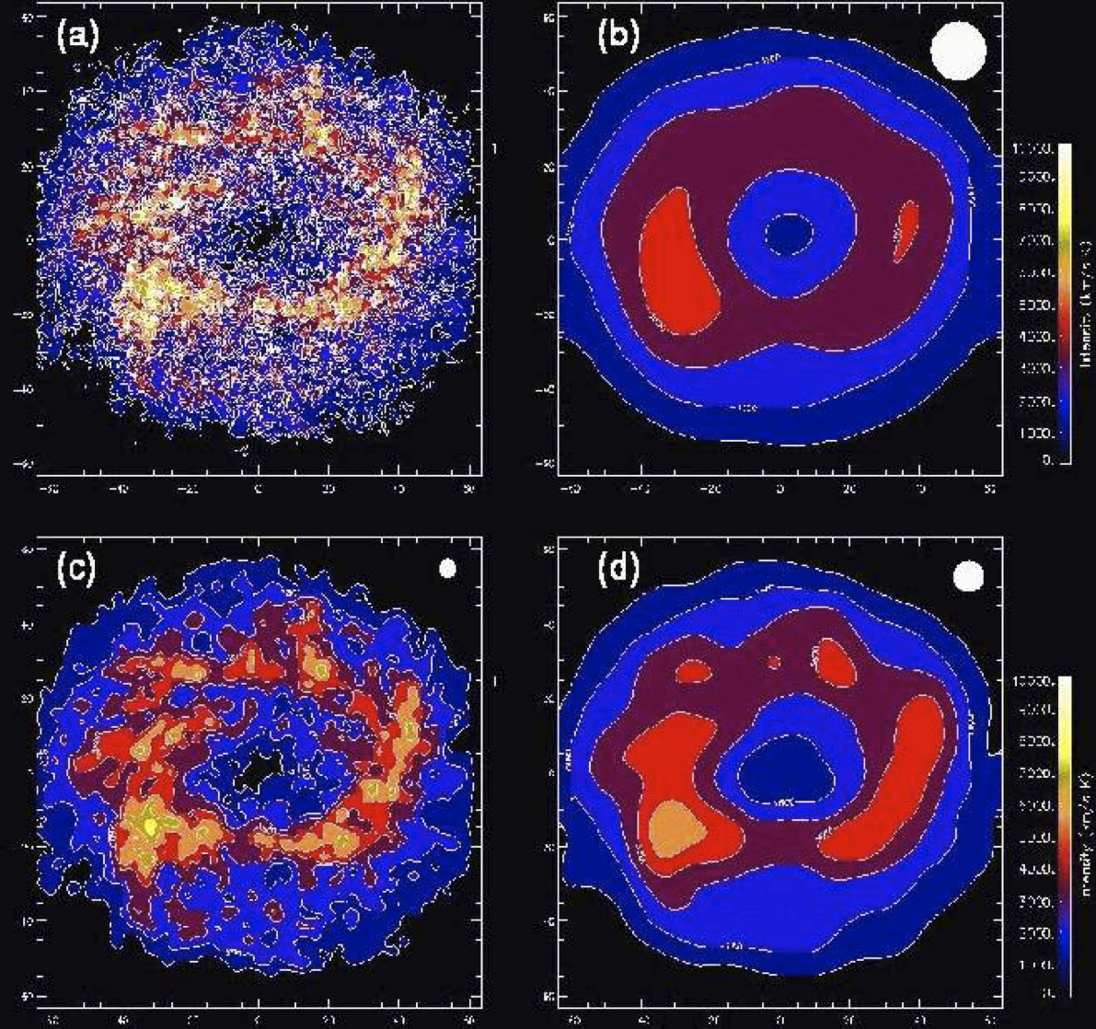
Conclusions
(Maiolino, 2008, NewAR, 52, 339; based on a model by Wada & Tomisaka, 2005, ApJ, 619, 92
model
64 pc
ALMA simulation

