Slide 1
Observing Lense-Thirring Precession in Tidal Disruption Flares
Nick Stone – 6/27/12
In collaboration with Avi Loeb
Harvard University Astronomy Department
arXiv:1109.6660, PRL 108, 6, 061302

Slide 2
Outline
Quick tidal disruption event (TDE) review
Tilted accretion disks
Lense-Thirring precession of TDE disks:
  Direct
  Indirect
Observational implications
First application (Swift 1644) – flare constrains combination of:
  Disruption parameters
  BH spin
  Jet physics questions

Slide 3
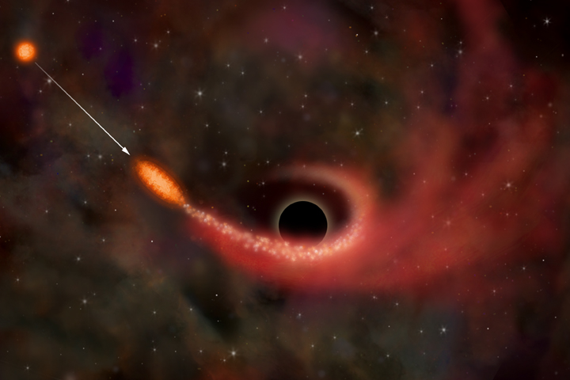
Tidal Disruption of Stars
In galactic nuclei, stars follow near-Keplerian orbits around supermassive black hole (SMBH)
Low-angular momentum orbits pass within the tidal radius
Tidal work on star exceeds its self-gravity, destroys it
(Wikimedia Commons)

Slide 4
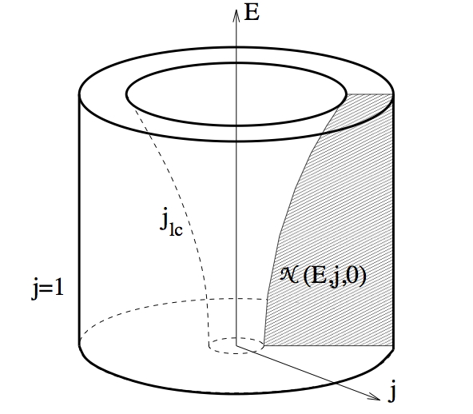
Tidal Disruption Rates
In normal galaxies, rate set by relaxational processes
~10⁻⁵ stars/yr, but enhanced by:
  Nuclear triaxiality
  Massive perturbers
In galaxy mergers, rate enhanced up to ~10⁻¹ stars/yr by:
  SMBH binaries
  Gravitational wave recoil
(Merritt & Milosavljevic 2003)

Slide 5
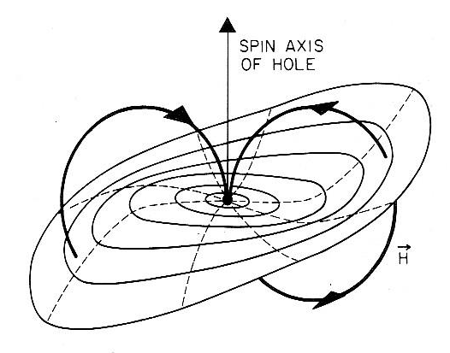
Lense-Thirring Precession
Gravitomagnetic dragging of inertial frames
  Generic to rotating spacetimes
  Goes as 1/r³ in Kerr
Differentially precessing mass annuli
Thin disks: competition between differential Ω_{prec} and shear viscosity aligns inner disk (Bardeen-Petterson)
(Gravity Probe B website)

Slide 6
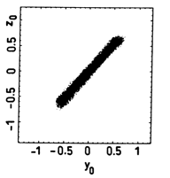
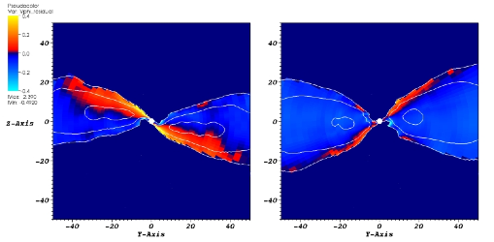
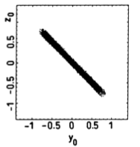
Torquing Thick Disks
Thick disks torqued off-axis precess like solid body rotators
  Specifically, H/r>α
Seen in various tilted disks:
  Protoplanetary (Papaloizou & Terquem 1994, Larwood+ 1996)
  SMBH (Fragile+ 2007, 2008)
Open question: where does jet point?
  J_{BH}?
  L_{disk}?
  Component of B-field geometry?
t=50t_{orb}
t=10t_{orb}
(Fragile+ 2008)
t=0
t=300
(Larwood+ 1996)

Slide 7
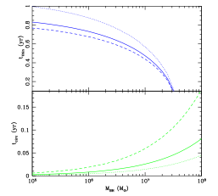
Direct Disk Precession
Periodic, with t_{prec}=2πsin(β)(J/τ)
Model valid for t_{circ}<t<t_{thin}
    For solar type stars, valid for ~1 yr after disruption
For density profiles of the form ,
t_{thin}~t_{Edd}
t_{circ} α t_{fall}

Slide 8
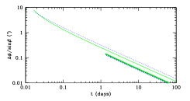
Differential Stream Precession
Nonperiodic effect
Generally subdominant
  Maximized for M_{BH}<10⁶M, R_{p}=R_{ISCO}
Maximum rates of dL_{disk}/dt~0.1°/min occur at t~t_{fall}
Δφ_{LT}~10Δφ_{Quad}

Slide 9
Observational Implications
Quasi-periodic modulation of disk lightcurve detectable through Fourier analysis
  Possible “blinking” if it becomes edge-on: ~10¹⁻² drop in luminosity, reddening
If jets align with L_{disk}:
  Direct precession of disk will drag jets across line of sight periodically
  DSP could create rapid high-energy transient (fake GRB?)
Strong constraints can be placed on {a_{BH}, β} if {θ_{jet}, M_{BH}} independently estimated

Slide 10
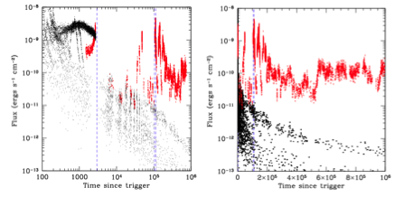
Swift J164449.3+573451
Discovered as long GRB by Swift on 3/28/11
M_{BH}~10⁶M, but L_{X}~10⁴⁷ erg/s
Eddington & rate arguments-> θ_{jet}~10^{-1.5}
(Levan+ 2011)

Slide 11
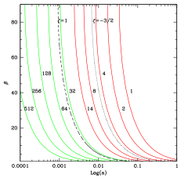
Constraining SW1644+57
We constrain a combination of {a_{BH}, β, jet alignment hypotheses}

Slide 12
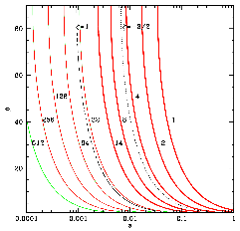
Constraining SW1644+57 (Updated)
We constrain a combination of {a_{BH}, β, jet alignment hypotheses}

Slide 13
Conclusions
For SW1644+57, trichotomy: at least one of the following statements is true
  The SMBH is near-Schwarzschild (a_{BH}<10⁻²)
  The pre-disruption stellar orbit was in the SMBH equatorial plane to within Δθ~θ_{jet}
  In this event, the jet did not align with L_{disk}
Observation of TDE jets offers unique laboratory for probing accretion physics
Even absent jets, modulations in TDE lightcurve can constrain SMBH spin

Slide 14
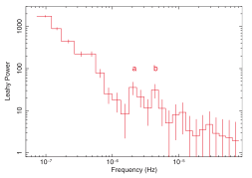
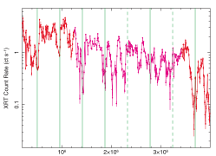
Bonus: Possible Detection of Jet Precession?
Saxton+ 2012 claim detection of periodic signal in Swift 1644
  “Jet precession+nutation”
Somewhat ambiguous signal
  Much variability unexplained
Possible interpretation:
  Precessing jet from disk almost in BH equatorial plane
  Unlikely, unless jet formation inhibited for significantly inclined disks
(Saxton+ 2012)

Slide 15
Questions?

Slide 16
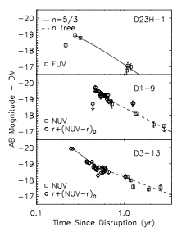
Observational History
About ~10 strong candidates
  Most UV/X-ray
  Some optical
Upcoming time domain surveys expected to see ~10s-1000s/yr
  LSST particularly promising
(Gezari+ 2008)

Slide 17
Tidal Disruption Physics
Tidal radius:
Spread in debris energy:
Return time for most tightly bound debris:
Lightcurve often assumed to follow:
Disk SED multicolor blackbody, peaked in UV/soft X-ray

Slide 18
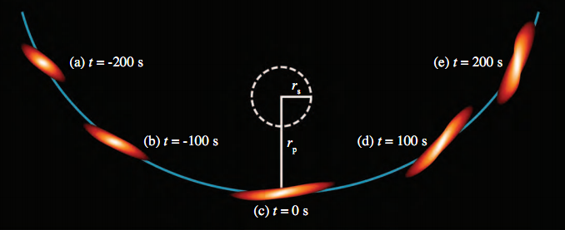
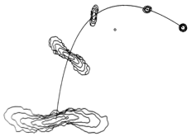
Tidal Disruption Physics – Open Questions
1st order analytic picture confirmed by numerical hydro
Super-Eddington phase uncertain
  Outflow?
  P_{Rad}-supported envelope?
Disk formation time uncertain
  T_{circ}~n_{orb}T_{fall}
Rate ~10⁻⁴-10⁻⁶/yr
Jets?
(Evans & Kochanek 1989)
(Guillochon+ 2009)

Slide 19
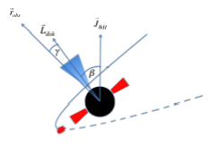
Tilted Accretion Flows
(Gravity Probe B website)
Tilted disks -> Lense-Thirring torques
In thin disk limit (H/R << α), Bardeen-Petterson effect -> warps in disk
GRMHD: for H/R~α or larger, disk precesses as solid body rotator
Open question: where does jet point?
  J_{BH}?
  L_{disk}?
  Component of B-field geometry?

